Slide 1
Results of the Microwave Transmission Measurements: Nominal and Ultimate Intensity Beams
F. Caspers, S. Federmann
21. 03. 2013

Slide 2
Overview
Measurement Setup
Comparison of nominal and ultimate intensity beam
Conclusion

Slide 3
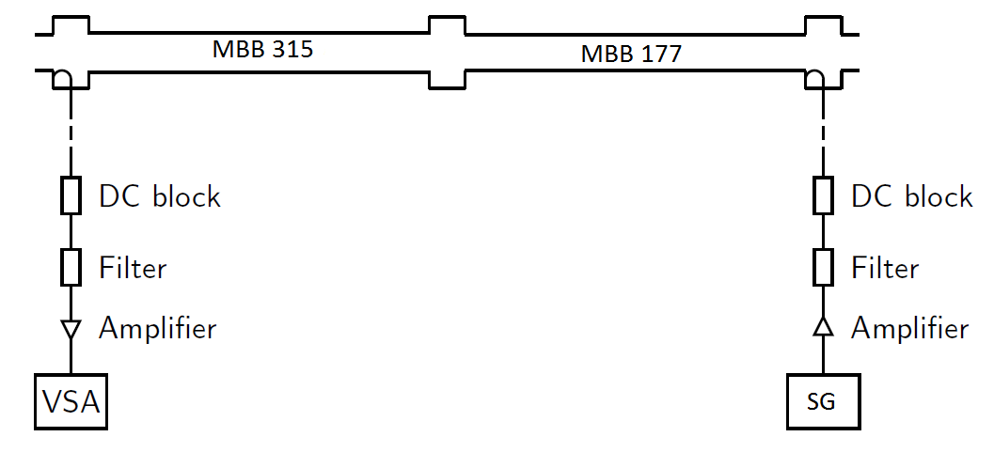
Measurement Set-Up
uncoated
uncoated
Surface at BA5

Slide 4
General Remarks
All results shown here were taken with LHC 25 ns beams
The intensity of the ultimate beam discussed in this talk is 1.6*10^10 ppb (March 2012)
The intensity of the discussed nominal beam is 1.2*10^10 ppb (March & November 2012)

Slide 5
Results
1st injection
2nd injection
No increase
Noise floor
3rd injection
Nominal beam, 3 batches
Ultimate beam, 1 batch
1st injection
+ 2 dB
Noise floor

Slide 6
Results
1st injection
2nd injection
+ 2 dB
Noise floor
3rd injection
Nominal beam, 3 batches
Ultimate beam, 2 batches
1st injection
+ 5 dB
2nd injection
Noise floor

Slide 7
Results
1st injection
2nd injection
+ 3 - 4 dB
Noise floor
3rd injection
Nominal beam, 3 batches
Ultimate beam, 3 batches
1st injection
2nd injection
+ 7 dB
3rd injection
Noise floor

Slide 8
Conclusions
Ultimate beam delivers a considerably higher phase modulation signal
1st injection: +2dB vs. no increase
2nd injection: +5dB vs. +2dB
3rd injection: +7dB vs. +3-4dB
For nominal beam there is no signal detectable for the first injected batch. Here we are limited by the dynamic range of our VSA
For the ultimate intensity we see a considerable increase of electron cloud with the second injection. This is a new signature for us.

Slide 9
Thank you for your attention!

Slide 10
Additional Slides

Slide 11
Theoretical Basis
Principle: Measurement of the induced phase shift of a microwave going through a plasma filled waveguide
Phase shift is proportional to the electron cloud density:
Assumption: we have a complete transmission through the electron cloud (no resonances)

Slide 12
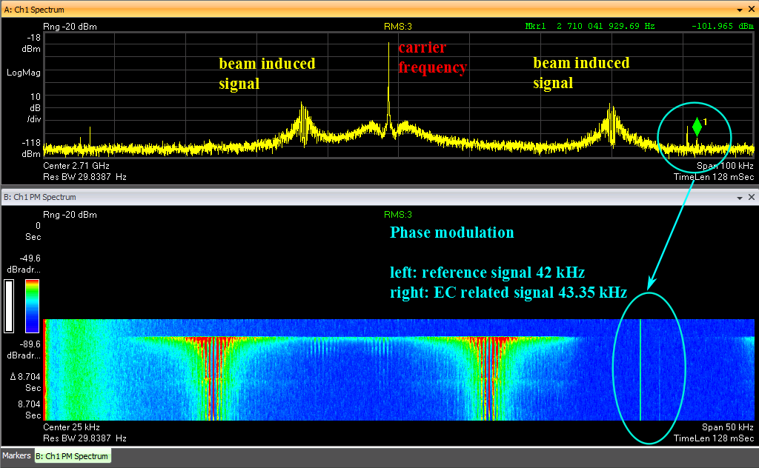
Screenshot of the VSA

Slide 13
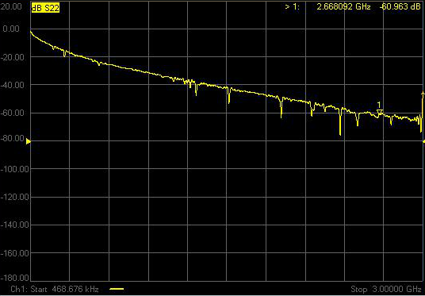
Cable losses

