Slide 1
Update on ZS transitions
B. Salvant
Acknowledgments:
B. Balhan, F. Caspers, J. Varela, C. Zannini

Slide 2
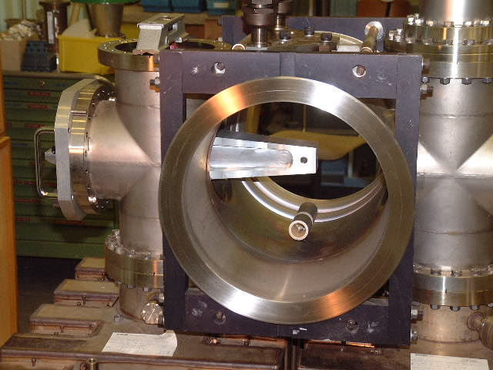
Context
Presentation at last SPSU on simulations of transitions between ZS tanks
Following the comments at the meeting, the simulations were revised and it turned out that:
The stainless steel used was not of the correct type, and the conductivity was overestimated (thanks Fritz!)
The geometry used was really oversimplified
There are damping resistors (as suggested by Jose, and confirmed by Bruno)

Slide 3
Transitions between ZS
Effective impedances at low frequency
Im(Zlong/n)~ 7 mOhm
Im(Zx)~ 2 kOhm/m
Im(Zy)~ 8 kOhm/m
1.18 GHz
Rs=1.1 MOhm (stainless steel)
Q=14000 (stainless steel)
900 MHz

Slide 4
More realistic pumping module
No damping resistor
Stainless steel 316 (conductivity 1.35e6 S/m)

Slide 5
1st mode:
H field
Shunt impedance (LinacOhm)
F=0.54 GHz
Rs=130 kLinacOhm (=65 kOhm)
Q=2000
E field
No damping resistor, but far from fields

Slide 6
2nd mode
H field
Shunt impedance (LinacOhm)
F=1.05 GHz
Rs=130 kLinacOhm (=65 kOhm)
Q=2500
E field
No damping resistor

Slide 7
With damping resistor
→ First try indicates that the 2nd mode is not affected much by the presence of a damping resistor in the middle of the pumping port

Slide 8
With damping resistor and holder
→ Same conclusion as before. Not much change

Slide 9
Outlook
Impedance given at the last meeting was overestimated
Very complicated structure (volume is not closed on both sides), needs more iterations for convergence studies
Measurements could be redone with TE/ABT if we think it is needed

