Slide 1
SPS flanges Simulations & Measurements Update
Fritz Caspers and Jose E. Varela
Acknowledgements: Jose A. Ferreira and Thomas Bohl

Slide 2
Outline
Introduction
Impedance List Update
Damping Resistors
Next Steps
Conclusions

Slide 3
Introduction
We continue to search for possible causes of the suspected 1.4GHz microwave instability in the SPS.
Update of the impedance list with latest simulation results.
Initial addressing of the damping resistor ‘problem’.
Big list of next steps.

Slide 4
Outline
Introduction
Impedance List Update
Damping Resistors
Next Steps
Conclusions

Slide 5
Updated Simulation Status
Flange |  | 1 | 2 | 3 | 4 | 5 | 6 | Total
156 | QF-MBA | 14 | 14 | 15 | 13 | 13 | 14 | 83
156 | MBA-MBA | 2 | 1 | 2 | 4 | 3 | 2 | 14
156 | QD-QD | 16 | 16 | 18 | 16 | 17 | 16 | 99
156 | QF-QF Non-enamelled | 5 | 5 | 3 | 6 | 5 | 5 | 29
156 | QF-QF Non-enamelled No Bellow | 3 | 4 | 2 | 2 | 4 | 2 | 17
156 | QD-QD Non-enamelled | 12 | 13 | 12 | 12 | 14 | 12 | 75
219 | BPV-QD | 14 | 15 | 16 | 15 | 17 | 13 | 90
219 | BPH-QF | 16/12 | 15/7 | 18/10 | 18/12 | 18/11 | 17/11 | 102/63
Analysed combinations

Slide 6
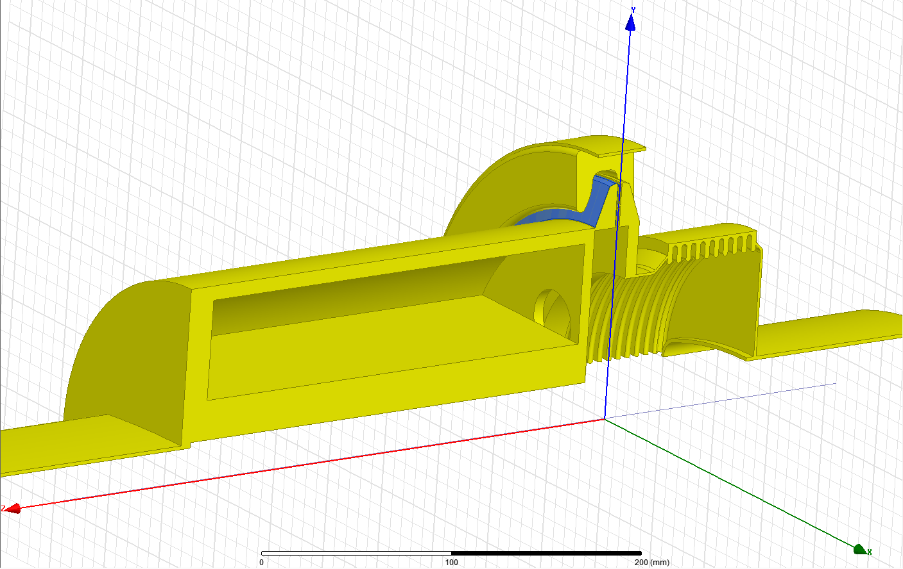
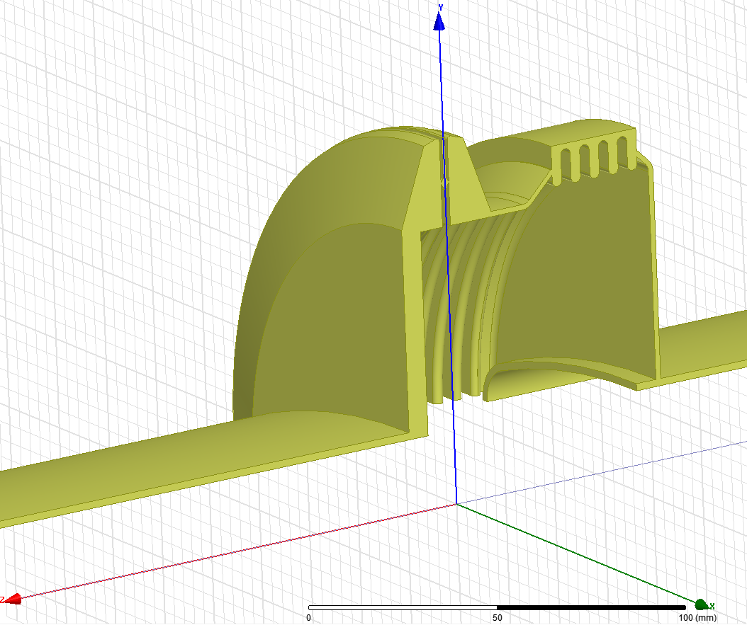
Simulations
HFSS models for the enamelled BPH-QF and QF-QF flanges.
QF-QF
BPH-QF

Slide 7
Simulations – Total Impedance so far
Flange Type | Enamel | Bellow | Num. of elements | Freq. [GHz] | Impedance | Q | R/Q [Ω]
BPH-QF | Yes | Yes | 39 | 1.28 | 1.03MΩ | 400 | 2496
QF-MBA | Yes | Yes | 83 | 1.41 | 1.6MΩ | 268 | 5985
MBA-MBA | Yes | Yes | 14 | 1.41 | 297kΩ | 285 | 1040
QF-QF | No | Yes | 27 | 1.41 | 3.91MΩ | 1828 | 2140
QD-QD | Yes | No | 99 | 1.57 | 17kΩ | 55 | 317
QF-QF | No | No | 19 | 1.61 | 559kΩ | 980 | 570
BPH-QF | Yes | Yes | 39 | 1.62 | 121kΩ | 120 | 1014
QD-QD | No | No | 75 | 1.8 | 651kΩ | 881 | 739
QD-QD | Yes | No | 99 | 1.89 | 186kΩ | 175 | 1070
No damping resistors included

Slide 8
Outline
Introduction
Impedance List Update
Damping Resistors
Effect of a Short Damping Resistor
Material Properties Fitting
Next Steps
Conclusions

Slide 9
Damping Resistors
For the QF-QF ‘high-Q’ flanges information about damping resistors can not be found in layouts.
Jose A. Ferreira is checking the presence of damping resistors in this particular type of bellows.
 | Sextant 1 | Sextant 2 | Sextant 3 | Sextant 4 | Sextant 5 | Sextant 6
 | SSS 002 - 10205 | SSS 037 – 20205 OK | SSS 079 – 30805 Under Vacuum | SSS 109 – 40205 NO resistor | SSS 151 – 50805 Ok | SSS 181 – 60205
 | SSS 008 – 10805 | SSS 049 – 21405 NO Resistor | SSS 097 – 32605 Ok | SSS 115 – 40805 Ok | SSS 155 – 51205 Ok | SSS 187 – 60805
 | SSS 012 – 11205 | SSS 061 – 22605 No bellow | SSS 103 – 33205 Ok | SSS 119 – 41205 Ok | SSS 169 – 52605 No bellow | SSS 191 – 61205
 | SSS 025 – 12605 No bellow | SSS 067 – 23205 Ok |  | SSS 133 – 42605 Ok | SSS 175 – 53205 Ok | SSS 204 – 62605
 | SSS 031 – 13205 OK | SSS 071 – 23605 Ok |  | SSS 139 – 43205 Ok | SSS 179 – 53605 Ok | SSS 210 – 63205
 |  |  |  | SSS 143 – 43605 Ok
Most bellows have the short damping resistor as they are ‘probably’ supposed to.
Two positions don’t have bellows – Outdated Layouts
One position has no resistor

Slide 10
Effect of a Short Damping Resistor
Three types of damping resistors have been provided by Jose A.
Only the short one fits the available bellow.
 | Enamel no Resistor | Enamel Resistor | Closed no Resistor | Closed Resistor
f [GHz] | 1.415 | 1.41 (-0.35%) | 1.417 | 1.411(-0.42%)
Q₀ | 152 | 79 | 1930 | 186
Properties of the resistor can not be deduced from this measurements.
The volume of the resistor represents around 1.5% of the total cavity volume.

Slide 11
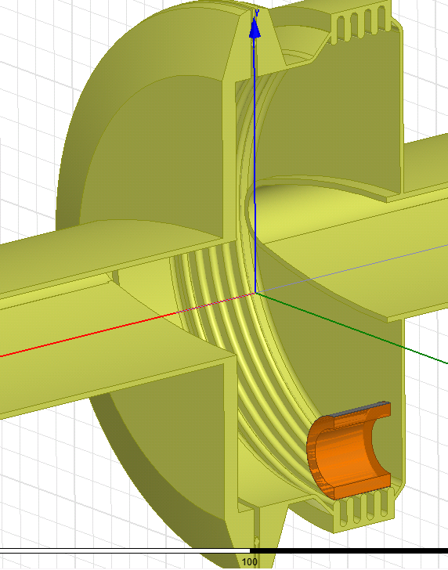
Material Properties ‘Fitting’
Initial damping resistor properties provided/measured by/with Thomas Bohl.
Increasing
Conductivity

Slide 12
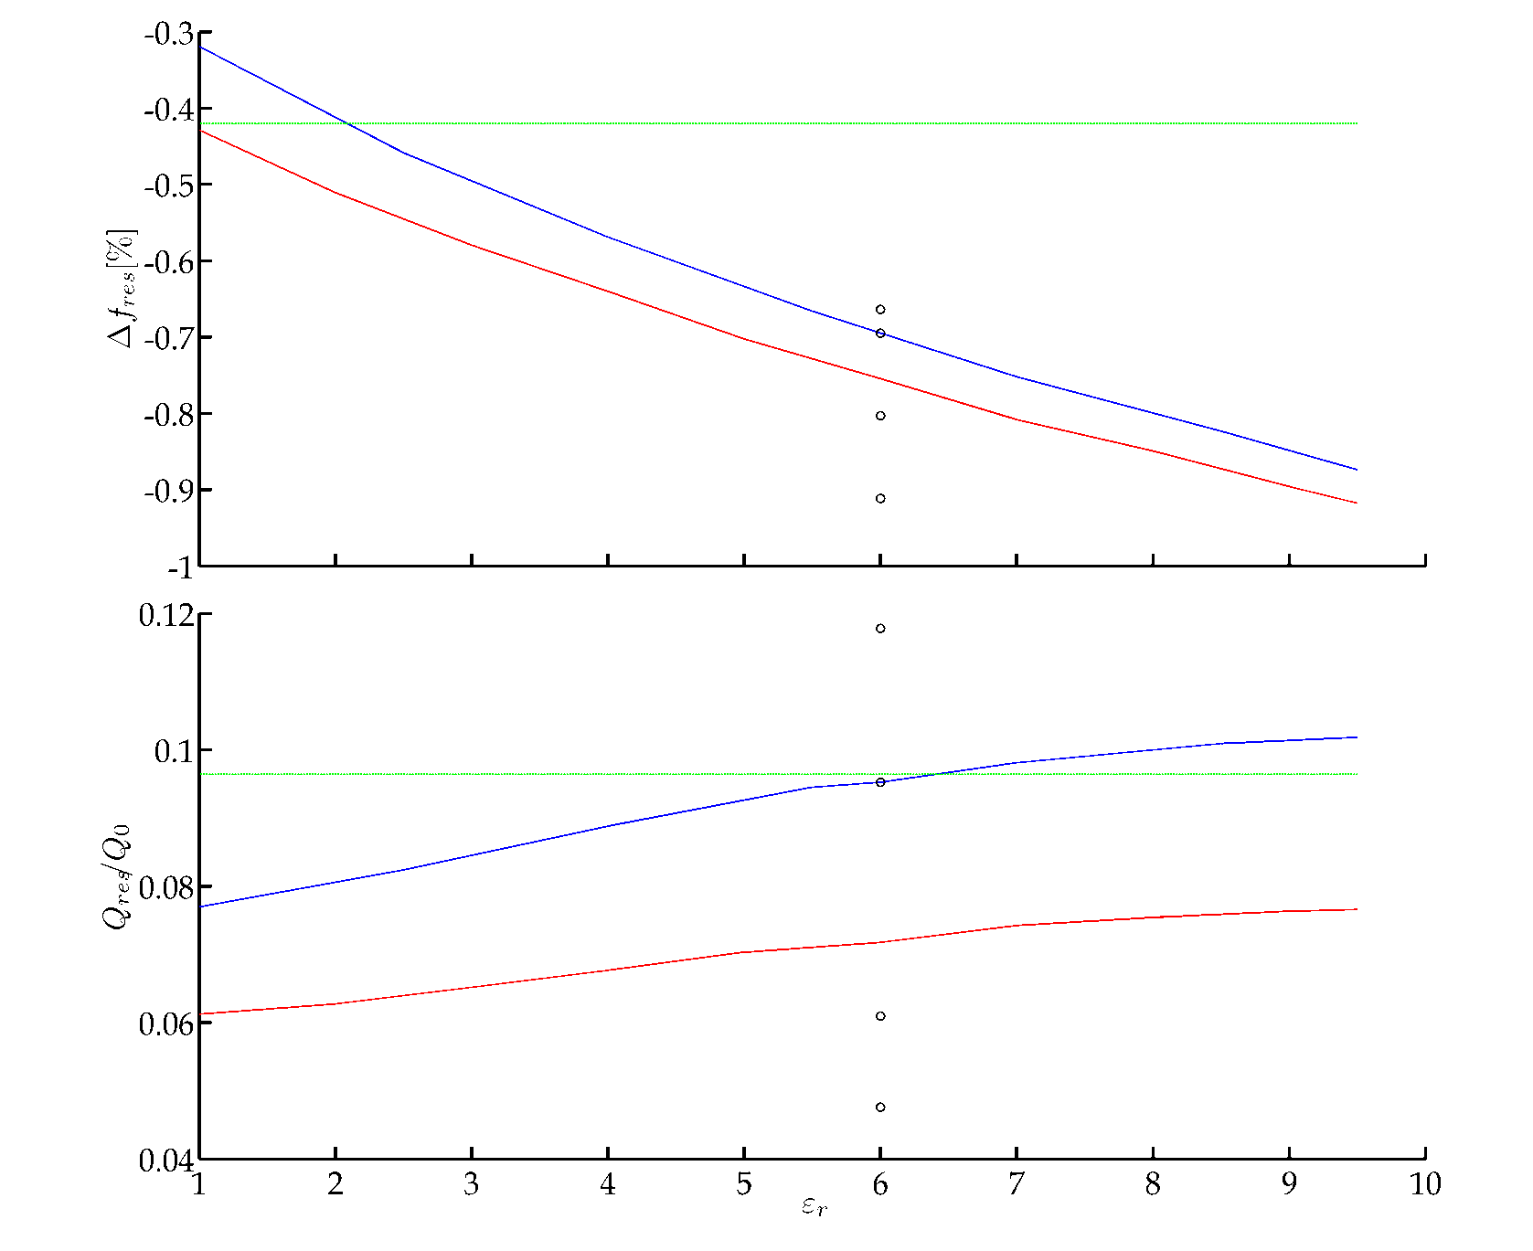
Material Properties ‘Fitting’
Increasing
Conductivity

Slide 13
Outline
Introduction
Impedance List Update
Damping Resistors
Next Steps
Damping Resistor Survey
Additional Dangerous Elements
Pumping Port Survey
Next Measurements Set
Conclusions

Slide 14
Next Steps – Damping Resistor Survey
Accurate information about the presence of damping resistors all around the machine is needed.
Opening all the machine to check the bellows is not feasible.
Radiography could be ‘easily’ use to check the resistor presence inside bellows (Jean-Michel Dalin).
The cost of this operation depends on the specific places of the bellows. Thus we have no cost estimation.

Slide 15
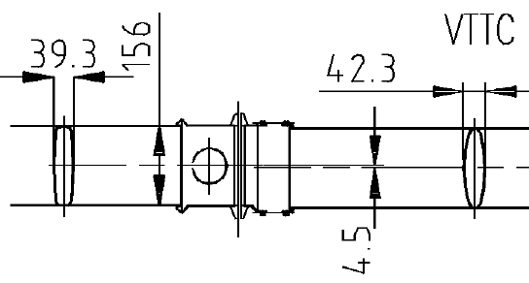
Next Steps – Additional Dangerous Elements
Asses additional sets of potentially dangerous elements.
There are 37 unshielded pumping ports
23 positions (in layouts) where the ‘ensemble’ may have high impedance.
The Vacuum Valves (VVS) types A and B.
Together with their surroundings.

Slide 16
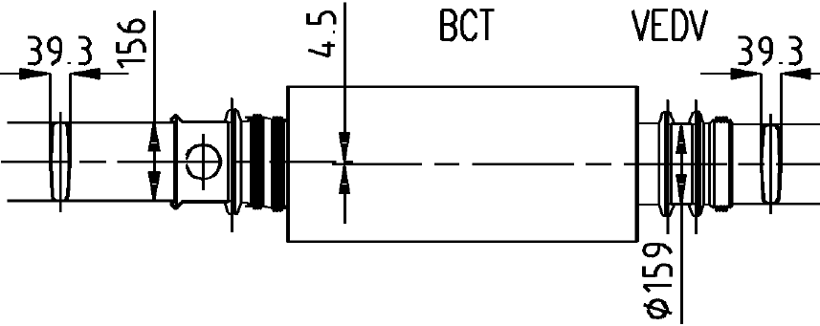
Next Steps – Additional Dangerous Elements
Asses additional sets of potentially dangerous elements.
There are 37 unshielded pumping ports
23 positions (in layouts) where the ‘ensemble’ may have high impedance.
The Vacuum Valves (VVS) types A and B.
Together with their surroundings.

Slide 17
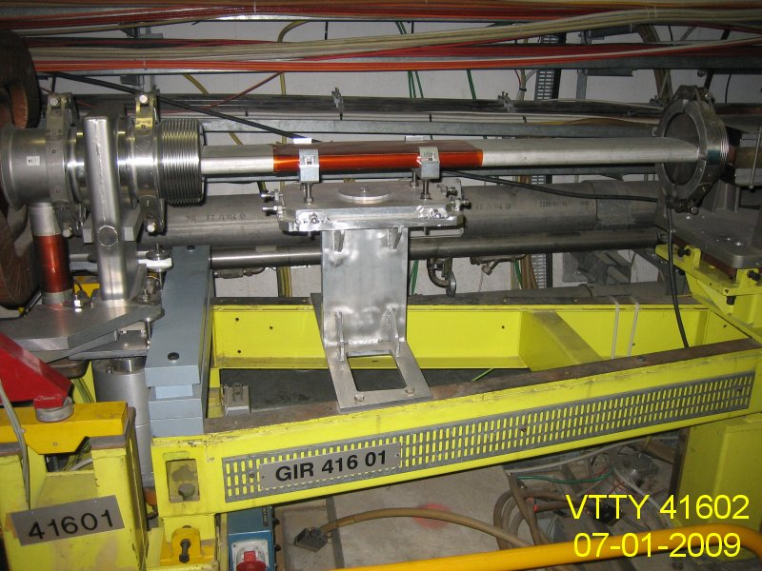
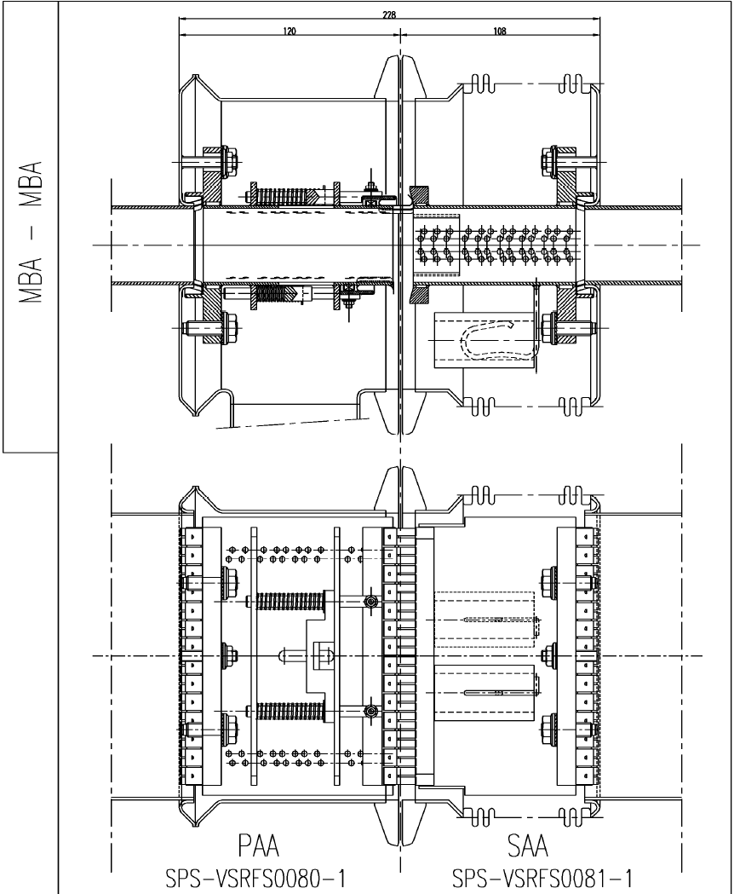
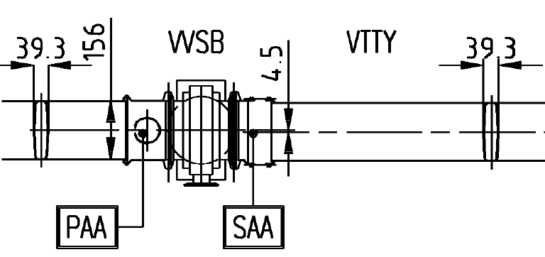
Next Steps – Additional Dangerous Elements

Slide 18
Next Steps – Pumping Port Survey
Measurement of the pumping port shields.
Reflection measurement sticking a probe in the ‘blade hole’.
Requirements:
Simulation campaign of the different scenarios, i.e. different finger misplacement for each shield type.
Laboratory replica to evaluate viability and sensitivity of the measurement.
Disconnection of the pump.
Portable measurement equipment.
Time

Slide 19
Next Steps – Pumping Port Survey
Measurement of the pumping port shields.
Reflection measurement sticking a probe in the ‘blade hole’.
Requirements:
Simulation campaign of the different scenarios, i.e. different finger misplacement for each shield type.
Laboratory replica to evaluate viability and sensitivity of the measurement.
Disconnection of the pump.
Portable measurement equipment.
Time

Slide 20
Next Steps – Next Measurements Set
Measurements:
Pieces of the ‘new’ measurement set-up, MBA-MBA enamelled with bellow, were received last Tuesday.
Overcome some ‘tolerance problem’
Measurements with/without damping resistor
Wire measurement
Weak coupling reflection measurement
Bead pull? (additional stuff required)

Slide 21
Outline
Introduction
Impedance List Update
Damping Resistors
Next Steps
Conclusions

Slide 22
Conclusions
The impedance list keeps growing as new elements are assessed.
Initial estimation of the effect of damping resistors has been measured and simulated.
Growing list of ‘Next Steps’ that should be done at some point.

