Slide 1
End-of-year talk
LIU-SPS BD WG meeting 12.12.13

Slide 2
Our meetings in 2013
During year - 9 meetings of LIU-SPS BD WG
(less than usual 12 in the past :-)
Main topics:
SPS impedance – 17 talks…
Instabilities – 7 talks
Main speakers:
5 talks: J. Varela, E. S.
4 talks: T. Argyropoulos, B. Salvant, H. Timko
3 talks – H. Bartosik, F. Caspers
Main writer: H. Bartosik - thanks a lot for Minutes!

Slide 3
Main efforts
SPS MDs: two months in 2013 and analysis of 2012 data
LIU days
SPS beam parameters – for RLIUP
LIU-SPS reviews (10!) => talks
SPS impedance model
Particle simulations

Slide 4
Priorities for MDs in 2013 (from meeting on 13.12.2012)
Reference impedance measurements (synchrotron frequency shift) in Q26 with single bunches of:
variable, in range (1-15)x10¹⁰ , intensity
constant small (0.25 eVs) longitudinal emittance
Impedance identification: long bunches with RF off in Q20 (very high intensity ~ 8x3x10¹⁰)
Single bunch stability in Q26 and Q20 (effect of bunch distribution due to the PS bunch rotation)
Single bunch stability in double RF system (Q26&Q20
=> All measurements were done and analysed. Now they should be compared with simulations

Slide 5
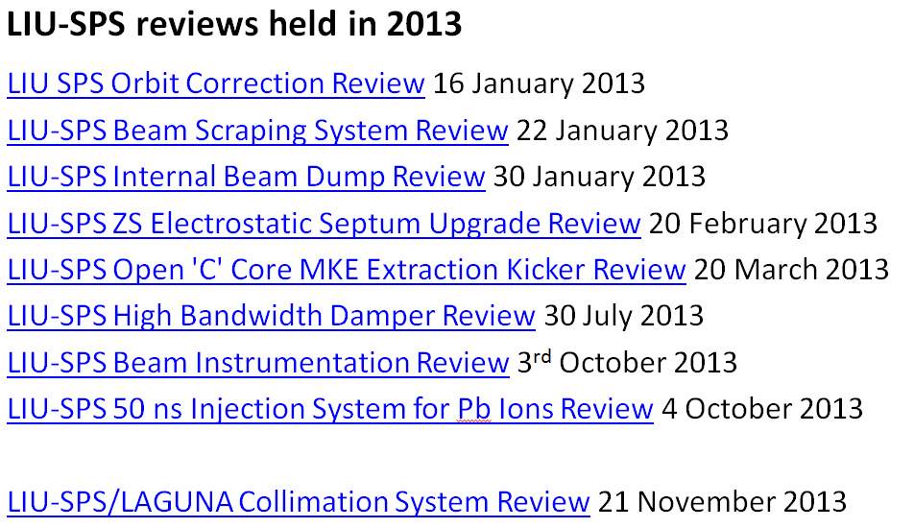
B. Goddard
LIU-SPS 800 MHz RF 12 December 2013

Slide 6
Plans for 2014
Beam re-commissioning after LS1
E-cloud: SPS scrubbing (do we need Ac-coating?)
Preparation of the LHC beam: 50 ns & 25 ns (BCMS)
Pushing intensity of 25 ns beam to the maximum
Preparation of doublets for scrubbing of LHC
- new (longer) magnetic cycle
- LLRF, transverse damper
SPS MDs
Effort for SPS impedance identification
Space charge studies
LIU day on 11 April 2014

Slide 7
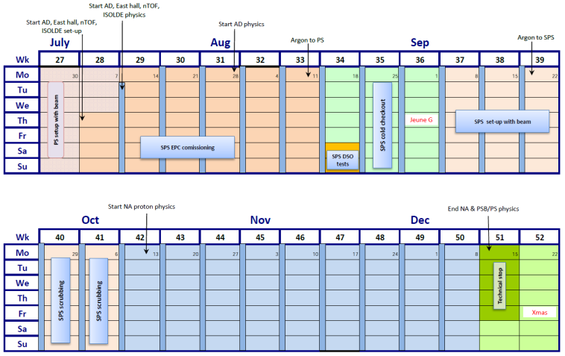
Injector schedule for 2014
MDs?

Slide 8
Merry Christmas! Happy New Year!

