Slide 1
Threshold for microwave instability of the LHC beam
T. Argyropoulos, E. Shaposhnikova
LIU-SPS BD WG
11/07/2013

Slide 2
Introduction
Beam measurements with RF off and long injected bunches (τ_{4σ} ~ 25 ns) showed a strong resonance at 1.4 GHz: high R_{sh} and low Q
Macro-particle simulations performed to identify the parameter space of this effective impedance:
Next step is to identify the source of this impedance in the SPS ring:
Most probable candidate the isolated vacuum flanges
(talk of J. E. Varela Campelo‎)
What is the effect that this impedance has on the beam? → important to understand for future actions
Results of simulations for the SPS flat top are presented
f_{r} (GHz) | Q | R_{sh} (kΩ)
1.35 – 1.45 | 5 – 10 | 300 – 400

Slide 3
Outline
Measurements used as reference for our simulation studies
Q20: bunch rotation at the SPS extraction
Q26: LHC single bunch MD
Simulation results
Summary

Slide 4
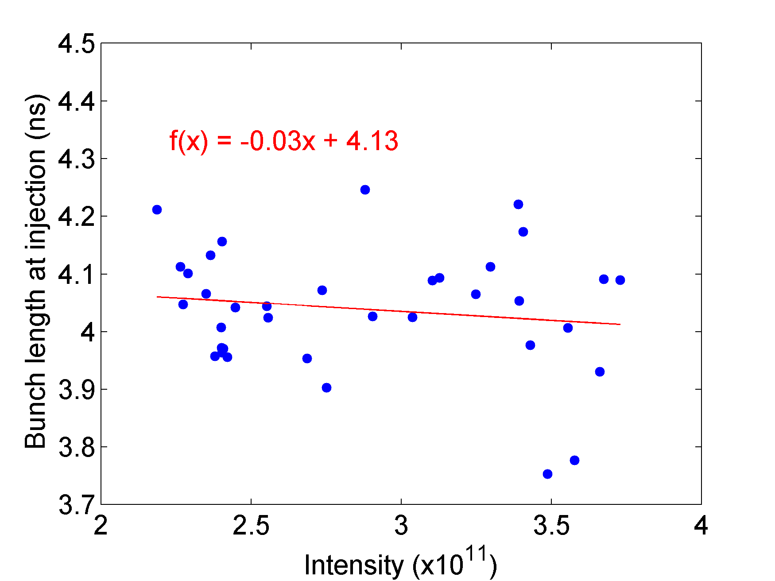
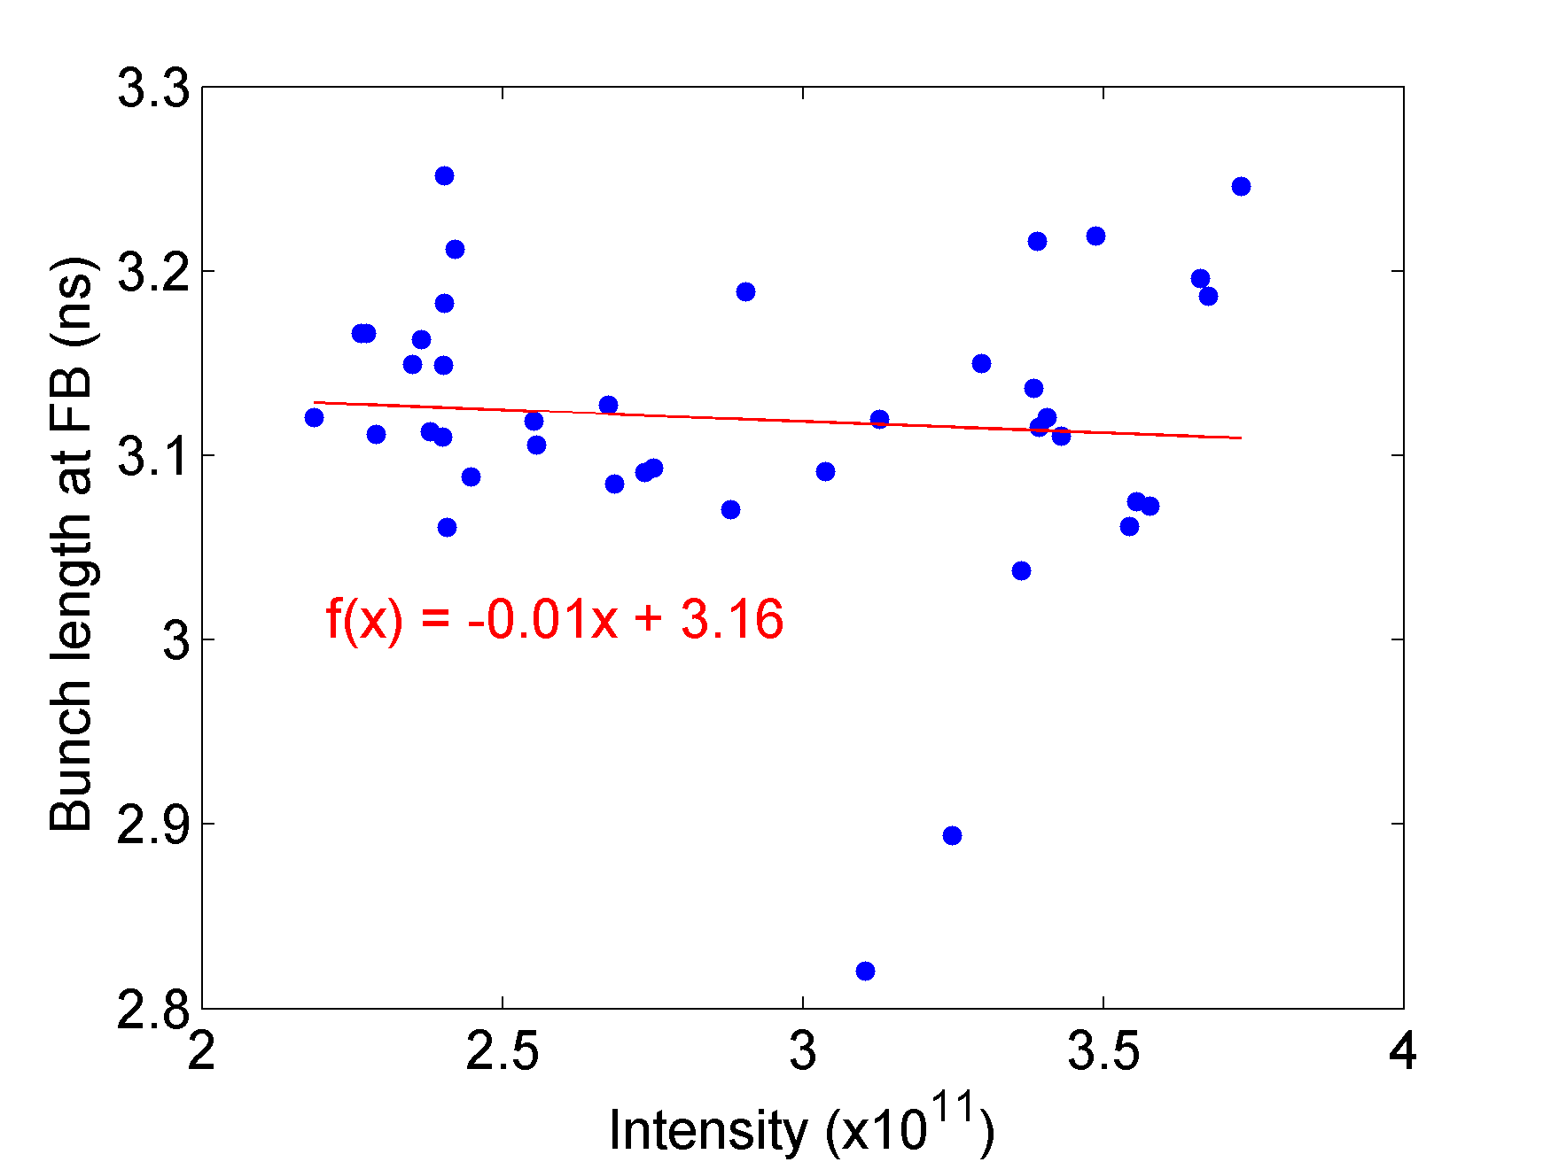
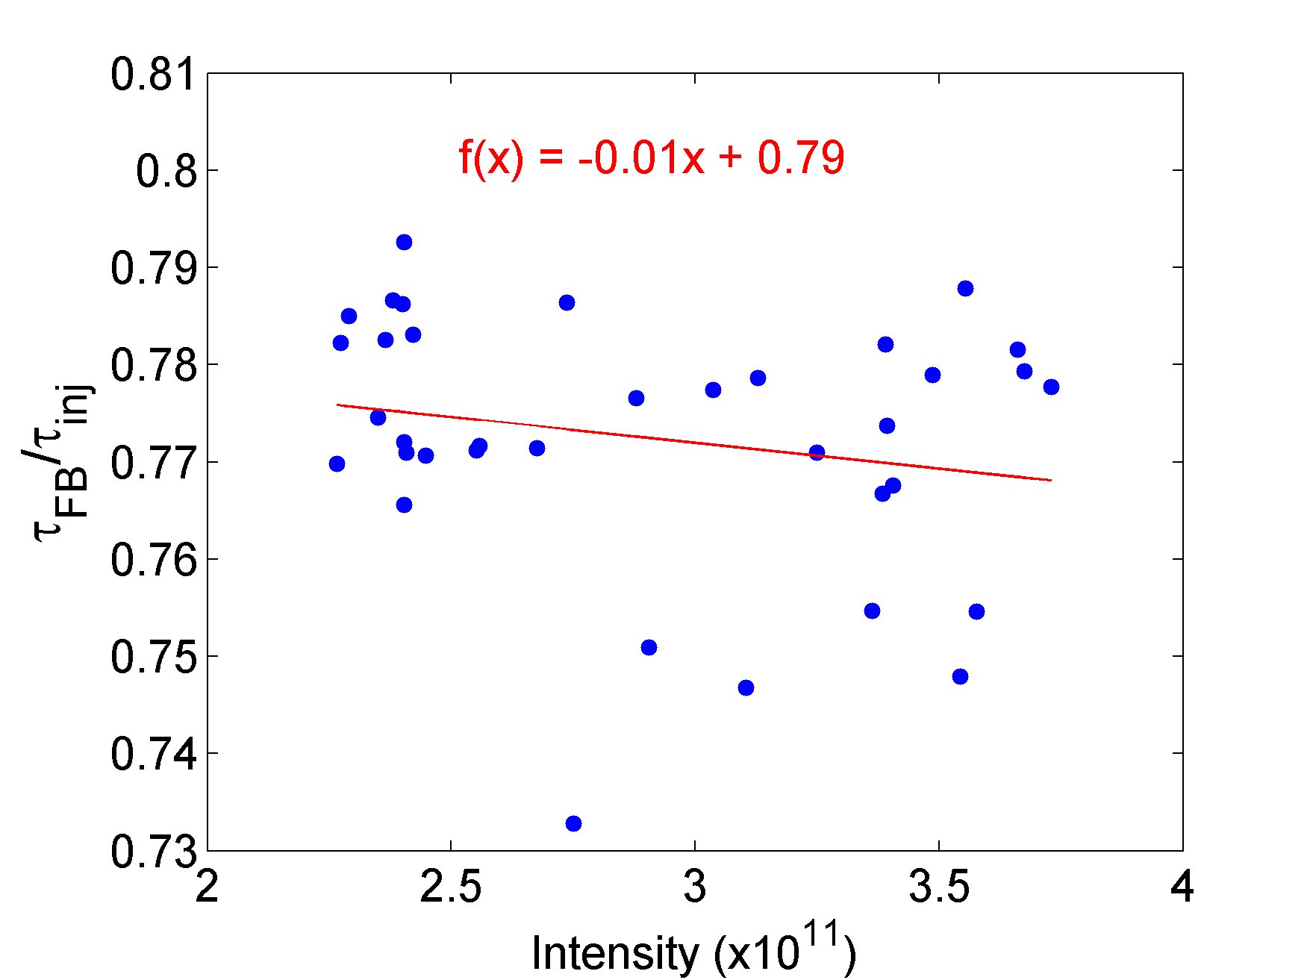
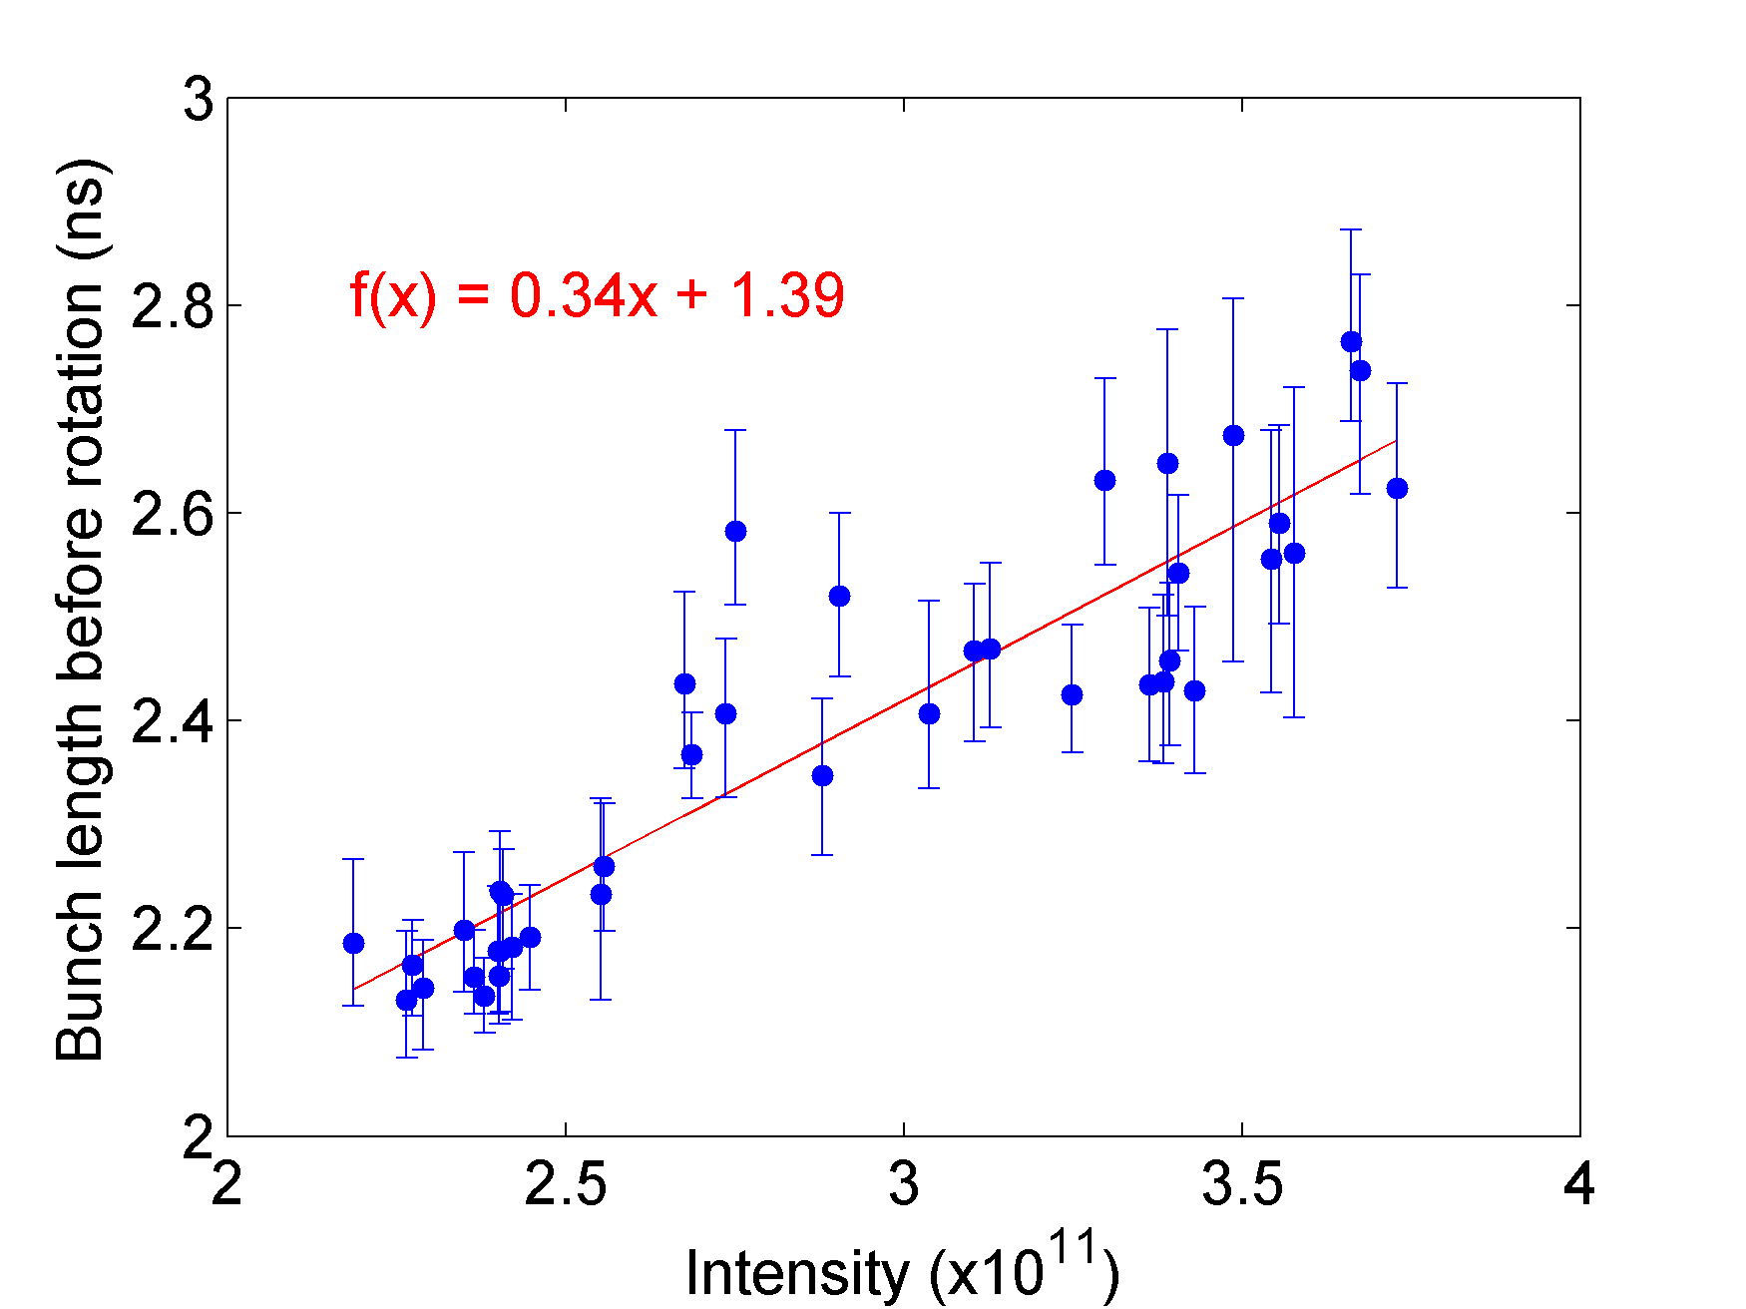
Measurements (1)
Bunch rotation: Q20 optics , V₂₀₀ = 2 MV, V₈₀₀ = 0.2 MV, p = 450 GeV/c , N_{p}: (1.1 - 2.7)x10¹¹ - (Action from the previous meeting to check the bunch length dependence after filamentation (~60 ms FB))

Slide 5
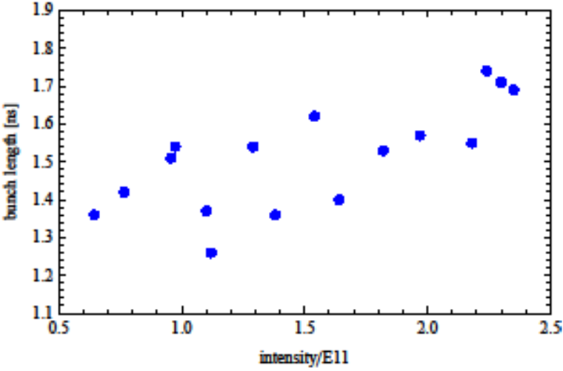
Measurements (2)
LHC single bunch MD: Q26 optics , V₂₀₀ = 4.5 MV, V₈₀₀ = 0.5 MV, p = 450 GeV/c , N_{p}: (0.6 - 2.4)x10¹¹
Bunch length vs Intensity at FT
Selected to reduce
the dependence of the
bunch lengths at FT on
intensity
constant ε_{l} at injection
ε_{l}~0.35 eVs
Threshold estimation at the time:
N_{th}~2.2x10¹¹

Slide 6

Simulation set-up
Distribution function: $F\left(H\right)={{(H}_{lim}−H) }^{2}$ ,
$H_{lim}$ corresponds to $ε_{l}=0.4 eVs$ and $0.35 eVs$
SPS known impedance model:
+ SPS kickers (C. Zannini)
Initial matched distribution created iteratively with conditions to match those in measurements
5x10⁵ macro-particles tracked for 5x10⁴ turns ( ~ 1.15 s)
 | f_{r} (MHz) | R_{sh} (MΩ) | Q
TWC200 – F (long) | 200.2 | 2.86 | 150
TWC200 – F (short) | 200.2 | 1.84 | 120
TWC200 – H | 629 | 0.388 | 500
TWC800 - F | 800.8 | 1.94 | 300

Slide 7
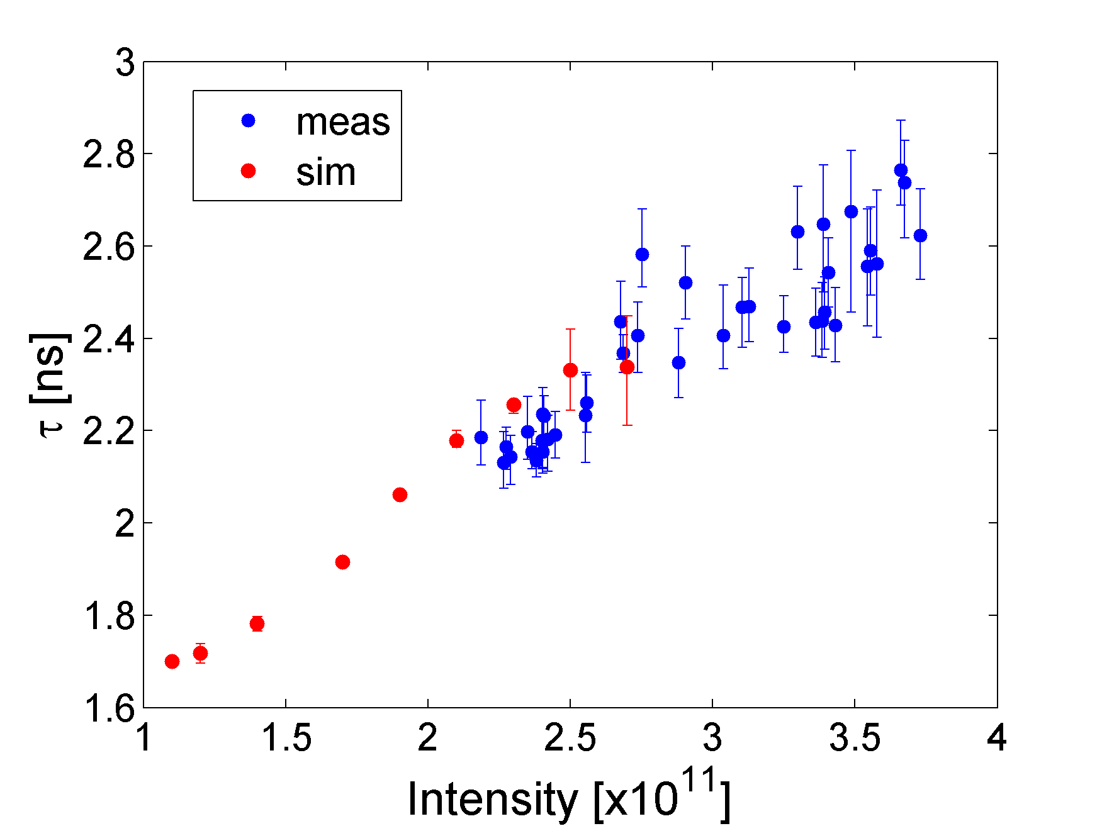
Simulation vs Measurements (1)
Bunch rotation: Q20 optics , V₂₀₀ = 2 MV, V₈₀₀ = 0.2 MV, p = 450 GeV/c , N_{p}: (1.1 - 2.7)x10¹¹
ε_{l} = 0.4 eVs (> measurements?)
comparable bunch lengths
similar slopes (see talks from
previous meeting)
threshold from simulations
N_{th}~1.3x10¹¹
does not correspond to reality
(no ramp and phase loop in
simulations)
errobars indicate the stability of the bunches - (quadrupole oscillations)

Slide 8
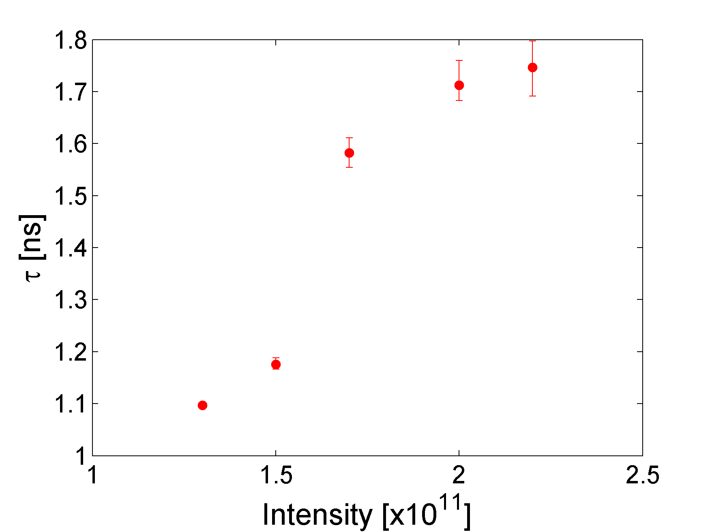
Simulation vs Measurements (2)
LHC single bunch MD: Q26 optics , V₂₀₀ = 4.5 MV, V₈₀₀ = 0.5 MV, p = 450 GeV/c , N_{p}: (0.6 - 2.4)x10¹¹
Simulations
Measurements
ε_{l} = 0.35 eVs
comparable bunch lengths
threshold from simulations N_{th}~1.4x10¹¹

Slide 9
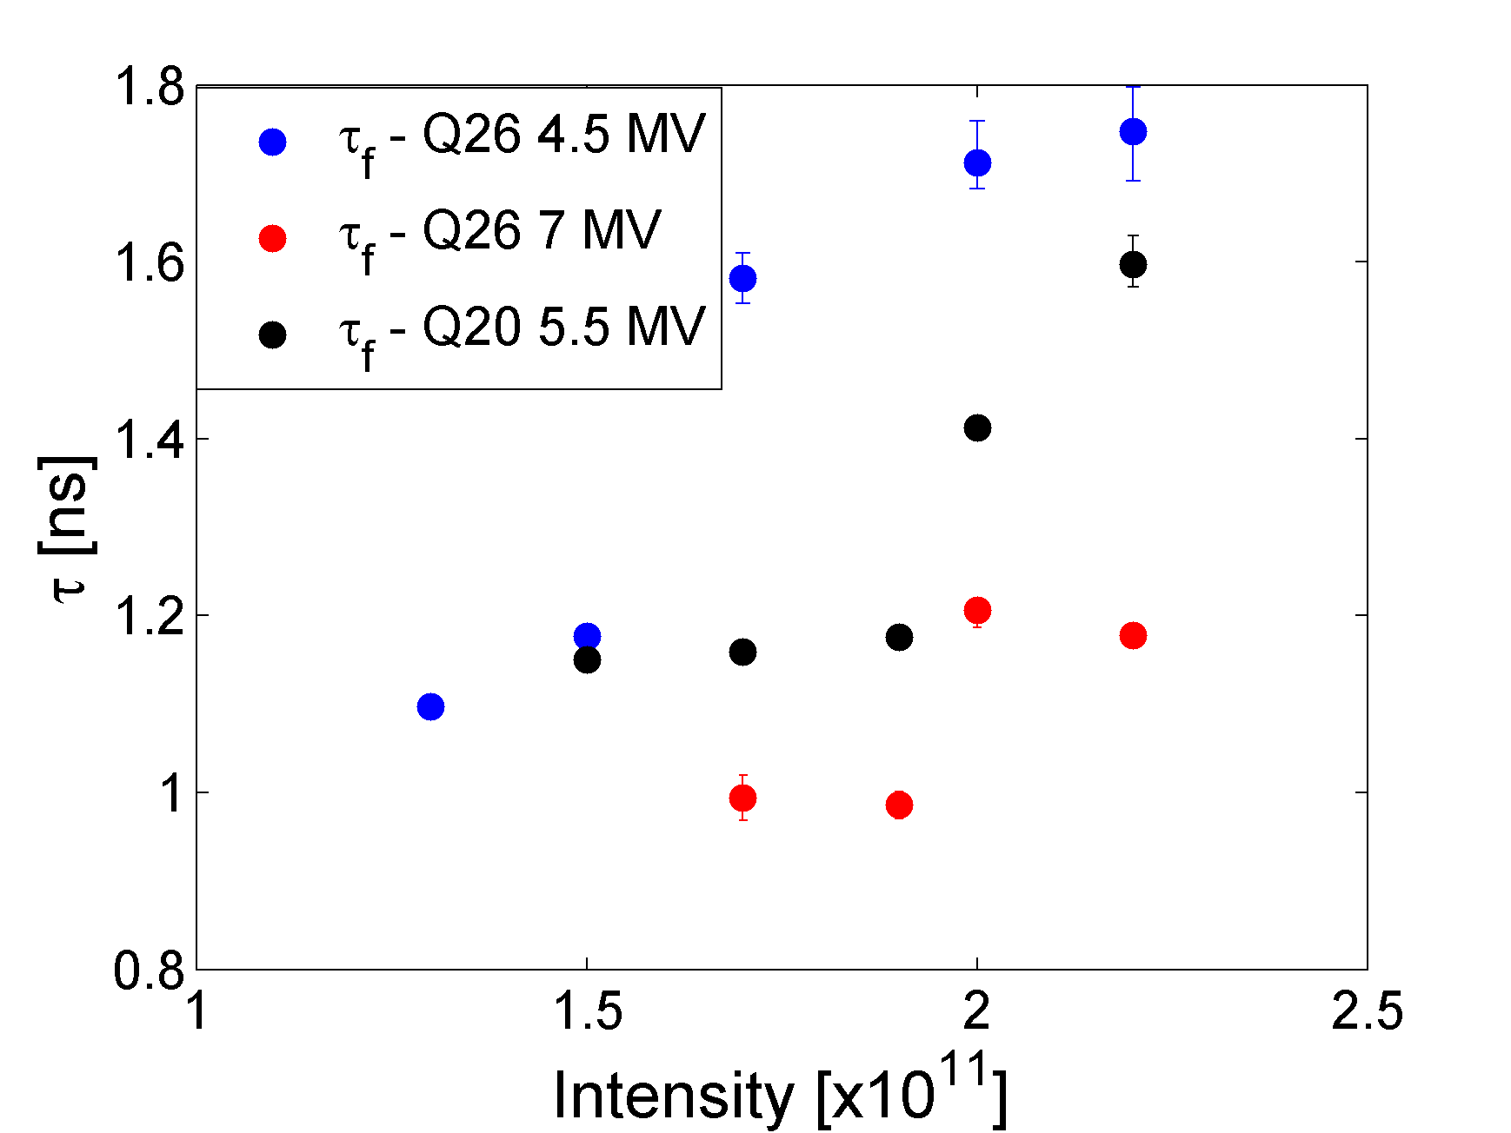
Simulation Q26 vs Q20
ε_{l} = 0.35 eVs
N_{th}~1.3x10¹¹
N_{th}~1.5x10¹¹ (estimated)
N_{th}~1.9x10¹¹
For Q26 is clearly better with 7 MV → threshold for microwave${ ∝\left(\frac{Δp}{p}\right)}^{2}$
Instability starts later during the tracking > 20.000 turns (for 4.5 MV <5000 turns)
For Q20 again fast instability (<5000 turns)
Comparing thresholds between Q26 (4.5 MV) and Q20 (5.5 MV) it seems that it scales according to the Keil-Schnell-Boussard criterion

Slide 10
Summary
Results generally agree with the bunch rotation and LHC MD
measurements
Threshold seems to improve with higher RF voltage → indication of microwave instability (MI) → 1.4 GHz
Comparison of Q20 and Q26 scales according to the Keil-Schnell-Boussard criterion
In reality we have a mixture of MI and LLD
More accurate simulations are needed for better agreement:
Particle distribution to be close to the measured one
Simulation of the ramp where the actual blow-up was observed
Implementation of phase loop

Slide 11
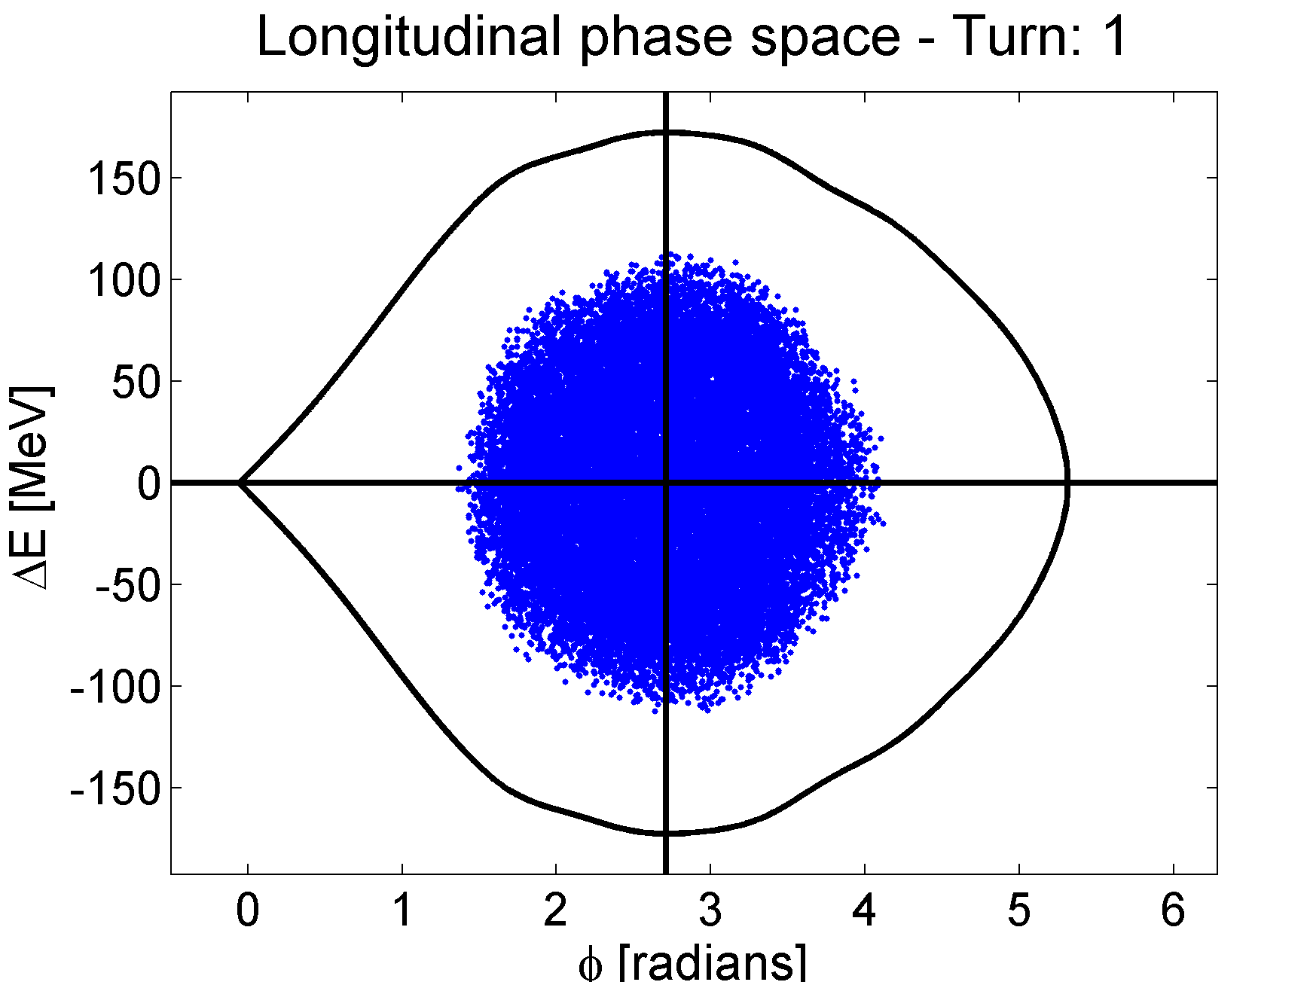
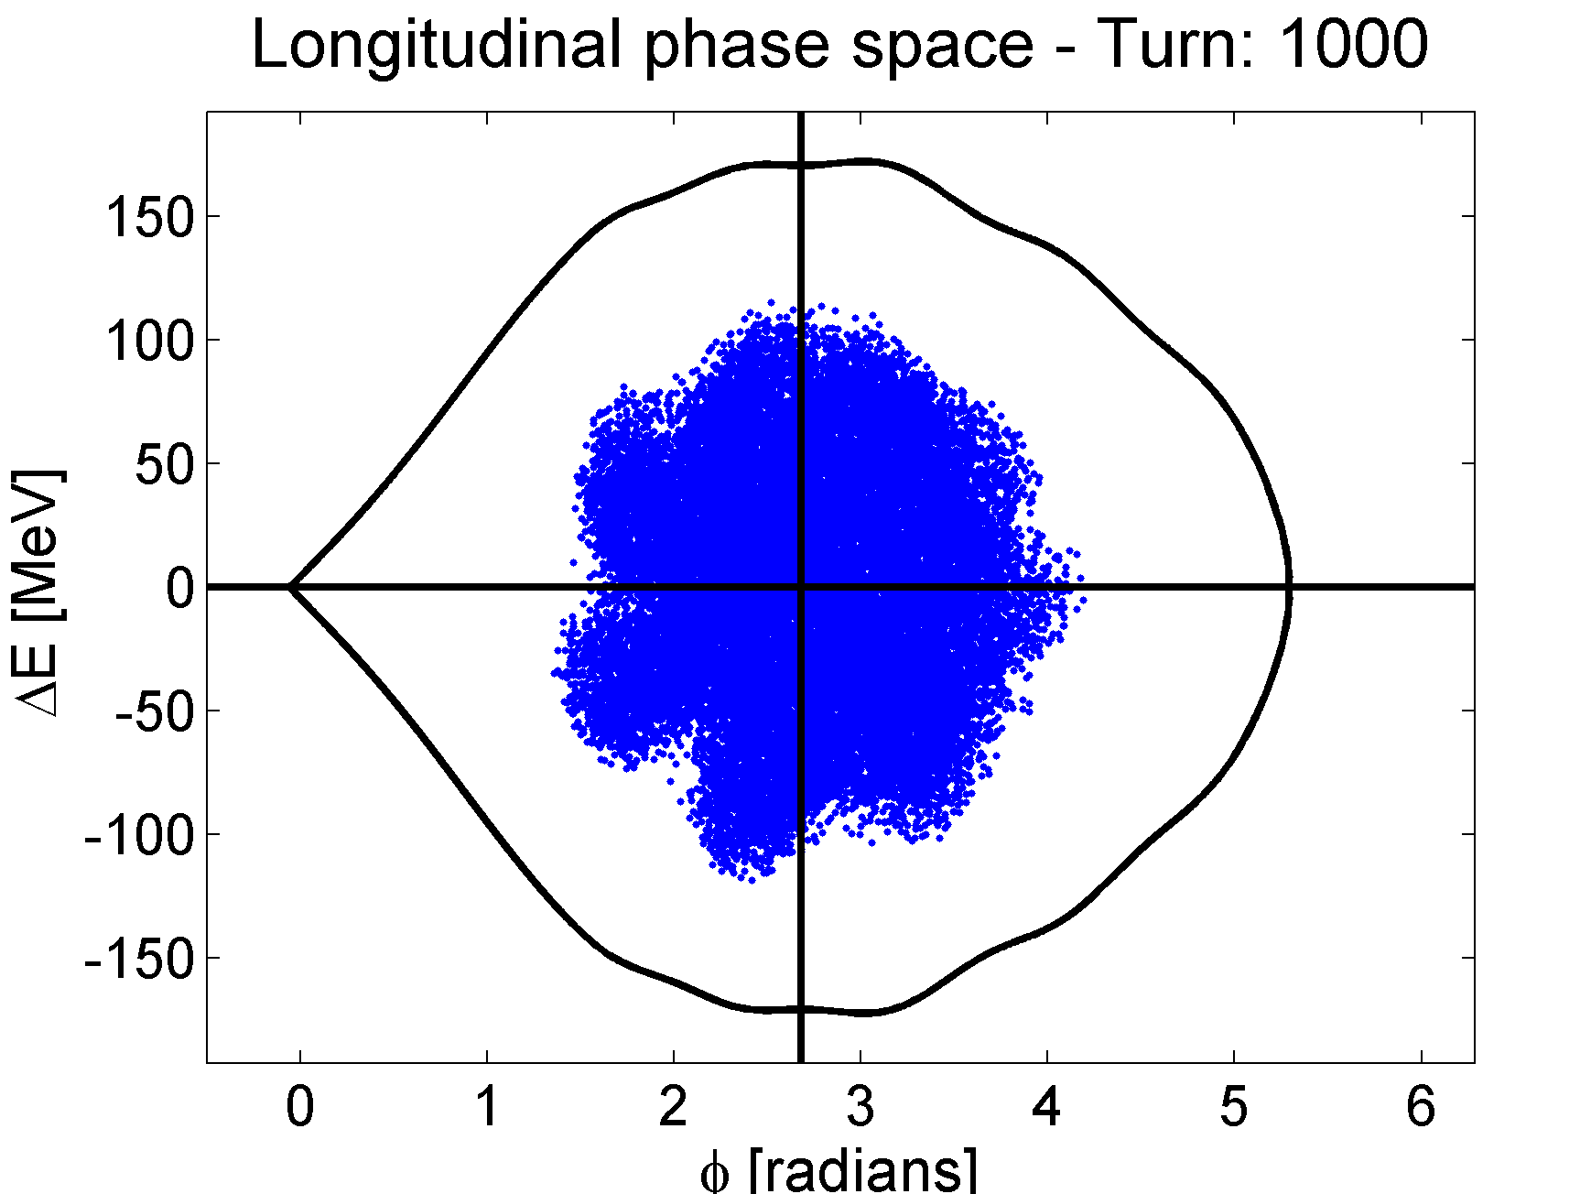
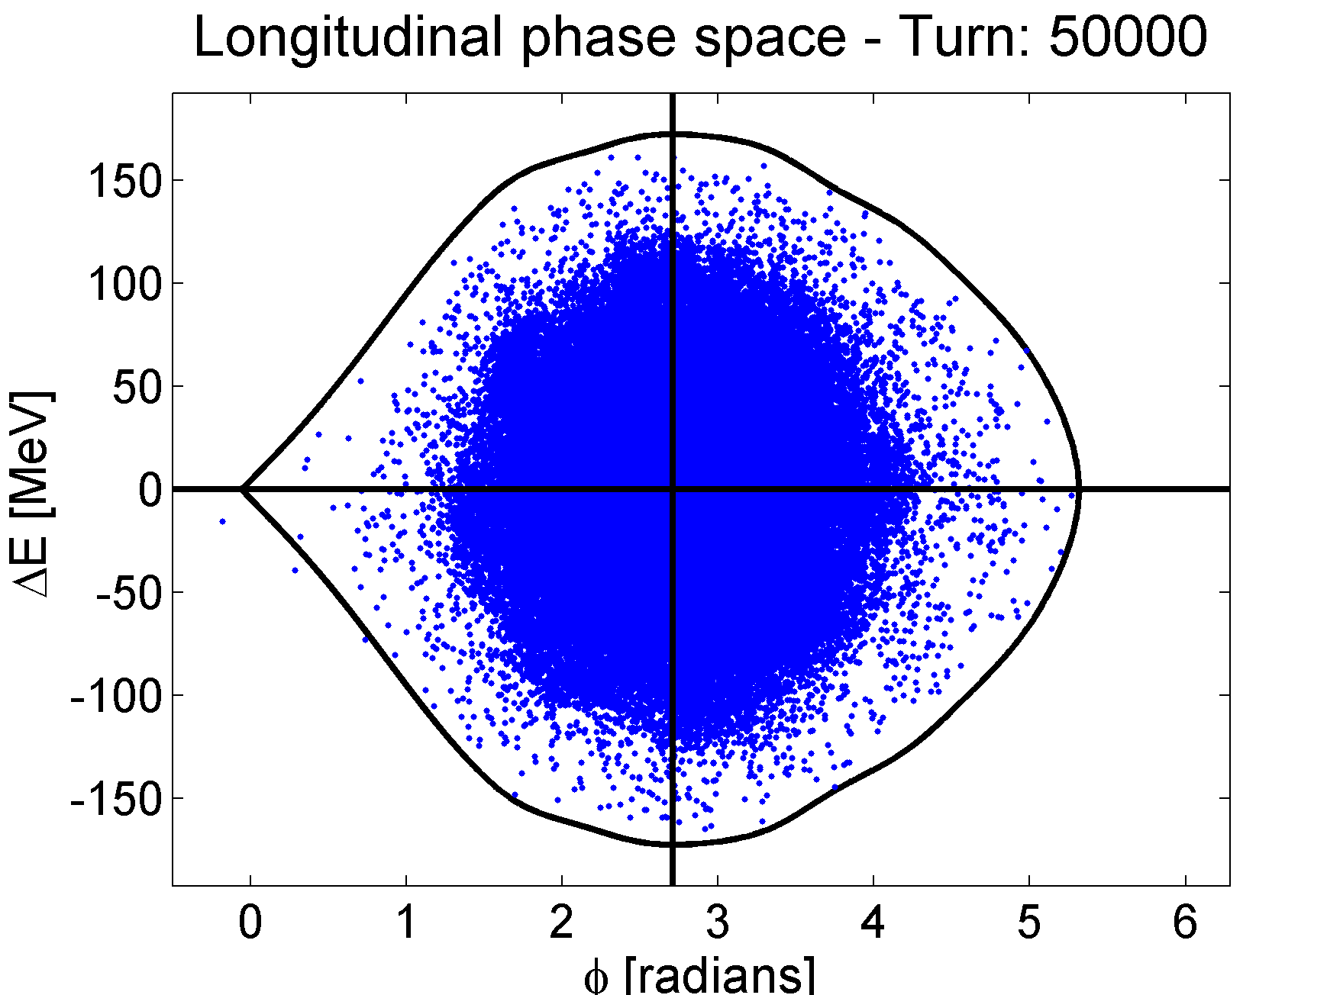
Simulation results - with 1.4 GHz
With the 1.4 GHz resonance:
f_{r}=1.42 GHz, Q=10, R_{sh} = 400 kΩ
Micro-structure pattern inside the bunch
Bunch is blowing-up after a few hundreds of turns (depends on the intensity)
Phase-space at different times for N_{p} = 1.9x10¹¹
High azimuthal mode(s) (m=3,4 ?) of bunch oscillations for this resonance
Bucket corresponds to Turn=1

Slide 12
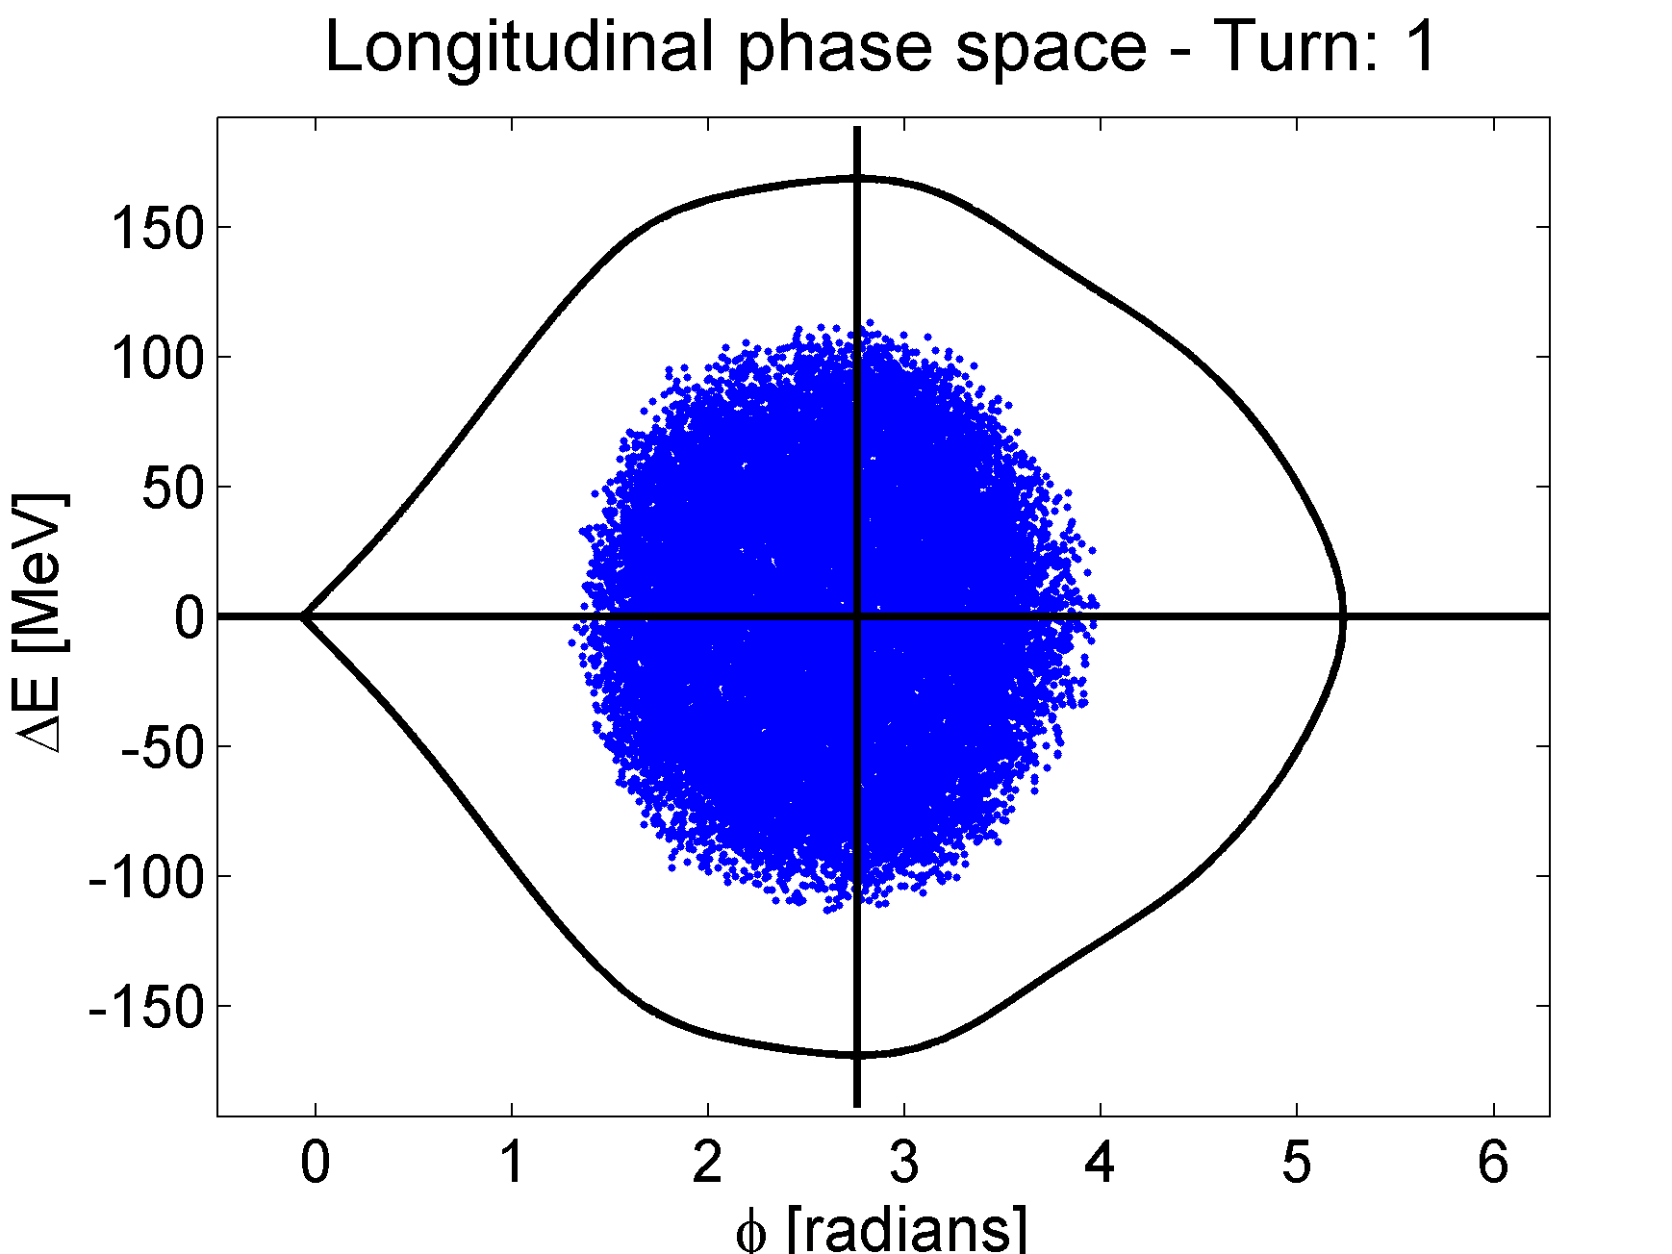
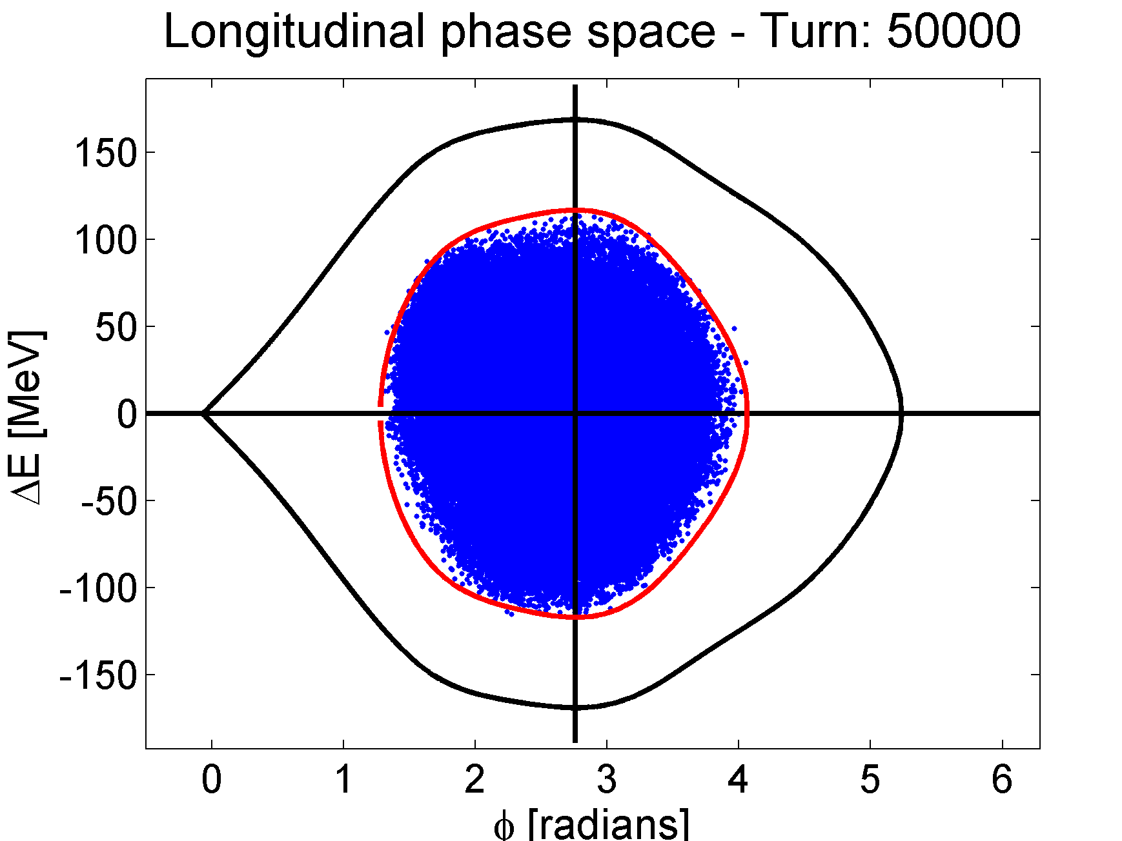
Simulation results - w/o 1.4 GHz
Bunch is more stable
Blows-up slowly and at higher intensities
Phase-space at different times for N_{p} = 2.3x10¹¹
Bucket corresponds to Turn=1
Initial distribution

Slide 13
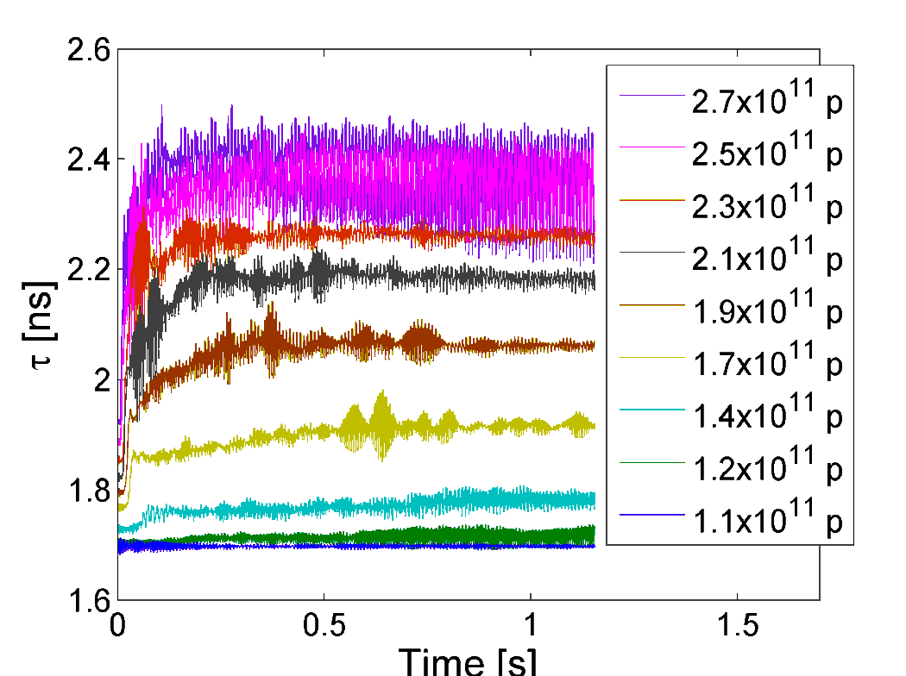
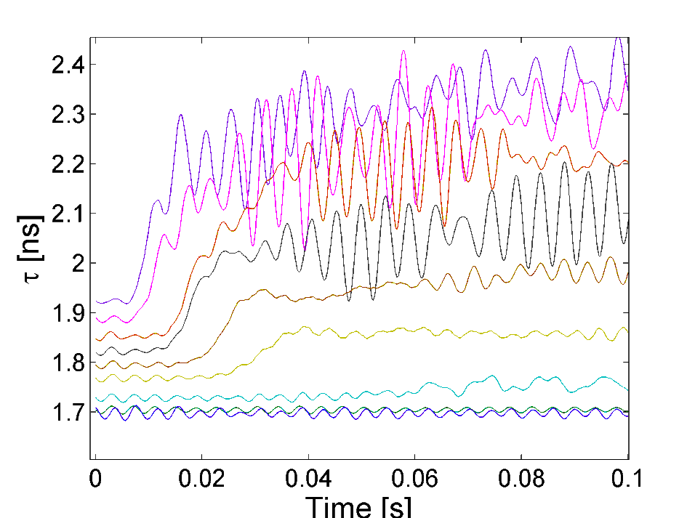
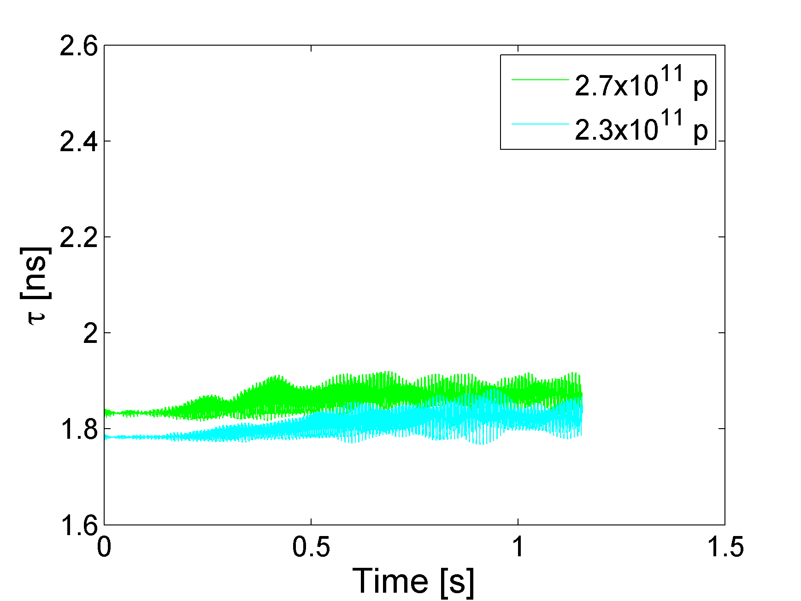
Simulation results
Bunch length evolution with 1.4 GHz
zoom
Bunch length evolution w/o 1.4 GHz
with 1.4 GHz resonance: bunch blows-up at the beginning even at low intensities (~1.4x10¹¹ p)
w/o 1.4 GHz: higher intensity threshold

Slide 14
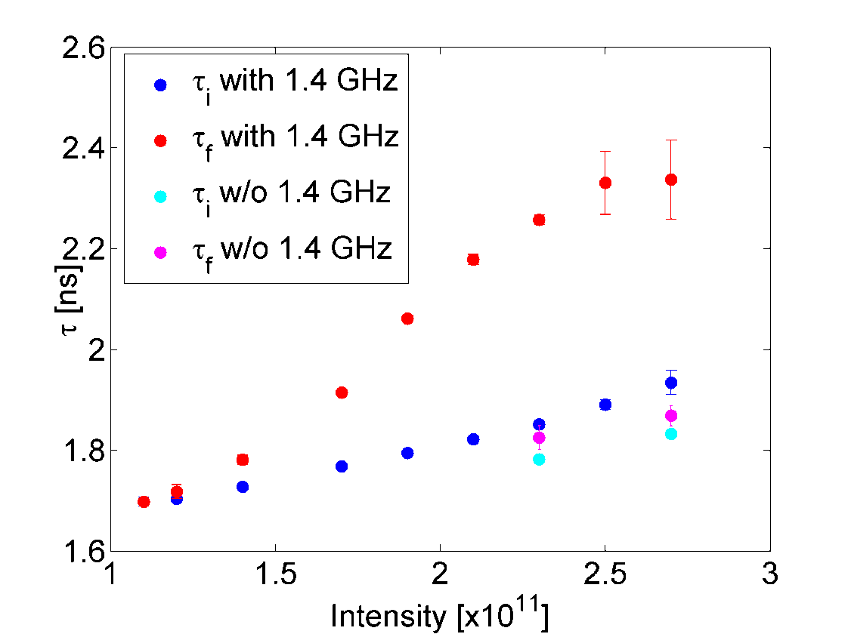
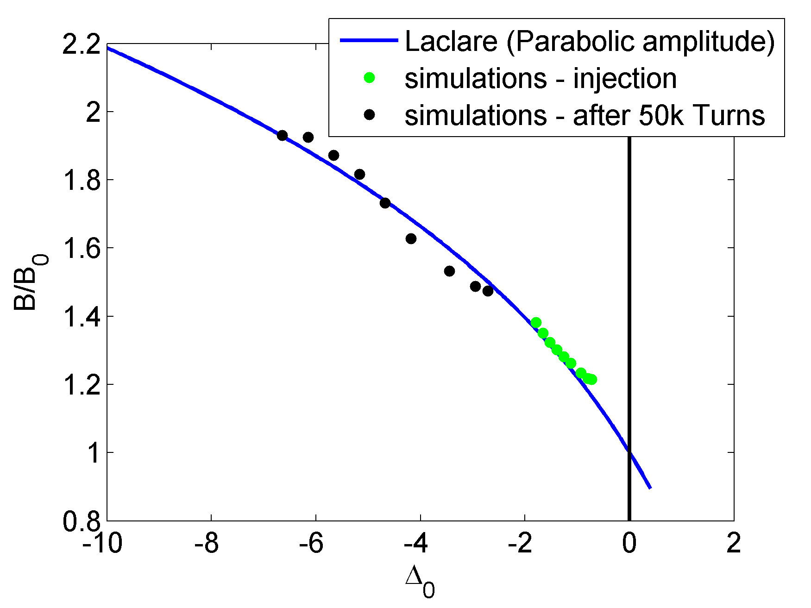
Simulation results
Fit with the formula: ${\left(\frac{B}{B_{0}}\right)}^{−1}={\left(\frac{B}{B_{0}}\right)}^{3}+Δ_{0}\left(I,B_{0}, Im\left(Z/n\right)\right)$ (neglecting synch. phase shift) (Laclare) for parabolic amplitude density and constant inductive $Z/n$
$B_{0}=f_{rev}τ_{0}$, with $τ_{0}=1.4 ns$ (from simulation)
Injection: $Z/n≅4 Ω$ - at 50k Turns: $Z/n≅15 Ω$

