Slide 1
SPS intensity limitation with and without 200 MHz RF upgrade
E. Shaposhnikova
LIU-SPS meeting
July 2013
Acknowledgments: T. Argyropoulos, T. Bohl, E. Montesinos, J. Esteban Muller

Slide 2
SPS 200 MHz RF system
4 Travelling Wave cavities:
2 cavities of 5 sections
2 cavities of 4 sections
Power/cavity limit (E. Montesinos):
700 kW for full ring (FT/CNGS & LHC beams) – continuous mode
(1.0-1.1) MW for 1/2 ring (LHC beam)
in principle possible in pulsed mode (after consolidation), but never tested and used for high intensities
need completely new SPS LLRF
reduced reliability
Voltage: now maximum 7.5 MV

Slide 3
Voltage per cavity with/without upgrade
P_{max}=1.4 MW/cavity
P_{max}=1.0 MW/cavity
5-section cavities are less efficient at ultimate LHC current for power limit of 1.4 MW/cavity (T. Bohl, Chamonix 2000) → 4 cav. x 4 sect. or 1x3+3x4 suggested
But 5-section cavities become “useless” for limit of 0.75 MW at 1.6x10¹¹ and at 1.8x10¹¹ for the 1.0 MW limit.
Voltage reduction at lower current can be avoided by rearranging existing 4 cavities into 6 cavities (2x4+4x3 = 20, with 2 spare sections) together with 2 new power plants

Slide 4
Flat top: maximum voltage (present situation)
Present situation (750 kW limit)
7.5 MV for nominal current (1.5 A)
For 25 ns beam with 1.56x10¹¹/bunch (Irf=2.0 A) will have (4-5) MV
20% longer bunches for the same emittance
significantly increased losses in LHC
1.0 MW pulsing: 7.5 MV up to 2.0 A
But what voltage is needed at this intensity?

Slide 5
Q20: bunch length on the flat top 25 ns beam (MD end 2012)
N_{p}~1.2x10¹¹ p/b
N_{p}~1.35x10¹¹ p/b
τ_{avg}=1.63 ns
τ_{avg}=1.47 ns
T. Argyropoulos et al.
low γ_{t}: to gain stability V ~ η; same stability with lower emittance (as now
Bunch length increases with intensity due to instabilities (or controlled blow-up) and
PS emittance. Here on flat top 11 % increase in τ_{avg} for 12% in intensity!
Reference point: N_{p}~1.35x10¹¹ p/b (1.7 A), bunch length 1.7 ns (BQM max 1.9 ns)

Slide 6
Voltage required for higher intensities
Voltage (V ~ ɛ²) to avoid
loss of Landau damping (LD): N ~ ɛ^{5/2}/V^{1/4} and V~N
microwave instability (MW): N ~ ɛ^{3/2} V^{1/4} and V~N
experiment: τ~N (?)
Potential well distortion (PWD) due to induced voltage (~τ⁻³ for ImZ/n=3.5 Ohm and τ=1.7 ns
parabolic bunch profile (μ=1)
parabolic amplitude (μ=3/2)

Slide 7
Flat top: available and needed voltage for present situation and with 1.0 MW pulsing
V for τ = const
(LD & PWD)
For nominal current (1.5 A) we have now 7.5 MV
For 25ns beam with 1.56x10¹¹/bunch (Irf=2.0 A) will have (4-5) MV
20% longer bunches for the same emittance plus 10% from emittance increase with intensity (ɛ~N^{1/2}) due to instabilities
significantly increased losses in LHC (but already now the LHC filling is very sensitive to the BQM bunch length)

Slide 8
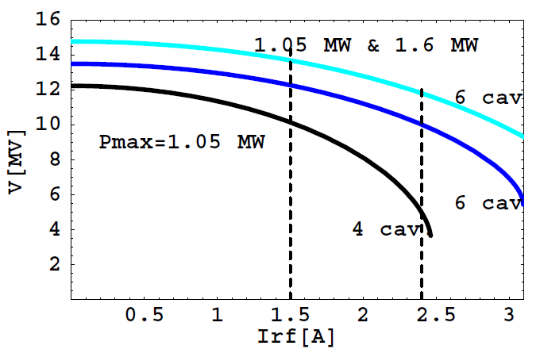
With 200 MHz upgrade
●
Pulsing to 1.05 MW =>
OK for 1.9 A (1.5x10¹¹/bunch)
Full upgrade:
- OK till 2.7 A (2.1x10¹¹)
- 10 MV for 3 A (2.3x10¹¹/bunch);
12.5 MV are required
(LD limit + PWD) => 1.8 ns
With full upgrade:
FB bandwidth – 5 MHz, needed for HI (2.5 MHz now)
20% less impedance and beam loading
V for τ = const
(LD & PWD)

Slide 9
Acceleration: voltage and power for nominal intensity in Q20 and Q26
Voltage
Power
=> Power is at the limit also during acceleration above nominal intensity!

Slide 10
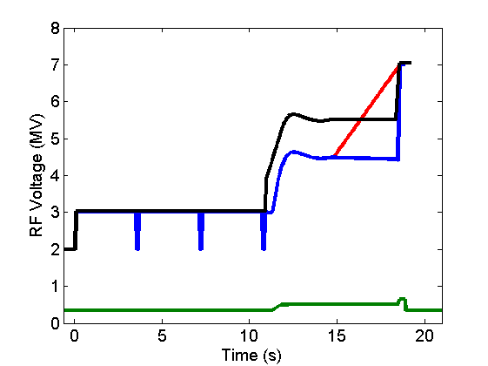
SPS voltage programs for Q26
emittance
blow-up MD
transfer to LHC
HI 25 ns beam
Larger emittance and higher voltage
were also required in Q26 optics
for high intensity 25 ns beam
200 MHz
nominal beams
ultimate 50 ns
800 MHz
T. Argyropoulos et al.

Slide 11
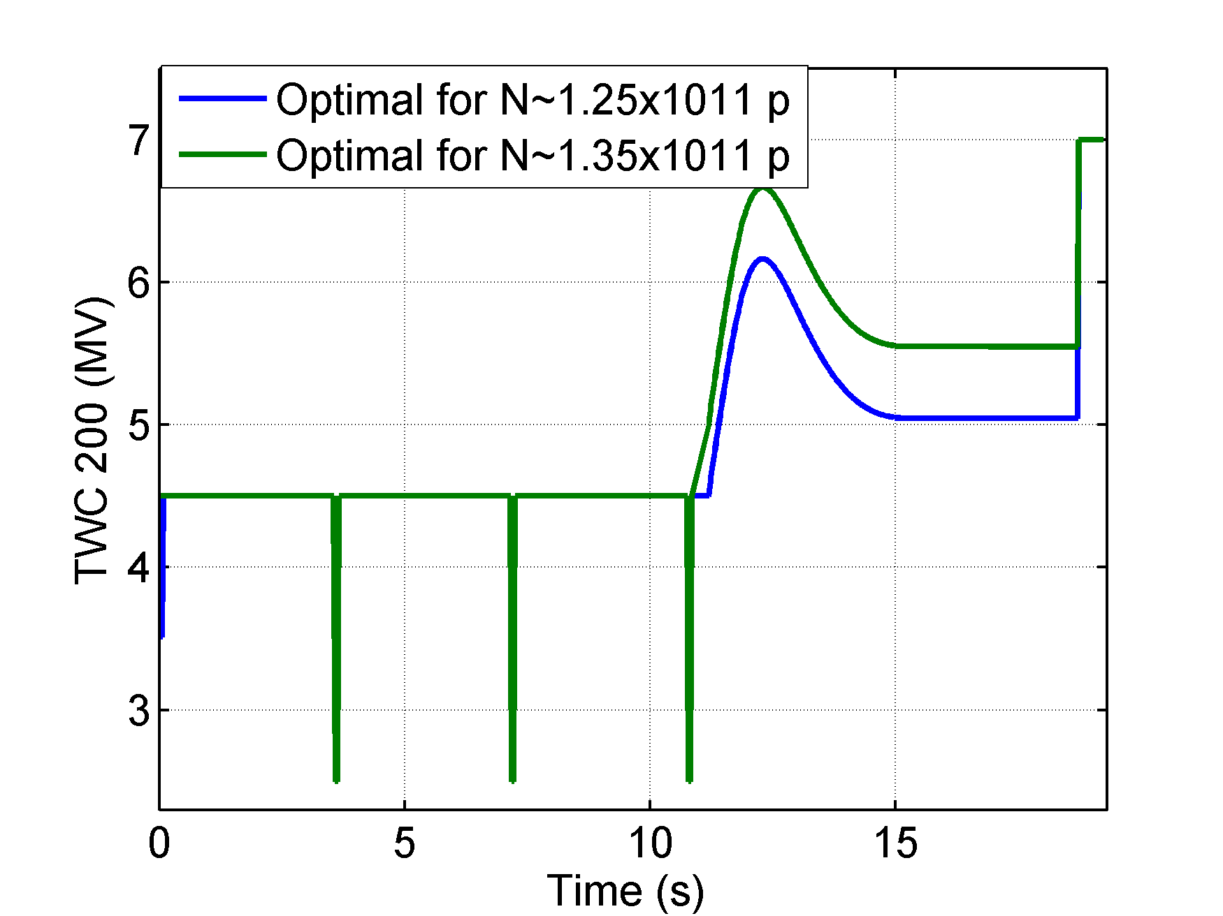
Voltage programs for Q20 (MDs)
200 MHz voltage program settings:
2.5 to 4.5 MV - 4 dips at injections
4.5 MV constant
3.5 to 4.5 MV – 1st injection and 2.5 to 4.5 MV – for the rest
As in III + 500 kV at acceleration and flat top (avoid losses for higher intensities)
As in IV but no first dip
optimal
Voltage increase during ramp required for higher intensities
Voltage close to the limit
For higher intensities
particle losses
or
increase length of the cycle
longer LHC filling time
T. Argyropoulos et al.

Slide 12
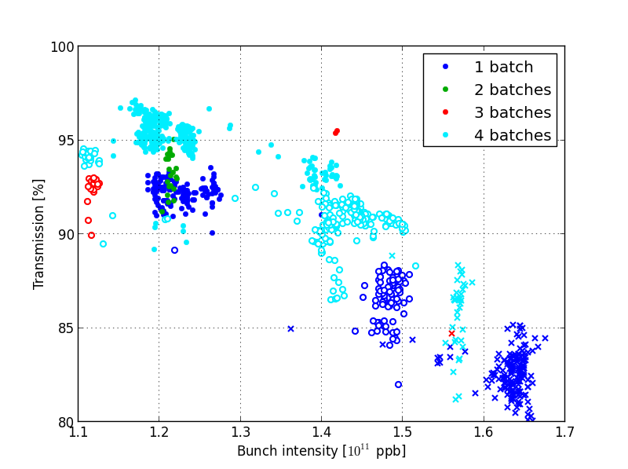
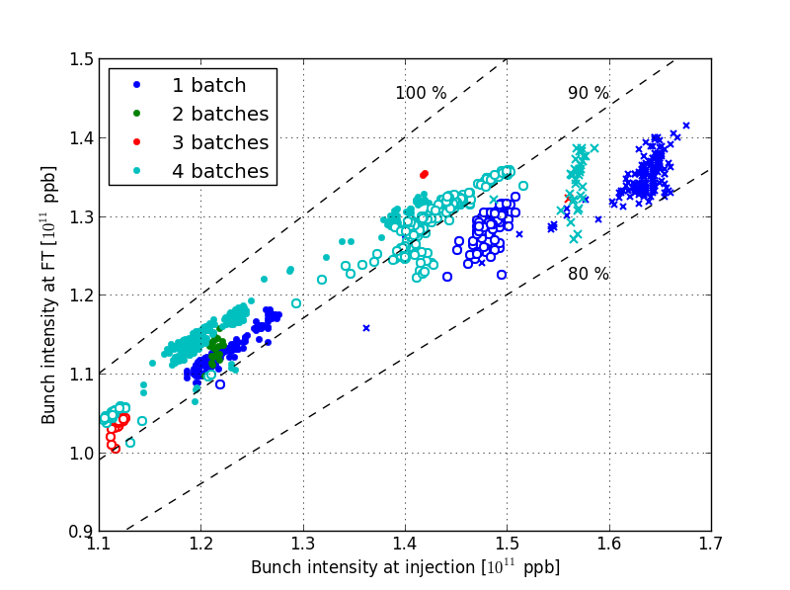
Transmission of 25 ns beam in MDs with Q20 optics
J. Esteban Muller et al.
=> The reason for large losses is not clear yet, could be transverse also

Slide 13
Summary for the 200 MHz upgrade scenarios (flat top, 25 ns beam)
 | Maximum bunch intensity with
Scenario | no performance degradation | 10% longer bunches, more losses in LHC
4 cavities, 750 kW - now | 1.35x10¹¹ | 1.45x10¹¹
4 cavities, 1.05 MW pulsing, new LLRF | 1.5x10¹¹ | 1.7x10¹¹
4 cavities with 1.05 MW & 2 cavities with 1.6 MW, new LLRF | 2.1x10¹¹ | 2.5x10¹¹
Note: all estimations are done with simplified models and scaling from present experimental results

Slide 14
Summary
The existing 5-section cavities become useless at ultimate intensities with power limit of 1.0 MW and at 1.6x10¹¹ p/b with 750 kW limit.
Nominal (now) Q20 optics provides higher beam stability but requires more RF voltage! Stability is at the limit for 1.35x10¹¹ @450GeV. We gain in longitudinal beam stability only if we increase voltage. Voltage is already at the limit at extraction to LHC and approaching limit during the cycle.
For power limit of 750 kW the bunch length of 25 ns beam with 1.56x10¹¹/bunch will increase by ~30%. This will lead to significant increase of losses and creation of satellite bunches in LHC
More 200 MHz voltage is required for higher intensity not only for beam transfer to the LHC (maximum available voltage used now) but also during the cycle. W/o RF upgrade - losses in SPS or longer cycle (slower ramp) and LHC filling time
Difficulties with controlled emittance blow-up in double RF system due to beam-loading => beam quality degradation (non-uniform bunches)
For shorter cavities the coupling impedance is reduced by 20%
In pulsing mode LLRF beam control should be rebuild

Slide 16
Power/cavity in 4- & 5- section cavities with P₄=P₅ (but V₄ ≠ V₅)
nominal intensity & 0.5 eVs
ultimate intensity & 0.6 eVs

Slide 17
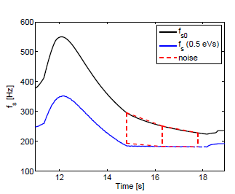
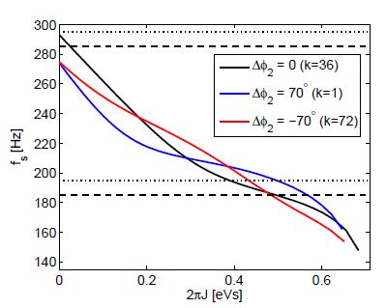
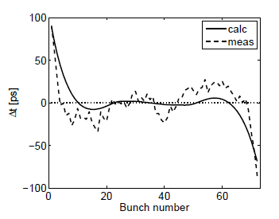
Effect of beam loading in the SPS 200 MHz RF on emittance blow-up by band-limited noise
applied noise
synchrotron frequency
distribution varies along batch
T. Argyropoulos et al., HB2010
measured & calcul.
k-th bunch position ∆φ_{s}

