Slide 1
Where are we on the impedance of the new design of the SPS wirescanner
Mauro Migliorati, Benoit Salvant and Carlo Zannini for the impedance team
Many thanks to Hannes Bartosik, Nicolas Critin, Heiko Damerau, Bernd Dehning, Federico Roncarolo and Ray Veness

Slide 2
Agenda
New design
Current design
Power loss
Mode geometry
Previous measurements
Comparison with wall current monitor
Summary

Slide 3
New Model (LHC)
CATIA model from Nicolas Critin
Model heavily simplified to be able to mesh the geometry
Only one longitudinal gap (2.3 mm)
Wire and gaps difficult to mesh

Slide 4
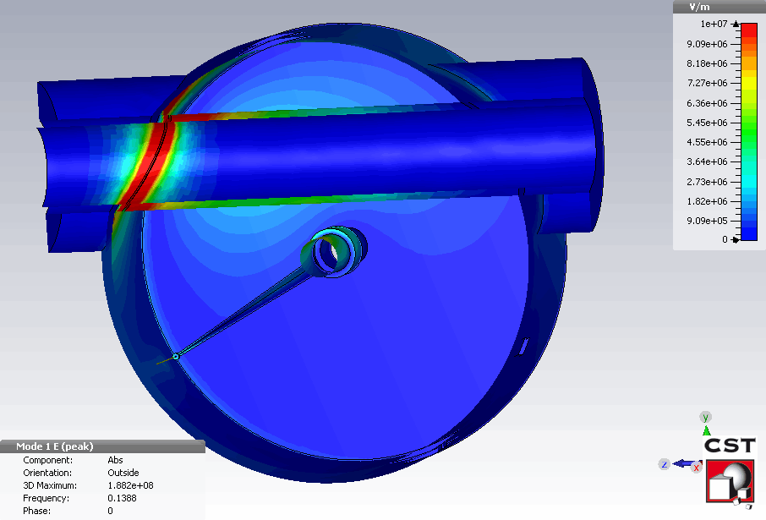
Results
Significant low frequency mode due to the longitudinal gap:
Shunt impedance (longitudinal): 250 kOhm
Quality factor: 2500
Frequency: 140 MHz
Quite worrying as is (for longitudinal coupled bunch instabilities)
Possibility to use ferrites (like in wall current monitor) or mode couplers to damp the mode

Slide 5
Solutions with ferrite?
With ferrite in green
With less ferrite in red
Re(Zlong) in Ohm
Re(Zlong) in Ohm
Frequency (GHz)
Frequency (GHz)
To be checked if these solutions can be implemented
To be compared with the current wire scanner design

Slide 6
New model for SPS
Same as LHC but bigger aperture
Resonance now at 80 kOhm at around f=160 MHz (Q=1300), without ferrites.

Slide 7
Proposal of Heiko and Hannes
Longitudinal impedance in Ohm
Frequency in GHz
→ Better than the initial solution, still worse than the current design
→ However, solution not feasible for BI (“the fork should rotate completely around the axis”)

Slide 8
Agenda
New design
Current design
Power loss
Mode geometry
Previous measurements
Comparison with wall current monitor
Summary

Slide 9
Current design (also simplified)
Wakefield simulations
Very high Q resonances, solver
Resonant frequencies are much lower for the new design

Slide 10
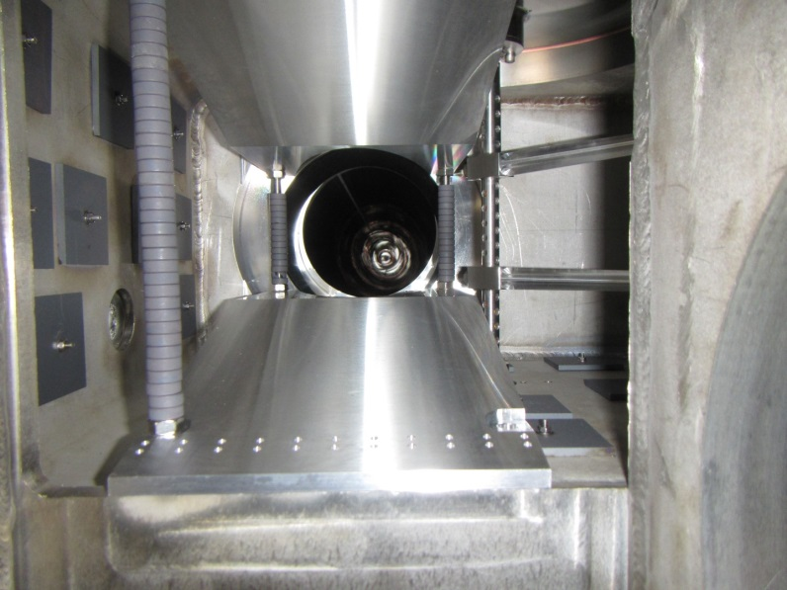
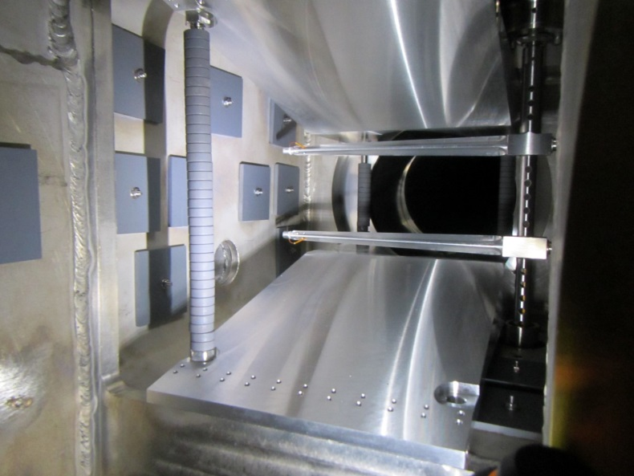
Subtleties of the current design
Taper in 416 H
vertical fork much wider than horizontal fork
→ resonance frequency change
416H Wire out
416 Wire in

Slide 11
Agenda
New design
Current design
Power loss
Mode geometry
Previous measurements
Comparison with wall current monitor
Summary

Slide 12
Comparison for the resonant modes (no ferrites)
Frequency | Shunt impedance (kOhm) | Q | Fields close to the wire? | Power loss at 450 GeV (from LHC spectrum)
140 MHz | 250 | 2500 | No | 60 kW
470 MHz | 15 | 3500 | Yes (partly H) | 0.3 kW
New design
Frequency | Shunt impedance (kOhm) | Q | Fields close to the wire? | Power loss at 450 GeV (from LHC spectrum)
290 MHz | 18.5 | 1660 | Yes | 1.3 kW
658 MHz | 55 | 7000 | Yes | 0.8 kW
682 MHz | 146 | 5500 | Yes | 2.4 kW
1020 MHz | 210 | 12000 | Yes | 0.5 kW
Current design
→ Hopefully there are ferrites to partially damp these modes!
→ Need to do that also for the SPS spectrum at injection energy?

Slide 13
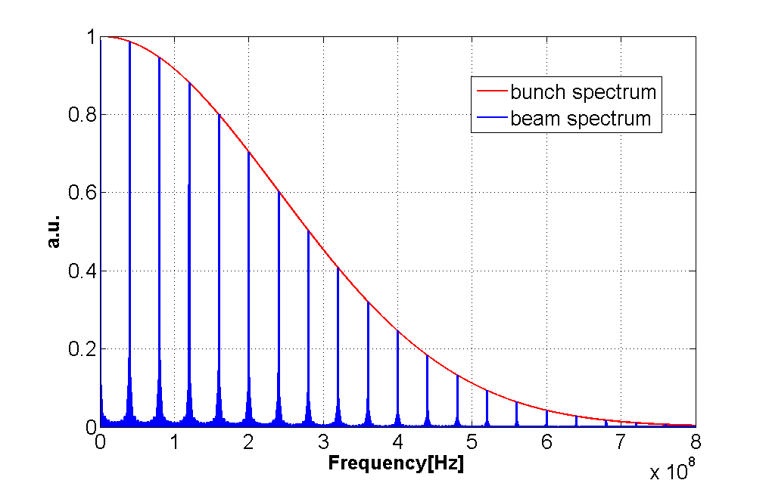
Spectrum at injection
From C. Zannini
72
8
72
8
72
8
72
25ns buckets
First lobe of the beam spectrum after around 700 MHz

Slide 14
Comparison for the resonant modes (no ferrites) modes also significant at injection?
Frequency | Shunt impedance (kOhm) | Q | Fields close to the wire? | Power loss at 450 GeV (from LHC spectrum)
140 MHz | 250 | 2500 | No | 60 kW
470 MHz | 15 | 3500 | Yes (partly H) | 0.3 kW
New design
Frequency | Shunt impedance (kOhm) | Q | Fields close to the wire? | Power loss at 450 GeV (from LHC spectrum)
290 MHz | 18.5 | 1660 | Yes | 1.3 kW
658 MHz | 55 | 7000 | Yes | 0.8 kW
682 MHz | 146 | 5500 | Yes | 2.4 kW
1020 MHz | 210 | 12000 | Yes | 0.5 kW
Current design
→ Hopefully there are ferrites to partially damp these modes!

Slide 15
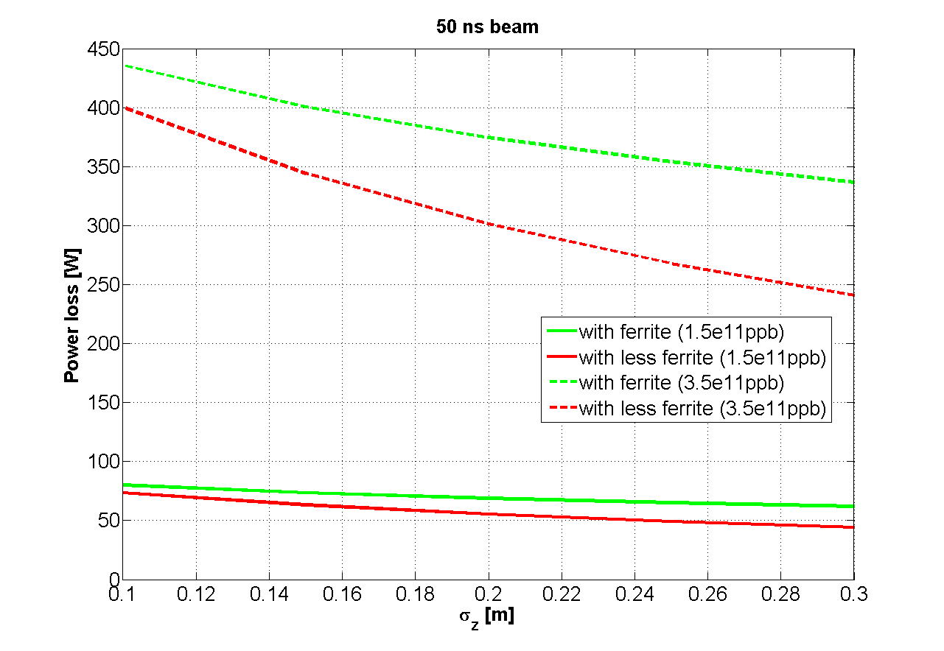
Simulated power loss with 50 ns SPS beam with ferrite as a function of bunch length
Carlo Zannini
Still between 50 and 100 W in the ferrite
Is that ok with the duty factor of LHC beams in the SPS?
Would cooling be needed and is it possible to cool there?

Slide 16
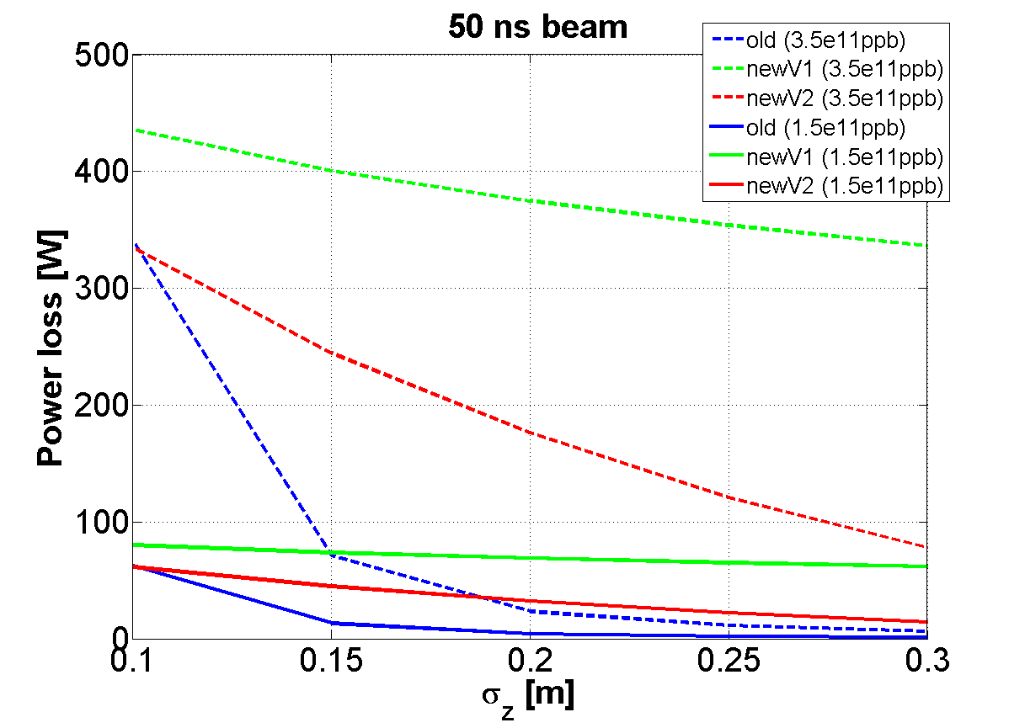
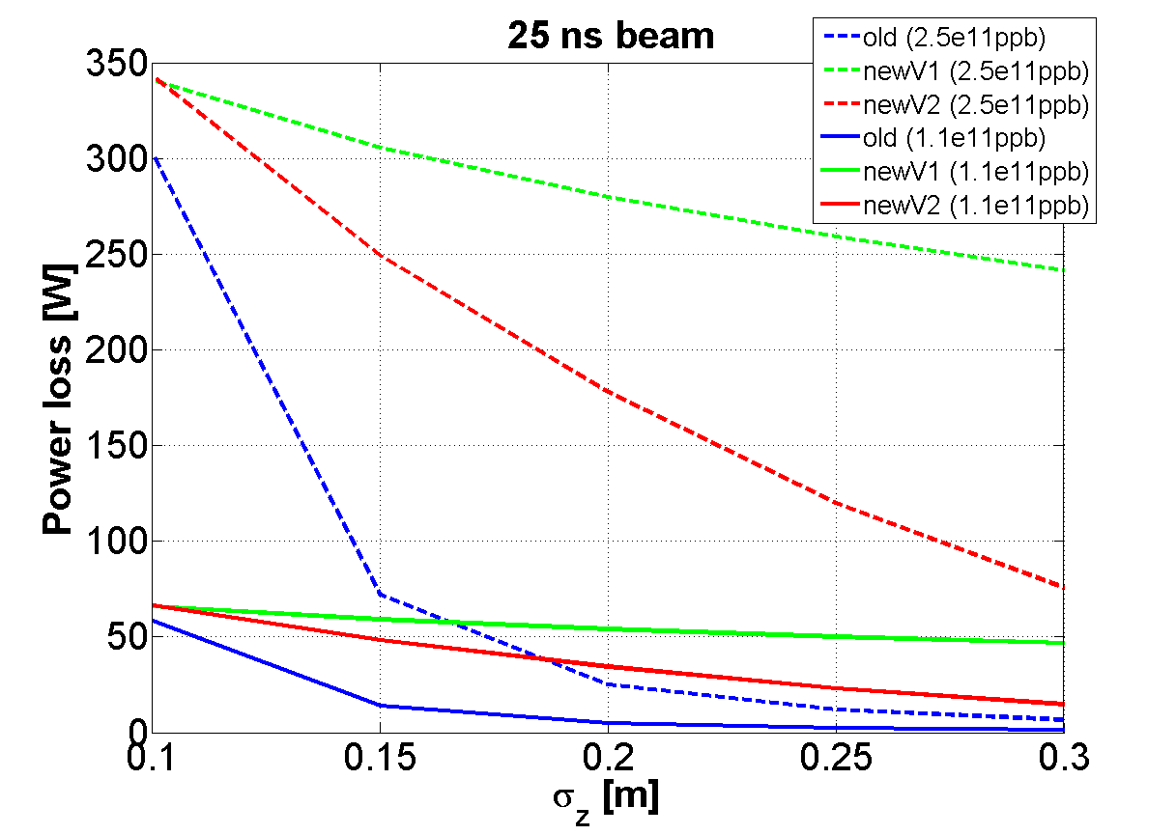
Power loss (with ferrites)
HL-LHC
New design
modified design (Heiko)
Current design
Predicted for post LS1

Slide 17
Agenda
New design
Current design
Power loss
Mode geometry
Previous measurements
Comparison with wall current monitor
Summary

Slide 18
New design
138 MHz
472MHz
H field
H field
E field
E field

Slide 19
Old design
293 MHz
658 MHz
681 MHz
1018 MHz
All fields for all modes are located around the wire forks
Ferrite location not ideal.

Slide 20
Agenda
New design
Current design
Power loss
Mode geometry
Previous measurements
Comparison with wall current monitor
Summary

Slide 21
Previous measurements by Federico et al in 2003
Cavity Mode Related Wire Breaking of the SPS Wire Scanners and Loss Measurements of Wire Materials" F. Caspers, B. Dehning, E. Jensen, J. Koopman, J.F. Malo, F. Roncarolo - Proc DIPAC 2003
Simulation results (from eigenmode, 2013)
Frequency Of main modes | Shunt impedance (kOhm) | Q
290 MHz | 18.5 | 1660
658 MHz | 55 | 7000
682 MHz | 146 | 5500
1020 MHz | 210 | 12000
→ Modes around 700 MHz
To be checked with the actual location of shielding and ferrite
To be checked with simulations of transmission measurements

Slide 22
Agenda
New design
Current design
Power loss
Mode geometry
Previous measurements
Comparison with wall current monitor
Summary

Slide 23
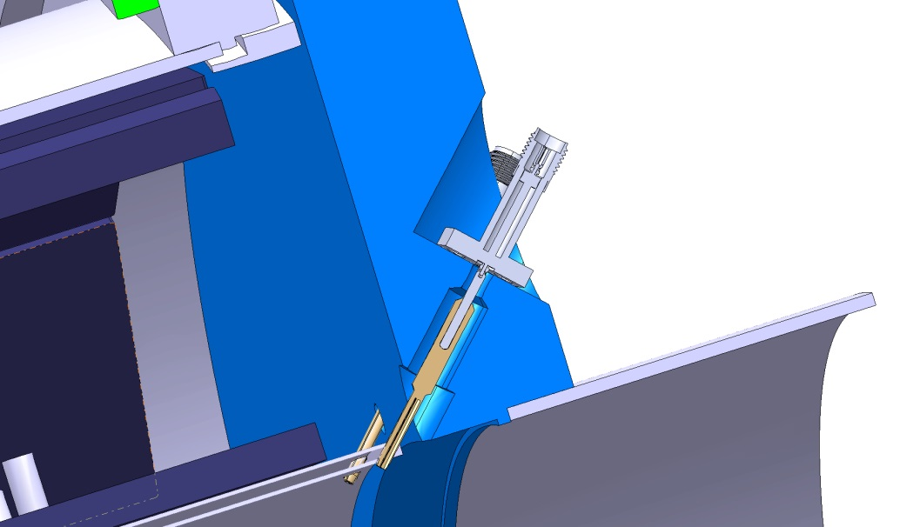
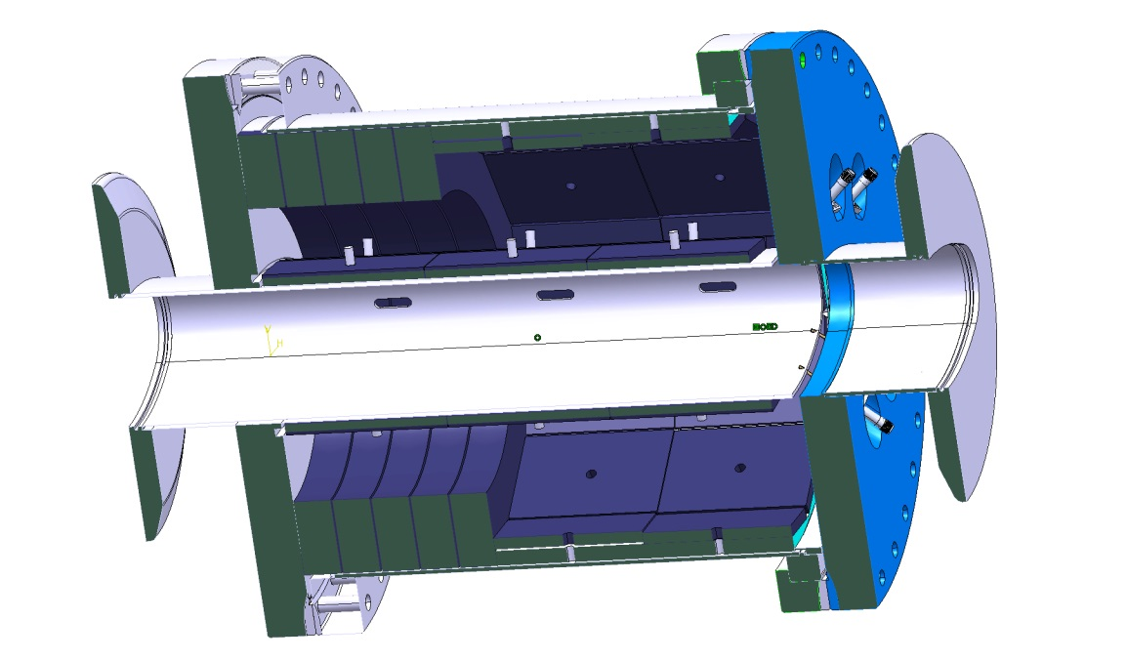
Example of Wall current monitor (J. Belleman - BI) impedance reduction of the pipe interruption with coaxial line
→ This reduction of the impedance of the gap does not seem possible with the wire scanner

Slide 24
Agenda
New design
Current design
Power loss
Mode geometry
Previous measurements
Comparison with wall current monitor
Summary

Slide 25
Outlook
New design of wire scanner seems very unfavourable from the impedance point of view due to the abrupt unmatched beam pipe interruption
Interesting solution proposed by Heiko and Hannes after MSWG helps reducing impedance, but not feasible for BI.
Putting ferrites reduces efficiently the heat load, but:
Is it possible to put ferrites there?
If needed, is it possible to cool the ferrites?
Work still on-going to:
Find acceptable solutions
Compare with previous measurements of Federico
See the impact of the position of the wire in the tank

