Slide 1
Reminder on longitudinal modes of the SPS BPMs and ZS pumping ports
Benoit Salvant for the impedance team

Slide 2
Context
Hunt for significant longitudinal modes above 1 GHz
ZS pumping modules simulated for the ZS review
SPS BPMs simulated in 2008/2009

Slide 3
Transitions between ZS
Effective impedances at low frequency
Im(Zlong/n)~ 7 mOhm
Im(Zx)~ 2 kOhm/m
Im(Zy)~ 8 kOhm/m
1.18 GHz
Rs=1.1 MOhm (stainless steel)
Q=14000 (stainless steel)
900 MHz

Slide 4
SPS BPMs
Reference:
http://cdsweb.cern.ch/record/1208424/files/CERN-ATS-2009-046.pdf
Talk at SPSU in March 2011 with improved model
Note: mistake in computing shunt impedance of transverse mode was discovered
106 BPH and 96 BPV in the SPS
Low frequency imaginary impedance for a BPH : Zlong/n ~ 1 mΩ, Zx=- 0.1 kΩ/m and Zy=2 kΩ/m.
Separate simulations for a BPV:
Zlong/n~0.5mΩ, Zy= 0.1 kΩ/m and Zx= 0.2 kΩ/m.

Slide 5
Modelled structure for the BPH
Ultrarelativistic beams
All materials are perfect conductors (except the ceramic spacers)
In fact:
- Electrodes + pipe should be in Stainless Steel
- Casing should be in Anticorodal
CST convention: Rs=|V|^2/Plosses
→ to be used for beam dynamics, the Rs values should be divided by 2 (work ongoing to clarify this and establish procedures)

Slide 6
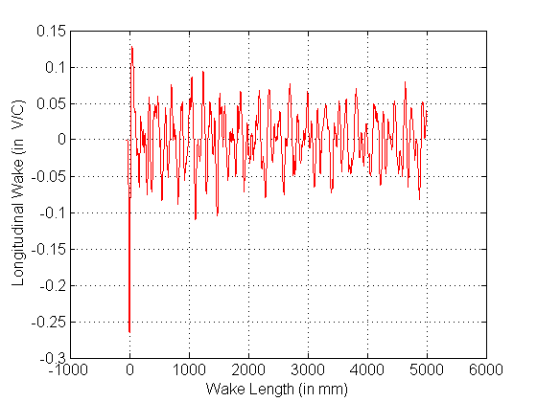
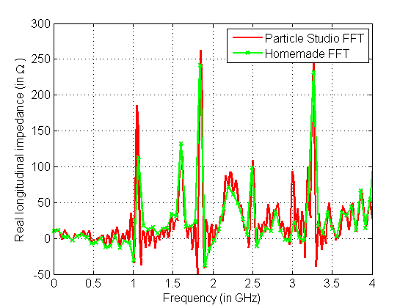
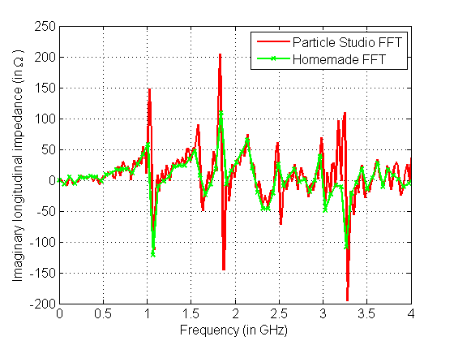
BPH longitudinal (with material losses)
fres (GHz) | Q | Rs (“center”) in Ohm | Rs/Q In Ohm
0.265 | 263 | 1766 | 6.7
0.885 | 482 | 275 | 0.6
0.892 | 493 | 374 | 0.8
1.052 | 773 | 3013 | 3.9
1.062 | 773 | 3591 | 4.6
1.598 | 672 | 804 | 1.2
1.613 | 686 | 11274 | 16.4
1.859 | 896 | 5567 | 6.2

Slide 7
Why don’t we see the first mode?
fres (GHz) | Q | Rs (“center”) in Ohm | Rs/Q In Ohm
0.265 | 263 | 1766 | 6.7
0.885 | 482 | 275 | 0.6
0.892 | 493 | 374 | 0.8
1.052 | 773 | 3013 | 3.9
1.062 | 773 | 3591 | 4.6
1.598 | 672 | 804 | 1.2
1.613 | 686 | 11274 | 16.4
1.859 | 896 | 5567 | 6.2
?

Slide 8
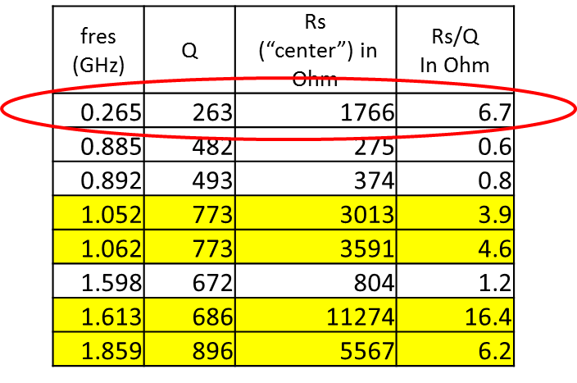
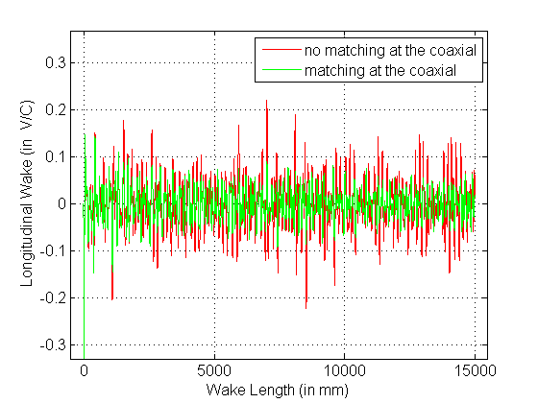
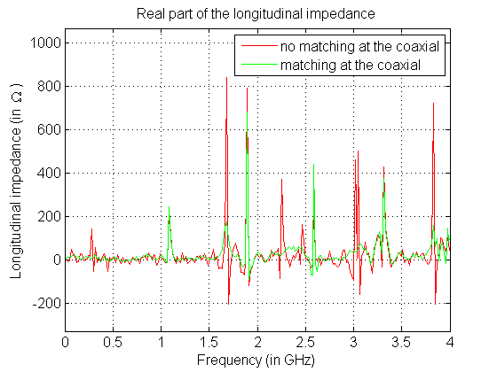
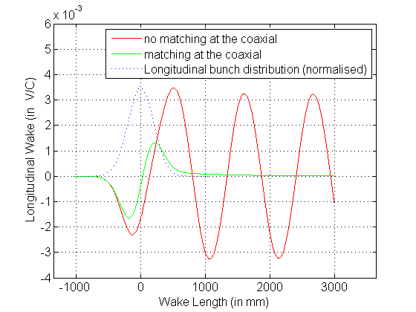
Effect of matching the impedance at electrodes coaxial ports in Particle Studio simulations (BPH)
Modes are damped by the “perfect matching layer” at the coaxial port
Short bunch (1 cm rms)
SPS bunch (20 cm rms)
Electrode coaxial port
Importance to match the BPM electrodes!

Slide 9
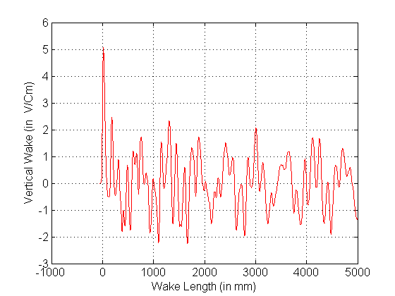
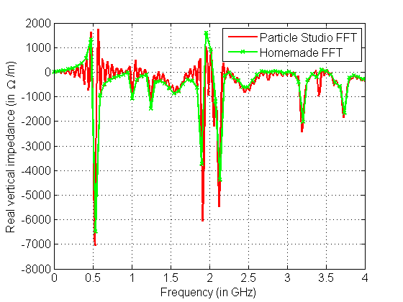
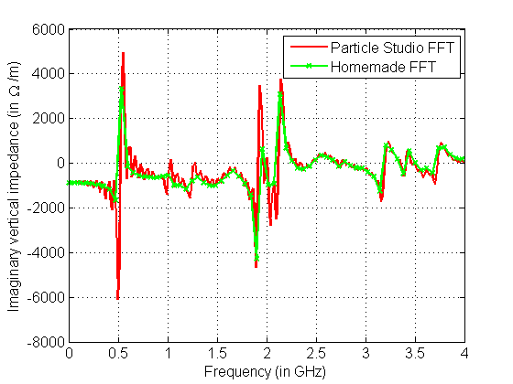
Note: BPH vertical (with material losses) to correct the mistake
fres (GHz) | Q | Rs | Rs | Rt | Rt/Q
 |  | (“center”) | (y=2mm)
 |  | in Ohm | in Ohm | in Ohm/m | in Ohm/m
0.528 | 465 | 0 | 52 | 1.18E+06 | 2529
0.532 | 483 | 0 | 9 | 2.02E+05 | 418
1.206 | 1276 | 0 | 21 | 2.08E+05 | 163
1.258 | 764 | 0 | 10 | 9.49E+04 | 124
1.271 | 688 | 0 | 5 | 4.70E+04 | 68
1.414 | 1514 | 0 | 68 | 5.74E+05 | 379
1.613 | 686 | 11274 | 11339 | 4.81E+05 | 702
1.665 | 1223 | 0 | 67 | 4.81E+05 | 393
1.859 | 896 | 5567 | 5590 | 1.48E+05 | 165
I did a mistake in 2009 in computing the transverse
Shunt impedance at that time: it should be
$${Rs}_{t}=\frac{c}{ω}\frac{Rs\left(∆y\right)−Rs(0)}{{∆y}^{2}}$$
Significant transverse modes (100 of these BPHs!)→ to be added to the model and used in beam dynamics simulations

Slide 10
BPV

Slide 11
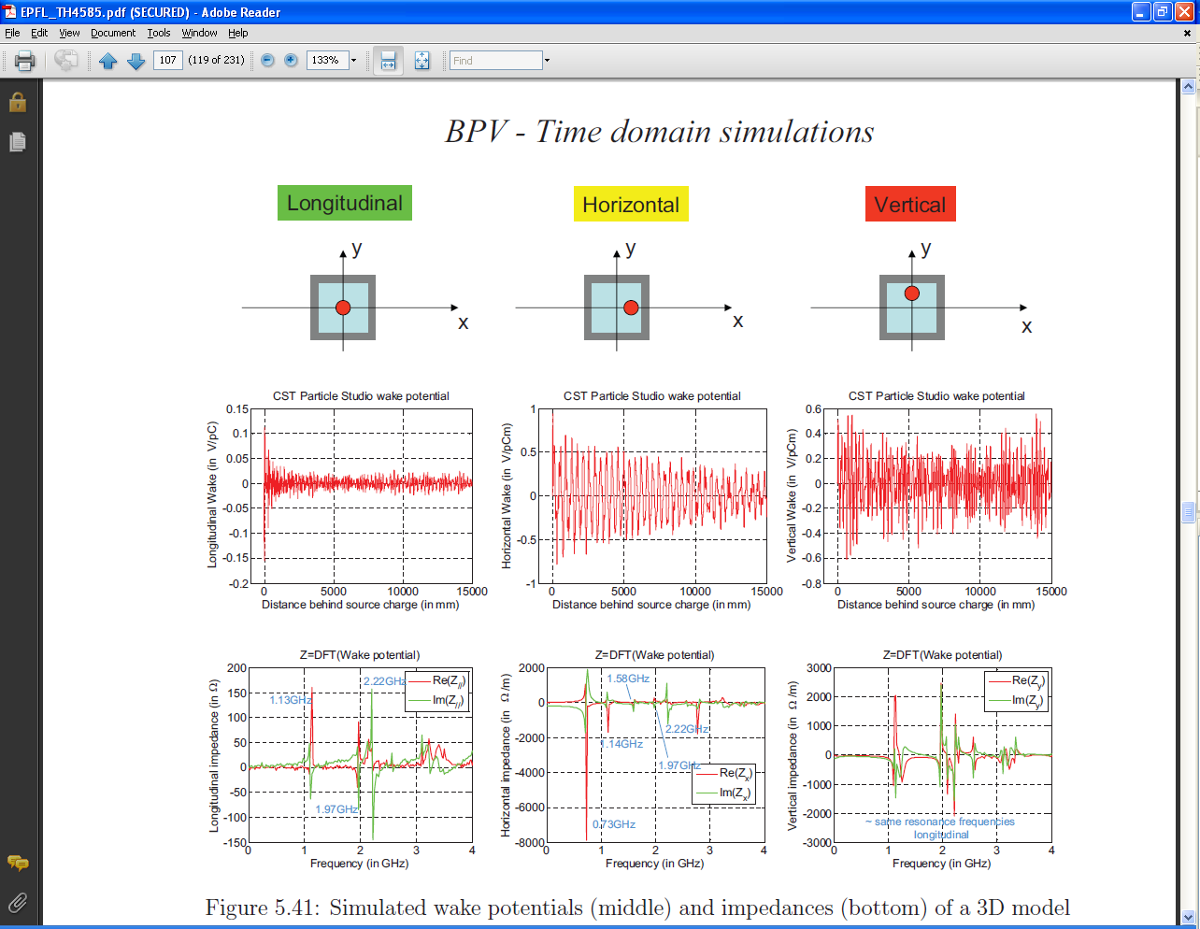
From PhD thesis…

Slide 12
BPV (with material losses)
Longitudinal
vertical
horizontal
fres | Q | Rs (“center”) | Rs(center)/Q In Ohm | Rs (y=2mm) | vertical Rs in Ohm/m | vertical Rs/Q in Ohm/m | Rs (x=2mm) | horizontal Rs in Ohm/m | horizontal Rs/Q in Ohm/m
 |  | In Ohm |  | In Ohm |  |  | In Ohm
0.293 | 239 | 90 | 0.4 | 93 | 1.22E+05 | 512 | 90 | 0 | 0
0.298 | 241 | 1595 | 6.6 | 1595 | 0 | 0 | 1596 | 4.01E+04 | 166
0.704 | 525 | 0 | 0 | 0 | 0 | 0 | 17 | 2.88E+05 | 549
0.715 | 548 | 0 | 0 | 0 | 0 | 0 | 7 | 1.17E+05 | 213
1.069 | 654 | 945 | 1.4 | 943 | -2.23E+04 | -34 | 948 | 3.35E+04 | 51
1.092 | 667 | 1188 | 1.8 | 1185 | -3.28E+04 | -49 | 1191 | 3.28E+04 | 49
1.185 | 610 | 241 | 0.4 | 254 | 1.31E+05 | 215 | 235 | -6.05E+04 | -99
1.215 | 624 | 26 | 0 | 43 | 1.67E+05 | 268 | 25 | -9.83E+03 | -16
1.57 | 745 | 0 | 0 | 0 | 0 | 0 | 0 | 0 | 0
1.576 | 724 | 0 | 0 | 0 | 0 | 0 | 2 | 1.52E+04 | 21
1.61 | 773 | 0 | 0 | 0 | 0 | 0 | 0 | 0 | 0
1.661 | 686 | 0 | 0 | 0 | 0 | 0 | 1 | 7.19E+03 | 10
1.871 | 2873 | 0 | 0 | 0 | 0 | 0 | 0 | 0 | 0
1.91 | 2430 | 0 | 0 | 0 | 0 | 0 | 0 | 0 | 0
1.96 | 1993 | 1503 | 0.8 | 1509 | 3.66E+04 | 18 | 1501 | -1.22E+04 | -6

Slide 13
Outlook
There are many resonances beyond 1 GHz for most SPS equipment due to the large pipe apertures
Single shunt impedances can reach 1 MOhm!
Which one is harmful for longitudinal dynamics?

