Slide 1
Results of the Microwave Transmission Measurements
07. 02. 2013
MD Runs 22. + 31.10., 02. + 05. 11., 05. 12. 2012 F. Caspers, S. Federmann

Slide 2
Overview
Measurement Setup
General Remarks
Objectives
Results
Conclusion

Slide 3
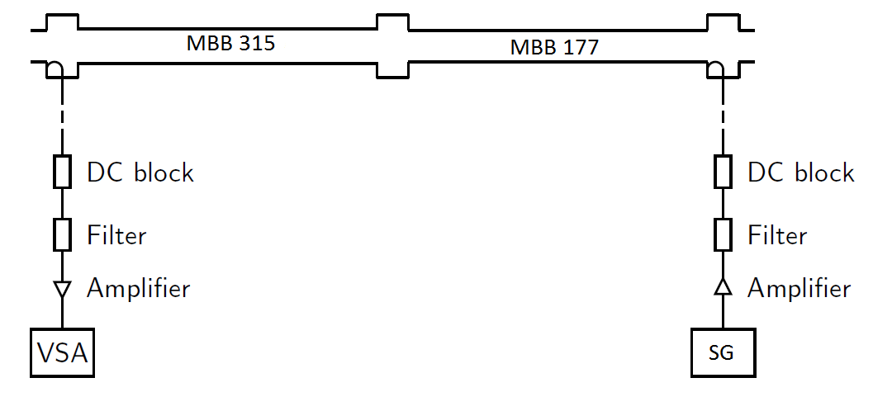
Measurement Set-Up
uncoated
uncoated
Surface at BA5

Slide 4
Objectives
This talk summarizes the results of eight MD runs (March to December 2012)
The electron cloud induced phase modulation signal was studied for high intensity beams
The electromagnetic ‘cleanliness’ of the new setup was tested
The functionality of the filter in the receiver path of the setup was tested

Slide 5
Results
PM Demodulation
Calibration signal @ 42kHz
Modulation signal @ 43.35kHz
3 batches with 25 ns spacing
3 batches with 50 ns spacing
PM Demodulation

Slide 6
Results
PM Demodulation
PM Calibration signal
AM Demodulation
PM Calibration signal
PM Calibration signal in AM modulation
No beam in SPS
SG connected directly to VSA
PM to AM conversion was detected
Determined to be 8% -> negligible for our ecloud singal (height: roughly 5 dB -> loss of 0.4 dB)

Slide 7
Results
PM Demodulation
Strong fake signal due to intermodulation
AM Demodulation
With filter in receiver path
Without filter in receiver path
Filter is absolutely crucial for our setup
Without it, lots of fake lines due to intermodulation are present

Slide 8
Results
Reduction of electron cloud signal from 7 to 3 - 5 dB above noise floor
Possible scrubbing?
2 effects visible:
Strong signal at injection (not fully understood)
Virtually no change in steady state but stronger fluctuations
+7dB
25 ns beam, 3 batches March 2012
+3-5dB
25 ns beam, 3 batches November 2012

Slide 9
Results
Injection effect also observed for 50 ns spacing
In March 2012, no injection signals are present whereas in November 2012 they are
50 ns beam March 2012
50 ns beam November 2012

Slide 10
Conclusions
Experimental setup works properly -> former findings could be confirmed (25 ns electron cloud signal present, 50 ns no signal visible)
Cleanliness of the experimental setup is due to use of filter -> confirmed for this setup
Potential scrubbing effect seen. “Same” beam (25 ns) caused a higher net signal height in March 2012 than in November 2012

Slide 11
Thank you for your attention!

Slide 12
Additional Slides

Slide 13
Theoretical Basis
Principle: Measurement of the induced phase shift of a microwave going through a plasma filled waveguide
Phase shift is proportional to the electron cloud density:
Assumption: we have a complete transmission through the electron cloud (no resonances)

Slide 14
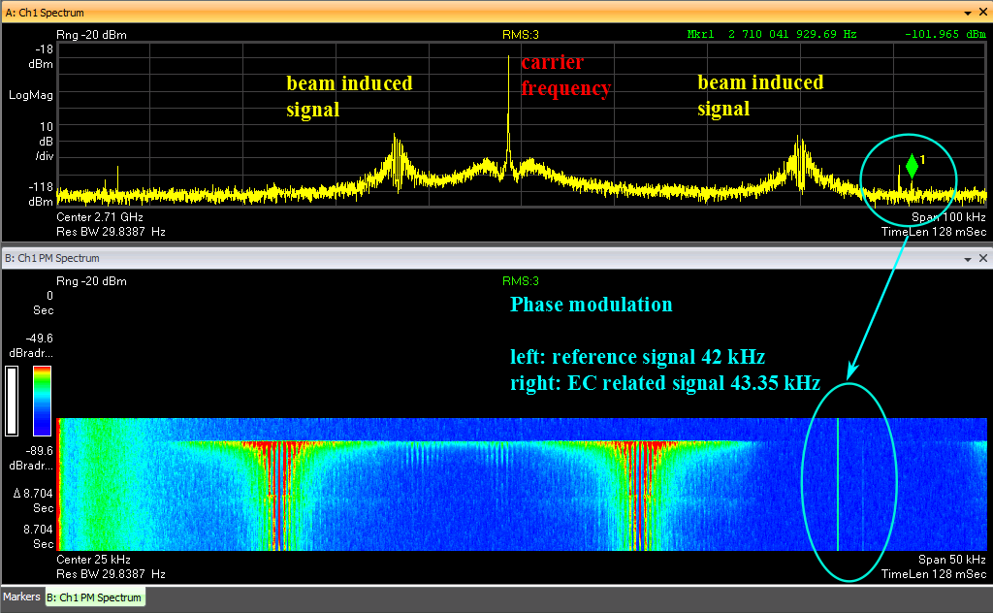
Screenshot of the VSA

