Slide 1
Reference measurements of the SPS longitudinal impedance
T. Argyropoulos, J. E. Muller, E. Shaposhnikova, H. Timko
Many thanks to S. Hancock and H. Damerau for preparing the beam
T. Bohl and H. Bartosik for longitudinal and transverse adjustments in the SPS
LIU-SPS BD WG
07/02/2013

Slide 2
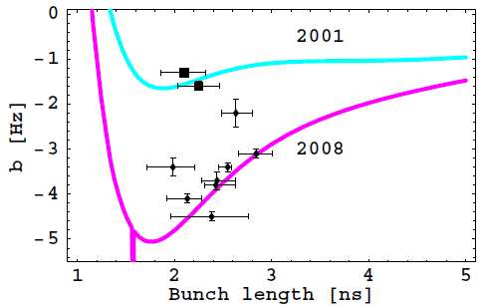
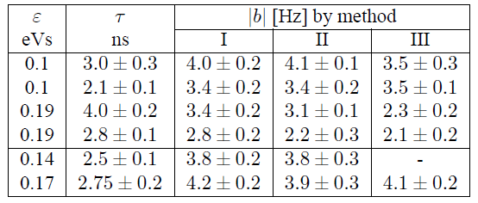
Introduction – old results
Measure the quadrupole frequency shift Δω₂ as a function of intensity →
complicated dependence on bunch length
→ for Gaussian bunch:
$$ω_{2s}\left(τ, Ν\right)≈2ω_{s0}\left\{1−\frac{{\left(ω_{rf}τ\right)}^{2}}{64}+\frac{Νeω_{0}}{4πhV_{0}}Z_{1}+{\left(\frac{2}{π}\right)}^{1/2}\frac{16Νeω_{0}h^{2}}{V_{0}{\left(ω_{rf}τ\right)}^{3}}\left[{\left(\frac{ImZ}{n}\right)}_{0}−\frac{3}{16\sqrt{2}}{\left(\frac{ImZ}{n}\right)}_{eff}^{m=2}\right]\right\}$$
Compare with old measurements from 2008 →need same experimental
conditions
E. Shaposhnikova et al. PAC09
Meas. on 2008

Slide 3
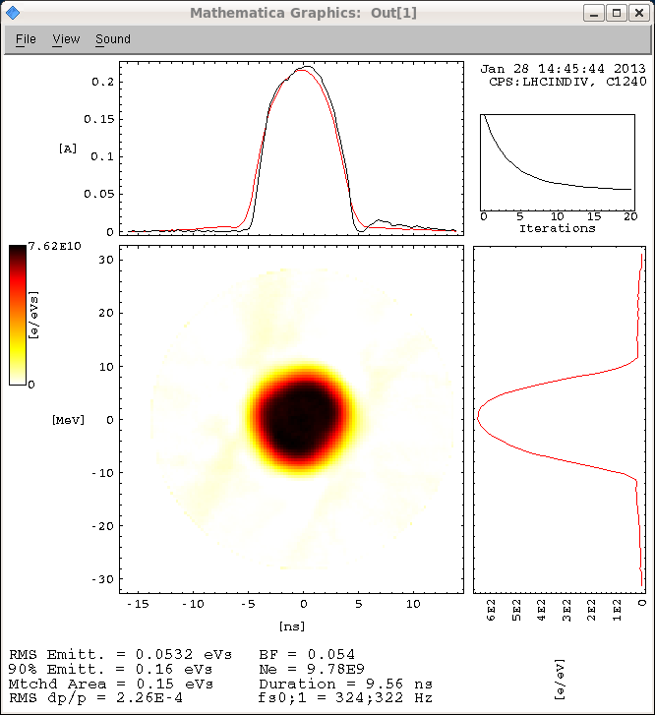
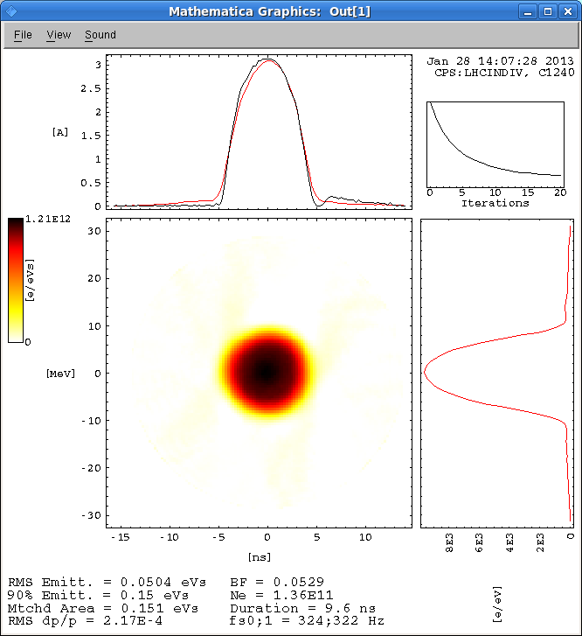
Beam preparation (at PSB)
The beam was prepared in the PSB:
ε_{l} was adjusted by longitudinal shaving during acceleration
Intensity was later selected by adjusting the controlled longitudinal emittance blow-up
Measured in the PS
ε_{l} = 0.15 eVs
N = 1.0x10¹⁰
ε_{l} = 0.15 eVs
N = 13.6x10¹⁰

Slide 4
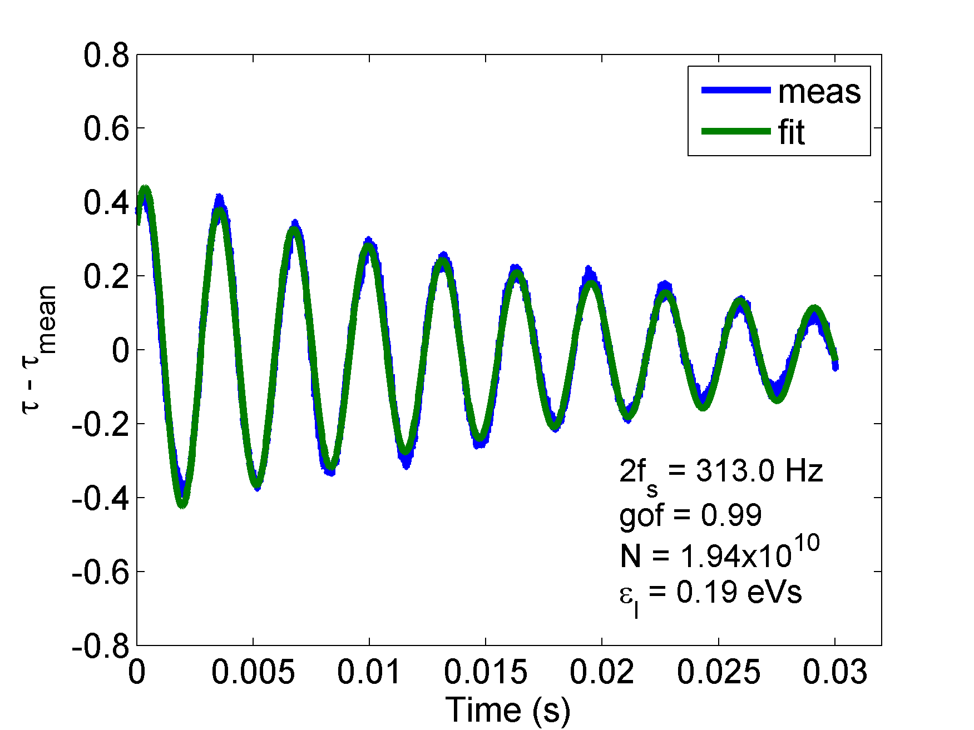
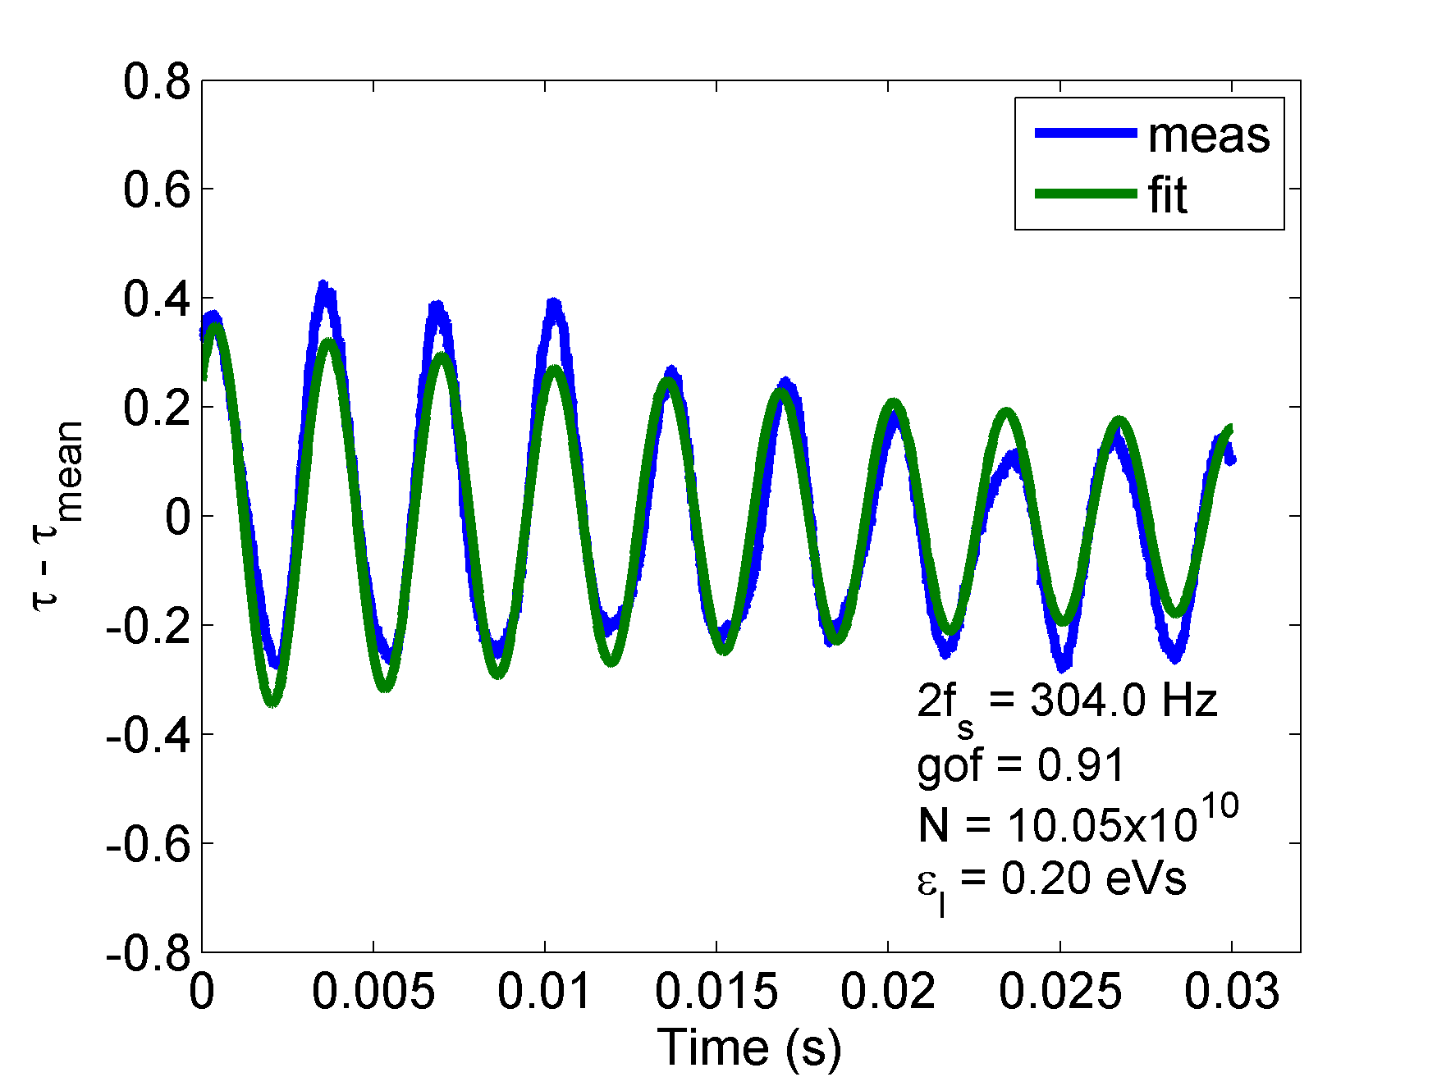
Conditions in the SPS – data analysis
Single proton bunch at 26 GeV/s
Single RF with V₂₀₀ = 900 kV
PL, FB, FF, long. Dampers were ON
Acquisitions of bunch profiles (first 1400 turns) → 4σ bunch length → fit to get the 2f_{s}
Examples of ε_{l} = 0.15 eVs at PS
Low intensity
High intensity

Slide 5

Measurements
MD on 28/01/2013 (I)
ε_{l} = 0.15 eVs in the PS
$τ_{avg}$ = 2.47 ns → ε_{l} = 0.19 eVs in the SPS
MD on 04/02/2013 (II)
ε_{l} = 0.1 eVs in the PS
$τ_{avg}$ = 1.76 ns → ε_{l} = 0.1 eVs in the SPS
ε_{l} = 0.15 eVs in the PS
$τ_{avg}$ = 2.52 ns → ε_{l} = 0.2 eVs in the SPS
ε_{l} = 0.2 eVs in the PS
$τ_{avg}$ = 2.89 ns → ε_{l} = 0.25 eVs in the SPS

Slide 6
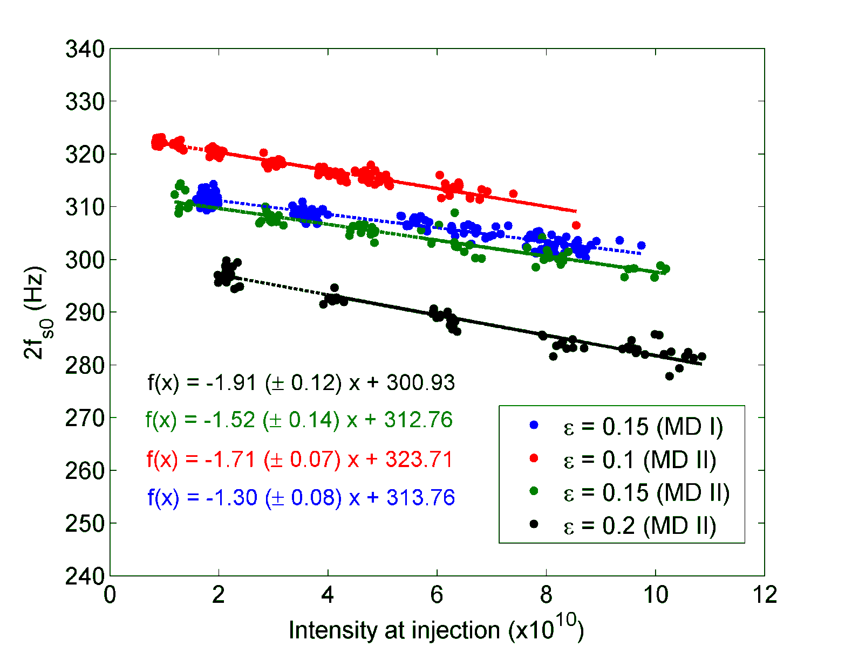
Preliminary results
Plotted only points where the fit was better than 95%
The slope for all is smaller than in 2008
(-2 < b < -1)

Slide 7
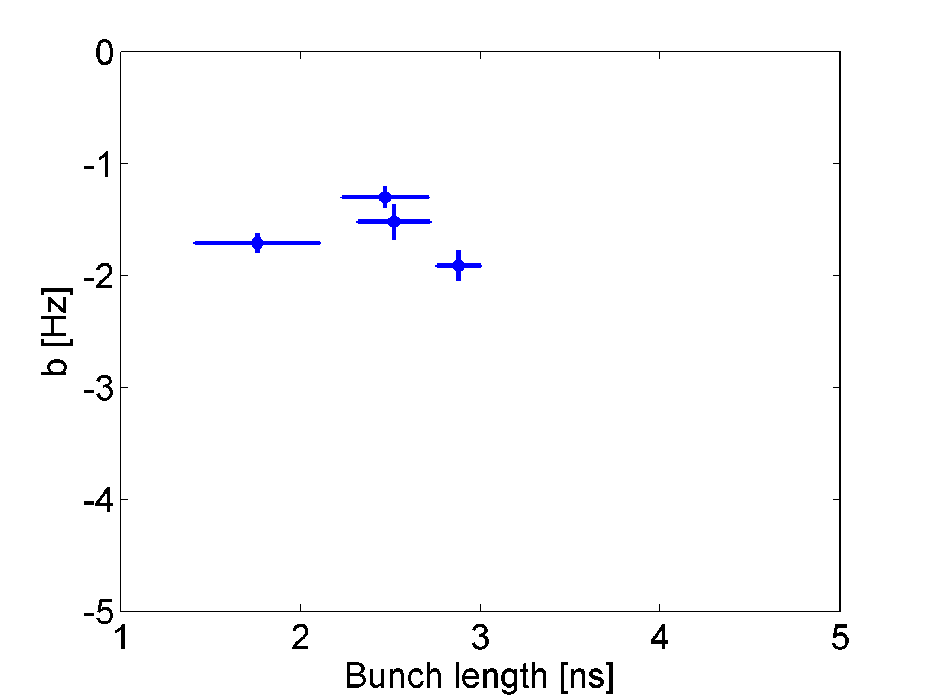
Preliminary results
Comparison with 2008 shows that impedance is reduced (due to the kickers shelding)

Slide 8
Conclusions
Measurements of the reactive part of the SPS impedance by measuring the quadrupole frequency shift
Single bunches with constant parameters for our intensity range (1x10¹⁰ – 10x10¹⁰) were produced in the PSB → preserved also in the PS
2 MDs on 28/01/2013 and 04/02/2013
Preliminary analysis shows impedance reduction compared to 2008 →
kickers were shielded
On-going simulations to verify these results with the current SPS longitudinal impedance model → essential for future studies
Very preliminary results are not in good agreement…
Reconsider the theoretical model (?)

Slide 9
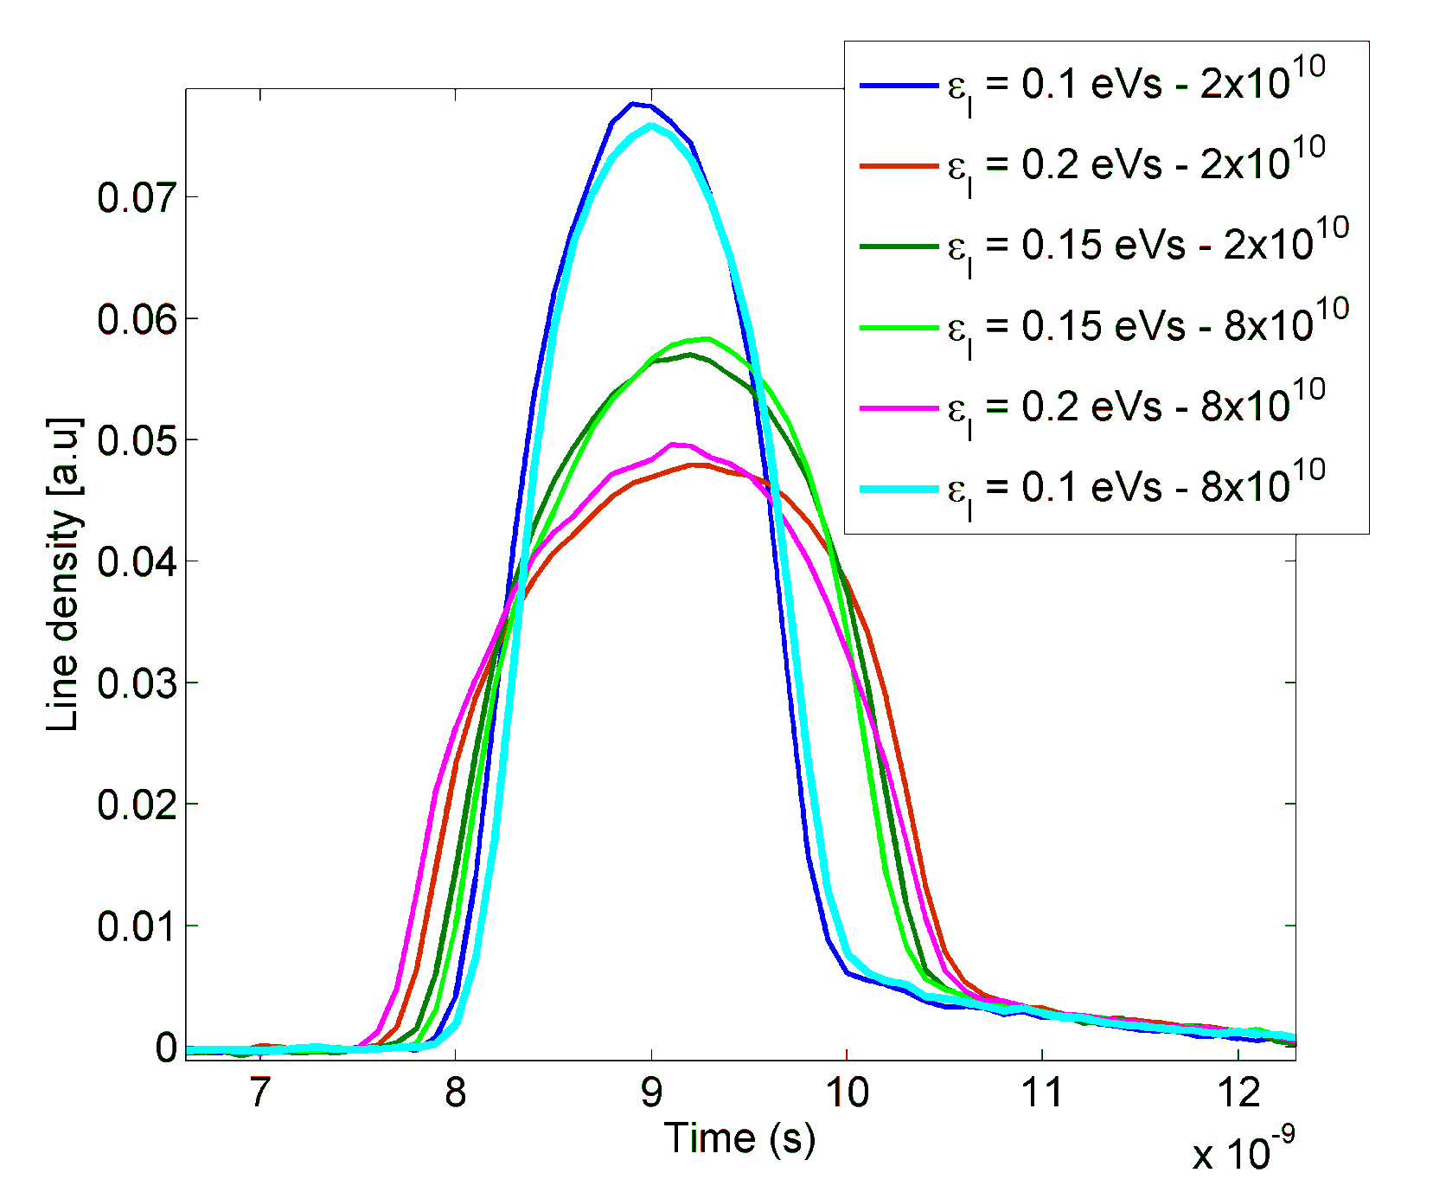
Bunch profiles at injection in the SPS

Slide 10
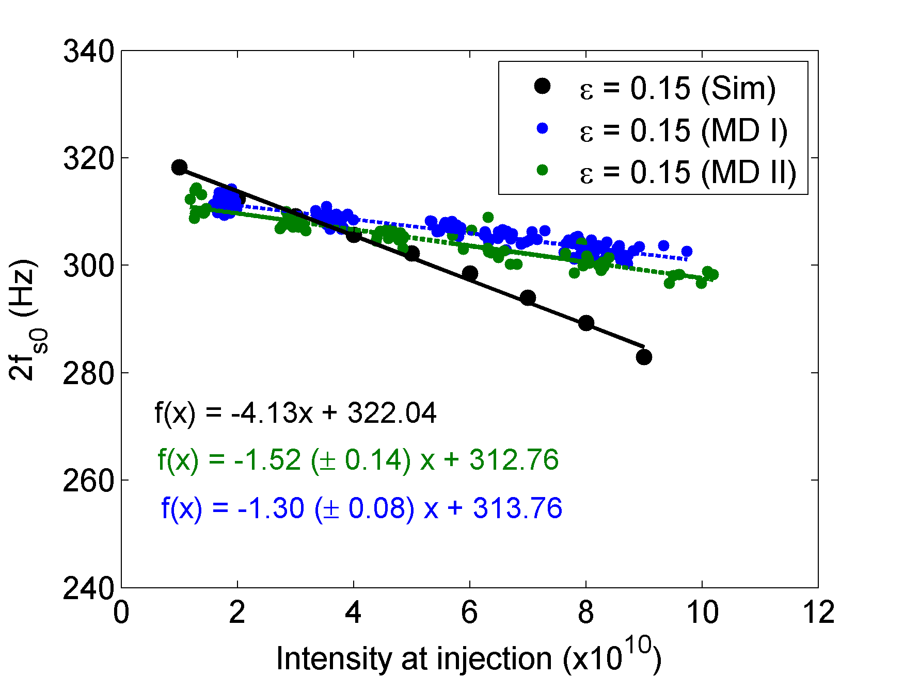
Compare with simulations
Simulations using the current SPS longitudinal impedance model
Initial distribution in the SPS: from tomoscope data simulated with ESME until extraction to the SPS (Helga)

