Slide 1
SPS Space charge studies – preliminary MD results
H. Bartosik, A. Molodozhentsev, Y. Papaphilippou,
G. Rumolo, F. Schmidt
SPSU - May 31, 2012

Slide 2
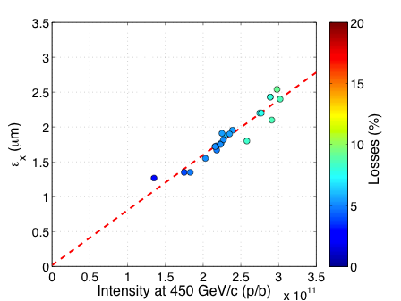
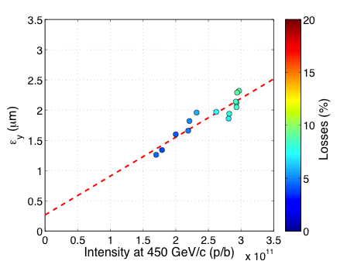
Emittance vs. Intensity in 2011
Working point was kept constant at 20.13/20.18
Injected up to 3.3e11p/b with emittances of about (ε_{x}+ε_{y})/2~1-1.5μm
Bunch length at injection was increasing with intensity
RF voltage at flat bottom was constant at 3.8MV

Slide 3
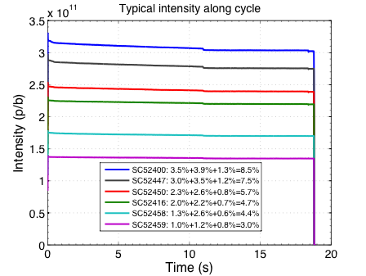
Losses in 2011
Injection losses
Increasing with intensity
Improved with damper?
Losses on flat bottom
Due to space charge?
Scale with beam size?
Scale with brightness?
Capture losses
Due to longitudinal tails
Not much we can do?

Slide 4
Space charge MDs in 2012
Injected single bunches with intensity of around 2.7e11p/b (1 PSB turn)
Transverse emittance at extraction from PS around (ε_{x}+ε_{y})/2~1.0-1.2μm
Bunch length at injection into SPS around 4ns
In dedicated MDs using the long cycle: 10.8s flat bottom and ramp to 450GeV
Dedicated MDs in week 17:
Estimating space charge tune spread from measurements
Losses for different working points
Study losses on flat bottom
Emittance blow-up close to integer resonance
Highest brightness available

Slide 5
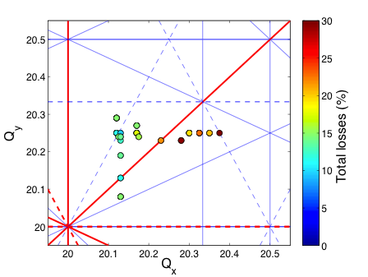
Tune scan – first steps …
23.04.2012
Area below coupling resonance seems bad → is the third order Q_{x}-2Q_{y} resonance ?
MD was done in parallel with PS interventions on extraction channel → absolute losses may not be representative !!!
Further tune scans and detailed analysis of the beam profiles to be done

Slide 6
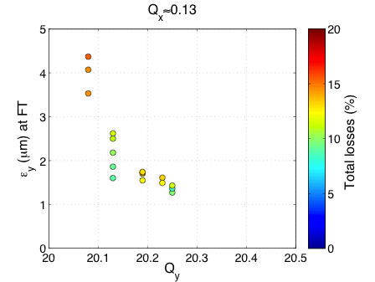
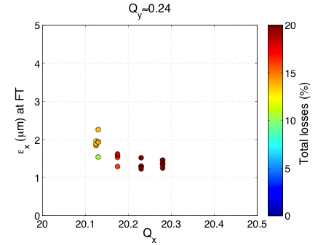
Estimation of space charge tune spread
23.04.2012
Approaching the integer resonances leads to
Emittance blow up in the respective plane
A reduction of losses in the horizontal plane (due to previously mentioned 3rd order resonance)
Increasing losses in vertical plane → aperture restriction
For 2.7e11p/b and about (ε_{x}+ε_{y})/2~1.0-1.2μm injected → ΔQ_{x}≈0.15 / ΔQ_{y}≈0.25

Slide 7
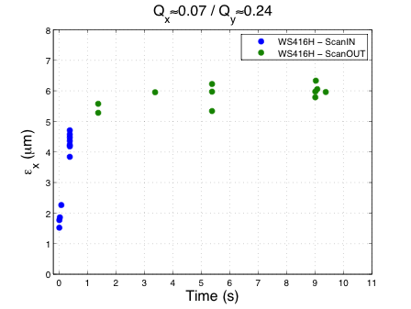
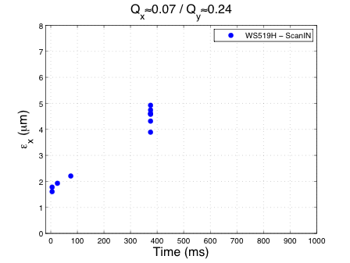
Emittance growth for Qx close to integer
26.04.2012
Same beam parameters as on 24.05.2012 (see above) → initial tune spread is about ΔQ_{x}≈0.15 / ΔQ_{y}≈0.25
(lossless) blow up of the core
εx>2μm after 40ms
εx~4-5μm after 400ms

Slide 8
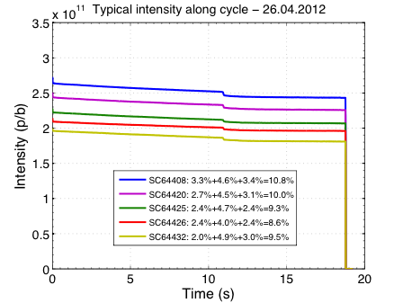
Typical losses at Qx/Qy≈20.15/20.22
26.04.2012
Quite large losses on flat bottom and capture compared to 2011
RF voltage: 3MV at injection → 4.5MV on flat bottom
MD was done in parallel with the PS interventions on gamma jump quadrupole (after the extraction bump MD)

Slide 9
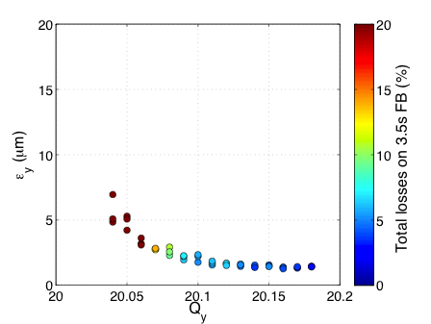
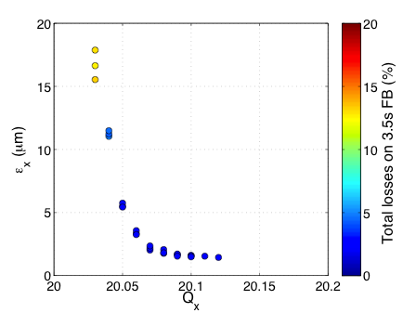
Behavior close to integer resonances
04.05.2012
Parallel MD → short flat bottom cycle
Standard LHCindiv bunch → 1.2e11p/b with (ε_{x}+ε_{y})/2~1.2μm
Expect ΔQ_{x}~0.07/ΔQ_{y}~0.11
Large aperture in horizontal plane allows for huge emittance blow-up without losses
Aperture limitations in vertical plane lead to increasing losses with vertical beam size

Slide 10
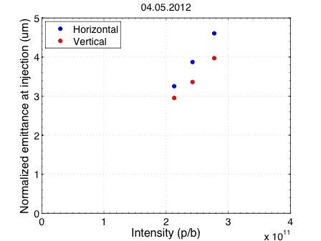
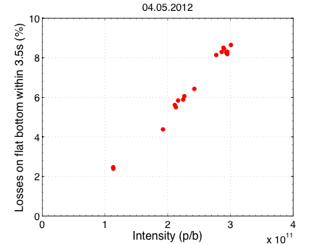
Losses on (short) flat bottom
Intensity is varied by changing number of turns injected into the PSB
Bunch length at extraction from PS remains constant
→ constant (low) brightness
Losses on flat bottom scale with transverse emittance
Dependence on brightness?
Proportional to emittance

Slide 11
Conclusions, questions and further steps
Space charge effects can be clearly observed when tune spread reaches integers
Behavior as expected → blow-up of the beam core without immediate losses (apart from aperture restrictions)
Good case for benchmarking with (PTC-ORBIT) simulations
The highest brightness delivered from the pre-injectors yields a tune spread of about ΔQ_{x}≈0.15 / ΔQ_{y}≈0.25 in the SPS
Even larger than required by LIU?
Operational beams sent to the LHC have about ΔQ_{x}≈0.08 / ΔQ_{y}≈0.13 in the SPS
Losses on the flat bottom (and capture losses) are larger than in 2011 → why?
Maybe bunch length was a bit shorter in 2011 → less capture losses?
Losses on flat bottom could be related to the PS interventions (more tails …)
Study the losses on flat bottom
In the context of high brightness (and in comparison with Q26: high brightness but low intensity)
Measure resonance driving terms and try to compensate resonances if needed
Better correction of orbit on flat bottom needed?
Further explore the tune diagram
Try the split tunes optics Q20s (Q_{x}=20.xx/Q_{y}=26.xx)

