Slide 1
Preliminary Results of the Microwave Transmission Measurements
MD Run 25.06.2012 F. Caspers, S. Federmann, M. Holz

Slide 2
General Information
The beam induced phase modulation of a carrier signal has been measured over the length of two consecutive, uncoated dipoles
The use of a vector spectrum analyzer with improved performance (thanks to M. Betz) enabled us to record complete cycles
46 cycles have been recorded. This equals a data volume of 5.6 GB

Slide 3
General Information
With the former VSA the recording time was limited to 8.2 s with the used bandwidth of 100 kHz
The new device allows recording times of up to 3 minutes with this setting
Therefore, we can now change the bandwidth to 1 MHz and still record for 20 s. Thus, we can now record not only the ground mode of the modulation, but also 20 harmonics.
Such a record in time traces would probably alow us to ‚see‘ the electron cloud over each batch.

Slide 4
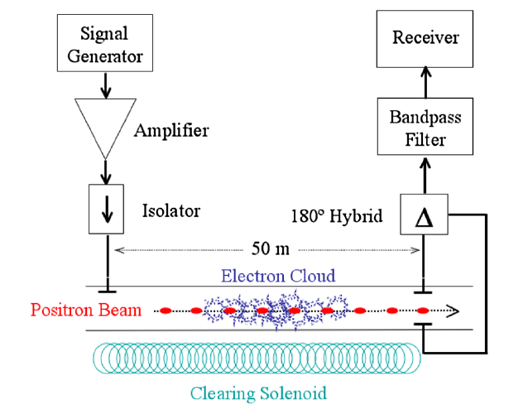
General Information
A similar functionality was implanted with hardware phase 4 detectors by De Santis
Here we are going to use the full capability of the VSA with large memory
Highly simplified graph – electronics for phase monitoring not shown

Slide 5
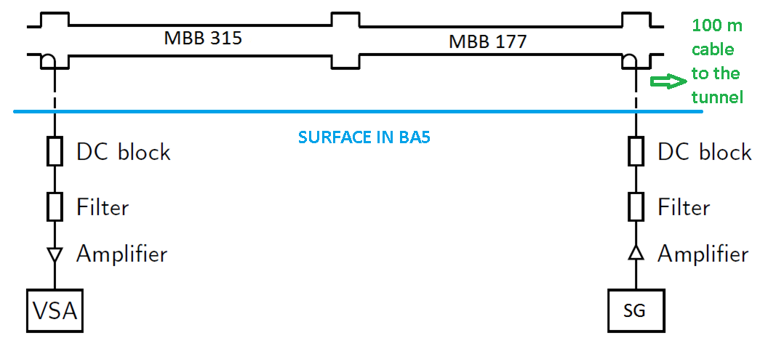
Measurement Set-Up
uncoated
uncoated

Slide 6
Preliminary Results \ LHCFAST3
4 batches with 25 ns spacing
Max. total intensity: 2180*10¹⁰ p
Batch injection can be seen in spikes of AM
It is clearly visible, that the Phase shift increases with batch injections

Slide 7
Preliminary Results \ LHCFAST3
During this measurement there was a beam whose injections where shifted as it can be seen in the plot.
Also, there were both spacings (25ns \ 50ns) in this beam
No significant rise in phase modulation can be seen.

Slide 8
Conclusions
Clear phase shifts could be measured.
However no clear correlation between beam intensity and phase modulation was seen – still under investigation
During the beam with shifted injections and both spacings, no rise in PM could be detected. This supports the idea that with 50 ns spacing there is much less electron cloud

