Slide 1

Electron Cloud Studies for the SPS
G. Iadarola, H.Bartosik, G. Rumolo, M. Taborelli
Many thanks to:
G. Arduini, T. Argyropoulos, T. Bohl, F. Caspers, S. Cettour Cave, H. Damerau,
B. Goddard, M. Driss Mensi, J. Esteban Mullet, S. Federmann, F. Follin, M. Holz,
W. Hofle, H. Neupert, Y. Papaphilippou, B. Salvant, E. Shaposhnikova, H. Timko,
Ulsroed, U. Werhle
Special thanks to all the SPS operator crew
LIU-SPS BD 30/08/2012

Slide 2
Outline
  Introduction
  Qualification of the LHC 25ns beam in the SPS
    Emittance along the train
    Effect of chromaticity
    Tune bunch by bunch
  Pressure observation
    Effects of losses
    Effect of batch spacing
    Ultimate intensity
  Direct electron cloud measurements on the strip detectors
    Effect of bunch intensity and number of bunches
    Conditioning observations
  Conclusions and proposals for future studies

Slide 3
Outline
  Introduction
  Qualification of the LHC 25ns beam in the SPS
    Emittance along the train
    Effect of chromaticity
    Tune bunch by bunch
  Pressure observation
    Effects of losses
    Effect of batch spacing
    Ultimate intensity
  Direct electron cloud measurements on the strip detectors
    Effect of bunch intensity and number of bunches
    Conditioning observations
  Conclusions and proposals for future studies

Slide 4
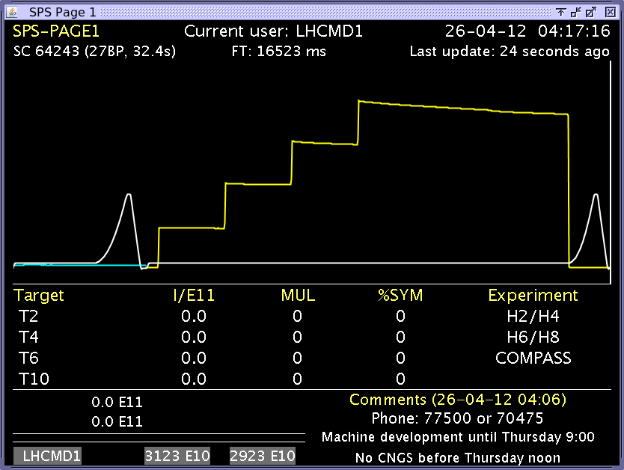
Introduction
      Results of electron cloud studies (typically 25ns beam, more focus 26GeV) from:
      2012 SPS Scrubbing Run (26-30 March)
      Dedicated MD 25 April
      Floating MD 22 May
      Dedicated MD 25 June

Slide 5
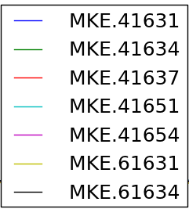
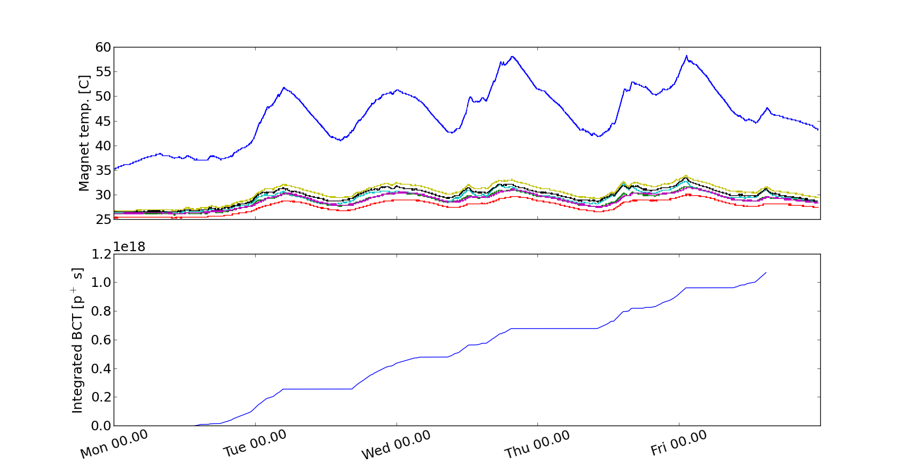
2012 SPS Scrubbing Run
Main limitation: heating of unshielded MKE
(LHC commissioning in parallel, cooldown periods needed)
Accumulated 25ns dose

Slide 6
Outline
  Introduction
  Qualification of the LHC 25ns beam in the SPS
    Emittance along the train
    Effect of chromaticity
    Tune bunch by bunch
  Pressure observation
    Effects of losses
    Effect of batch spacing
    Ultimate intensity
  Direct electron cloud measurements on the strip detectors
    Effect of bunch intensity and number of bunches
    Conditioning observations
  Conclusions and proposals for future studies

Slide 7
2012 SPS Scrubbing Run – measured beam parameters
25ns beam nominal intensity
PS (before bunch rotation): N_{b}~1.25x10¹¹ppb / ε_{h}~2.5μm / ε_{v}~2.5μm
SPS flat bottom (18s): N_{b}~1.15x10¹¹ppb / ε_{h}~3μm / ε_{v}~3.5μm
SPS flat top: N_{b}~1.15x10¹¹ppb / ε_{h}~3μm / ε_{v}~3.5μm
(within specifications)
25ns beam ultimate intensity
PS (before bunch rotation): N_{b}~1.8x10¹¹ppb / ε_{h}~4μm / ε_{v}~3.5μm
SPS flat bottom (8s): N_{b}~1.6 x10¹¹ppb / ε_{h}~5μm / ε_{v}~4.5μm

Slide 8
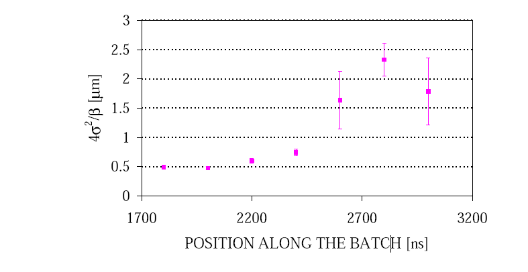
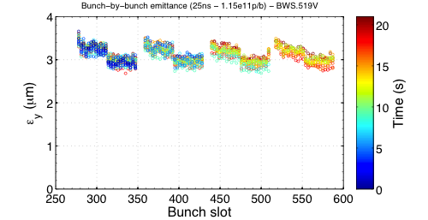
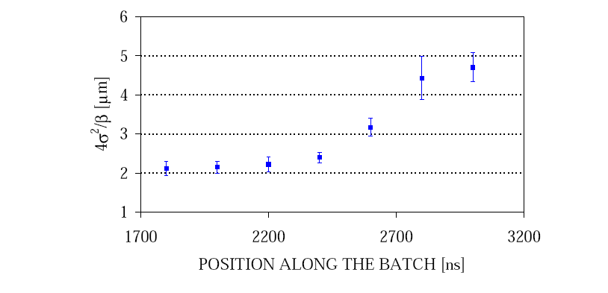
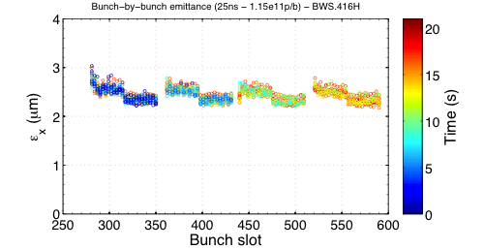
LHC 25ns beam: emittances
  2000 (1 batch 0.8x10¹¹ppb)
  2012 (4 batches 1.15x10¹¹ppb)
  Vertical emittance
  Vertical
  Horizontal emittance
  Horizontal

Slide 9
LHC 25ns beam: emittances
  2000 (1 batch 0.8x10¹¹ppb)
  2012 (4 batches 1.15x10¹¹ppb)
  Vertical
No emittance growth in 2012 with 4 batches
With low chromaticity in both planes
Identical behavior of all 4 batches
No blow-up along bunch train
  Vertical
  Horizontal
  Horizontal

Slide 10
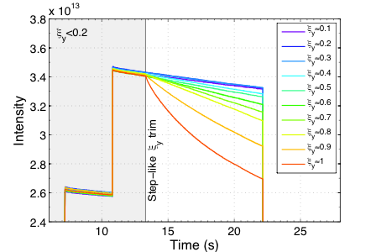
LHC 25ns beam: chromaticity
  2012
2002 - G. Arduini, K. Cornelis et al.
No need for large chromaticity in 2012 with 4 batches of 1.15x10¹¹p/b
Best life-time with smallest chromaticity
No instability or beam degradation with chromaticity around 0.1

Slide 11
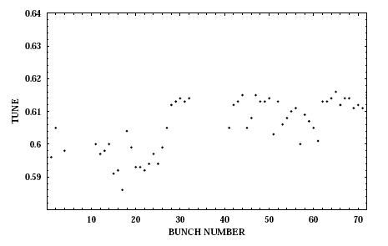
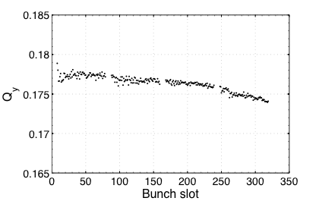
LHC 25ns beam: bunch by bunch tune
  2000 (one batch)
  2012 (four batches)
  Vertical
ΔQ<0.005
ΔQ>0.02
G. Arduini, K. Cornelis et al.
Positive tune shift!
(dominated by ecloud)
Negative tune shift!
(dominated by resistive wall impedance?)

Slide 12
Outline
  Introduction
  Qualification of the LHC 25ns beam in the SPS
    Emittance along the train
    Effect of chromaticity
    Tune bunch by bunch
  Pressure observation
    Effects of losses
    Effect of batch spacing
    Ultimate intensity
  Direct electron cloud measurements on the strip detectors
    Effect of bunch intensity and number of bunches
    Conditioning observations
  Conclusions and proposals for future studies

Slide 13
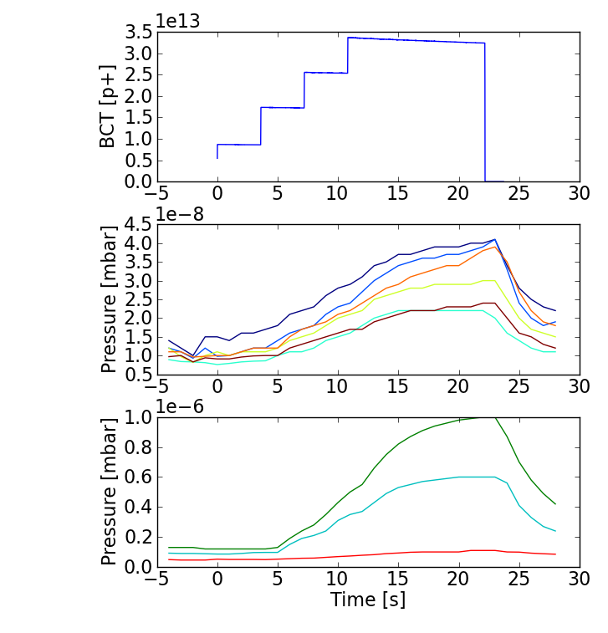
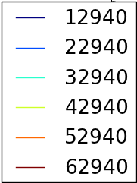
Dynamic pressure rise
  Together with effects on the beam, the dynamic pressure rise is the only other observable to qualify the present conditioning state of the SPS ring.
26 GeV

Slide 14
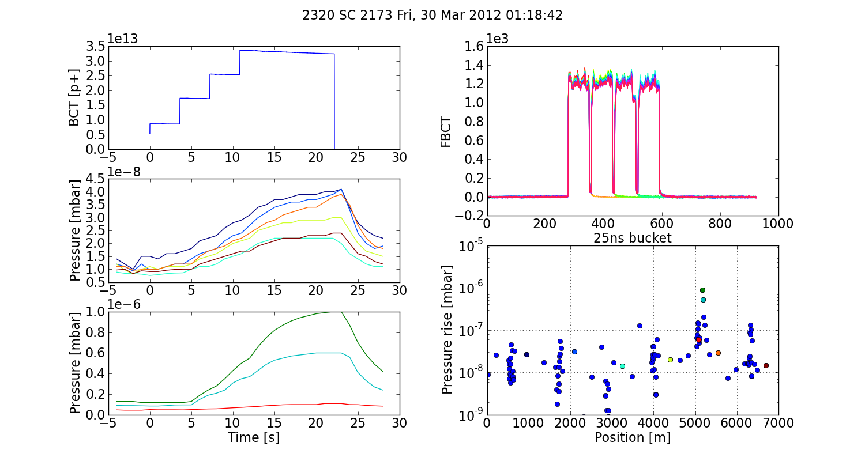
Dynamic pressure rise
  Typical pressure rise profile (25ns)

Slide 15
Dynamic pressure rise
  Typical pressure rise profile (25ns)
26 GeV
Arcs
Time evolution on a few selected gauges:
One per arc (between two MBB)

Slide 16
Dynamic pressure rise
  Typical pressure rise profile (25ns)
26 GeV
Arcs
Time evolution on a few selected gauges:
One per arc (between two MBB)
Three gauges around point 5 (highest press. rise observed in the ring - e-cloud equipments, UA9, BBLR)
Point 5

Slide 17
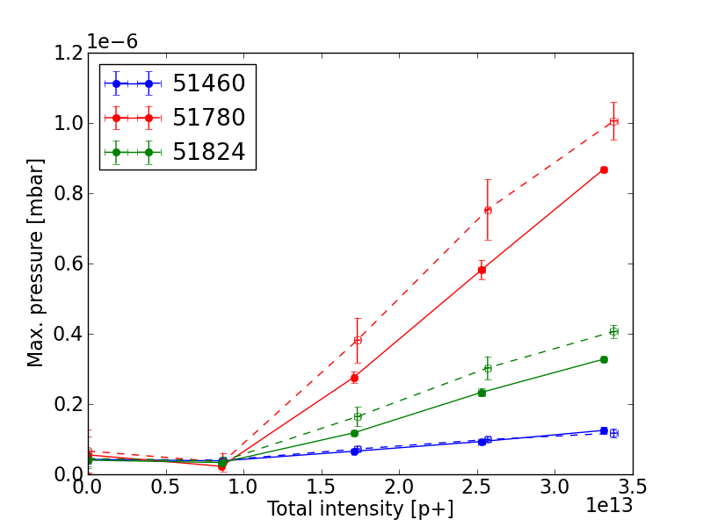
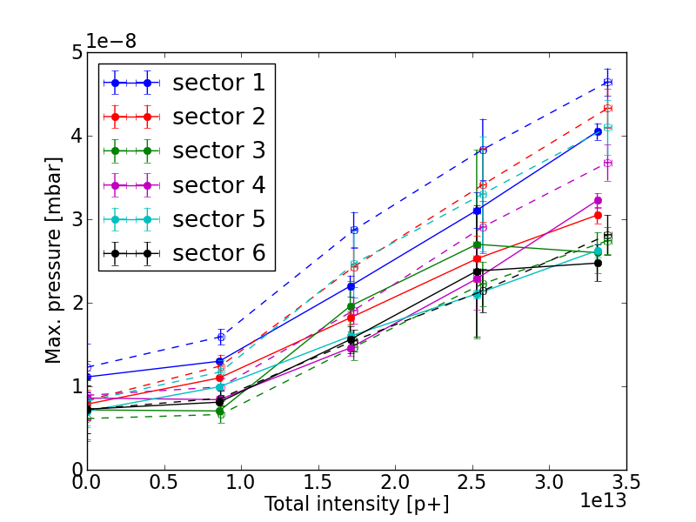
Dynamic pressure rise
25ns beam, 1.2e11ppb, 26 GeV, 23s cycle
Q26
Q20
Point 5
288b.
Arcs
216b.
144b.
288b.
216b.
144b.
72b.
72b.

Slide 18
Dynamic pressure rise
25ns beam, 1.2e11ppb, 26 GeV, 23s cycle
Q26
Q20
Point 5
288b.
Arcs
216b.
144b.
288b.
216b.
144b.
72b.
72b.
Ramarks:
More than factor 10 between Point 5 and the arcs

Slide 19
Dynamic pressure rise
25ns beam, 1.2e11ppb, 26 GeV, 23s cycle
Q26
Q20
Point 5
288b.
Arcs
216b.
144b.
288b.
216b.
144b.
72b.
72b.
Ramarks:
More than factor 10 between Point 5 and the arcs
No particular difference between Q20 and Q26

Slide 20
Dynamic pressure rise
25ns beam, 1.2e11ppb, 26 GeV, 23s cycle
Q26
Q20
Point 5
288b.
Arcs
216b.
144b.
288b.
216b.
144b.
72b.
72b.
Ramarks:
More than factor 10 between Point 5 and the arcs
No particular difference between Q20 and Q26
In 2012 the pressure rise is smaller by a factor 10⁴ w.r.t 2002!
(>=1week scrubbing runs in 2002, 2003, 2004, 2006, 2007 )

Slide 21
Outline
  Introduction
  Qualification of the LHC 25ns beam in the SPS
    Emittance along the train
    Effect of chromaticity
    Tune bunch by bunch
  Pressure observation
    Effects of losses
    Effect of batch spacing
    Ultimate intensity
  Direct electron cloud measurements on the strip detectors
    Effect of bunch intensity and number of bunches
    Conditioning observations
  Conclusions and proposals for future studies

Slide 22
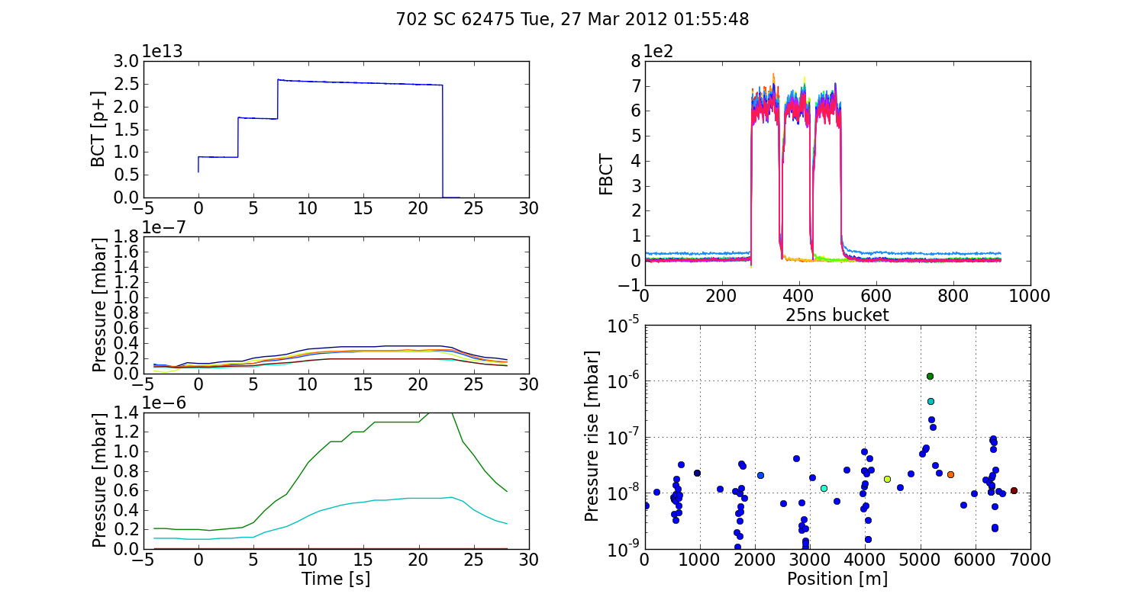
Dynamic pressure rise – effect of losses
Cycle with nominal settings
Arcs
Point 5

Slide 23
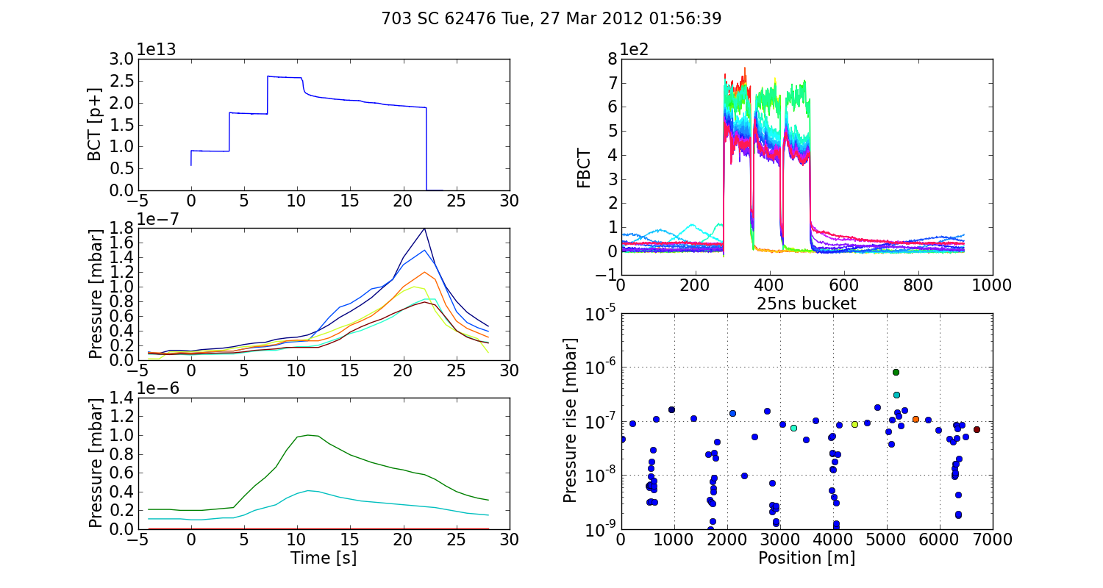
Dynamic pressure rise – effect of losses
Cycle with low RF voltage
Arcs
Point 5

Slide 24
Dynamic pressure rise – effect of losses
Cycle with nominal settings
Arcs
Quite uniform pressure increase in the arcs
No strong effect in the straight sections
Point 5

Slide 25
Dynamic pressure rise – effect of losses
Cycle with low RF voltage
Arcs
Quite uniform pressure increase in the arcs
No strong effect in the straight sections
Point 5

Slide 26
Dynamic pressure rise – effect of losses
Cycle with nominal settings
Opposite behavior! Can be explained if:
In the arcs we are dominated by losses
Electron cloud is developing in some of the equipment in Point 5 (UA9, BBLR, e-cloud equipment, not entirely conditioned, frequently vented)
Arcs
Point 5

Slide 27
Dynamic pressure rise – effect of losses
Cycle with low RF voltage
Opposite behavior! Can be explained if:
In the arcs we are dominated by losses
Electron cloud is developing in some of the equipment in Point 5 (UA9, BBLR, e-cloud equipment, not entirely conditioned, frequently vented)
Arcs
Point 5

Slide 28
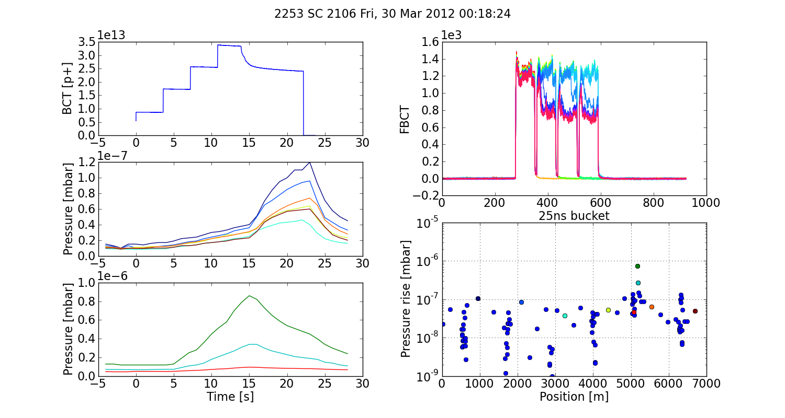
Dynamic pressure rise – effect of losses
Cycle with low vertical chromaticity (<0.05), transverse instability
Arcs
Point 5

Slide 29
Outline
  Introduction
  Qualification of the LHC 25ns beam in the SPS
    Emittance along the train
    Effect of chromaticity
    Tune bunch by bunch
  Pressure observation
    Effects of losses
    Effect of batch spacing
    Ultimate intensity
  Direct electron cloud measurements on the strip detectors
    Effect of bunch intensity and number of bunches
    Conditioning observations
  Conclusions and proposals for future studies

Slide 30
Dynamic pressure rise – effect of batch position
Arcs
Point 5

Slide 31
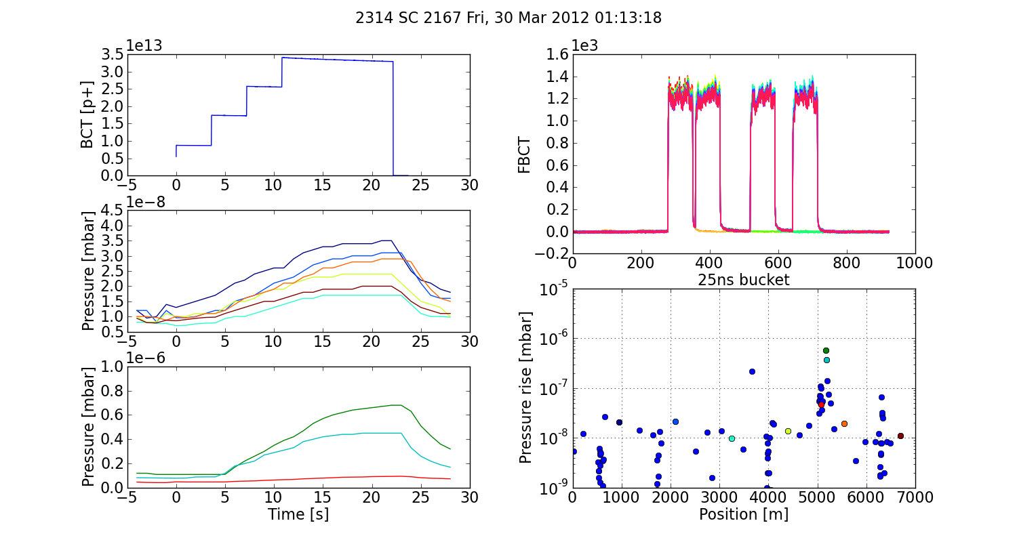
Dynamic pressure rise – effect of batch position
Arcs
Small effect bat reproducible:
Probably there is a small contribution of the electron cloud
Point 5

Slide 32
Outline
  Introduction
  Qualification of the LHC 25ns beam in the SPS
    Emittance along the train
    Effect of chromaticity
    Tune bunch by bunch
  Pressure observation
    Effects of losses
    Effect of batch spacing
    Ultimate intensity
  Direct electron cloud measurements on the strip detectors
    Effect of bunch intensity and number of bunches
    Conditioning observations
  Conclusions and proposals for future studies

Slide 33
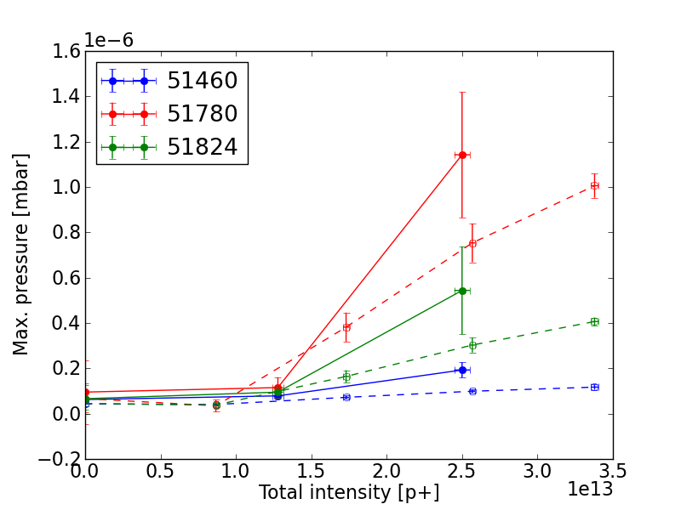
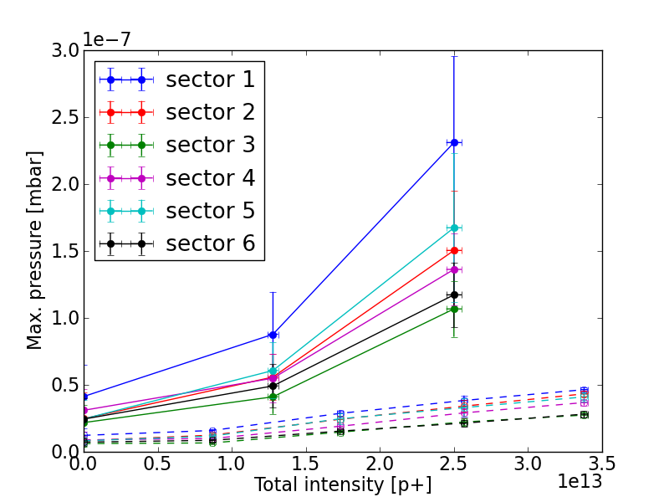
Dynamic pressure rise – “Ultimate intensity”
25ns beam, 26 GeV, 23s cycle
1.8e11 ppb
1.2e11 ppb
144b.
72b.
72b.
144b.
216b.
288b.

Slide 34
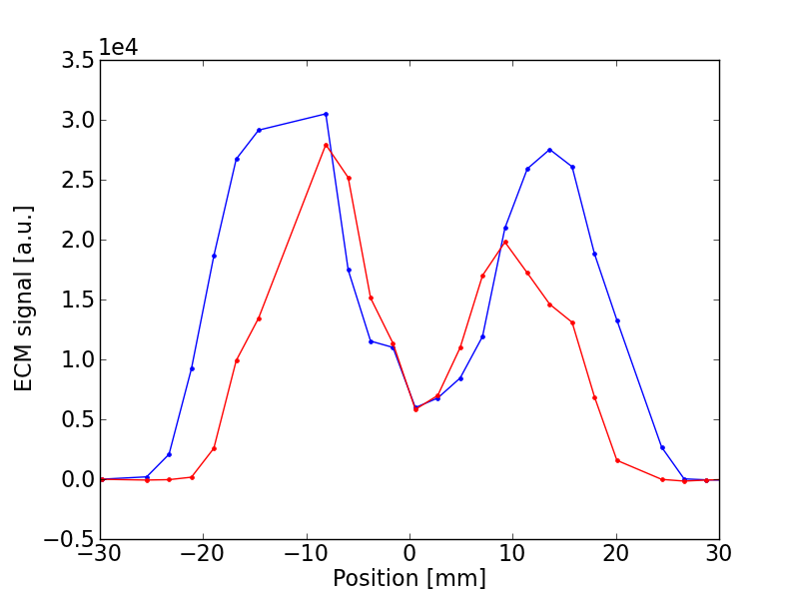
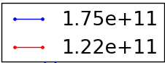
Dynamic pressure rise – “Ultimate intensity”
25ns beam, 26 GeV, 23s cycle
1.8e11 ppb
1.2e11 ppb
144b.
72b.
Much stronger pressure rise in the arcs:
Compatible with e-cloud:
for higher intensity the e-cloud can extend to non conditioned regions
72b.
144b.
216b.
288b.

Slide 35
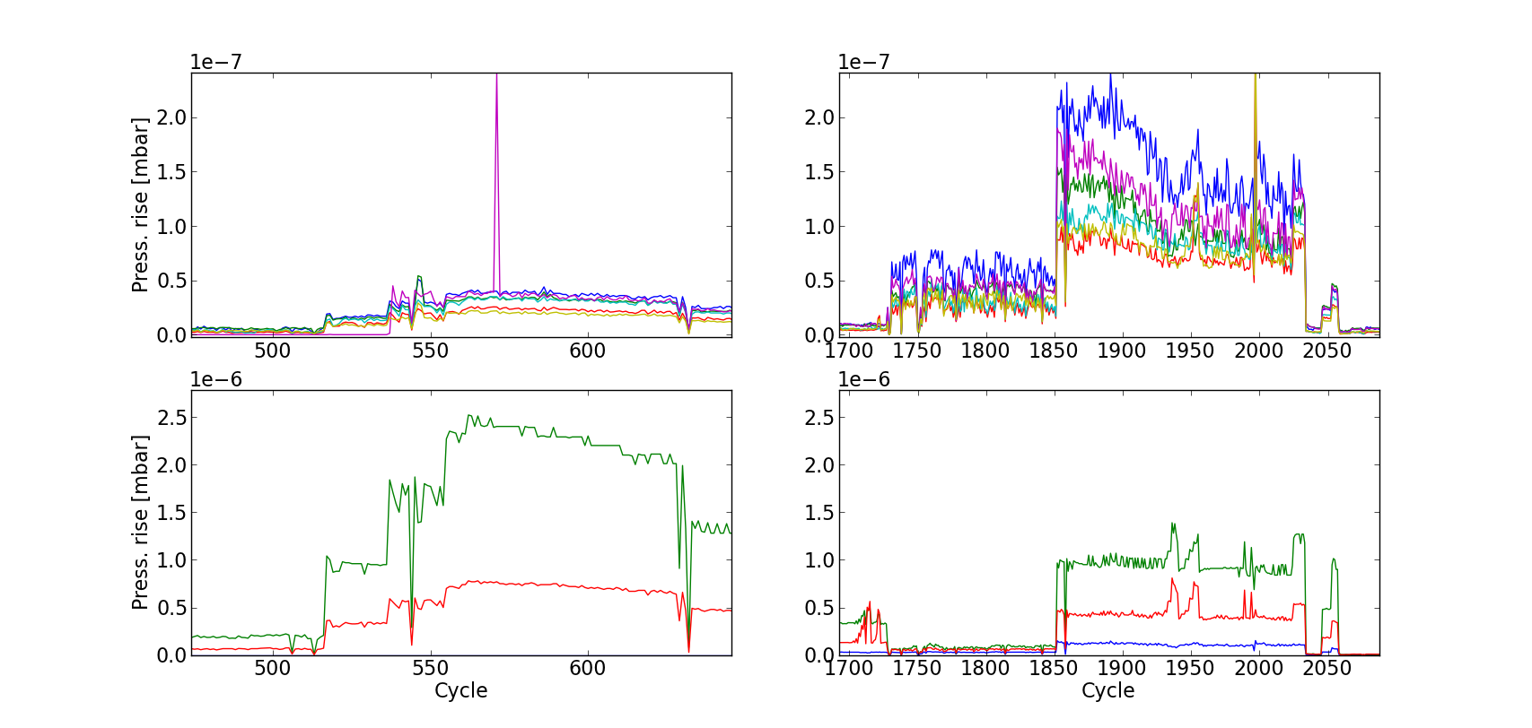
Dynamic pressure rise – “Ultimate intensity”
25ns beam, 26 GeV, 23s cycle
1.8e11 ppb
1.2e11 ppb
144b.
72b.
Much stronger pressure rise in the arcs:
Compatible with e-cloud:
for higher intensity the e-cloud can extend to non conditioned regions
Indications of conditioning were observed within a few hours of run with high intensity
72b.
144b.
216b.
288b.

Slide 36
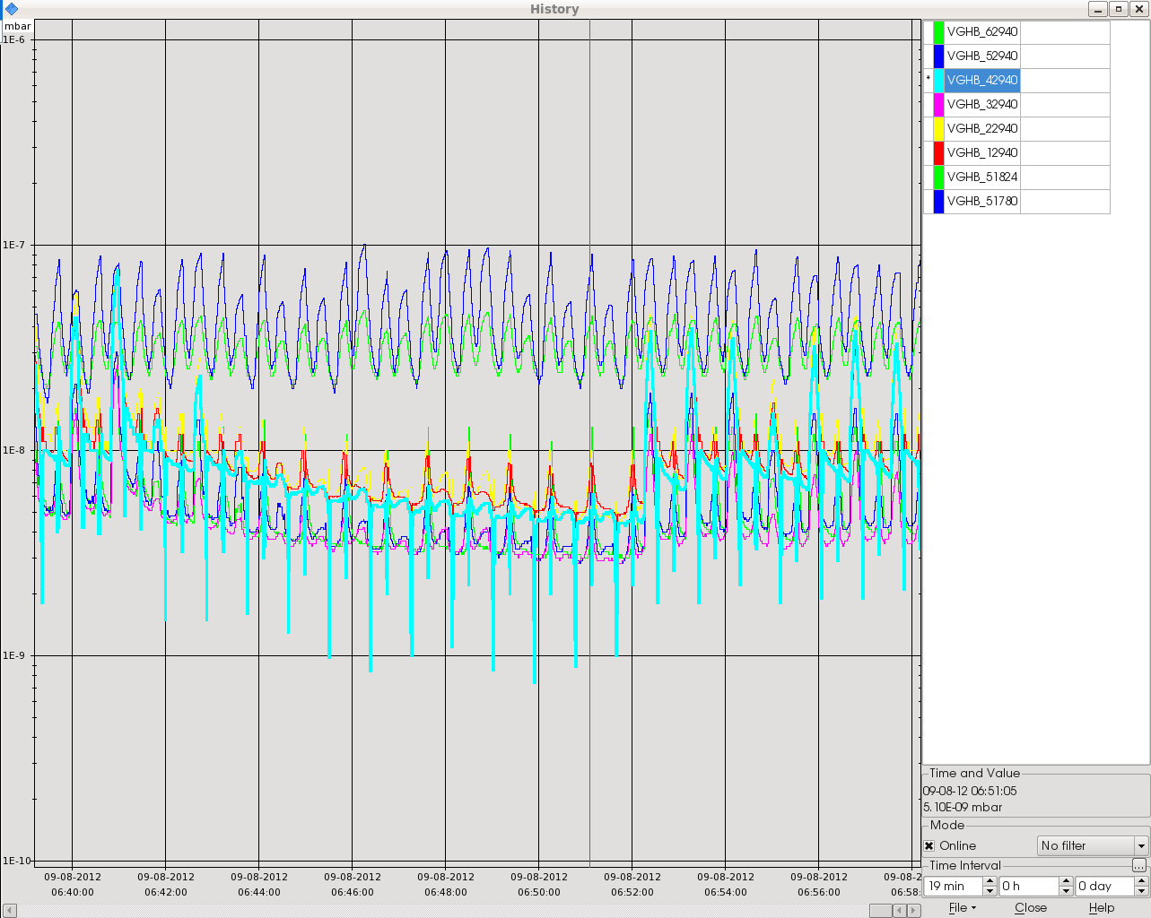
Preliminary: effect of radial steering
50ns beam, 26 GeV, 23s cycle
Radial steering

Slide 37
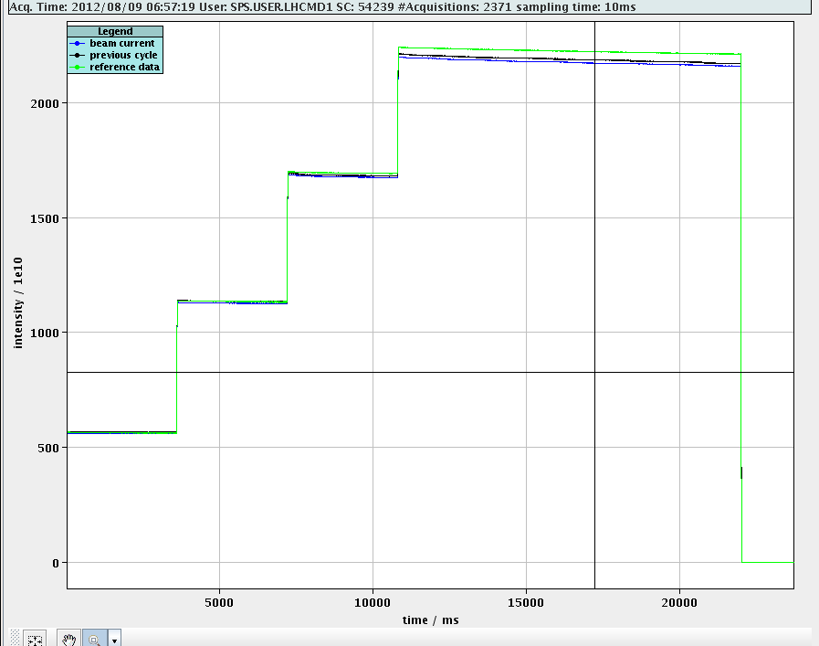
Preliminary: effect of radial steering
50ns beam, 26 GeV, 23s cycle
Radial steering

Slide 38
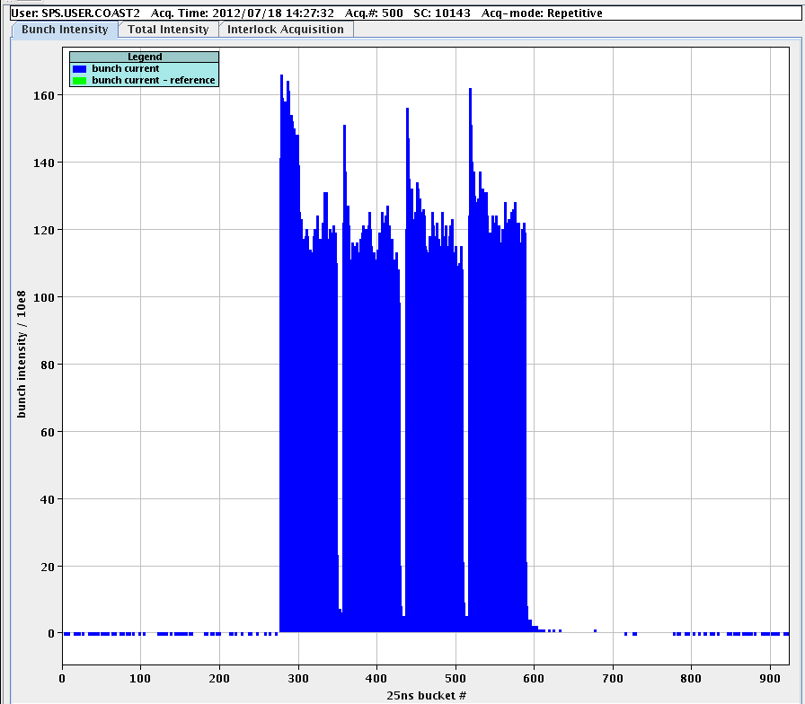
Preliminary: coast 270GeV (UA9 run)
25ns beam, 270GeV

Slide 39
Outline
  Introduction
  Qualification of the LHC 25ns beam in the SPS
    Emittance along the train
    Effect of chromaticity
    Tune bunch by bunch
  Pressure observation
    Effects of losses
    Effect of batch spacing
    Ultimate intensity
  Direct electron cloud measurements on the strip detectors
    Effect of bunch intensity and number of bunches
    Conditioning observations
  Conclusions and proposals for future studies

Slide 40
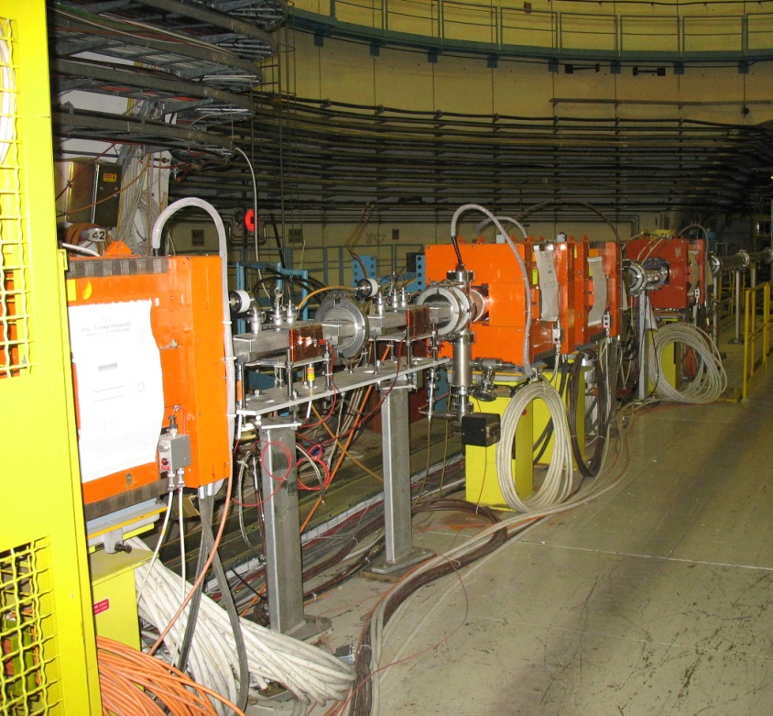
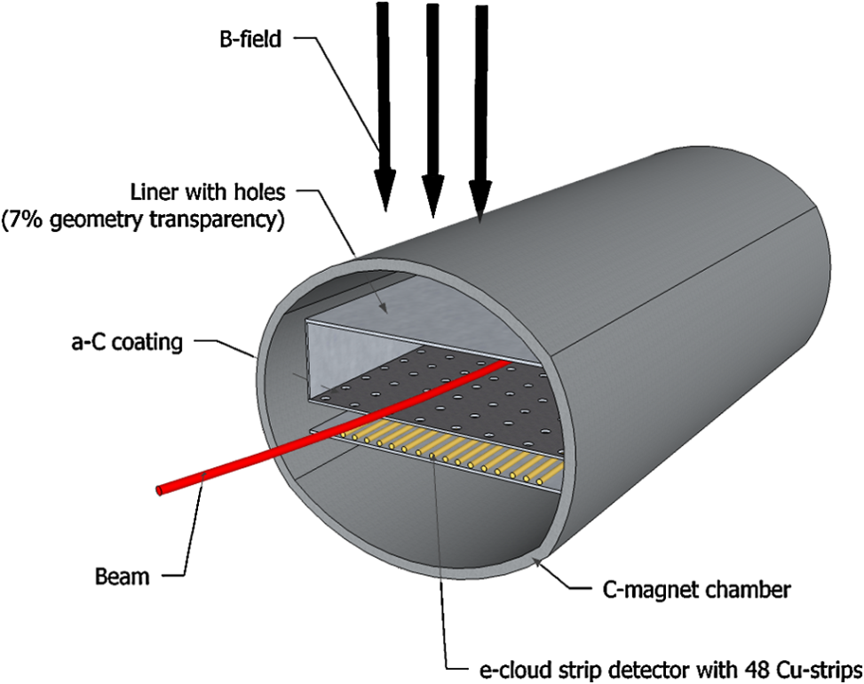
Strip detectors
C. Y. Vallgren et al., PRSTAB
Very powerful tool since they allows to measure the horizontal profile of the electron flux to the wall (av. over 10 – 100 ms) , but:
It is not representative of the present conditioning state of the machine
The holes may significantly affect (slow down) the conditioning of the chamber

Slide 41
Outline
  Introduction
  Qualification of the LHC 25ns beam in the SPS
    Emittance along the train
    Effect of chromaticity
    Tune bunch by bunch
  Pressure observation
    Effects of losses
    Effect of batch spacing
    Ultimate intensity
  Direct electron cloud measurements on the strip detectors
    Effect of bunch intensity and number of bunches
    Conditioning observations
  Conclusions and proposals for future studies

Slide 42
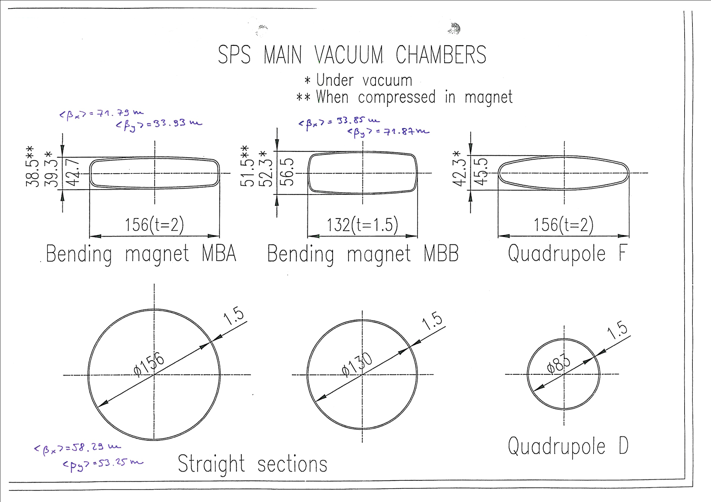
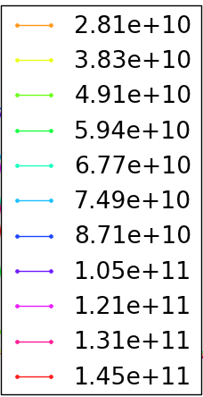
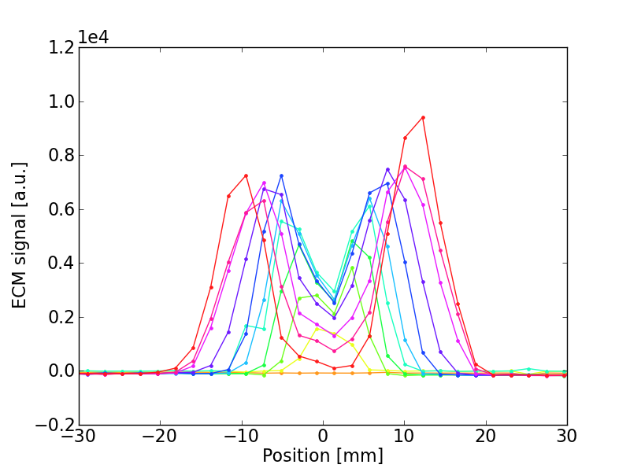
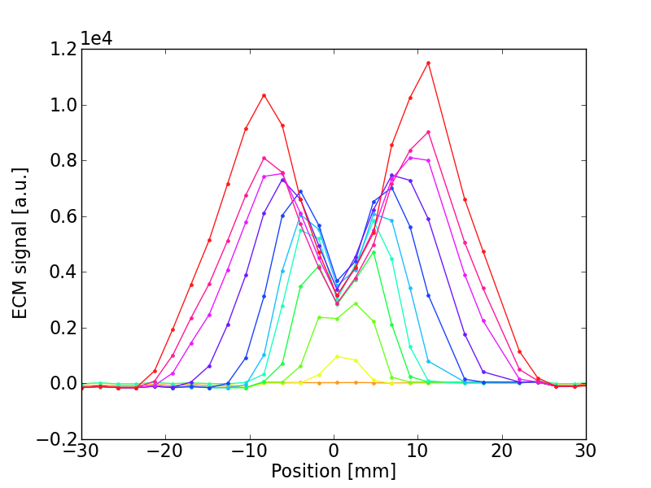
Strip detectors – dependence on bunch intensity
  MBA
  MBB
Ramarks:
MBA is less critical than MBB
E-cloud in the central region (important for beam quality) is non increasing with bunch intensity (consistent with our EC model ☺)

Slide 43
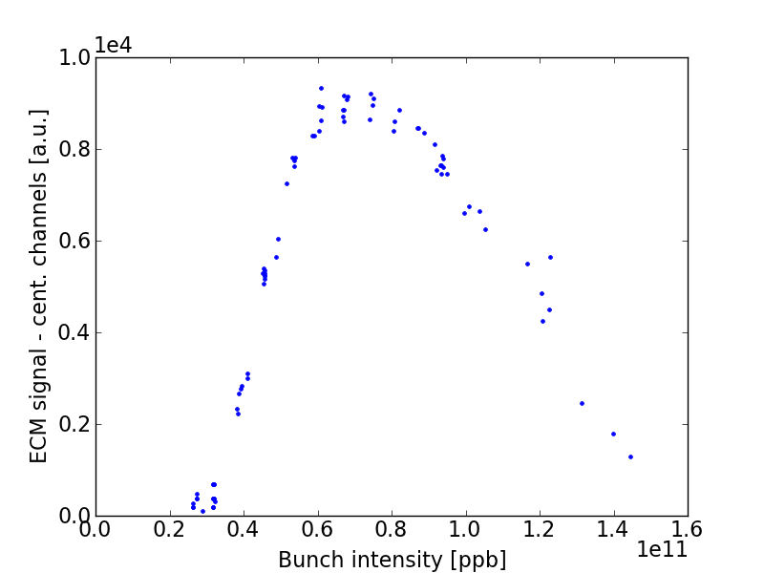
Strip detectors
  MBA
  MBB
Ramarks:
MBA is less critical than MBB
E-cloud in the central region (important for beam quality) is non increasing with bunch intensity (consistent with our EC model ☺)

Slide 44
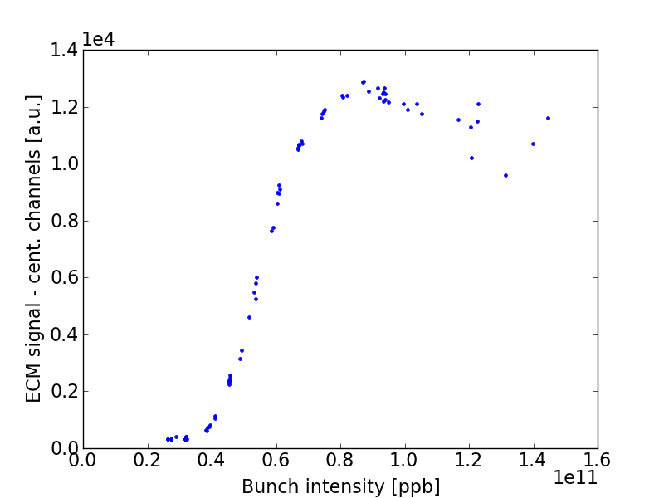
Strip detectors
  MBA
  MBB
Ramarks:
MBA is less critical than MBB
E-cloud in the central region (important for beam quality) is non increasing with bunch intensity (consistent with our EC model ☺)

Slide 45
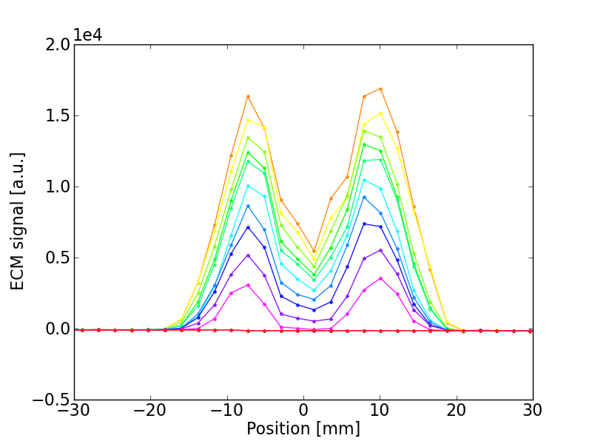
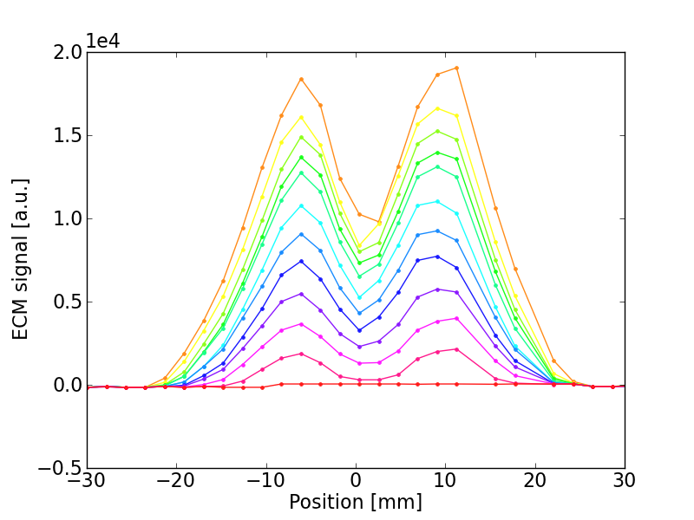
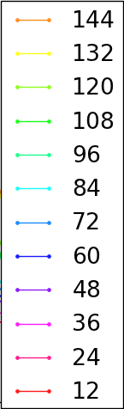
Strip detectors – dependence on number of bunches
  MBA
  MBB
Ramarks:
MBA is less critical than MBB
225ns gap is not enough to decouple

Slide 46
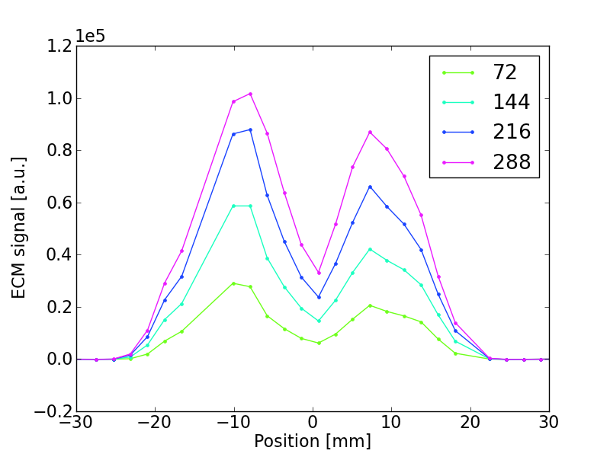
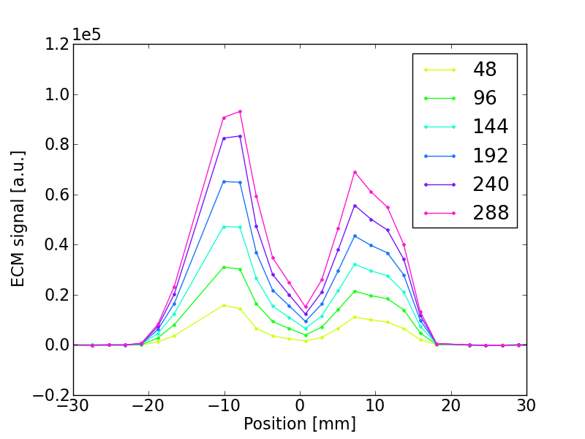
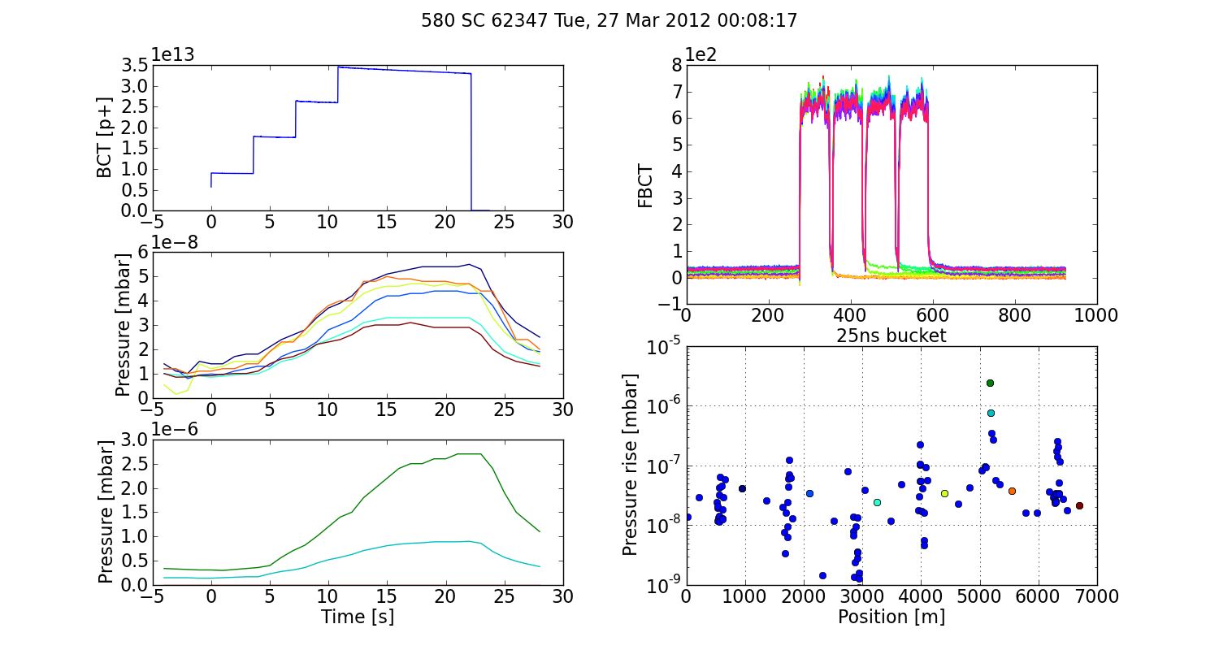
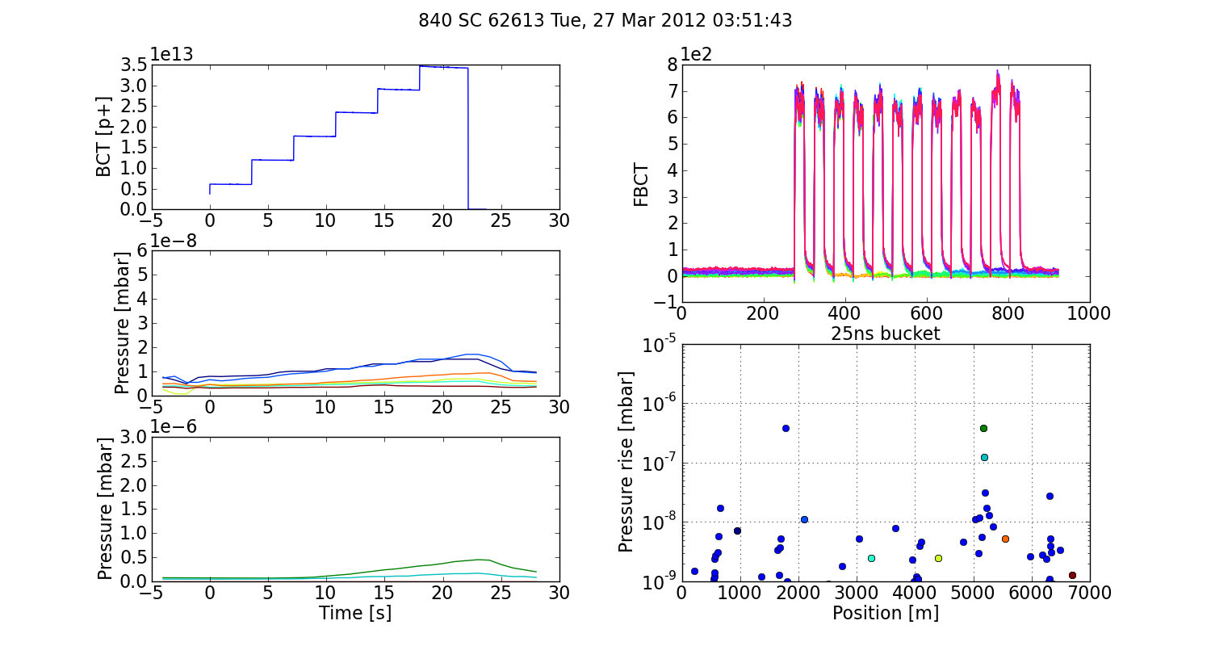
Strip detectors – “microbatches”
  Nominal
  Microbatch

Slide 47
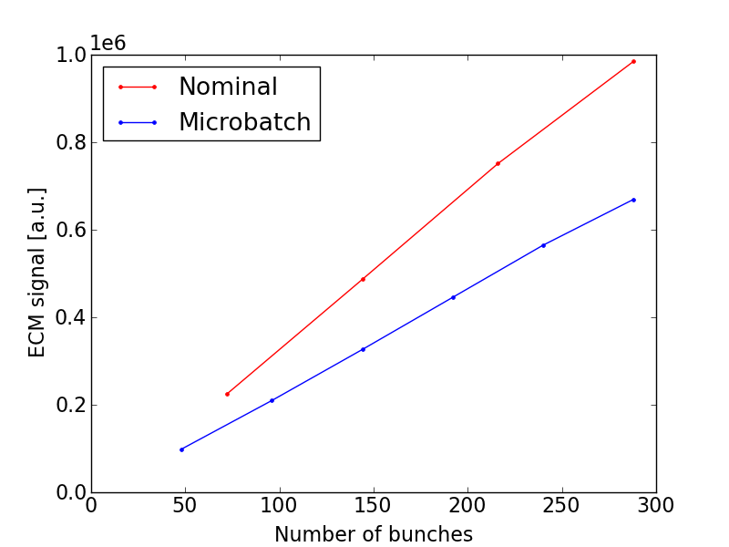
Strip detectors – “microbatches”
  Nominal
  Microbatch
~ 30%

Slide 48
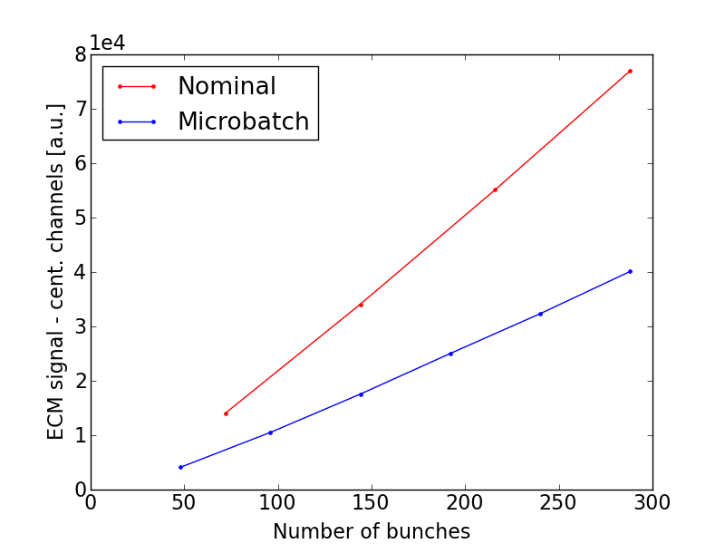
Strip detectors – “microbatches”
  Nominal
  Microbatch
~50%

Slide 49
Outline
  Introduction
  Qualification of the LHC 25ns beam in the SPS
    Emittance along the train
    Effect of chromaticity
    Tune bunch by bunch
  Pressure observation
    Effects of losses
    Effect of batch spacing
    Ultimate intensity
  Direct electron cloud measurements on the strip detectors
    Effect of bunch intensity and number of bunches
    Conditioning observations
  Conclusions and proposals for future studies

Slide 50
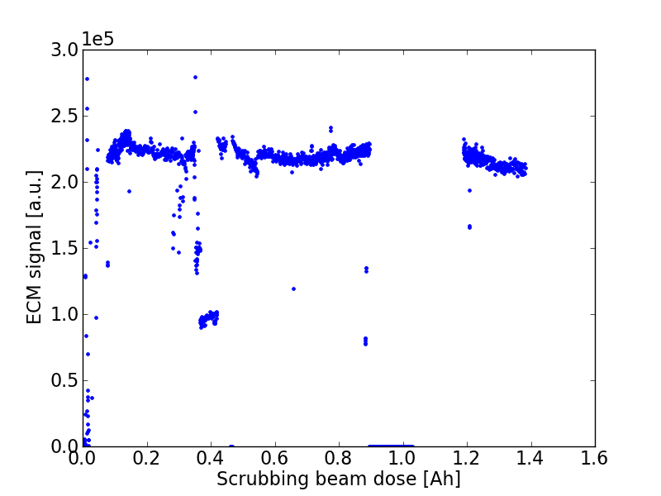
Strip detectors – conditioning
Warning: expected to be slower than in “real” bending magnets!
2012 Scrubbing run
MBB

Slide 51
Strip detectors – conditioning
Warning: expected to be slower than in “real” bending magnets!
Not much conditioning observed during SR, but the liner had been already exposed to 25ns beam
2012 Scrubbing run
B = 0
B = 0.12T
  Scrubbing beam dose [p⁺]
MBB

Slide 52
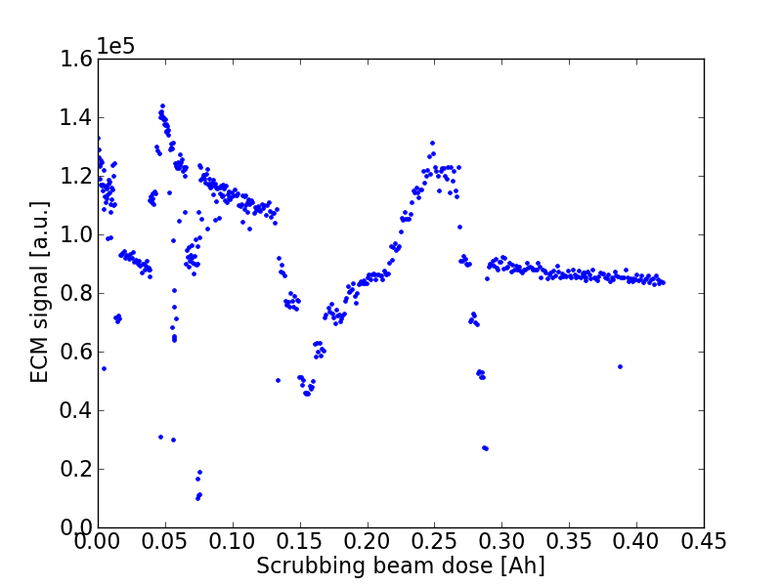
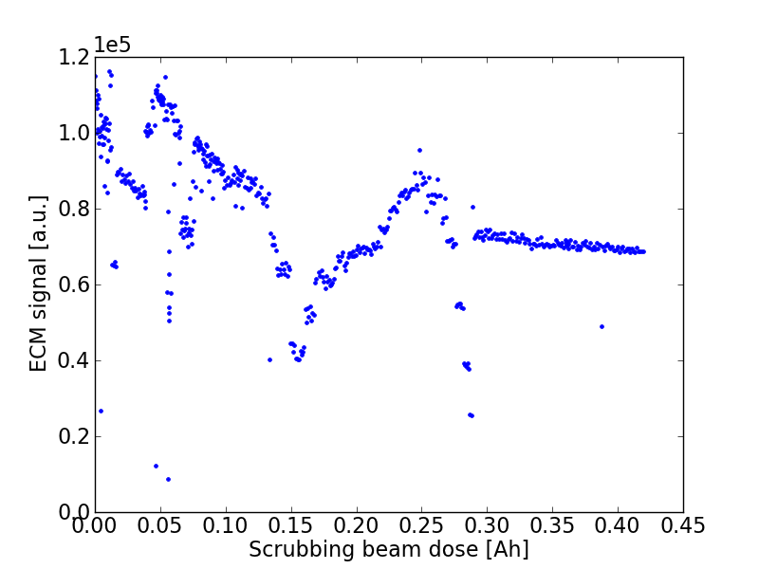
Strip detectors – conditioning
Warning: expected to be slower than in “real” bending magnets!
MD 25/04/2012 (few h.)
~40%
2012 Scrubbing run
MBB
~ 40%
MBB
MBA

Slide 53
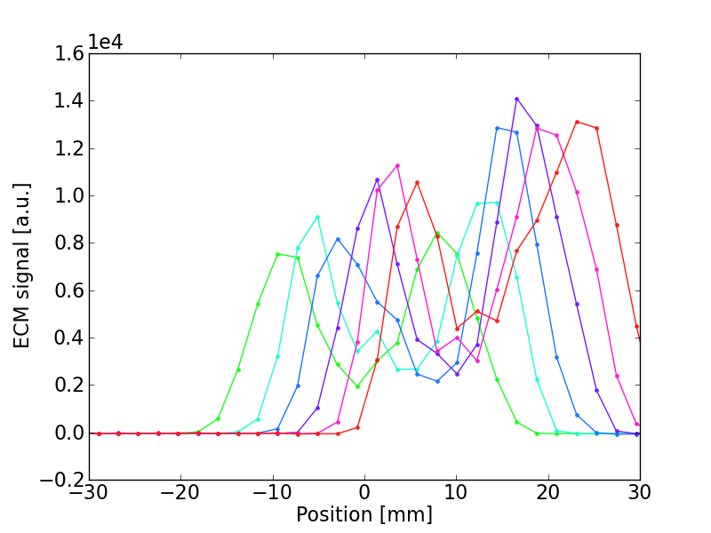
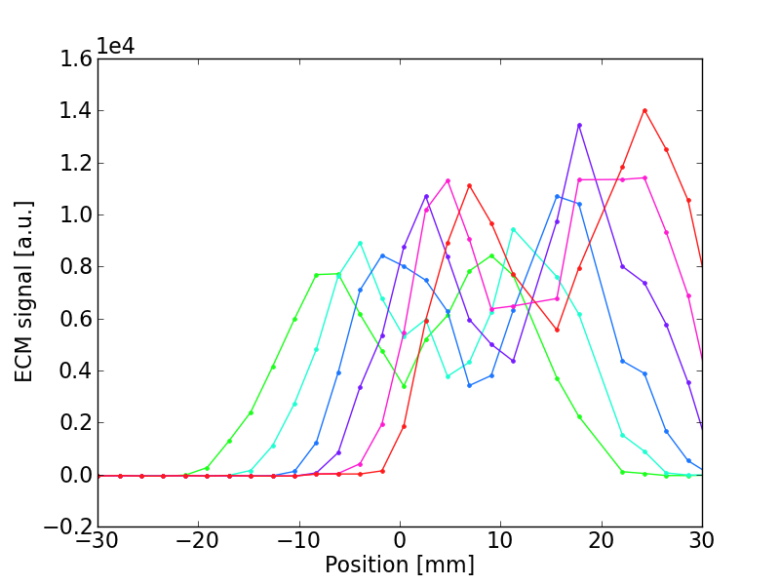
Strip detectors – conditioning
The conditioned area can be localized with horizontal displacements of beam in the ECM
MBA
MBB

Slide 54
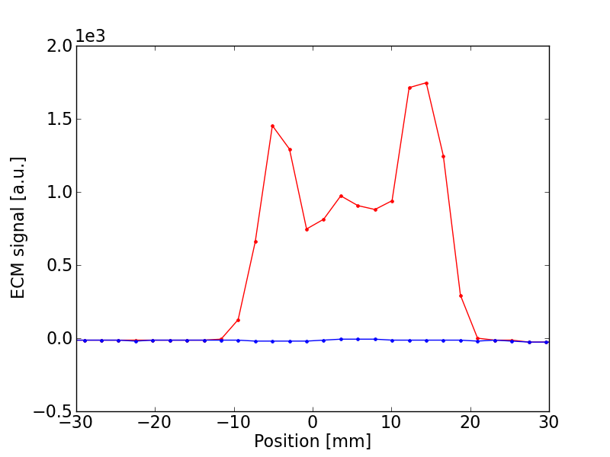

Strip detectors – conditioning
Measurements with 50ns beam before and after few hours of scrubbing
Before scrubbing
After scrubbing
MBA
MBB
Ramarks:
MBA is less critical than MBB

Slide 55
Outline
  Introduction
  Qualification of the LHC 25ns beam in the SPS
    Emittance along the train
    Effect of chromaticity
    Tune bunch by bunch
  Pressure observation
    Effects of losses
    Effect of batch spacing
    Ultimate intensity
  Direct electron cloud measurements on the strip detectors
    Effect of bunch intensity and number of bunches
    Conditioning observations
  Conclusions and proposals for future studies

Slide 56
Summary and conclusions
  No visible effect of electron cloud on nominal LHC 25ns beam (parameters within LHC design report specifications)
  Pressure rise much smaller than in the past (dominated by losses?)
  Emittances (?) and pressure rise with ultimate intensity
    First tests conducted, further studies are needed
  Data from “direct” ecloud measurements has been collected (for models and simulation code benchmarking)

Slide 57
Thanks for your attention!

Slide 58

Bending Magnet MBB: e⁻ density
No
EC
y
z
Courtesy C. Y. Vallgren
x
z

Slide 59
Microbatch
(a)
(d)
(b)
(e)
(c)

Slide 60

Microbatch
(a)
(d)
(b)
(e)
(c)

Slide 61
Microbatch
(a)
(d)
(b)
(e)
(c)

Slide 62

Uncaptured beam (2008)

Slide 63

Uncaptured beam (2008)

Slide 64


2006 vs 2012

Slide 65

Shielded pickup

Slide 66

Shielded pickup

Slide 67

Shielded pickup

Slide 68

Shielded pickup

Slide 69
2012 SPS Scrubbing Run
Monday 26/03:
Setup 25ns Q26 long FB and standard LHC cycles
Study of the effect of the batch spacing on EC observables
The microbatch filling scheme
Tuesday 27/03:
Setup 25ns Q20 long FB cycle and 50ns std LHC cycle
Study of the effect of the batch spacing on EC observables (50ns beam)
Tests on the effect of uncaptured beam on the EC
Wednesday 28/03:
EC studies with the std LHC cycle (26GeV -> 450GeV)
Tests on pressure rise on aC coated chambers
Tests on clearing electrode
EC studies with 50ns beam (unshielded MKE cooldown)
Thursday 29/03:
EC studies with ultimate intensity 25ns beam (1.8e11ppb)
PS-SPS transmission studies
Transverse instability study (Q26)
EC studies with 50ns beam (unshielded MKE cooldown)
Friday 30/03 (8h + access):
Transverse instability study (Q20)
(For a detailed timeline see ATS note in preparation)

Slide 70
2012 SPS Scrubbing Run
25ns beam in the machine was exploited for setup and data collection on several equipments:
Strip detectors (continuous acquisition)
StSt removable sample for SEY measurements
Shielded pickup (continuous acquisition)
Microwave transmission setup
aC coating tests
Clearing electrode tests
Slow electron detector
Bunch by bunch emittance measurements commissioned
  Pressure (1Hz acquisition), beam parameters (BCT, FBCT, bunch length, transverse emittance) are available for the entire week
Most of the data have been collected and analyzed (ATS note in preparation)

Slide 71


LHC 25ns beam: emittances
  Horizontal
  Vertical
Average emittance per with 4 batches of 1.15x10¹¹p/b in 2012
No measurable emittance growth within 20s flat bottom
Emittances within nominal LHC beam parameters

Slide 72


