Slide 1
Final steps for making Q20 operational
T. Argyropoulos, W. Bartmann, H. Bartosik, T. Bohl, C. Bracco,
J. Esteban Muller, E. Gianfelice-Wendt, B. Goddard, V. Kain,
Y. Papaphilippou, E. Shaposhnikova, G. Vanbavinckhove
LIU-SPS-BD August 15, 2012

Slide 2
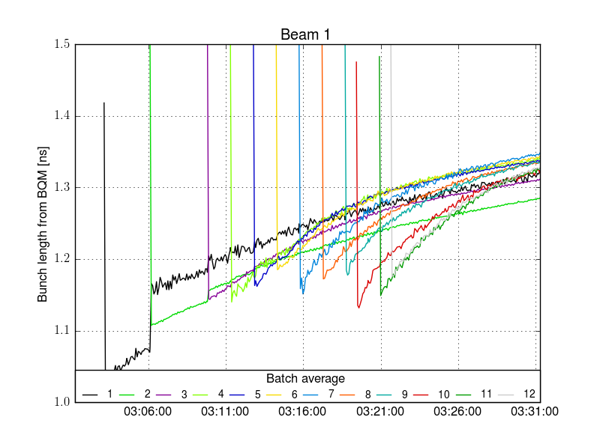
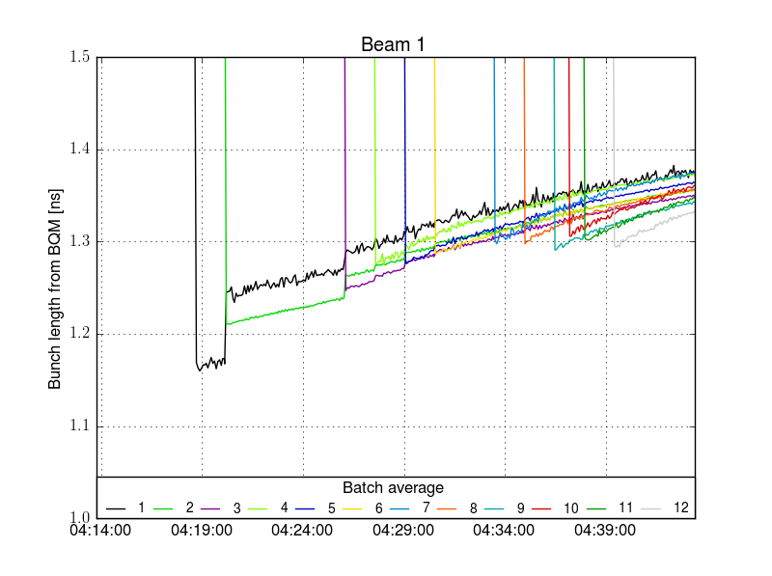
Final steps for making Q20 operational
Final checks on extraction conditions
Aperture in extraction channels (DONE)
Steering in transfer lines with final extraction settings (WHEN INJECTING INTO LHC)
Preparation and setup of probe cycle with Q20 optics (IN PREPARATION)
Study bunch length and transverse emittance evolution on LHC flat bottom (TEST FILL)
Measure transverse emittance growth on LHC flat bottom
Find optimal settings for controlled longitudinal blow-up in SPS to minimize IBS
(≈1.58e11 p/b)
Fill 2944
(≈1.58e11 p/b)
Fill 2947
from Q20 – short bunches
from Q20 – long bunches

Slide 3
Final steps for making Q20 operational
Final checks on extraction conditions
Aperture in extraction channels (DONE)
Steering in transfer lines with final extraction settings (WHEN INJECTING INTO LHC)
Preparation and setup of probe cycle with Q20 optics (IN PREPARATION)
Study bunch length and transverse emittance evolution on LHC flat bottom (TEST FILL)
Measure transverse emittance growth on LHC flat bottom
Find optimal settings for controlled longitudinal blow-up in SPS to minimize IBS
Test ramp and going into collisions to qualify the beam from Q20 (TEST FILL)
Small issue with tune feedback on test ramp during LHC MD – coincidence?
Minimize impact on other physics users (DONE)
No particular disturbance on physics users was observed during tests last week

Slide 4
Additional items to consider
Optimize RF settings if blow-up in SPS is needed/wanted
Total spread of bunch lengths smaller compared to Q26
Systematic increase along train when using controlled longitudinal blow-up
Reason for increasing bunch length not clear yet
No controlled blow-up: ε_{l}≈0.37eVs
Controlled blow-up: ε_{l}≈0.48eVs
N≈1.58x10¹¹p/b
N≈1.58x10¹¹p/b
SPS flat top – Q20
SPS flat top – Q20

Slide 5
Additional items to consider
Optimize RF settings if blow-up in SPS is needed/wanted
Total spread of bunch lengths smaller compared to Q26
Systematic increase along train when using controlled longitudinal blow-up
Reason for increasing bunch length not clear yet
No controlled blow-up: ε_{l}≈0.37eVs
Controlled blow-up: ε_{l}≈0.48eVs
N≈1.58x10¹¹p/b
N≈1.58x10¹¹p/b
SPS flat top – Q20
SPS flat top – Q26
SPS flat top – Q20

Slide 6
Additional items to consider
Optimize RF settings if blow-up in SPS is needed/wanted
Total spread of bunch lengths smaller compared to Q26
Systematic increase along train when using controlled longitudinal blow-up
Reason for increasing bunch length not clear yet
Prepare 25ns beam nominal intensity with Q20 optics
Choose the best moment to start with Q20
Should be ready with 25ns beam for scrubbing run and LHC MDs with 25ns beam after TS3
Avoid switching back and forth several times (consider also ion beams, …)
TODAY

