Slide 1
Longitudinal instabilities in the SPS and beam dynamics issues with high harmonic RF system
52nd ICFA Advanced Beam Dynamics Workshop HB2012
E. Shaposhnikova, T. Argyropoulos,
T. Bohl, J. E. Muller, H. Timko
Thanks to A. Burov, C. Bhat, H. Damerau, G. Papotti, J. Tuckmantel, ABP and Operation teams

Slide 2
Outline
CERN SPS performance
Longitudinal instabilities
observations
cures
Issues with high harmonic RF system
phase control
synchrotron frequency distribution
Summary

Slide 3
Present and future SPS performance
 | Present operation |  | SPS record |  | Aim after LIU
 | LHC | CNGS | LHC | CNGS | LHC | LHC
SPS beam energy [GeV] | 450 | 400 | 450 | 400 | 450 | 450
bunch spacing [ns] | 50 | 5 | 25 | 5 | 25 | 50
bunch intensity/10¹¹ | 1.6 | 0.1 | 1.3 | 0.13 | 2.2 | 3.6
number of bunches | 4x36 | 2x2100 | 4x72 | 2x2100 | 4x72 | 4x36
SPS beam intensity/10¹³ | 2.3 | 4.2 | 3.75 | 5.3 | 6.35 | 5.2
SPS cycle length [s] | 21.6 | 6.0 | 21.6 | 6.0 | 21.6 | 21.6
LHC beams: beam brightness and quality
CNGS-type beams: beam power and proton flux
Longitudinal instabilities are one of the main intensity limitations,
much higher intensities are required in future => LIU project (2020)
Source of instability is unknown and no mode could be identified

Slide 4
Longitudinal multi-bunch instability Single 200 MHz RF system
50 ns beam, 1.6x10¹¹ p/b
25 ns beam, 1.2x10¹¹ p/b
Instability starts at energy ~ 1/N_{tot} => multi-bunch effect
(P1/P2 = 162/109 = 1.49 and N2/N1=2x1.2/1.6 = 1.5)
Low threshold: single batch 2-3x10¹⁰ p/b unstable at flat top (450 GeV/c)
Single bunch N_{th} ~ 1.3x10¹¹

Slide 5
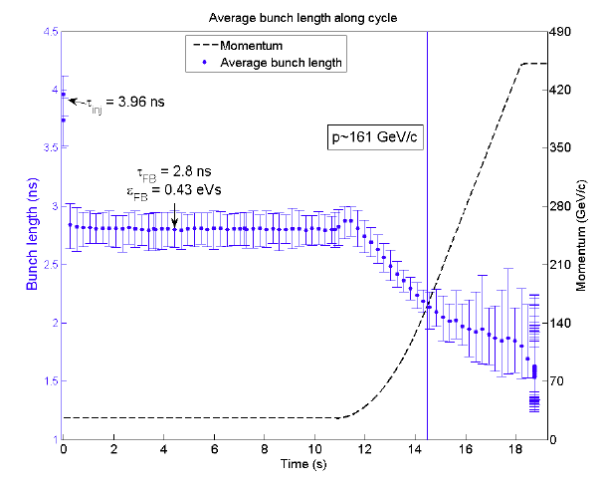
Multi-bunch instability Single RF, LHC beam with 50 ns spacing, 1.6x10¹¹p/b
1batch x 36 bunches
4 x 36 bunches, 250 ns batch gaps
Instability starts at the same energy for 1 and 4 batches,
6 bunches unstable over wide range (240-410) GeV/c
short-range wake => SPS TW RF systems (Q=150, 300)?

Slide 6
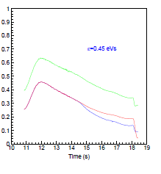
Beam stabilisation - cures
Active damping (low mode number): RF feedback, feed-forward, longitudinal damper
4th harmonic RF system (800 MHz) in bunch-shortening (BS) mode
Larger injected emittance => PS-SPS transfer (talk of H. Timko). Large emittance at 450 GeV/c => capture losses in the LHC 400 MHz RF system => controlled emittance blow-up in the SPS by factor 2.5
Optics (“Q20”) with lower transition energy (γ_{t}=22.8 -> 18 (talk of H. Bartosik) => N_{th} ~|η| (factor 2.8 – 1.6), but one still needs the double RF and blow-up
Impedance reduction (measurements of HOMs in 2 RF systems in 2013-2014)
2 RF systems
emit. blow-up
Rsh [MOhm]
emit. blow-up
+ 800 MHz
1 RF: 200 MHz

Slide 7
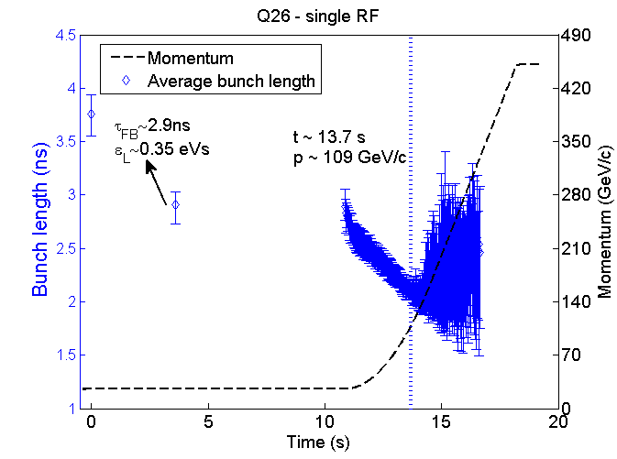
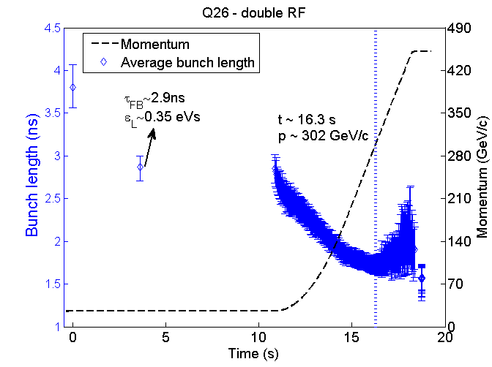
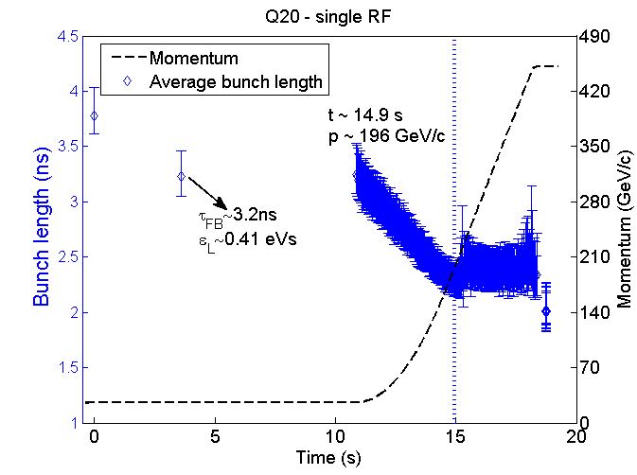
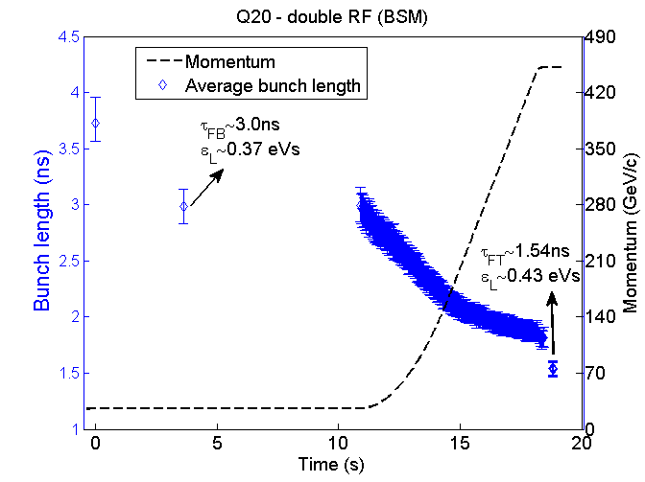
Beam stabilisation (25 ns, 1.2x10¹¹ p/b) Q20 and double RF (BS-mode), V₂/V₁=1/10
Single RF
Q26
Double RF
Q26
Single RF
Q20
Double RF
Q20

Slide 8
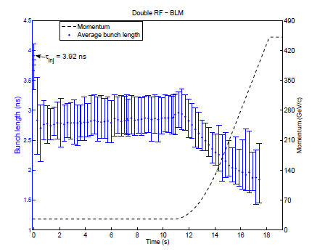
Operation modes of high harmonic RF system in the SPS
Bunch-lengthening
Bunch-shortening
Used in most/all accelerators in the world
- larger synchrotron frequency spread
- larger bucket in BL-mode
- smaller peak density (SC, heating,…)
but unstable in the SPS => beam dump!
Stable with V₂/V₁ = 1/10
=> Can we increase this ratio?

Slide 9
Landau damping with a high harmonic RF: bunch-shortening or bunch-lengthening mode?
Voltage in a double RF system:
V=V₁sinϕ + V2 sin(nϕ +φ₂ )
n=h₂/h₁ and above transition:
BL-mode: φ₂ = 0
BS-mode: φ₂ = π
Phase: very tight control in BL-mode
(2) Synchrotron frequency distribution:
In BL-mode region ω_{s}'(J_{cr})=0 exists for any voltage ratio => loss of Landau damping for long bunches (> 1.8 ns)
Same in BS-mode for large V₂/V₁
V₂/V₁ = 1/10 during the SPS cycle
h₂/h₁ = 4
V₂/V₁ = 0.23

Slide 10
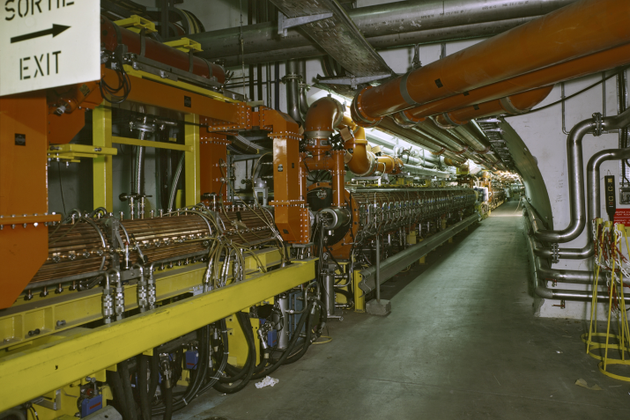
4th harmonic RF system in the SPS
Two 800 MHz travelling wave RF structures were installed in the SPS as “Landau cavities” in 1979, in real operation for LHC beams from 2010
Only one cavity is used (has RF power)
V_{max}=650 kV, 2nd cavity is idle
=> induced voltage in 2 cavities
Beam current component at 800 MHz increases during cycle (3 ns -> 1.5 ns)
=> Beam loading is 20 higher on flat top
Impedance
(1 cavity)

Slide 11
Phase calibration of 4th harmonic RF system
Phase shift is known up to some offset determined from measured bunch tilt at low intensity and large ratio V₂/V₁
Beam calibration done each year, then phase is adjusted for the best beam stability during cycle
Relative phase is programmed through the cycle (BS-mode above transition):
φ₂ = - 4 φ_{s} + π
V₂/V₁=0.25,
0.2, 0.1
bunch tilt
measurements
V₂/V₁=0.2
N=1x10¹⁰

Slide 12
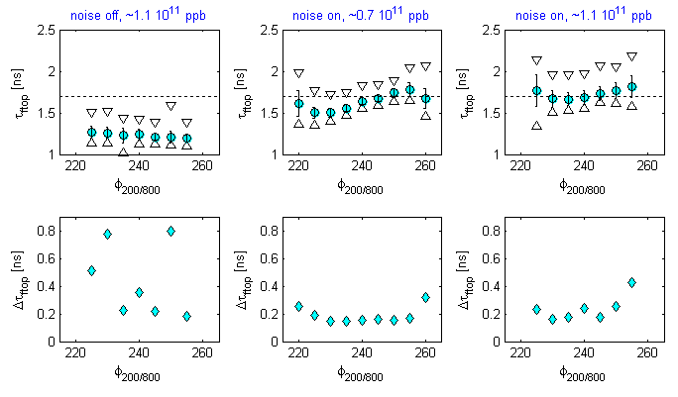
Bunch length and stability at 450 GeV/c as a function of the 800 MHz phase
Bunch length (av., max-min)
at 450 GeV/c
Beam stability
from ∆τ
G. Papotti et al.
Phase is changed through the whole cycle (phase offset)
Large (+/- 20 deg at 200 MHz) phase range of BS-mode
Short bunches are still unstable on flat top

Slide 13
Phase control: effect of beam loading in 800 MHz RF system
no beam loading
800 MHz on, beam loading
φ₂ ~ π/4
800 MHz off, beam loading,
passive cavity but φ₂ = π/2
800 MHz on, beam loading
compensated
Difficult to program φ₂ accordingly => FB and FF (2014)

Slide 14
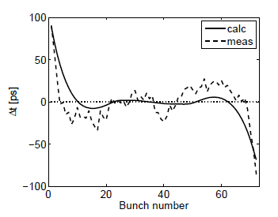
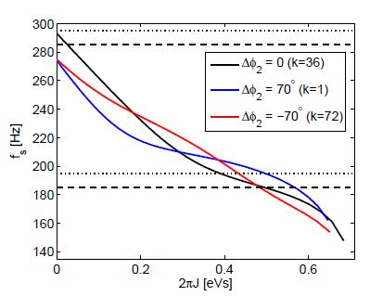
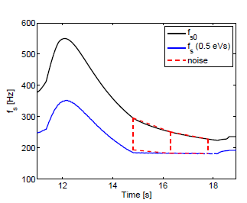
Phase control: effect of beam loading in 200 MHz RF system
measured & calcul.
bunch position ∆φ_{s}
synchrotron frequency
distribution varies along batch
T. Argyropoulos et al., HB2010
emittance BU:
applied noise
Δφ₂~ π/4 for bunch displacement of 100 ps
and V₈₀₀/V₂₀₀=0.1

Slide 15
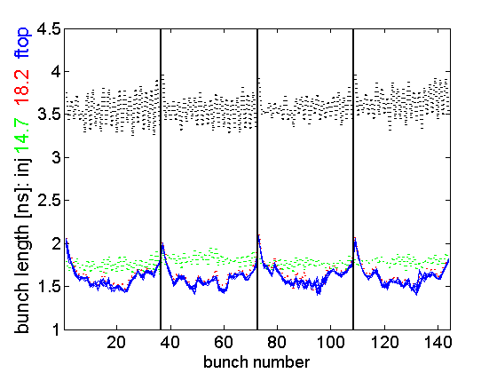
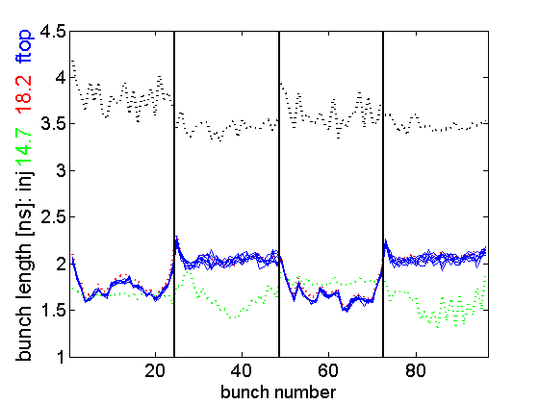
Phase control in a double RF system: issues with controlled emittance blow-up
50 ns spaced LHC beam
75 ns spaced LHC beam
ni
Non-uniform emittance blow-up due to beam loading in a double RF system
Non-uniform emittance blow-up and beam instability for short injected bunches

Slide 16
Multi-bunch instability double RF (BS-mode)
In a single RF (200 MHz):
threshold for 50 ns beam at flat top is factor 5 lower than for a single bunch (~1.1x10¹¹)
In a double RF (BS-mode):
these thresholds are very close
the instability is often observed on individual bunches only (with smallest emittances)
Single bunch phenomenon?
50 ns beam, 2 RF, 1.3x10¹¹ p/b
0.46 eVs

Slide 17
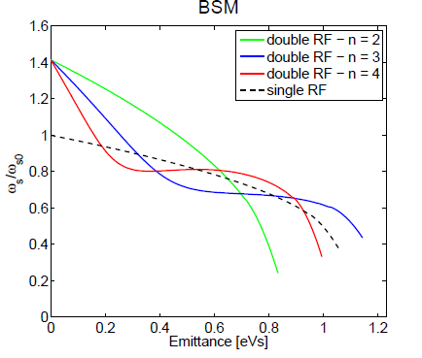
Synchrotron frequency distribution in a double RF system with V₂/V₁=h₁/h₂
Higher is h₂/h₁ - larger is spread for the same voltage V₂, but
a region with zero derivative is closer to the bunch center
limitation to the voltage ratio or bunch length in BS-mode
limitation to the bunch length in BL-mode

Slide 18
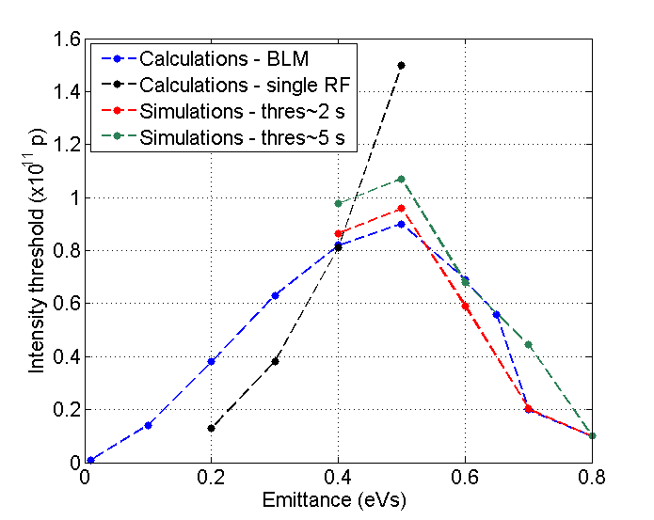
Loss of Landau damping in BL-mode for inductive impedance above transition
Simulations and calculations (Van Kampen modes) confirm observations in the SPS for BL-mode in (100 + 200) MHz RF at 26 GeV/c during ppbar:
Unstable bunches with emittance > 0.65 eVs
Can be stabilised by phase shift from BL-mode
(T. Argyropoulos, A. Burov, E. S.)
Similar behavior to the resistive wake in a double RF
(A. Burov, HB2010)

Slide 19
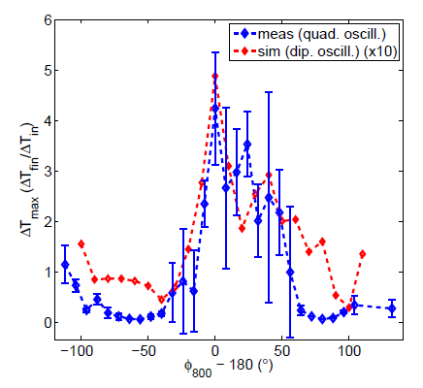
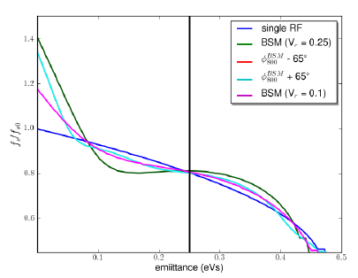
Synchrotron frequency distribution and phase between 2 RF systems in BS-mode
Very good agreement between measurements and simulations
(with SPS impedance model):
single bunches are unstable in BS-mode with V2/V1=4
can be stabilised by significant phase shift of 800 MHz RF system
(T. Argyropoulos et al., IPAC’12)

Slide 20
Summary
The SPS produces a good quality LHC beam at intensities by order of magnitude above the threshold of the longitudinal multi-bunch instability.
The SPS beam is stabilised by the 4th harmonic RF system in BS-mode, efficient even in the presence of strong beam loading in both RF systems; FB and FF systems should improve stability at high energies (less controlled emittance blow-up).
In the SPS, due to choice of harmonic (4th), the working parameter space is very limited for both BL-mode (emittances) and BS-mode (voltage ratio or emittances).
BL-mode cannot be used in the SPS with present beam loading and even in future with FF and FB for 800 MHz due to long bunches.
The 2nd harmonic RF system can have the largest bucket filling factor, but needs a very accurate phase control in BL-mode.

Slide 21
Future plans
Implementation of the Q20 optics – ongoing
Measurements of HOMs in 200 MHz and 800 MHz RF systems – during 2013-2014
FB and FF for the 800 MHz RF system - 2014
Upgrade of the 200 MHz RF system (double power, shorter cavities, new beam control and impedance reduction by 20%) – 2020
Search for other impedance sources
Comparison of measurements and simulations (single bunch) to refine the SPS impedance model
Design study of the 2nd harmonic RF system for HL-LHC

Slide 23
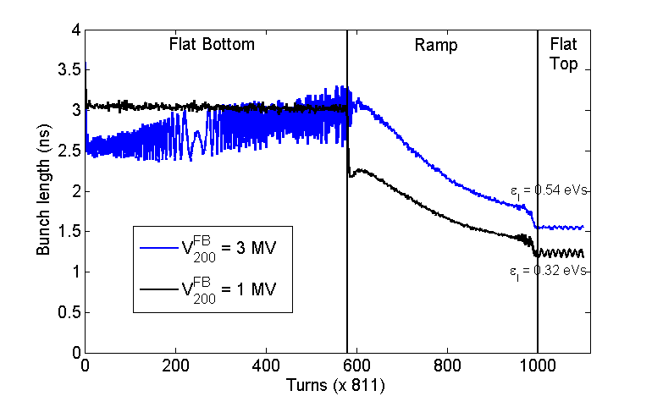
Loss of Landau damping for a single bunch in a single RF system
Measurements:
similar N_{th}~1x10¹¹ for the loss of Landau damping on flat bottom (V=2 MV) and flat top
strong dependence on capture voltage (1 - 3 MV)
Sacherer’ criteria:
Predicts factor 10 higher thresholds at injection (26 GeV/c)
Only 10% difference for 1 - 3 MV
15% emittance blow-up during cycle but effective inductive impedance also depends on bunch length (~2)
→ initial distribution?
Indeed, modulated bunch profile after bunch rotation in the PS, confirmed by simulations (talk of H. Timko )

Slide 24
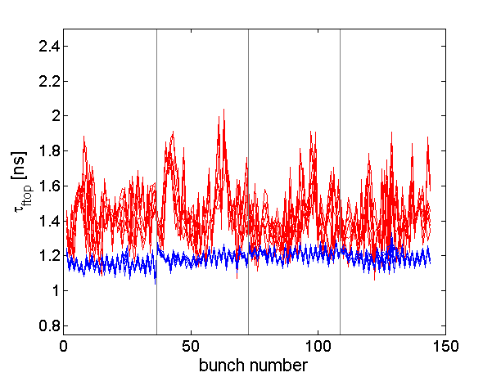
Multi-bunch and single bunch thresholds
In a single RF (200 MHz):
threshold for 50 ns beam at flat top is factor 5 lower than for a single bunch (~1.1x10¹¹)
In a double RF (BS-mode)
thresholds are more close at flat top
50 ns beam:
1.2 ns (0.36 eVs): 1.2x10¹¹ p/b
single bunch:
1.1 ns (0.3 eVs): 1.2x10¹¹ p/b
flat bottom, 50 ns beam:
- 3 ns (0.35 eVs): 1.3x10¹¹ p/b
bunch length on flat top
50 ns beam, 1.2x10¹¹ p/b
single RF
double RF
bunch length on flat top
vs intensity
double RF
single bunch

Slide 25
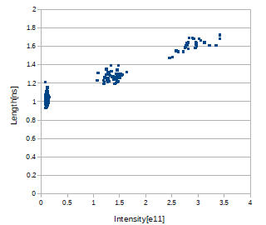
Single bunches on flat top, 800 MHz in BS-mode, no controlled emittance blow-up
Q26: FT bunch length vs intensity
V200=4.5MV, V800= 0.5MV
Q20: FT bunch length vs intensity
V200=7 MV, V800= 0.7MV
T. Bohl
In Q26 on FT N_{th}= 2.2x10¹¹
FB – probably Nth= 2.7x10^11
In Q20 N_{th}= 2.7x10¹¹
=> similar thresholds for the same bunch length ~1.55 ns but higher threshold is expected

Slide 26
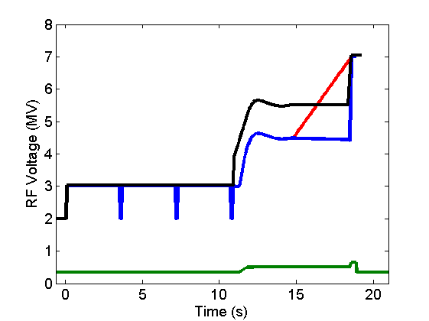
SPS operational cycle for LHC beams: voltage programs
transfer to LHC
CBI threshold decreases with energy during the cycle
ultimate 25 ns beam
Rsh [MOhm]
200 MHz
emit. blow-up
operational 50 ns
+ 800 MHz
800 MHz
1 RF: 200 MHz
800 MHz used in bunch-shortening mode
Phase shift is programmed through the cycle

Slide 27
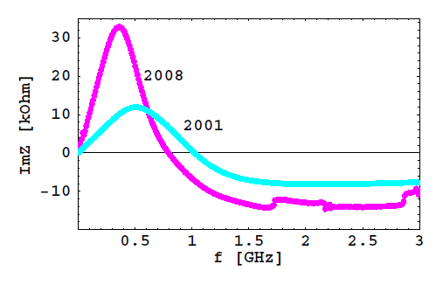
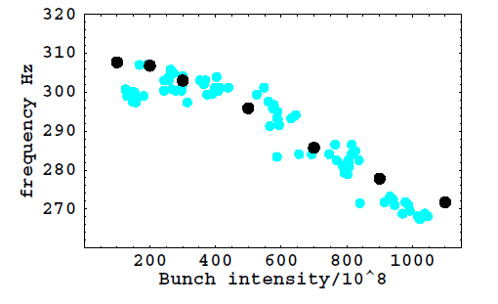
SPS longitudinal impedance: reactive part
all kickers
(data - B. Salvant)
7 from 8 MKE kickers - main contributors to the SPS inductive impedance ImZ - were serigraphed this year but the instability threshold didn’t change!
and 2012
Synchrotron frequency shift
f_{2s}(N) = a + b N/10¹⁰
good agreement,
not much room for extra impedance
simulations
measurements

Slide 28
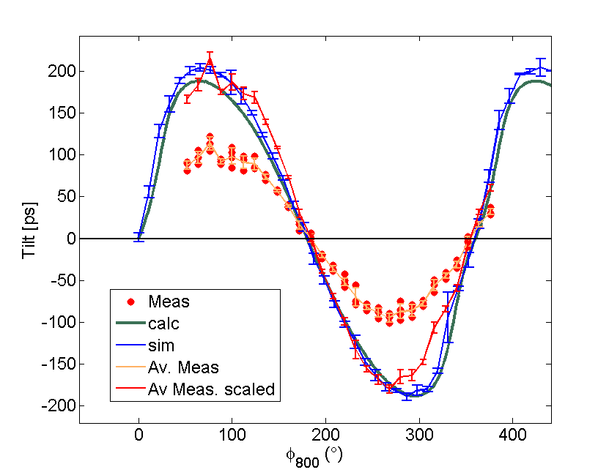
4th harmonic (800 MHz): phase calibration
In reality what we measure is
where is an unknown offset which has to be calibrated
Calibration is done by measuring the symmetry of the bunch (bunch tilt) while
varying the phase with:
Single proton bunch at low intensity (N_{p}~1. x10¹⁰ p/b)
Voltage ratio between the two RF systems V₂₀₀ /V₈₀₀ = 0.25
Very good agreement between simulations and calculations
Good agreement also with the measurements (after scaling)
BSM
BLM

Slide 29
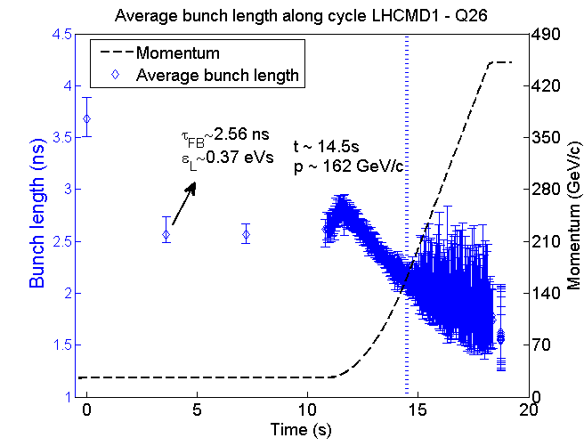
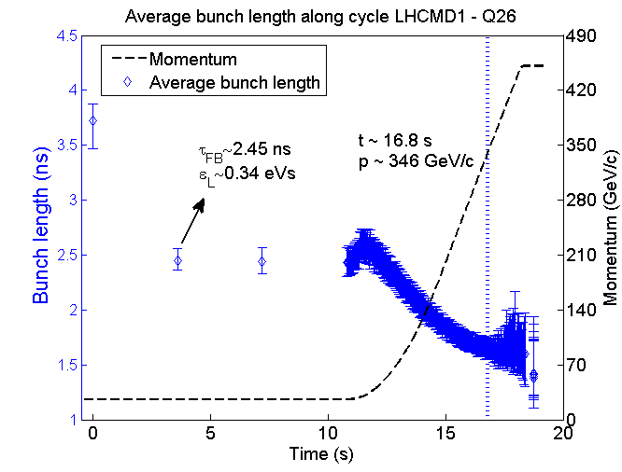
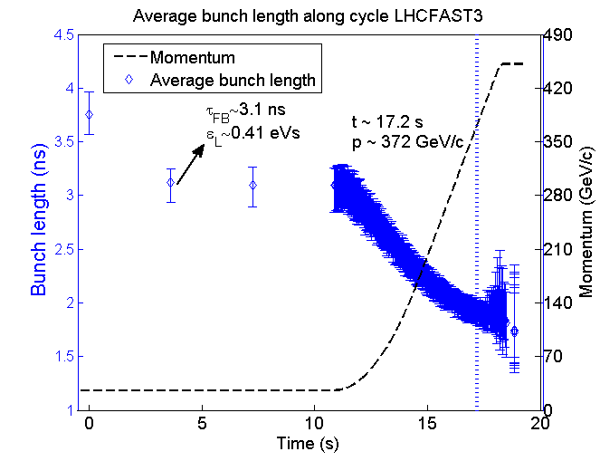
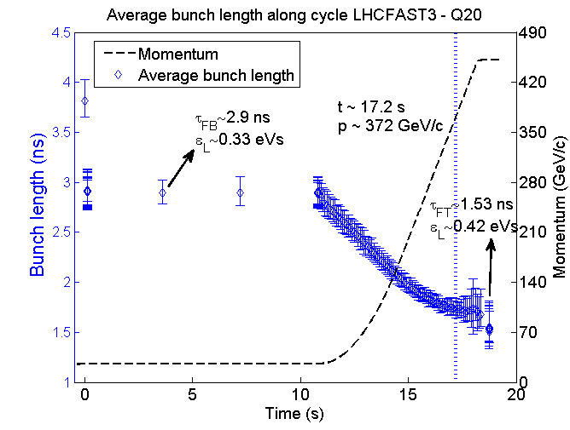
Beam stabilisation 50 ns beam, 1.6x10¹¹ p/b

Slide 30
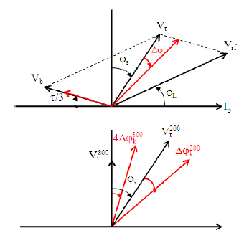
Beam induced voltage during ramp
200 MHz, 4.5 MV + FF&FB
steady
transient
800 MHz, 0.5 MV
Now the reference signal is sampled outside the beam
T. Argyropoulos et al., HB2010

