Slide 1
First results of the SPS MD in W39 with 25 ns beam in Q20 optics
J. Esteban Müller, T. Bohl, C. Lazaridis, E. Shaposhnikova
LIU-SPS BD WG 27/09/2012

Slide 2
Conditions for 25 ns
N_{b} ~ 1.1 x 10¹¹ ppb
200 MHz voltage: 4.5 MV at FB
800 MHz voltage: 10% of the 200 MHz
Longitudinal damper settings copied from the 50 ns operational beam
This needs to be checked
Blow-up:
Amplitude was changed in order to find good settings
Low frequency margin set to 0.85 (instead of 0.8)

Slide 3
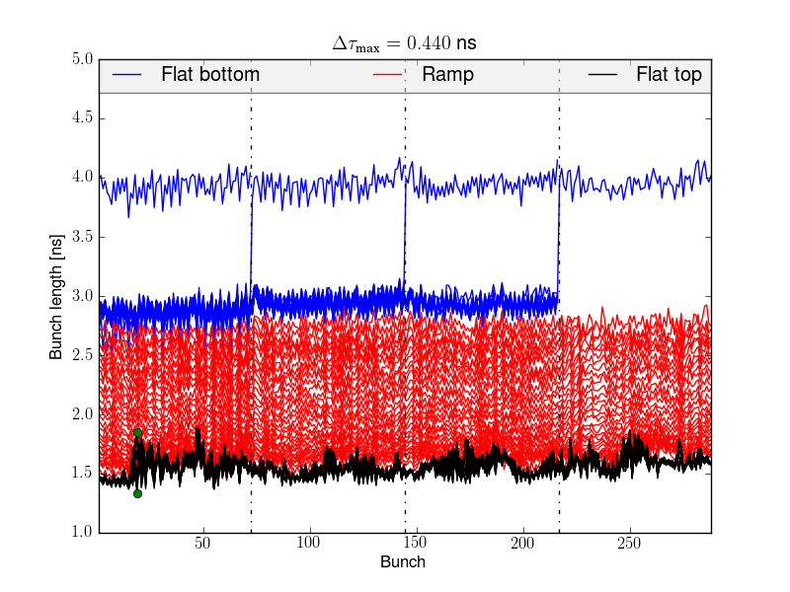
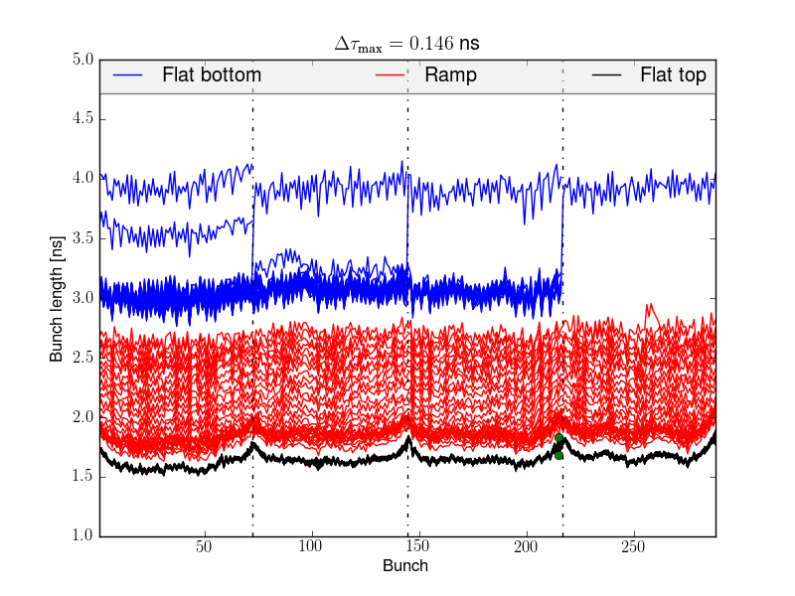
25 ns Q20
Unstable at FT without blow-up
Stable with blow-up, but the effect is stronger for bunches in the head and the tail of the batch
Blow-up needs to be optimized for this beam
Blow-up OFF
Blow-up ON

Slide 4
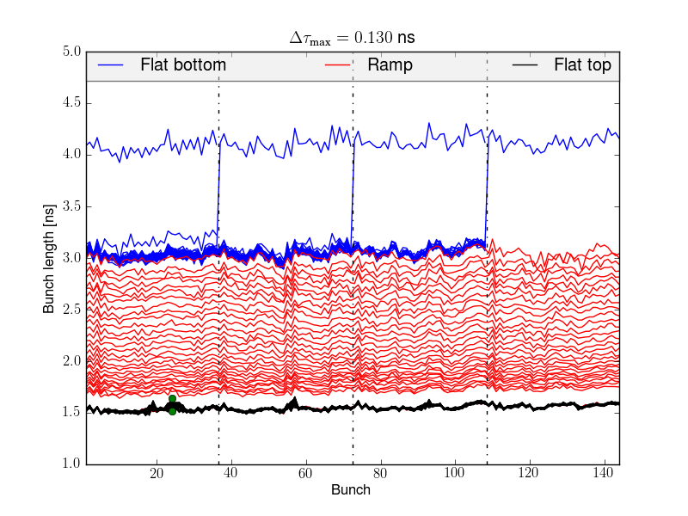
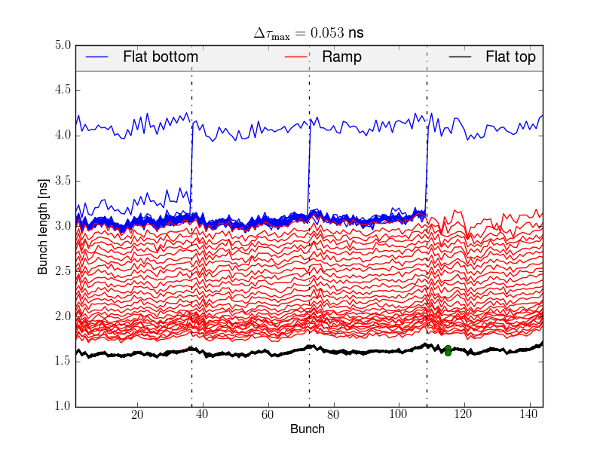
50 ns Q20 for LHC filling
N_{b} ~ 1.55 x 10¹¹ ppb
200 MHz voltage: 4.5 MV at FB
800 MHz ON
Blow-up OFF
Blow-up ON
Few bunches unstable at FT
Stable

