Slide 1
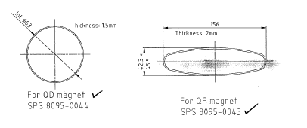
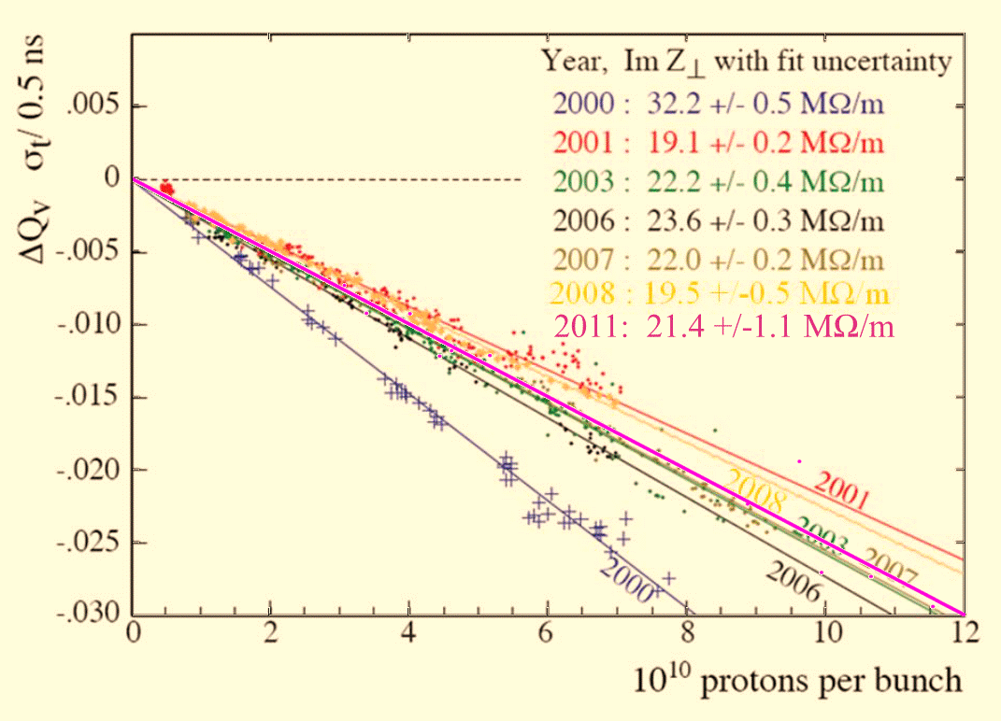
SPS transverse impedance measurements
Resistive wall budget
Kickers impedance budget
Tune shifts with intensity
Localization
Update of the SPS transverse impedance
Acknowledgement: B.Salvant , J.Albertone, C. Boccard, T.Argyropoulos, H.Bartosik, S. Gilardoni, G.Iadarola, E. Métral, M.Migliorati, J.Mueller, Y.Papaphilippou, G.Rumolo. SPS OP team, C.Zannini.

Slide 2
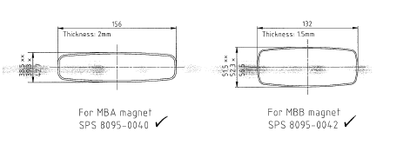
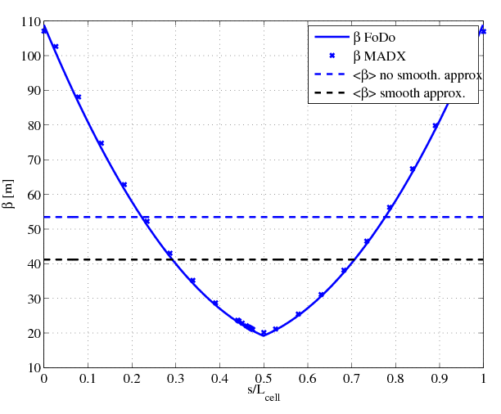
Resistive wall impedance budget:
Using the integrated beta function instead of the average beta function
#MBA=360
#MBB=384
#QD=108
#QF=108
L_{QD}=3.085m
L_{MBA}=6.26m
L_{straights}=1587m
SPS
QF
2xMBA
2xMBB
2xMBB
2xMBA
QF
QD

Slide 3

Resistive wall impedance budget:
Using the integrated beta function instead of the average beta function
#MBA=360
#MBB=384
#QD=108
#QF=108
L_{QD}=3.085m
L_{MBA}=6.26m
L_{straights}=1587m
SPS
QF
2xMBA
2xMBB
2xMBB
2xMBA
QF
QD
$$Z_{eff}∝\oint_{0}^{L}{Z(s)\frac{β\left(s\right)}{R/Q}ds}$$
The resistive wall impedance was recalculated with the Transmission Line method from Carlo, both for Q20 and Q26.
The effective impedance is 10% lower in Q20 than Q26
MΩ/m
Zx
Zy
Zx
Zy
Zx
Zy

Slide 4
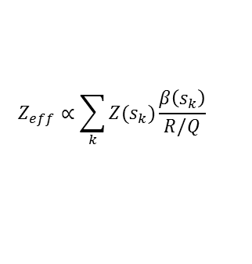
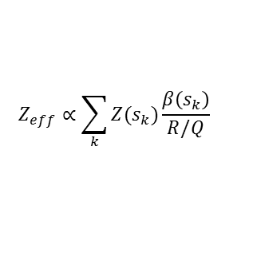
Kickers impedance budget in Q20 and Q26 with the new kicker model
$$Z_{eff}∝\sum_{k}{Z(s_{k})\frac{β\left(s_{k}\right)}{R/Q}}$$
7 MKEs out of 8 have been serigraphed.
The total kicker impedance is around
Im(Zy)=8MΩ/m in the vertical plane
Im(Zx)=900kΩ/m in the horizontal.
$$Z_{eff}∝\sum_{k}{Z(s_{k})\frac{β\left(s_{k}\right)}{R/Q}}$$
→ With the new model with serigraphed kickers, we do not predict anymore a positive tune shift for the horizontal plane.

Slide 5
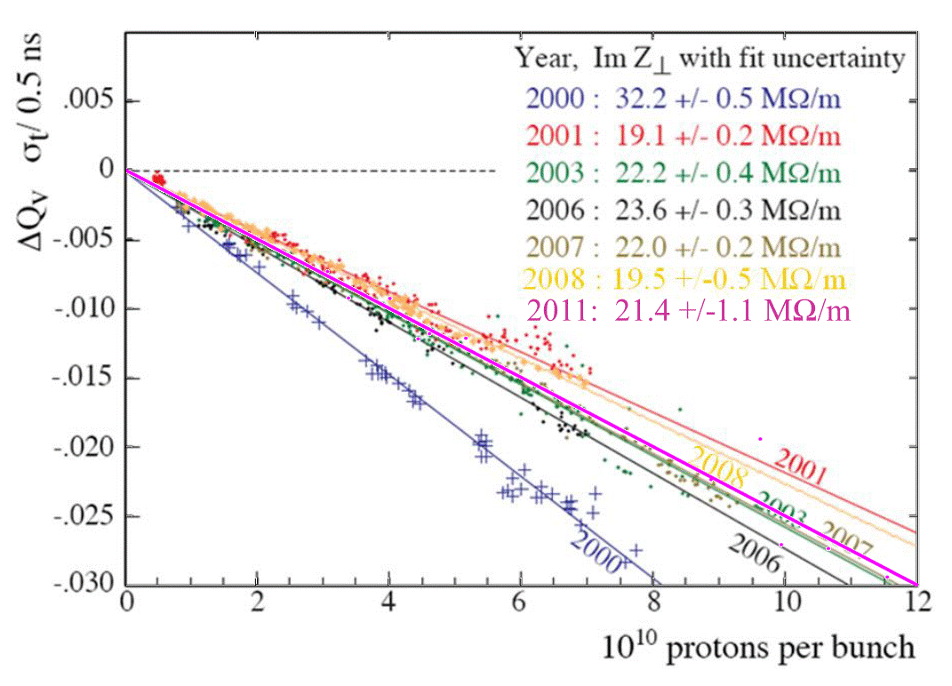
Tune shifts – Vertical plane: comparing with other years
History
(see Elias talk at SPSU 21/08/2007)
2000 → impedance removal
campaign (lepton cavities,
pumping ports, other?)
2001 → no MKE kicker
2003 → 5 MKE kickers
2006 → 9 MKE (incl. 0.5 MKEser)
2007 → 8 MKE (incl. 1.5 MKEser)
2008 → “
2009 → 8 MKE (incl. 3 MKEser)
2010 → “
2011 → 8 MKE (incl. 5 MKEser)
2012 → 8 MKE (incl. 7 MKEser)
…
2014 → 8 MKE (incl. 8 MKEser)
2011
Measurements from 27/10/2011 with a bunch of 2.7ns. To be checked with different lengths in order to see the impact of the non constant imaginary impedance spectrum.
→ The serigraphy does not seem to affect much the transverse impedance, as predicted by simulations.

Slide 6
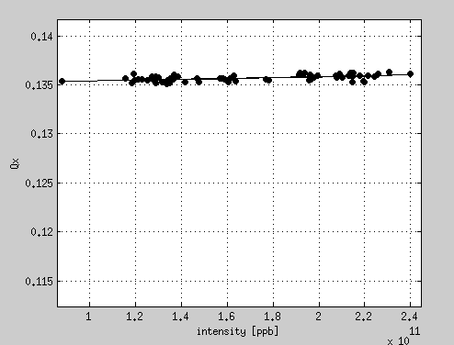
Tune shifts measurements 2012 – Horizontal plane
Estimation | Z_{eff}
Tsutsui | -1.6MΩ
Advanced | +0.8MΩ
Measurements | -0.4MΩ
Zx=-0.4 +/- 0.1 MΩ/m
Measurements from 23/04/2012 with a single bunch of 2.7ns (bunch length stable, thanks to RF colleagues for the data!).
The positive slope is still there despite the serigraphed kickers.
Are there other elements with strong horizontal quadrupolar impedance? (MSE, MST?)
measurements in the vertical plane are planned very soon

Slide 7
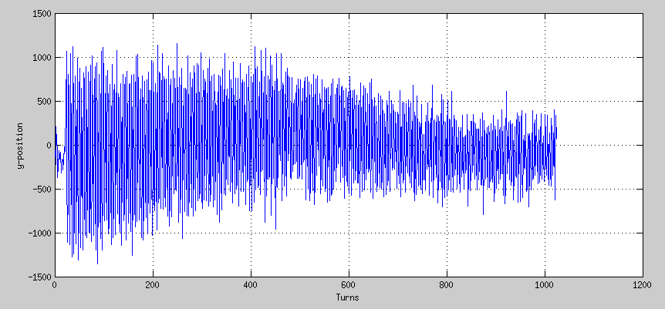
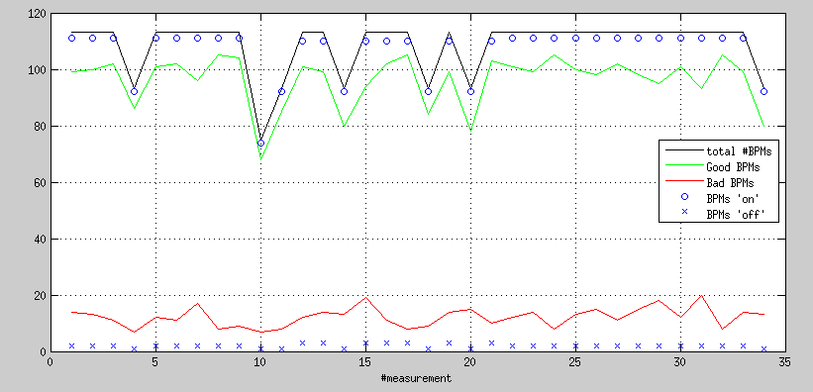
Localization: MOPOS issues during the 27/10/2011 MD
Example of a trace from an SPS shoebox
Statistics of operating BPMs (27/10/2011)
Number of BPMs
→ Noisy signal… but “good” BPM
Number of acquisitions
We had 2-3 BPMs offline and 15-17 BPMs not working properly.
80% were working, but the level of noise is not acceptable for a clean phase reconstruction.

Slide 8
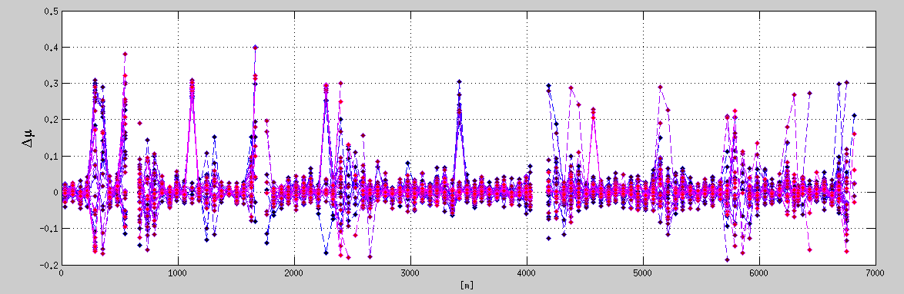
Localization: phase reconstruction
Difference of phase advance with respect to the MADX model
The measured ∆μ exceed sometimes even the tune shift! This is a problem either from the phase reconstruction side (unwrapping around MADX phase model) or from the signal itself.
In both cases an analysis of accuracy and error propagation was never done (to my knowledge) and has to be done in order to assess limits either in BPM resolution, number of Turns to be recorded, SNR (i.e. intensity range, bunch length and kick amplitude to be used).
→ More work needed, in strong collaboration with BI (C. Boccard, J. Albertone)

Slide 9
Conclusions and Next plans
The resistive wall impedance agrees with the one calculated in the past for both optics Q20 and Q26.
The kickers impedance seems to be worse in Q26 than Q20 but, for different optics, comparisons should now be done on tune shifts.
The horizontal tune shift do not match our predictions with theory. Crosschecks with headtail simulations are ongoing.
The vertical tune shift shows that the situation has been quite stable (within 15%) since 2007. We plan to repeat the measurement with shorter bunches to cover more impedance spectrum
The localization algorithm needs to be analyzed more deeply. A working point as to be defined in terms of SNR, Nturns, Intensity, Bunch length, BPM resolution, #of BPMs Vs reconstructed position.
1- MD with BI colleagues to get the best out of the MOPOS is foreseen for the next days
2- MD in PS where the orbit BPM system is newer.

Slide 14
