Slide 1

2012 SPS Scrubbing run
What has been done and a first look to the data
H. Bartosik, G. Iadarola
LIU-SPS-BD meeting 26-04-2012

Slide 2
  Acknowledgement
Many thanks to:
Theodoros A., Thomas B., Fritz C., Stephan C. C., Riccardo D.M.,
Heiko D., Mounir D. M., Juan E. M., Silke F., Fabio F., Steve H., Michael H., Wolfgang H., Holger N., Yannis P., Giovanni R., Benoit S., Elena S., Mauro T., Helga T., Adrian U., Urs W.

Slide 3
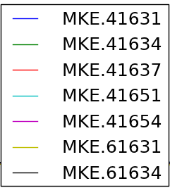
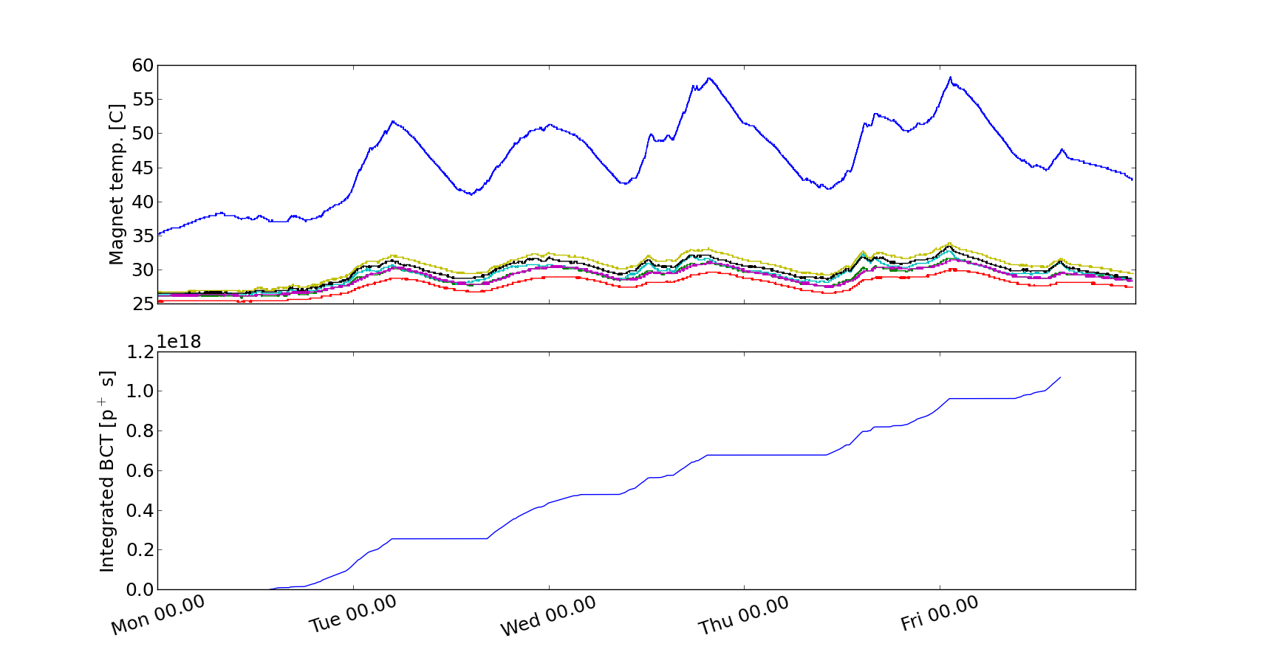
  MKE1 heating
Schedule determined MKE1 heating -> we had to alternate:
25ns beam scrubbing dose accumulation
Cool down periods
Accumulated 25ns dose

Slide 4
  MKE1 heating
Schedule determined MKE1 heating -> we had to alternate:
25ns beam scrubbing dose accumulation
Cool down periods
e-cloud studies with 50ns beam
Accumulated 25ns dose

Slide 5
  What we were measuring
  Large amount of data acquired:
  e-cloud evolution on StSt liner in the e-cloud monitor
  accumulation of electron dose on the StSt removable sample
  e-cloud measurements with shielded pickup
  e-cloud measurements with microwave transmission technique
  Pressure measurements with gauges along the entire ring
  Bunch by bunch pickup (for bunch by bunch tune and intra-bunch motion)
  Beam quality parameters (BCT, FBCT, bunch length, transverse emittance…)

Slide 6
  Studies
  E-cloud measurents:
  Producing uncaptured beam
  With different batch spacings
  With different bunch lengths
  With microbatch filling scheme
  With different orbit bumps at ECM location
  Pressure rise in long coated vacuum chambers
  E-cloud instability studies (low chromaticity)
  Bunch by bunch emittance measurements for 25ns beams
  Injected ultimate intensity for 25ns beam (1.8e11 ppb up to 3 bathes NOT accelerated)
  PS -> SPS transmission studies

Slide 7
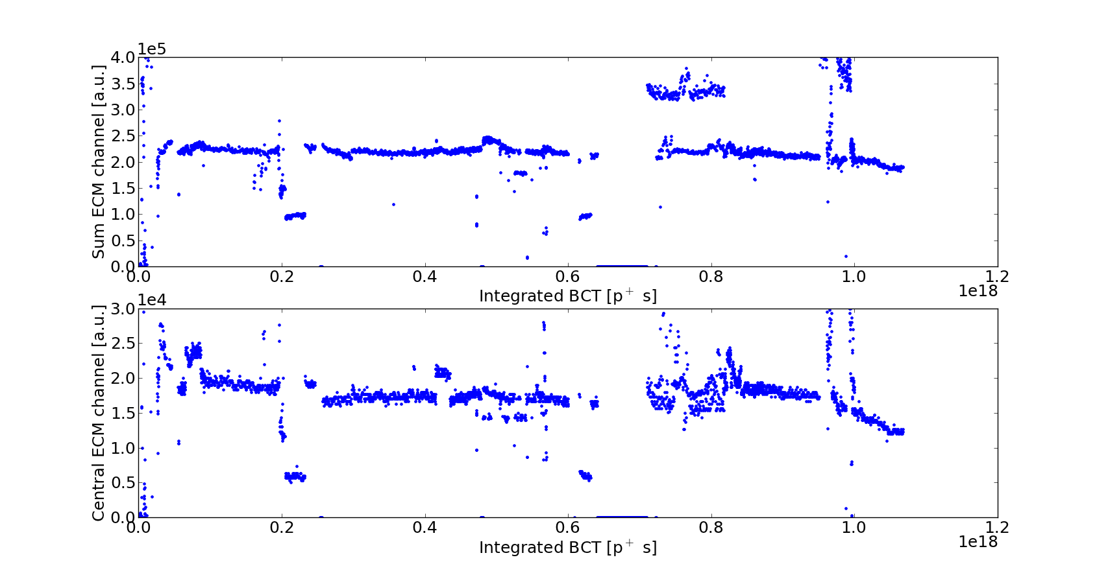
  Scrubbing on the StSt liner: 2012

Slide 8
  Scrubbing on the StSt liner: 2012

Slide 9
  Scrubbing on the StSt liner: 2012
To understand

Slide 10
  Scrubbing on the StSt liner: 2012
High intensity (1.8e11 ppb)

Slide 11
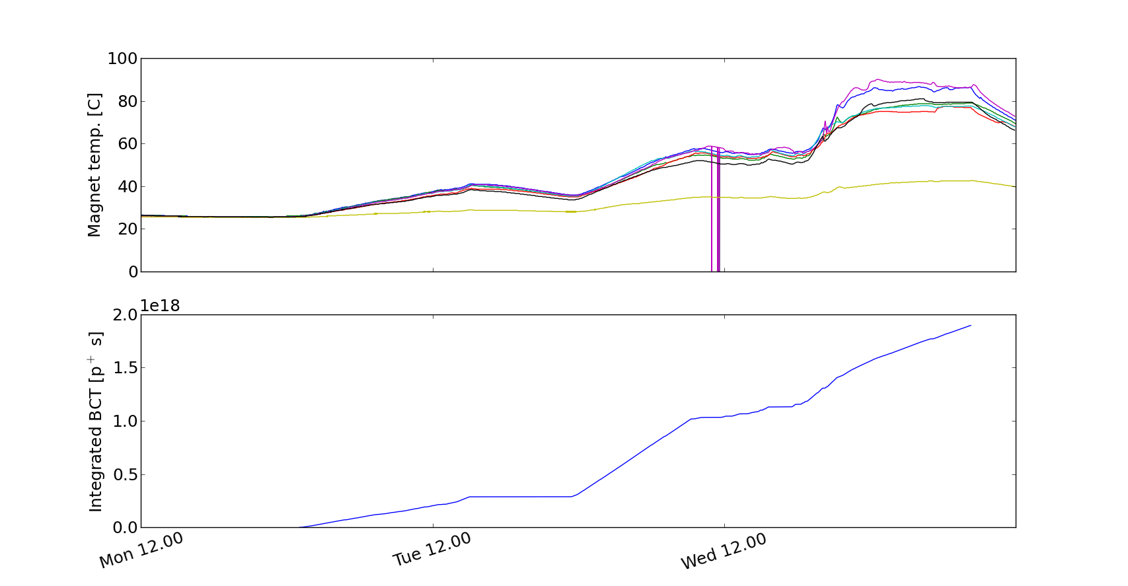
  Scrubbing on the StSt liner: a look to 2008

Slide 12
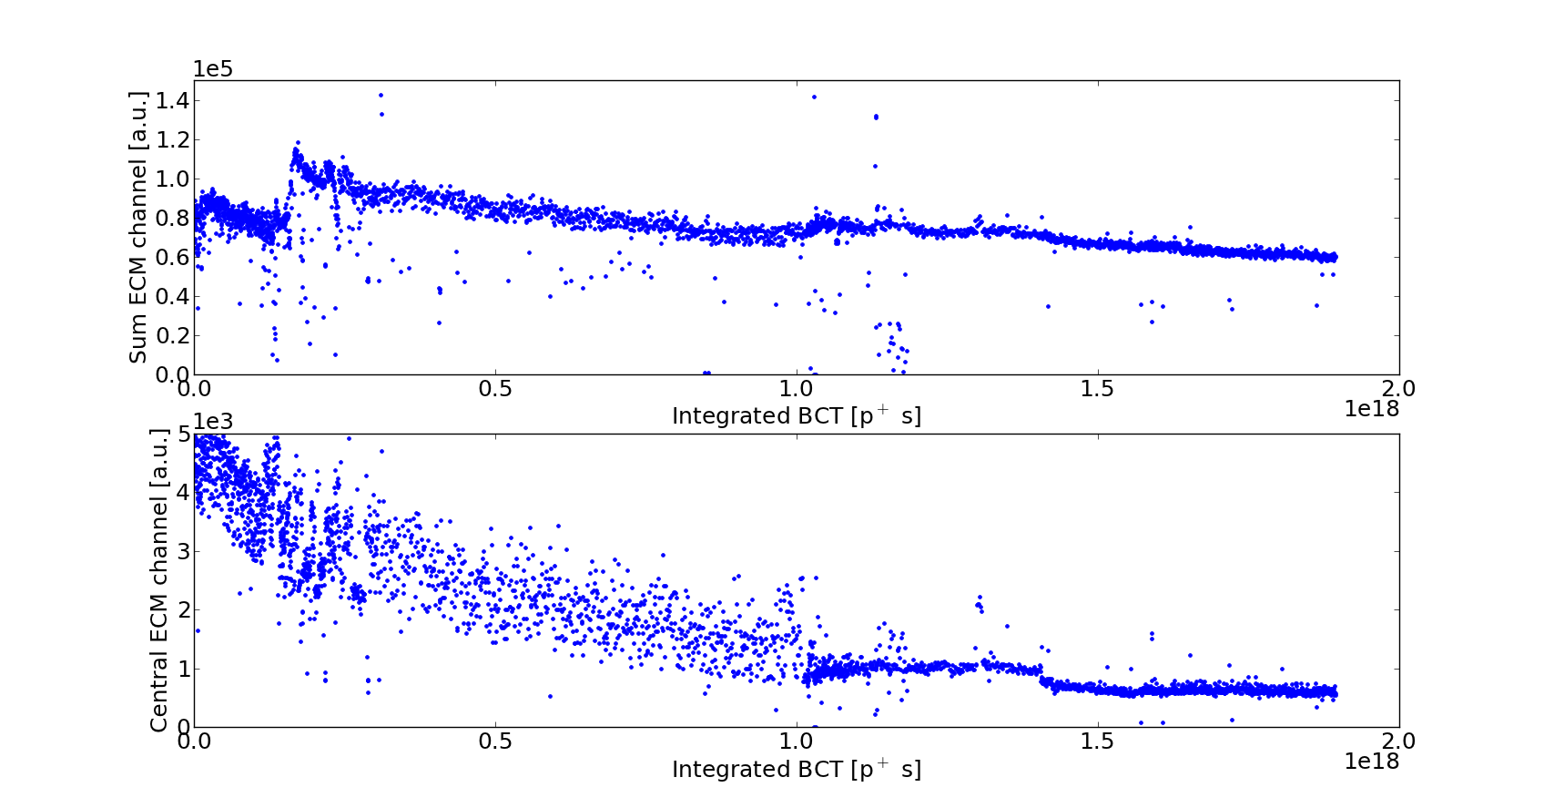
  Scrubbing on the StSt liner: a look to 2008

Slide 13
  Scrubbing on the StSt liner: a look to 2008
~30%
x5

Slide 14
  Scrubbing on the StSt liner: a look to 2008
First stage with 0.8e11 ppb

Slide 15
  Scrubbing on the StSt liner: a look to 2008
What happens here?

Slide 16
  Scrubbing on the StSt liner: 2012
B = 0.12T
B = 0
B = 0.12T

Slide 17
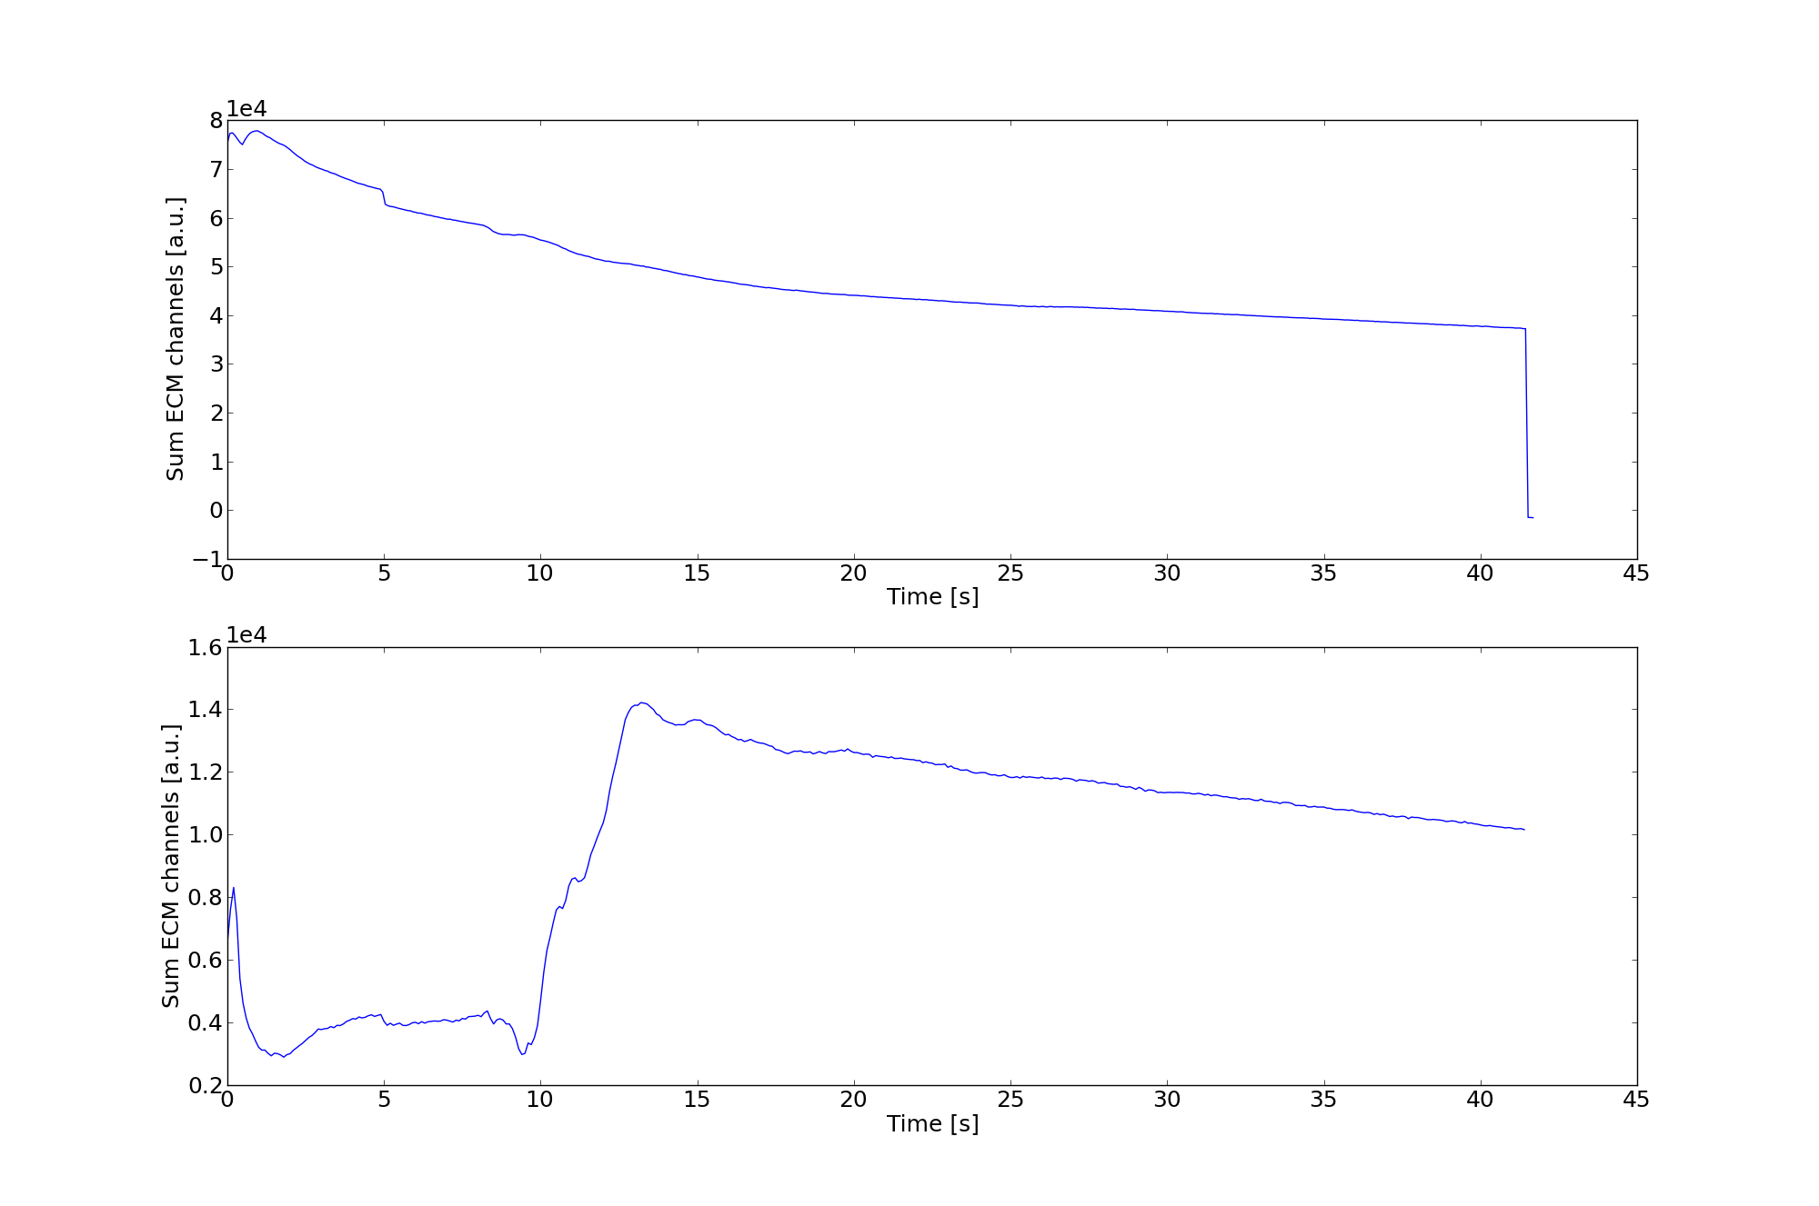
  Uncaptured beam - 2008
StSt liner
aC coated liner

Slide 18
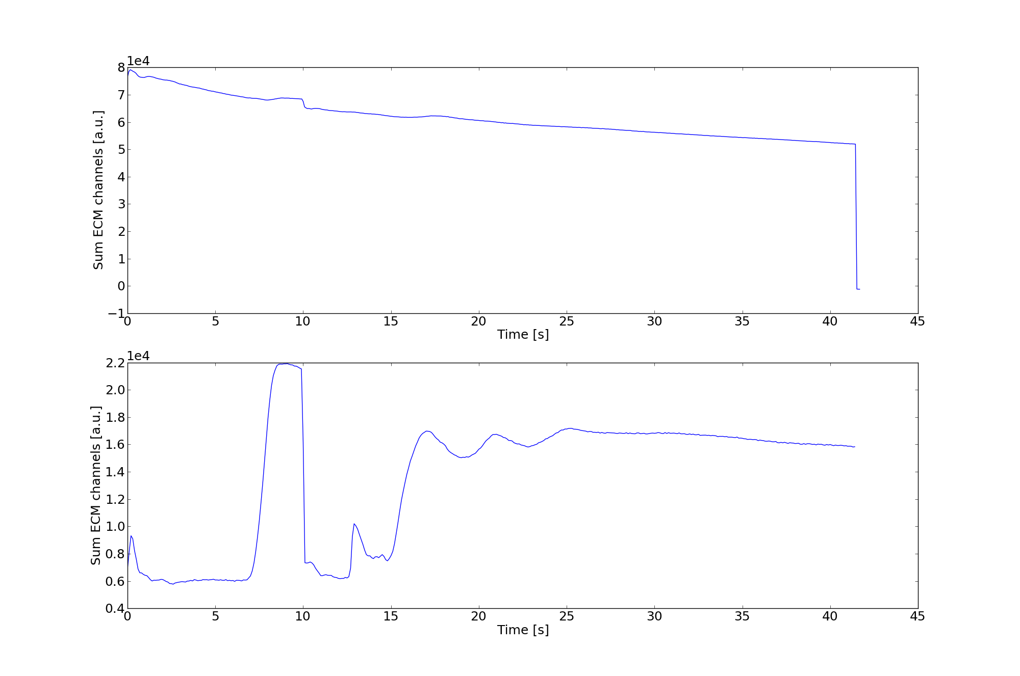
  Uncaptured beam - 2008
Kick out uncaptured beam
StSt liner
aC coated liner

Slide 19
  Shielded pick-up measurement
Raw data
20MHz high pass filtered

Slide 20
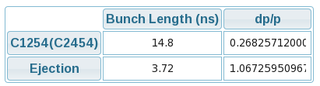
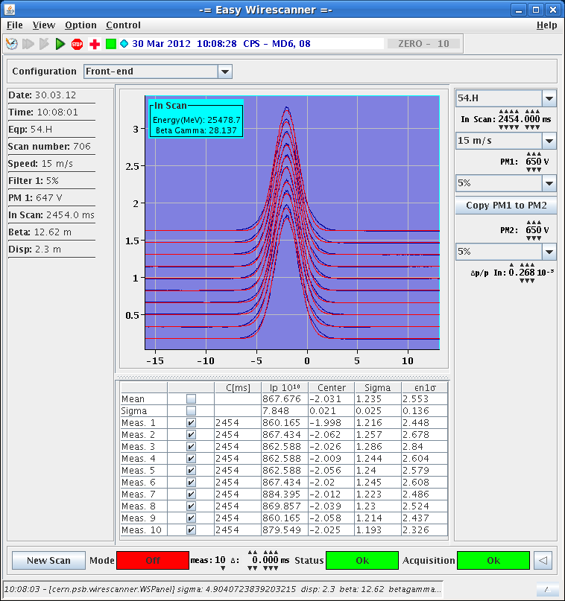
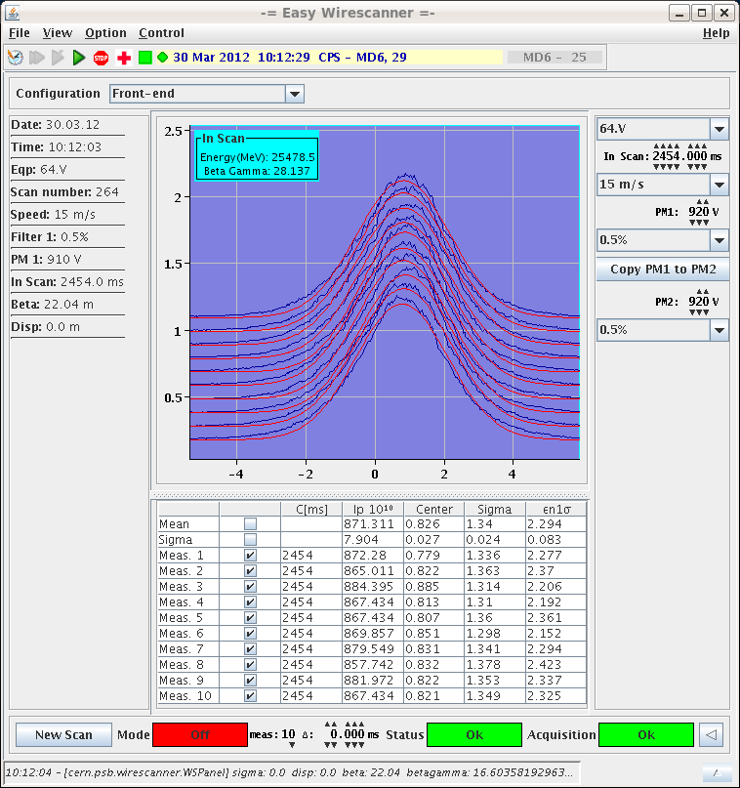
  Beam characteristics from PS – 25ns “nominal”
  ~1.25e11p/b
  εh~2.6μm / εv~2.3μm
  ε_{l}~0.3eVs/τ_{l}~3.7ns

Slide 21
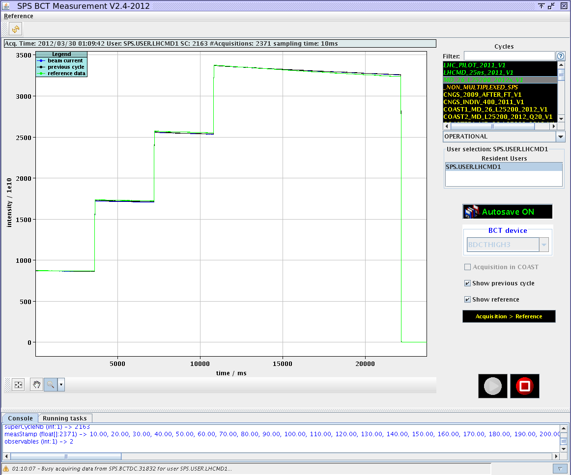
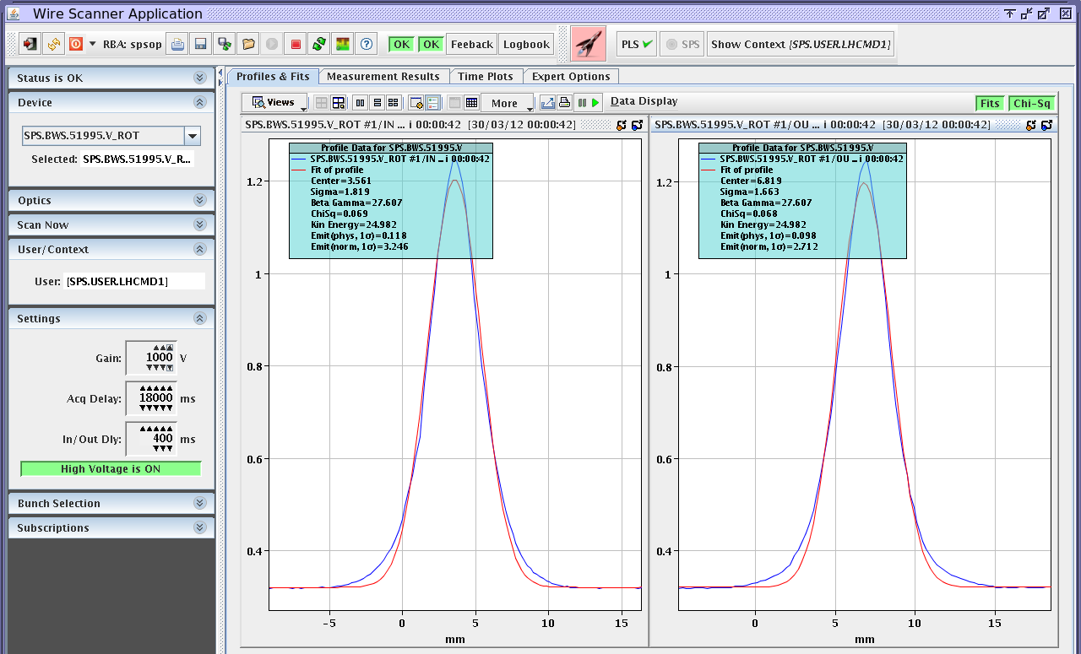
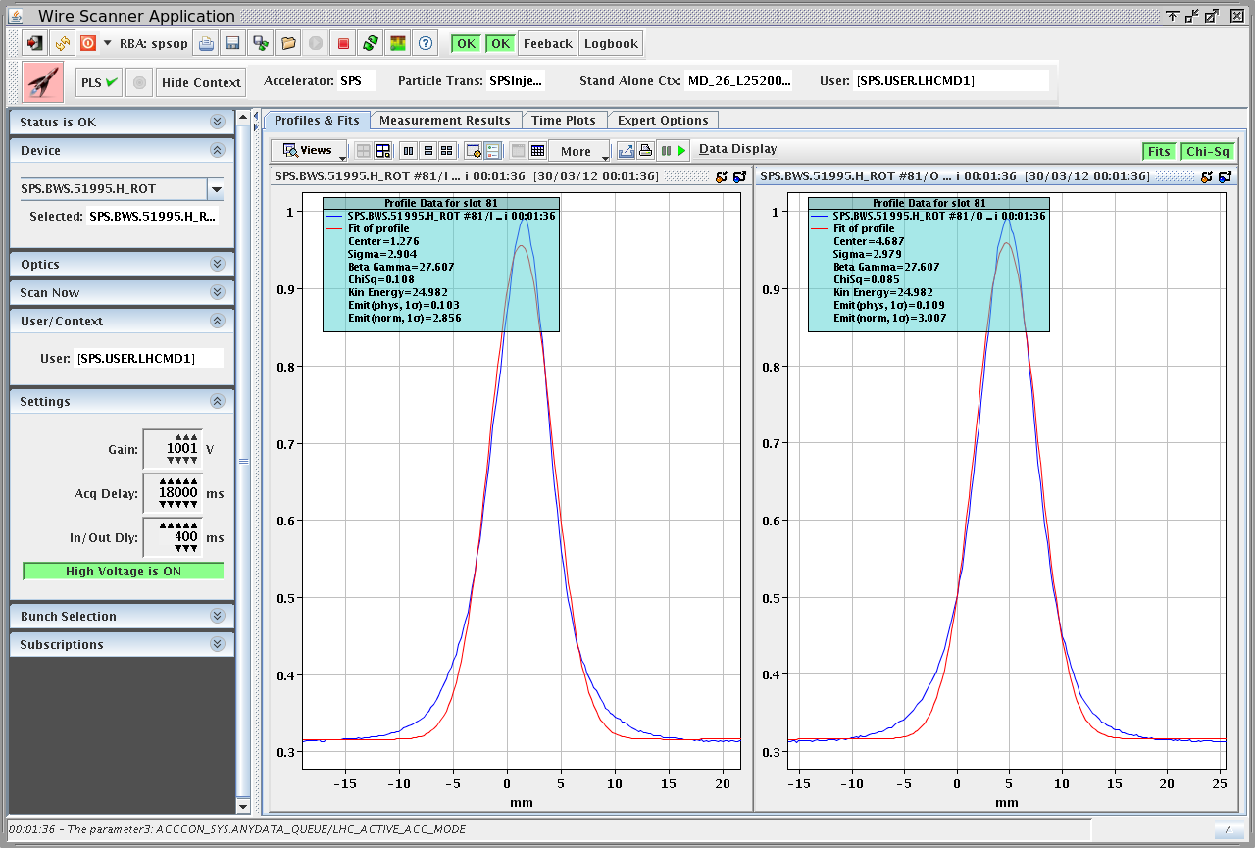
  Beam characteristics end of flat bottom – 25ns “nominal”
  Injected around 1.25e11p/b
  ε_{h}~2.9μm / ε_{v}~3.0μm (WS519 at 18s)
  ε_{h}~2.5μm / ε_{v}~2.8μm (WS416 at 11s)

Slide 22
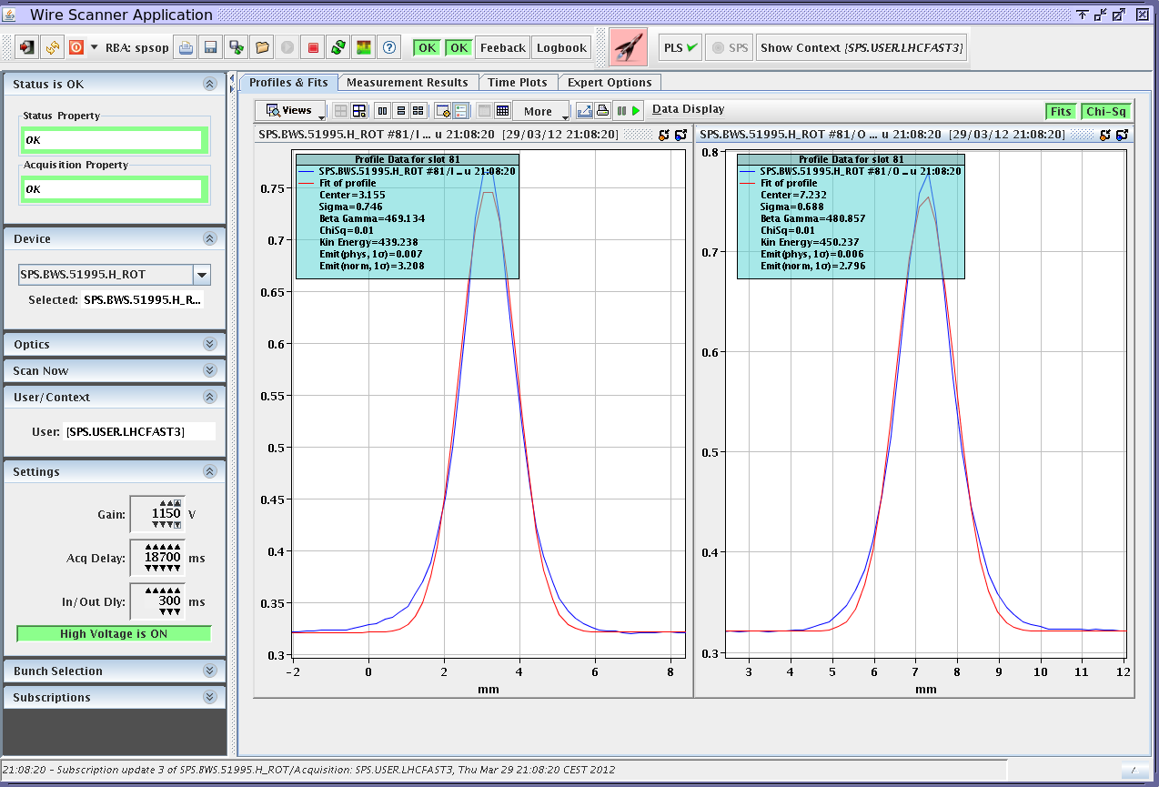
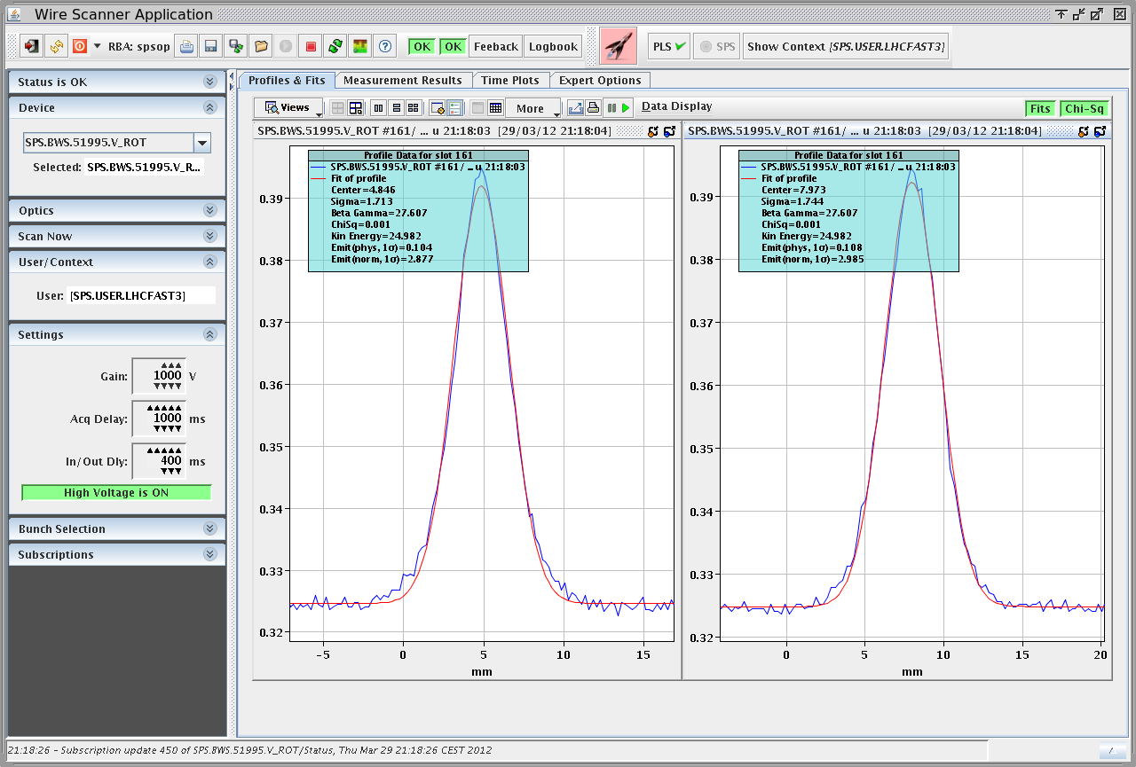

  Beam characteristics flat top – 25ns “nominal”
  ε_{h}~3.0μm/ε_{v}~2.9μm (WS519) after injection of first batch
  ε_{h}~3.0μm/ε_{v}~2.9μm (WS519) at flat top for 3 batches
  Almost no blow-up along flat bottom and along the ramp?
  Possible blow-up right at/after injection?

Slide 23
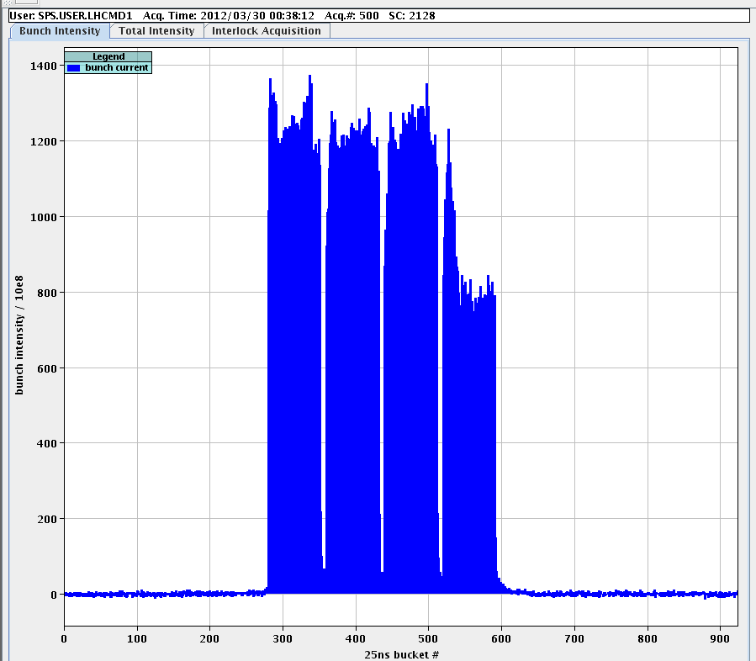
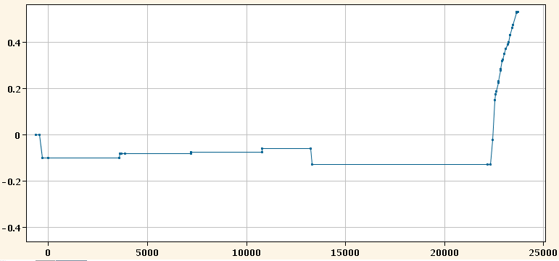
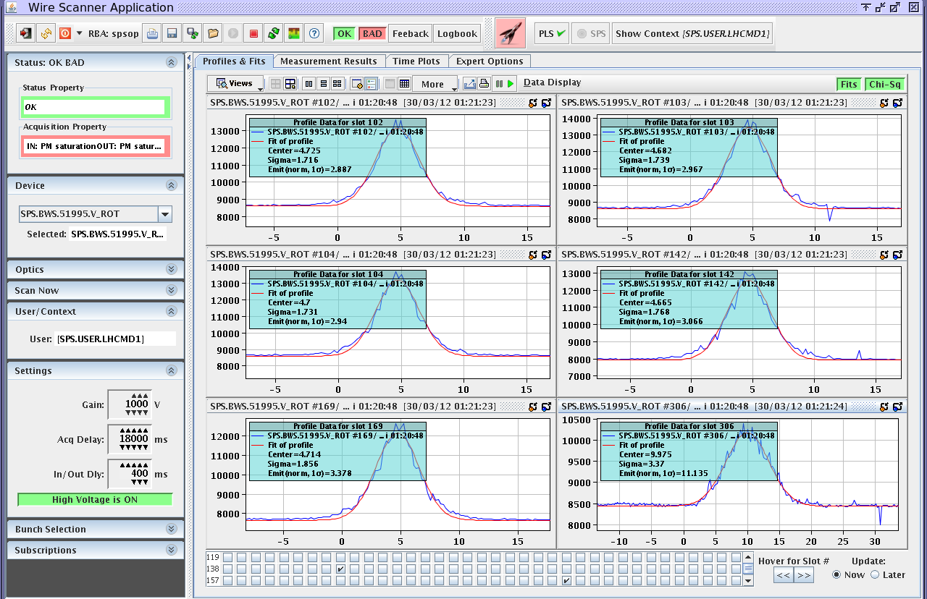
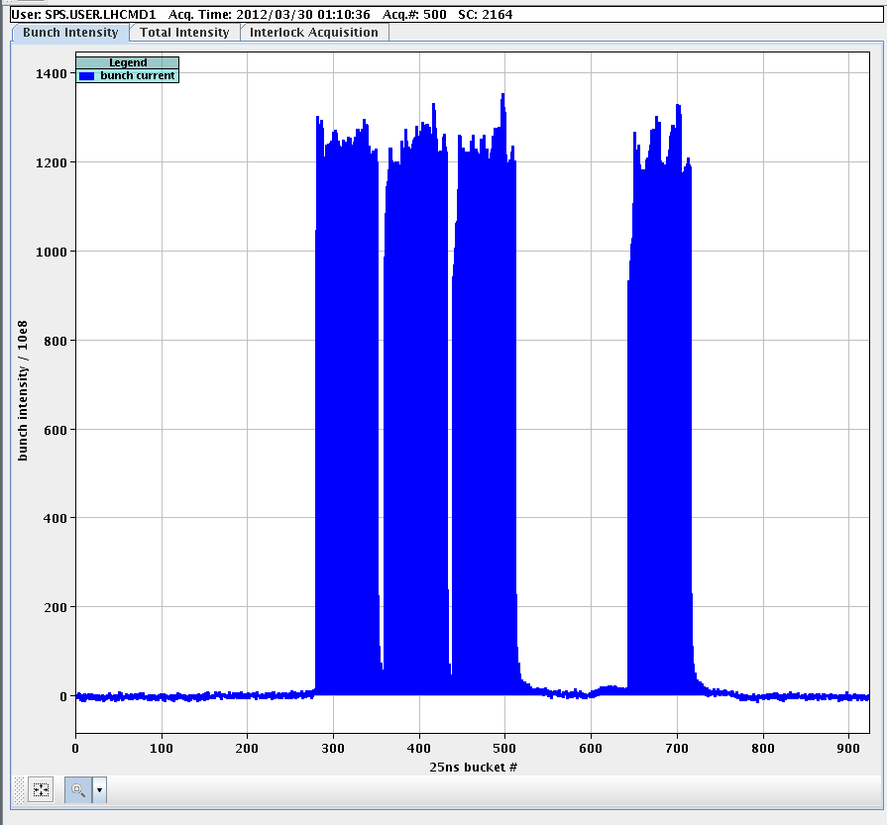
  ?Ecloud? instability with 4 batches 25ns “nominal”
Losses on tail of 4th batch
Lowering chromaticity after 4th injection …
Large emittance for bunches with losses
No instability for this bunch pattern

Slide 24
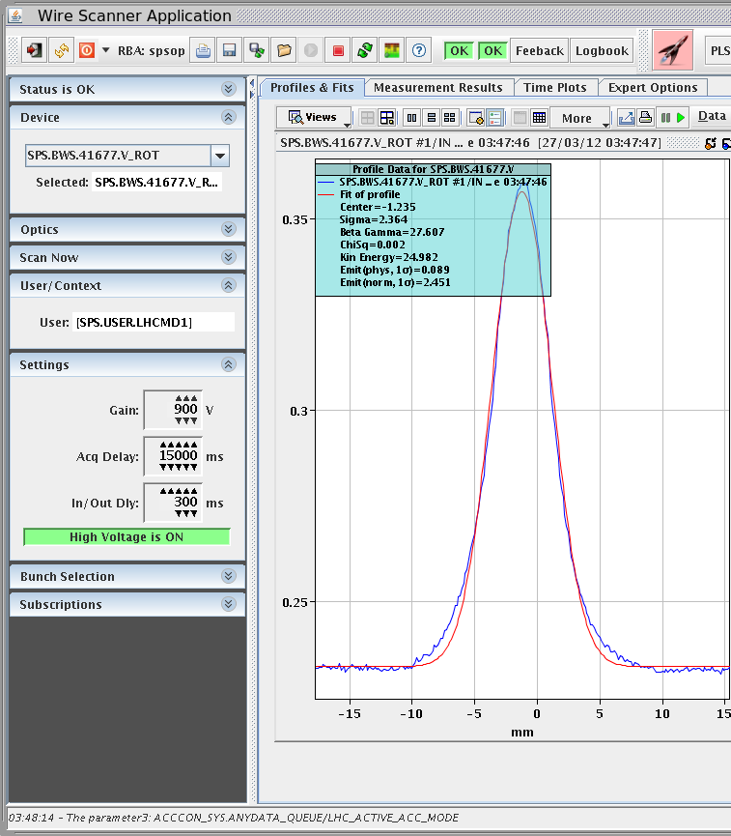
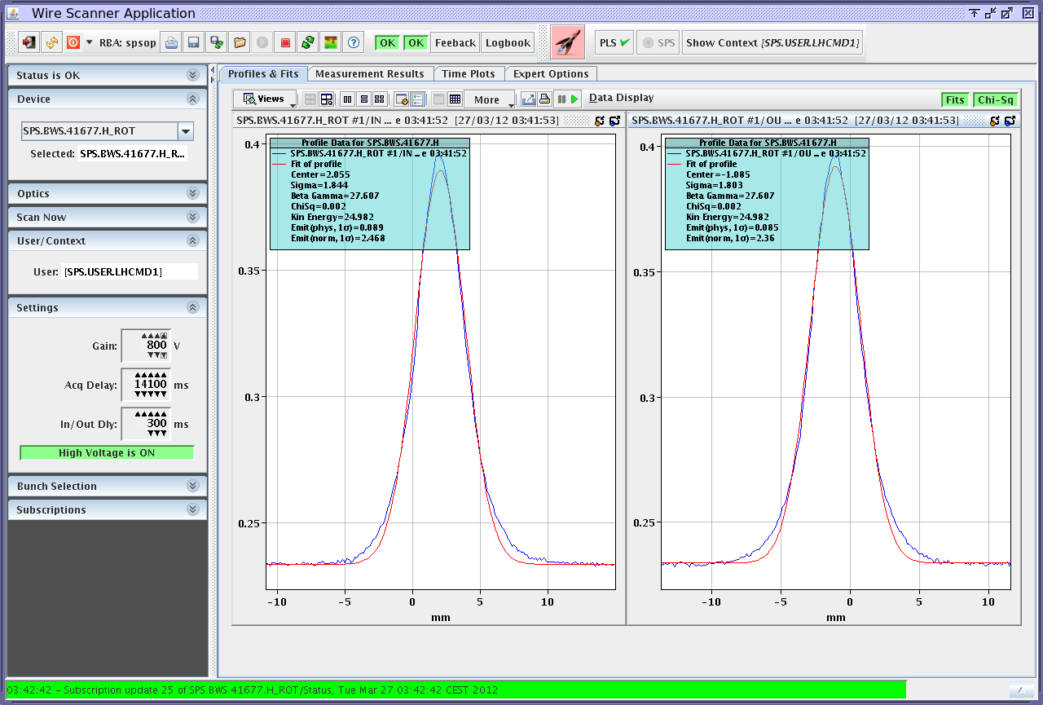
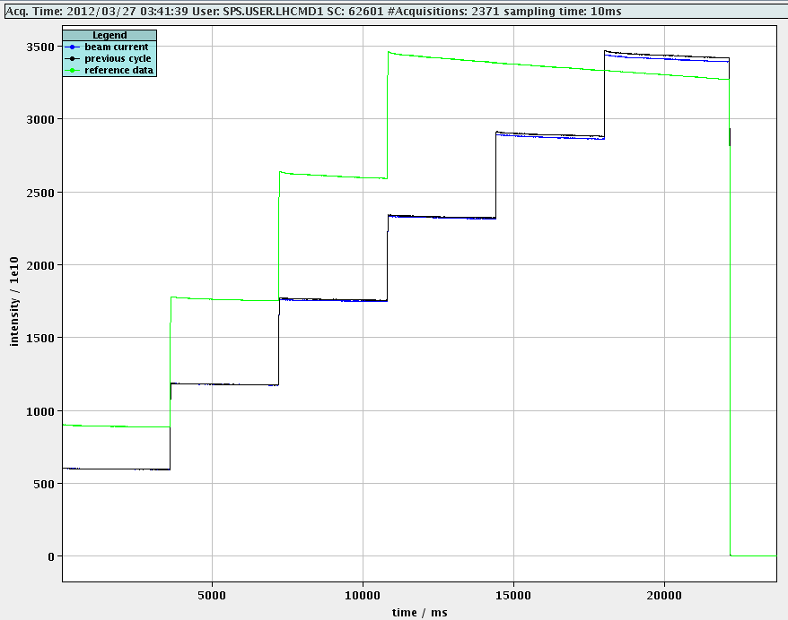
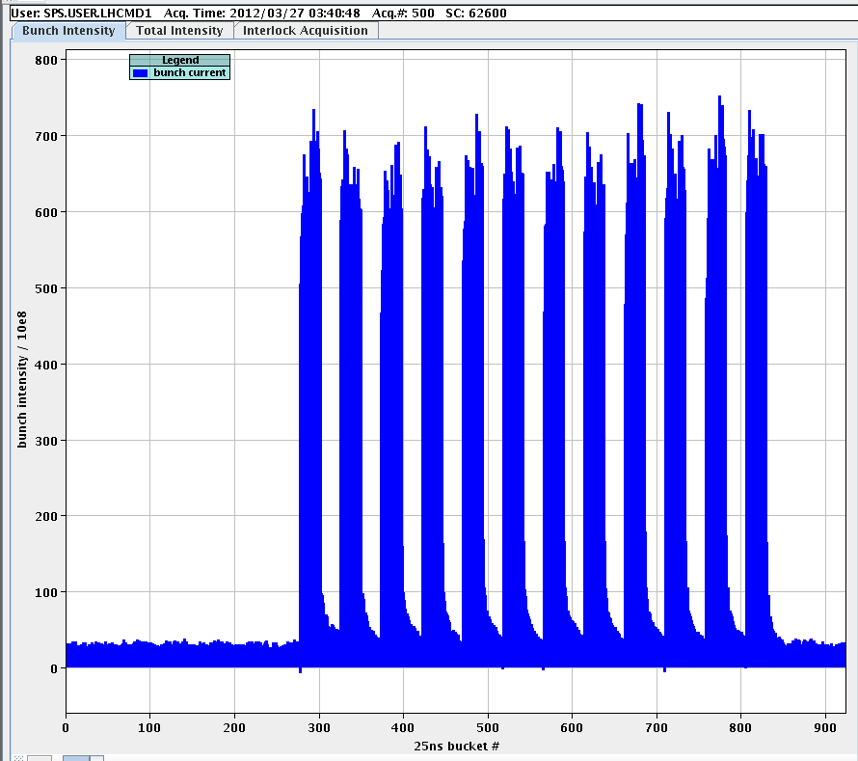
  Beam characteristics – Microbatch scheme
  6x 2x(24 bunches + 24 empty)
  Less vacuum activity
  EFB around 1.18e11p/b
  ε_{h}~2.5μm/ε_{v}~2.5μm (WS416) after injecting 5th batch
  Better lifetime for 288 bunches

Slide 25
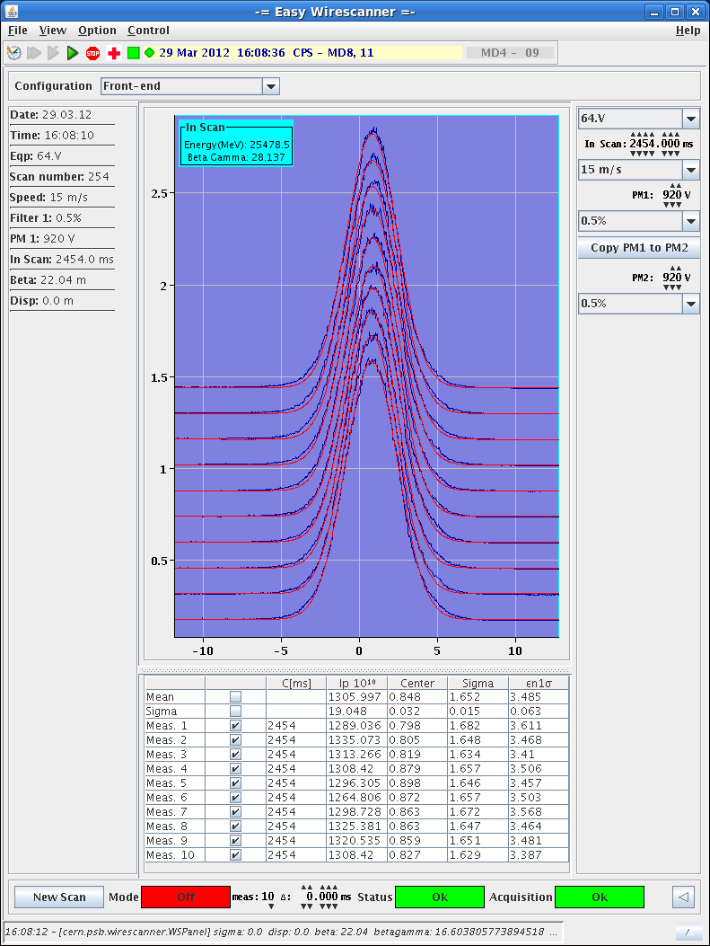
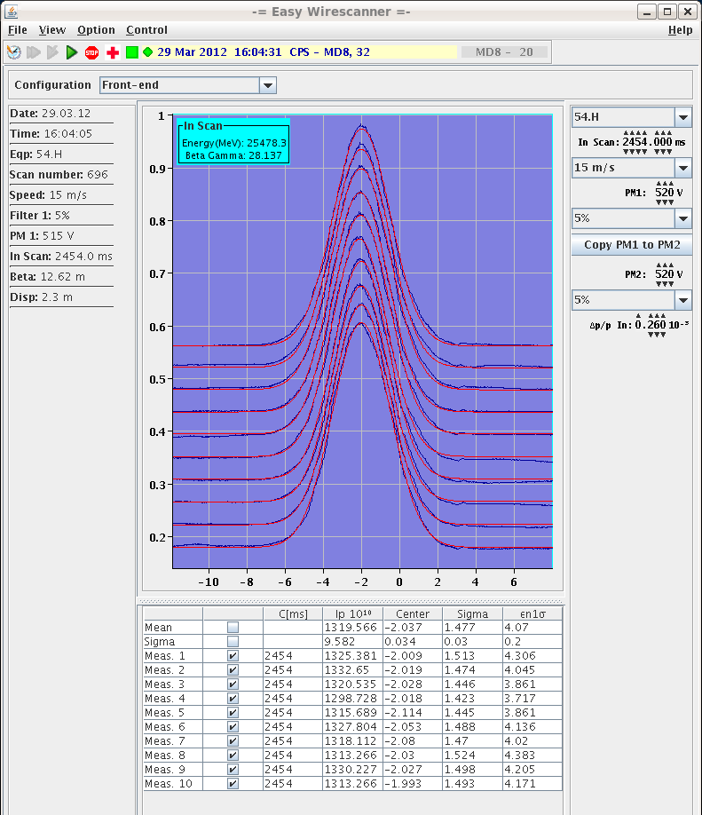
  Beam characteristics from PS – 25ns “ultimate”
  N~1.8e11p/b
  ε_{h}~4.1μm/ε_{v}~3.5μm
  ε_{l}~0.34eVs/τ_{l}~4.1ns

Slide 26
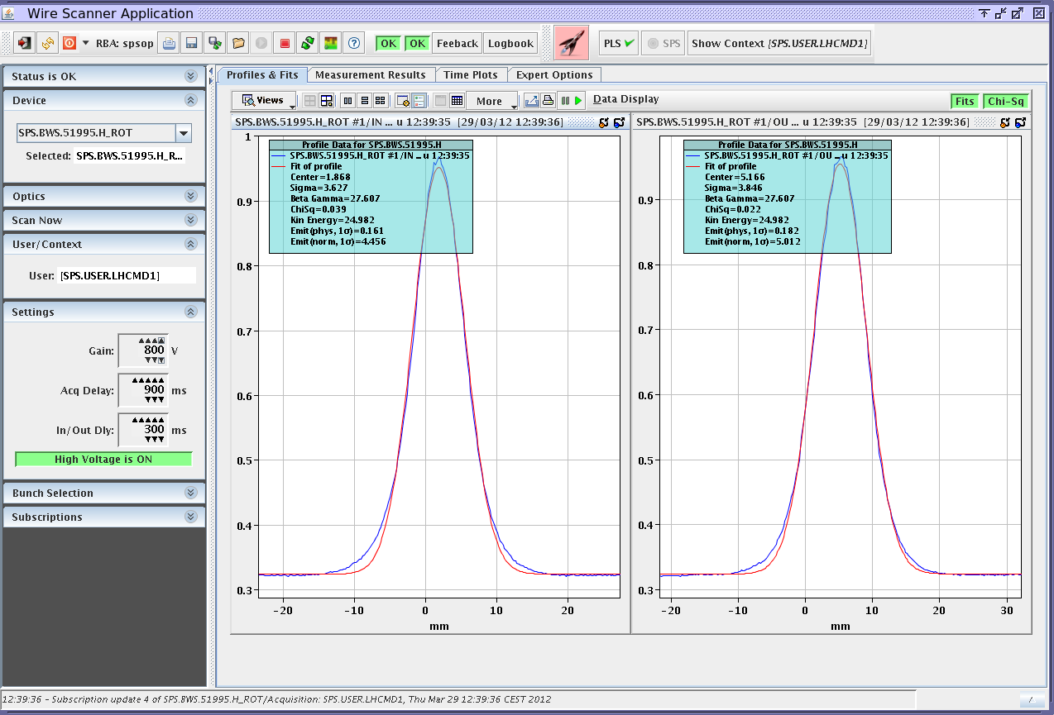
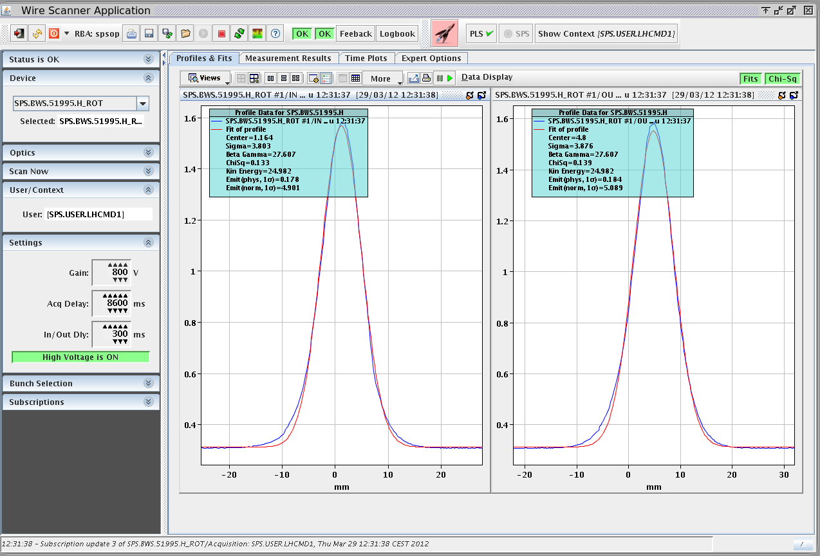
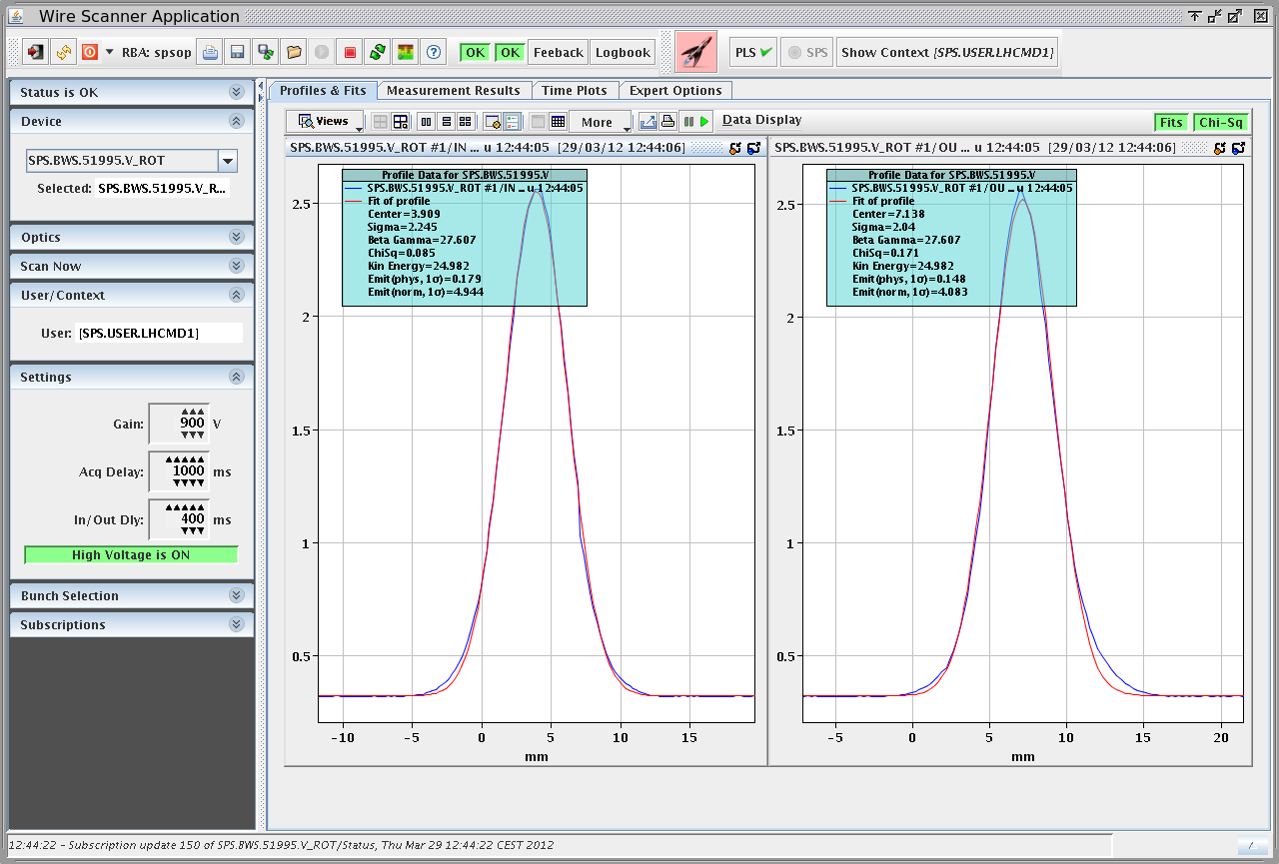
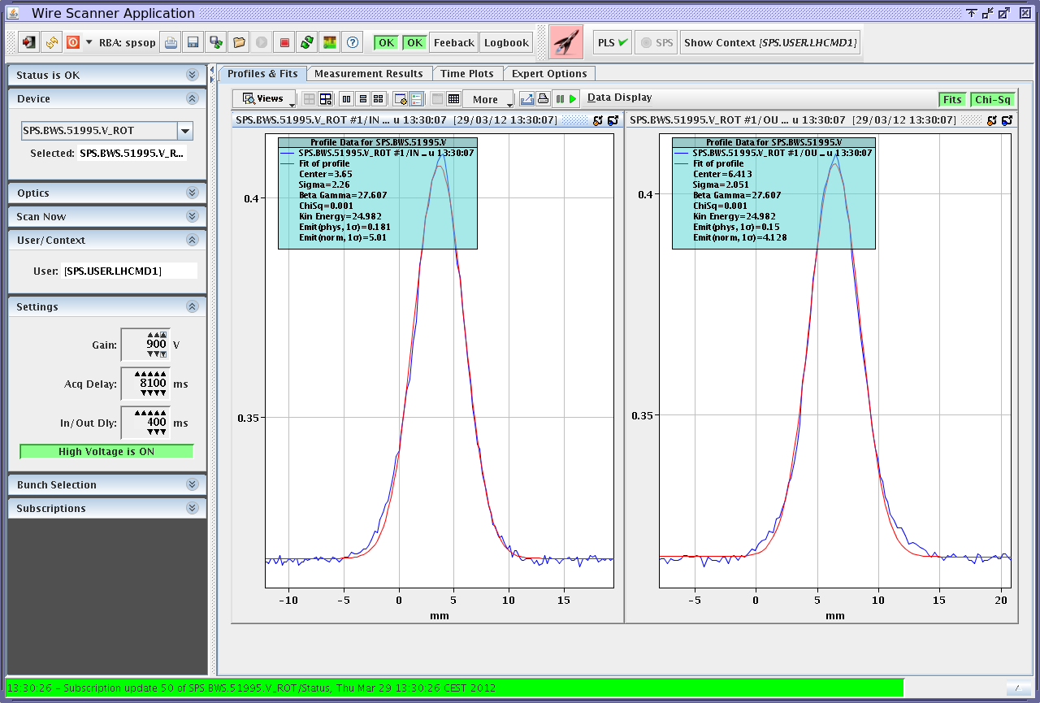
  Beam characteristics end of flat bottom – 25ns “ultimate”
  2 (3 for short time) of 25ns ultimate beam (1.8e11p/b injected)
  Blow-up right at injection? (remember also problem with injection kicker rise time …)
ε_{h}~4.7μm close to injection of first batch
Ε_{h}~5.0μm @8s
ε_{v}~4.5μm close to injection of first batch
ε_{v}~4.5μm @8.1s

Slide 27
Thanks for your attention!

Slide 28
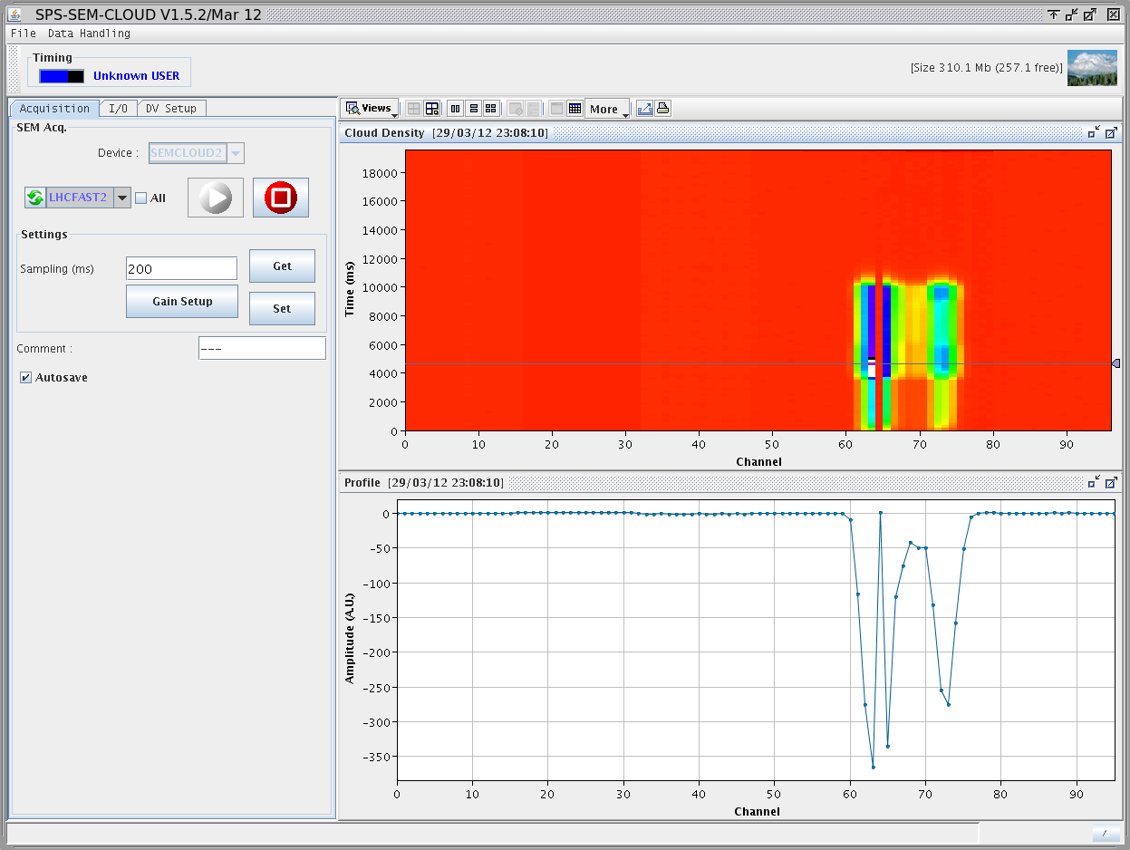
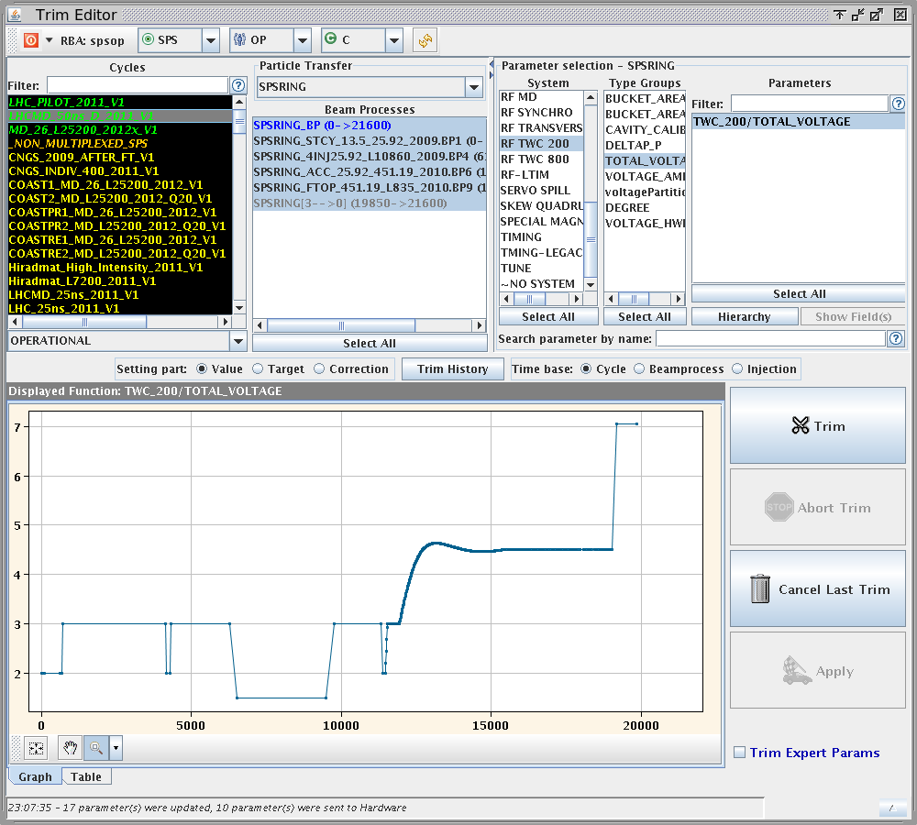
  Effect of bunch length

Slide 29
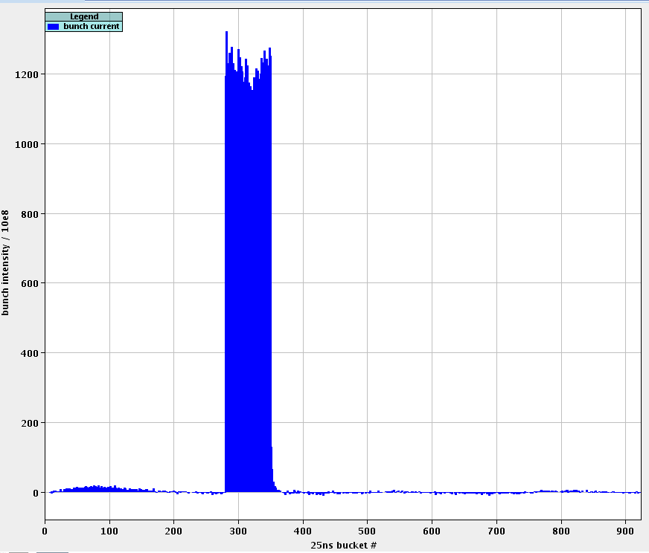
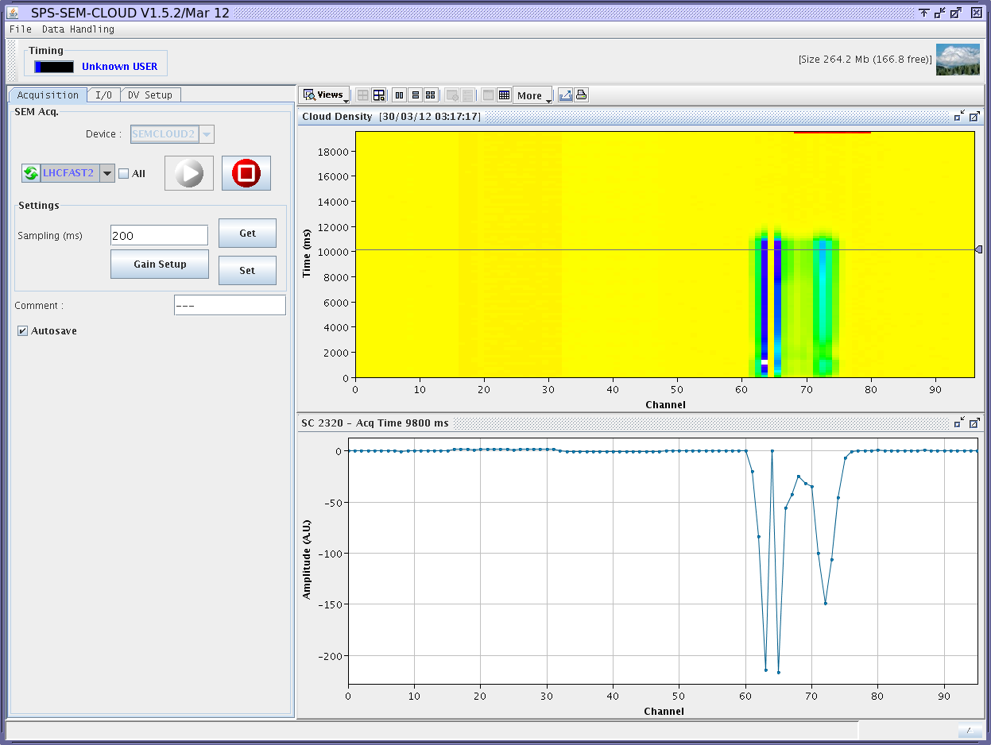
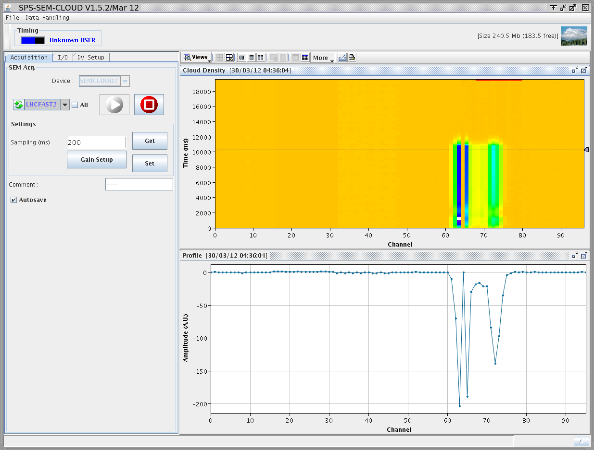
  Uncaptured beam
  Small effect but quite repeatable

Slide 30
  Shielded pick-up measurement – 08/03/2012

Slide 31
  Monday 26-03-2012
MKE1
cool-down (~3h)
Setup 25ns Q26 cycles
No beam
(Injection septum ~4h)
No beam (PS ~1h)
Set MKQV for uncaptured beam cleaning
Problem with PSB kicker -> tests on micro-batch filling scheme
Dalay last batch position to study ecloud decay
(on microbatch and nominal 25)
LHCMD2 (25ns Q20 26GeV)
LHCFAST2 (50ns Q26 accel)
LHCMD1 (25ns Q26 26GeV)
LHCFAST3 (25ns Q26 accel)

Slide 32
  Tuesday 27-03-2012
Decreasing number of batches to limit MKE1 heating
MKE1
cool-down (~4h)
Setup 25ns Q20 cycle
No beam
(Access BA5 ~3h)
No beam
(PS - SPS synchro ~1.5h)
Dalay last batch position to study ecloud decay
(on 50ns beam)
Tests on uncaptured beam
Investigating longitudinal instability
Switch off/on ion pumps near ecloud monitors
LHCMD2 (25ns Q20 26GeV)
LHCFAST2 (50ns Q26 accel)
LHCMD1 (25ns Q26 26GeV)
LHCFAST3 (25ns Q26 accel)

Slide 33
  Wednesday 28-03-2012
MKE1 cool-down
No beam (PS ~1h)
No beam (RF ~1h)
Finish damper settings on Q20
Tests on
aC coated drift
Solved longitudinal instability on LHCMD1 cycle (feedback gain)
Study effect on ecloud of bunch length and uncaptured beam
Bunch by buch emittance measurements
Tests on clearing electronde
(B scan in ecloud monitor)
Dalay last batch position to study ecloud decay
(on 50ns beam)
LHCMD2 (25ns Q20 26GeV)
LHCFAST2 (50ns Q26 accel)
LHCMD1 (25ns Q26 26GeV)
LHCFAST3 (25ns Q26 accel)

Slide 34
  Thursday 29-03-2012
Pressure interlock on MKE
Transverse stability for low chromaticity Q26
MKE1 cool-down
No beam (Vac. valve ~1h)
No beam
(MKE vacuum ~1h)
No beam (PS ~1h)
Orbit bump
High intensity tests (25ns 1.8e11ppb up to 3 batches)
PS-SPS stransmission studies
Bunch length study
Dalay last batch position to study ecloud decay
(on 50ns beam)
Uncaptured beam study
Orbit bump for ecloud localiz.
LHCMD2 (25ns Q20 26GeV)
LHCFAST2 (50ns Q26 accel)
LHCMD1 (25ns Q26 26GeV)
LHCFAST3 (25ns Q26 accel)

Slide 35
  Friday 30-03-2012
Transverse stability for low chromaticity Q20
Orbit bump (25ns)
Meas. with B=0 at ecloud monitors
LHCMD2 (25ns Q20 26GeV)
LHCFAST2 (50ns Q26 accel)
LHCMD1 (25ns Q26 26GeV)
LHCFAST3 (25ns Q26 accel)

Slide 36
  Scrubbing?
8 - 03 - 2012 – Different calibration
26 - 03 - 2012
30 - 03 - 2012

Slide 37
  Scrubbing?
8 - 03 - 2012 – Different calibration
26 - 03 - 2012
30 - 03 - 2012

Slide 38
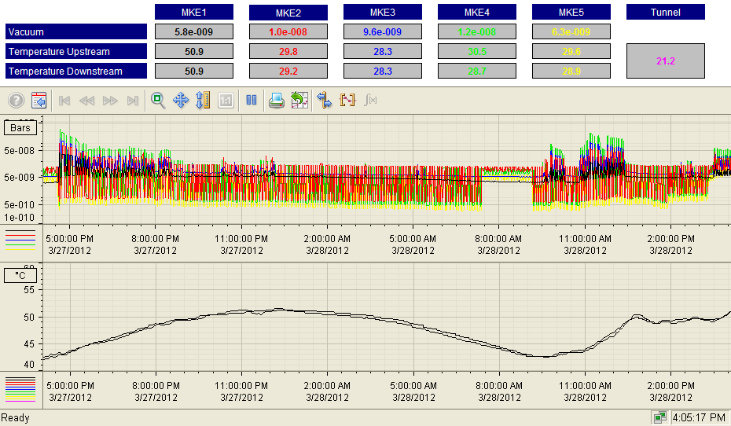
  Kicker heating

