Slide 1
Q20 optics for FT/CNGS beam
E. Shaposhnikova
LIU SPS-BD meeting,
26.01.2012

Slide 2
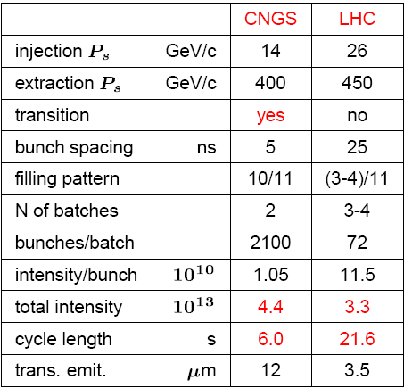
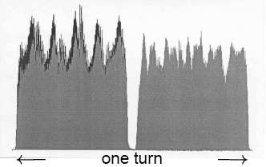
SPS beams
Nominal parameters of two main types of proton beam in the SPS
FT/CNGS beam from PS:
practically debunched beam
5-turn extraction
no bunch-to-bucket transfer
injection below transition
high intensity
LHC beam fills half of the ring and FT/CNGS beam – whole ring

Slide 3
LAGUNA-LBNO FP7 Design Study WP4: LB ν beams, detector magnetization
Task 4.1: Study of impact of CERN SPS accelerator intensity upgrade to ν beams
intensity reach of SPS within the foreseen LIU project
identify limitations to reach ≃750kW of beam power for νs (total beam intensity ~ 7x10¹³)
WP4: Ilias Efthymiopoulos

Slide 4
LIU-SPS upgrades
Main difference between the two beams:
injection at 14 GeV/c and transition crossing => different beam control (LLRF)
CNGS beam fills whole ring and LHC beam fills half of the ring => different requirements for beam power (continuous regime and possible pulsed regime)
bunch spacing => multi-bunch effects (CB instabilities, heating…)
CNGS-type beam will profit from planned LIU-SPS upgrades:
impedance reduction
e-cloud mitigation
200 MHz and 800 MHz RF upgrade
beam instrumentation
low γt optics?

Slide 5
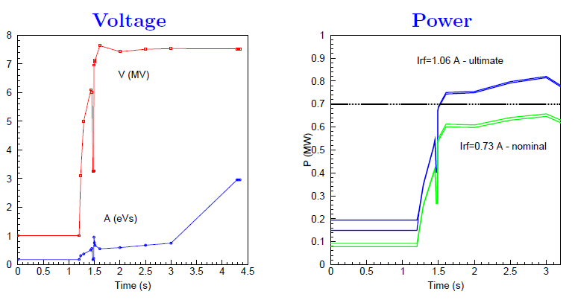
FT/CNGS acceleration cycle: voltage and power
at the moment maximum available voltage is used after transition crossing due to uncontrolled emittance blow –up during transition crossing
- any voltage reduction leads to beam losses

Slide 6
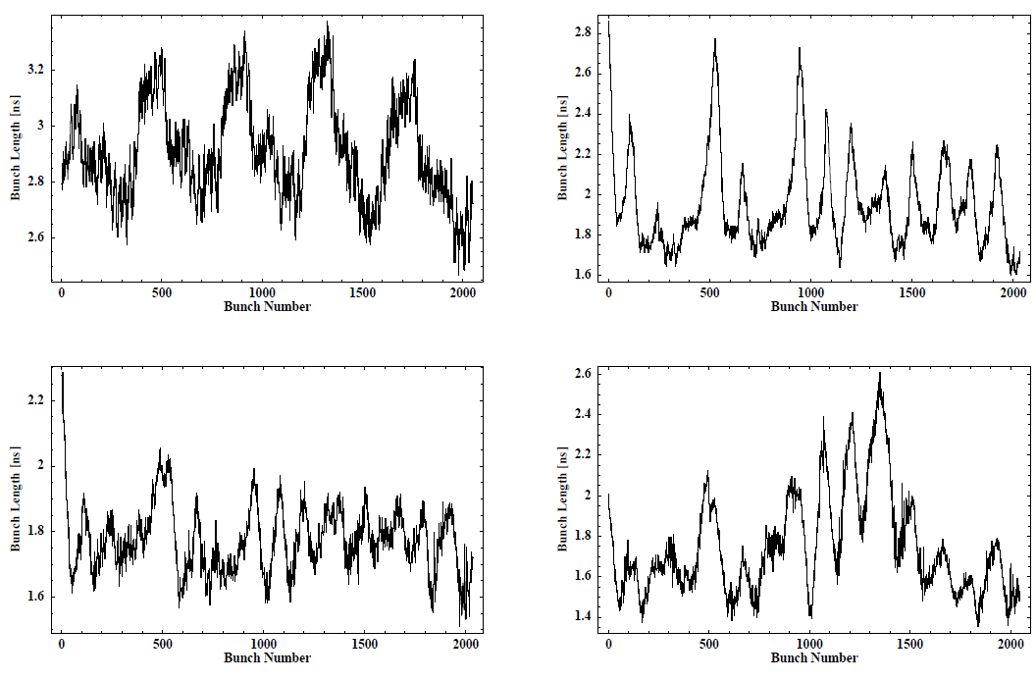
Bunch length along the batch during cycle for high intensity beam (5.6x10¹³ injected, 15% losses) (AB-Note-2005-034 RF, T. Bohl et al.)
t=1.315 s
t=1.534 s,
γ>γt
t=3.286 s
t=4.163 s

Slide 7
Voltage during FT/CNGS cycle for two optics
Q26
Q20
=> after transition crossing some bunches have emittance > 0.6 eVs
=> voltage above present limit of 7.5 MV even for 0.4 eVs

Slide 8
Could the Q20 optics help to reduce uncontrolled emittance blow-up?
Voltage program for 0.6 eVs
Slip factor for Q20 and Q26

Slide 9
Summary and proposed studies for 2012
Voltage limitation due to emittance blow-up occuring at transition crossing and after it (for high intensity beam)
Main limitations are due to multi-bunch effects and not single bunch
Possible improvements to LLRF have been identified during the 2004 high intensity run, but probably will not be implemented before 2018 (together with the 200 MHz RF upgrade)
Repeat measurements done in 2004 with high intensity in nominal optics (some difference in time of transition crossing) and with 800 MHz RF system
=> MDs with Q20 optics for CNGS cycle are needed

