Slide 1
Parameters of high-intensity single bunches at 450 GeV
Helga Timkó
BE-RF-BR
in collaboration with
Theodoros Argyropoulos, Hannes Bartosik, Thomas Bohl, Juan Esteban Müller, Alexey Petrenko, Elena Shaposhnikova

Slide 2
Introduction & motivation
High-intensity single bunches are not only interesting for ‘academic’ purposes, but might be used as an operational physics beam in the future, e.g. for the plasma wake-field acceleration project AWAKE
Two MDs on bunch rotation at SPS flat top have been carried out
Q26, 11th July 2012
Q20, 30th October 2012
Aim: to measure the bunch parameters we can reproducibly achieve and that will impact the design of the wake-field acceleration experiment
Shortest possible bunch length, smallest emittances, highest intensity
Reproducibility/spread of these parameters (also important!)
From the operational point of view, stability is also an issue

Slide 3
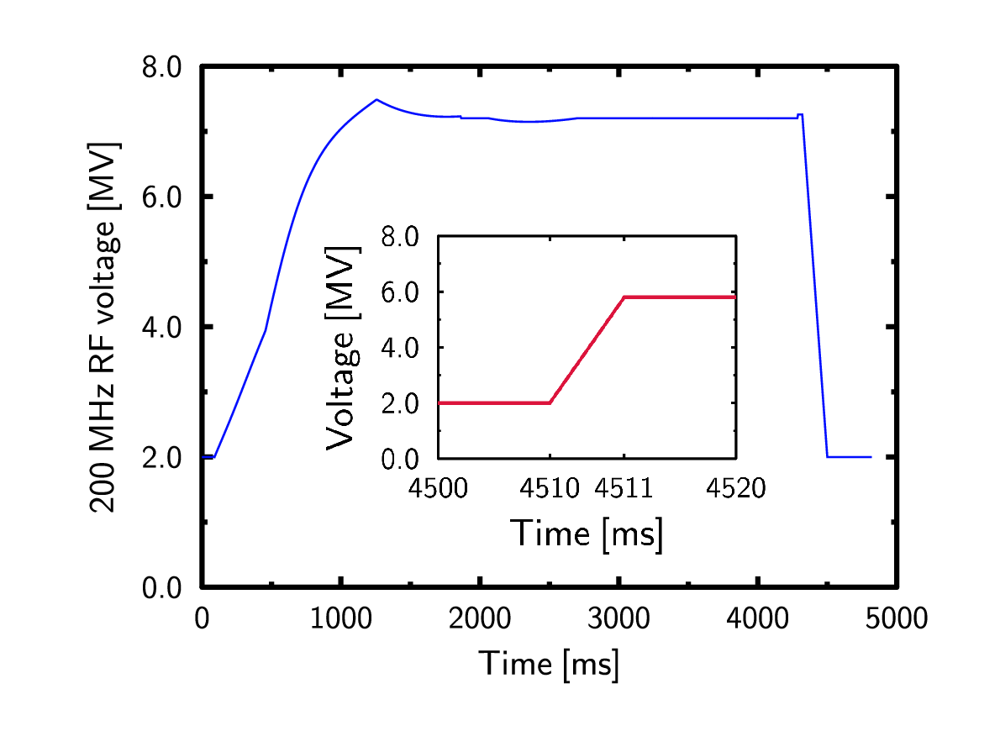
Q26: Experimental setup
Fast acceleration cycle to 450 GeV, 4.7 s long – could be operational for AWAKE
High intensity single bunches
Losses increase with intensity (10—13 %)
Constant 7 MV: bunch lengths measured on flat top as a reference
Bunch rotation: done at flat top
Fast (~ 1 ms) rise of the 200 MHz RF voltage from 2 MV to 5.8 MV
The 800 MHz RF system was on for beam stability (V₈₀₀ = 0.1 MV at flat top)
No controlled emittance blow-up (as for LHC beams) – maybe needed for highest intensities, see below

Slide 4
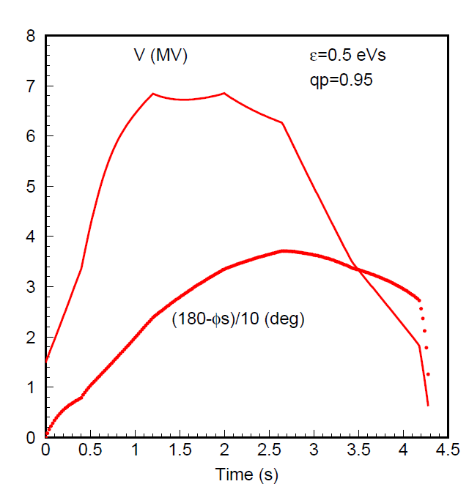
Optimization…
Cycle was not optimised: bucket area increases during acceleration
Bad for stability
The MD cycle starts to deviate significantly around 2.5 – 3 s
A constant bucket area for the fast cycle would give some-thing like this:
See AB-Note-2006-018 RF

Slide 5
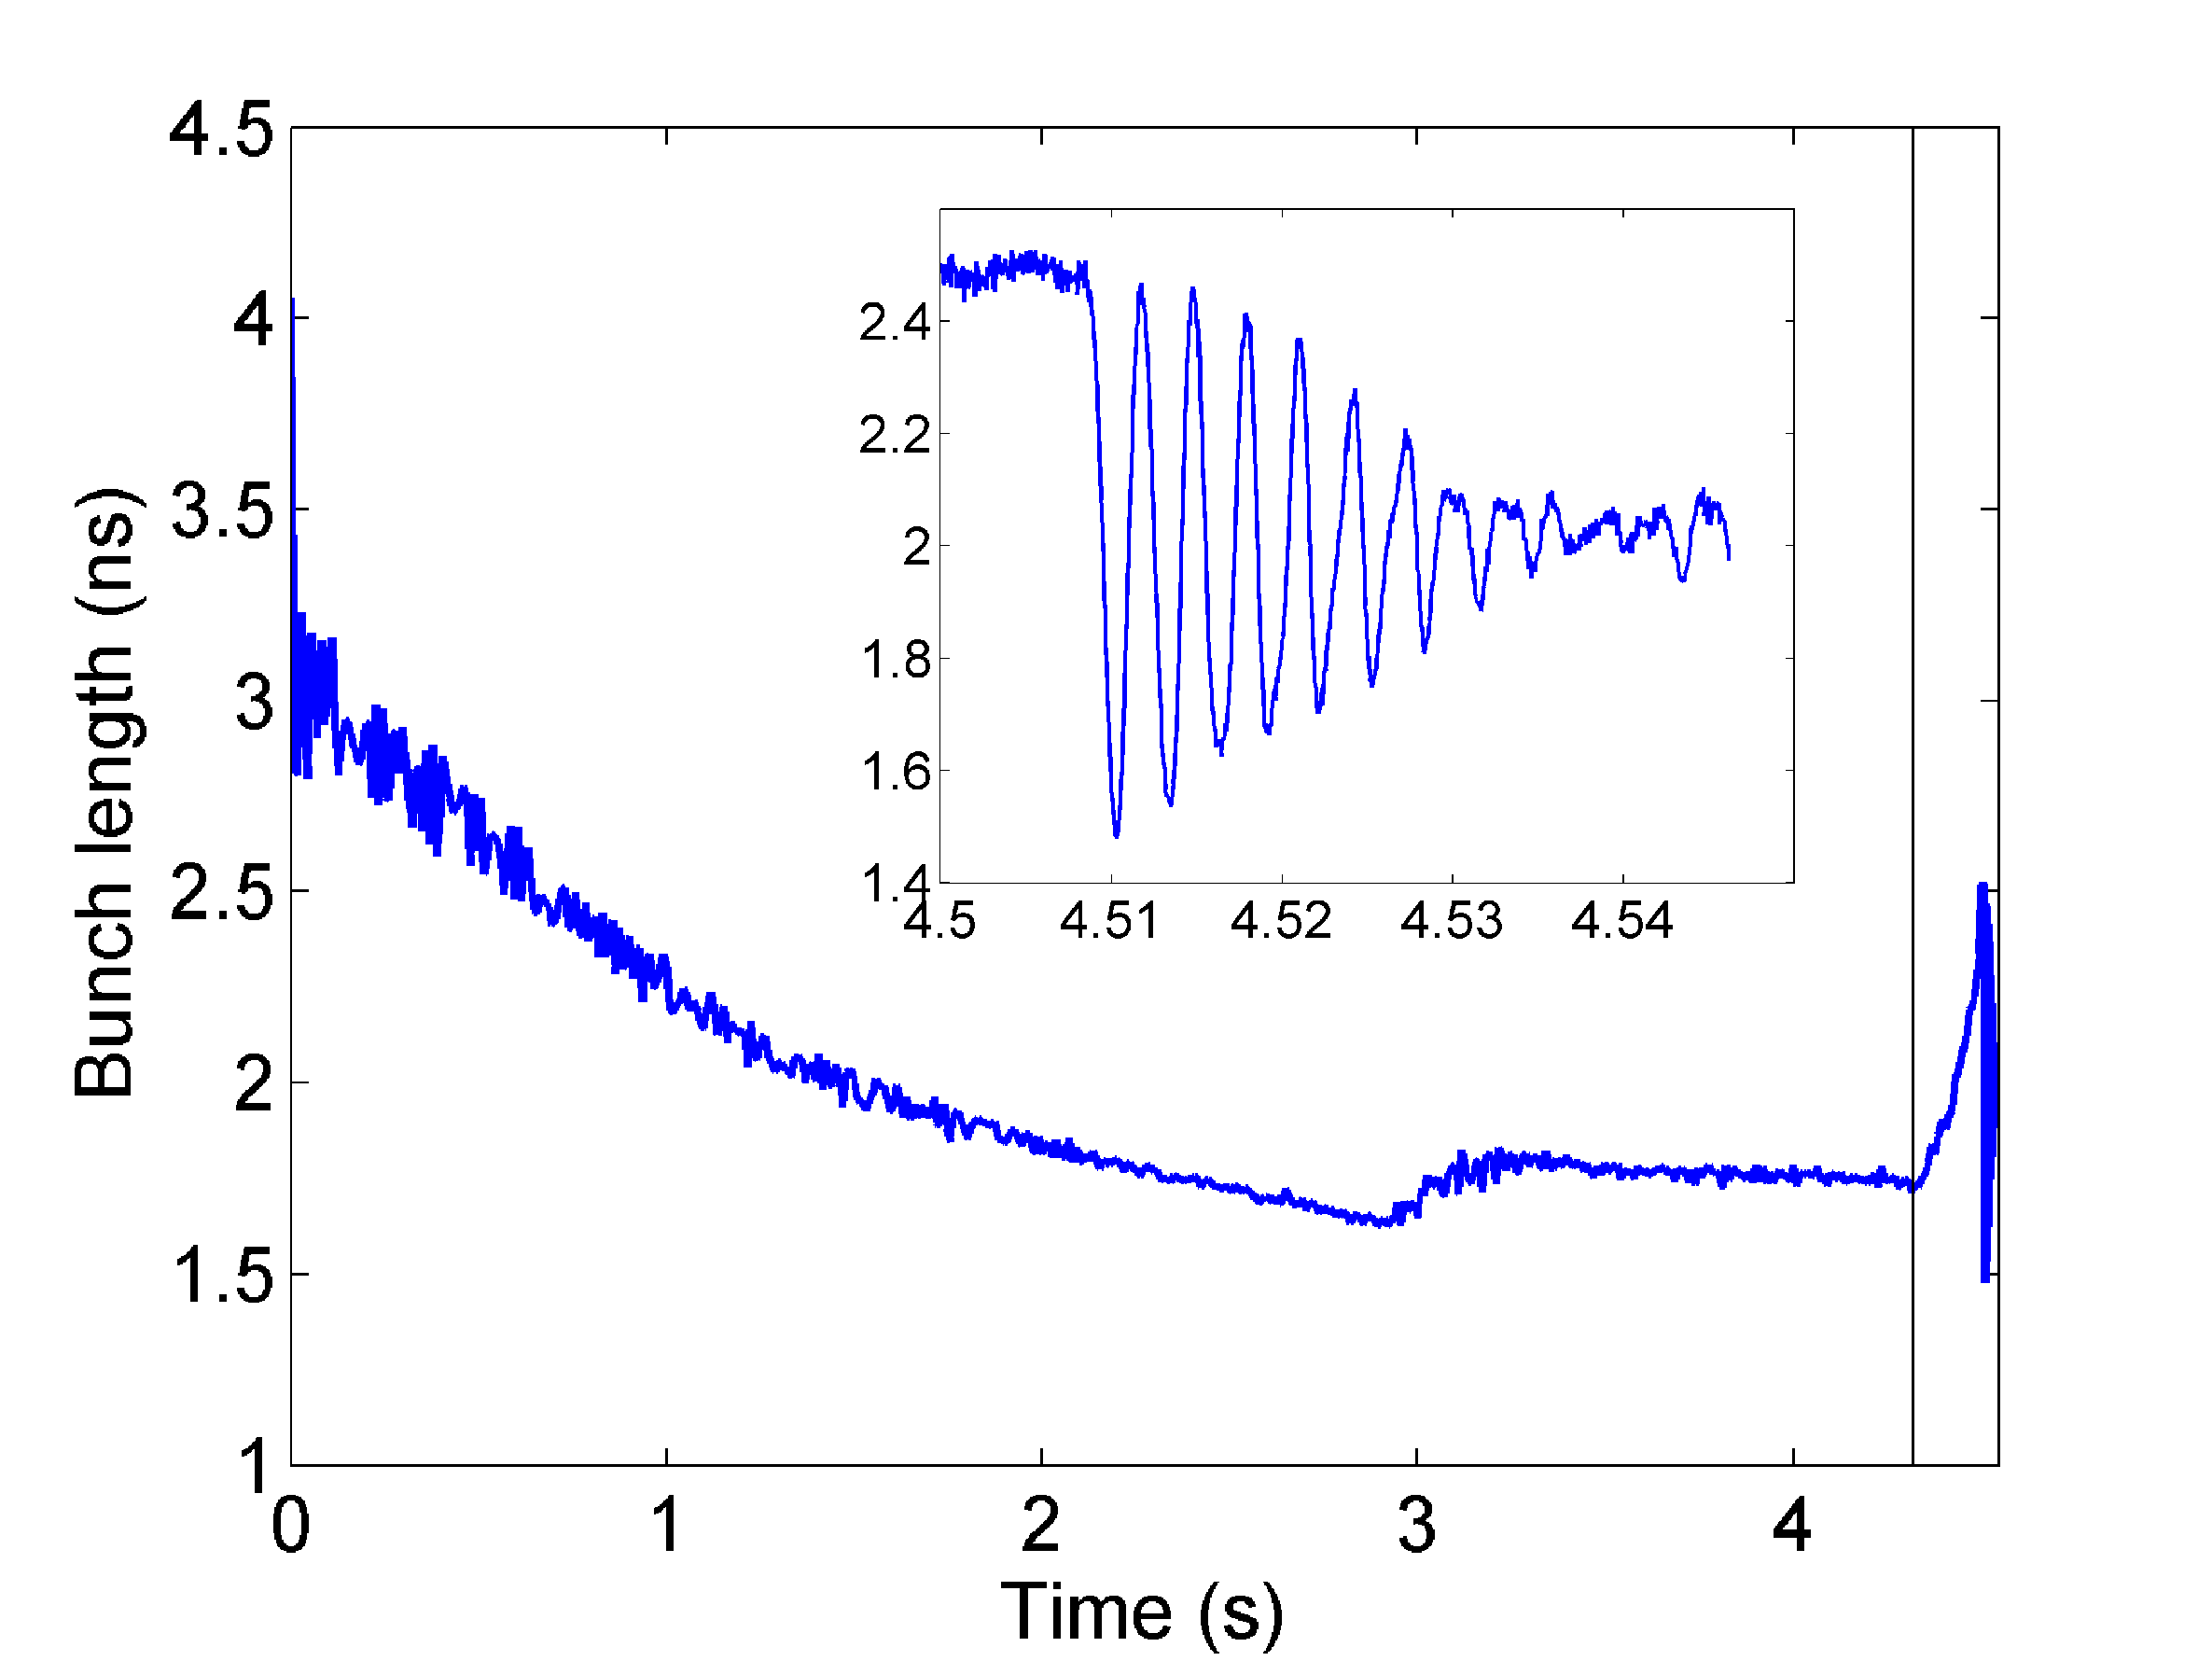
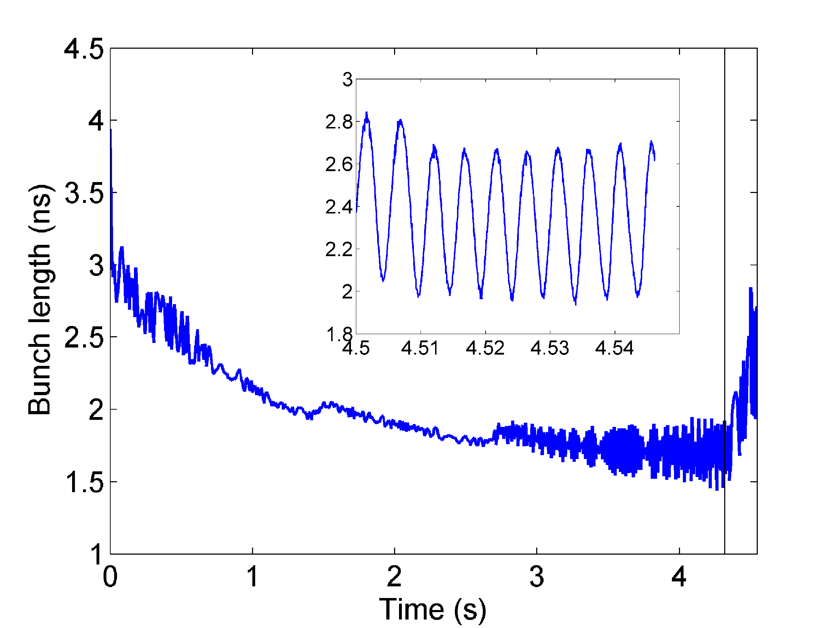
Q26: Instabilities
For the measured intensity range in most cases: instability at the end of the ramp
A blow-up is usually seen, too, which has a stabilizing effect
A controlled blow-up for operation is preferable; could improve reproducibility
In 2 out of 10 cases, bunches were very long (in single RF)
Where V is too high…

Slide 6
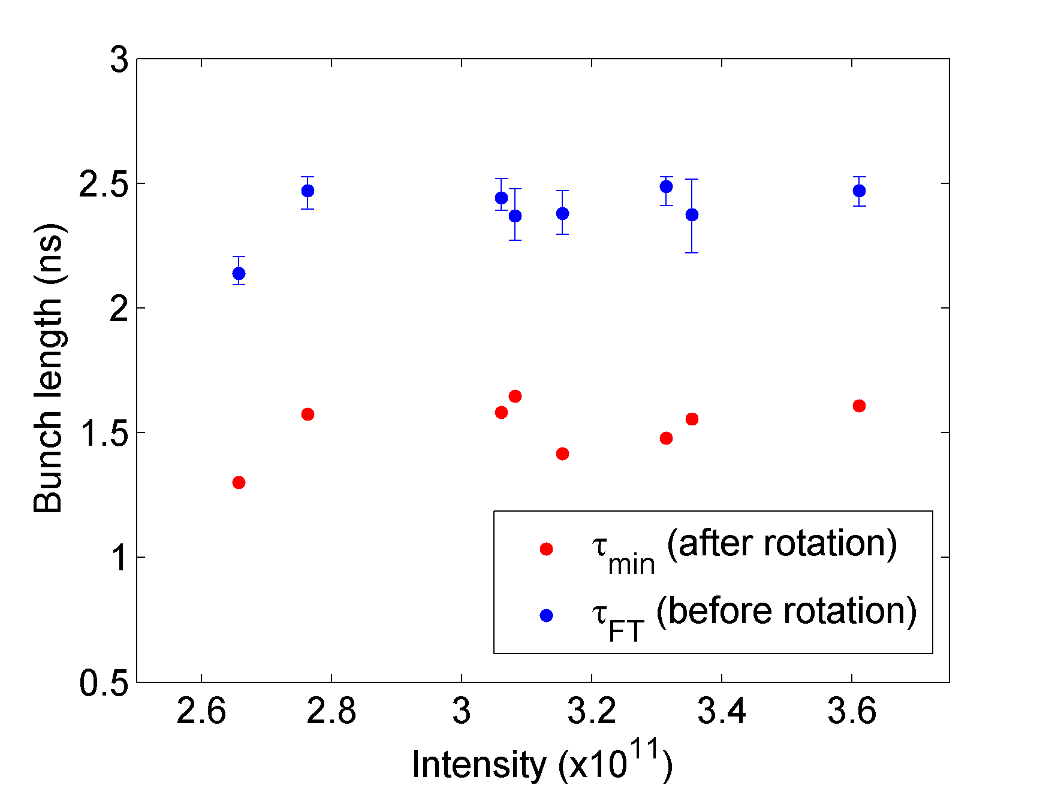
Q26: Bunch length
Bunch length on FT at 2 MV, before rotation:
(2.39 ± 0.11) ns
Bunch length after rotation (¼ T_{s} ):
(1.52 ± 0.12) ns
Intensity variation at 450 GeV (due to int. reduction in PSB):
(2.6 ... 3.6) × 10¹¹ ppb
Keeping 7 MV at flat top:
1.65 ns

Slide 7
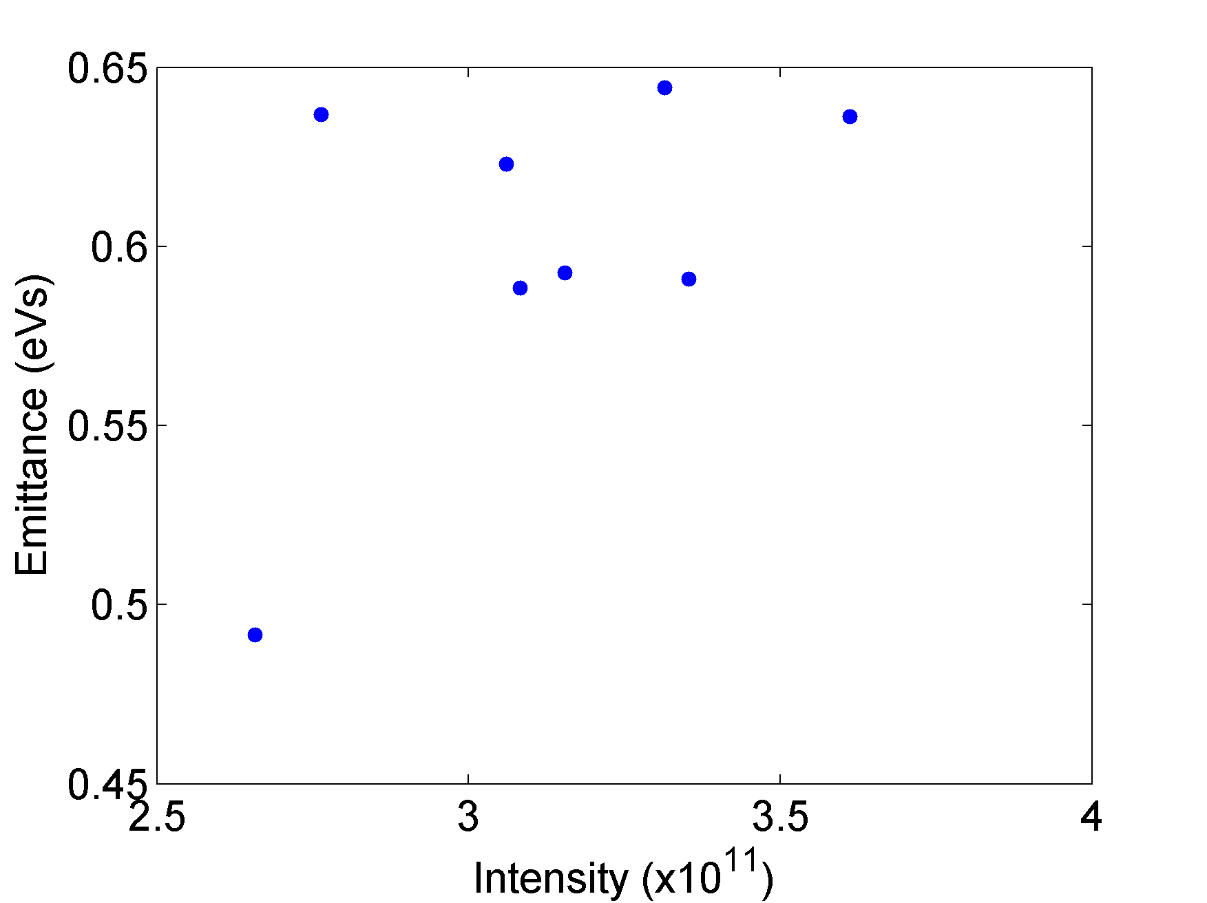
Q26: Longitudinal emittance
Measured just before the rotation
Uncontrolled emittance blow-up during ramp (~ 0.35 eVs injected), then no dependence of bunch length/emittance on intensity at 450 GeV
The large scatter of the data points might be due to instabilities
The cycle was not optimal
We don’t have much statistics…

Slide 8
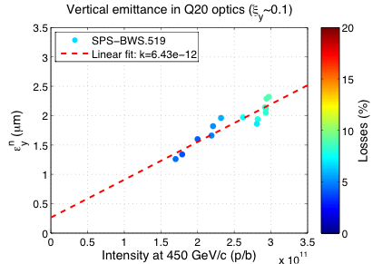
Q26: Transverse emittance
Typical transverse emittance at 450 GeV for high-intensity single bunches in Q26
Data from another MD with a long LHC cycle (7.2 s ramp)
Losses up to 10 %
Round beam, in principle...
Courtesy of H. Bartosik

Slide 9
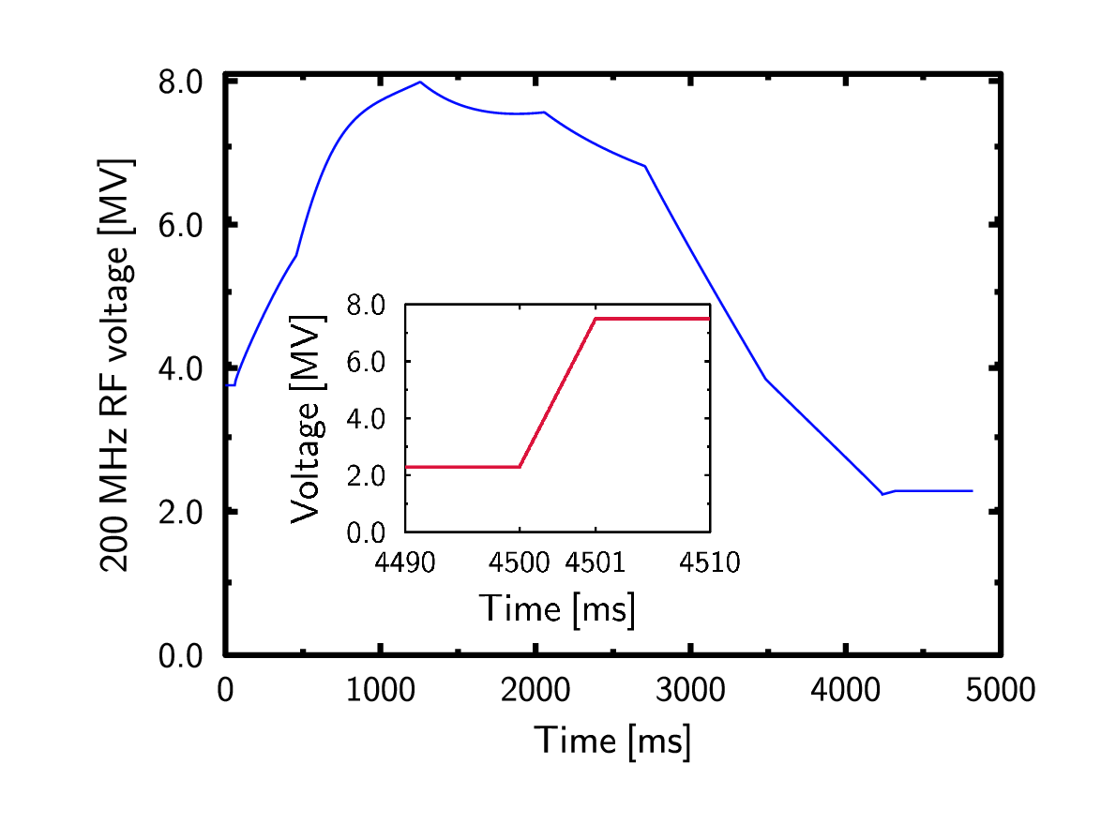
Q20: Experimental setup
Fast acceleration cycle to 450 GeV
High intensity single bunches
Losses: 7—13 %, increase with intensity
Bunch rotation: Fast (~ 1 ms) rise now from 2 MV to 7.7 MV
Due to hardware improvement
Adiabatic (10 ms) voltage increase to 8 MV as a reference
The 800 MHz RF system was on for beam stability (we tried different voltages at flat top)
No controlled emittance blow-up (as for LHC beams) – maybe needed for highest intensities, see below

Slide 10
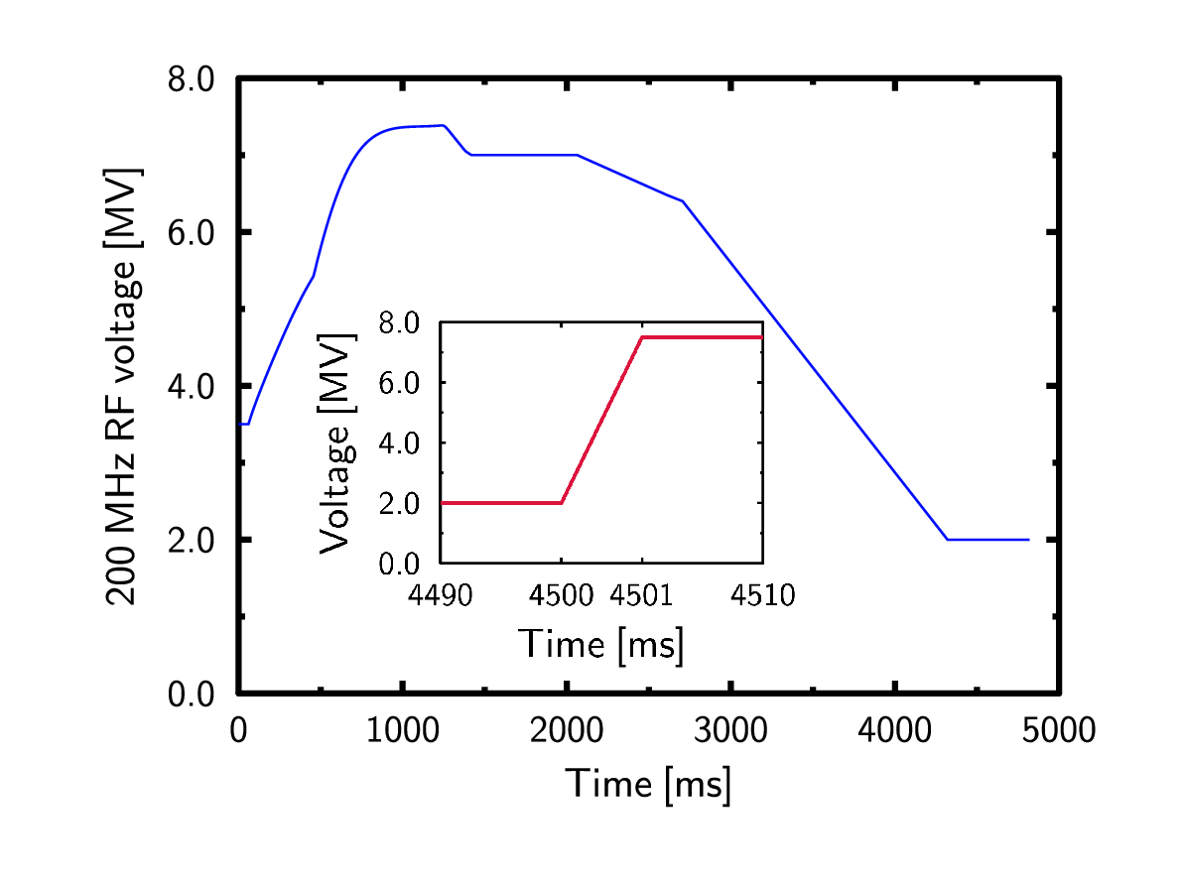
Setting up the cycle
We tried to keep a constant bucket area throughout most of the cycle
For stability, a too high voltage should be avoided
At flat top, the voltage had to be increased to compensate the potential well distortion
The higher the intensity, the more voltage is needed
At lower intensities
At higher intensities

Slide 11
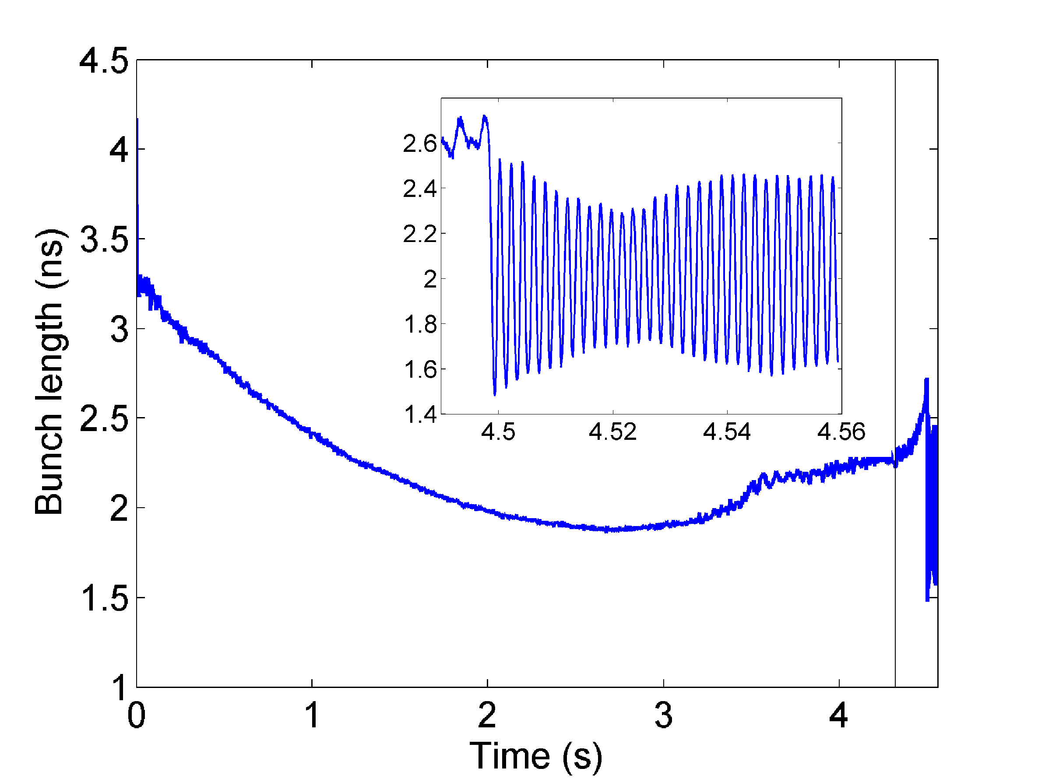
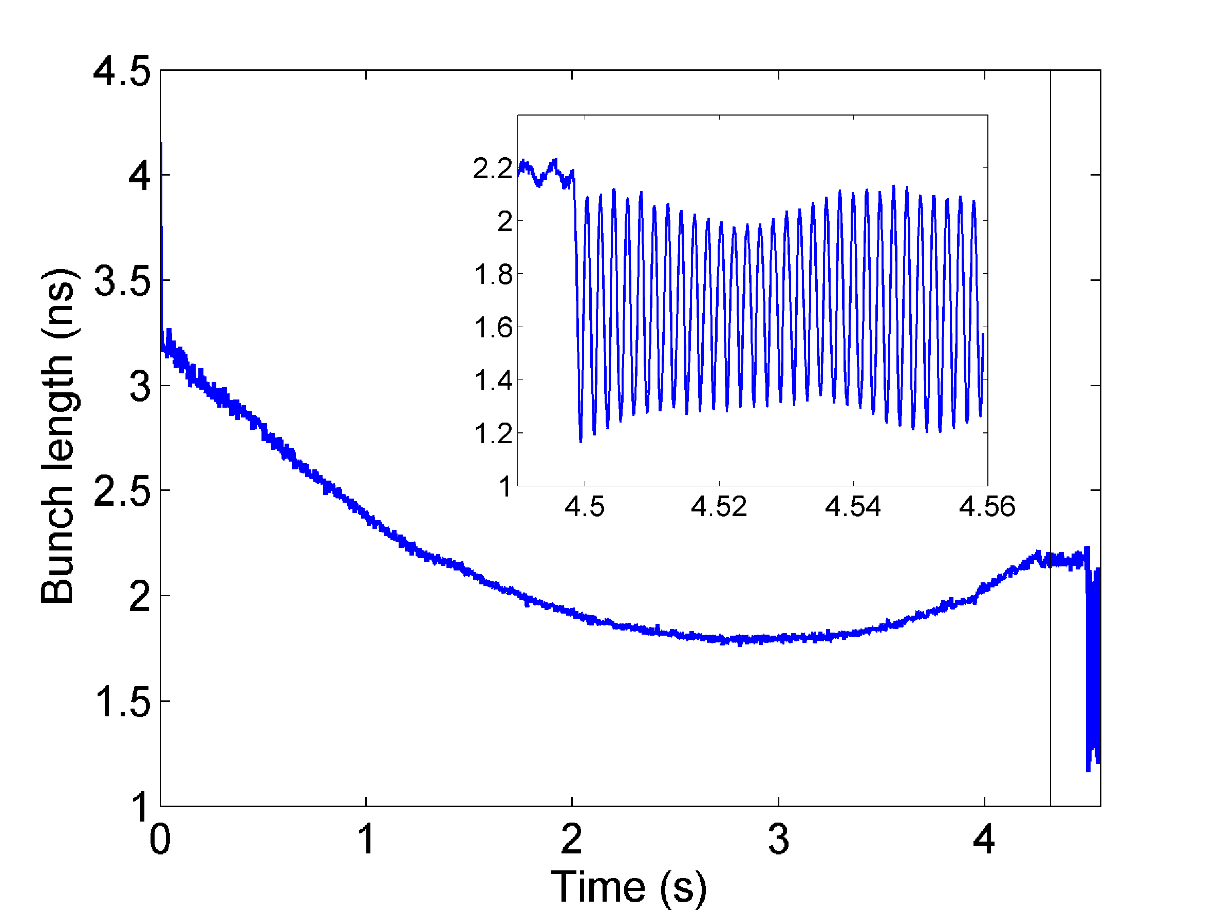
Q20: Stability
Instabilities, if present, were less violent, but still led to blow-up
Double RF in all cases
All rotated bunches usable
A smaller controlled emittance blow-up than for Q26 would probably be sufficient to improve reproducibility
At lower intensities (≤ 3 × 10¹¹ ppb), the beam is typically stable

Slide 12
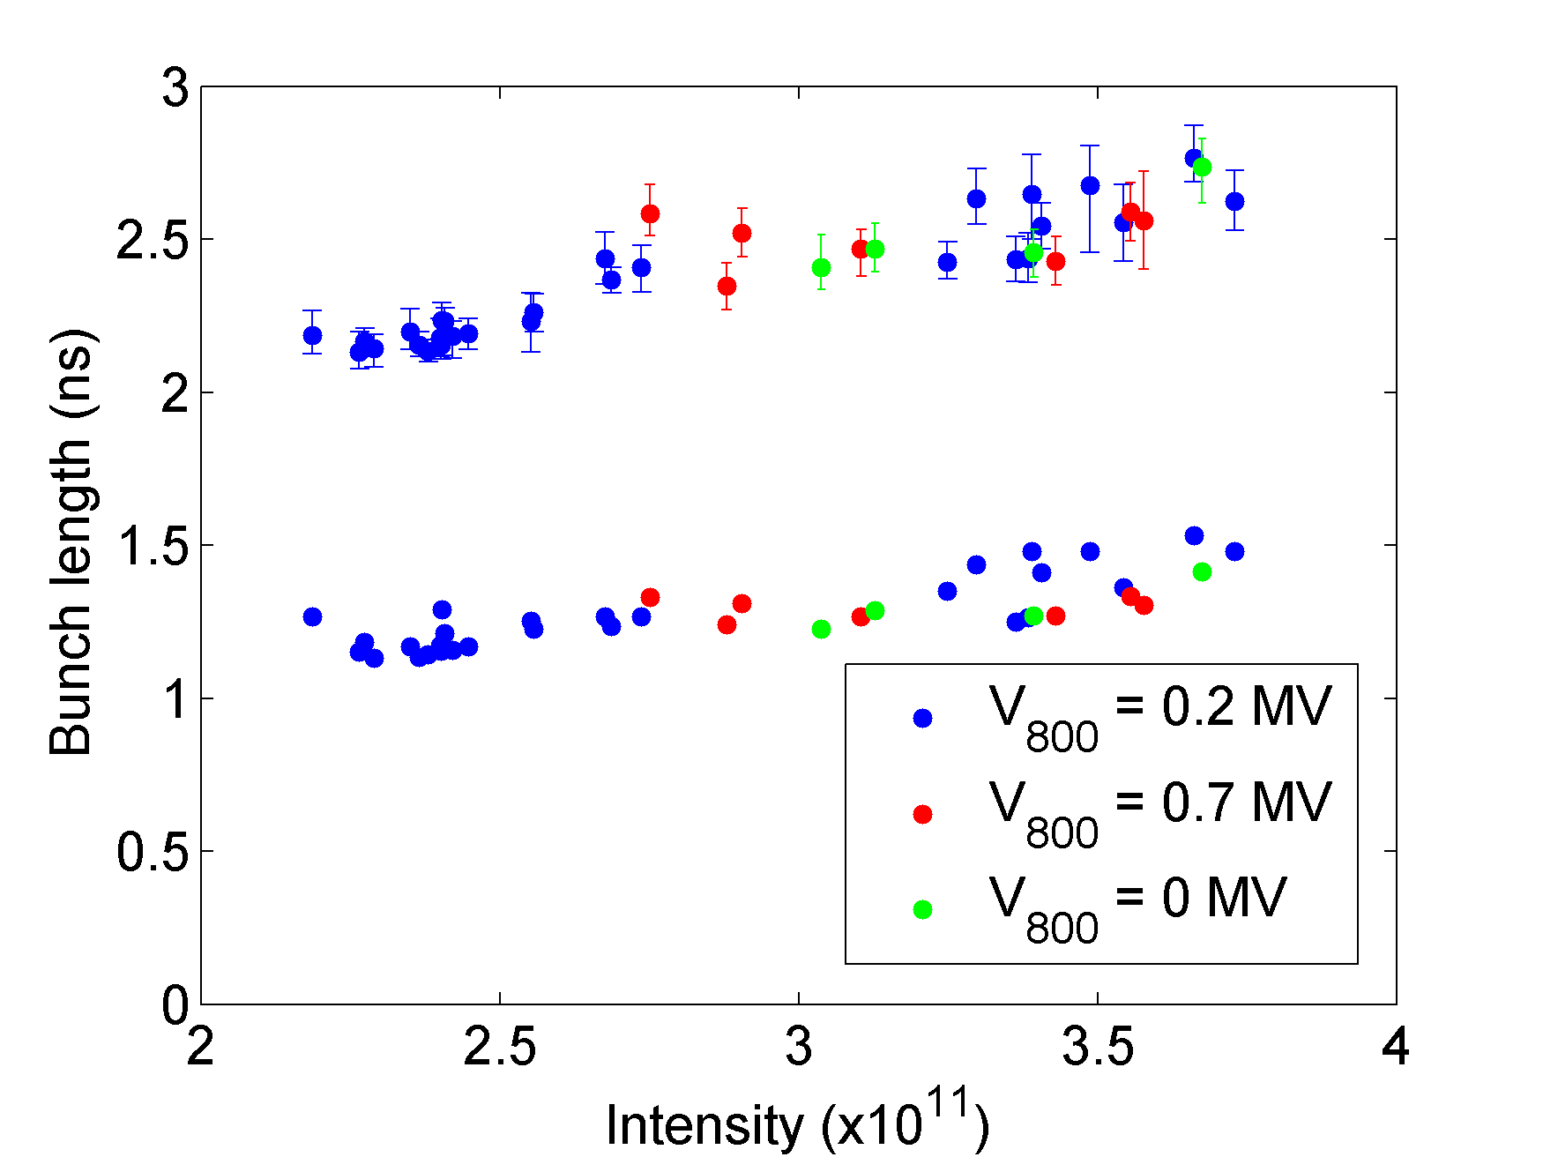
Q20: Bunch length Measured in two intensity ranges
Before rotation
After rotation
Bunch length on FT at 2 MV, before rotation:
(2.38 ± 0.10) ns (set I)
(2.52 ± 0.12) ns (set II)
Bunch length after rotation (¼ T_{s} ):
(1.19 ± 0.05) ns (set I)
(1.34 ± 0.09) ns (set II)
Intensity
(2.2 … 2.6) × 10¹¹ ppb (I)
(2.7 … 3.8) × 10¹¹ ppb (II)
Adiabatic shortening:
1.6 ns for 2.8 × 10¹¹ ppb
Set II
Set I

Slide 13
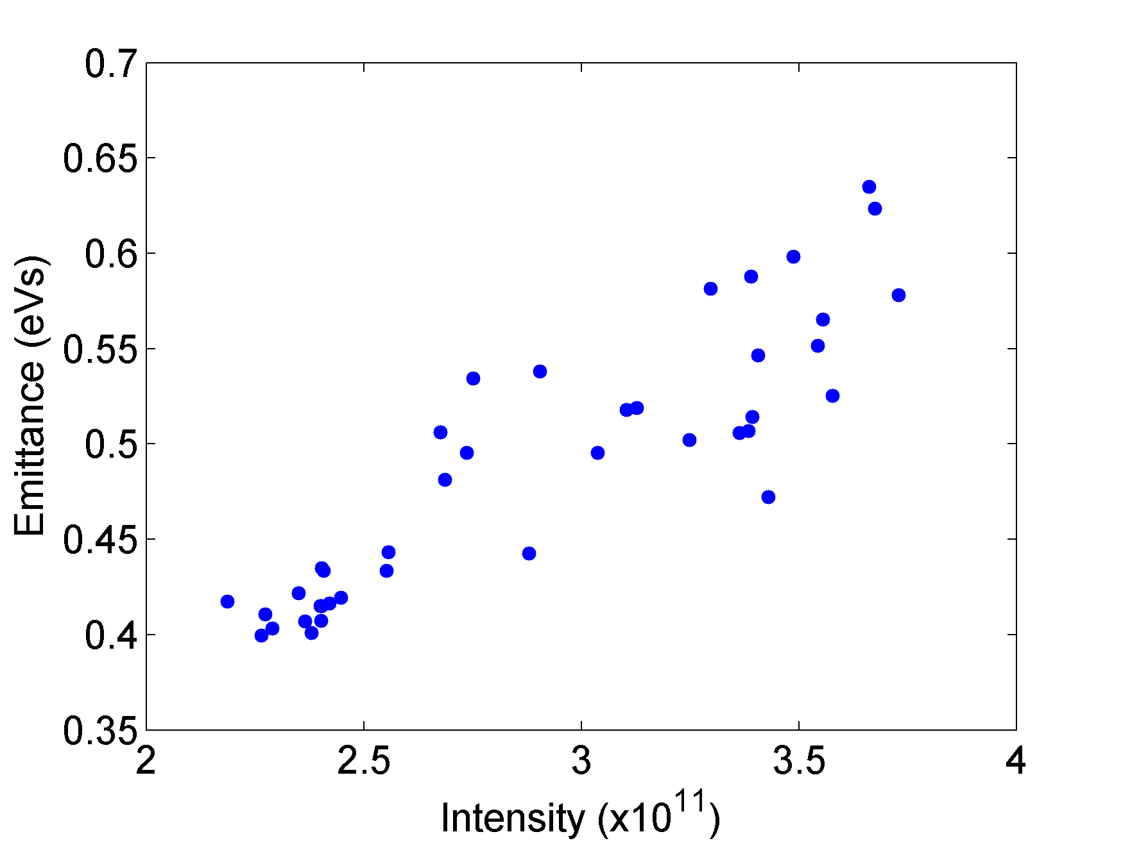
Q20: Longitudinal emittance
For future operation, intensities of up to 3—4 × 10¹¹ ppb are considered
The corresponding longitudinal emittance: 0.55 – 0.7 eVs
The calculation of the emittance doesn’t take the potential well distortion into account
Instability not visible below 3 × 10¹¹ ppb (maybe no blow-up?)

Slide 14
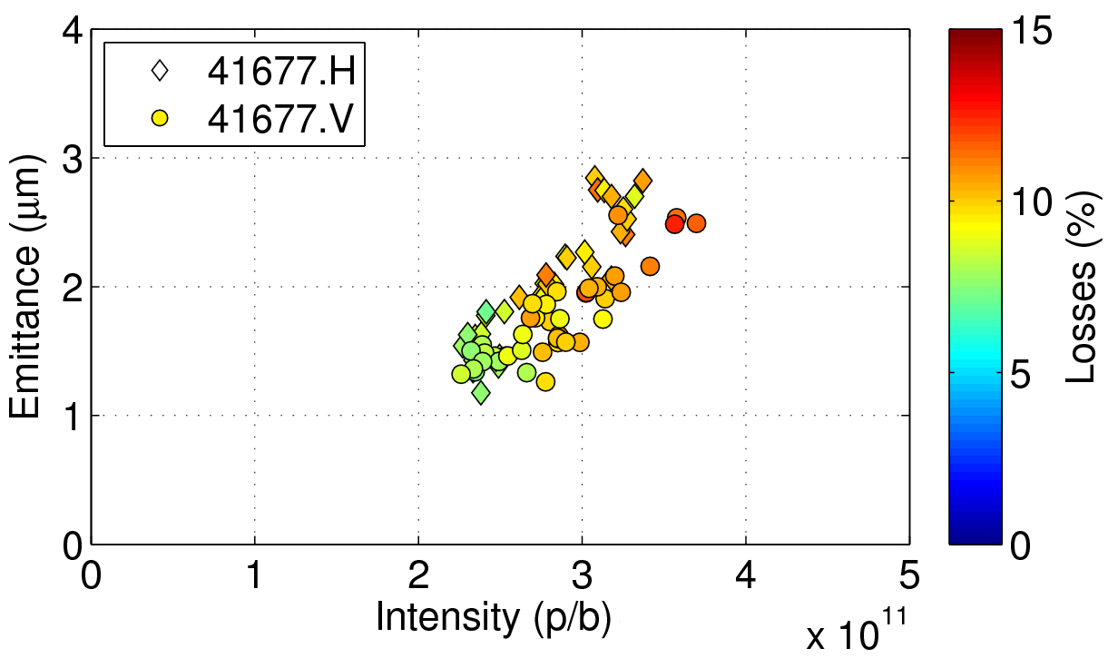
Q20: Transverse emittance
Measurements with wire scanners are not very accurate (± 20 %)
Difference in H and V component might be just due to different wire scanners
Round beam, in principle...

Slide 15
Comparison
In measurements with the Q26 optics, the cycle was not optimized
Less voltage for rotation, more instabilities
Direct comparison cannot be made
Adiabatic scaling of bunch lengths: τ’/τ = (V/V’)^{¼}
Not applicable for rotation, but gives an idea of what could have been obtained with a rotation of 7.7 MV instead of 5.8 MV: 1.52 → 1.42 ns
 | Q26 (high I) | Q20 (low I) | Q20 (high I)
Intensity | (2.6 ... 3.6) × 10¹¹ (p/bunch) | (2.2 … 2.6) × 10¹¹ (p/bunch) | (2.7 … 3.75) × 10¹¹ (p/bunch)
Bunch length after rotation | 1.3 … 1.7 ns | 1.1 … 1.3 ns | 1.25 … 1.6 ns
Transverse emittance | 1.9 … 2.6 µm (earlier data) | 1.3 … 1.7 µm | 1.8 … 2.8 µm

Slide 16
Conclusions
Single bunch parameters were measured in the SPS at 450 GeV in Q26 and Q20 with/without bunch rotation, primarily for AWAKE
Which optics is preferable, Q20 or Q26?
Q26 was not optimized, so results cannot be directly compared
Instabilities in Q26 were more severe, but we might be able to improve this
Similar bunch lengths are achievable before and after rotation
Q20 has a higher threshold is probably preferable for stability
Both transverse and longitudinal instability thresholds are higher for Q20
Transverse emittances are probably slightly lower for Q20 optics (TBC)
The higher the intensity, the more the bunch parameters will vary
Reproducibility might be an issue for the plasma experiment

