Slide 1

First tests with a 25ns “doublet” beam at the SPS injection
G. Iadarola, H.Bartosik, G. Rumolo
Many thanks to:
T. Argyropoulos, T. Bohl, S. Cettour Cave, H. Damerau, L. Kopylov , J. Esteban Muller,
F. Follin, S. Hancock, C. Lazaridis, Y. Papaphilippou, E. Shaposhnikova, M. Taborelli
Special thanks to all the SPS operator crew
LIU-SPS -BD meeting 22/11/2012

Slide 2
Outline
  Why a scrubbing beam
  Why “doublets”
  Tests with single bunch in the SPS
  Test with a bunch train
    Effect on strip-detector signal
    Effect on pressure along the ring
  Conclusions and future studies

Slide 3
Outline
  Why a scrubbing beam
  Why “doublets”
  Tests with single bunch in the SPS
  Test with a bunch train
    Effect on strip-detector signal
    Effect on pressure along the ring
  Conclusions and future studies

Slide 4
Why do we need a scrubbing beam?
What do we need?
“Example” scrubbing curve from lab

Slide 5
Why do we need a scrubbing beam?
What do we need?
“Example” scrubbing curve from lab
What do we have?
MBB – 25ns beam

Slide 6
Why do we need a scrubbing beam?
What do we need?
  Possible issue:
  The beam is still degraded due to EC
  The dose is not sufficient to continue scrubbing in a reasonable time
“Example” scrubbing curve from lab
What do we have?
MBB – 25ns beam

Slide 7
Why do we need a scrubbing beam?
What do we need?
  Possible issue:
  The beam is still degraded due to EC
  The dose is not sufficient to continue scrubbing in a reasonable time
“Example” scrubbing curve from lab
  Possible solution:
  A “scrubbing beam” which exhibits a lower multipacting threshold
What do we have?
Scrubbing beam
MBB – 25ns beam

Slide 8
Why do we need a scrubbing beam?
What do we need?
  Possible issue:
  The beam is still degraded due to EC
  The dose is not sufficient to continue scrubbing in a reasonable time
“Example” scrubbing curve from lab
  Possible solution:
  A “scrubbing beam” which exhibits a lower multipacting threshold
  No need for acceleration
  No stringent requirements on beam quality
What do we have?
Scrubbing beam
MBB – 25ns beam

Slide 9
Outline
  Why a scrubbing beam
  Why “doublets”
  Tests with single bunch in the SPS
  Test with a bunch train
    Effect on strip-detector signal
    Effect on pressure along the ring
  Conclusions and future studies

Slide 10
Why “doublets”?
  The “simplest” idea would be to shrink the bunch spacing:
  PS bunch rotation is designed “around” 40MHz → Not possible to inject “bunch to bucket” with spacing shorted than 25ns

Slide 11
Why “doublets”?
  The “simplest” idea would be to shrink the bunch spacing:
  PS bunch rotation is designed “around” 40MHz → Not possible to inject “bunch to bucket” with spacing less than 25ns
  A “relatively easy” scheme could be to extract a 25ns bunch train with long bunches (~10ns) and capture each bunch in two SPS buckets getting a 25ns “doublet” beam.

Slide 12
Why “doublets”?
  Why should it work?
Electron emission
Electron absorption
PyECLOUD simulation

Slide 13
Why “doublets”?
  Why should it work?
Below the threshold the two effects compensate each other, no accumulation over subsequent bunch passages
PyECLOUD simulation

Slide 14
Why “doublets”?
  Why should it work?
Shorter e-cloud decay
More efficient e⁻ production
PyECLOUD simulation

Slide 15
Why “doublets”?
  Why should it work?
Accumulation between subsequent turns
PyECLOUD simulation

Slide 16
Simulation study
MBB - 26GeV
  Intensity per bunch of the doublet (b.l. 4ns)
(b.l. 3ns)
  Remarks:
  The doublet beam shows a lower multipacting threshold compared to the standard 25ns beam if the intensity is larger than 0.8e11ppb (1.6e11ppb from the PS)

Slide 17
Simulation study
MBB - 26GeV
  Intensity per bunch of the doublet (b.l. 4ns)
(b.l. 3ns)
  Remarks:
  The doublet beam shows a lower multipacting threshold compared to the standard 25ns beam if the intensity is larger than 0.8e11ppb (1.6e11ppb from the PS)
  The scrubbed region is smaller → to be used, with radial steering, as a last stage of the scrubbing

Slide 18
Outline
  Why a scrubbing beam
  Why “doublets”
  Tests with single bunch in the SPS
  Test with a bunch train
    Effect on strip-detector signal
    Effect on pressure along the ring
  Conclusions and future studies

Slide 19
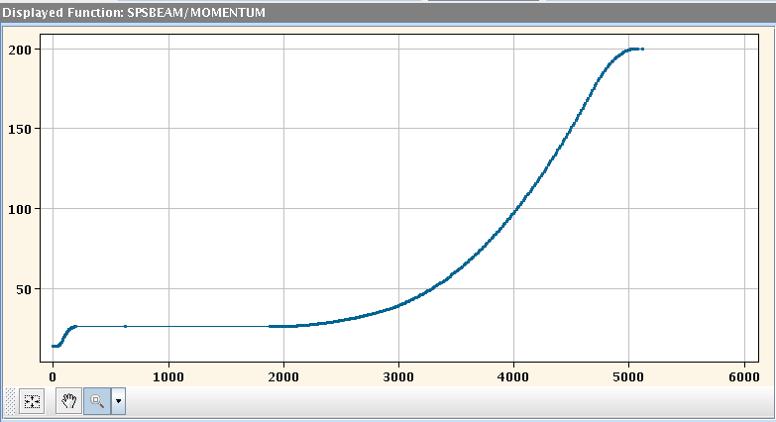
Test with single bunch
  On 25-26 Oct. a first test was carried out with a single bunch to test the capture scheme:
  Special PS cycle for a single 10ns long bunch was setup by PS experts
  SPS cycle (Q26) with one injection + 1s flat bottom + acceleration to 32GeV

Slide 20
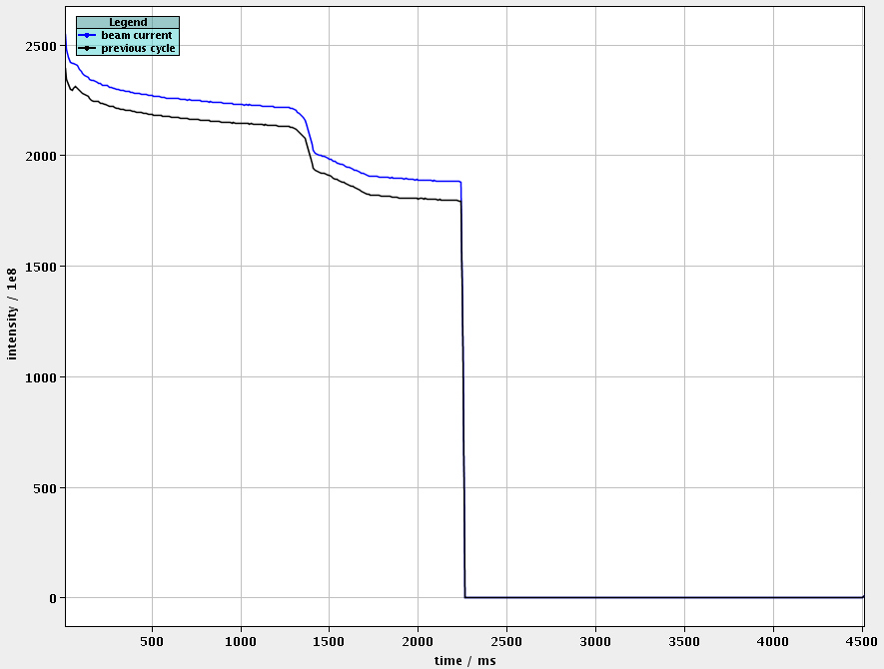
Test with single bunch
  On 25-26 Oct. a first test was carried out with a single bunch to test the capture scheme:
  Special PS cycle for a single 10ns long bunch was setup by PS experts
  SPS cycle (Q26) with one injection + 1s flat bottom + acceleration to 32GeV
ramp

Slide 21
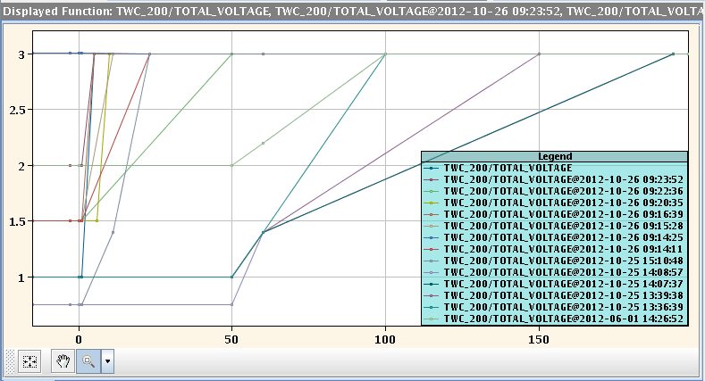
Test with single bunch
  On 25-26 Oct. a first test was carried out with a single bunch to test the capture scheme:
  Special PS cycle for a single 10ns long bunch was setup by PS experts
  SPS cycle (Q26) with one injection + 1s flat bottom + acceleration to 32GeV
  RF Voltage program has been optimized to maximize the capture

Slide 22
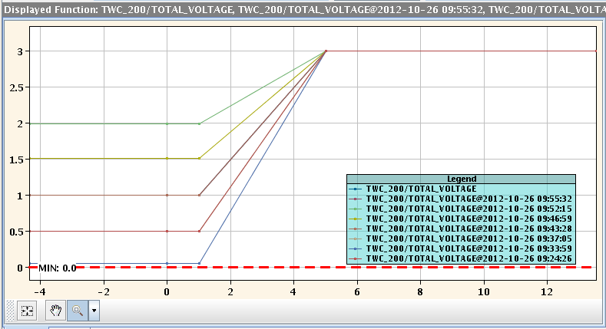
Test with single bunch
  Main indications from these tests:
  Max. capture (>95%) is obtained injecting on V_{RF}≤1MV and increasing to 3MV after few ms

Slide 23
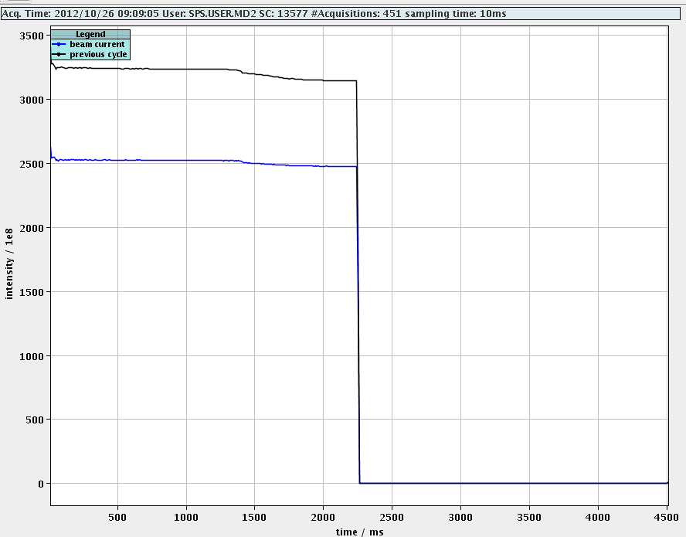
Test with single bunch
  Main indications from these tests:
  Max. capture (>95%) is obtained injecting on V_{RF}≤1MV and increasing to 3MV after few ms

Slide 24
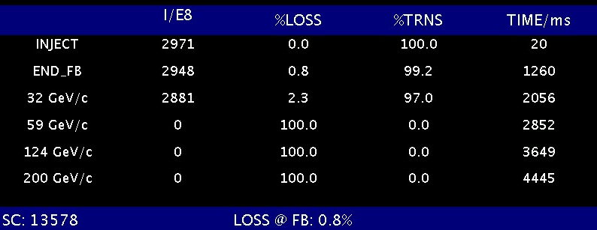
Test with single bunch
  Main indications from these tests:
  Max. capture (>95%) is obtained injecting on V_{RF}≤1MV and increasing to 3MV after few ms

Slide 25
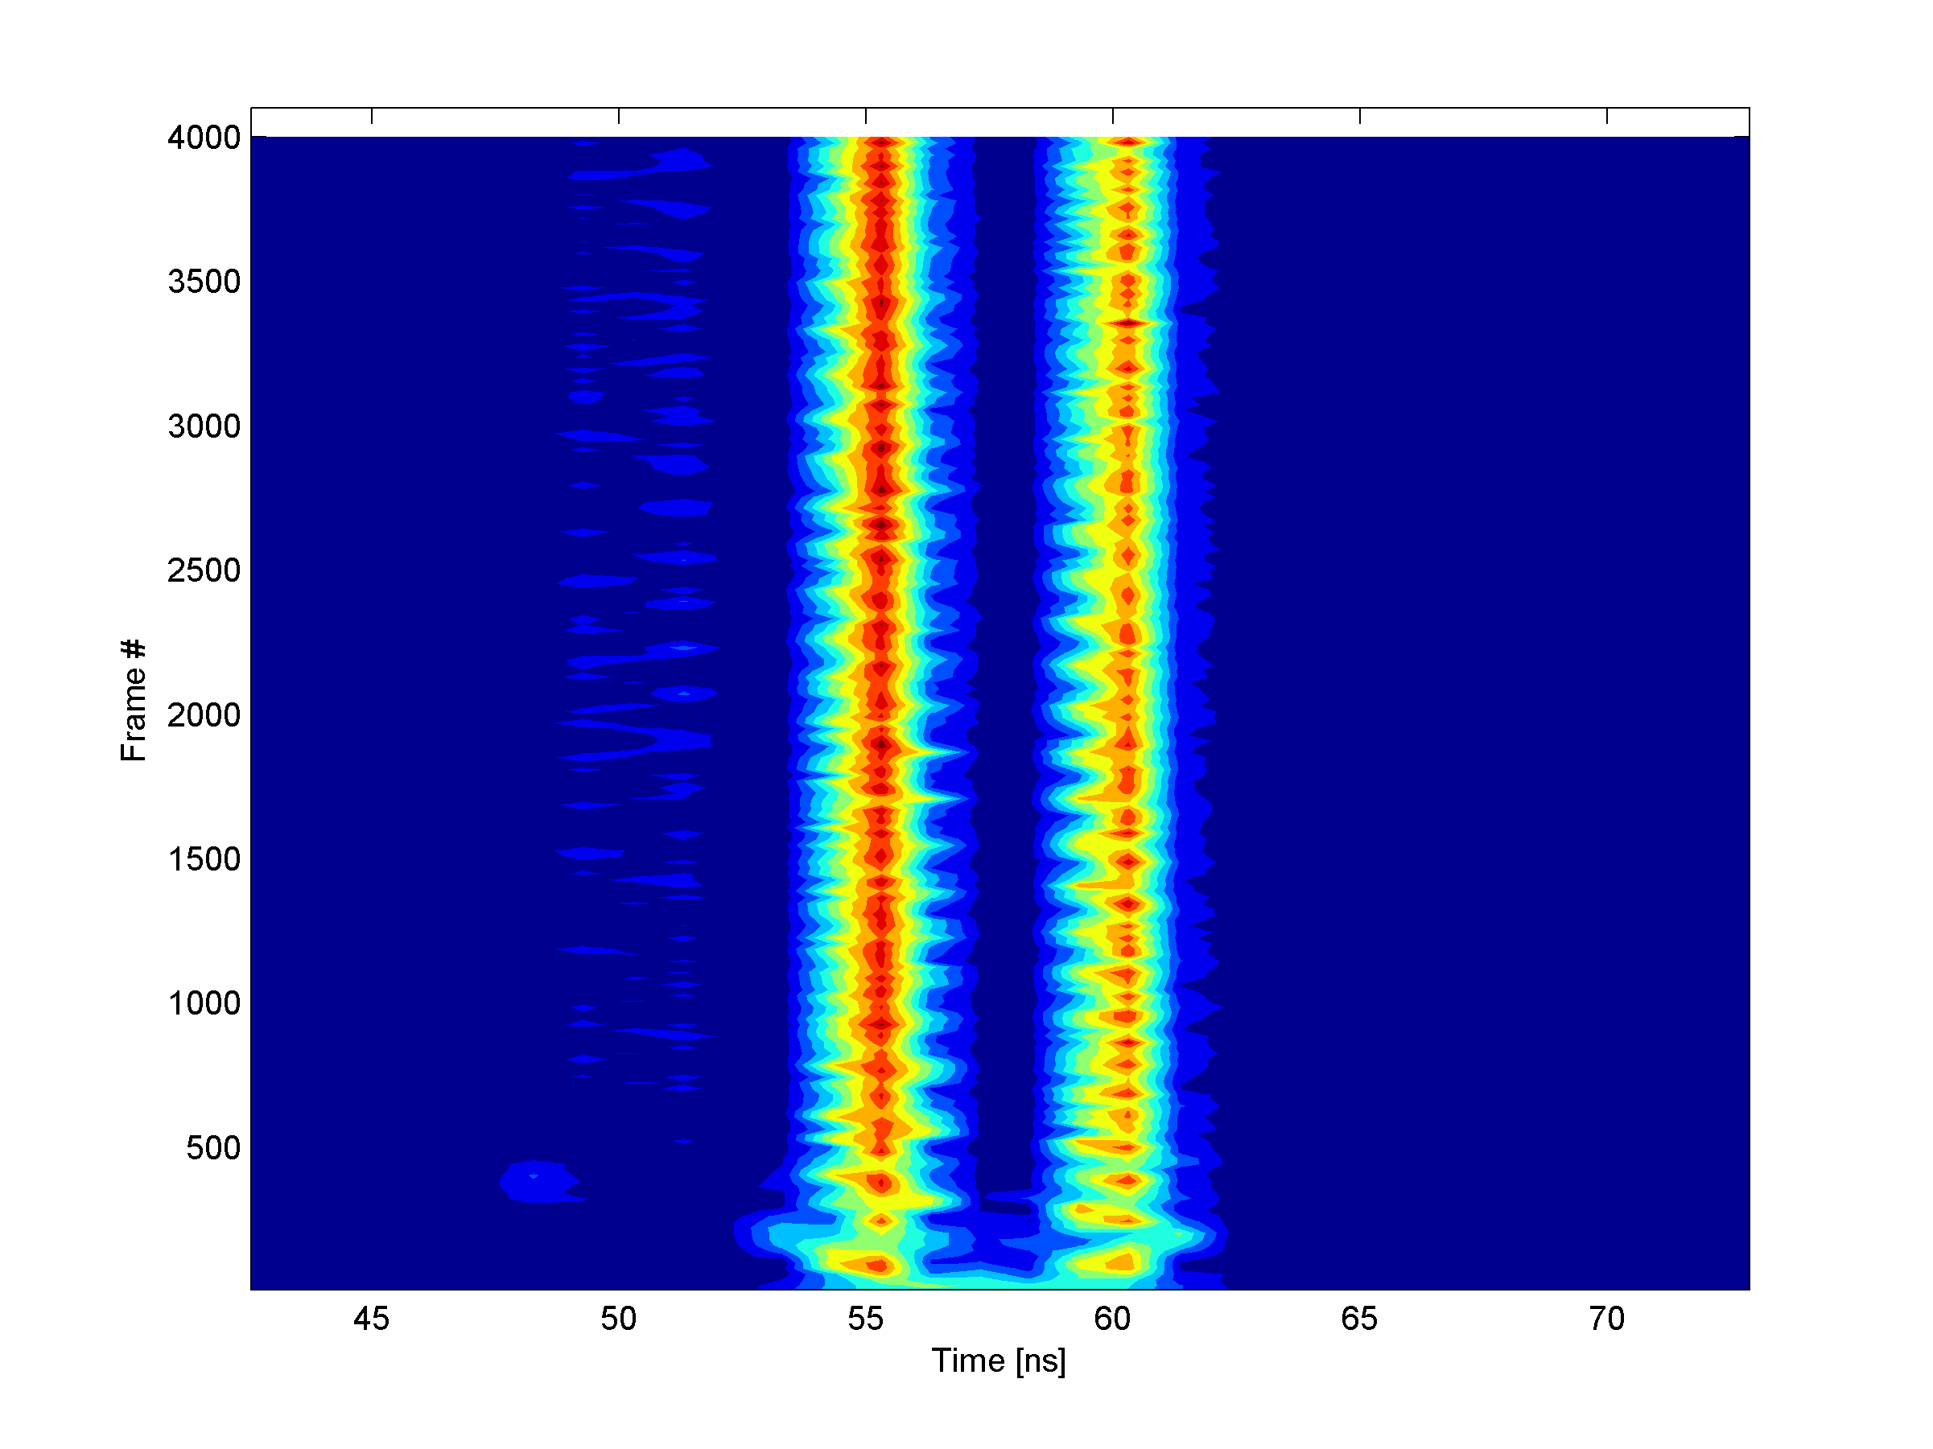
Test with single bunch
  Main indication from these tests:
  Max. capture (>95%) is obtained injecting on V_{RF}≤1MV and increasing to 3MV after few ms
Thanks to C. Lazaridis

Slide 26
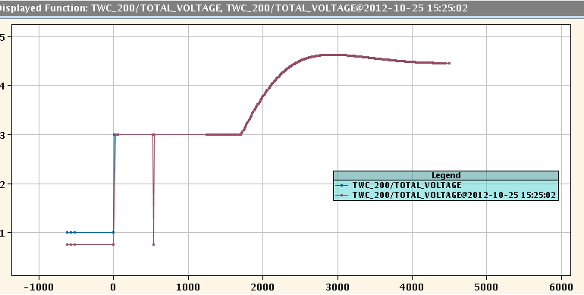
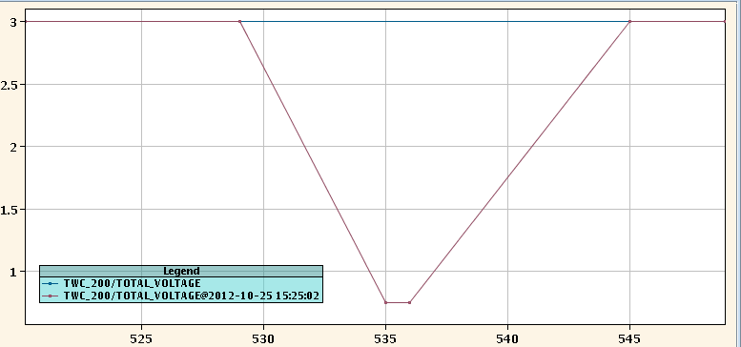
Test with single bunch
  Main indication from these tests:
  Max. capture (>95%) is obtained injecting on V_{RF}≤1MV and increasing to 3MV after few ms
  A dip in the voltage program, simulating a second injection, does not significantly affect the transmission

Slide 27
Outline
  Why a scrubbing beam
  Why “doublets”
  Tests with single bunch in the SPS
  Test with a bunch train
    Effect on strip-detector signal
    Effect on pressure along the ring
  Conclusions and future studies

Slide 28
Test with bunch train
  On 15 Oct. a first test was carried out with a single bunch:
  Special PS cycle for 72x(10ns long bunch) was setup by PS experts (up to 1.85ppb injected in the SPS)
  Same SPS cycle as for single bunch test (to check capture)
  Injecting with V_{RF}=1MV and ramping to 3MV in 5ms
  Damper OFF (setup to be done) → beam stabilized with high chromaticity (ξ_{x}=0.5, ξ_{y}=0.35)

Slide 29
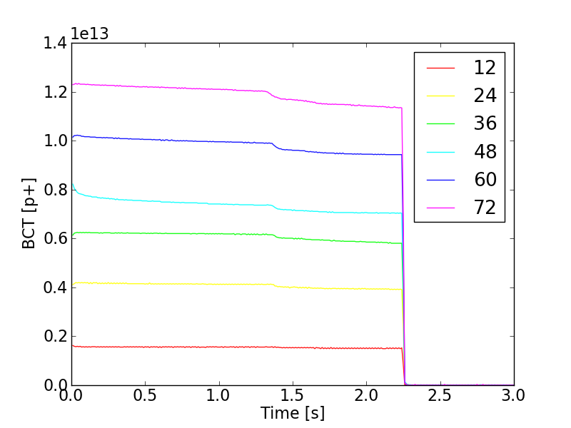
Test with bunch train
  Remarks:
  Still good capture

Slide 30
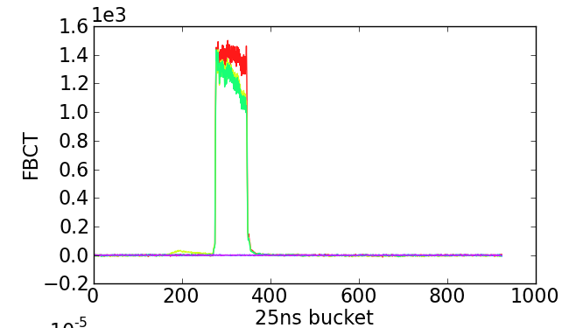
Test with bunch train
Increased chroma.
  Remarks:
  Still good capture
  We can control slow losses with high chromaticity settings

Slide 31
Test with bunch train: beam profile
  Beam profile along the cycle
Thanks to T. Argyropoulos and J. Esteban Muller

Slide 32
Test with bunch train: beam profile
  Beam profile along the cycle
Thanks to T. Argyropoulos and J. Esteban Muller

Slide 33
Test with bunch train: beam profile
  Beam profile along the cycle
Thanks to T. Argyropoulos and J. Esteban Muller

Slide 34
Test with bunch train: beam profile
  Beam profile along the cycle
Thanks to T. Argyropoulos and J. Esteban Muller

Slide 35
Test with bunch train
  Beam profile along the cycle
Thanks to T. Argyropoulos and J. Esteban Muller

Slide 36
Test with bunch train: beam profile
  Beam profile along the cycle
Thanks to T. Argyropoulos and J. Esteban Muller

Slide 37
Outline
  Why a scrubbing beam
  Why “doublets”
  Tests with single bunch in the SPS
  Test with a bunch train
    Effect on strip-detector signal
    Effect on pressure along the ring
  Conclusions and future studies

Slide 38
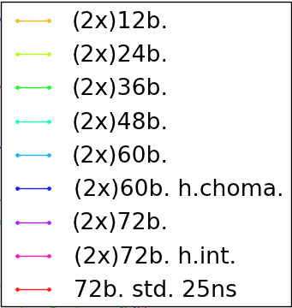
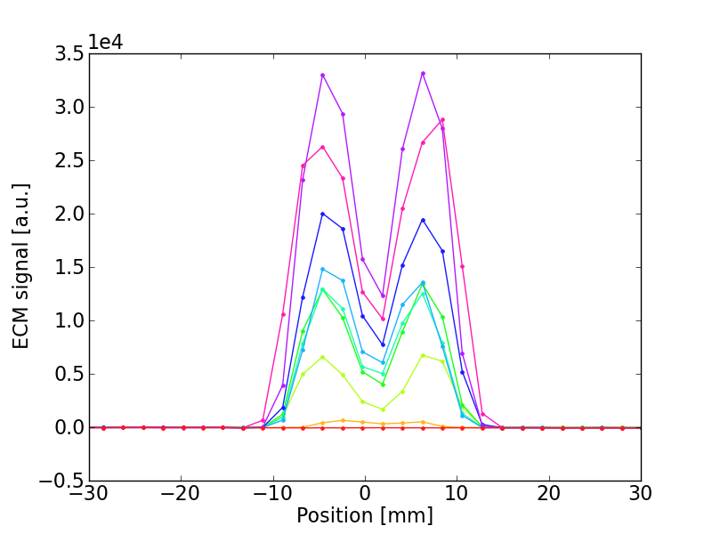
Test with bunch train: EC strip detectors
  MBA-like Stainless Steel liner
25ns “doublet” (1.7e11p/doublet)
25ns standard
(1.6e11p/bunch)

Slide 39
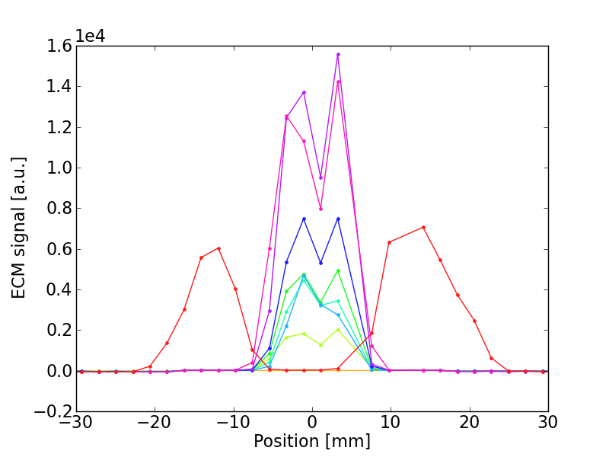
Test with bunch train: EC strip detectors
  MBB-like Stainless Steel liner
25ns “doublet” (1.7e11p/doublet)
25ns standard
(1.6e11p/bunch)

Slide 40
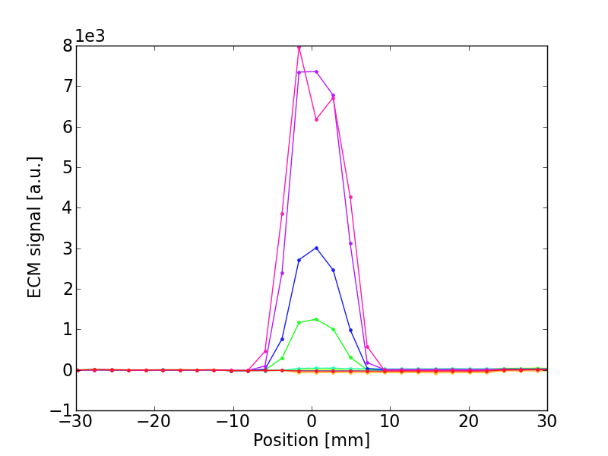
Test with bunch train: EC strip detectors
  MBB-like Copper liner
25ns “doublet” (1.7e11p/doublet)
25ns standard
(1.6e11p/bunch)

Slide 41
Outline
  Why a scrubbing beam
  Why “doublets”
  Tests with single bunch in the SPS
  Test with a bunch train
    Effect on strip-detector signal
    Effect on pressure along the ring
  Conclusions and future studies

Slide 42
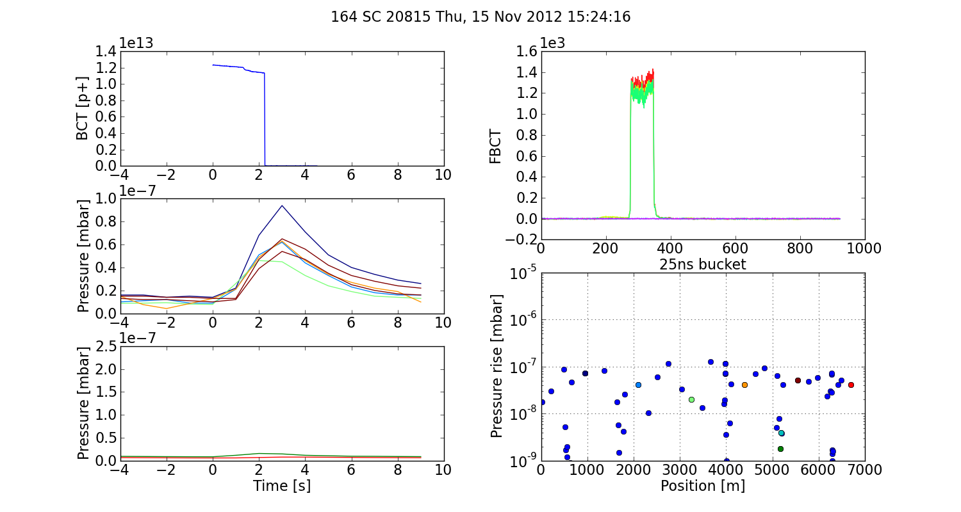
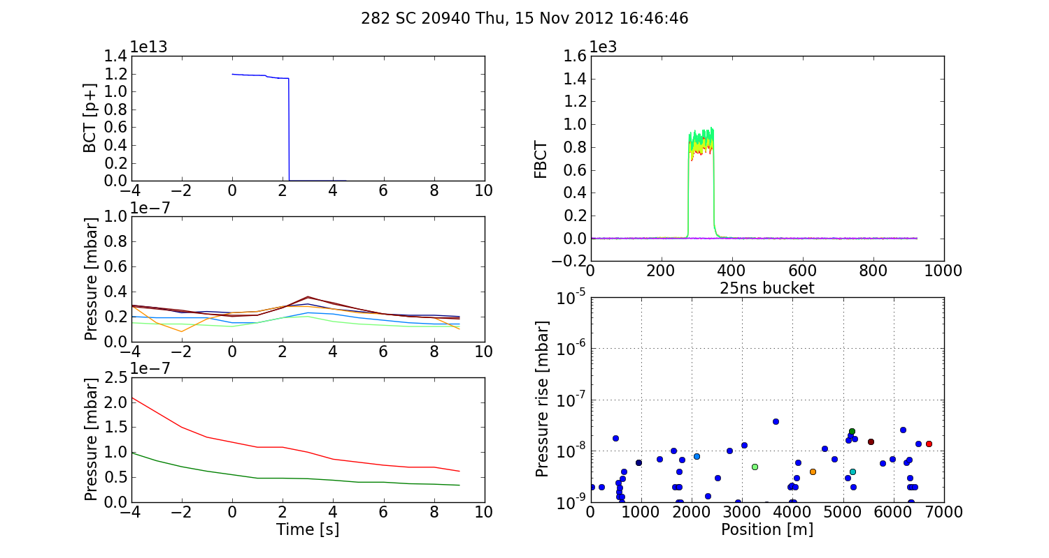
Test with bunch train: pressure
  72 “doublets”
Arcs
  72 bunches
Higher press. rise
Arcs

Slide 43
Outline
  Why a scrubbing beam
  Why “doublets”
  Tests with single bunch in the SPS
  Test with a bunch train
    Effect on strip-detector signal
    Effect on pressure along the ring
  Conclusions and future studies

Slide 44
Summary and proposals for future work
Summary:
  A 25ns spaced train with 72 “doublets” can be produced in the SPS by capturing 10ns long bunches into two SPS RF buckets
  A clear enhancement on the e-cloud signal w.r.t. standard 25ns beam has beam observed in the SPS strip detectors
  Enhancement observed also on the pressure rise along the ring
Future work:
  Transverse damper tests
  Tests with more than one batch
  Strategy for radial position displacement along future Scrubbing Runs (at 26GeV can be done with orbit correctors)

Slide 45
Thanks for your attention!

Slide 46
