Slide 1
Observations with 25ns beam in the SPS Q20 MDs in November 2012
H. Bartosik, G. Iadarola, Y. Papaphilippou, G. Rumolo
Longitudinal studies and optimization:
T. Argyropoulos, T. Bohl, J. Esteban Muller, E. Shaposhnikova, H. Timko
Many thanks to the SPS OP crew and
H. Damerau and S. Hancock for beam preparation in the PS
LIU-SPS-BD, 22. Nov. 2012

Slide 2
General
Few MDs with 25ns beam with nominal and high intensity in Q20
From nominal up to 1.65x10¹¹p/b at injection (→ 1.3x10¹¹p/b at flat top)
Good beam quality for nominal intensity
Issues for higher intensities
Longitudinal stability and transmission (see Theo’s presentation)
Transverse
Losses and emittance blow-up on the flat bottom for fourth and/or third batch
Increasing chromaticity helps to some extend (no stable conditions reached for highest intensity yet)
Wirescanners
Cannot measure at flat top! (2 wire breakages with high intensity 25ns beam)

Slide 3
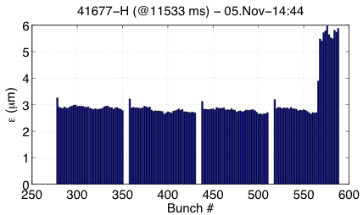
Transverse emittance blow-up
In horizontal plane for
Low chromaticity (ξ_{x}~0.15, ξ_{y}~0.2)
High intensity (1.4x1011p/b at injection)
Need to increase chromaticity and/or optimize damper settings

Slide 4
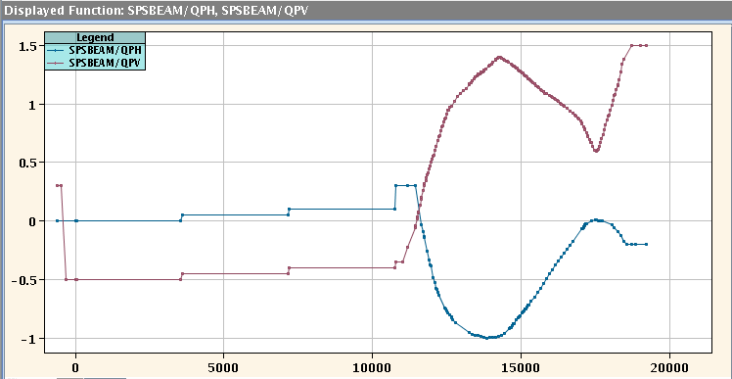
Optimized chromaticity knob settings
Introduced chromaticity steps at each injection for stabilizing beam
ξ_{y}~0.3 at the fourth injection
ξ_{y}~0.2 at the fourth injection (remember offset …)
Still slight horizontal instability for 4th batch with 1.4x10¹¹p/b at injection
No wire scans for higher intensity performed after the last wire breakage
Further optimization of chromaticity and/or damper settings needed

Slide 5
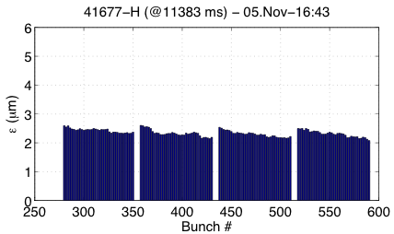
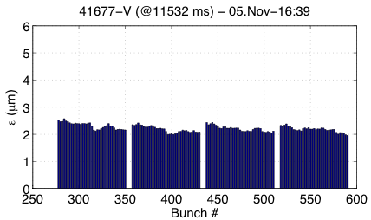
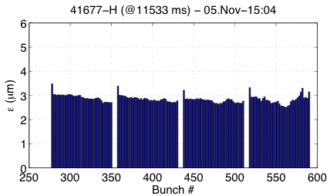
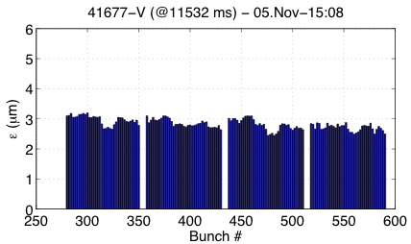
Bunch-by-bunch emittances – End of flat bottom
~ 1.2x10¹¹p/b @ injection
~ 1.10x10¹¹p/b @ flat top
~ 1.4x10¹¹p/b @ injection
~ 1.25x10¹¹p/b @ flat top

Slide 6
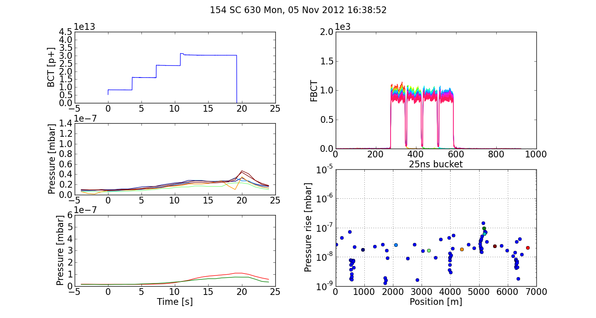
Pressure rise – 1.2x10¹¹p/b @injection

Slide 7
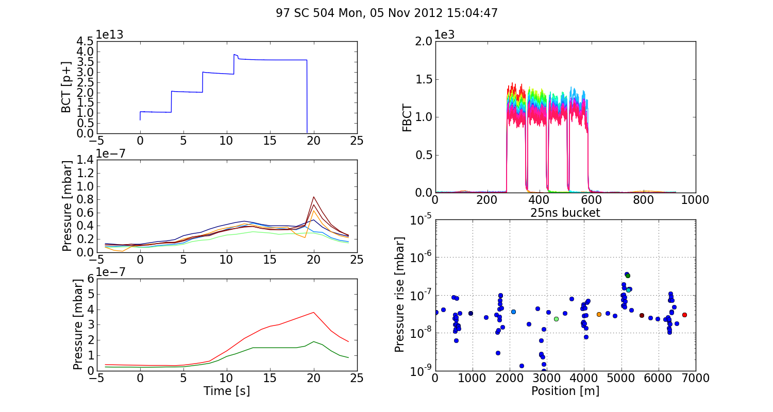
Pressure rise – 1.4x10¹¹p/b @injection

Slide 8
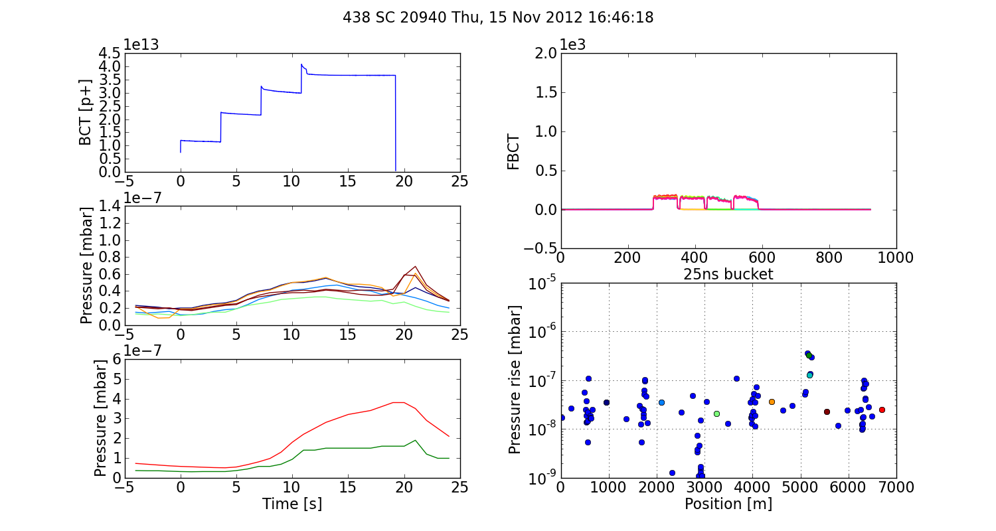
Pressure rise – 1.6x10¹¹p/b @injection

Slide 9
Summary
Nominal intensity
In good shape (transverse emittance and longitudinal stability/quality at flat top)
1.1x10¹¹p/b at flat top
Higher intensity ≥ 1.4x10¹¹p/b at injection
Need to increase chromaticity on flat bottom and probably optimize damper settings – especially in horizontal plane
Transmission depends strongly on voltage settings on flat bottom (see Theo’s presentation)
Pressure rise increasing with intensity – but still very small compared to early years
Further studies needed with high intensity
Optimization of transverse and longitudinal settings
Beam instrumentation to be improved
Wirescanners for high intensity
Fast BCT

