Slide 1
PS-to-SPS Transfer Studies
Helga Timkó
BE-RF-BR
in collaboration with
Theodoros Argyropoulos, Thomas Bohl, Heiko Damerau, Steven Hancock, Juan Esteban Müller, Elena Shaposhnikova

Slide 2
Outline
Reminder of previous results
Measurements
Simulations in BSM
Optimisation of PS bunch rotation
Voltages and timings
Phase and energy errors at injection
Their impact on the transmission
SPS voltage at injection
Losses at the start of the acceleration ramp

Slide 3
PREVIOUS RESULTS
PS-TO-SPS TRANSFER:

Slide 4
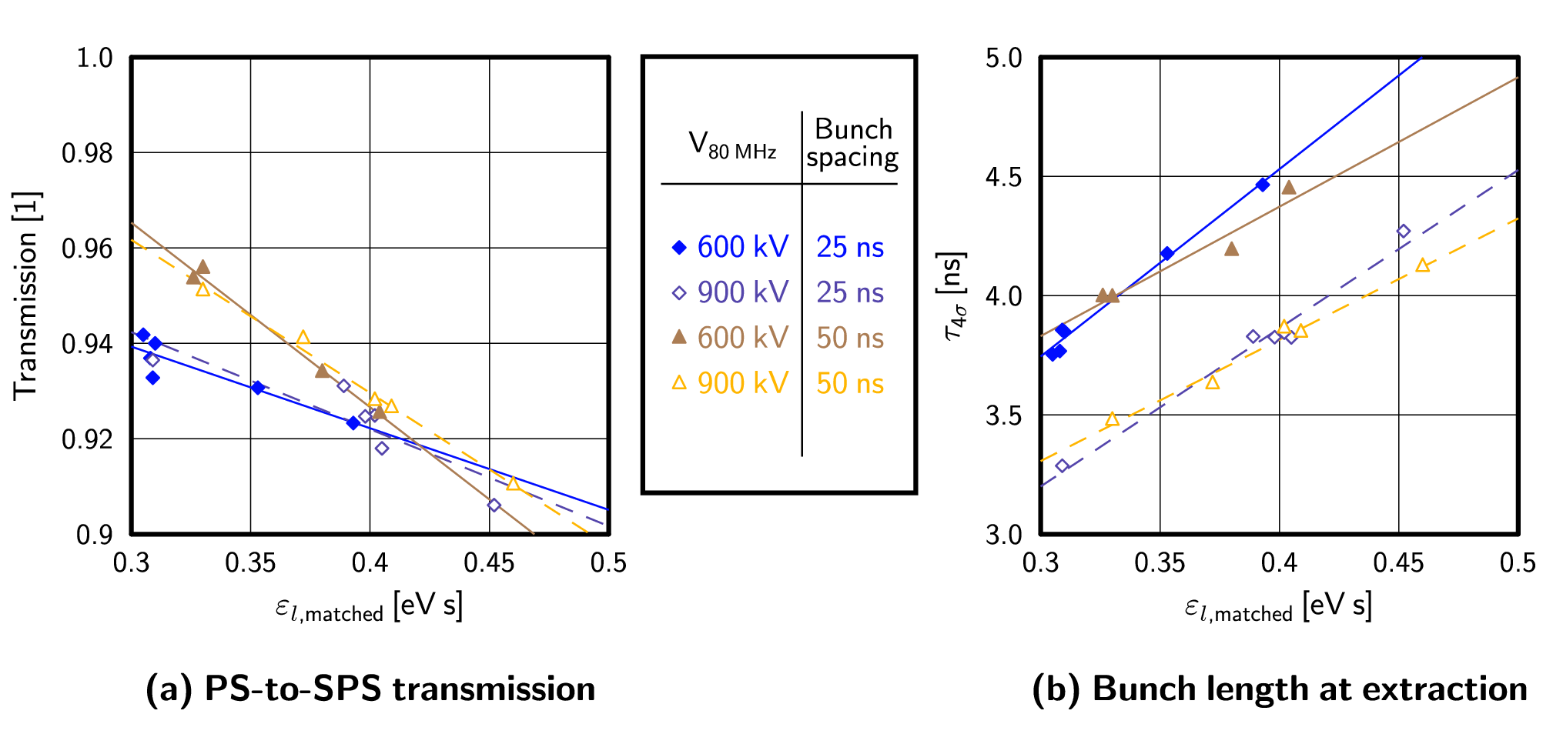
MDs: 25 ns and 50 ns beam
50 ns: 4th July 2011
25 ns: 7th November 2011
Transmission didn’t improve using 900 kV

Slide 5
PS rotation timing
However, in the MDs above we adjusted only t_{80 MHz}
t_{40 MHz} = 150 μs was kept the same for both 600 kV and 900 kV cases

Slide 6
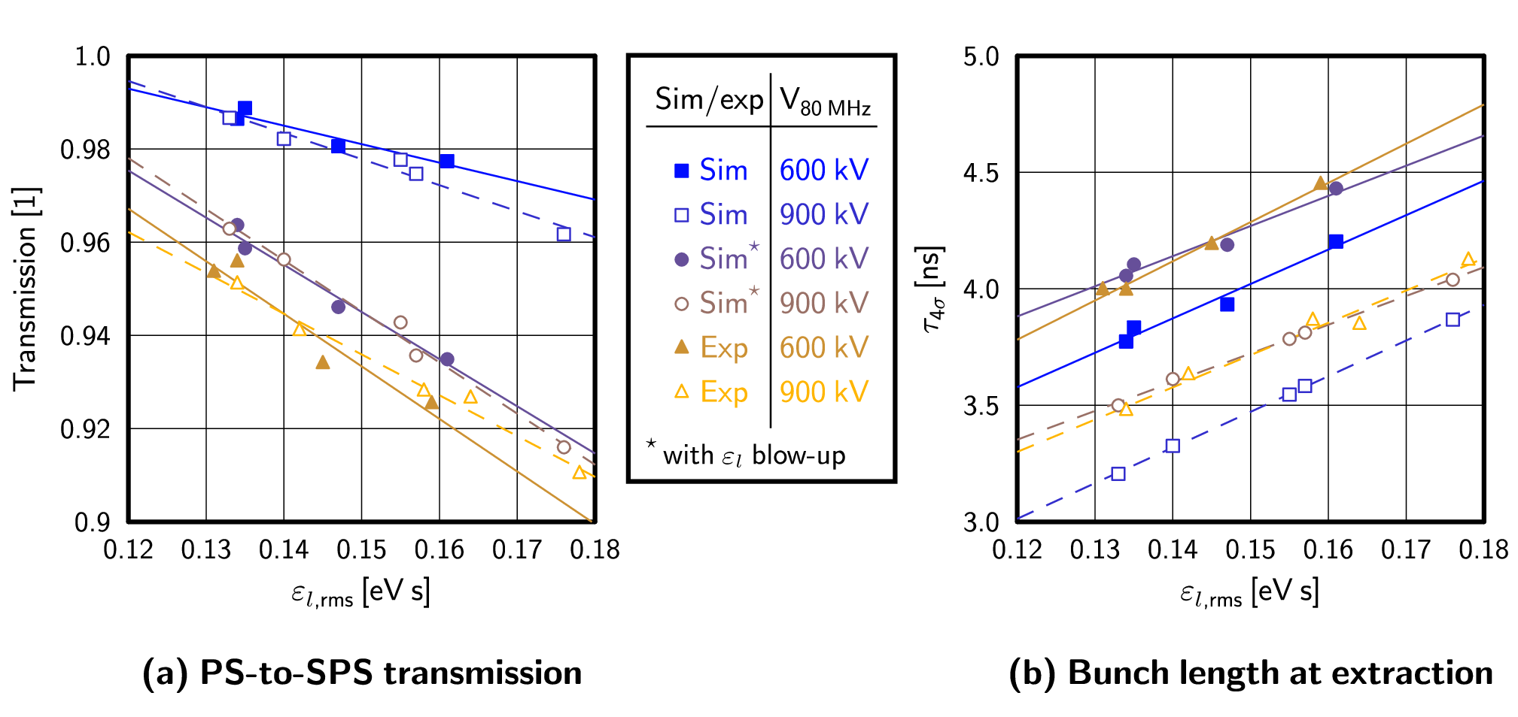
Corresponding simulations
Corrected: now with SPS 800 MHz component in BSM
Reproduce exp. results when emittance blow-up is added
Notes:
In simulations, the voltage programme and the initial particle distributions were exactly the same as during the MDs. However, simulations are idealised: single bunches, neglecting intensity effects, have been modelled.

Slide 7
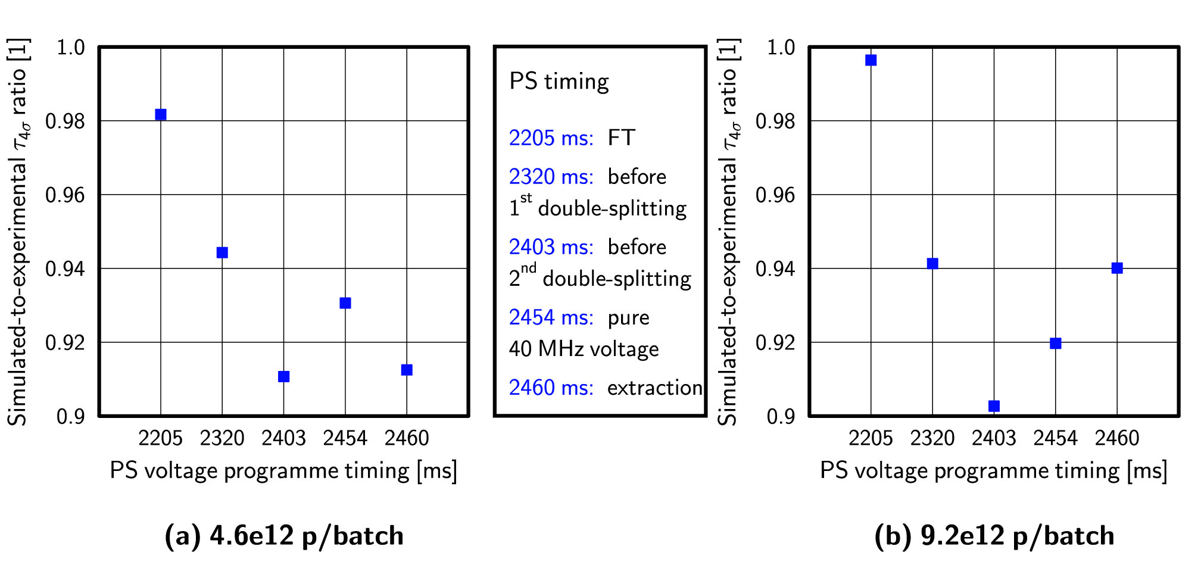
Emittance blow-up
… turns out to be justified (MD on 1st November 2011):
There is an emittance blow-up in the PS at FT

Slide 8
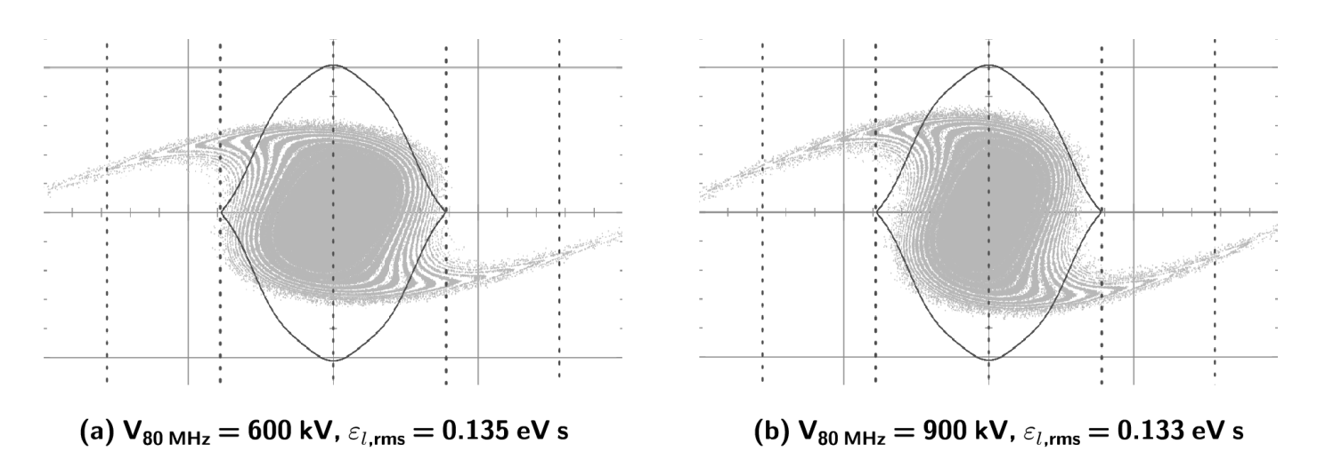
Bunch shapes
… look difficult to capture: what can we do about these long tails?

Slide 9
OPTIMISATION STUDIES
PS-TO-SPS TRANSFER:

Slide 10
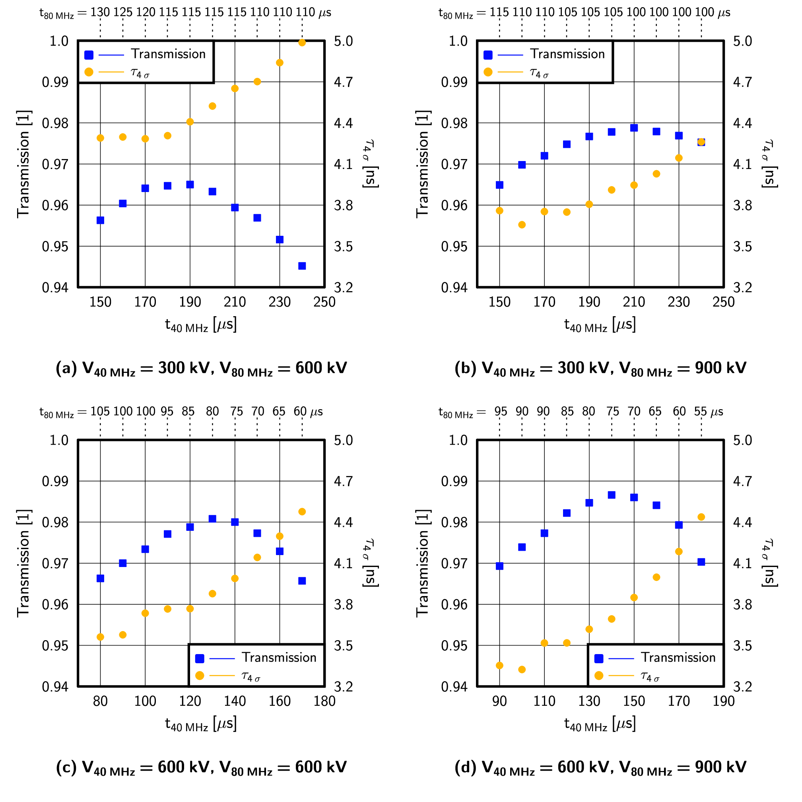
Optimising the bunch rotation
For 1+2 cavities, optimal timing reduces losses: 4.4 % → 3.5 %
Using 2+3 cavities instead of 1+2:
3.5 % → 1.3 %

Slide 11
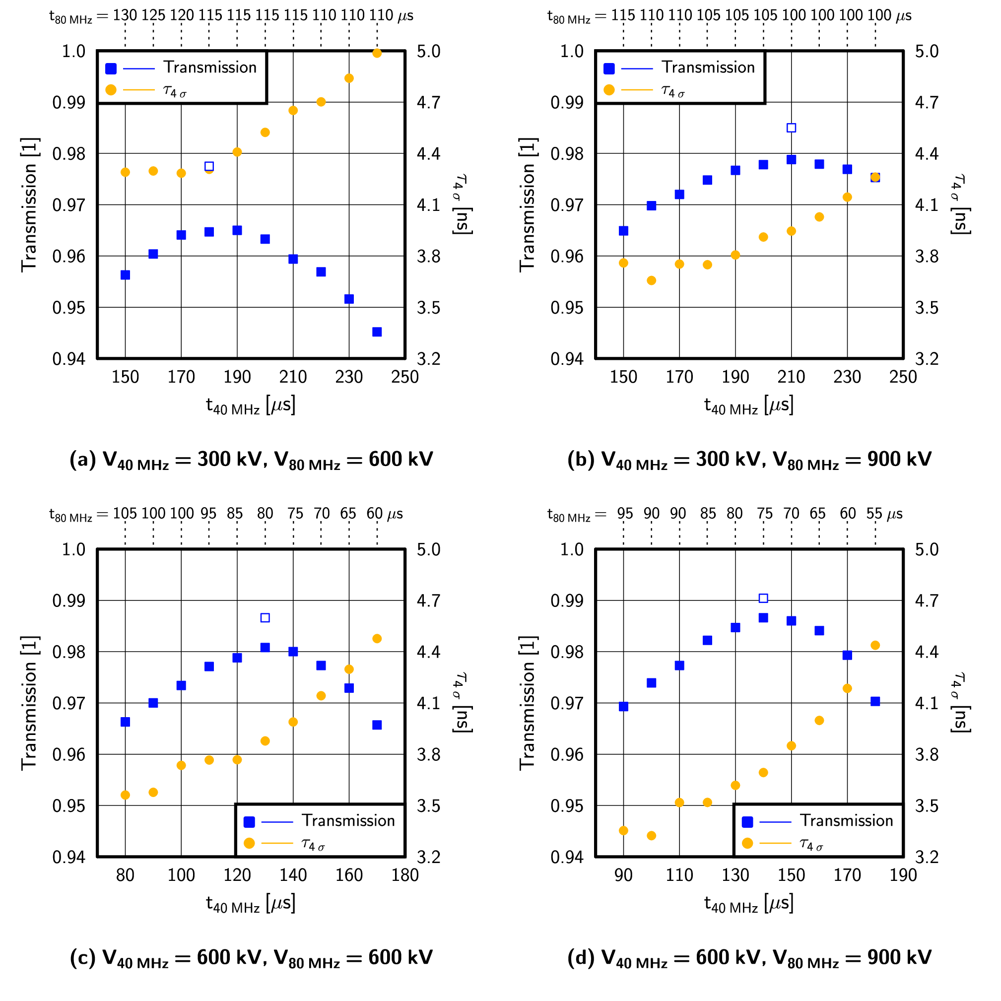
Optimising the bunch rotation
For 1+2 cavities, optimal timing reduces losses: 4.4 % → 3.5 %
Using 2+3 cavities instead of 1+2:
3.5 % → 1.3 %
Transmission is better in BLM, but BLM is unstable

Slide 12
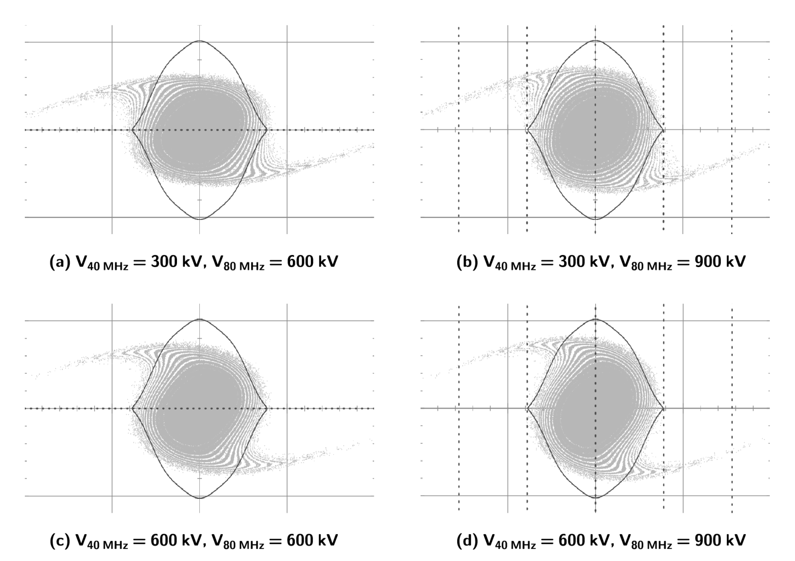
Optimised bunch shapes
… now improved:
tails less populated

Slide 13
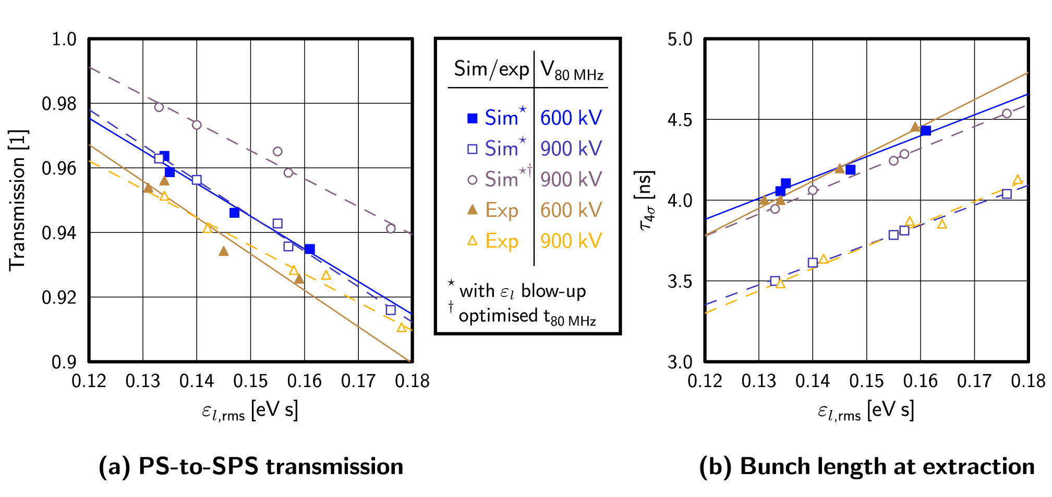
Effect on transmission
With optimised timing and 900 kV in the PS:
Losses are reduced, despite having longer bunches

Slide 14
FURTHER PARAMETERS OF IMPACT
PS-TO-SPS TRANSFER:

Slide 15
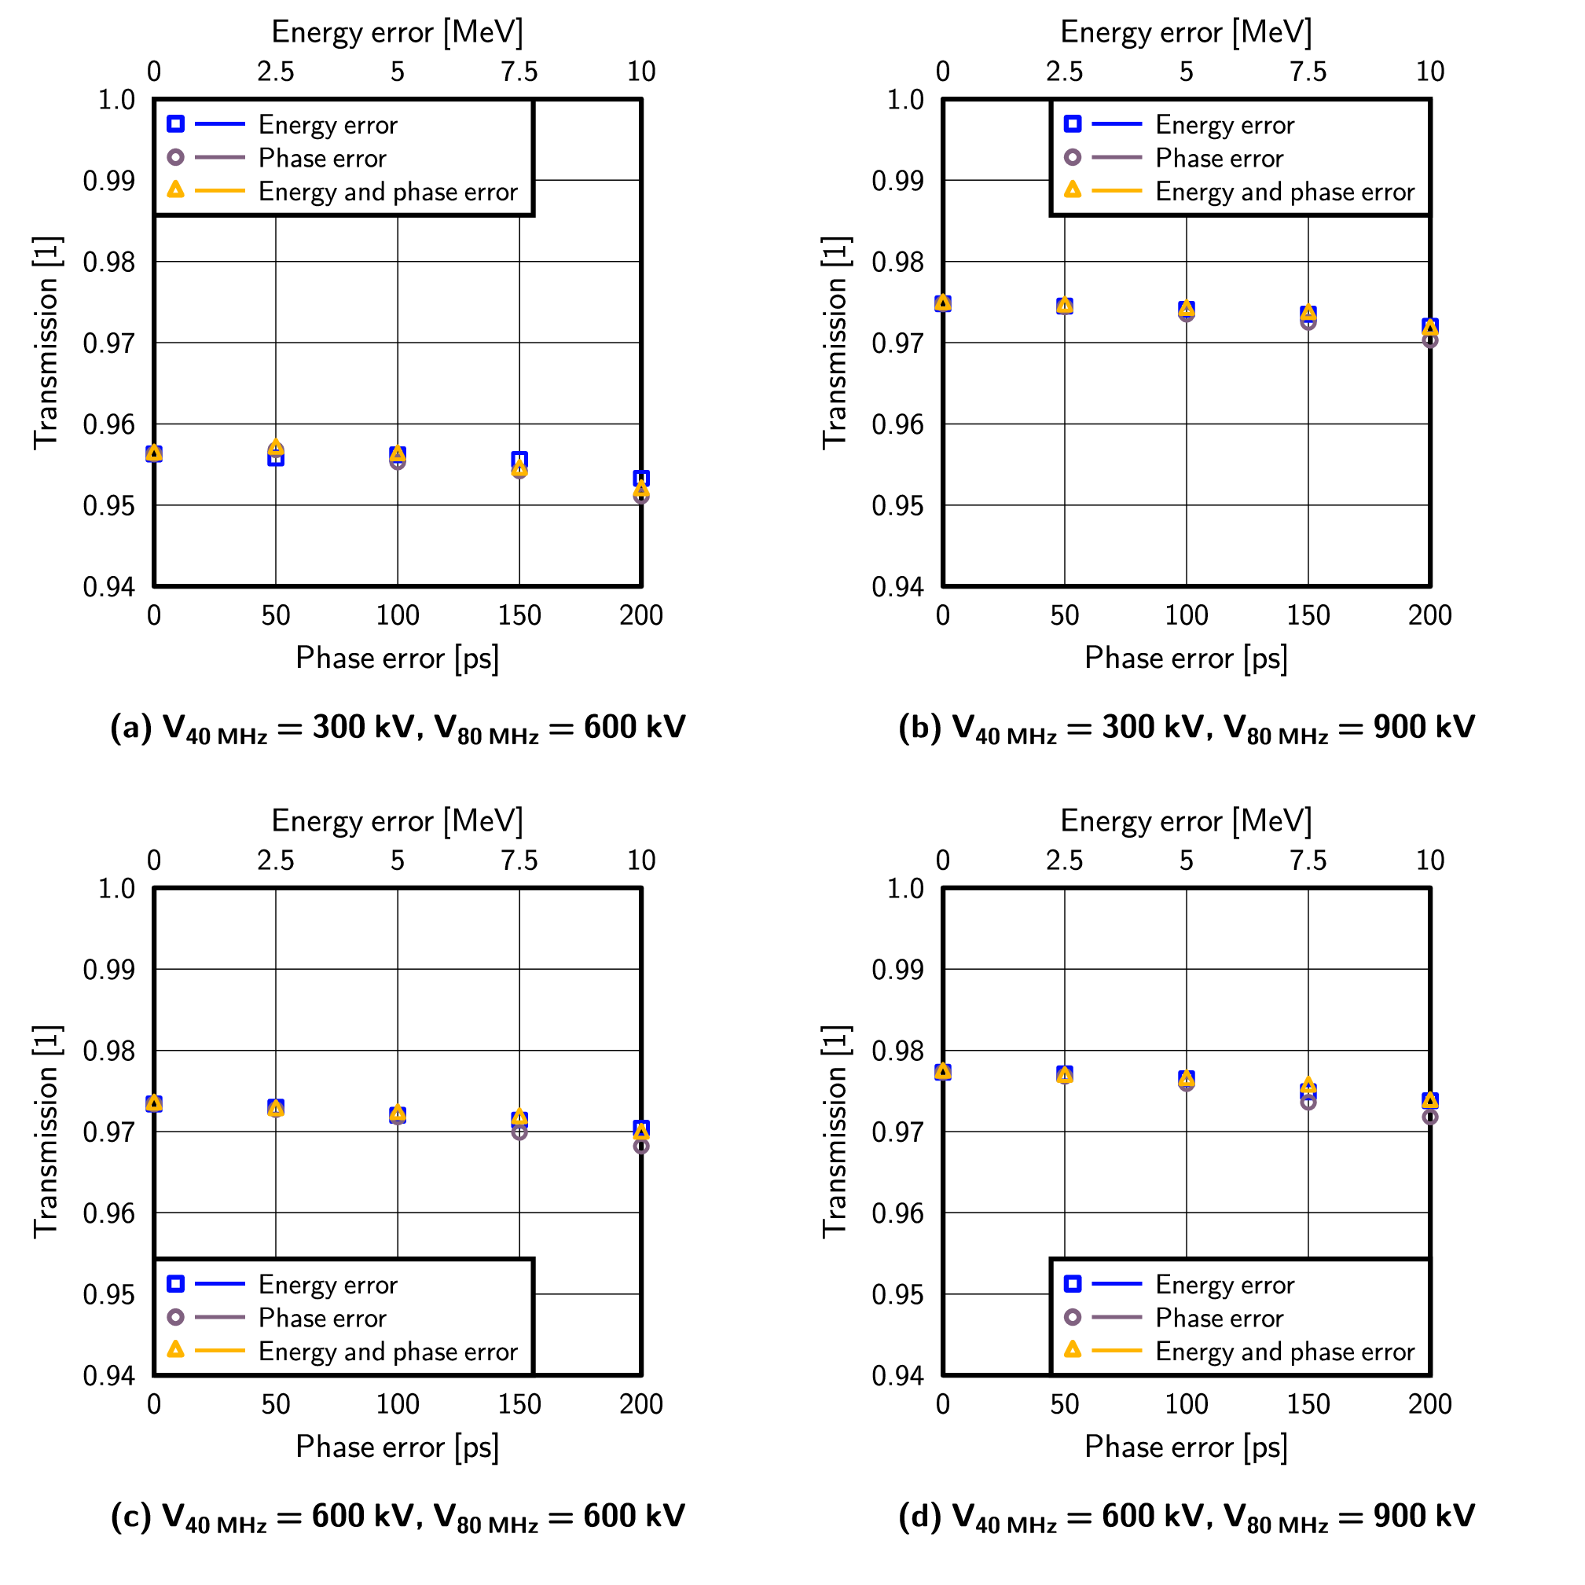
Injection to SPS: phase and energy errors
When the timing t_{40 MHz} is 30 μs below optimal

Slide 16
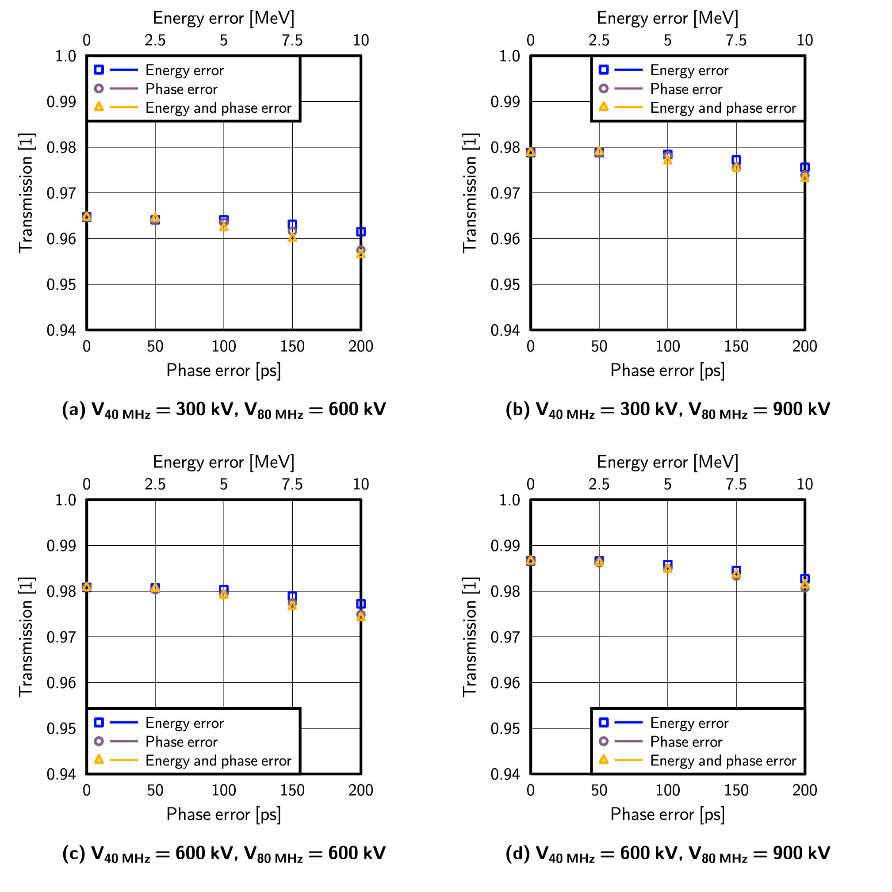
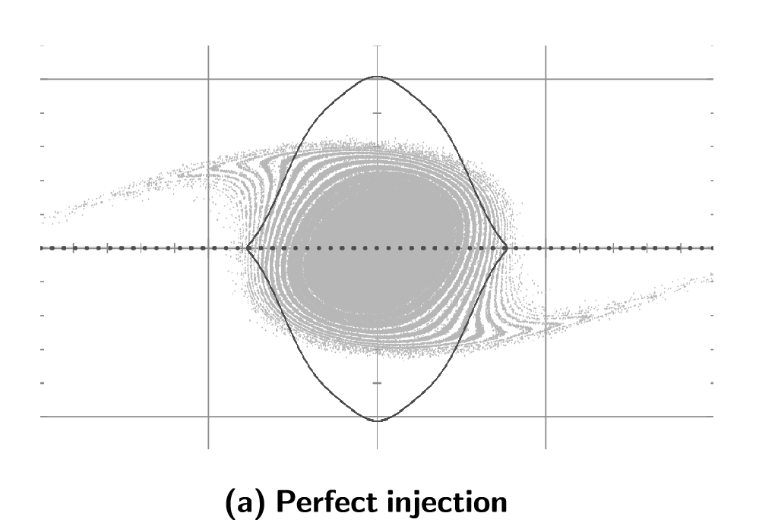
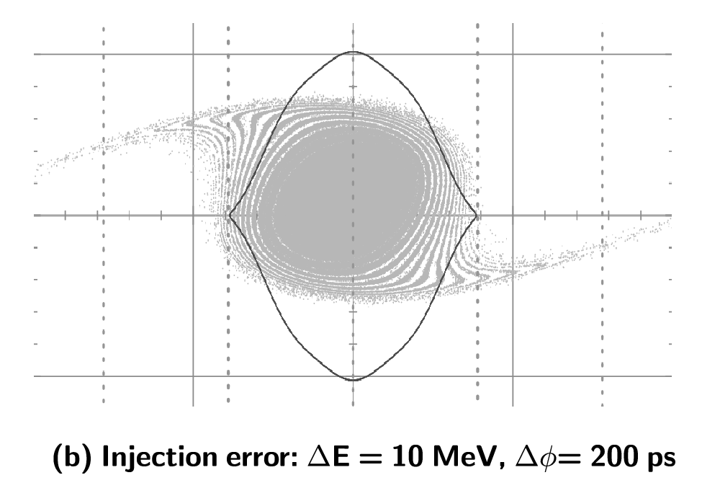
Injection to SPS: phase and energy errors
When the timing t_{40 MHz} is optimal

Slide 17
SPS capture voltage
The choice of the SPS voltage at injection can largely influence the losses in the beginning of the acceleration ramp
Observed ranking in measurements:
The best: 2 MV at injection, 3 MV in-between injections (2↑3 MV)
2 MV constant and 3 MV constant result in more losses
Losses vary with beam intensity, emittance 800 MHz RF voltage, number of injected batches, etc.

Slide 18
SPS capture voltage
Using the real voltage and momentum programme for the acceleration ramp, we simulated injection + acceleration:
2↑3 MV has 3-4 % better transmission than 3 MV
No difference between 2 MV and 2↑3 MV is seen in our sims

Slide 19
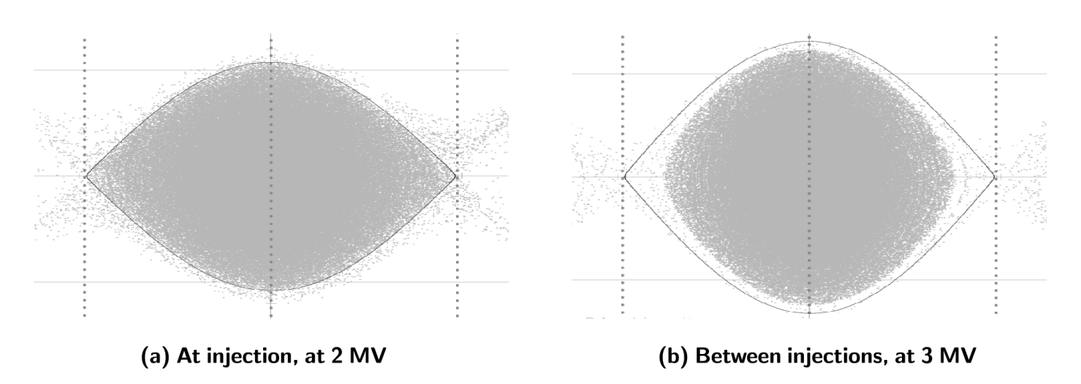
SPS capture voltage: interpretation of results
Constant injection voltage → the bunch fills the bucket
Higher voltage ⇒ more losses during acceleration
2↑3 MV behaves as 2 MV constant – at least in our simulations, where intensity effects were not considered:

Slide 20
Summary
Even after optimisation, the PS “S” bunch completely fills the SPS bucket ⇒ sensitive to settings and intensity effects
Simulations predict: bunch shape at transfer can be considerably optimised by PS rotation voltages and timing
Use of 3rd 80 MHz cavity gives ~ 2 % improvement in transmission
Use of 3rd 40 MHz cavity gives smaller improvement, ~ 1 %
New optimum timings for both present configuration and additional cavities to be tested in MDs (planned 2012)
Injection errors in phase and energy add ~ 1 % losses
BSM increases losses by ~ 1 % compared to single RF
SPS capture voltage can affect losses in the beginning of the acceleration ramp
Simulations explain empirically found improvements for 2↑3 MV
We can expect significant increase in losses for higher emittances (intensities)
All simulations so far were done for single bunches, without taking intensity effects into account.

