Slide 1
Update on single bunch instability on the SPS flat top
J. Esteban Müller, T. Argyropoulos, T. Bohl, E. Shaposhnikova, H. Timkó

Slide 2
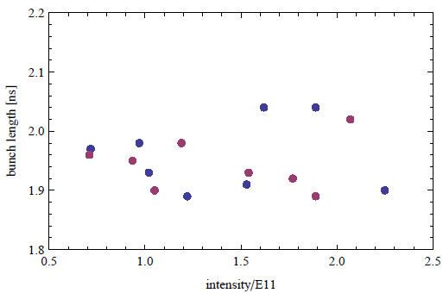
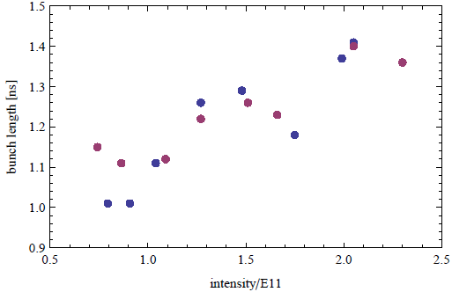
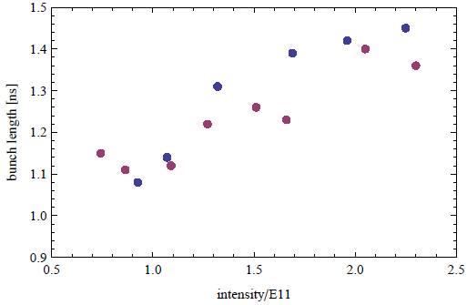
Bunch lengths at SPS before extraction
During the LHC MD #1 we observed:
Dependence of bunch length on intensity for smaller bunches
Beam 1
Beam 2

Slide 3
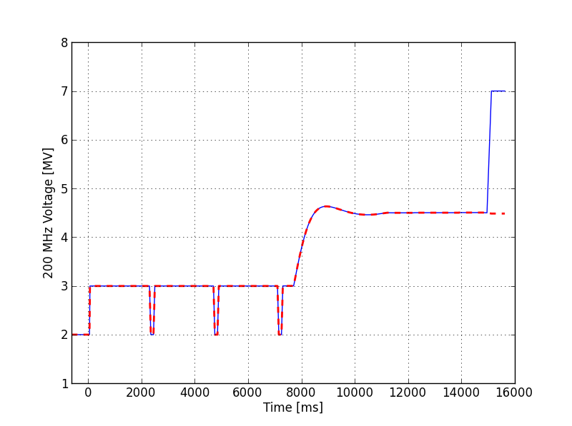
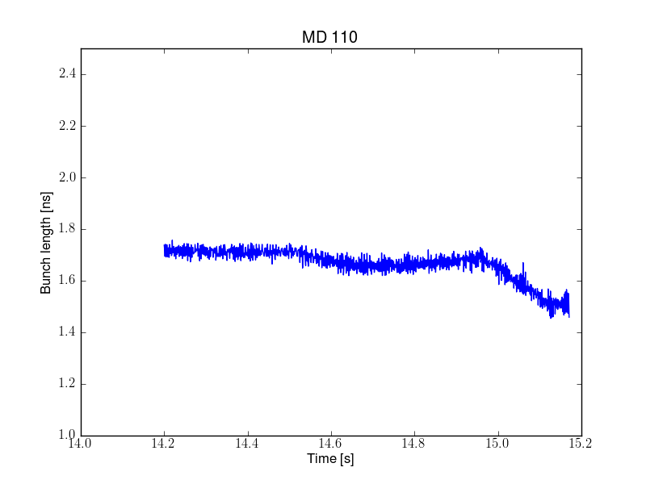
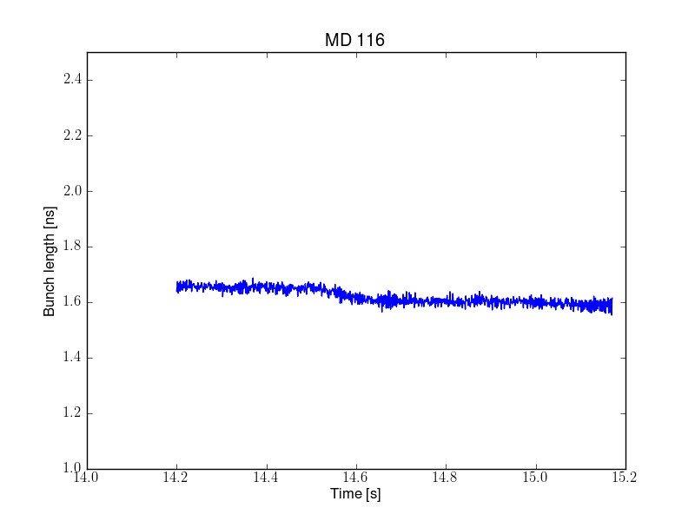
Different voltage at SPS extraction
Loss of Landau damping observed at the end of the FT
Keeping the voltage constant to 4.5 MV at the FT improves stability
7 MV
4.5 MV

