Slide 1
(Quick?) update on the PS-to-SPS transfer MDs
Helga Timkó
BE-RF-BR
in collaboration with
Theodoros Argyropoulos, Thomas Bohl, Heiko Damerau, Steven Hancock, Juan Esteban Müller, Elena Shaposhnikova

Slide 2
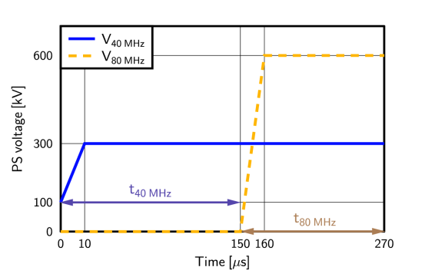
Measurement conditions
We have a dedicated cycle now, LHCMDION, for systematic measurements under stable conditions
Single batch, 50 ns spaced LHC-type beam, 36 bunches
Intensity: 1.6-1.7× 10¹¹ ppb
Varying the PS rotation timings t_{40 MHz} and t_{80 MHz}
SPS voltage as usual
SPS FB is shortened to 1260 ms
SPS acceleration ramp only until at 30 GeV
Bunch length:
at PS ejection
Transmission:
(intensity at 30 GeV) / (injected intensity)

Slide 3
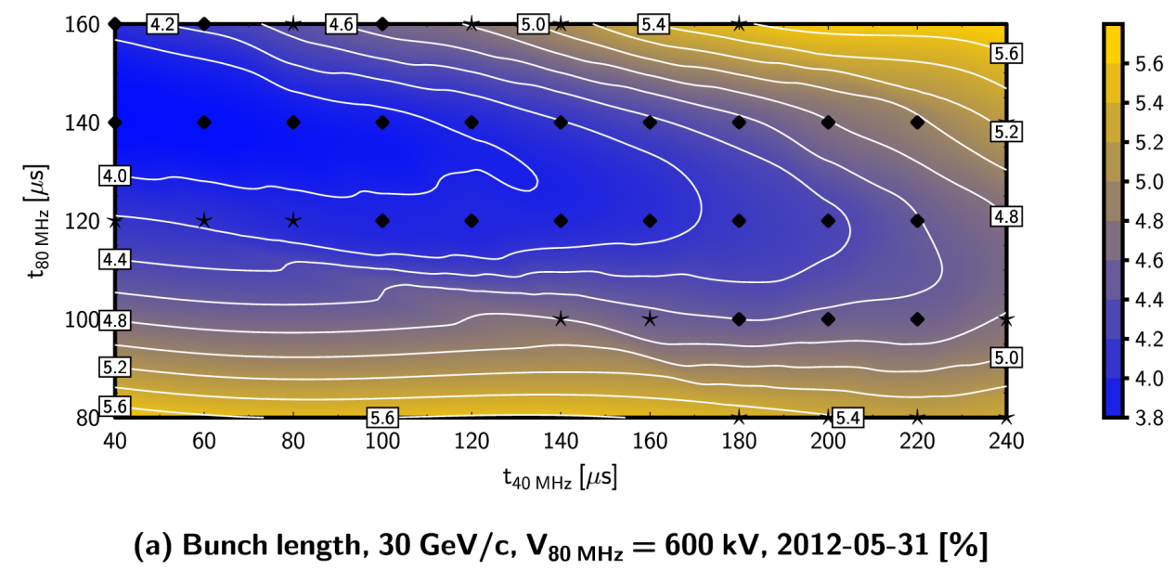
1×40 MHz, 2×80 MHz cavities
Gain:
T_{OP} = 96.2 %
T_{MAX} = 97.1 %

Slide 4
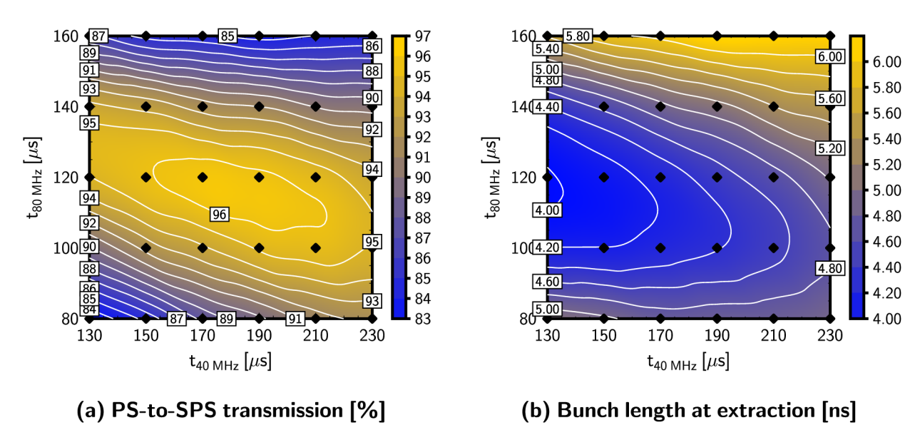
… in agreement with the previous MD & simulations…
Previous MD w/ 25 ns, different intensity, cycle, etc.
Simulated T & τ
FAIRLY REPRODUCIBLE!

Slide 5
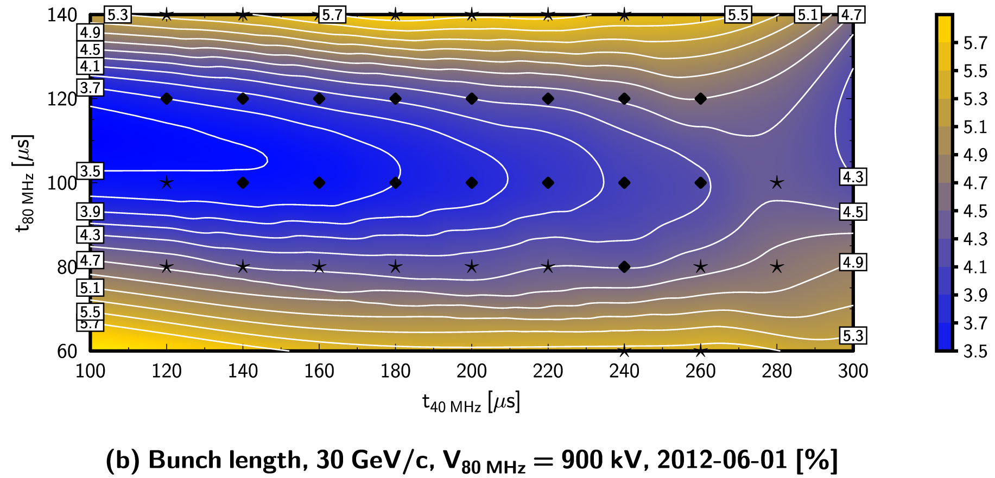
1×40 MHz, 3×80 MHz cavities
Gain:
T_{OP} = 95.4 % (1+2 cav’s)
T_{MAX} = 96.3 % (1+3 cav’s)
N.B. we used larger ε_{long} than operational, also for measuring T_{OP}
∴ not a perfect reference

Slide 6
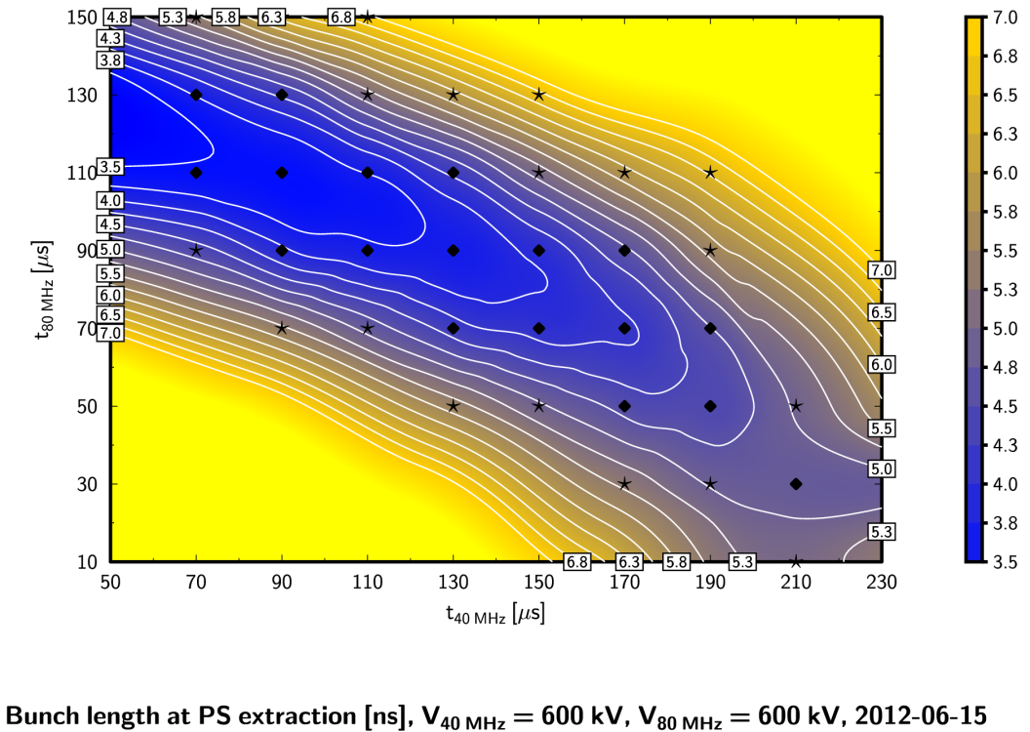
2×40 MHz, 2×80 MHz cavities
Gain:
T_{OP} ≈ 94.8 % (1+2 cav’s)
T_{MAX} = 97.7 % (1+3 cav’s)
As predicted by sim’s…
N.B. we used larger ε_{long} than operational, but not for T_{OP}

Slide 7
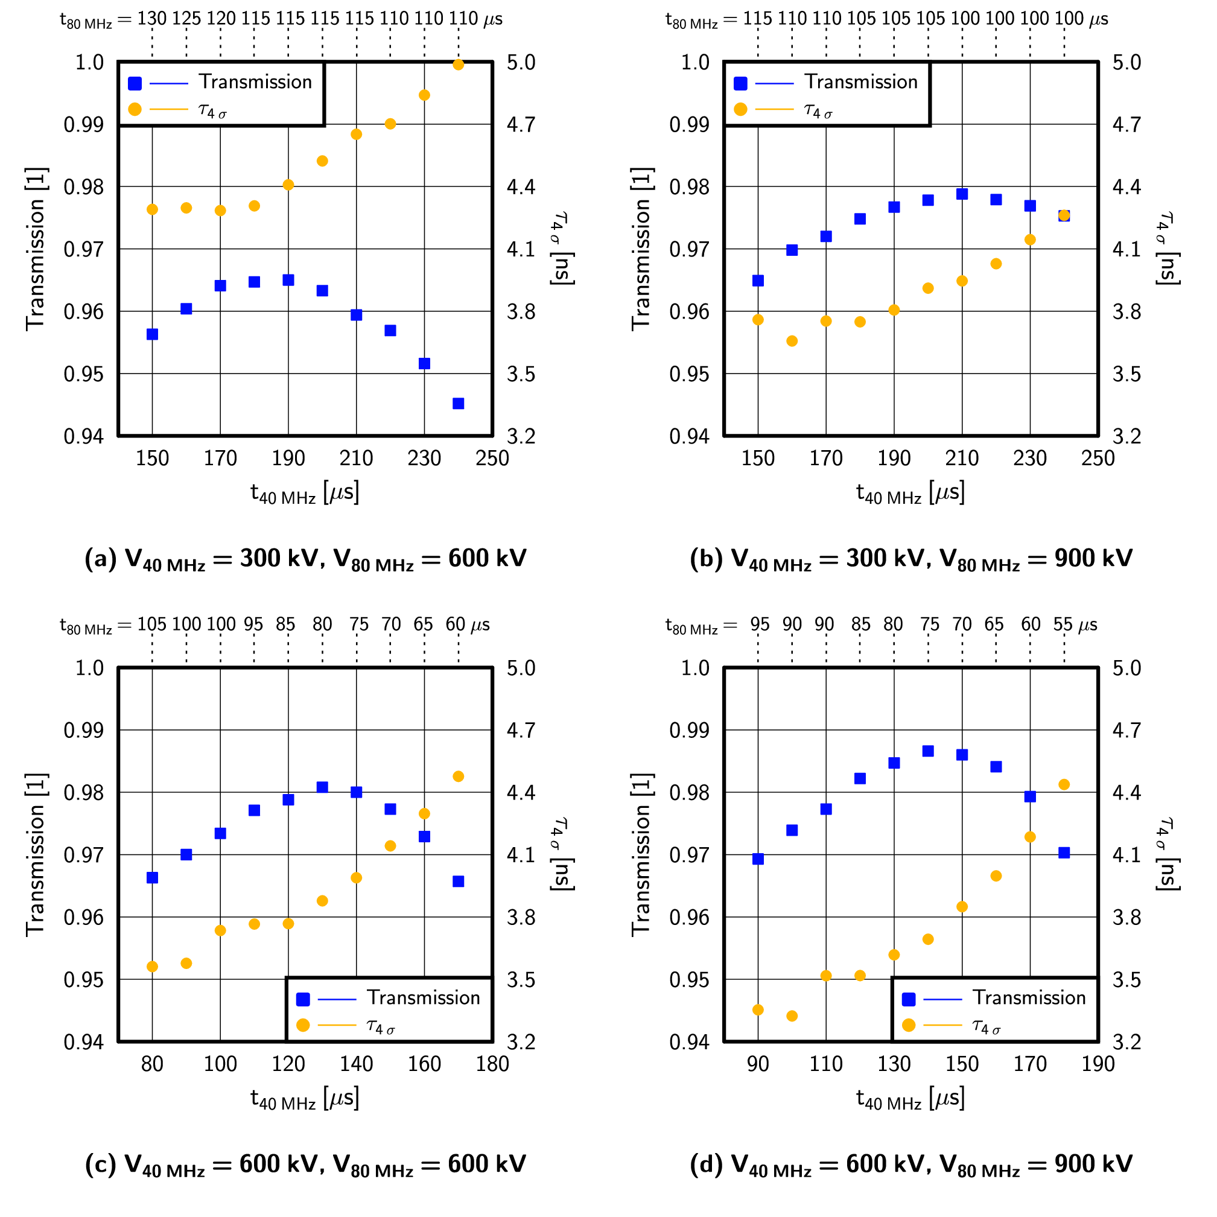
Loss balance
Simulated:
L_{OP} = 4.4 %
L_{MIN,1+2cav} = 3.5 %
L_{MIN,1+3cav}= 2.1 %
L_{MIN,2+2cav} = 1.9 %
L_{MIN,2+3cav} = 1.3 %
Measured:
1+2 cav.: 3.8 → 2.9 %
1+3 cav.: 4.6(?) → 3.7 %
2+2 cav.: 5.2 → 2.3 %
Optima in the predicted places
Optimum ‘corridor’ slope as expected, too

Slide 8
Conclusions
We have now a set of systematic, reproducible measurements for different voltage options
The ‘2+2 cavity’ case shows significant improvement
The ‘1+3 cavity’ case should be repeated for completeness
An additional measurement of the optimal timings with different voltages and one single reference point is also necessary to correctly estimate the gain in the different cases
We used larger ε_{long} than usual for the measurements with spare cavities
For 1+2 cavities, once we also tried the optimal timing when additional blow-up was applied in the PS; the transmission got slightly worse
Need further studies on the emittance margin
Only 3 weeks left to complete our studies, to verify the above!

