Slide 1
RF measurements during floating MD in Week 46 15th of November 2012
Participants:
T. Argyropoulos, H. Bartosik, T. Bohl, J.F. Esteban Muller,
E. Shaposhnikova, H. Timko
LIU-SPS BD WG 13/12/2012

Slide 2
General
MD title:
Longitudinal set up of the 25 ns LHC beam with Q20 optics
MD aim:
Achieve beam stability and acceptable beam parameters at flat top
for high intensities
Focused on the first batch: this suffers more → phase loop + bunch length
decreasing along the flat bottom → smaller bunch lengths (emittances)
Beam conditions:
Single batch of 72 bunches
Intensities at injection N_{p}~(1.6-1.7) x10¹¹ p/b → ~(1.31-1.4) x10¹¹ at FT
Large incoming longitudinal emittances from the beginning (τ_{avg} ~ 4.2 ns)
Varying parameters @SPS:
TWC 200 MHz voltage amplitude at FB (operation always in double RF)
Longitudinal emittance blow-up (amplitude and only at the very end)

Slide 3
Summary (of previous MD@5-11-2012)
Bad transmission:
~85-89 % with single batch
~90-92 % with 4 batches
Optimal machine conditions for N_{p}~1.3x10¹¹ p/b at FT
Not yet for higher intensities
Significant improvement with longer incoming bunches (τ_{inj} ~4.2 ns)
as in the operational 50 ns beam. → more losses (1-2% ?)
It seams that for smaller bunches with higher intensities BUP is more difficult
to optimize (observed also in the past) → more induce voltage → effect on the
shape of the incoherent synchrotron frequency spread (?)
Comparison with the MD@2012-10-03 before the low level set-up (beam was unstable
for N_{p}>1.4x10¹¹ p/b at injection):
Smaller bunch lengths at injection
Similar at flat bottom after capture
Beam was stable in the MD@2012-11-05
Even more losses this time ~ 15 – 19 %
Only high intensities →
optimized but still
some time is needed
Only long bunches

Slide 4
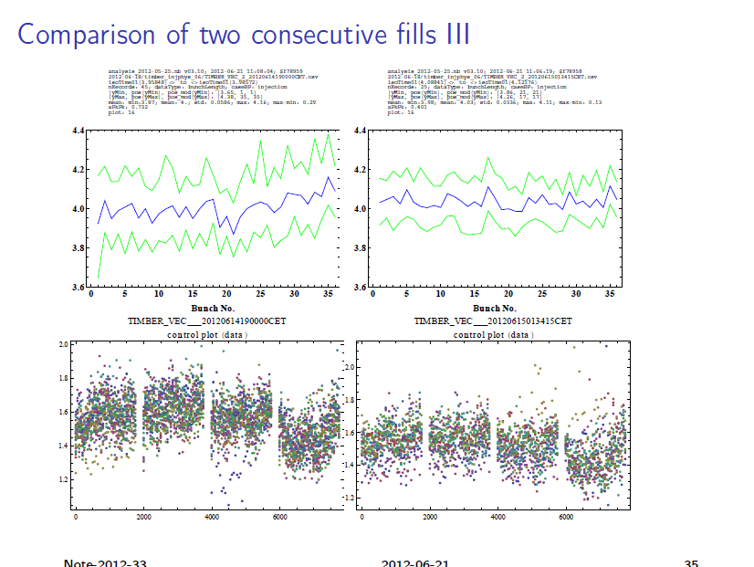
Previous observations (Q26)
Difference: uniformity of CPS spill:
λ_{pp} = 0:29 ns versus
λ_{pp} = 0:13 ns
Almost same τ_{avg}
but much lower τ_{min}
T. Bohl, LIU-SPSU 21/06/2012

Slide 5
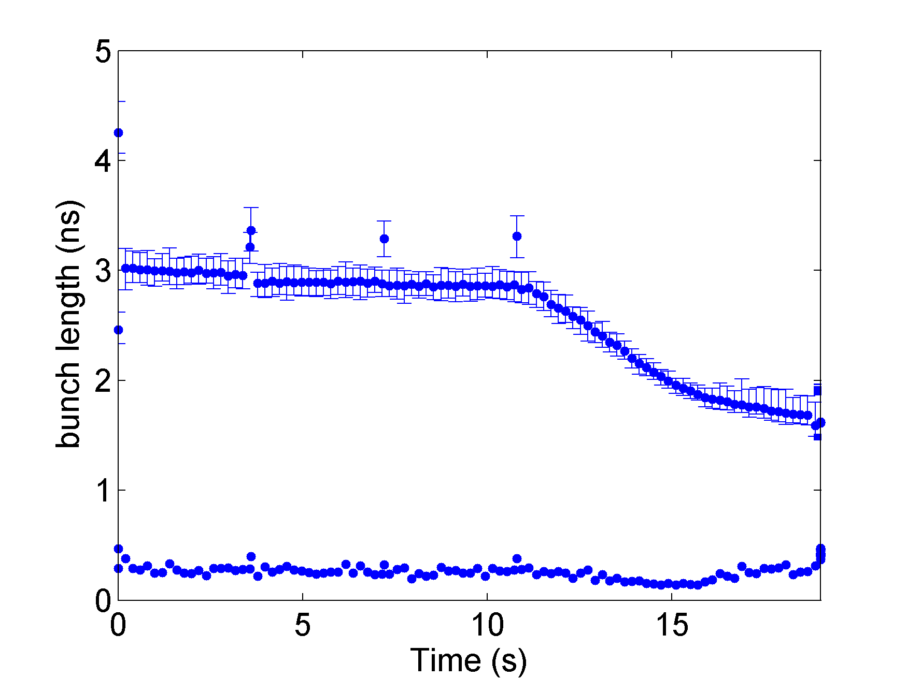
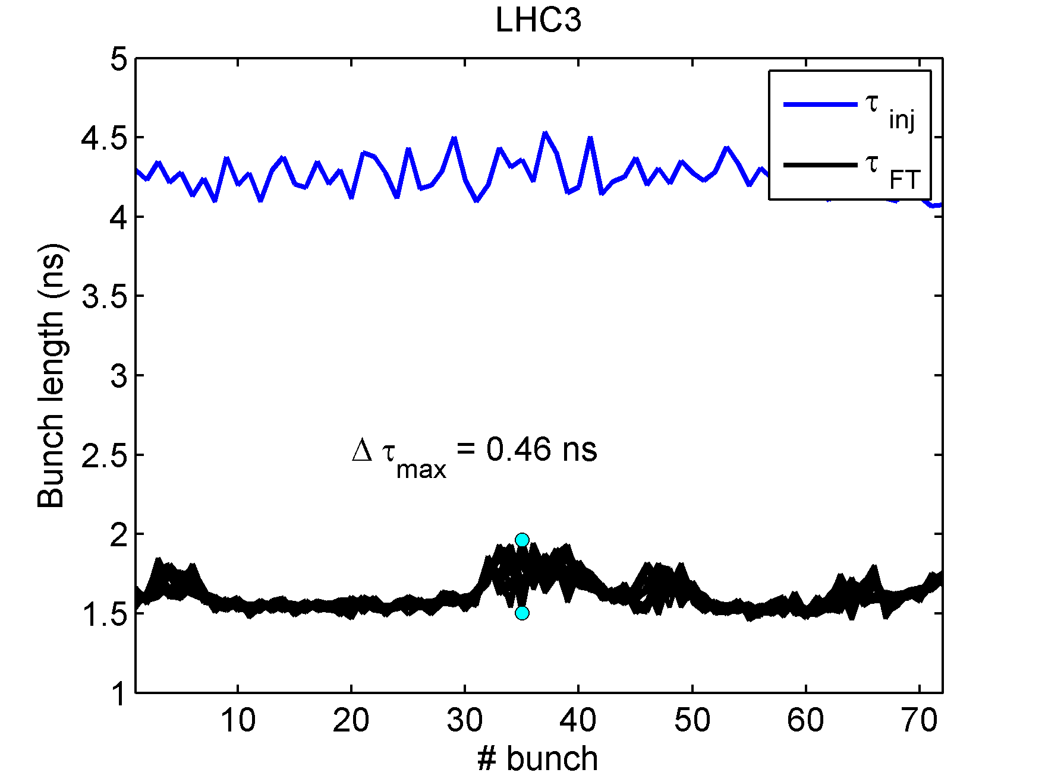
Controlled emittance BUP
At that time we were also sensitive at FB → one of the motivations to go to Q20
Similar issues with the injected bunch lengths and their spread inside the batch
still present
Why the incoming emittances are so important since we blow-up the beam in the
SPS (form ε_{l} ~ 0.35 eVs to ~ 0.6 eVs) ??
Instability in the SPS is
not observed before the BUP:
Controlled emittance blow-up is difficult to be optimized for high intensities and
when the spread in bunch lengths is big due to the potential well distortion and the
large variation of the incoherent synchrotron frequency shifts (~Ν/τ³)(?).

Slide 6
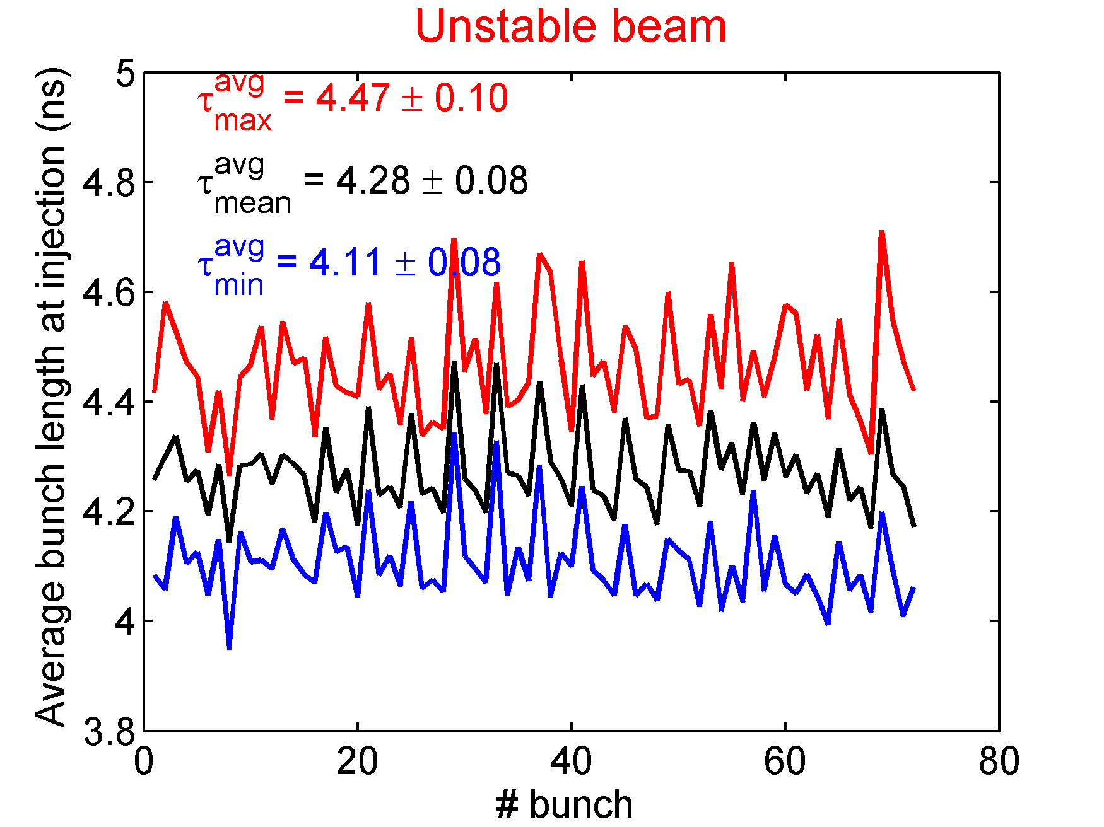
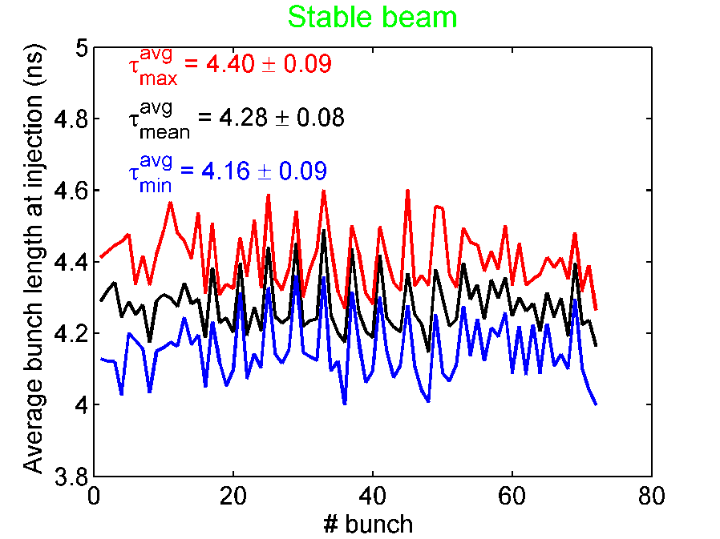
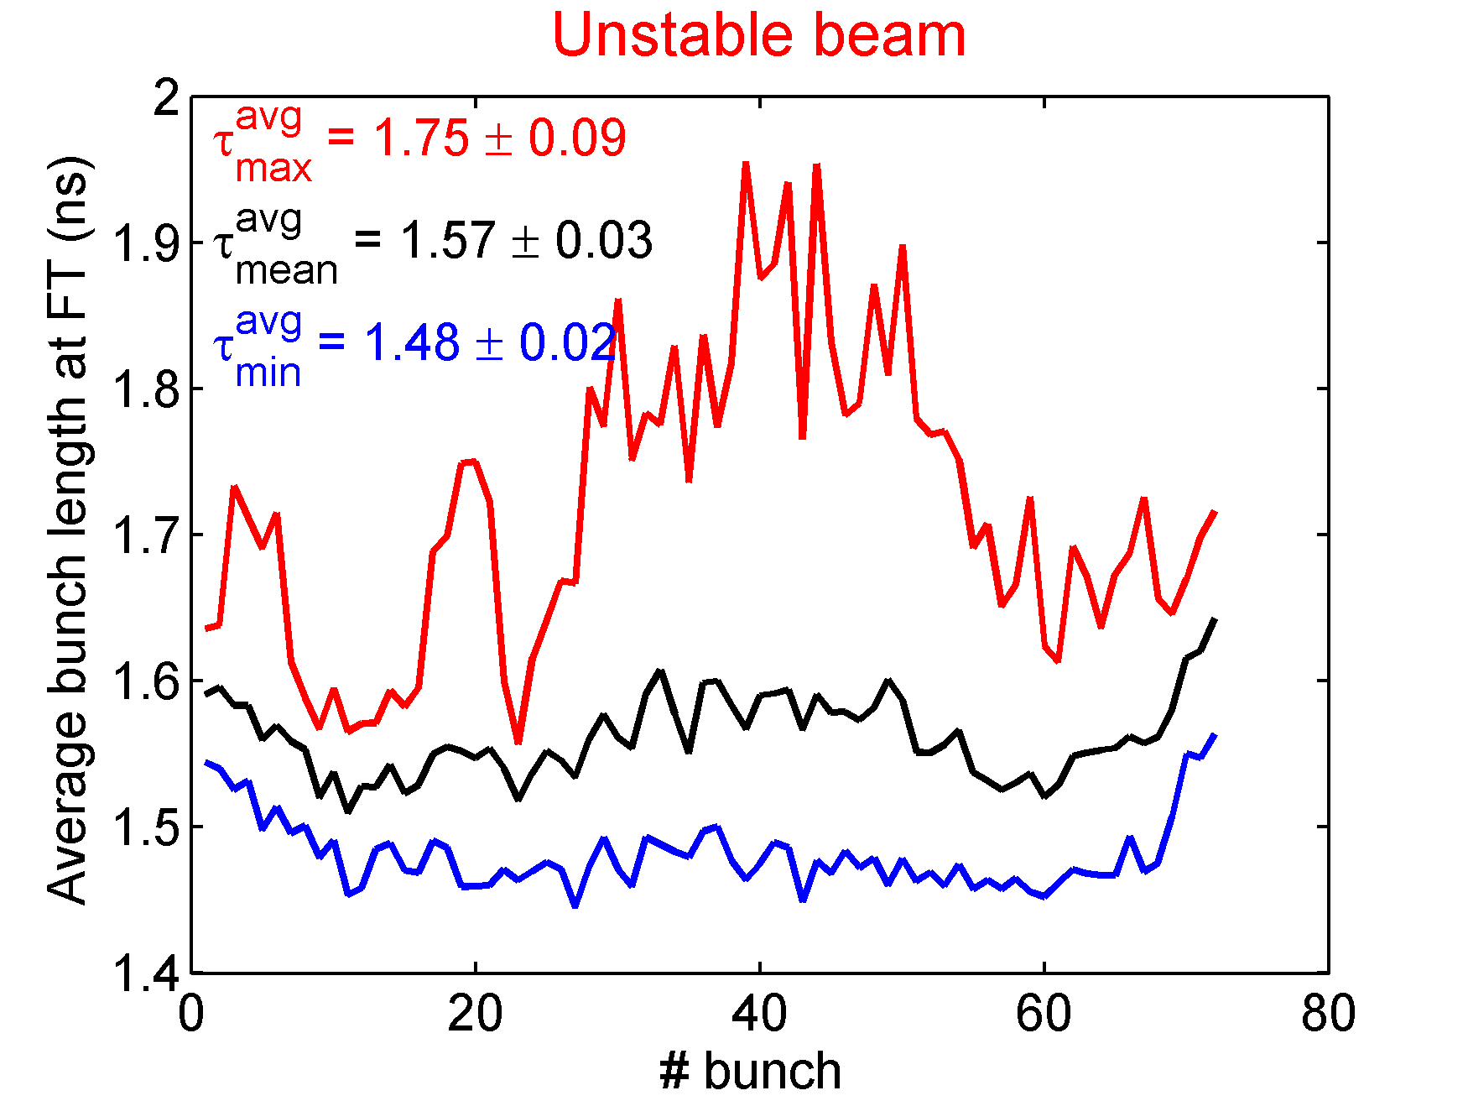
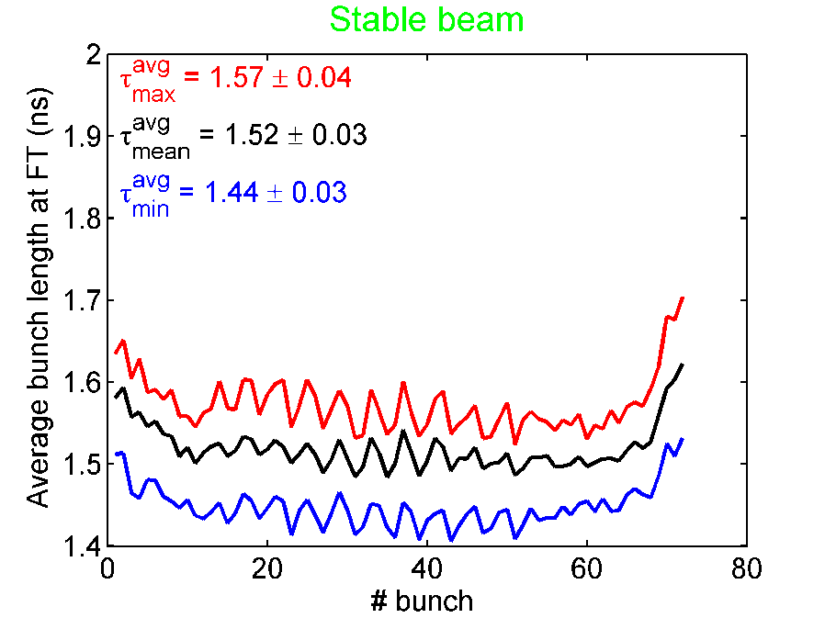
Examples of this MD
Average of all measurements
Unstable: Δτ_{max}≥0.15 ns
Same τ_{avg} but
smaller spread
in the stable case
(higher τ_{min})
average over
cases with
different
conditions (RF
Voltage)

Slide 7
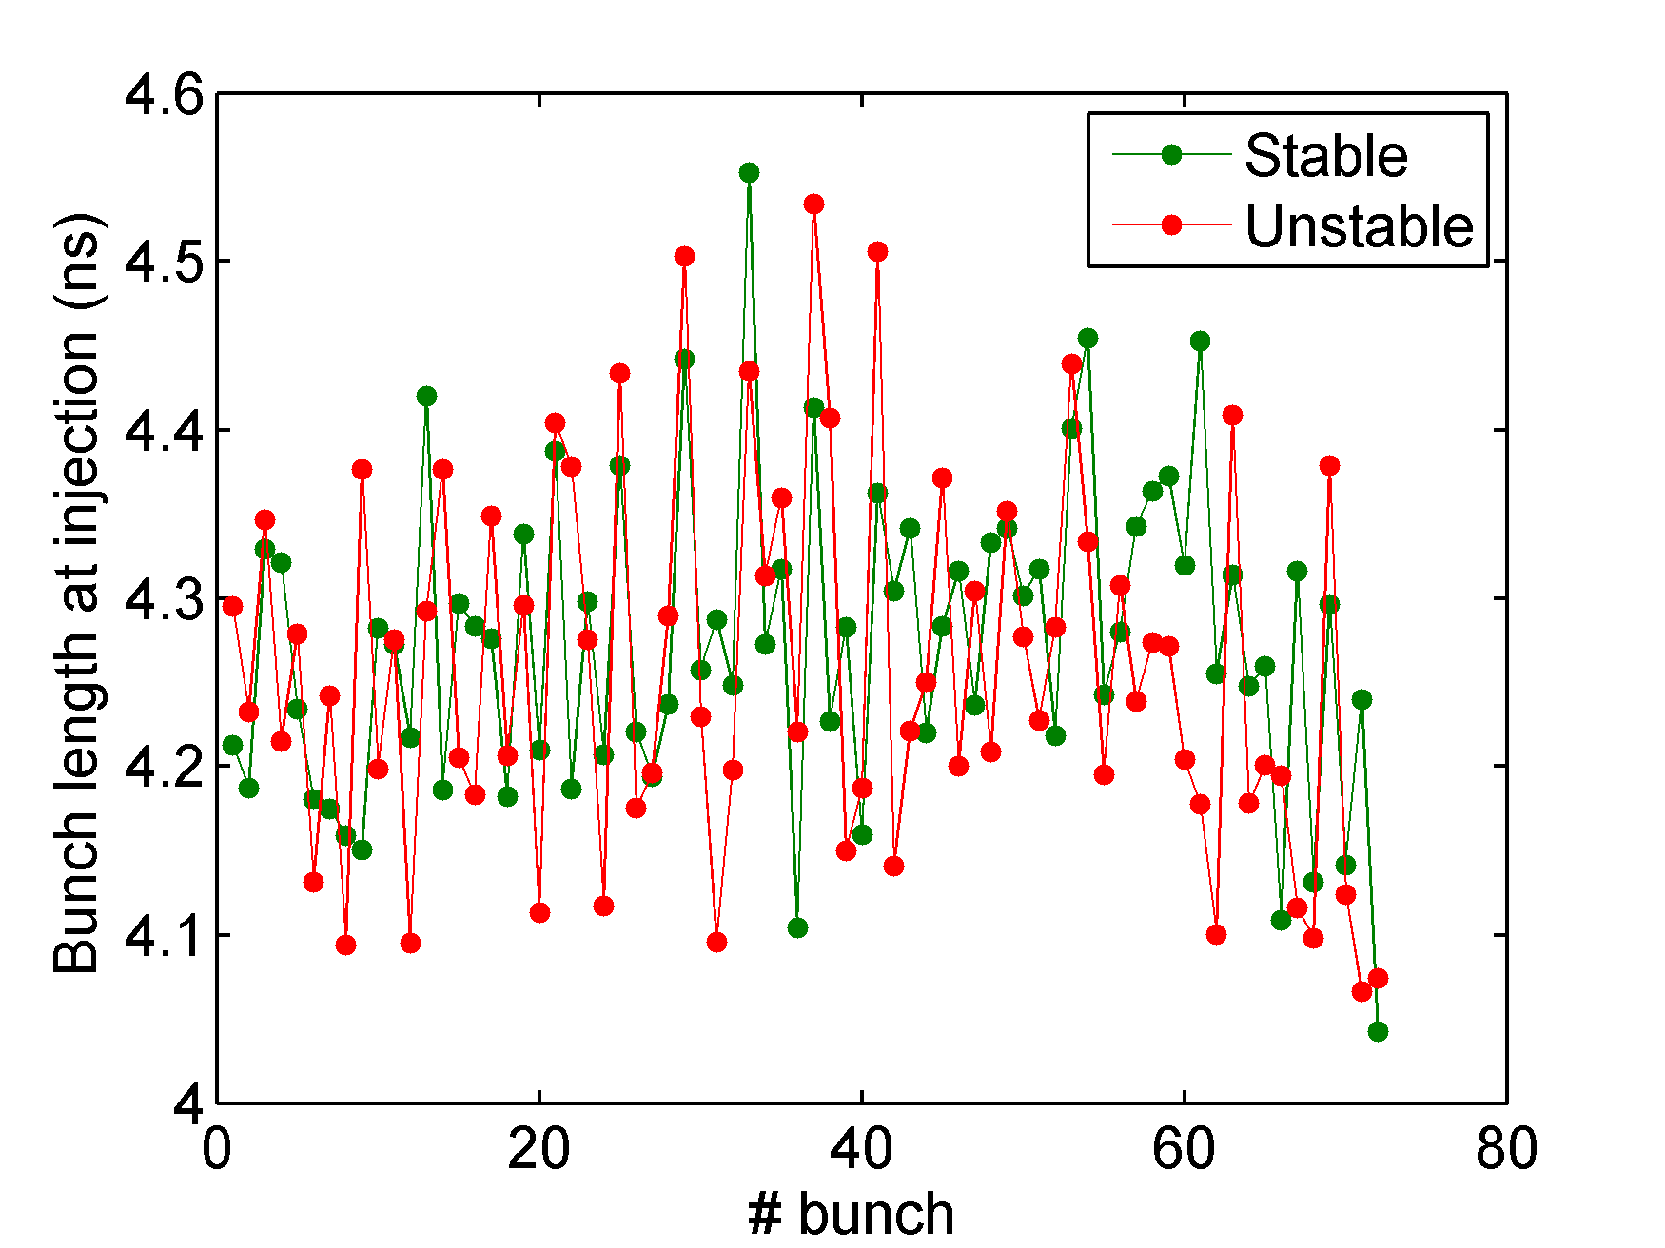
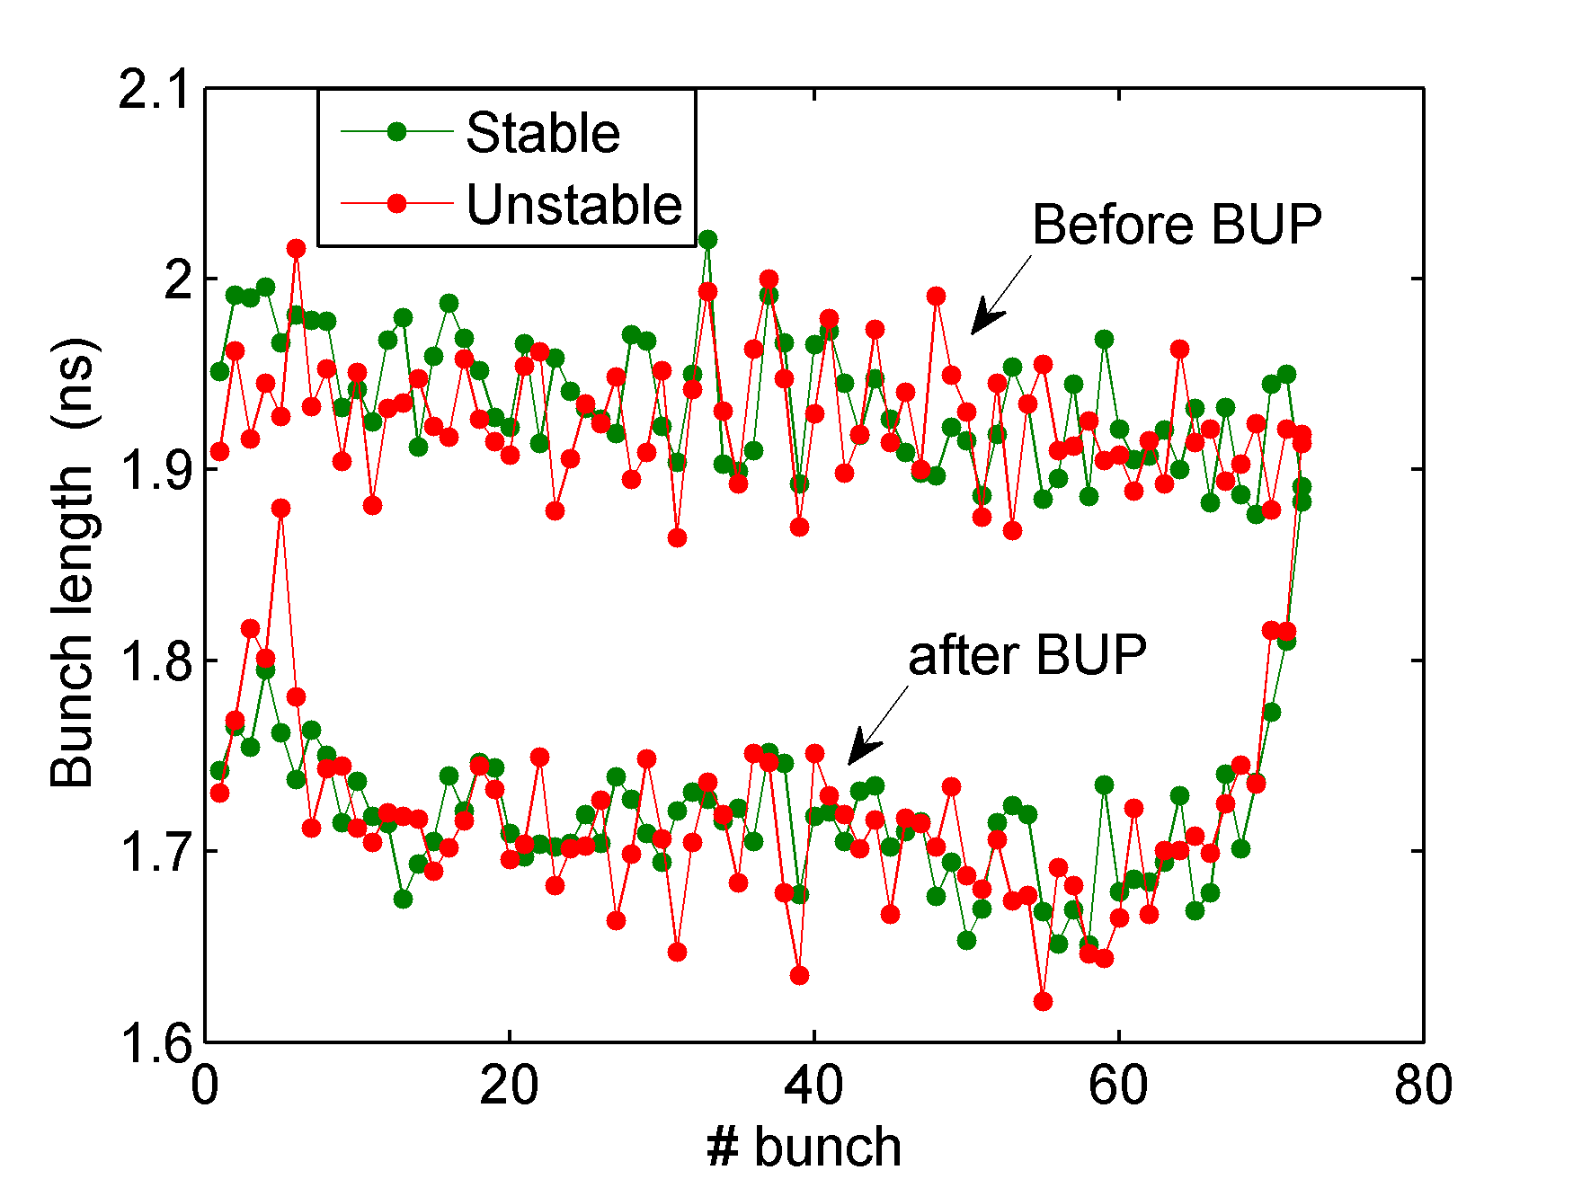
Examples of this MD
Examples with the same conditions
Same τ_{avg} and even τ_{min} at injection
τ_{avg} = 4.27 ns - τ_{avg} = 4.26 ns
τ_{min} = 4.04 ns - τ_{min} = 4.07 ns
More bunches with lower bunch
length in the unstable case
Small bunches at the end of the
batch are blown-up more
effectively due to the effect of
beam loading → remain stable
Bunches in the middle of the batch
suffer more → lower values of
bunch lengths for the unstable case
before the BUP

Slide 8
Incoherent Synchrotron frequency shift
For typical bunch lengths before controlled emittance BUP and for 100 ps difference
in the bunch length, ω_{s}(0) can change by more than 3 % only by the potential well
distortion.
In the center of the batch the synchrotron frequency distribution (fs(J), J: action) is
monotonic and with big slope → the effect of the frequency shift is quite strong!
For smaller bunches the effect of the 800 MHz impedance is also stronger (beam
loading)
This issue will be further investigated next year:
systematic analysis of all the data
come-up eventually with specifications for the injected beam parameters
for high intensities

