Slide 1
Emittance and intensity dependence of PS-to-SPS transfer
Helga Timkó
BE-RF-BR
in collaboration with
Theodoros Argyropoulos, Thomas Bohl, Heiko Damerau, Steven Hancock, Juan Esteban Müller, Elena Shaposhnikova

Slide 2
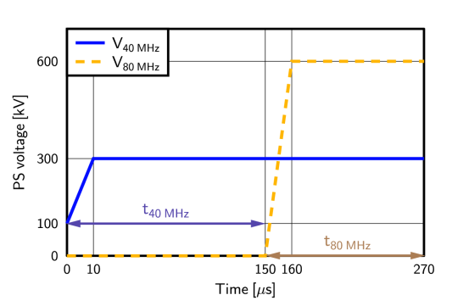
Measurement conditions
Dedicated cycle: LHCMDION
Single batch, 50 ns spaced LHC-type beam, 36 bunches
Intensity: ~1.6× 10¹¹ ppb, unless stated otherwise
Varying the PS rotation timings t_{40 MHz} and t_{80 MHz}
SPS voltage as usual
SPS FB is shortened to 1260 ms
SPS acceleration ramp only until at 30 GeV
Bunch length:
at PS ejection
Transmission:
(intensity at 30 GeV) / (injected intensity)

Slide 3
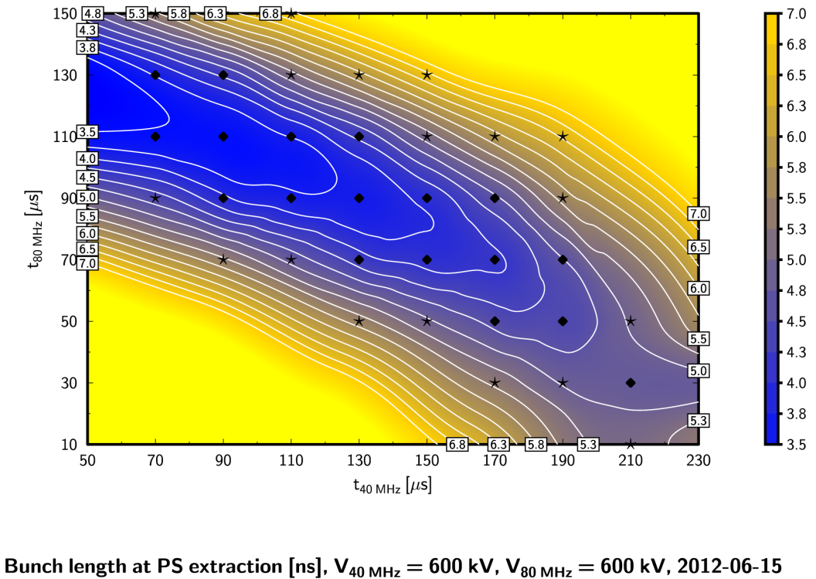
Reminder
Gain:
T_{OP} ≈ 94.8 % (1+2 cav’s)
T_{MAX} = 97.7 % (2+2 cav’s)
Highest loss reduction was achieved when switching on the spare 40 MHz cavity

Slide 4
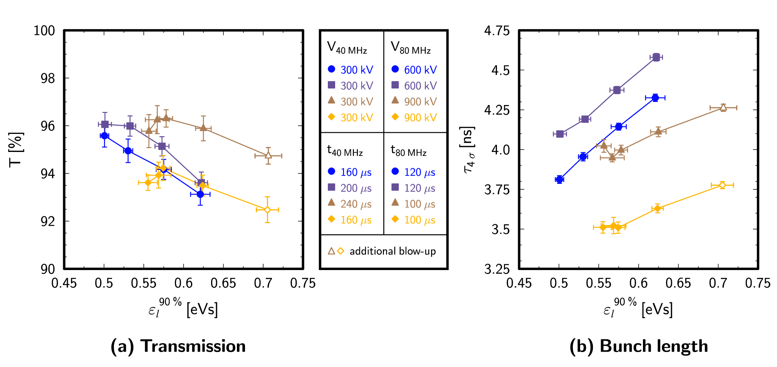
Why did we not see an improvement earlier?
Reproducing last year’s MD results: optimising t_{80MHz} based on τ doesn’t help; need to optimise t_{40MHz} as well

Slide 5
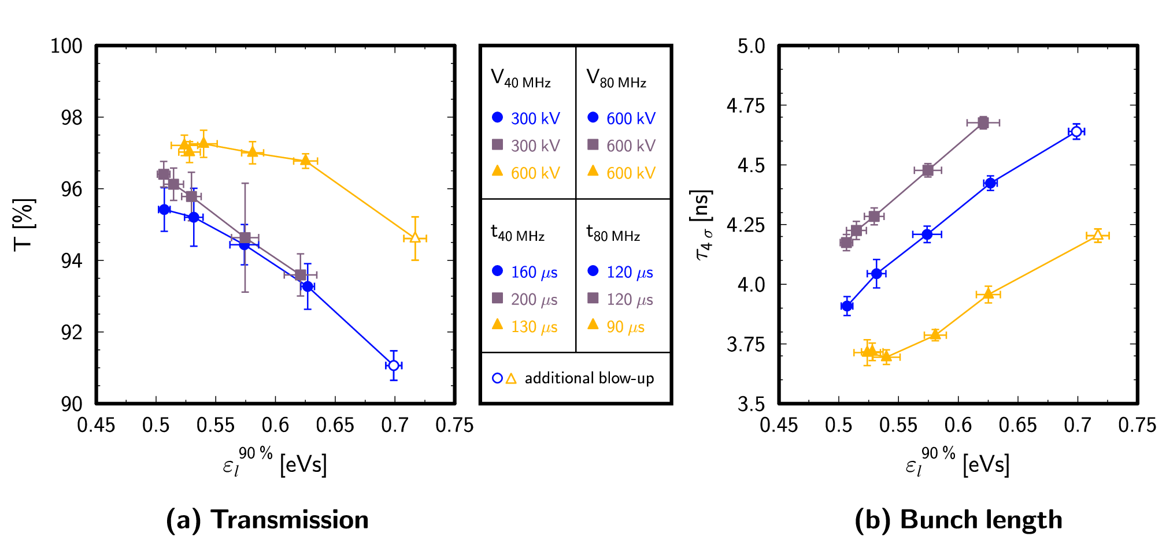
Best settings: 2+2 cavities
Even with an emittance increased by 50 %, we can achieve similar transmission to currently operational settings!

Slide 6
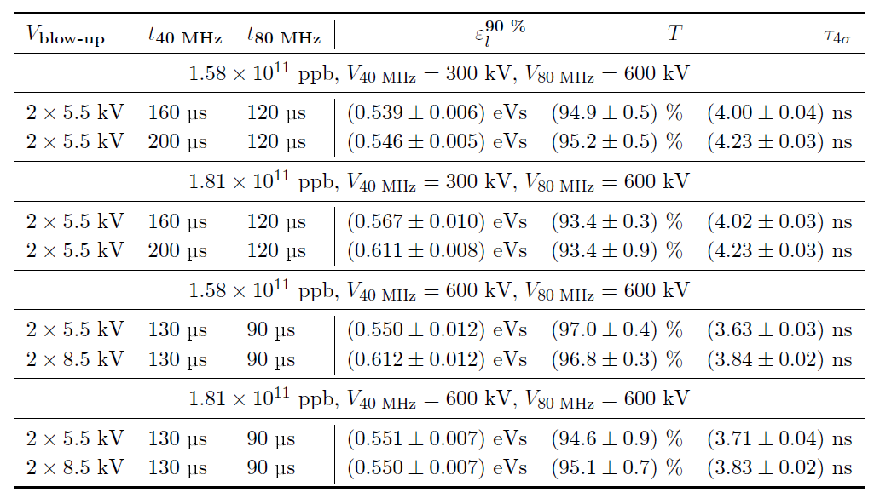
Intensity dependence
About ~ 15 % intensity margin for the same transmission

Slide 7
Conclusions
We have performed 7 MDs with a dedicated cycle, 1 batch
Results are reproducible and consistent with simulations
Preferred settings:
V_{40MHz} = 600 kV, V_{80MHz} = 600 kV, t_{40MHz} = 130 μs, t_{80MHz} = 90 μs
Gain: transmission 94.8 → 97.7 %, losses 5.2 → 2.3 %
We understand now the results of previous years and know what we have to do differently
With the new settings, we gain also a significant emittance and intensity margin
Our studies with the test cycle are now complete (for Q26)
Need to test the new scheme with 4 batches, filling-type scenario

