Slide 1
MKE heating with and without serigraphy
C. Zannini and G. Rumolo
Thanks to: T. Argyropoulos
M. Barnes, T. Bohl, G. Iadarola

Slide 2
Overview
Review of the impedance for the SPS extraction kickers (MKE)
Power loss estimation
-Power loss calculation method
-Application to the SPS extraction kickers
Comparison with heating observations
Effect of the bunch distribution
Summary and Future Plans

Slide 3
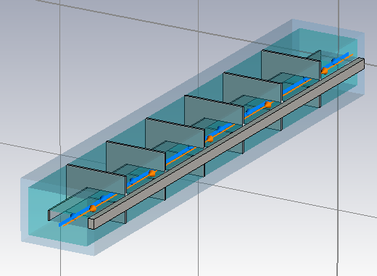
MKE kicker
The unshielded kicker exhibits a significant ferrite heating

Slide 4
MKE kicker with serigraphy
Notes:
Inserire figura nuovo modello

Slide 5
Comparing MKE with and without serigraphy
f=45 MHz
Notes:
Where the peak is the half length resonance of the serigraphy

Slide 6
Comparing MKE with and without serigraphy
The simulation of the EM fields seems to confirm that we have a quarter-wavelength resonance

Slide 7
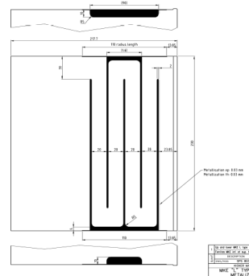
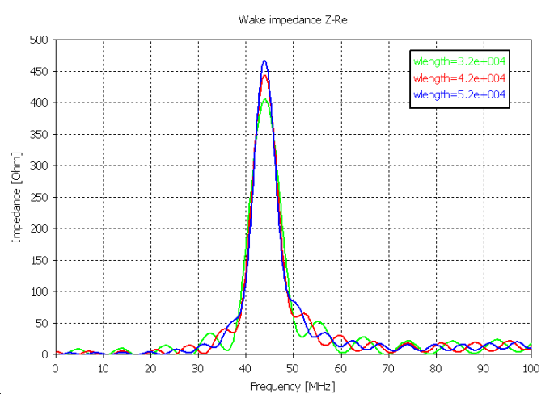
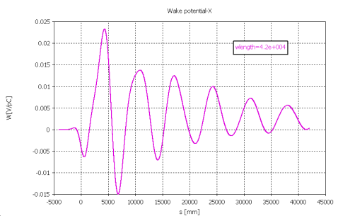
An accurate low frequency model
Model of the serigraphy
Accurate geometry of the serigraphy
Accounting finite conductivity
Low frequency simulations
Longer bunch length
Studies of convergence
Fit of the ferrite properties at low frequency

Slide 8
An accurate low frequency model

Slide 9
Overview
Review of the impedance for the SPS extraction kickers (MKE)
Power loss estimation
-Power loss calculation method
-Application to the SPS extraction kickers
Comparison with heating observations
Effect of the bunch distribution
Summary and Future Plans

Slide 10
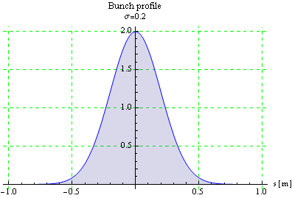
Power loss estimation
Single bunch approximation
The single bunch approximation is valid only for broadband impedance because does not account for coupled bunch.

Slide 11
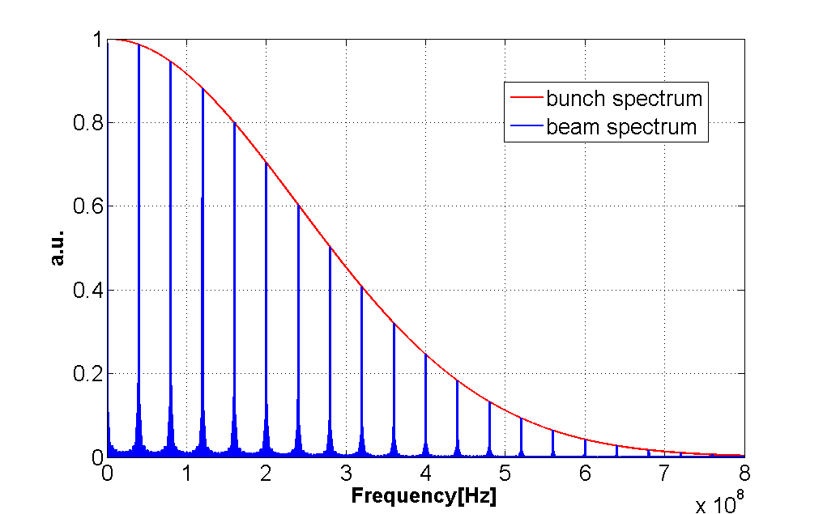
Power loss estimation
72
8
72
8
72
8
72
25ns buckets
Full calculation

Slide 12
Overview
Review of the impedance for the SPS extraction kickers (MKE)
Power loss estimation
-Power loss calculation method
-Application to the SPS extraction kickers
Comparison with heating observations
Effect of the bunch distribution
Summary and Future Plans

Slide 13
Spectrum for the 25 ns beam distribution
Due to peak of the serigraphy, we carry out the full calculation of the power loss.

Slide 14
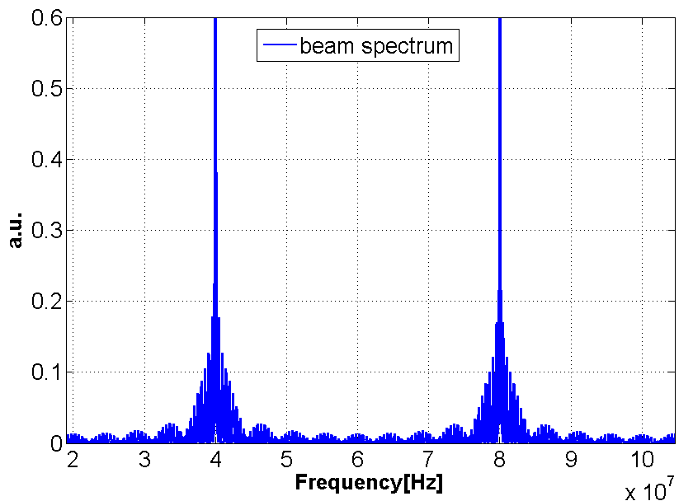
Low frequency components of the beam spectrum
40 MHz

Slide 15
Power loss of MKE with and without serigraphy for the 25ns SPS beam
Due to the resonance introduced by the serigraphy the single bunch approximation differs from the full calculation because it does not account for coupled bunch

Slide 16
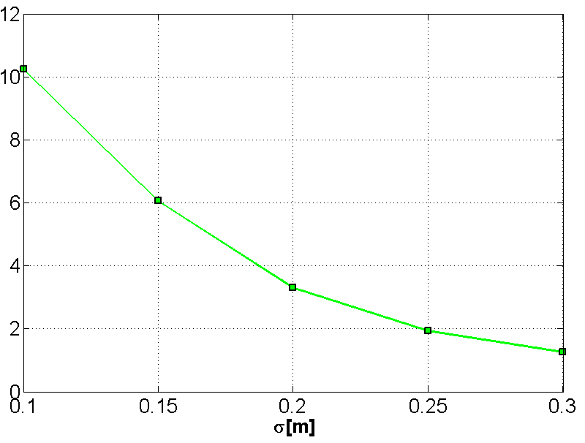
Power loss of MKE with and without serigraphy for the 25ns SPS beam
At σ=0.3 the PWL on the MKE without serigraphy is only 30% larger than the PWL on the MKE with serigraphy

Slide 17
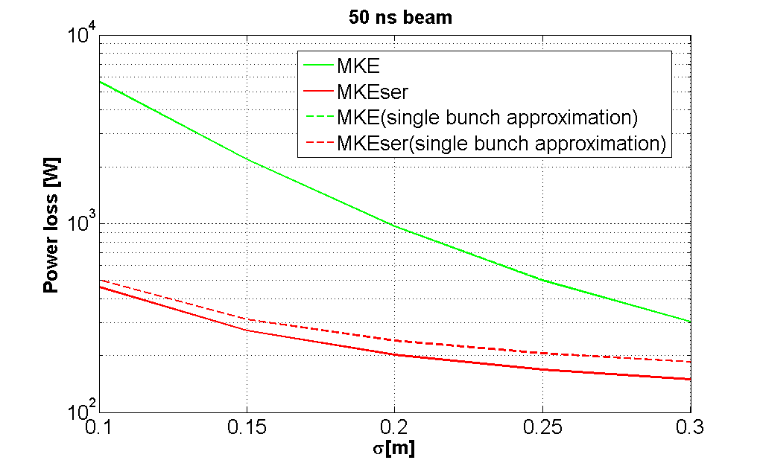
Power loss of MKE with and without serigraphy for the 50ns SPS beam
Due to the resonance introduced by the serigraphy the single bunch approximation differs from the full calculation because it does not account for coupled bunch

Slide 18
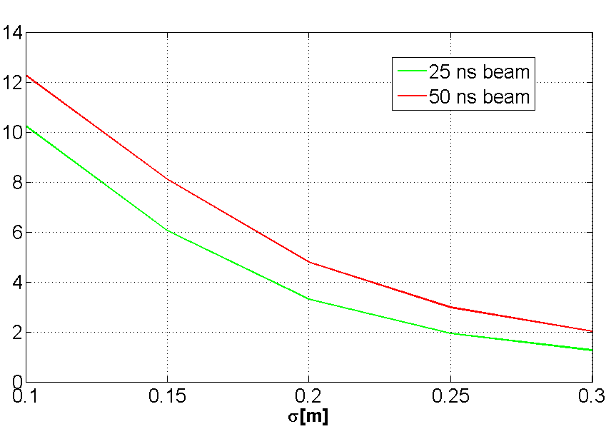
Comparing the power loss of 25 and 50 ns beam
At flat bottom the PWL on the MKE without serigraphy is expected to be a factor 3-4.5 smaller than the MKE with serigraphy for the 25 ns beam and a factor 4.5-6 smaller for the 50 ns beam
At σ=0.3 the PWL on the MKE without serigraphy is only 30% larger than the PWL on the MKE with serigraphy for the 25 ns beam and a factor 2 larger for the 50ns beam

Slide 19
Overview
Review of the impedance for the SPS extraction kickers (MKE)
Power loss estimation
-Power loss calculation method
-Application to the SPS extraction kickers
Comparison with heating observations
Effect of the bunch distribution
Summary and Future Plans

Slide 20
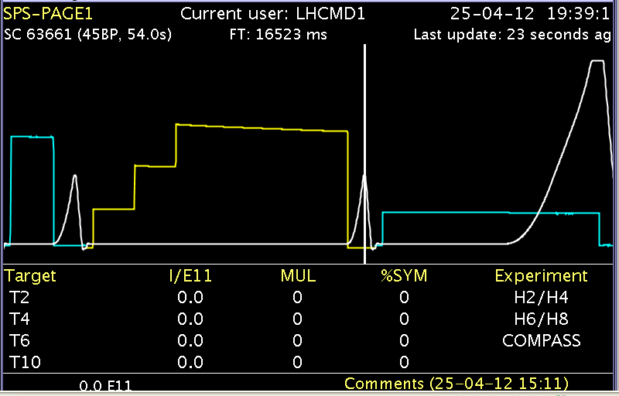
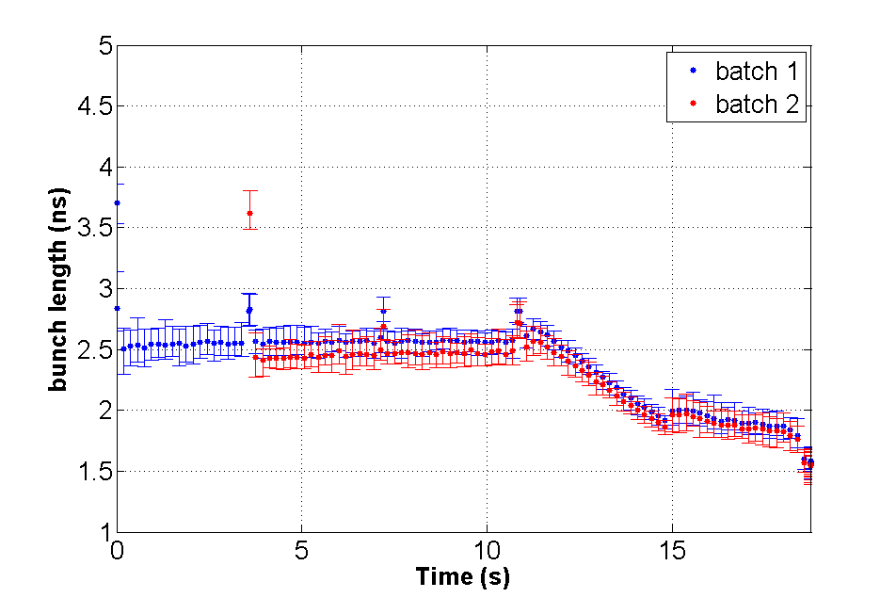
Methods for calculation of PWL and ΔT/Δt
Up to now we calculated the power loss in a regime with four batches circulating in the SPS. In order to compare with heating observation we need to consider the dynamics of the beam with the time
T. Argyropoulos
We assume the intensity per bunch unchanged

Slide 21
Methods for calculation of PWL and ΔT/Δt
Renormalizing to the intensity the power loss remains unchanged for 1,2 and 4 batches. This proves that to account the cycle effect we need to consider only the intensity change

Slide 22
Methods for calculation of PWL and ΔT/ Δ t
Up to now we calculated the power loss in a regime with four batches circulating in the SPS. In order to compare with heating observation we need to consider the dynamics of the beam with the time
T. Argyropoulos
The power loss is assumed to be uniform distributed on the ferrite and the cooling system is not taken into account
"F is the cooling factor which is at least a factor of 2 (J. Uythoven et al, BEAM INDUCED HEATING OF THE SPS FAST PULSED MAGNETS, EPAC 2004)"

Slide 23
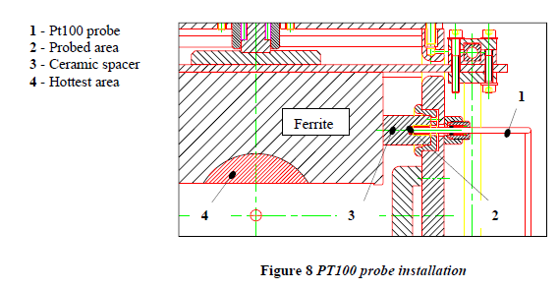
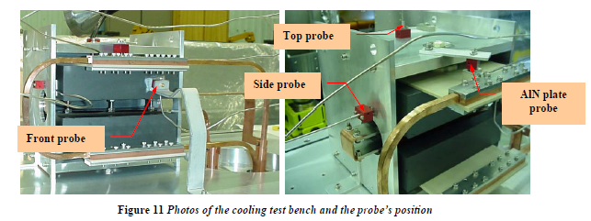
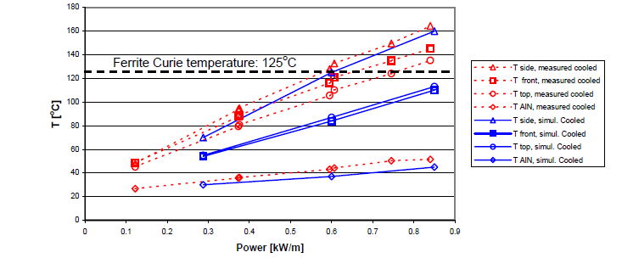
Cooling test bench: ferrite temperatures at different probe positions
SPS Extraction Kicker Magnet Cooling Design M. Timmins, A. Bertarelli, J. Uythoven, E. Gaxiola AB-Note-2004-005 BT (Rev.2) TS-Note-2004-001 DEC (Rev. 2)
The front probe measures more or less the average temperature of the ferrite

Slide 24
25 April-26 April: 25 ns beam Ecloud studies
43 C
28 C
23 C

Slide 25
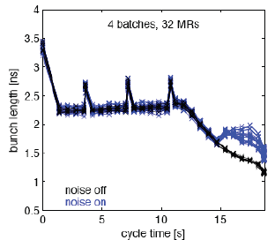
25 April-26 April: 25 ns beam Ecloud studies
G. Papotti
We assume a bunch length of about 18 cm with the 25 ns beam at flat bottom
In very good agreement with the measured heating

Slide 26
25 April-26 April: 25 ns beam Ecloud studies

Slide 27
25 April-26 April: 25 ns beam Ecloud studies
Each point is the integral of the intensity along the 25ns cycle

Slide 28
25 April-26 April: 25 ns beam Ecloud studies
G. Papotti
ΔT_{MKE} =19 [K]
“The cooling is expected to reduce the heating at least of a factor 2 (J. Uythoven et al, BEAM INDUCED HEATING OF THE SPS FAST PULSED MAGNETS, EPAC 2004)"

Slide 29
25 April-26 April: 25 ns beam Ecloud studies
Deltat=3 hours

Slide 30
25 April-26 April: 25 ns beam Ecloud studies
G. Papotti
ΔT_{MKE} =11.5[K]
“The cooling is expected to reduce the heating at least of a factor 2 (J. Uythoven et al, BEAM INDUCED HEATING OF THE SPS FAST PULSED MAGNETS, EPAC 2004)"
ΔT_{MKE} =3 [K]

Slide 31
50 ns beam: statistics
LHC Fill | ΔT[MKE]/ΔT[MKEser]
2728 | 4.5
2729 | 6
2732 | 4.5
2816-2817 | 5
2818 | 5
2836 | 6
2838-2839 | 5
2845 | 5
2847 | 5

Slide 32
50ns beam 8 of july: LHC Fill 2818

Slide 33
50ns beam 8 of july: LHC Fill 2818
Each point is the integral of the intensity along the 50 ns cycle

Slide 34
50ns beam 8 of july: LHC Fill 2818
T. Argyropoulos
ΔT_{MKE} =7.5[K]
“The cooling is expected to reduce the heating at least of a factor 2 (J. Uythoven et al, BEAM INDUCED HEATING OF THE SPS FAST PULSED MAGNETS, EPAC 2004)"
ΔT_{MKE} =1.5[K]

Slide 35
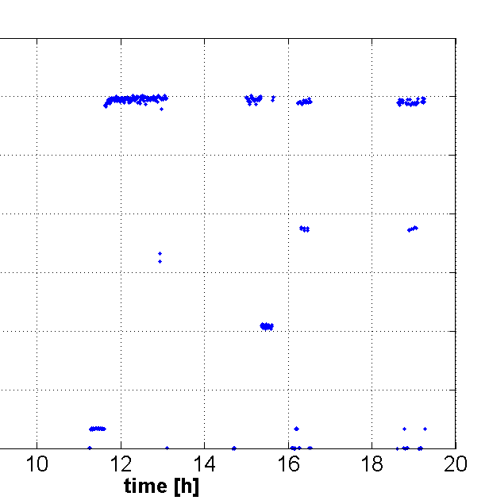
50ns beam 8 of july: LHC Fill 2818
The integral of the intensity along the 50ns cycle is almost constant
Deltat=1.3 hours

Slide 36
50ns beam 8 of july: LHC Fill 2818
T. Argyropoulos
ΔT_{MKE} =4.5[K]
“The cooling is expected to reduce the heating at least of a factor 2 (J. Uythoven et al, BEAM INDUCED HEATING OF THE SPS FAST PULSED MAGNETS, EPAC 2004)"
ΔT_{MKE} =1[K]

Slide 37
Overview
Review of the impedance for the SPS extraction kickers (MKE)
Power loss estimation
-Power loss calculation method
-Application to the SPS extraction kickers
Comparison with heating observations
Effect of the bunch distribution
Summary and Future Plans

Slide 38
Effect of tails

Slide 39
Effect of tails
Lobes due to the truncation. This situation is unrealistic but is one of the worst conditions for lobes. The decay in frequency is very slow.

Slide 40
Effect of tails
The power loss on the MKE with and without serigraphy calculated with the truncated Gaussian starts to differ from the one calculated using the Gaussian distribution only for truncation below 2.5σ

Slide 41
Effect of core profile

Slide 42
Effect of core profile

Slide 43
Effect of core profile

Slide 44
Effect of core profile
BQM
FWHM

Slide 45
Effect of core profile

Slide 46
Overview
Review of the impedance for the SPS extraction kickers (MKE)
Power loss estimation
-Power loss calculation method
-Application to the SPS extraction kickers
Comparison with heating observations
Effect of the bunch distribution
Summary and Future Plans

Slide 47
Summary
The peak due to the serigraphy was accurately characterized
A power loss calculation formalism was presented and applied to the MKE kickers for the SPS 25 and 50 ns beam. The limitations of the single bunch approximation were discussed.
The PWL ratio between the PWL on the shielded MKE and the unshielded MKE has been found in very good agreement with the measured heatings
An attempt of calculation of the ΔT/ Δ t was presented and found to be in good agreement with the measured ΔT/ Δ t
The dependence of the PWL with the bunch distribution was investigated
The good agreement with respect to the beam induced heating observed in the machine is also a confirmation with beam of the SPS kicker impedance model

Slide 48
Future plans: MD proposal
25 ns at 30 cm
The model predicts that the power loss on the MKE without serigraphy is only a 30% larger with respect to the MKE with serigraphy (better after a technical stop)
50ns at injection
To eliminate in the analysis the uncertainity due to the time evolution of the bunch length
25 or 50ns coasting beam
“Static” situation that cuold be simply benchmarked with the model (ideally, because in reality bunch lengths and intensities will change in time)

Slide 49
Thank you very much for your attention

