Slide 1
Observations with 25ns beam in the SPS
H. Bartosik, G. Iadarola, G. Rumolo
SPSU - August 02, 2012

Slide 2
Introduction
Summary of 25ns beam observations in the SPS
2012 scrubbing run
25th April
22nd May
25th June
All observations and results presented were obtained with nominal SPS optics
Typically on the flat bottom cycle which was setup in the scrubbing run
With nominal intensity (~1.2e11 p/b)
The pressure rise observed with 25ns beam is typically 10⁴ times smaller compared to 2002 (see presentation of Gianni)
Measurements
Bunch-by-bunch emittance measurements (as tested during the scrubbing run)
Lifetime (or losses) as function of vertical chromaticity
Tune shift along the bunch train

Slide 3
2012 SPS Scrubbing Run – measured beam parameters
25ns beam nominal intensity
PS (before bunch rotation): N_{b}~1.25x10¹¹ppb / ε_{h}~2.5μm / ε_{v}~2.5μm
SPS flat bottom (18s): N_{b}~1.15x10¹¹ppb / ε_{h}~3μm / ε_{v}~3.5μm
SPS flat top: N_{b}~1.15x10¹¹ppb / ε_{h}~3μm / ε_{v}~3.5μm
(within LHC design report specifications)
25ns beam ultimate intensity
PS (before bunch rotation): N_{b}~1.8x10¹¹ppb / ε_{h}~4μm / ε_{v}~3.5μm
SPS flat bottom (8s): N_{b}~1.6 x10¹¹ppb / ε_{h}~5μm / ε_{v}~4.5μm

Slide 4
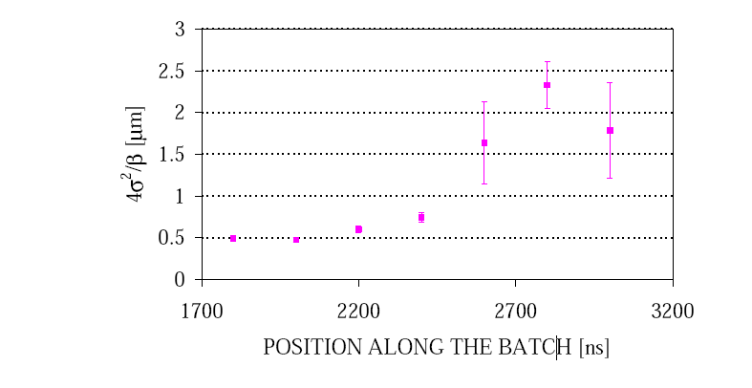
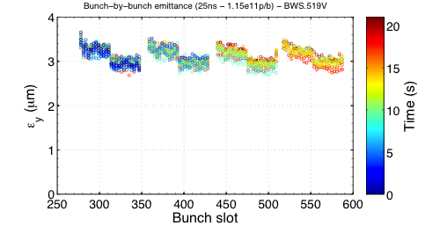
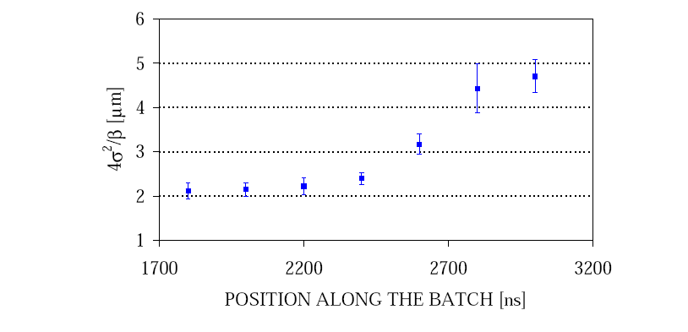
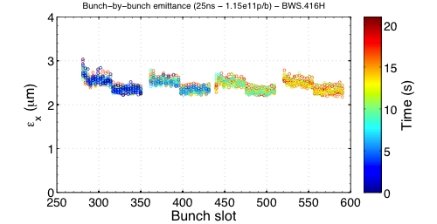
LHC 25ns beam: emittance (flat bottom)
2000 (1 batch 0.8x10¹¹ppb)
2012 (4 batches 1.15x10¹¹ppb)
Vertical emittance
Vertical
Horizontal emittance
Horizontal

Slide 5
LHC 25ns beam: emittance (flat bottom)
2000 (1 batch 0.8x10¹¹ppb)
2012 (4 batches 1.15x10¹¹ppb)
Vertical emittance
No emittance growth in 2012 with 4 batches
With low chromaticity in both planes
Identical behavior of all 4 batches
No blow-up along bunch train
Vertical
Horizontal emittance
Horizontal

Slide 6
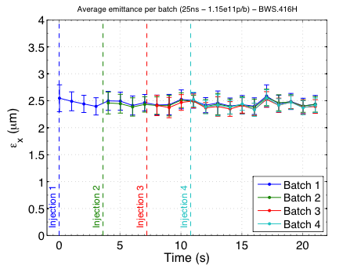
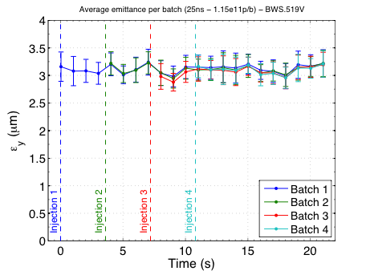
LHC 25ns beam: emittances
Horizontal
Vertical
Average emittance per with 4 batches of 1.15x10¹¹p/b in 2012
No measurable emittance growth within 20s flat bottom
Emittances within nominal LHC beam parameters

Slide 7
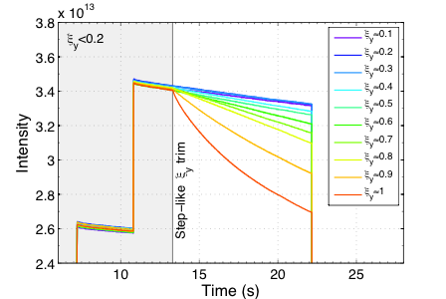
LHC 25ns beam: chromaticity
2012
2002 - G. Arduini, K. Cornelis et al.
No need for large chromaticity in 2012 with 4 batches of 1.15x10¹¹p/b
Best life-time with smallest chromaticity
No instability or beam degradation with chromaticity around 0.1

Slide 8
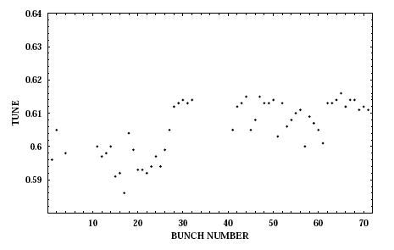
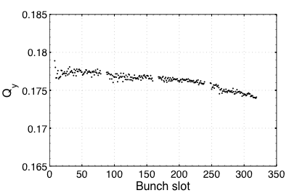
LHC 25ns beam: bunch by bunch tune
2000 (one batch)
2012 (four batches)
Vertical
ΔQ<0.005
ΔQ>0.02
G. Arduini, K. Cornelis et al.
Positive tune shift!
(dominated by ecloud)
Negative tune shift!
(dominated by resistive wall impedance?)

Slide 9
Summary and outlook
No signature of electron cloud on beam observables with 25ns beam of nominal intensity in 2012
All four batches show same emittance at the end of long flat bottom
No measurable emittance growth along long flat bottom
Best life-time obtained with smallest chromaticity
Negative vertical tune-shift along bunch train
Next steps
Coast to study long term behavior (emittance growth, losses), also at different energies
→ electron cloud effects can be revealed?
Study the 25ns beam with ultimate intensity (1.8e11 p/b) and intermediate intensities
→ electron cloud may be revived?
Large radial steering on flat bottom
→ put the beam on unscrubbed regions of the vacuum chamber in the arcs …

