Slide 1
SPS MD summary (Nov. 7th and 9th 2011): 25ns and 50ns in Q20 and Q26 optics
SPSU meeting November 24th 2011
H. Bartosik on behalf of T. Argyropoulos, T. Bohl, H. Damerau, A. Guerrero, J. Esteban Muller, Y. Papahilippou, G. Rumolo, E. Shaposhnikova, B. Salvant, W. Höfle

Slide 2
7.11.2011, 25ns MD - Overview
Monday November 7th:
Setup and measurements on 25ns beam in Q20 and Q26 optics
Studies on transmission from PS to SPS with 25ns beam (T. Bohl, H. Damerau)
E-cloud measurements (M. Taborelli)
Single bunch measurements on flat bottom (T. Argyropoulos)
Preparation for high bandwidth feedback MD on Nov. 11th
Cycles
LHCMD1: long cycle with Q26 optics
LHCFAST3: long cycle with Q20 optics
MD1: flat bottom cycle with Q26 optics

Slide 3
Beam dump position in Q20 with 39kV
MKDH and MKDV are sweeping the beam on high energy beam dump TIDVG
Dump trajectory is going off-center through quadrupole QFA.118
Due to weaker quadrupole gradients in Q20, slightly smaller kick downwards (beam is dumped closer to edge of dump block)
Due to intervention on MKDV on electrical feed-through only reduced kicker strength from MKDV available (39kV instead of 47kV)
Beam must be dumped at least 10mm below edge of TIDVG (≥-27 on SEM grid)
Still within the good region for both optics, even with reduced voltage
single bunch
1 batch
Q26 (39kV)
Q20 (39kV)
Good region
Good region
MADX Simulation
TIDVG

Slide 4
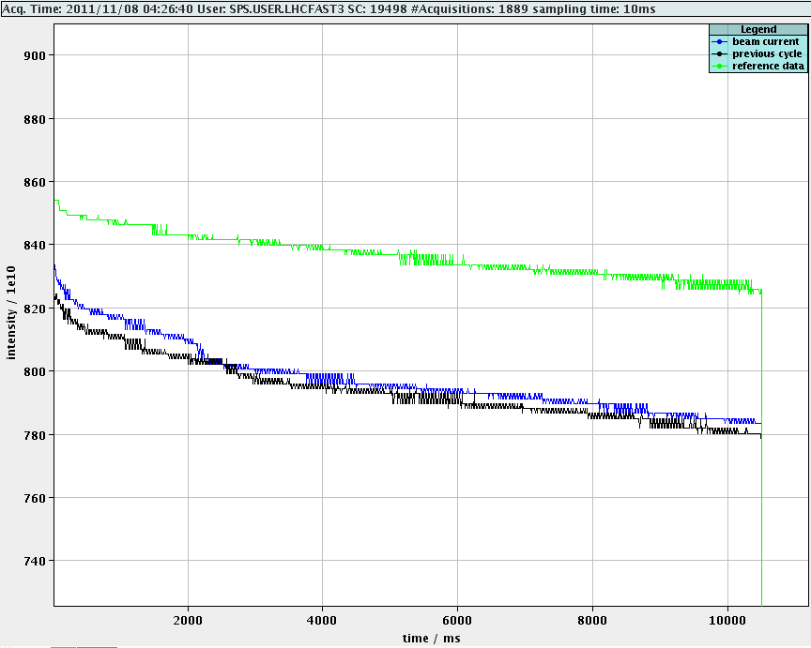
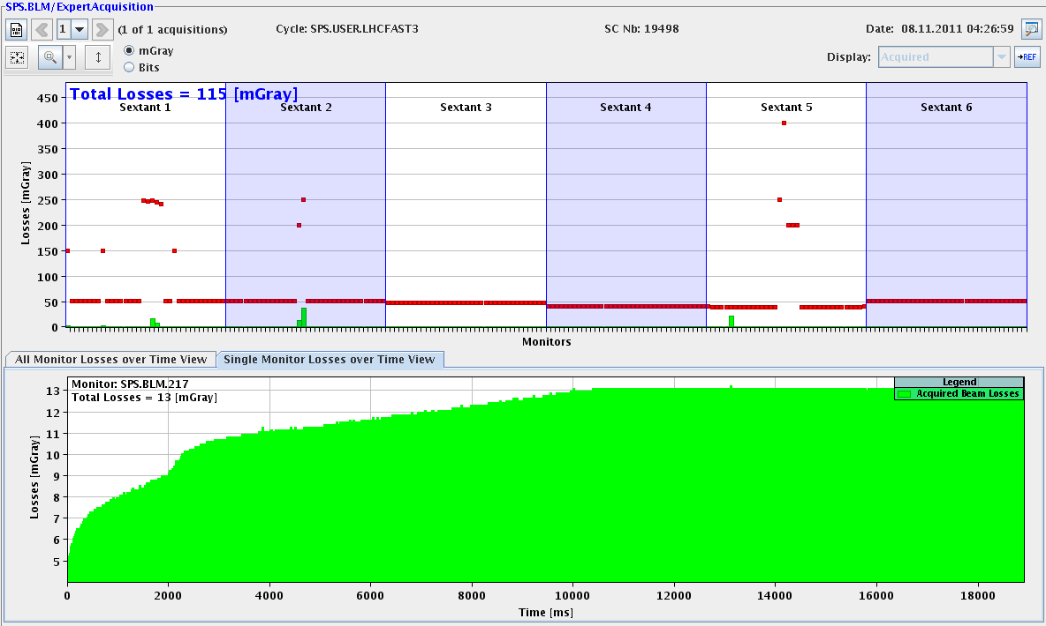
Optimizing orbit on flat bottom - Q20
Losses close to ZS (217, 218) in Q20 cycle
Only on flat bottom
Correctors usually disabled in this region
Losses were eliminated by orbit bump in vertical plane
with orbit bump
without orbit bump
BLM 217
End of flat bottom

Slide 5
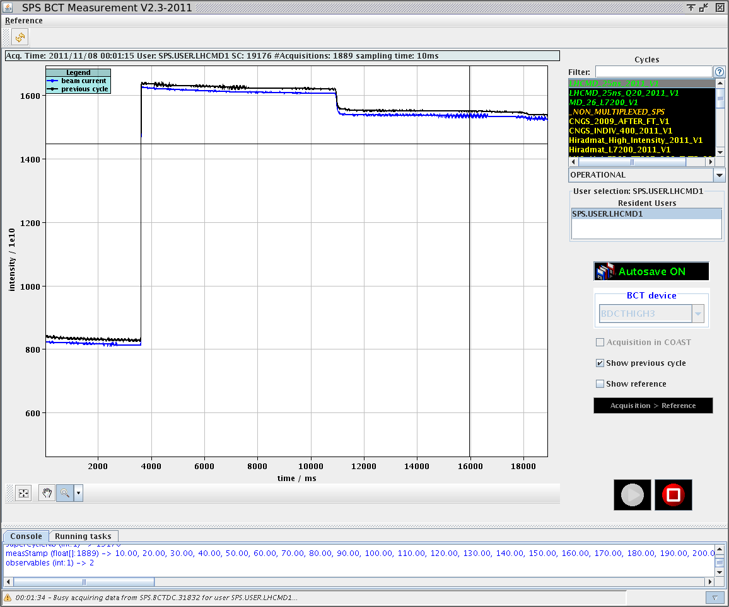
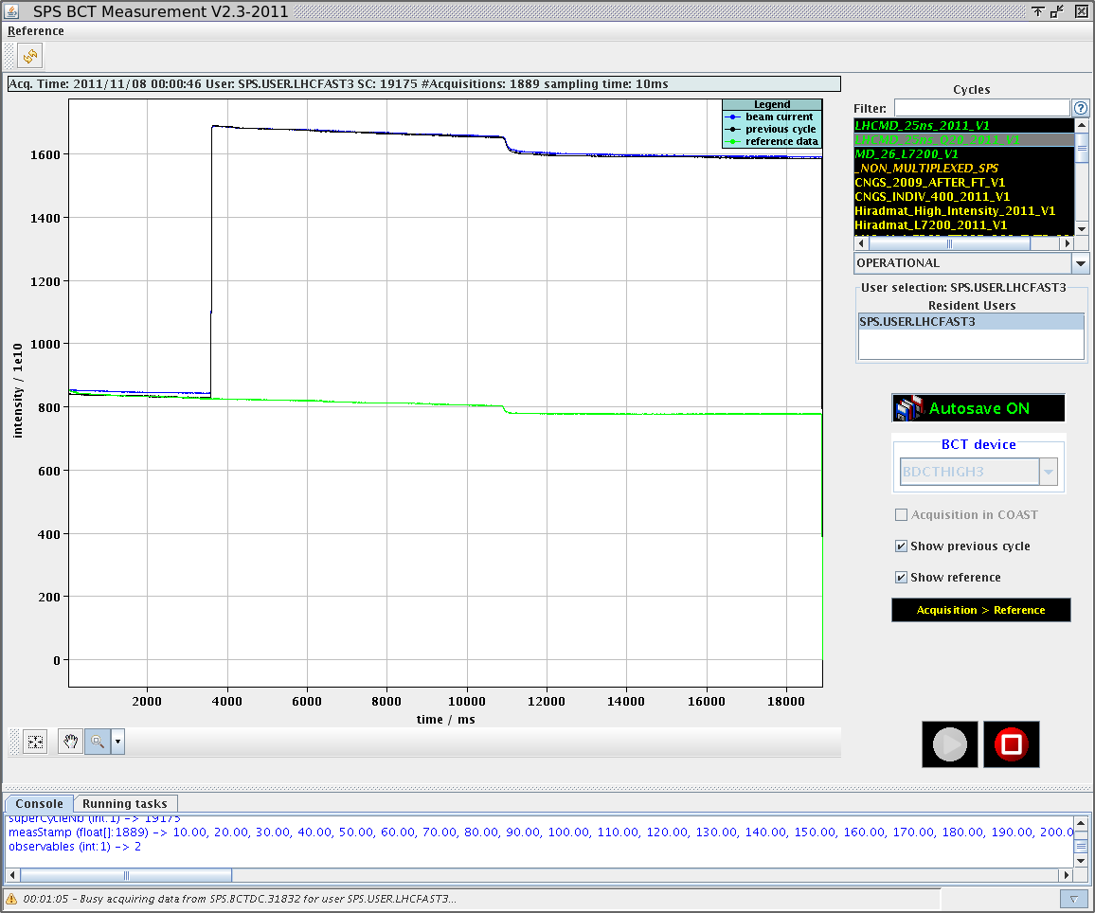
Intensities with 25ns beam
Intensities in the two optics around 1.1x10¹¹p/b
Slightly higher in Q20 (Injected intensities about the same)
Higher chromaticity in Q26 may be needed for improving transmission
Went up to 2 batches at most
Q26
Q20

Slide 6
Emittance – 1 batch (25ns, 72 b.)
Q20: Measurements with WS.416 → ε_{x}~2.9μm and ε_{y}~2.4μm
Q26: Measurements with WS.416 → ε_{x}~2.8μm and ε_{y}~2.6μm

Slide 7
Emittance – 2 batches (25ns, 144 b.)
Q20: Measurements with WS.416 → ε_{x}~3μm and ε_{y}~2.6μm (bigger tails?)
Q26: Measurements with WS.416 → ε_{x}~2.7μm and ε_{y}~2.7μm

Slide 8
9.11.2011, 50ns MD – Overview
Wednesday November 9th
Setup and measurements on 50ns beam with moderate and high intensity
Single bunch measurements on flat bottom (T. Argyropoulos)
High bandwidth feedback MD on flat bottom cycle
Cycles
LHCMD1: long cycle with Q26 optics
LHCFAST3: long cycle with Q20 optics
MD1: flat bottom cycle with Q26 optics

Slide 9
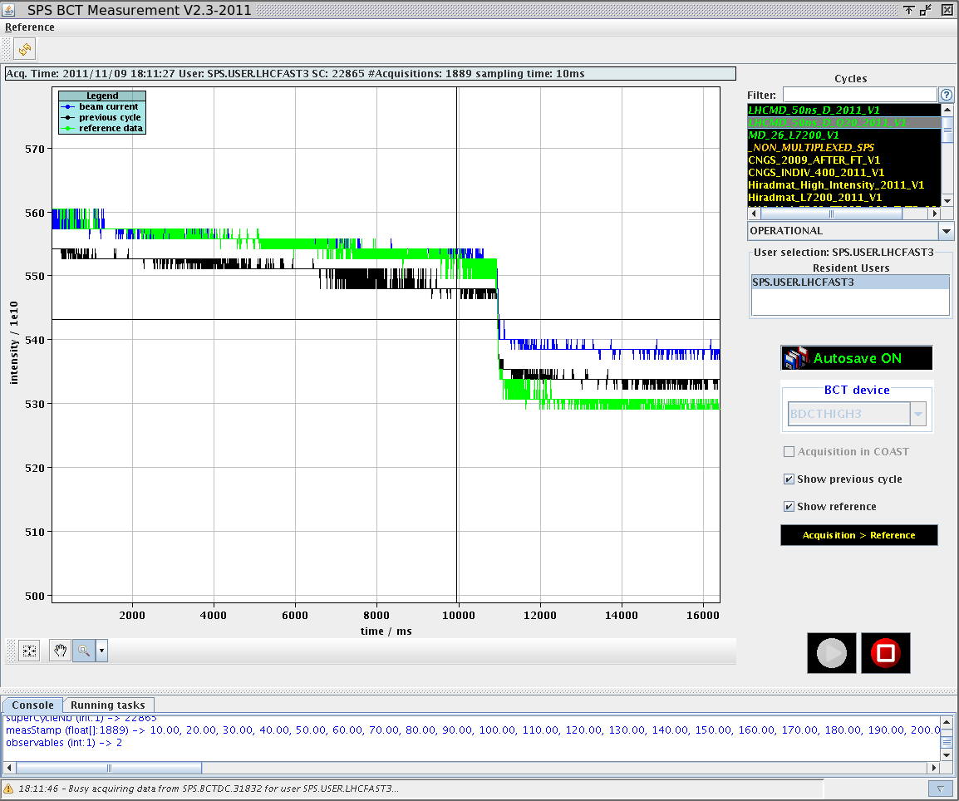
Changing voltage at injection in Q20
Initially the voltage program was scaled from the nominal optics
High voltage at injection and along the flat bottom (5.6MV)
Lowering voltage at injection and along flat bottom
Capture losses and total transmission were improved by lowering voltage to 2.5MV (close to matched) at injection and 4.5MV (0.6eVs bucket area) along flat bottom
Found later: increasing voltage 800MHz helps for stability (see talk of T. Argyropoulos)
Optimization for nominal optics can not be applied to Q20!!
~1.5x10¹¹p/b
Reducing voltage at capture improved transmission by ~2%
High voltage at capture leads to more losses at start of ramp

Slide 10
Transmission
1 batch, 1.55x10¹¹p/b
1 batch, 1.55x10¹¹p/b
4 batches, 1.55x10¹¹p/b
Q26
1 batch, 1.95x10¹¹p/b
Q20
1 batch, 1.95x10¹¹p/b
4 batches, 1.95x10¹¹p/b
4 batchES, 1.95x10¹¹p/b
Q26
Q20
Chromaticity settings not optimal in Q26? → better injection efficiency in Q20
Injection efficiency worse for later batches in both optics
Transmission from SPS-BCT overestimated (losses within first 10ms not seen)

Slide 11
Intensity in 50ns MD
Transmission on the SPS-BCT comparable in both optics
Extracted intensity systematically higher in Q20 due to better injection efficiency with the settings during the MD
Need to optimize chromaticity settings in Q26 MD cycle (zero chromaticity value probably different than usual due to preceding MD1 cycle)
Maximum intensity at flat top in Q20 optics around 1.7x10¹¹p/b (however longitudinally unstable, see talk of T. Argyropoulos)

Slide 12
Transverse dampers
Still issues with damper V2
Amplifier was exchanged during technical stop just before the MD session
Still response for high frequencies not as expected
Reason for this behavior not understood up to now
Further investigation during winter shutdown
Difficult to setup in this condition
Reduced gain/switched off for the moment
Further setup and optimization needed
For Q20 but maybe also for Q26

Slide 13
Emittance measurements (I)
Used both WS.519 and WS.416
General problem for 50ns beam with small emittance at flat top: very few data points to resolve the beam profile
Decreased speed of wire by factor 4 for 416 in order to increase data points
Still WS.416 did not perform as good as for 25ns beam 2 days before (baseline not constant in most measurements as was the case for 25ns)
Wire speed cannot be adjusted as easily as for 519 → used standard setting
Many measurements → statistics
Off-line analysis with A. Guerrero ongoing → Gaussian fit over smaller range
WS.416 to be trusted more here due to more data points
Systematically higher emittance values with WS.519
Detailed analysis to follow …
Baseline not constant with WS.416
Only few data points with WS.519

Slide 14
Emittances for 1.5x10¹¹p/b (450GeV)
Q20: WS.416
ε_{x}~1.6μm/ε_{y}~1.8μm
… on average (spread ±0.3μm)
Bigger spread with WS.519 …
(and larger average)
Q26: WS.416
ε_{x}~1.6μm/ε_{y}~1.7μm
… on average (spread ±0.2μm)
Bigger spread with WS.519 … (and larger average)

Slide 15
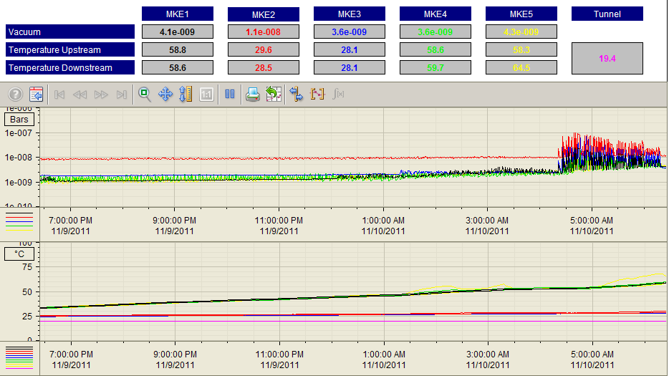
Vacuum and kicker heating
starting to inject 4 batches, 1.95x10¹¹p/b
stopped just before hitting interlock threshold of 70ºC
starting to inject 4 batches, 1.55x10¹¹p/b

Slide 16
Summary
25ns MD
Beam dump in Q20 optics with reduced voltage (39kV) is OK
Careful orbit correction on flat bottom in Q20 optics mandatory
Emittances: ε_{x}~2.7μm/ε_{y}~2.7μm (Q26) and ε_{x}~3μm/ε_{y}~2.6μm (Q20) – maybe necessary to measure dispersion at the wirescanner location for both optics
50ns MD
Transverse setup still needs further optimization (chromaticity on flat bottom and transverse dampers) → more careful analysis of transmission during setup necessary
Transverse damper V2 still not working properly
Scaling longitudinal settings from nominal optics to Q20 not optimal (in Q20, matched voltage at injection seems to perform better)
Emittance measurements not as reliable as during 25ns MD → analysis of data still ongoing
Kicker heating close to interlock limit of 70ºC with 4 batches

