Slide 1
PS to SPS Transfer Studies
Elena Shaposhnikova, Helga Timkó, Theodoros Argyropoulos, Thomas Bohl, Heiko Damerau, Juan Esteban Müller
BE-RF-BR

Slide 2
Outline
Earlier PS to SPS transfer studies
Why we are still interested to continue
Measurement and simulation
Methods
July ‘11 MD: bunch length and transmission as a function of emittance
November ‘11 MD: Tracking the bunch lengths in the PS during splitting and rotation
Conclusions and outlook

Slide 3
PREVIOUS STUDIES
PS TO SPS TRANSFER:

Slide 4
Motivation
Larger emittances in PS (and SPS) are preferable from the longitudinal stability and the delivered intensity point of view, but
Larger ε_{l} → longer τ at ejection → more transfer losses
Bunch ‘gymnastics’ in the PS to SPS transfer:
Starting from (4+2)×3=18 bunches in PS, 10 MHz
Single or double splitting for a 50 ns (20 MHz) or 25 ns (40 MHz) bunch spacing, respectively
Non-adiabatic bunch rotation to shorten the bunch length
Injection to the 200 MHz SPS bucket

Slide 5
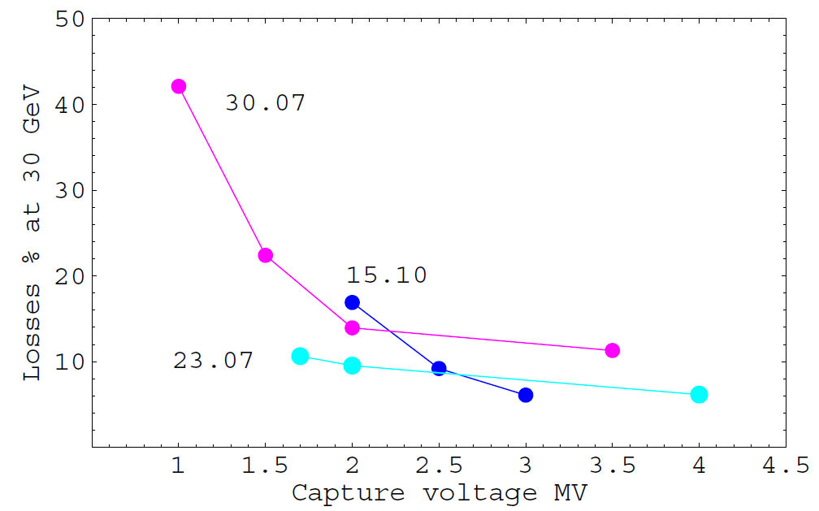
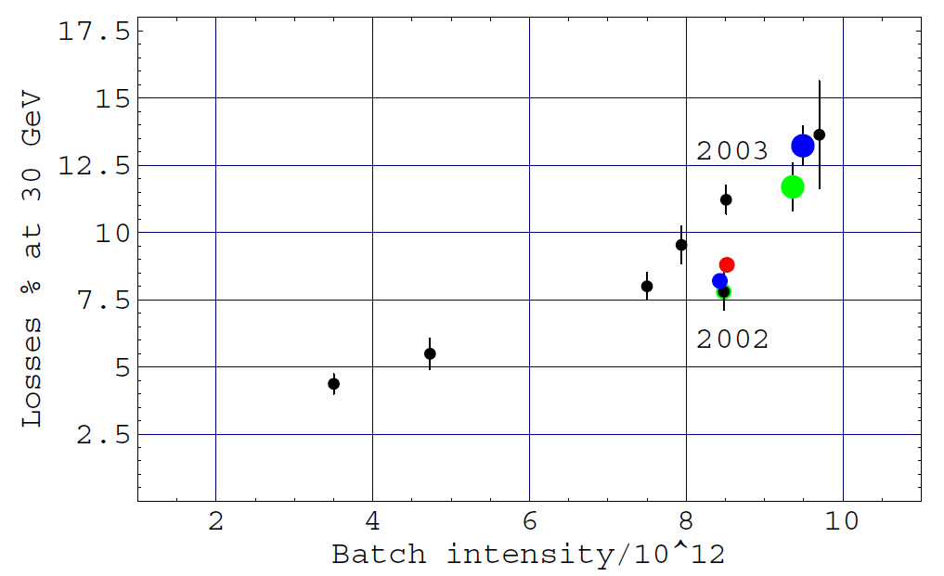
Capture losses, 2003/2004 CERN-AB-Note-2004-036
Matched voltage at injection to SPS: 750 kV
Capture loss vs. capture voltage/intensity was studied
72 bunches w/ 25 ns spacing, 3-4 batches
τ_{4σ} = 4.2 ns, ε_{l} = 0.35 eVs at injection to the SPS
New voltage programme: 2-3 MV injection steps

Slide 6
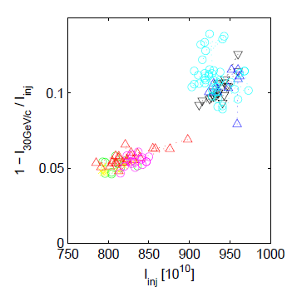
Transfer optimisation, 2008 CERN-AB-Note-2008-021
Study of the bunch shaping in the PS: bunch rotation with 2 or 3 cavities, i.e. 600 or 900 kV, respectively
The idea behind: higher voltage → more stretched bunches → shorter τ after rotation → less beam losses (?)
Observed: no clear dependence on the rotation voltage
But: a strong dependence of beam loss on intensity
Total losses

Slide 7
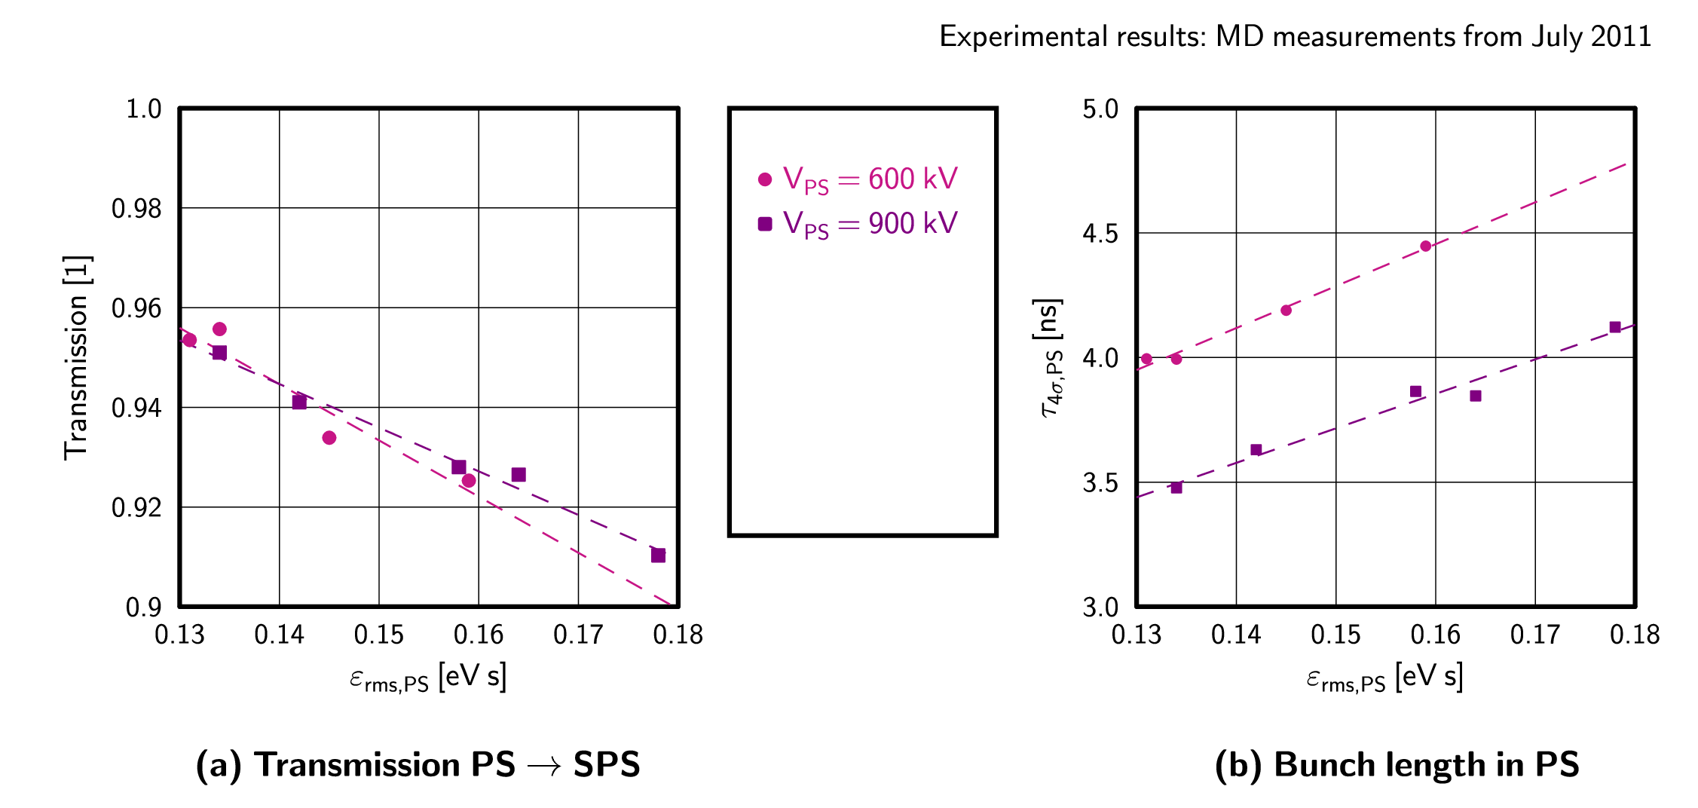
Rotation voltage revisited, July 2011
Systematic scan of losses vs. bunch length for 600 and 900 kV PS rotation voltage; 50 ns scenario
Transmission doesn’t improve
Operational

Slide 8
Comparison with Simulations
JULY 2011 MD DATA:

Slide 9
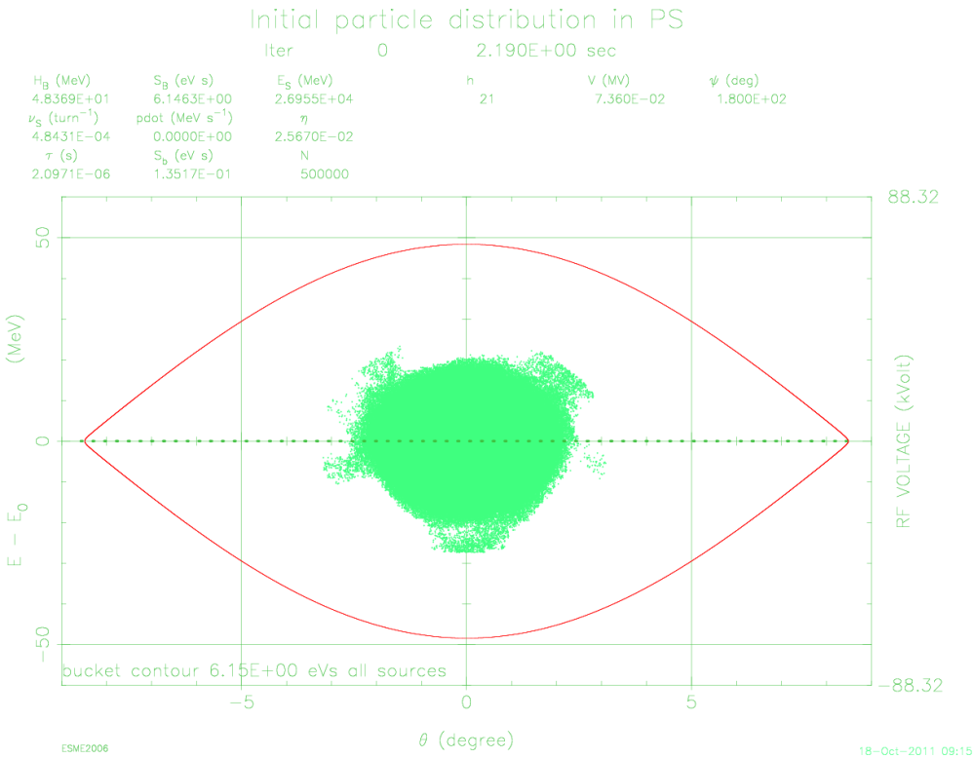
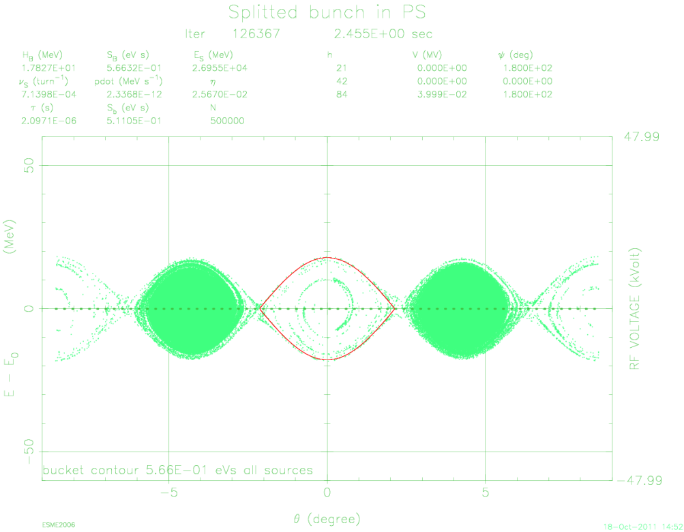
Simulation methods (50 ns scenario)
Use the experimentally measured PS FB bunch distribution (sample 500,000 particles) and real PS & SPS voltage programme
STEP 1: Split the initial bunch

Slide 10
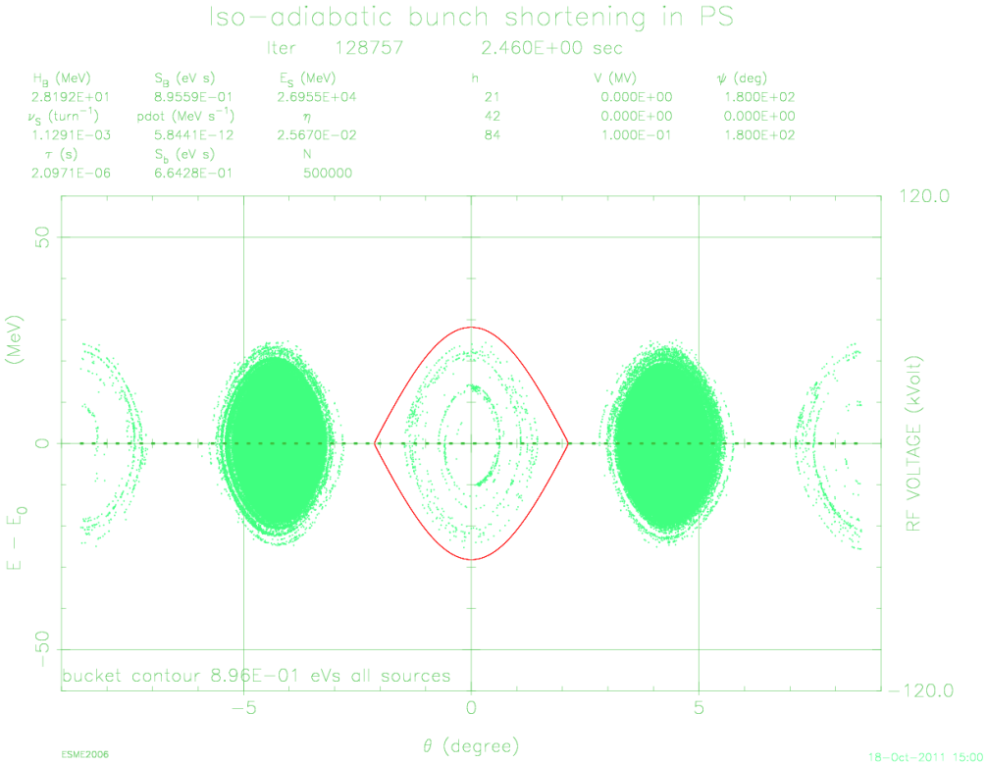
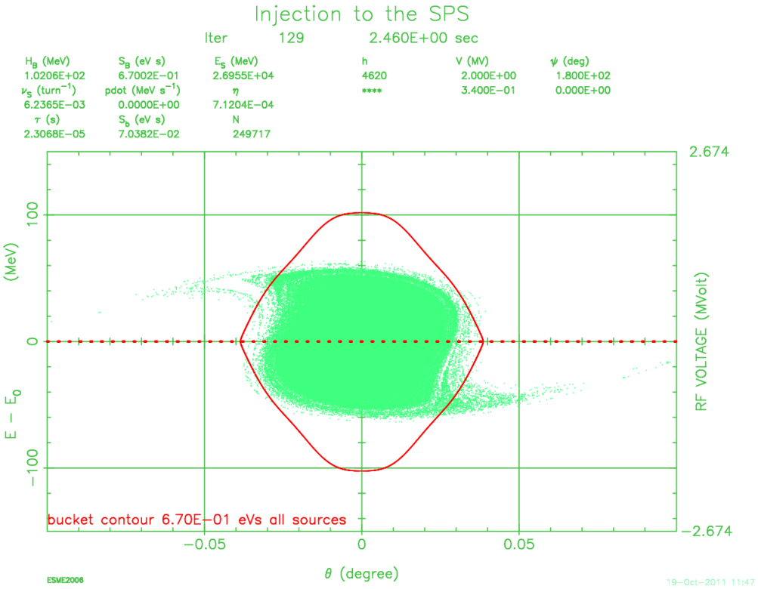
Simulation methods cont’d (50 ns scenario)
STEP 2: iso-adiabatic bunch shortening
STEP 3: non-adiabatic bunch rotation
STEP 4: injection to SPS bucket
N.B. bunch length at ejection is critical!

Slide 11
Simulations vs. measurements
In principle, simulations apply the same bunch gymnastics as experiments
However, simulations do not take into account
Intensity
Impedance
Error sources such as synchronisation of RF phases between different harmonics etc.

Slide 12
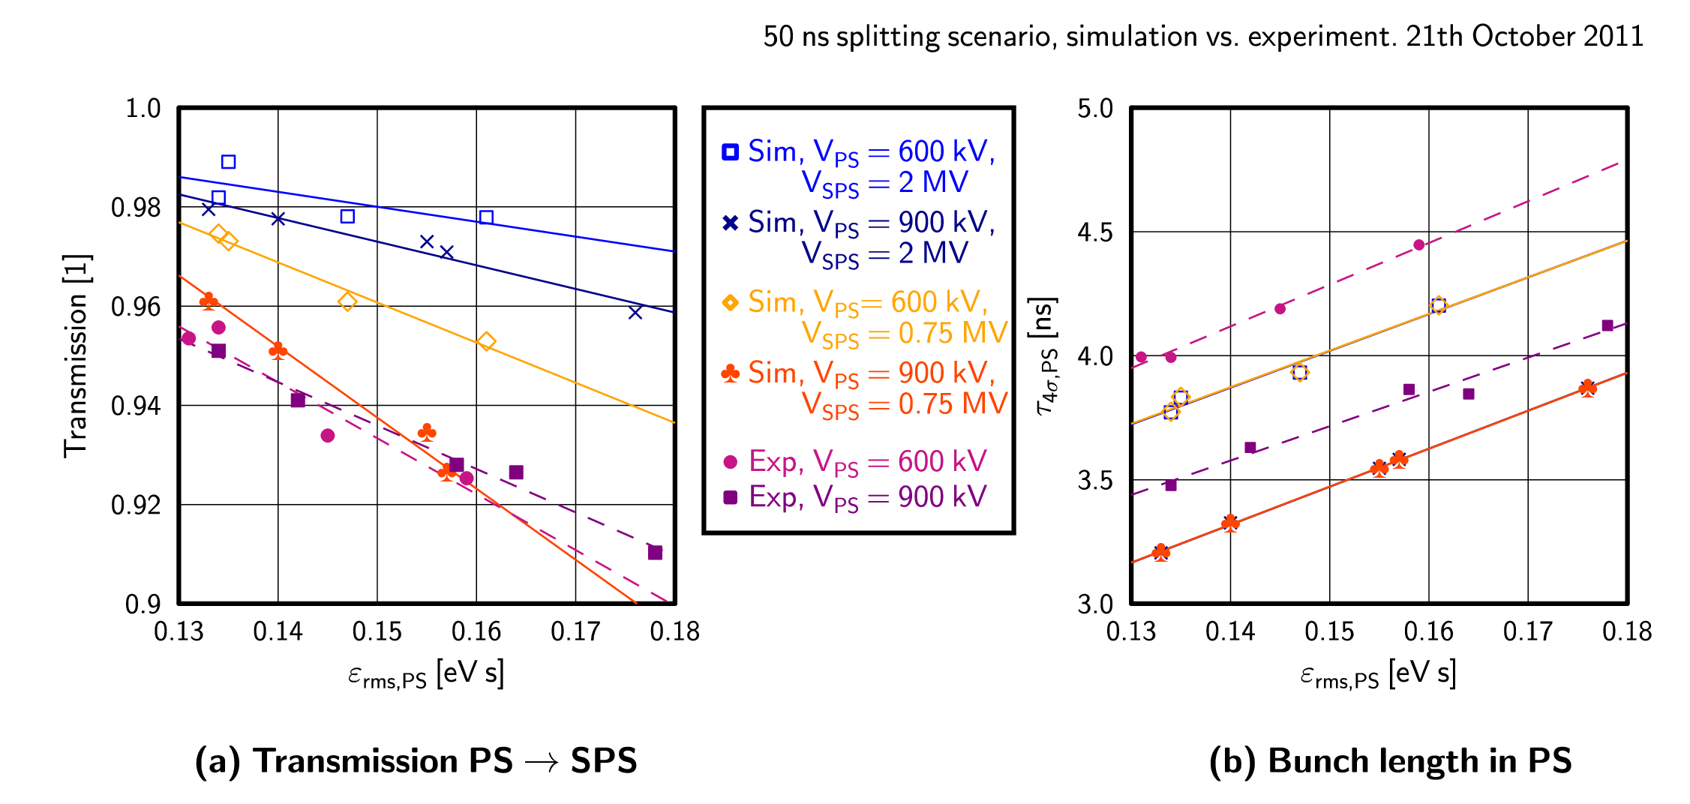
Results
Simulated τ’s are systematically lower, but same trend
Reproduces the earlier finding that higher SPS voltage is better

Slide 13
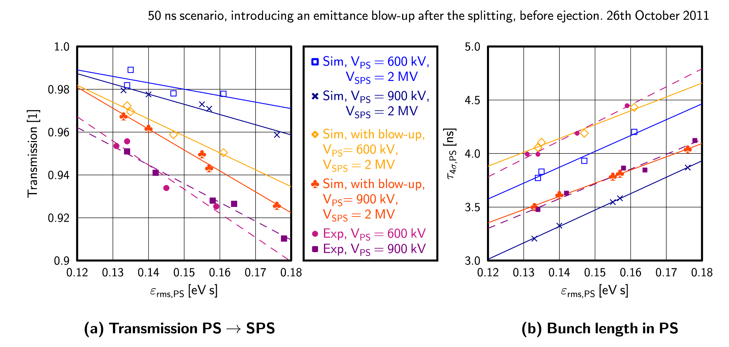
Results cont’d
Introduce a blow-up in simulations to compare τ’s Transmission roughly comparable (N.B. simulation is ‘perfect’)

Slide 14
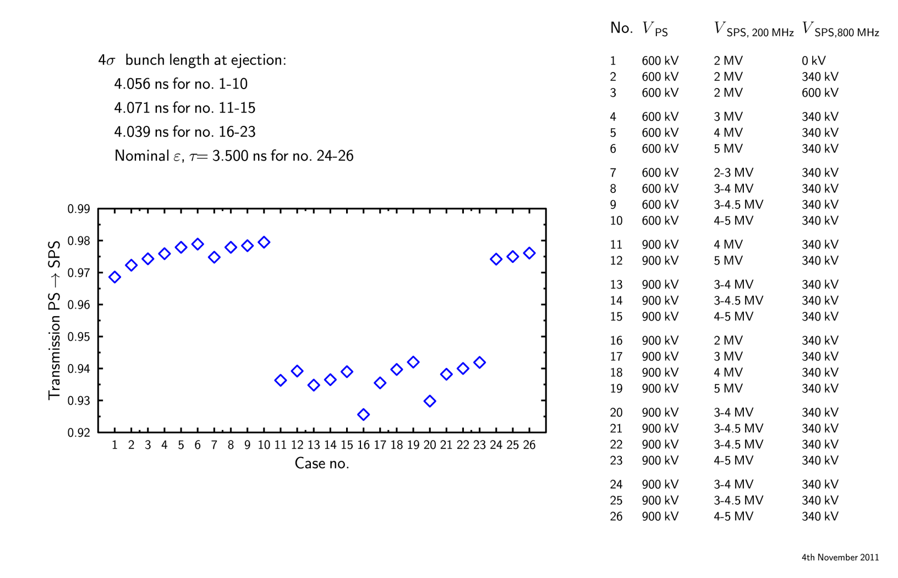
Predicted effect of different voltage programmes
As seen in the ‘08 MD, losses are little affected by V_{SPS}
What counts is ε at injection
ε_{rms} = 0.08 eVs (@ rot),
ε_{rms} = 0.09 eVs (@ inj)
ε_{rms} = 0.1 eVs (@ rot),
ε_{rms} = 0.14 eVs (@ inj)
ε_{rms} = 0.1 eVs (@ rot),
ε_{rms} = 0.14 eVs (@ inj)
ε_{rms} = 0.08 eVs (@ rot),
ε_{rms} = 0.1 eVs (@ inj)

Slide 15
TRACKING THE bunch Lengths
NOVEMBER 2011 MD DATA:

Slide 16
The evolution of bunch length in the PS
We then measured τ at different moments in the PS, while taking in parallel tomoscopy data of the initial FB bunch distribution
Losses in SPS (excl. acceler.): ~1.7 % (4.6e12), ~2.8 % (9.2e12)
N.B. very low!!
Intensity (p/batch) | 4.6e12 | 9.2e12 | 5.7e12
Time (ms) | τ_{4σ} (ns)
2205 (FB) | 31.37 | 33.49 | 31.45
2320 (bef. 1st splitt.) | 45.34 | 49.25 | 45.61
2403 (bef. 2nd splitt.) | 28.29 | 30.92 | 28.56
2454 (pure 40 MHz) | 13.78 | 15.11 | 13.86
2460 (at extraction) | 3.71 | 3.89 | 3.69

Slide 17
Corresponding simulations
Systematically lower simulated bunch lengths, already from the very beginning
Intensity (p/batch) | 4.6e12 exp | 4.6e12 sim | 9.2e12 exp | 9.2e12 sim
Time (ms) | τ_{4σ} (ns)
2205 (FB) | 31.37 | 30.80 | 33.49 | 33.36
2320 (bef. 1st splitt.) | 45.34 | 42.82 | 49.25 | 46.36
2403 (bef. 2nd splitt.) | 28.29 | 25.76 | 30.92 | 27.91
2454 (pure 40 MHz) | 13.78 | 12.82 | 15.11 | 13.89
2460 (at extraction) | 3.71 | 3.39 | 3.89 | 3.66

Slide 18
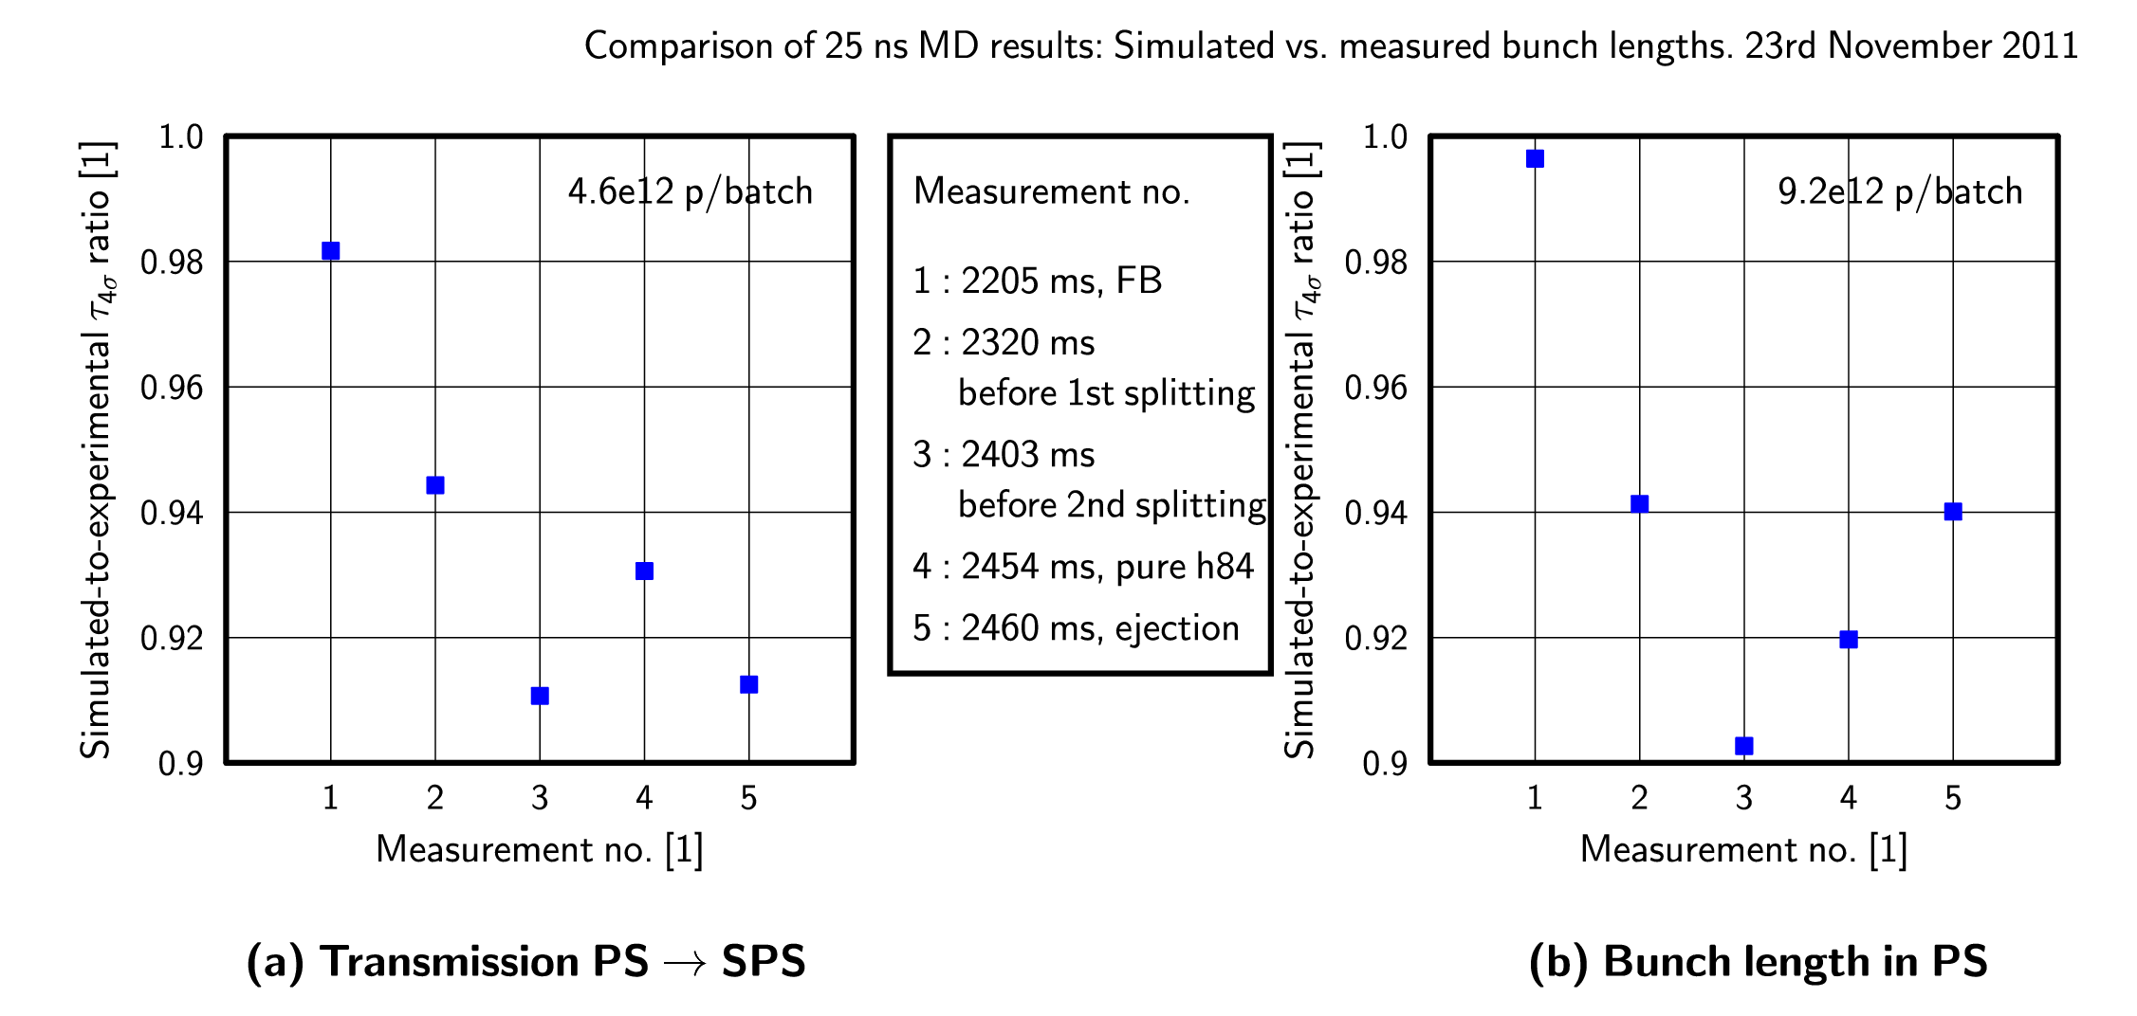
Simulation vs. experiments
The ratio of the simulated/experimental bunch lengths shown in the previous table; the experimental emittance is blown-up

Slide 19
Conclusions and outlook
Transmission was improved over the years but is still an issue if emittance needs to be increased
Increasing the SPS voltage at injection can somewhat improve the transmission, however,
The key factor is the emittance at extraction
ESME simulations reproduce the experimentally observed trends
An emittance blow-up was observed in the PS already before the first splitting
Explanation for simulated bunch lengths being shorter
Work in progress:
Compare with recent MD on 25 ns-scenario transmission
Look for possible reasons of the emittance blow-up

