Slide 1
Non-adiabatic Bunch Rotation in the PS:
Can the Spare 40MHz (80MHz) Cavity Help?
S. Hancock

Slide 2
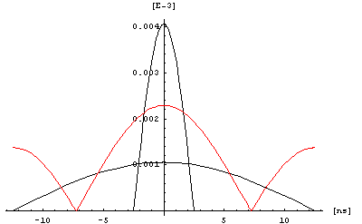
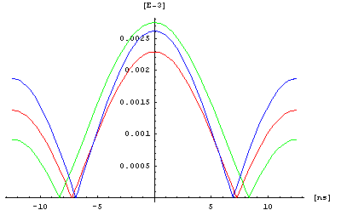
Introduction
The non-adiabatic bunch rotation is “written in stone”: starting from 100kV there is a step in the single 40Mhz cavity voltage, then two 80MHz cavities are introduced in a second step. The steps go to 300kV per cavity. The final product (red) is still a long way short of being matched to the bucket in the SPS. Adding the spare 40MHz (green) or spare 80MHz (blue) cavity does little to improve the mismatch, but the 40MHz option offers more acceptance and would not perturb ion operation.
(1, 2)  (40MHz, 80MHz)
(2, 2)  (40MHz, 80MHz)
(1, 3)  (40MHz, 80MHz)
2MV @ SPS
100kV @ 40MHz

Slide 3
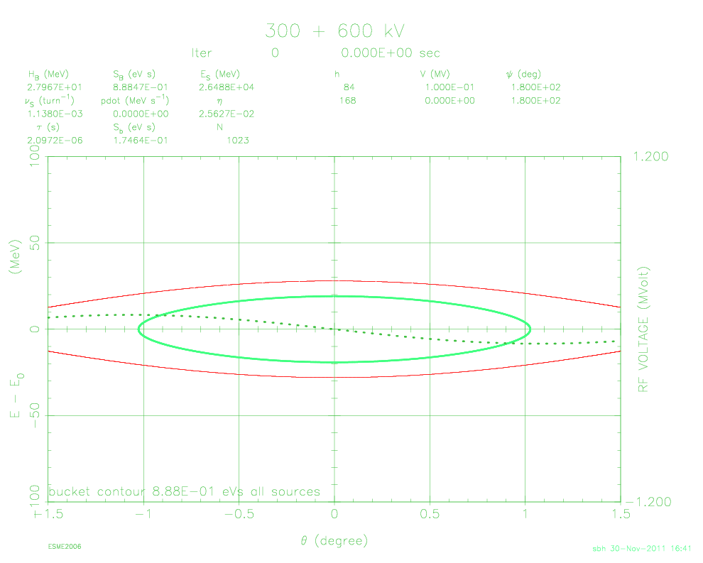
Initial Conditions
In the following phase space plots, all scales are fixed and the right-hand images employ the spare 40MHz cavity for comparison with the long-established norm. The starting point is a matched bunch contour.
0.35eVs
0.35eVs

Slide 4
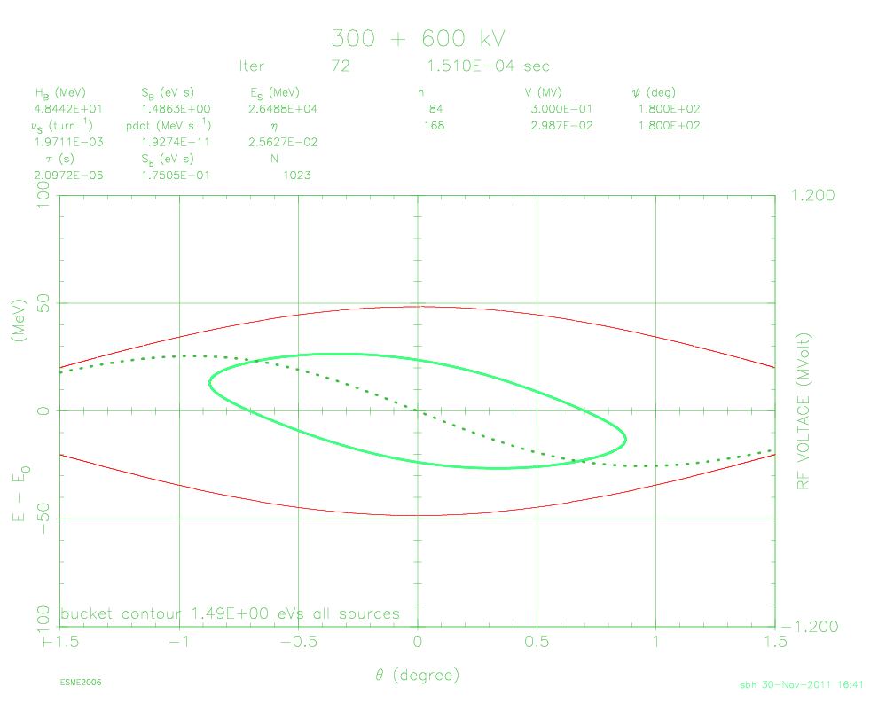
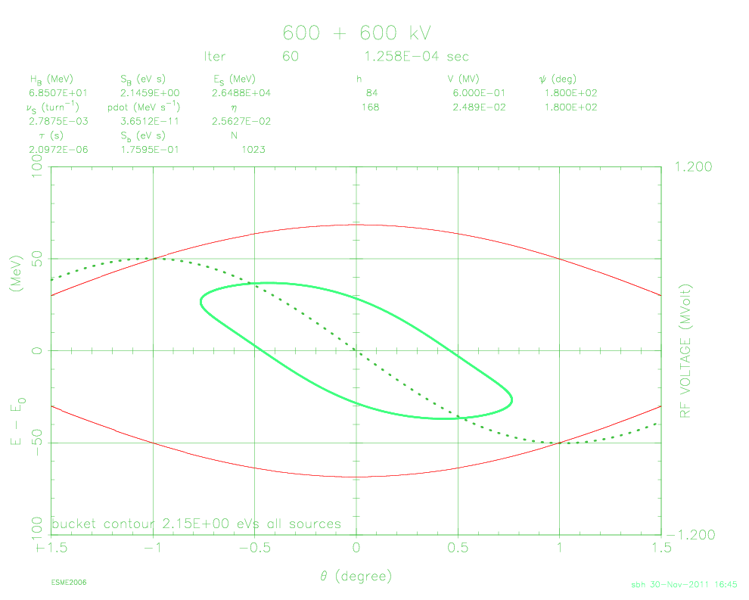
Single-harmonic Bucket
Using the second 40MHz cavity means that the bunch can be shortened further before the 80MHz starts because the subsequent reduced compression factor is compensated by the extra rotation voltage. The increased 40MHz can thus be used to buy more bucket margin…
∆t₁ = 150μs
∆t₁ = 125μs

Slide 5
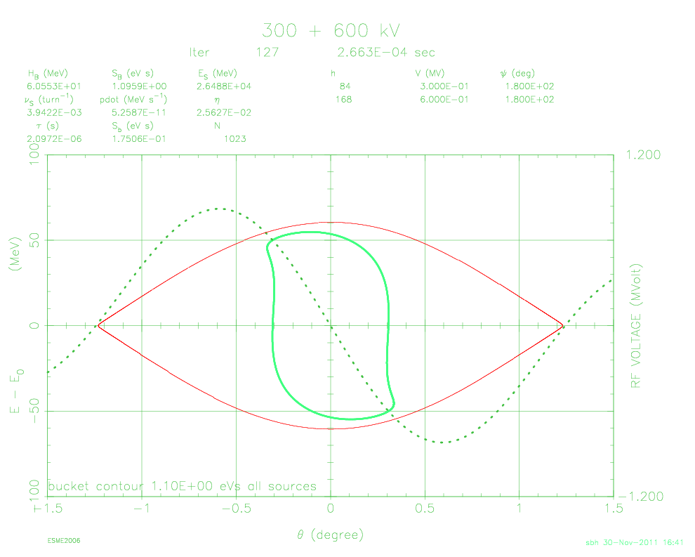
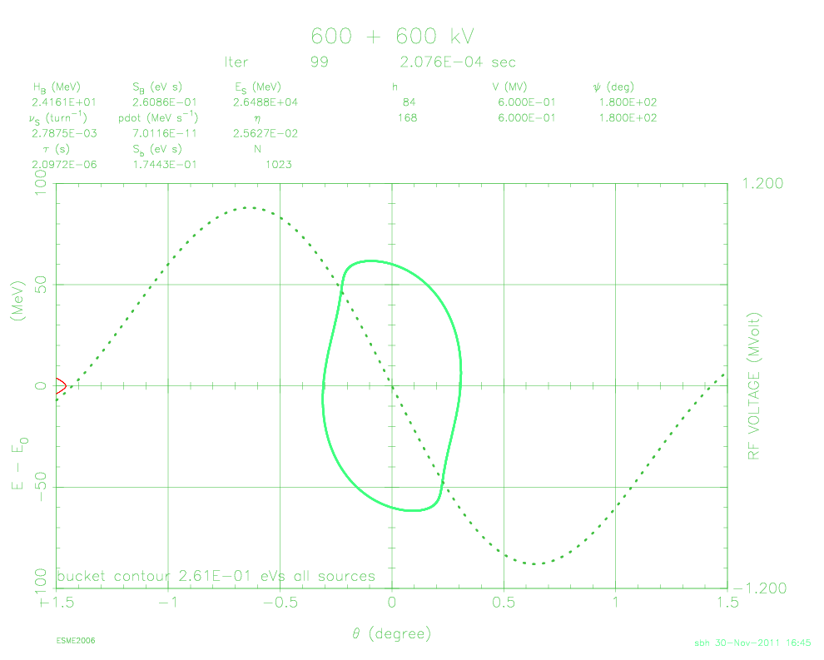
Dual-harmonic Bucket
…and hence a more linear rotation rather than a shorter final product. (ESME does not always draw the main bucket!)
Bucket half-height = 73MeV
∆t₂ = 115μs
∆t₂ = 80μs

Slide 6
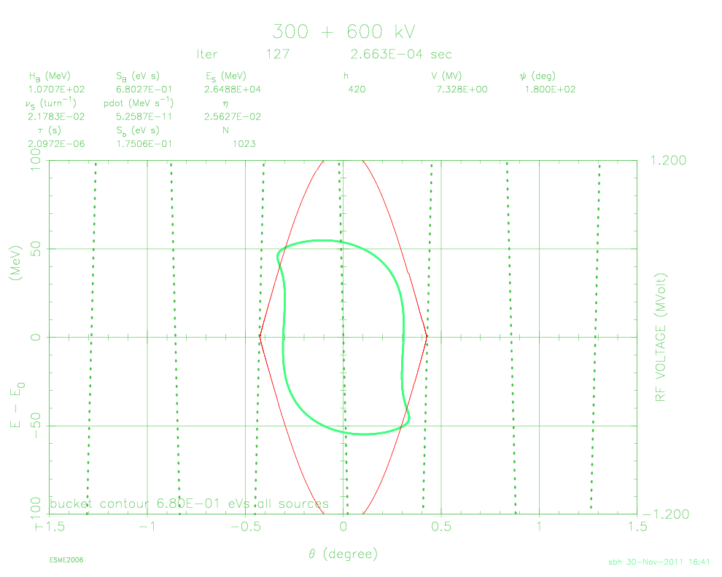
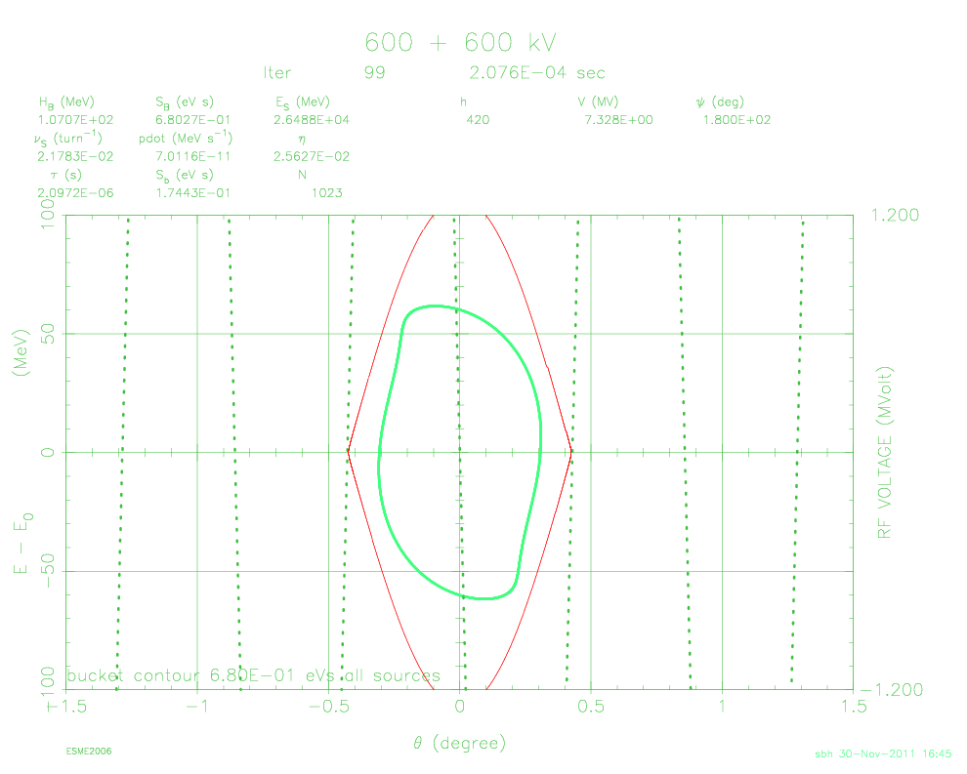
SPS Bucket
The target is the eye of a needle. Not only is the bucket waiting in the SPS 5 times shorter than the PS one as the rotation starts, but a 200MHz system in the PS would need to deliver 7.3MV to generate the same bucket that 2MV produces in the SPS. The high frequency systems actually installed in the PS together deliver an order of magnitude less voltage than this.

Slide 7
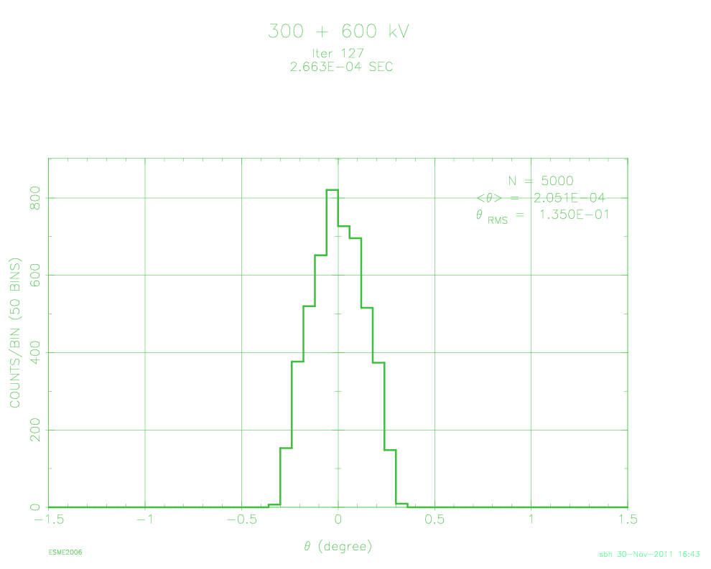
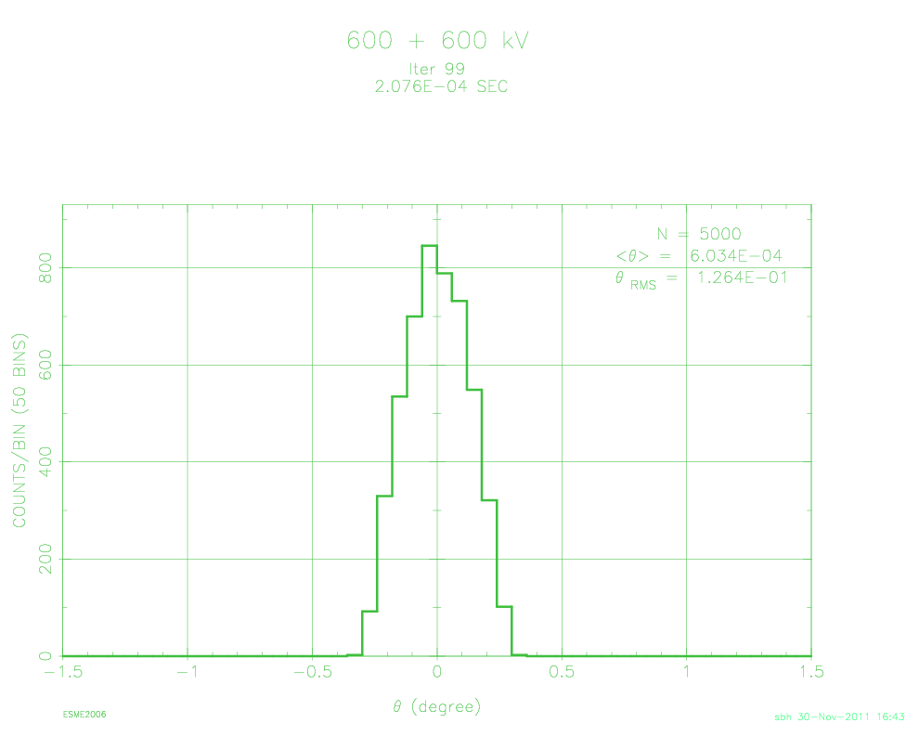
RMS Bunch Length
Tracking many particles rather than a contour yields the resultant longitudinal distribution (for a parabolic initial one). ∆t₂ was scanned in these simulations to find the minimum θ_{RMS}. Note that the preceding contour images used this same optimized value of ∆t₂.
5θ_{RMS} ↔ 3.93ns
5θ_{RMS} ↔ 3.68ns

Slide 8
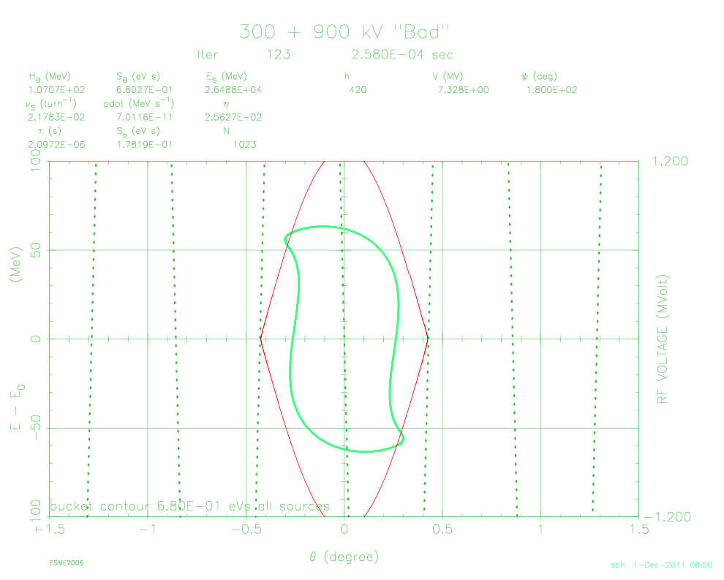
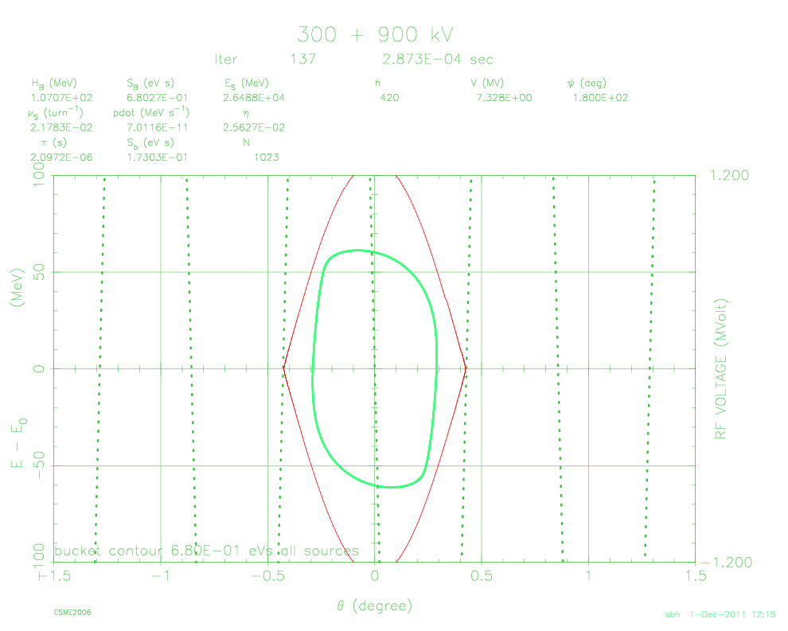
Spare 80MHz Cavity
Using the second 80MHz cavity means that the bunch really must be rotated longer at 40MHz otherwise the shortening of the dual-harmonic bucket makes the filamentation worse.
MDs to generate loss maps in (∆t₁,∆t₂) space will prove if the real machine parameters can be optimized to permit larger longitudinal emittances (not shorter bunches!) to be transferred.
∆t = 150 + 105μs 5θ_{RMS} ↔ 3.42ns
∆t = 185 + 100μs 5θ_{RMS} ↔ 3.63ns

