Slide 1
Space charge calculations
H. Bartosik
SPSU, 19.12.2011

Slide 2
Overview
Calculations for direct space charge tune spread for the SPS (protons)
Comparing the nominal (Q26) with the low γ_{t} optics (Q20)
Using the formula
Slightly smaller space charge tune spread can be expected in Q20 optics due to higher dispersion in the arcs

Slide 3
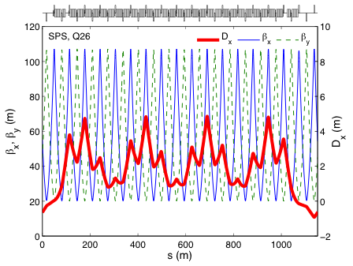
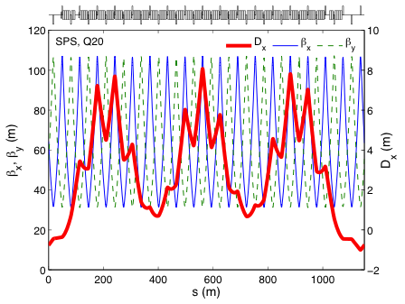
Comparison of optics
Significantly higher dispersion function in Q20 optics (maxima increased from 4.5m to 8m)
Effective reduction of direct space charge tune spread depends on rms momentum spread in the bunch!

Slide 4
Comparing a few cases …
 |  |  | flat bottom (like 50ns beam)
 | “nominal” beam | high intensity Q20 | Q26 | Q20
energy (GeV) | 26 | 26 | 26 | 26
RF voltage Q20/Q26 (MV) | 2/5.75 | 1.33/3.8 | 3/- | -/4.5
bucket area (eVs) | 0.69 | 0.55 | 0.83 | 0.6
4σ bunch length (ns) | 2.9 | 3.3 | 2.6 | 3.1
rms momentum spread | 1.75x10⁻³ | 1.5x10⁻³ | 2x10⁻³ | 1.5x10⁻³
intensity (10¹¹) | 1.3 | 3.3 | 1.7 | 1.7
norm. emittance X/Y (μm) | 3/3 | 2/2 | 1.8/1.8 | 1.8/1.8
ΔQ_{x}/ΔQ_{y} in Q20 | -0.035/-0.057 | -0.12/-0.19 |  | -0.068/-0.113
ΔQ_{x}/ΔQ_{y} in Q26 | -0.041/-0.065 | -0.13/-0.21 | -0.075/-0.136
Tune spread is expected to be around 10-15% smaller in Q20 in comparable beam conditions
Up to 20% smaller tune spread in Q20 for parameters that could be used for 50ns beam on flat bottom (see last two columns on the right)
Reached up to ΔQ_{x}~-0.12 and ΔQ_{y}~-0.19 in high intensity MD with the Q20 optics with tunes of about Q_{x}/Q_{y}~20.13/20.18 …
Remember, this is an estimation; tune spread depends a lot on actual particle distribution in all 3 dimensions!!

