Slide 1
PS to SPS Transfer Studies – Update on Simulations
Elena Shaposhnikova, Helga Timkó, Theodoros Argyropoulos, Thomas Bohl, Heiko Damerau, Steven Hancock, Juan Esteban Müller
BE-RF-BR

Slide 2
Last meeting’s conclusions
ESME simulations reproduced the experimental observation that using 3 cavities in PS instead of 2
Shortens the bunch length at extraction for a given emittance
But the transmission does not improve
Needed to introduce an emittance blow-up in simulations to match the observed bunch length
We concluded that increasing the SPS voltage at injection can somewhat improve the transmission, however,
The key factor is the emittance at extraction

Slide 3
Bunch shapes with 2/3 cavities
For the same bunch length, bunch shapes are slightly different in the two cases
In the tails between 2—3 σ we have:
~ 0.8—0.9 % for 600 kV
~ 1.5—1.6 % for 900 kV
About 0.8 % difference
Show[
ListPlot[t61, PlotRange®{{-1.,1.}, {0.,1.2}}, PlotStyle®{Blue}], ListPlot[t94, PlotRange®{{-1.,1.}, {0.,1.2}}, PlotStyle®{Red}]]

Slide 4
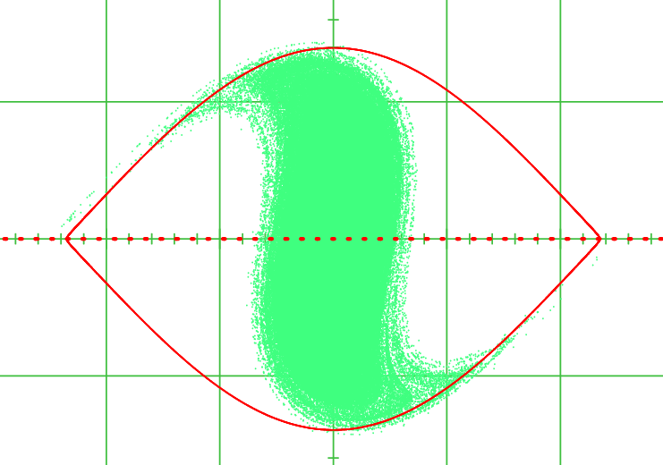
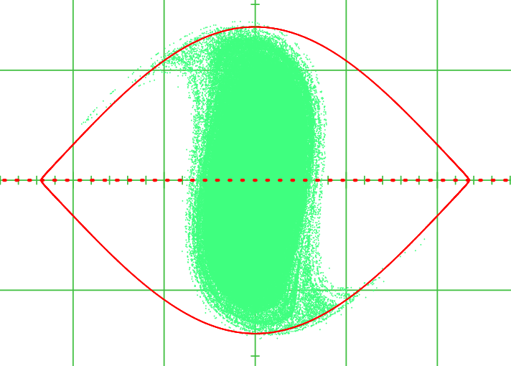
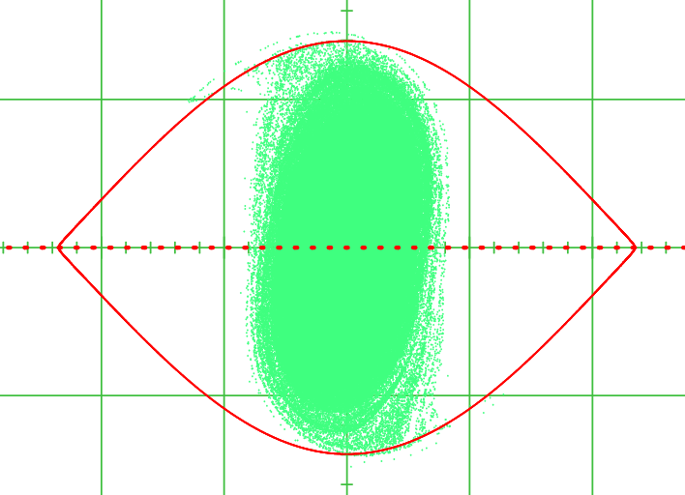
Another parameter that can be optimised…
As Steve suggested, we can optimise the sum Δt_{40MHz} + Δt_{80MHz}, which will influence the bunch shape and length
Δt_{40MHz} : bunch shortening time (300 kV)
Δt_{80MHz} : bunch rotation time (600 or 900 kV)
Δt_{40MHz} = 150 μs
Δt_{40MHz} = 180 μs
Δt_{40MHz} = 210 μs

Slide 5
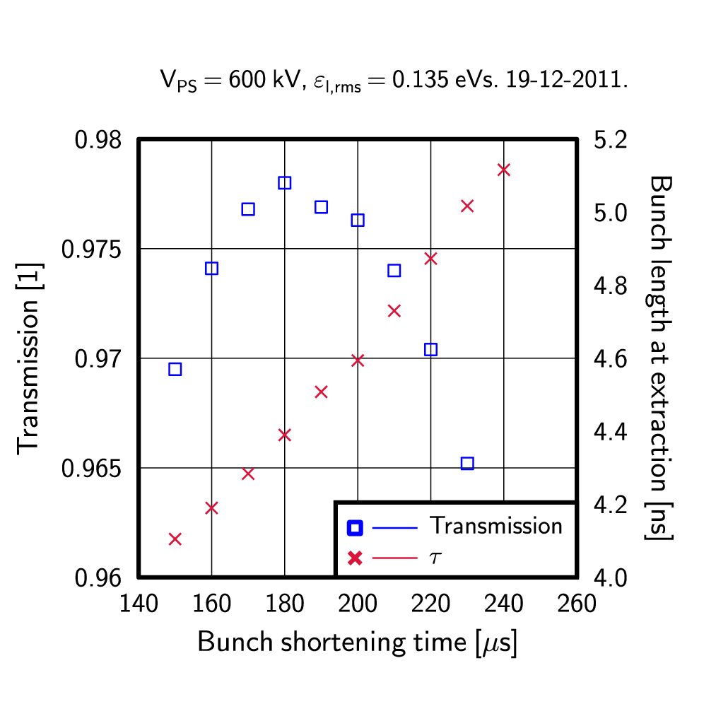
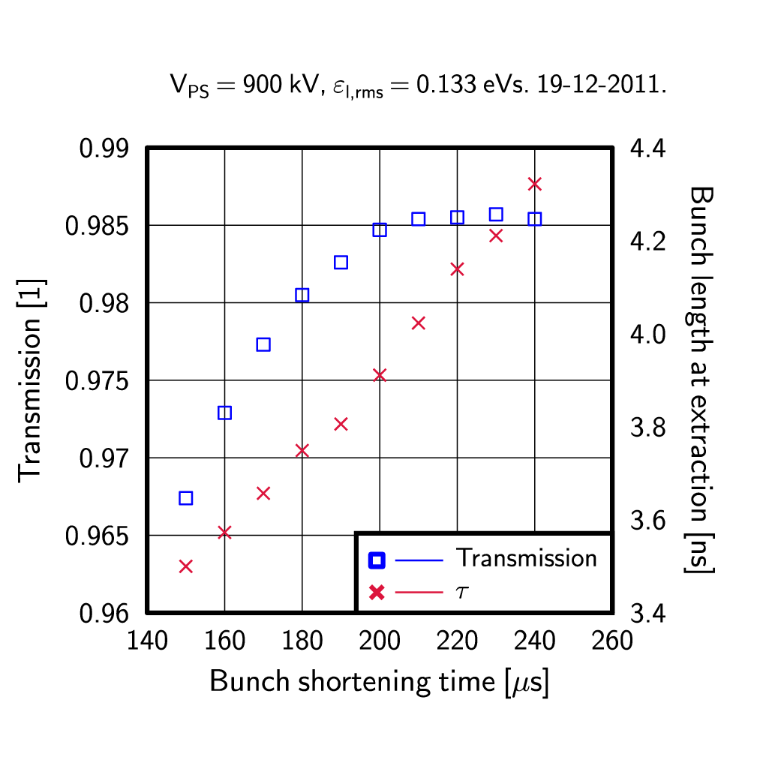
Optimal bunch shortening time
600 kV, 2 cavities
900 kV, 3 cavities

Slide 6
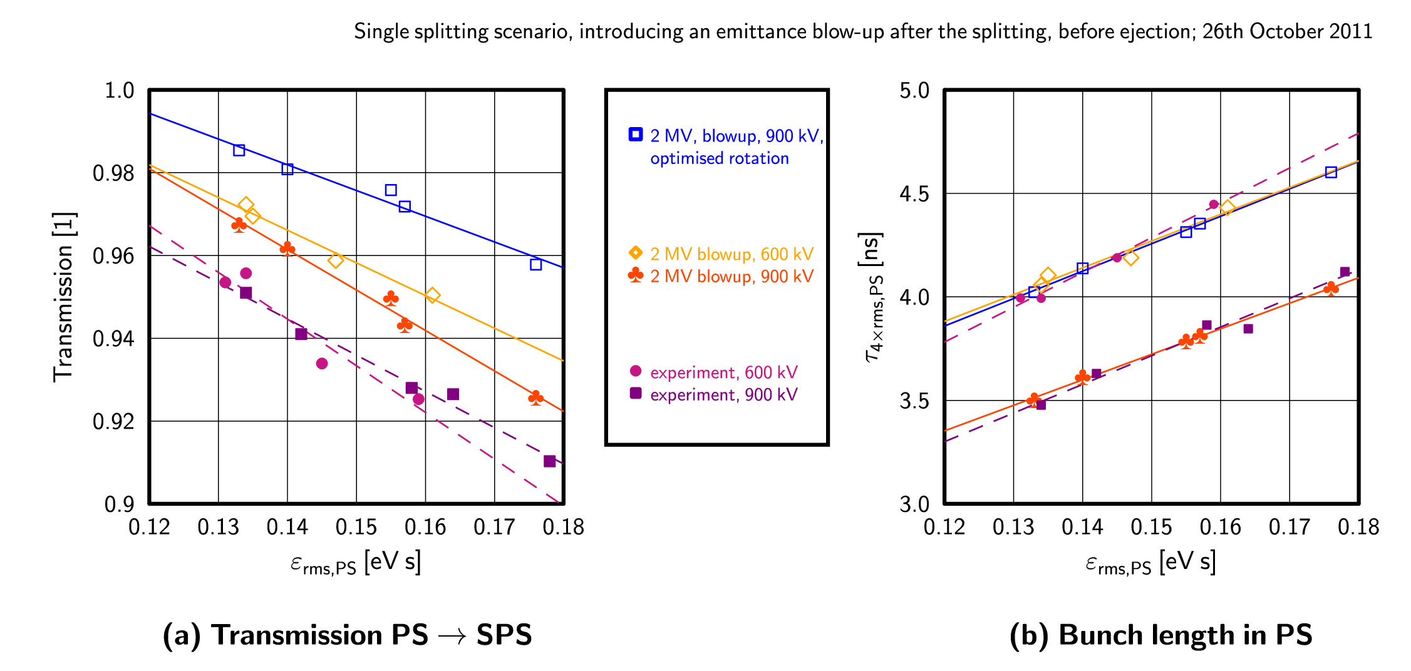
Comparing to previous results…
…Transmission can be improved! (below: 150 → 210 μs)
But: bunch length grows as well

Slide 7
Conclusions, outlook
The transmission can be improved by optimising the bunch shortening time
However, this will result also in longer bunches
Using 3 cavities we can have some margin to increase the bunch length at (and a bit above) the currently operational emittance
To find out whether another cavity in the PS would be useful, we
Need to confirm these findings experimentally
Need more realistic simulations incl. impedances to estimate how much the transmission improves

