Slide 1
Update on SPS BPM impedance
B. Salvant
for the 2008 impedance team

Slide 2
Reference:
http://cdsweb.cern.ch/record/1208424/files/CERN-ATS-2009-046.pdf
106 BPH and 96 BPV in the SPS
Low frequency imaginary impedance for a BPH :
Zlong/n ~ 1 mΩ, Zx=- 0.1 kΩ/m and Zy=2 kΩ/m.
Separate simulations for a BPV:
Zlong/n~0.5mΩ, Zy= 0.1 kΩ/m and Zx= 0.2 kΩ/m.

Slide 3
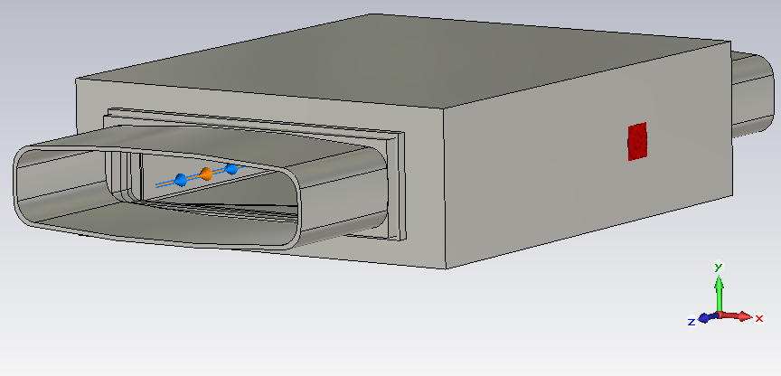
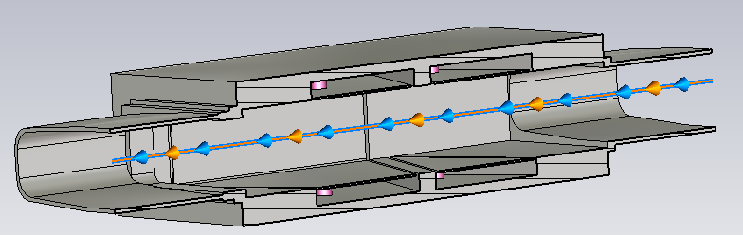
Modelled structure for the BPH
Ultrarelativistic beams
All materials are perfect conductors (except the ceramic spacers)
In fact:
- Electrodes + pipe should be in Stainless Steel
- Casing should be in Anticorodal
Rs=|V|^2/Plosses

Slide 4
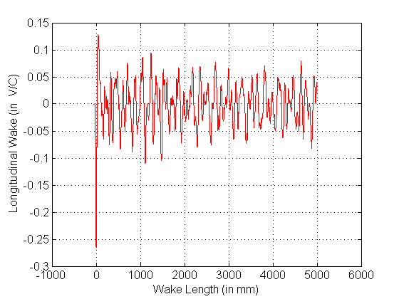
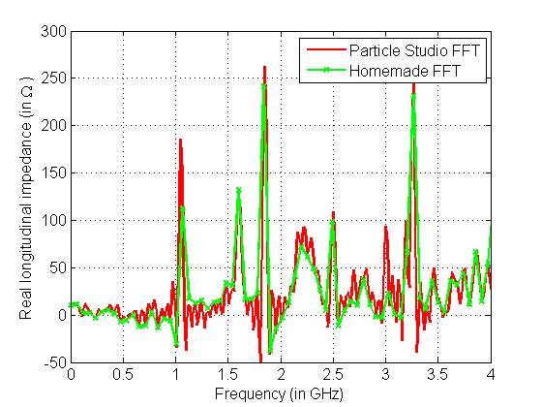
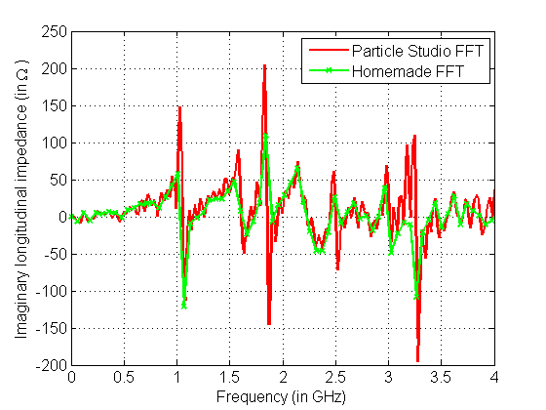
BPH longitudinal (with material losses)
fres (GHz) | Q | Rs (“center”) in Ohm | Rs/Q In Ohm
0.265 | 263 | 1766 | 6.7
0.885 | 482 | 275 | 0.6
0.892 | 493 | 374 | 0.8
1.052 | 773 | 3013 | 3.9
1.062 | 773 | 3591 | 4.6
1.598 | 672 | 804 | 1.2
1.613 | 686 | 11274 | 16.4
1.859 | 896 | 5567 | 6.2

Slide 5
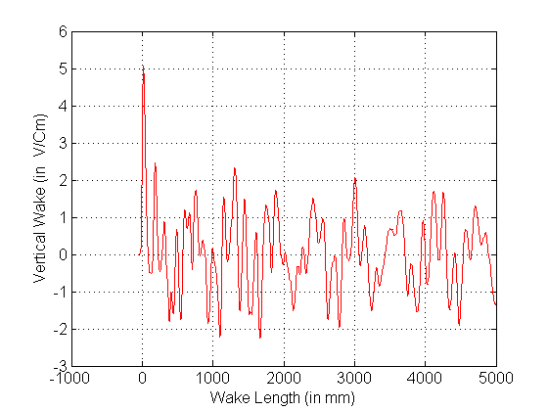
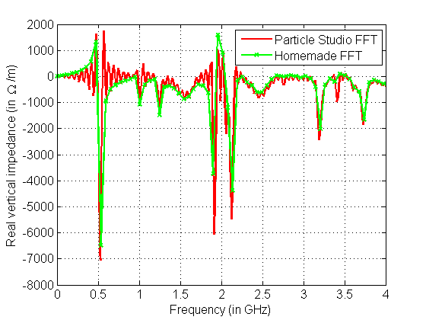
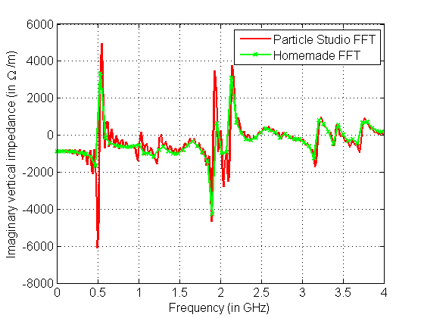
BPH vertical (with material losses)
fres (GHz) | Q | Rs (“center”) in Ohm | Rs (y=2mm) in Ohm | Abs(DeltaRs(y=2)) /Deltay in Ohm/m | Abs(DeltaRs(y=2)) /Deltay/Q in Ohm/m
0.528 | 465 | 0 | 52 | 26118 | 56.1
0.532 | 483 | 0 | 9 | 4641 | 9.6
1.206 | 1276 | 0 | 21 | 10286 | 8.1
1.258 | 764 | 0 | 10 | 4910 | 6.4
1.271 | 688 | 0 | 5 | 2471 | 3.6
1.414 | 1514 | 0 | 68 | 34172 | 22.6
1.613 | 686 | 11274 | 11339 | 32727 | 47.7
1.665 | 1223 | 0 | 67 | 33402 | 27.3
1.859 | 896 | 5567 | 5590 | 11554 | 12.9

Slide 6
BPH horizontal (with material losses)
fres | Q | Rs (“center”) | Rs (x=2mm) | Abs(DeltaRs) /Deltay | Abs(DeltaRs) /Deltay/Q
0.885 | 482 | 275 | 282 | 3511 | 7.3
0.892 | 493 | 374 | 378 | 2006 | 4.1
1.598 | 672 | 804 | 815 | 5379 | 8.0
1.613 | 686 | 11274 | 11210 | 32005 | 46.7
1.833 | 905 | 71 | 92 | 10945 | 12.1
1.859 | 896 | 5567 | 5544 | 11285 | 12.6
Quite insignificant change of transverse displacement on shunt impedance

Slide 7
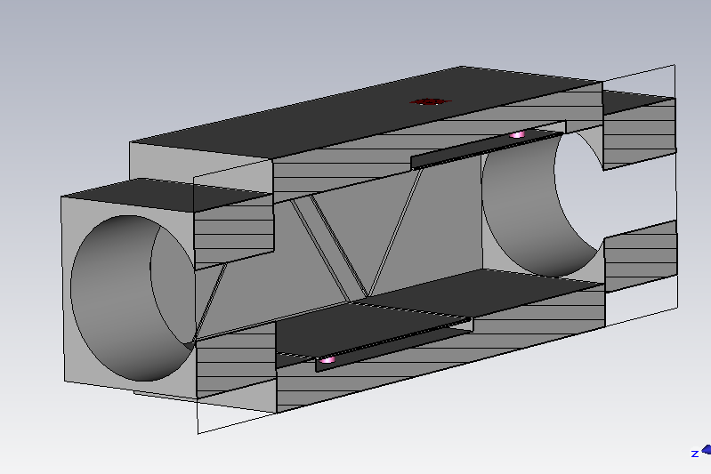
BPV

Slide 8
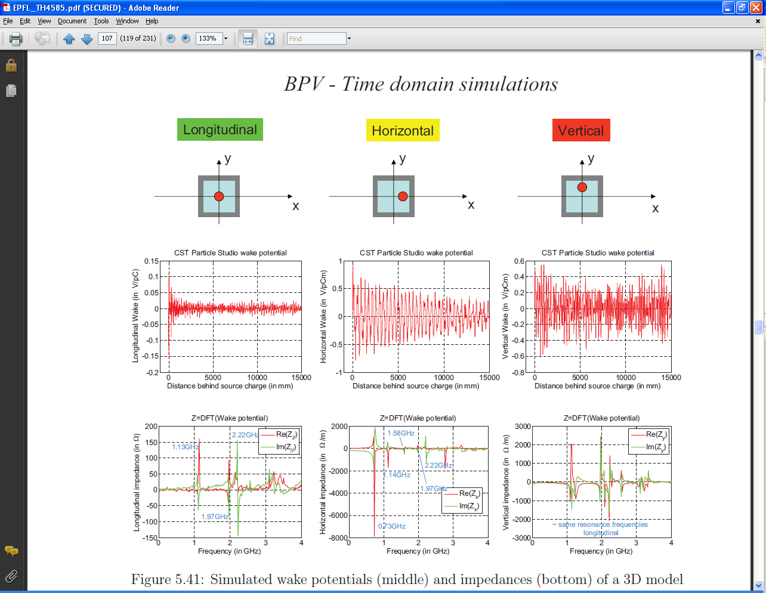
From PhD thesis…

Slide 9
BPV (with material losses)
Longitudinal
vertical
horizontal
fres | Q | Rs (“center”) In Ohm | Rs(center)/Q In Ohm | Rs (y=2mm) In Ohm | Abs(DeltaRs(y=2)) /Deltay In Ohm/m | Abs(DeltaRs(y=2)) /Deltay/Q In Ohm/m | Rs (x=2mm) In Ohm | Abs(DeltaRs) /Deltay In Ohm/m | Abs(DeltaRs) /Deltay/Q In Ohm/m
0.293 | 239 | 90 | 0.4 | 93 | 1571 | 6.6 | 90 | 17 | 0.1
0.298 | 241 | 1595 | 6.6 | 1595 | 142 | 0.6 | 1596 | 240 | 1.0
0.704 | 525 | 0 | 0.0 | 0 | 0 | 0.0 | 17 | 8282 | 15.8
0.715 | 548 | 0 | 0.0 | 0 | 0 | 0.0 | 7 | 3611 | 6.6
1.069 | 654 | 945 | 1.4 | 943 | 1146 | 1.8 | 948 | 1643 | 2.5
1.092 | 667 | 1188 | 1.8 | 1185 | 1692 | 2.5 | 1191 | 1668 | 2.5
1.185 | 610 | 241 | 0.4 | 254 | 6533 | 10.7 | 235 | 3033 | 5.0
1.215 | 624 | 26 | 0.0 | 43 | 8499 | 13.6 | 25 | 680 | 1.1
1.570 | 745 | 0 | 0.0 | 0 | 0 | 0.0 | 0 | 10 | 0.0
1.576 | 724 | 0 | 0.0 | 0 | 0 | 0.0 | 2 | 1087 | 1.5
1.610 | 773 | 0 | 0.0 | 0 | 0 | 0.0 | 0 | 34 | 0.0
1.661 | 686 | 0 | 0.0 | 0 | 0 | 0.0 | 1 | 531 | 0.8
1.871 | 2873 | 0 | 0.0 | 0 | 48 | 0.0 | 0 | 54 | 0.0
1.910 | 2430 | 0 | 0.0 | 0 | 0 | 0.0 | 0 | 148 | 0.1
1.960 | 1993 | 1503 | 0.8 | 1509 | 2584 | 1.3 | 1501 | 1439 | 0.7

Slide 10
Effect on the beam
→ Headtail simulations
Simulations done at the time with small longitudinal emittance (0.15 eVs)
All BPMs are lumped in one location accounting for the respective beta functions.
Linear longitudinal restoring force
No direct space charge

Slide 11
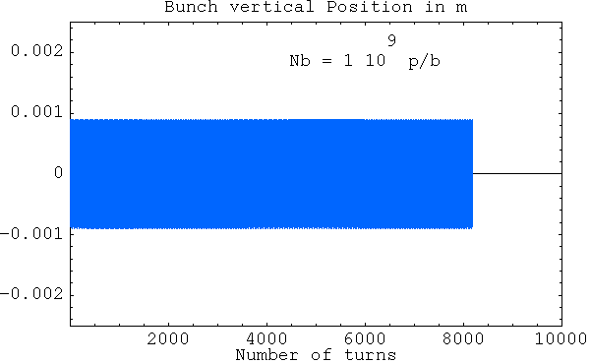
BPMs alone (vertical plane)

Slide 12

BPMs alone (horizontal plane)

Slide 13
Summary
Effect of impedance of BPH and BPV is small on transverse single bunch dynamics
Longitudinal modes :
  Rs~1 to 10 k Ω
  R/Q~ 5 to 20 Ω
  Larger for BPHs than BPVs
  Frequencies above 1 GHz
Transverse modes:
  Modes at 0.5 GHz (vertical for BPH) and 0.7 GHz (horizontal for BPV)
  Rs~1 to 20 kΩ/m
  R/Q~ 5 to 50 Ω/m

Slide 14
However…
fres (GHz) | Q | Rs (“center”) in Ohm | Rs/Q In Ohm
0.265 | 263 | 1766 | 6.7
0.885 | 482 | 275 | 0.6
0.892 | 493 | 374 | 0.8
1.052 | 773 | 3013 | 3.9
1.062 | 773 | 3591 | 4.6
1.598 | 672 | 804 | 1.2
1.613 | 686 | 11274 | 16.4
1.859 | 896 | 5567 | 6.2
?

Slide 15
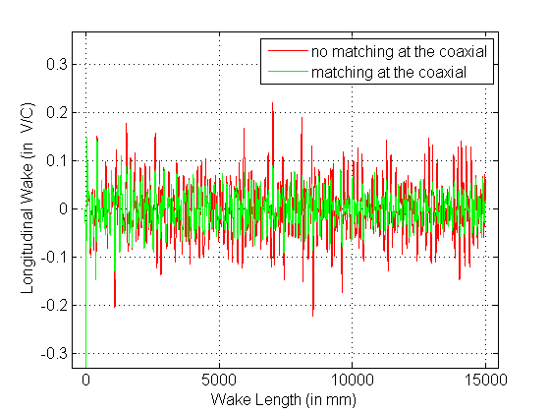
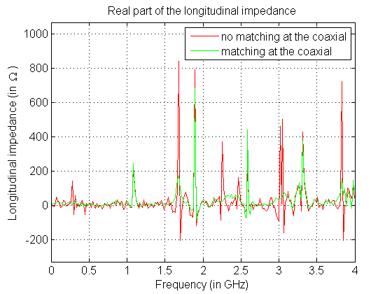
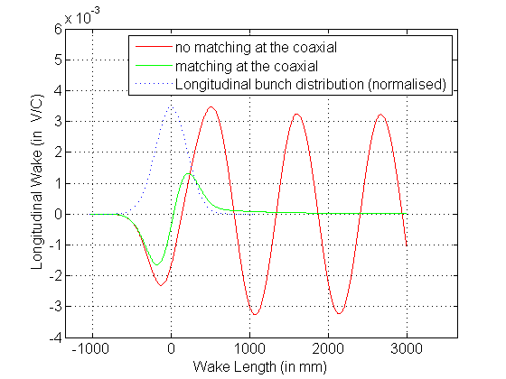
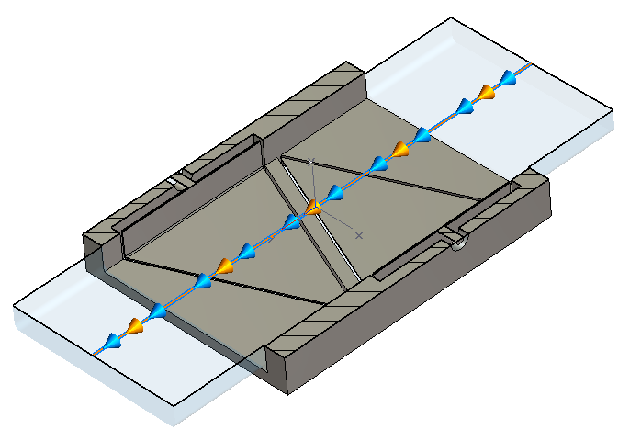
Effect of matching the impedance at electrodes coaxial ports in Particle Studio simulations (BPH)
Modes are damped
by the “perfect matching layer”
at the coaxial port
Short bunch (1 cm rms)
SPS bunch (20 cm rms)
Electrode
coaxial port
Importance to match the BPM
electrodes!

Slide 17
BPH
Longitudinal
vertical
horizontal
fres | Q | Rs (“center”) | Rs(center)/Q | Rs (y=2mm) | Abs(DeltaRs(y=2)) /Deltay | Abs(DeltaRs(y=2)) /Deltay/Q | Rs (x=2mm) | Abs(DeltaRs) /Deltay | Abs(DeltaRs) /Deltay/Q
0.260 | 260 | 77 | 0.3 | 77 | 10 | 0.0 | 78 | 354 | 1.4
0.265 | 263 | 1766 | 6.7 | 1767 | 256 | 1.0 | 1766 | 234 | 0.9
0.528 | 465 | 0 | 0.0 | 52 | 26118 | 56.1 | 0 | 0 | 0.0
0.532 | 483 | 0 | 0.0 | 9 | 4641 | 9.6 | 0 | 0 | 0.0
0.885 | 482 | 275 | 0.6 | 277 | 1189 | 2.5 | 282 | 3511 | 7.3
0.892 | 493 | 374 | 0.8 | 377 | 1594 | 3.2 | 378 | 2006 | 4.1
1.034 | 1798 | 0 | 0.0 | 14 | 7065 | 3.9 | 0 | 0 | 0.0
1.052 | 773 | 3013 | 3.9 | 3015 | 1294 | 1.7 | 3014 | 517 | 0.7
1.062 | 773 | 3591 | 4.6 | 3594 | 1559 | 2.0 | 3591 | 67 | 0.1
1.206 | 1276 | 0 | 0.0 | 21 | 10286 | 8.1 | 0 | 0 | 0.0
1.258 | 764 | 0 | 0.0 | 10 | 4910 | 6.4 | 0 | 0 | 0.0
1.271 | 688 | 0 | 0.0 | 5 | 2471 | 3.6 | 0 | 0 | 0.0
1.414 | 1514 | 0 | 0.0 | 68 | 34172 | 22.6 | 0 | 0 | 0.0
1.598 | 672 | 804 | 1.2 | 809 | 2404 | 3.6 | 815 | 5379 | 8.0
1.613 | 686 | 11274 | 16.4 | 11339 | 32727 | 47.7 | 11210 | 32005 | 46.7
1.638 | 982 | 0 | 0.0 | 4 | 1844 | 1.9 | 0 | 0 | 0.0
1.665 | 1223 | 0 | 0.0 | 67 | 33402 | 27.3 | 0 | 0 | 0.0
1.801 | 3024 | 0 | 0.0 | 11 | 5458 | 1.8 | 0 | 0 | 0.0
1.833 | 905 | 71 | 0.1 | 71 | 159 | 0.2 | 92 | 10945 | 12.1
1.859 | 896 | 5567 | 6.2 | 5590 | 11554 | 12.9 | 5544 | 11285 | 12.6

Slide 18
Longitudinal
Time domain (CST PS)
Frequency domain eigenmode solver at the peaks (CST MWS)
Frequency (GHz) | Rs (Ohm) (PEC) | Q (PEC) | R/Q (Ohm)
1.04 | 1.6 10⁴ | 3150 | 5
1.61 | 4.6 10⁴ | 2690 | 17
1.81 | 2.5 10⁴ | 3357 | 7

Slide 19
Dipolar vertical impedance (PEC)
Frequency | Rs (Ohm) (PEC) at y=1mm | Rs (Ohm) (PEC) at y=4 mm | Q (PEC) | Rs/Q (Ohm/m)
0.53
1.03
1.2
1.92

Slide 20
Longitudinal (with losses)
Frequency | Rs (Ohm) (PEC) | Rs (Ohm) (with losses) | Q (PEC) | Q (with losses) | R/Q (Ohm)
1.04 | 8.2 10⁴ | 1.96 10⁴ | 3080 | 740 | 27
1.61 | 378 | 88 | 2620 | 610 | 0.14
1.81 | 4.9 10⁵ | 1.2 10⁵ | 3380 | 820 | 145
Electrodes + pipe → Stainless Steel
Casing → Anticorodal

