Slide 1
News on Headtail simulations for SPS
Benoit for the SPSU and ICE

Slide 2
Agenda
Comparison of simulations with nominal and low gamma transition
How to obtain emittance growth?
  From indirect space charge?
    PTC/ORBIT
    HEADTAIL
    Other code?
  From incoherent part of the impedance?
    HEADTAIL
plans

Slide 3
Nominal Vs Low GammaT
Used the same low voltage (2 MV) for both nominal and low GammaT to be closer to measurements.
HeadTail simulations
  1 impedance kick per turn.
  No longitudinal or transverse space charge.
  Impedance model includes kickers, BPHs, BPVs, 200 MHz and 800 MHz RF cavities, beam pipe (1 turn wake).
  Non linear longitudinal restoring force.
  Chromaticity=0

Slide 4
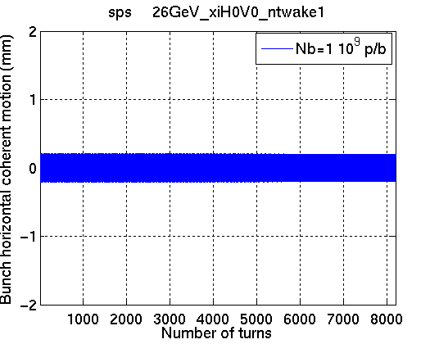
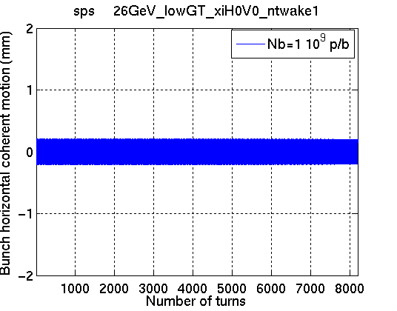
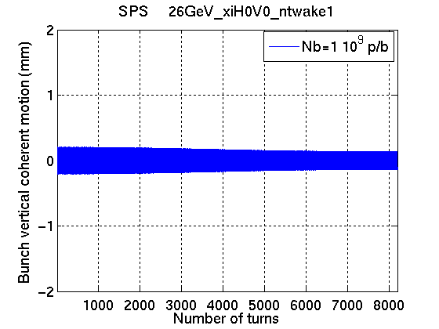
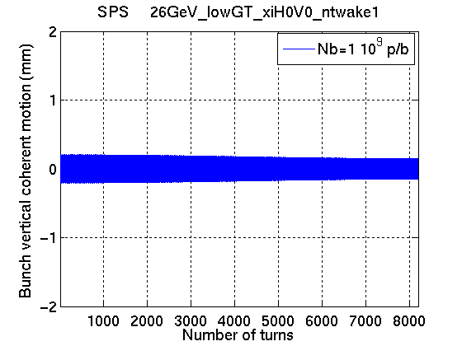
Intensity thresholds
Nominal Vs Low GammaT
Nominal → main threshold at 1.6e11p/b
Low GammaT→ main threshold at 2.8e11p/b
Note: longitudinal emittance much smaller in simulations with low gammaT

Slide 5
Intensity thresholds
Nominal Vs Low GammaT

Slide 6
Intensity thresholds
Nominal Vs Low GammaT

Slide 7
Tune shifts
Nominal Vs Low GammaT

Slide 8
Agenda
Comparison of simulations with nominal and low gamma transition
How to obtain emittance growth?
  From indirect space charge?
    PTC/ORBIT
    HEADTAIL
    Other code?
  From incoherent part of the impedance?
    HEADTAIL
plans

Slide 9
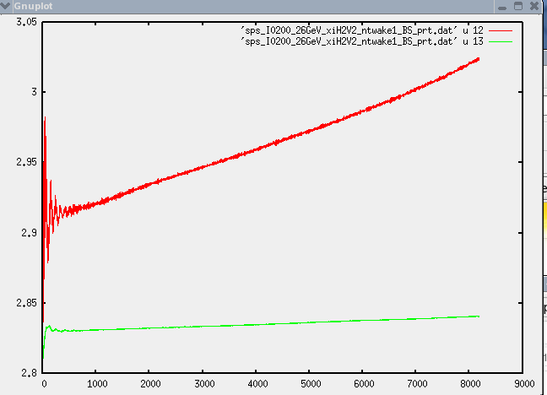
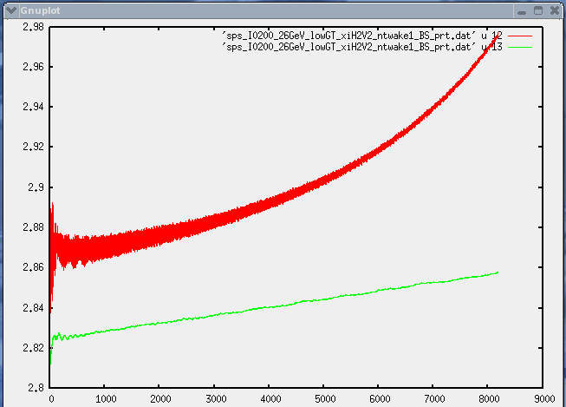
Emittance growth with Headtail?
Nominal Vs low GammaT
Horizontal emittance
Horizontal emittance
Vertical emittance
Vertical emittance
Number of turns
Number of turns
Chromaticity of Q’=2 in both cases (to have stability)
→ Blow up due to quadrupolar impedance seem to affect more the horizontal plane
→ Very different from situation in the machine!!!

Slide 10
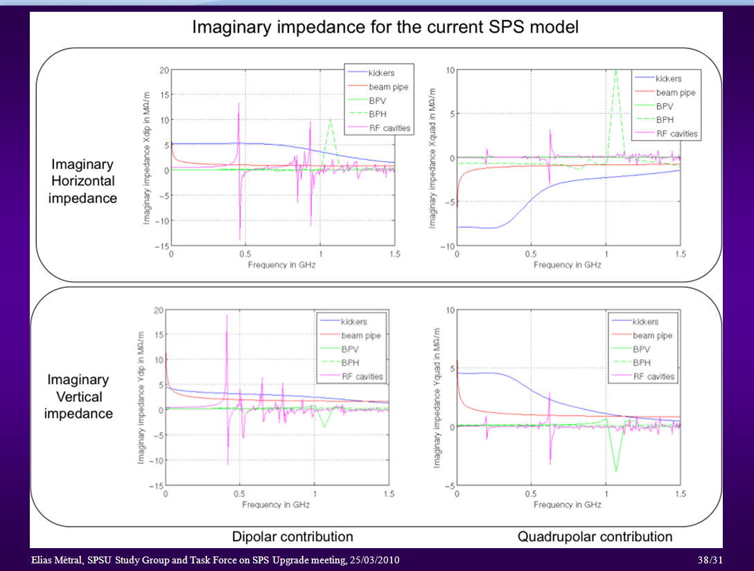

Slide 11
Preliminary conclusion
Need to check the validity of using a single kick for incoherent effects
→ need to refurbish the Headtail version with lattice and adapt it to our ZBASE tool
→ we are working on it
Since the quadrupolar impedance is larger in the horizontal plane… probably blow up is due to another mechanism.

Slide 12
Plans for the impedance/HEADTAIL team
Assess possibility to use HEADTAIL with lattice for emittance
Work on initialization
Improve models of the kickers
  To account for C-shaped structures
  To account for metallic stripes on MKE
  To account for laminar material in MKD
  To account for longitudinal segmentation in MKP
  To account for external circuits
Improve SPS impedance model
  Pumpimg ports (shielded and unshielded)
  MSE/MST
  ZS
  Etc.

