Slide 1
Ecloud MD 10nov2010
SPSU Study Group
17 Feb 2011

Slide 2
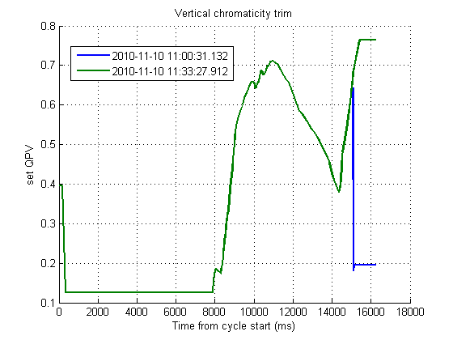
Context
50 ns bunch spacing
Intensity around 8e10 p/b (from FBCT)
Injection of 3 batches
Strong decrease of vertical chromaticity at flat top led to vertical instability
Other measurements in parallel
Damper was most likely on

Slide 3
LHC BPM data

Slide 4
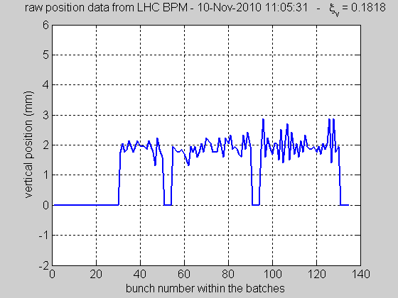
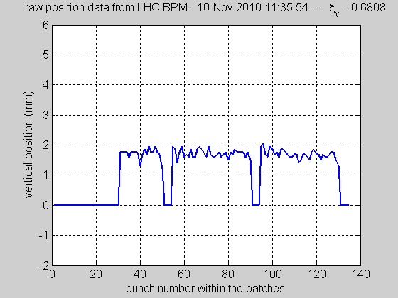
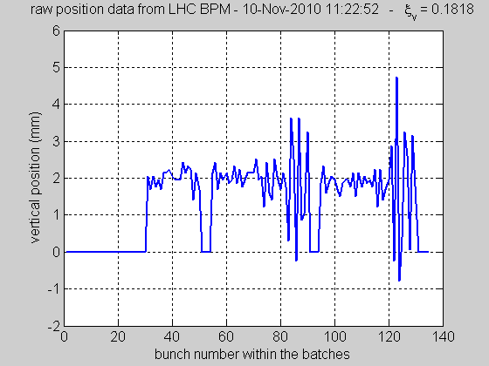
Observed vertical instability when vertical chromaticity is low
Low chromaticity at flat top
High chromaticity at flat top
stable
Unstable (single or coupled bunch?)

Slide 5
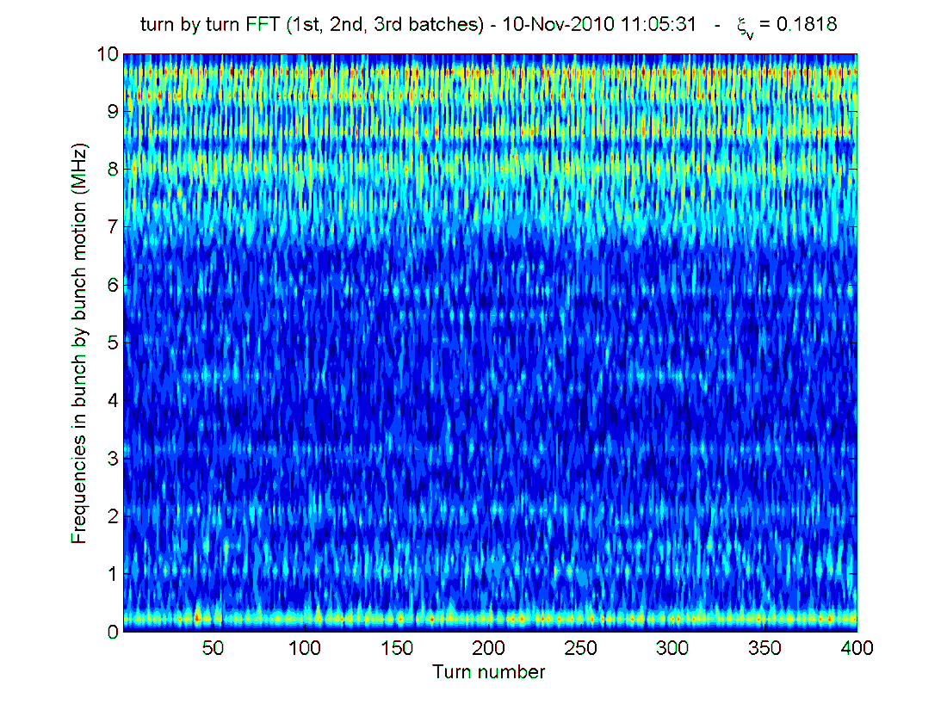
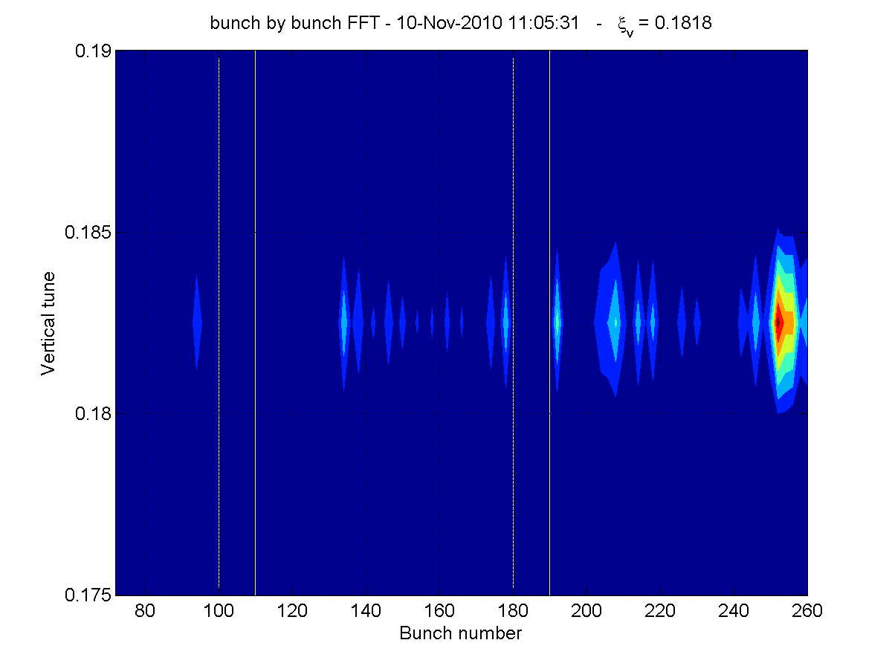
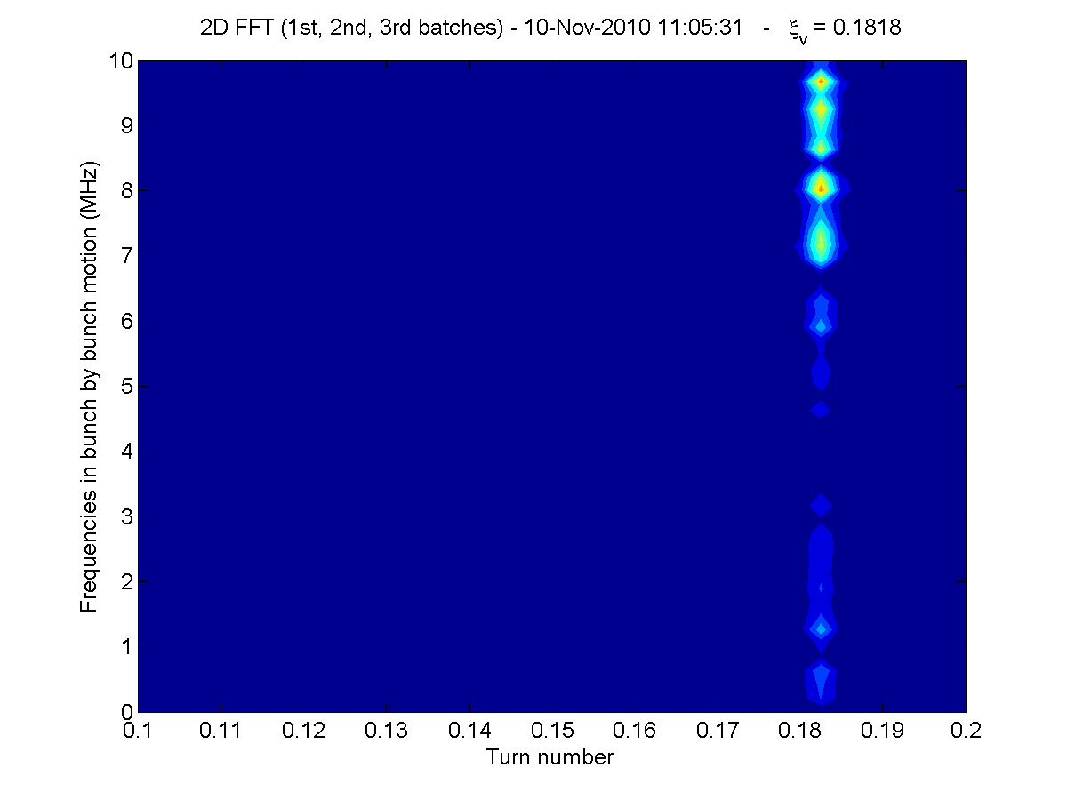
Low chromaticity at flat top

Slide 6
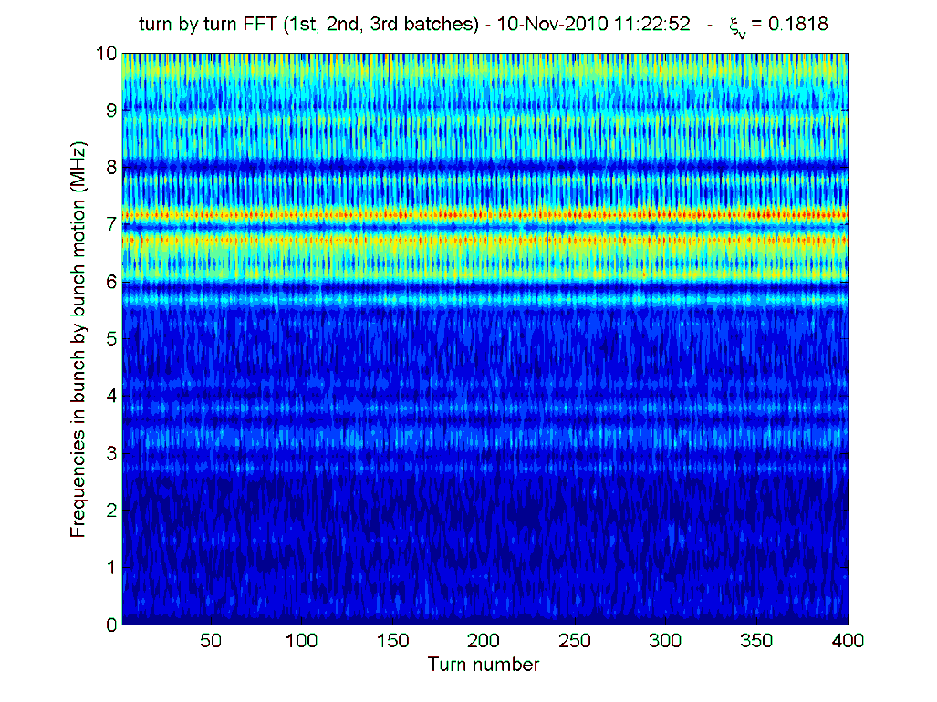
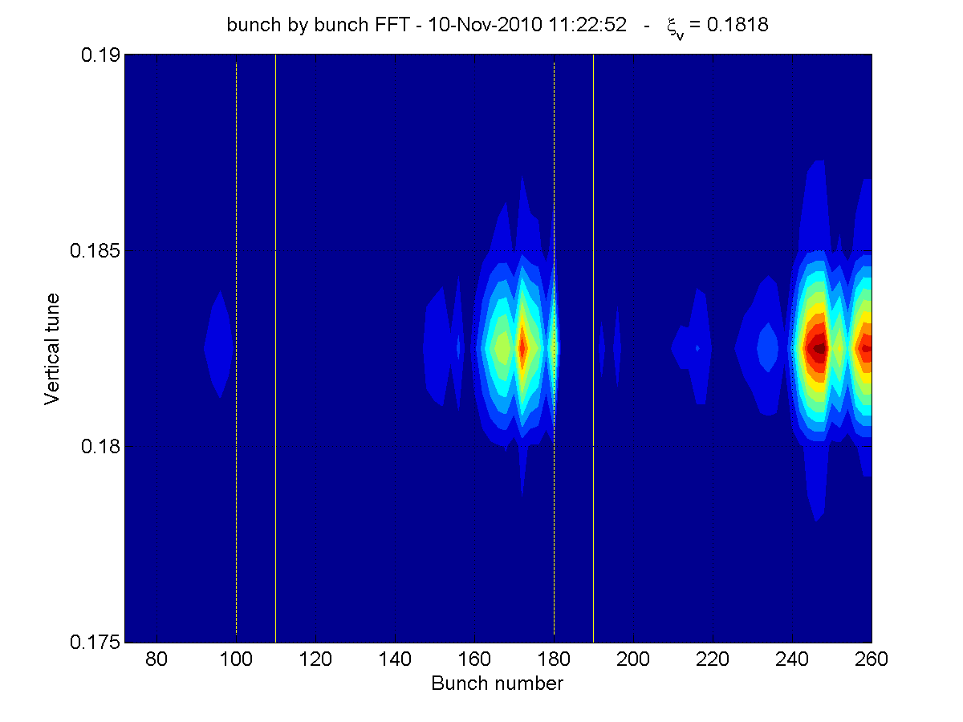
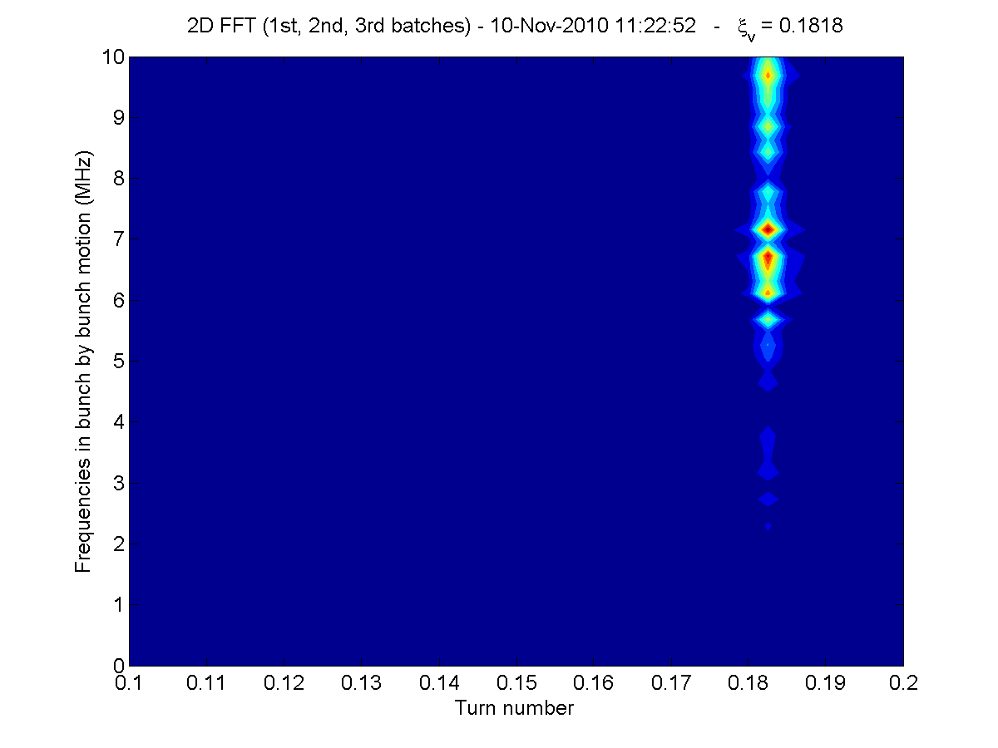
Low chromaticity at flat top

Slide 7
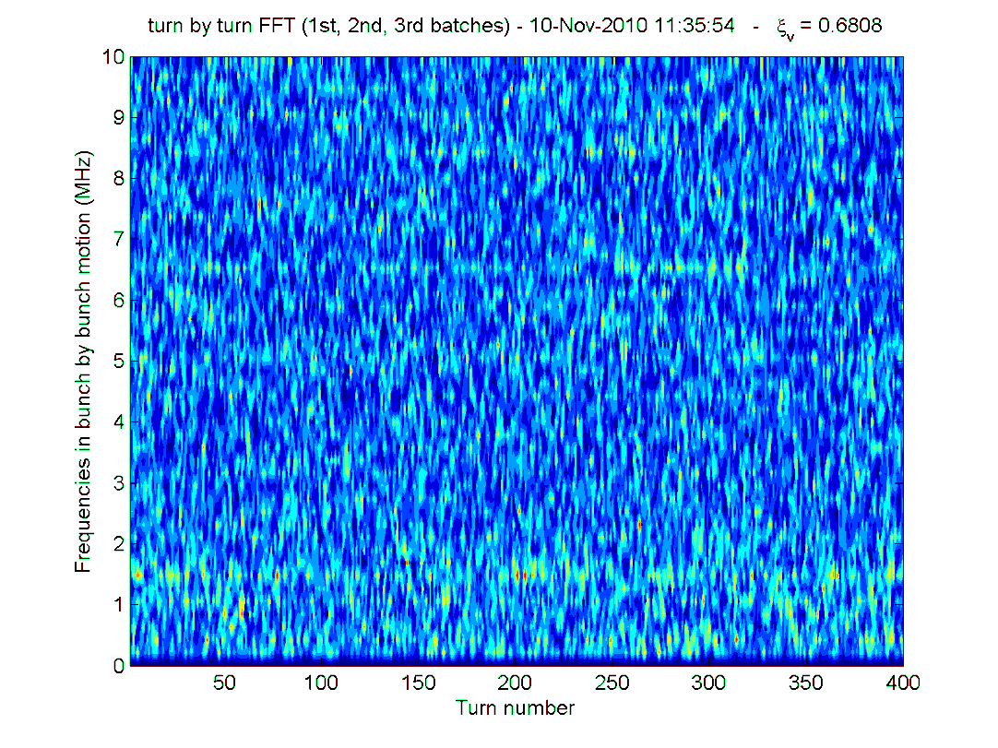
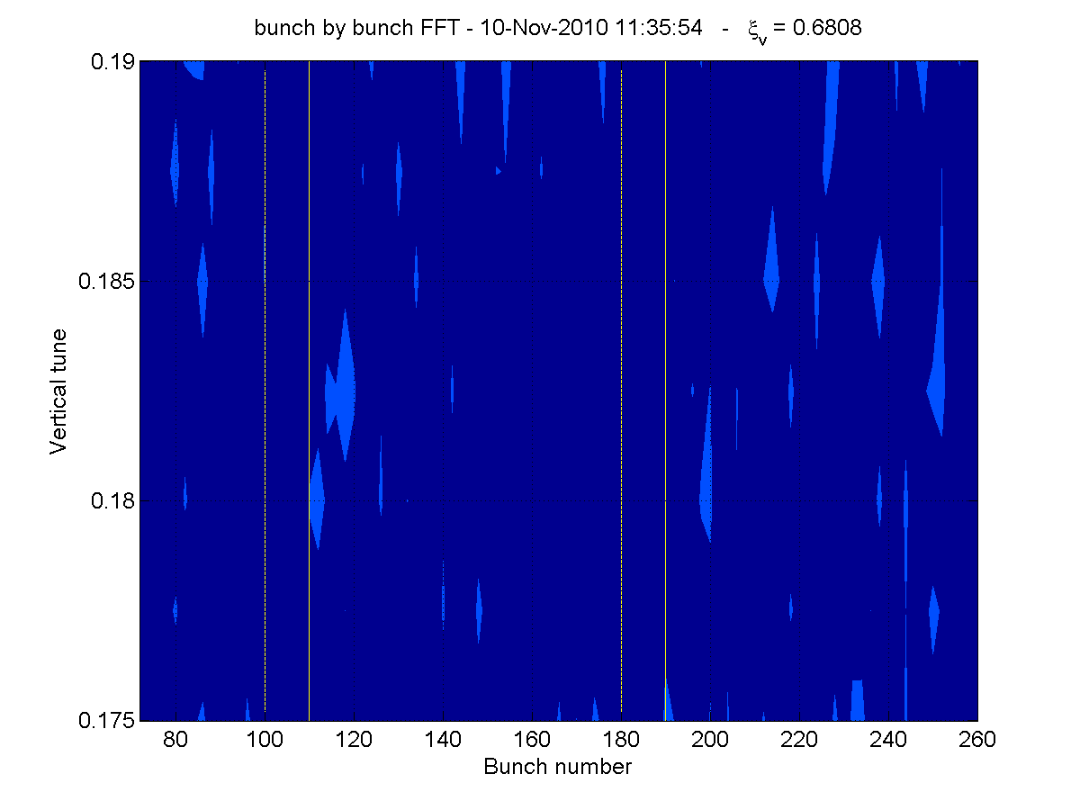
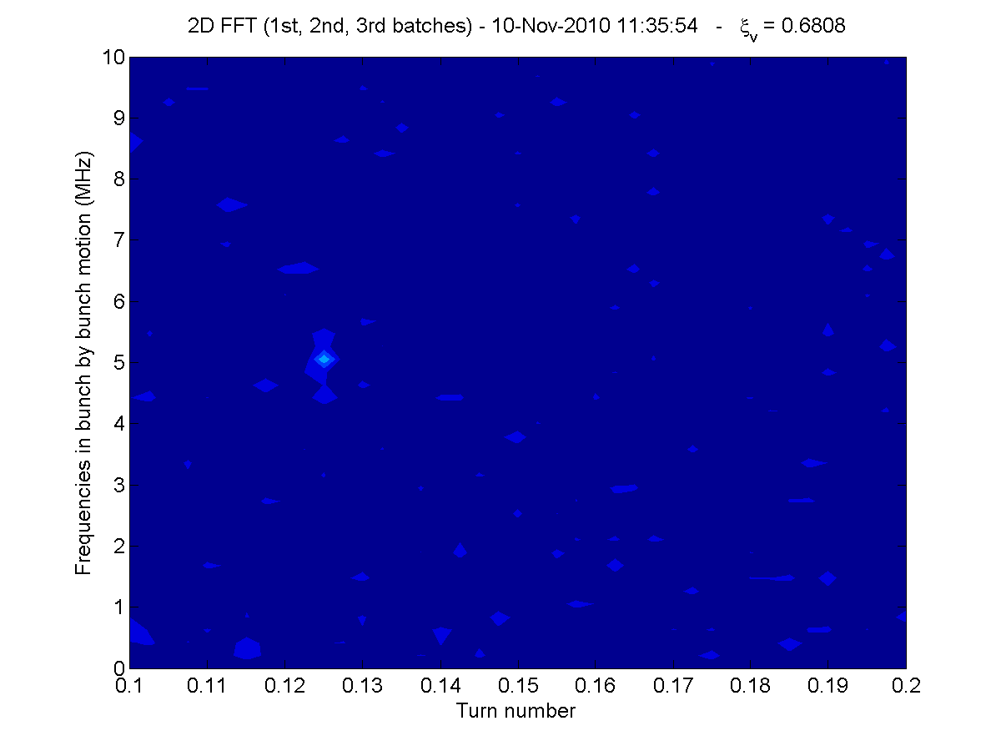
High chromaticity at flat top

Slide 8
BPW data

Slide 9
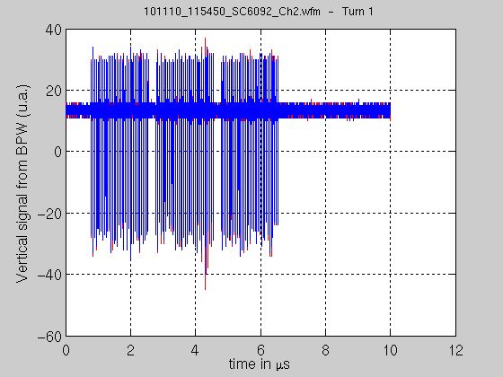
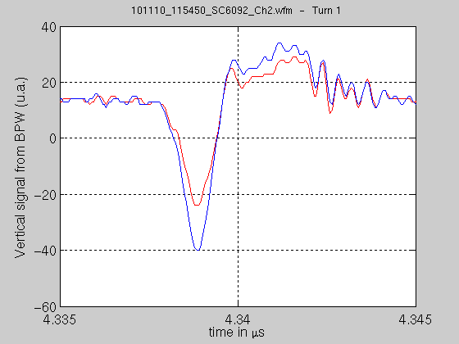
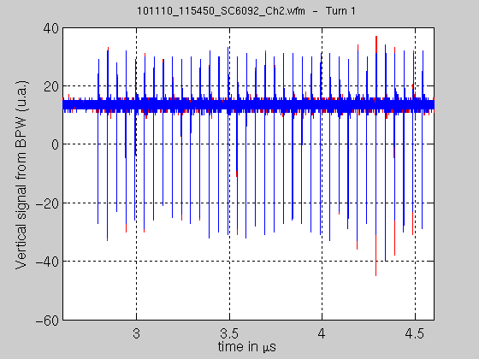
Low chromaticity (QPV=0.18)
- Instability at the end of the second batch
Small shift to the left is also seen in sum signal → no higher order mode visible
→ Coupled bunch instability or chromaticity<0?

Slide 10
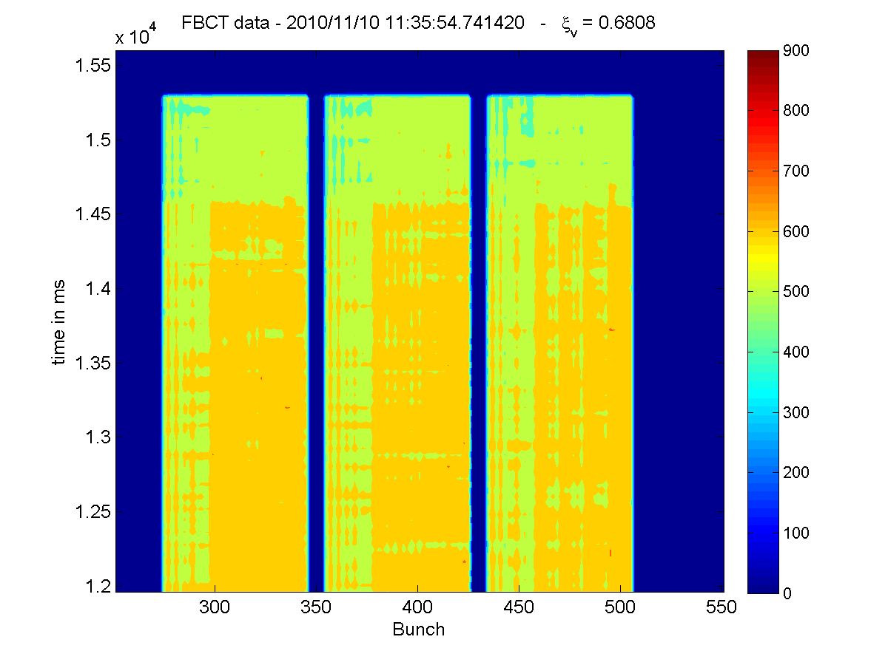
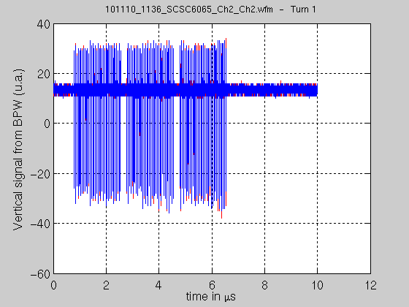
High chromaticity (QPV=0.68)
→ Much more stable

Slide 11
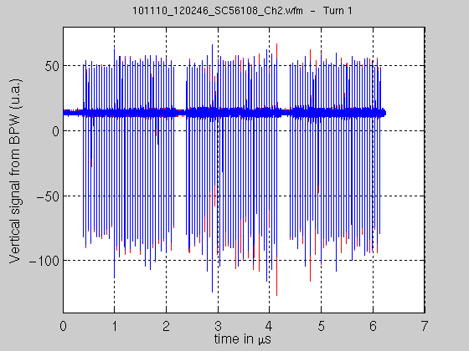
lower chromaticity (QPV=0.15)
→ Very unstable motion (again mode 0), but losses not consistent with negative chromaticity… However, damper was on

Slide 13
Conclusions
Vertical coherent instability observed with low chromaticity (negative? → then damped by damper but not all bunches are treated equally)
Mode 0 and coherent motion along the bunch point to a coupled bunch instability.

