Slide 1
Possible increase of bunch intensity in the SPS for HL-LHC
T. Argyropoulos , E. Shaposhnikova
preparation for LIU & HL-LHC brainstorming meeting

Slide 2
Motivation
Potential for a single bunch intensity @50 ns from the SPS injectors (< 4x10¹¹)
Space charge (and TMCI in the Q20 optics) limitation at injection in the SPS
Controlled longitudinal emittance blow-up is needed during the ramp in the SPS to cure long. coupled-bunch instabilities with threshold ~1/E_{s}
Present LHC beams fill only a half of the SPS ring
Avoid RF gymnastics in the LHC itself (more sensitive for particle losses)

Slide 3
Proposal: momentum slip stacking
Fill whole SPS ring (8 batches)
Merge 4+4 batches on the intermediate flat portion during the cycle (~ 200 GeV) to have 4 batches with twice higher bunch intensity
Use 2 /4 RF cavities to capture 4 batches separately (required beam control doesn’t exist)
Accelerate first 4 batches and decelerate another 4 batches by f_{rf} variation
Let two parts of the beam drift for some time towards each other
Bring two parts back to initial f_{rf} by deceleration (acceleration)

Slide 4
Momentum slip stacking
∆p
………………………………………………………………………….
………………………………………………………………………….
………………………………………………………………………….

Slide 5
Momentum slip stacking
This technique is possible in principle with the wide-band 200 MHz TW RF system of the SPS (Q=130):
cavity bandwidth ∆f_{rf} = f_{rf}/(2Q)=0.7 MHz → transient time of 600 ns, voltage can be modulated to act at this distance on the two parts of the beam separately (at initial stage)
to accelerate (decelerate) the beam by ∆p_{o}: ∆f_{rf}/f_{rf}= η∆p_{o}/p

Slide 6
Possible issues
The 800 MHz RF system is required for beam stability → the same gymnastics? Possible in principle (low Q)
Beam loading for low 200 MHz voltage required during gymnastics
Longitudinal emittance blow-up with final emittance more than 1 eVs → the 200 MHz capture RF system in the LHC
Particle losses at high energy during this gymnastics
New beam control needed (could be included in the RF upgrade but no real tests before)

Slide 7
Example (work in progress)
Frequency (momentum) program for acceleration (deceleration) by dp=400 MeV/c
from 200 GeV/c (dR=4 mm)
Voltage program for emit=0.5 eVs, qp=0.9
Particle simulations with ESME (T. Argyropoulos):
code debugging, still some problems
initial emit=0.5 eVs, final emit > 1.2 eVs (?)
losses < 4%
total time for gymnastics ~0.5 s
→ further optimisation needed + intensity effects

Slide 8
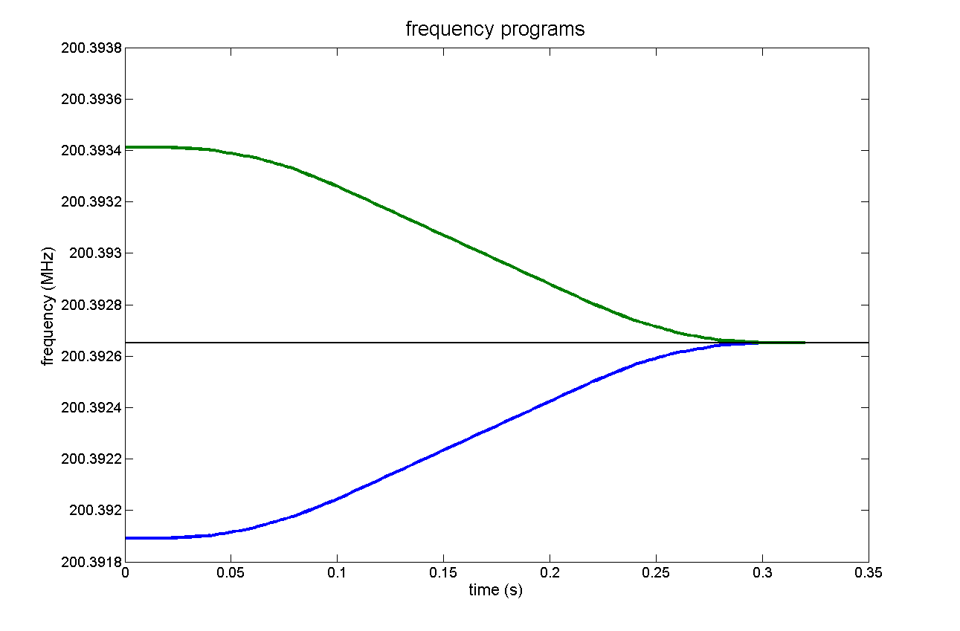
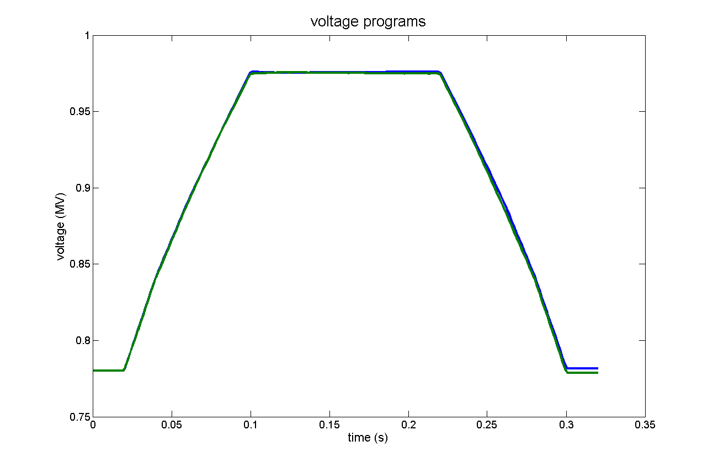
Momentum slip stacking at 200 GeV/c in the SPS
Frequency program
Voltage program

