Slide 1
Follow up on MKP impedance simulations
C. Zannini for the simulations
H. Day, C. Zannini, M. Barnes, F. Caspers, Y. Sillanoli, S. Bouleghlimat for the measurements
Acknowledgments: L. Ducimetiere, E. Metral, W. Weterings
SPSU meeting
September 15th 2011

Slide 2
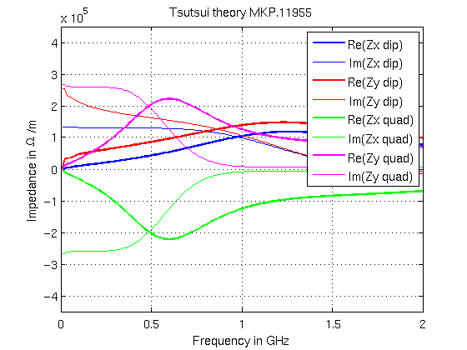
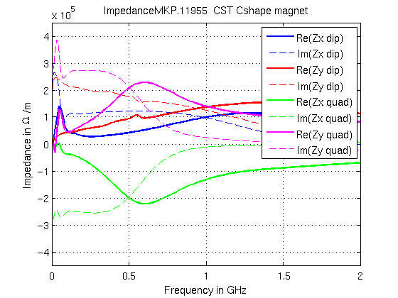
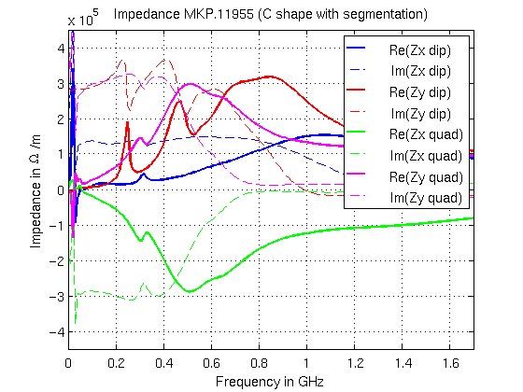
Comparisons of MKP model impedances for the same ferrite length (i.e. kicker 18% longer)
Tsutsui
Significant modifications
in the quadrupolar impedance with the Cshape but dipolar vertical impedance changes only with the segmentation
C shape magnet
C shape magnet with segmentation

Slide 3
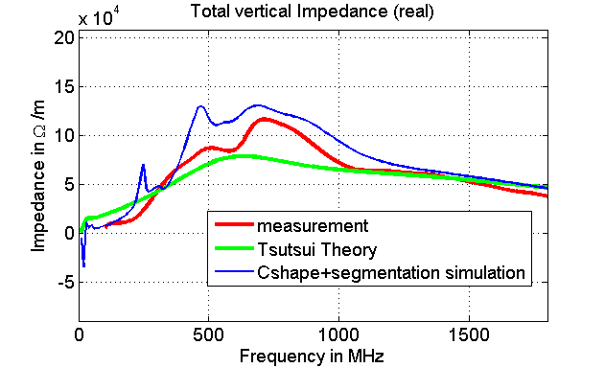
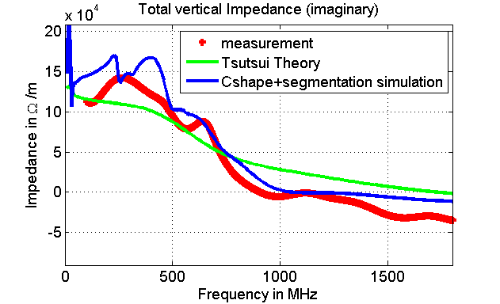
Comparison between single wire measurements on one MKP cell in 2010 (with transition pieces)
Tsutsui
C shape magnet with segmentation
Agreement is not too bad…
Two-wire measurements not conclusive
Transition pieces, internal and external circuits still need to be added to the model

