Slide 1
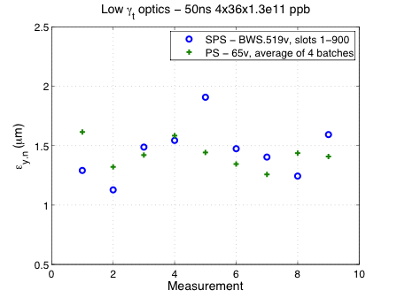
Wirescans in PS (all batches at extraction) and SPS at extraction
  PS: average emittance ε_{y,n}=1.45μm
  SPS: average Q20 optics ε_{y,n}=1.45μm
  SPS: average Q26 optics ε_{y,n}=1.40μm
  Smallest emittance in SPS: 1μm !?!
  To be investigated …

Slide 2
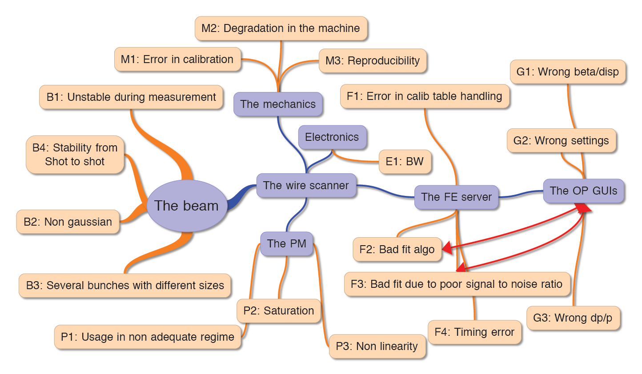
BWS Error Sources

Slide 3
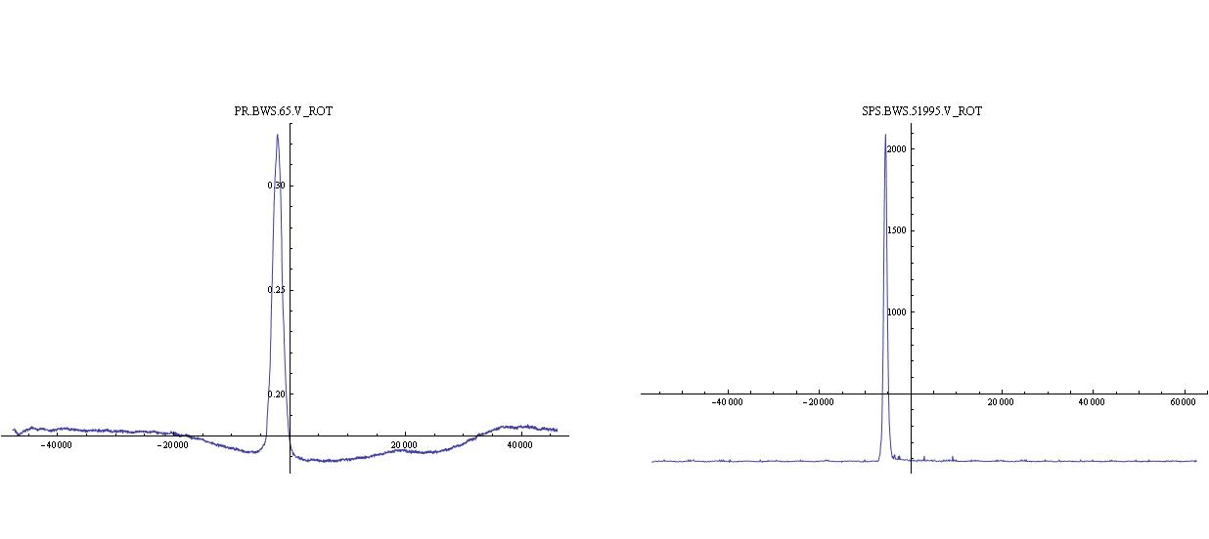
Q20 data analysis
Profile data extracted from the Logging DB (corresponding to ~1h)
Offline computation of emittaces
Second emittance computation with N sigma profile points
PS: signal to noise ratio not optimal
SPS: slight sign of PM saturation
PS
SPS

Slide 4
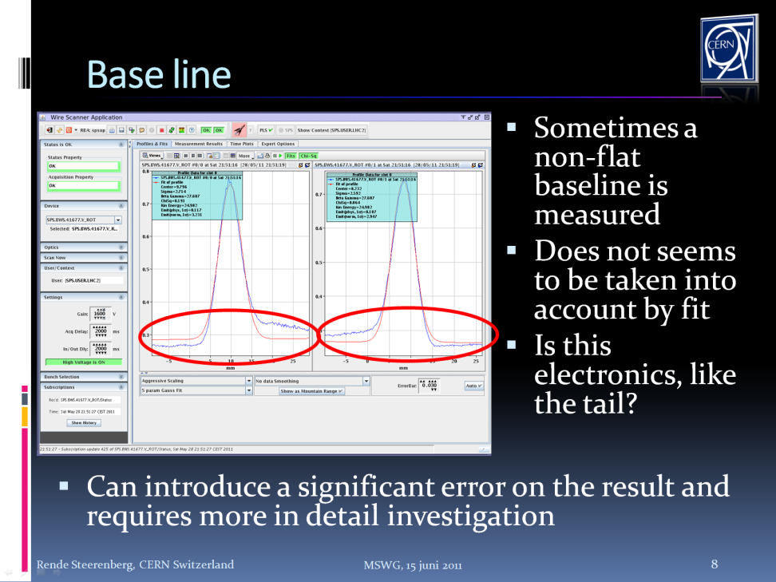

Slide 5
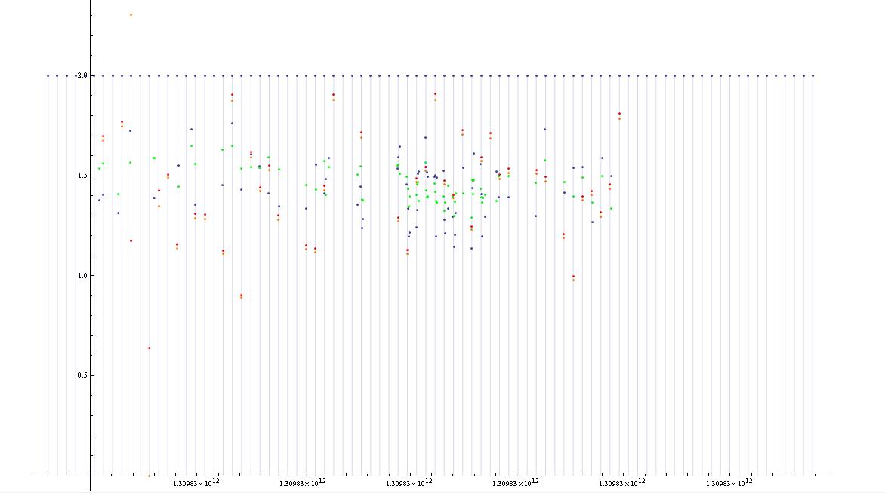
Emittance from 20 sigma profile
Ε(um)
t(ns)
LHCFAST3 cycle timestamp
SPS Full profile Gaussian fit
PS Full profile Gaussian fit
SPS 20 sigma Gaussian fit
PS 20 sigma Gaussian fit

Slide 6
Emittance from 20 sigma profile
Ε(um)
t(ns)
LHCFAST3 cycle timestamp
SPS Full profile Gaussian fit
PS Full profile Gaussian fit
SPS 20 sigma Gaussian fit
PS 20 sigma Gaussian fit

Slide 7
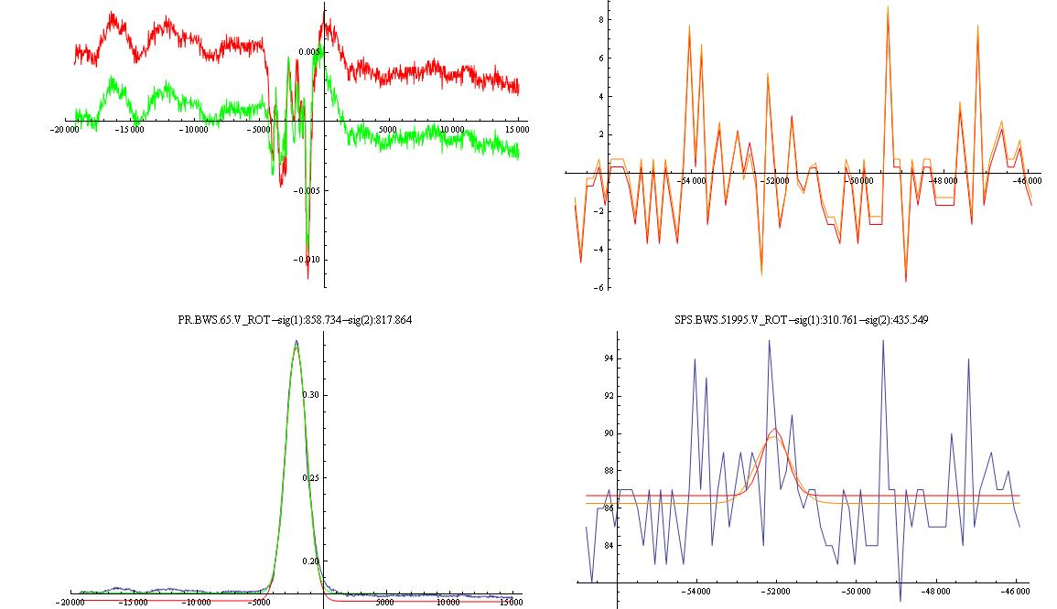
Residuals
A(mA)
A(mV)
Pos(um)
Pos(um)
A(mA)
A(mV)
Pos(um)
Pos(um)
Acquired profiles

Slide 8
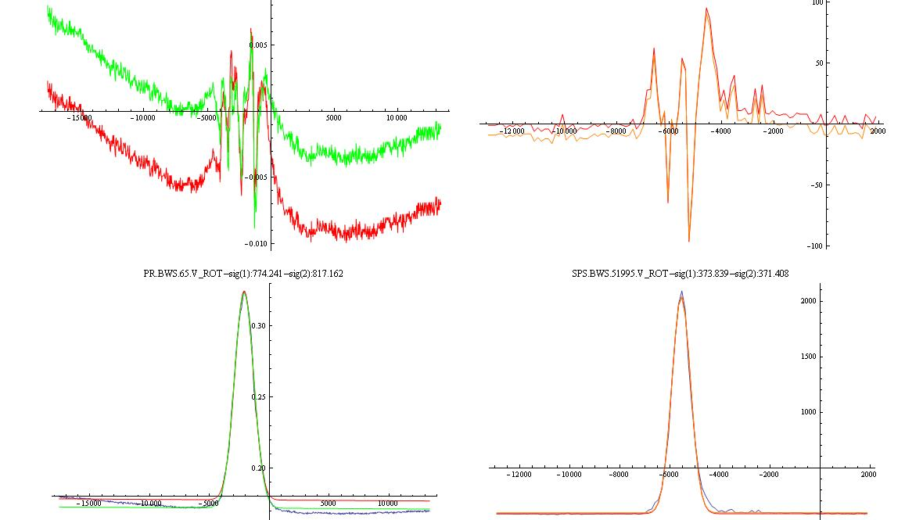
Residuals
A(mA)
A(mV)
Pos(um)
Pos(um)
A(mA)
A(mV)
Pos(um)
Pos(um)
Acquired profiles

Slide 9
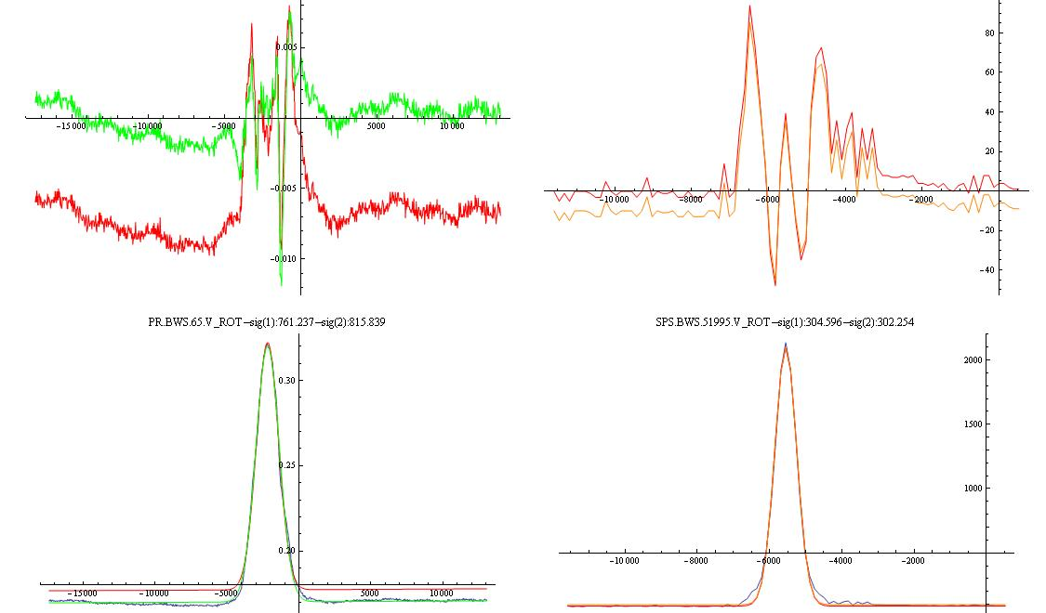
Residuals
A(mA)
Pos(um)
Pos(um)
A(mA)
Pos(um)
Pos(um)
Acquired profiles

Slide 10
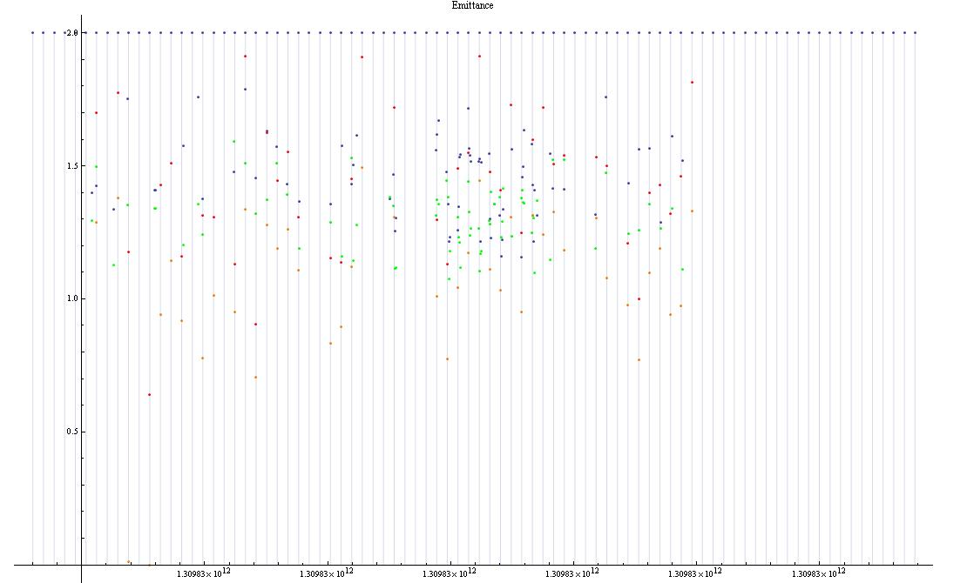
Emittance from 2 sigma profile
Ε(um)
t(ns)
LHCFAST3 cycle timestamp
SPS Full profile Gaussian fit
PS Full profile Gaussian fit
SPS 2 sigma Gaussian fit
PS 2 sigma Gaussian fit

Slide 11
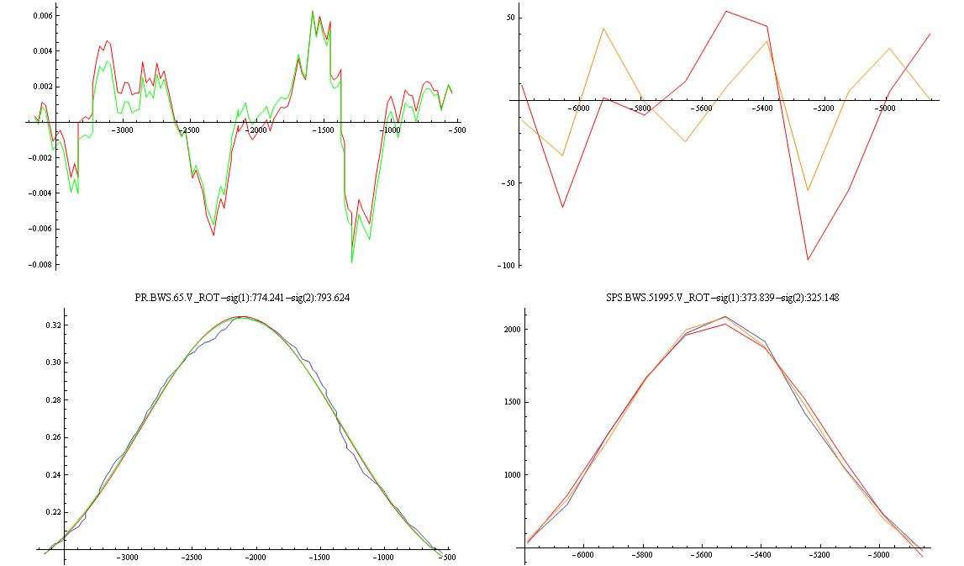
A(mA)
Residuals
A(mV)
Pos(um)
Pos(um)
A(mV)
A(mA)
120um
Pos(um)
Pos(um)
Calibration table needs to be recomputed
Acquired profiles

Slide 12
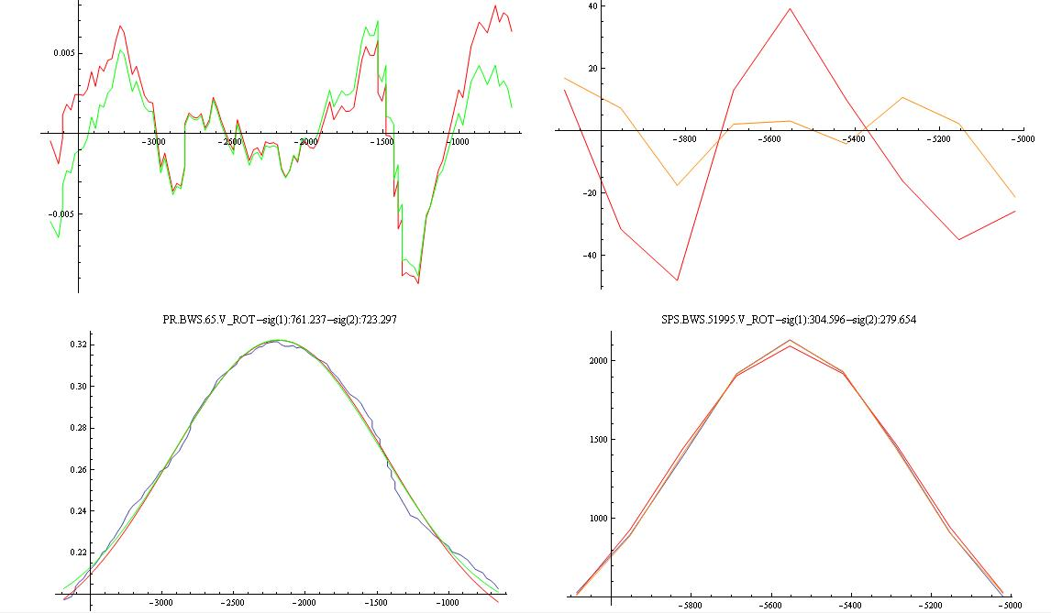
A(mA)
Residuals
A(mV)
Pos(um)
Pos(um)
A(mV)
A(mA)
Pos(um)
Pos(um)
Acquired profiles

Slide 13
Conclusions
Most of the measurements are within the expected error (Eerror=2 Sigmaerror)
There are some obviously wrong measurements:
  WS error in the measurement
  Another source ?(human, beam, timing…)
  But the tendency agrees.
We can change the average result already in a 20% percent just by using different amount of data -> We need to define precisely what do we call ‘size of the beam’:
  Which profile do we use to compute sigma?
  How do we compute sigma?
  Apply the same everywhere
  Try to define error bars: In this particular case in the SPS we try to measure sizes of ~350um and the potentiometer resolution is ~200um (in fact ~120um around a centered beam so we have ~ 3 points per sigma)

Slide 14
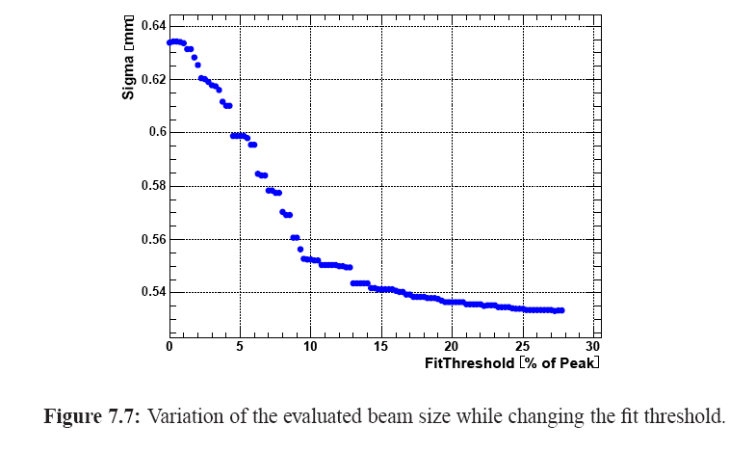
FIT
Thesis: Federico Roncarolo

Slide 15
Conclusions
Most of the measurements are within the expected error (Eerror=2 Sigmaerror)
There are some obviously wrong measurements:
  WS error in the measurement
  Another source ?(human, beam, timing…)
  But the tendency agrees.
We can change the average result already in a 20% percent just by using different amount of data -> We need to define precisely what do we call ‘size of the beam’:
  Which profile do we use to compute sigma?
  How do we compute sigma?
  Apply the same everywhere
  Try to define error bars: In this particular case in the SPS we try to measure sizes of ~350um and the potentiometer resolution is ~200um (in fact ~120um around a centered beam so we have ~ 3 points per sigma)
The sources of errors attached to this instrument are quite numerous and varied. If we want to withdraw conclusions, take decisions with respect to these kind of measurements we need to build up enough statistics and:
  The WS is an instrument not easy to set up. Take time to find best measurements conditions.
  Try to use several.
Offline analysis needed: logging of other variables, beta, intensity, dp/p, emittance from op. app.

