Slide 1
ESME Simulations of Single Bunch Instability in the SPS
Chandra Bhat
T. Argyropoulos, H. Bartosik,
T. Bohl, E.Shaposhnikova
SPSU-BD Study Group Meeting
14/7/2011
Special thanks to Jim MacLachlan

Slide 2
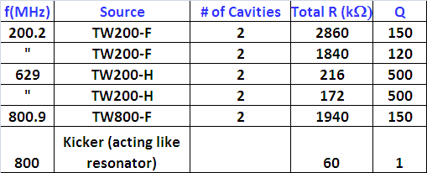
Experiment in SPS
Beam Intensity at Injection ~1.1E11ppb
LE(4σ) (PS) = 0.21 eVs ← This is needed to match the profile in the SPS
PS to SPS beam transfer
PS Bunch is prepared in 40MHz,
Compressed and Fast bunch rotation in 40 MHz and 80MHz in 5msec
Transferred to SPS bucket of 200MHz+800MHz with different voltage ratios and initial phases (not matched, emittance growth is inevitable)
Beam is held in the SPS at 26GeV Flat-bottom for 10 sec, data is collected.
In the SPS all Feedback loops were turned off
The Impedance table for the SPS cavities
Standard γT=23.2 and reduced γT=18
Ref. T. Linnecar and E. Shaposhnikova, SL-Note-96-49-RF(1996);

Slide 3
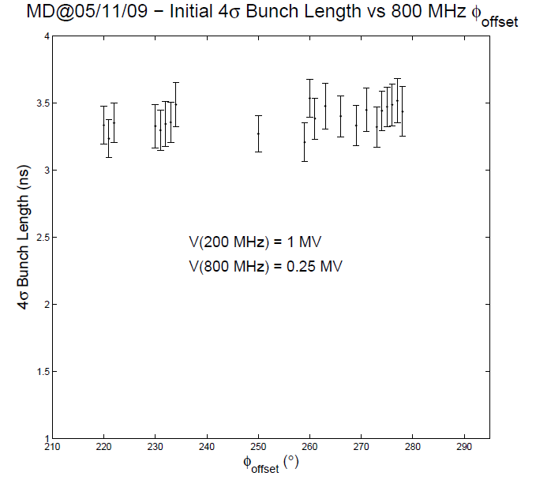
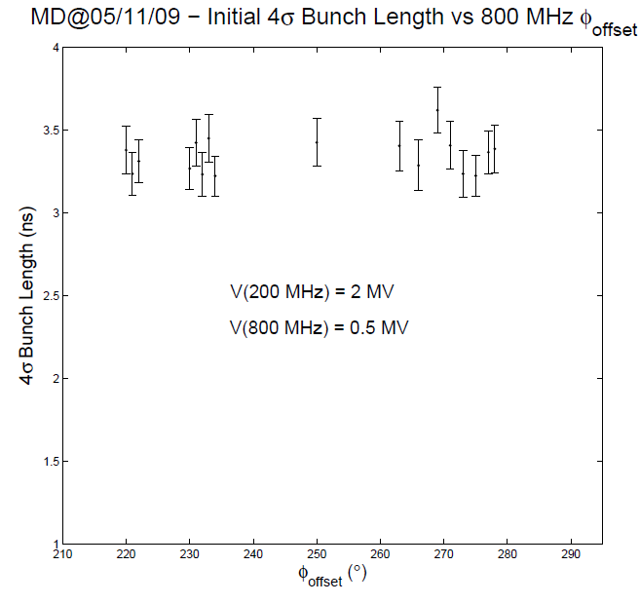
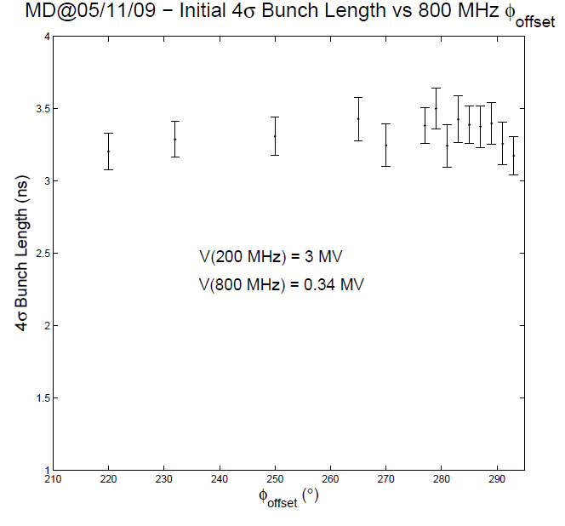
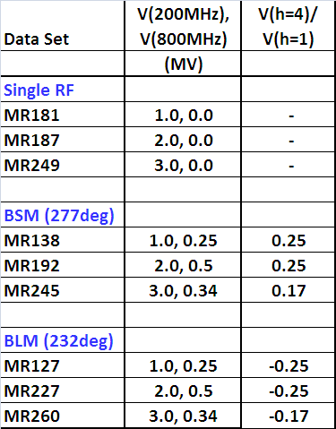
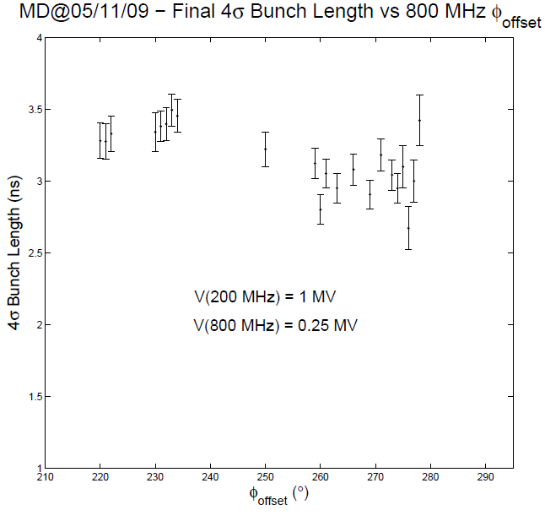
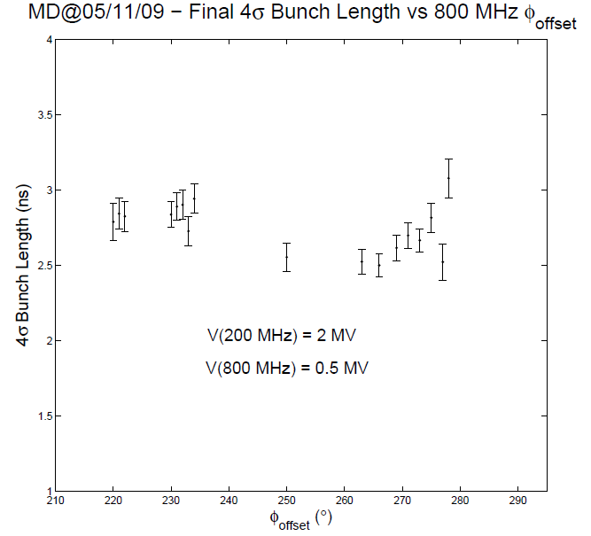
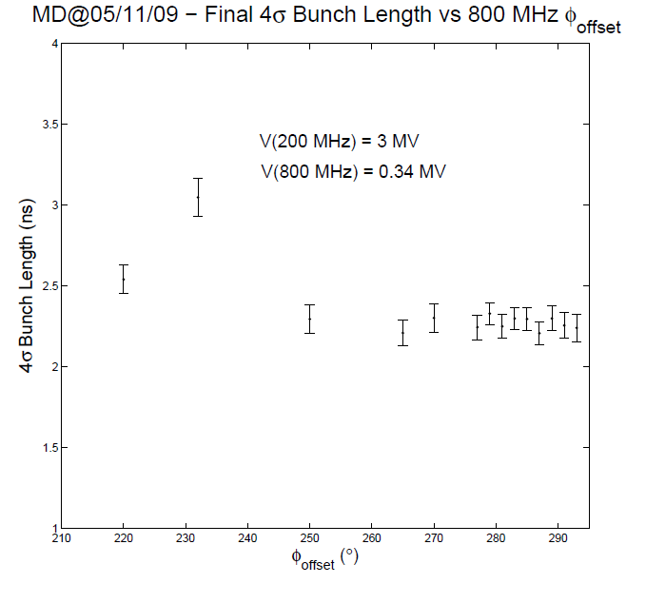
SPS Data from 5/11/2009, BE—Note-2008-025-MD (gT23) (T. Argyropoulos et. al.)
Experimental Data Sets (Randomly Chosen)
Single RF
BLM
BSM
@ Injection
@ 10 sec
232deg
277deg
LE(4σ)true = -0.325ns+0.952 [4σ_{τ}(Gaus)]

Slide 4
ESME Simulations
The code is developed since 1981. There are number of versions released since then.
We use es2009_4 ← I tested independently for single, multiple-harmonic, barrier rf systems taking into account of multi-particle and impedance effects.
The simulation is carried out to mimic all the steps involved in the experiment in the PS and SPS
The initial bunch property in the PS before bunch compression is established by comparing the simulated bunch profile with the 1st scope trace in the SPS for that beam.
We let the beam evolve for 10 sec in the SPS and look for instability, phase space evolution.

Slide 5
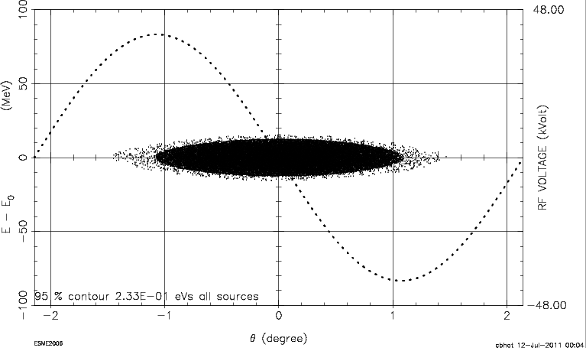
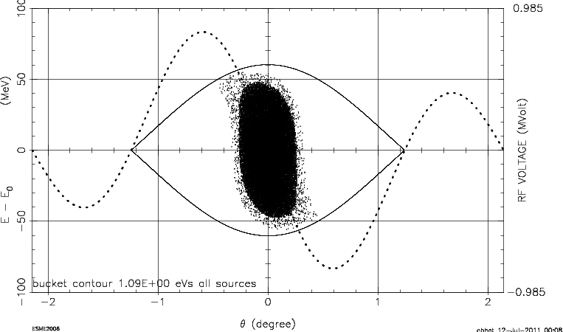
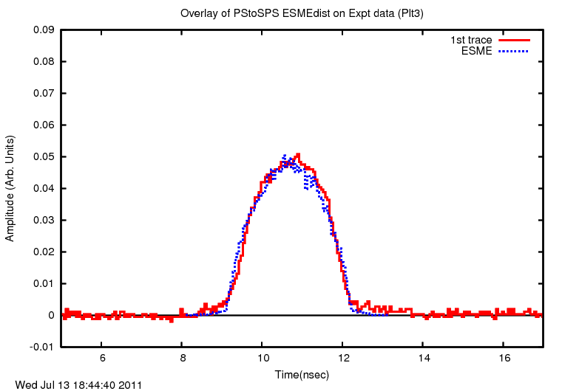
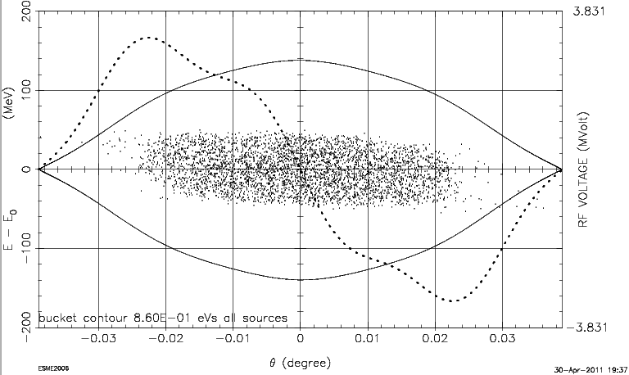
Beam in the PS & Beam in SPS at injection
Beam in the PS
LE(95%)=0.23 eVs
V(40Mhz) = 40kV
Beam in the PS
LE(95%)=0.23 eVs
V(40MHz)= 300kV
V(80MHz)=600kV
Beam in the SPS
LE(95%)=0.23 eVs
V(200MHz)= 3MV
V(800MHz)=0.34MV
Beam in the SPS: ESME profile overlapped on the 1st trace in the SPS
Data set: MR245
Beam is mismatched to the bucket

Slide 6
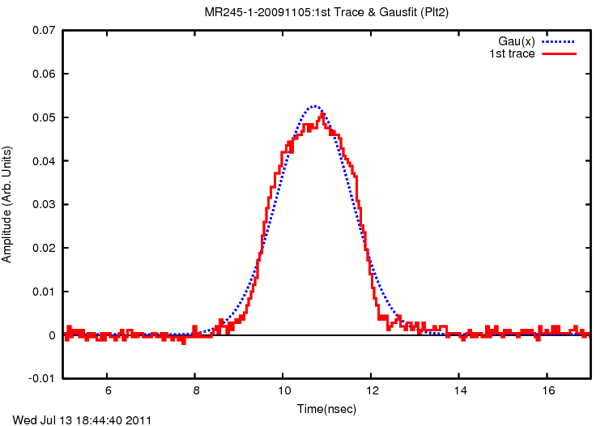
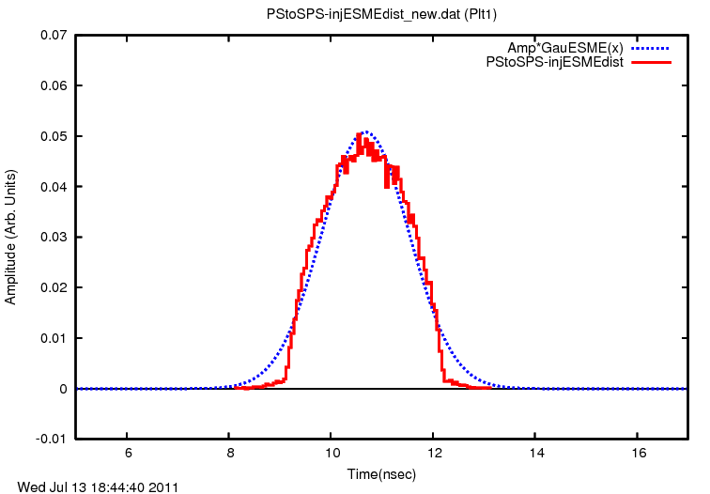
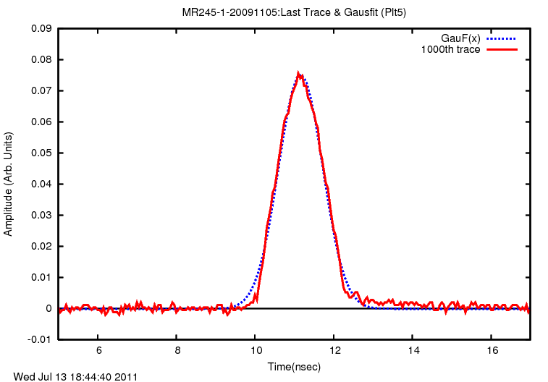
A comment on 4σ Width and Emittance
Beam in the SPS:
Data set: MR245
1st trace Gaussian Fit
Beam in the SPS:
ESME
1st trace Gaussian Fit
BL(95%)=3.0 nsec
BL(Gaussian4σ)= 3.4 nsec
BL(4*RMSW)= 3.2 nsec
BL(95%)= 2.6 nsec
BL(Gaussian4σ)= 3.42 nsec
BL(4*RMSW)= 3.0 nsec
Beam in the SPS:
Data set: MR245
Trace@10s Gaussian Fit

Slide 7
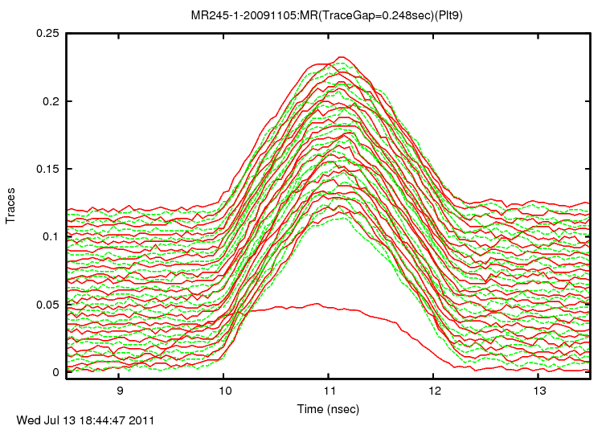
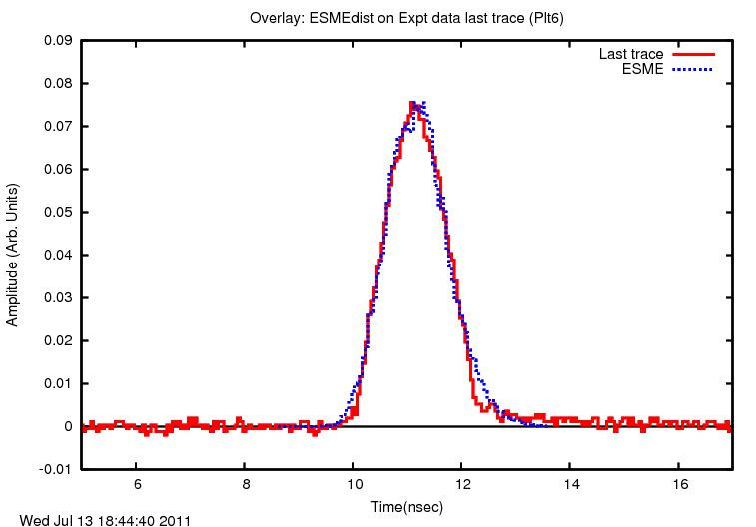
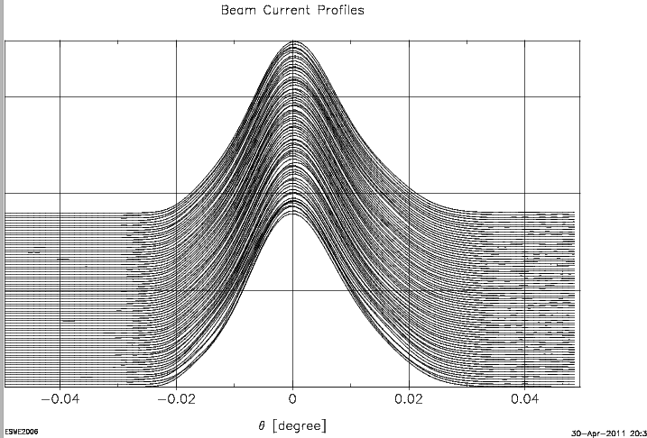
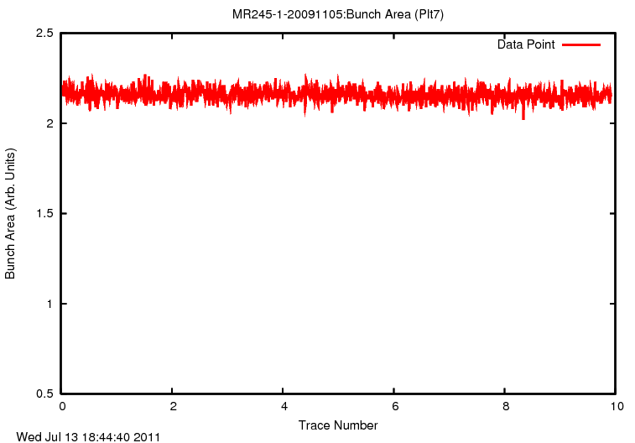
MR245: No Beam Loss case (BSM)
Data
Trace@10s &
ESME Simulation
ESME
Simulation
Data
ESME

Slide 8
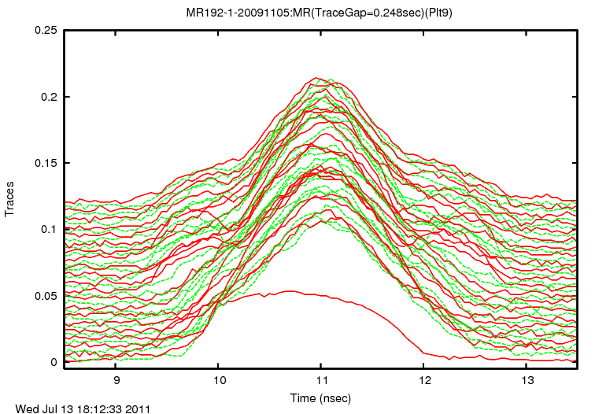
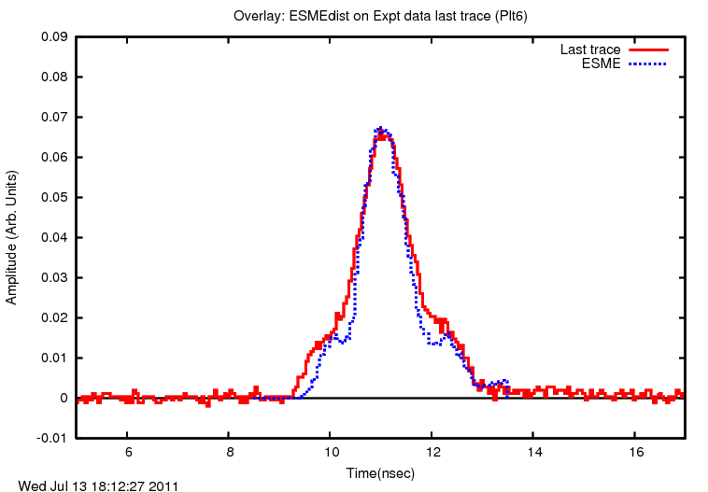
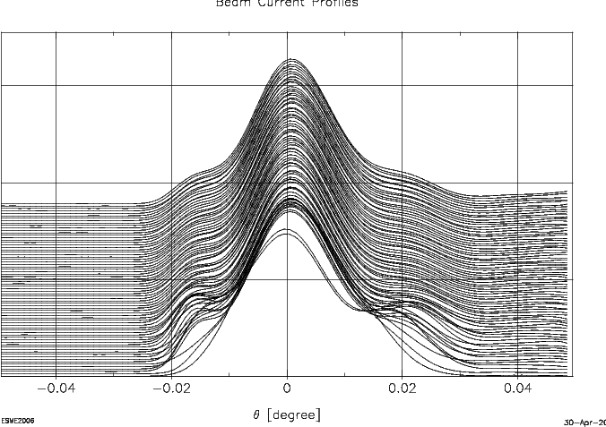
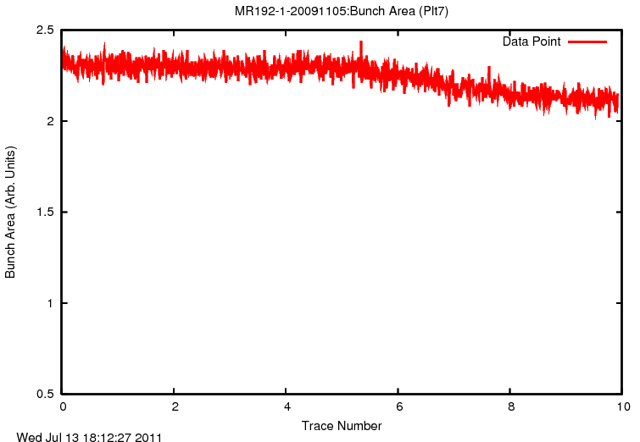
MR192: Beam Loss case (BSM)
Data
Trace@10s &
ESME Simulation
ESME
Simulation
♦
♦
♦
♦
♦
♦
Data
ESME
♦

Slide 9
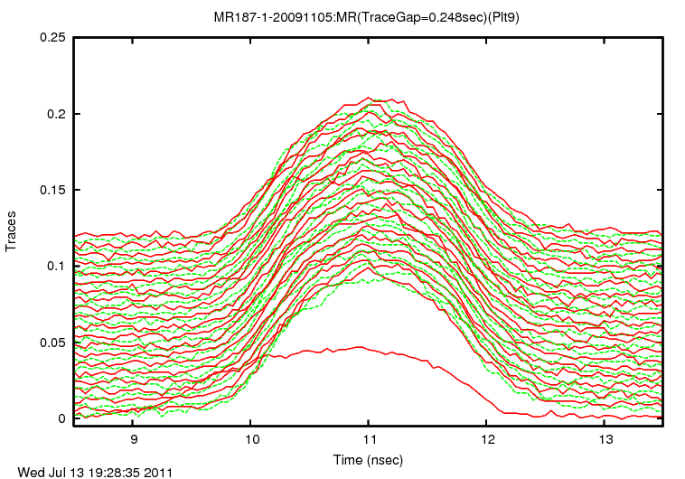
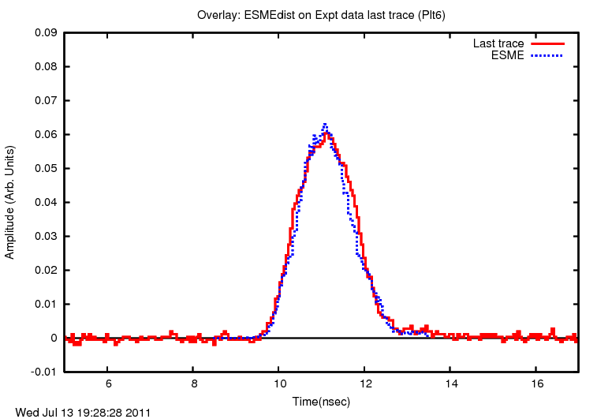
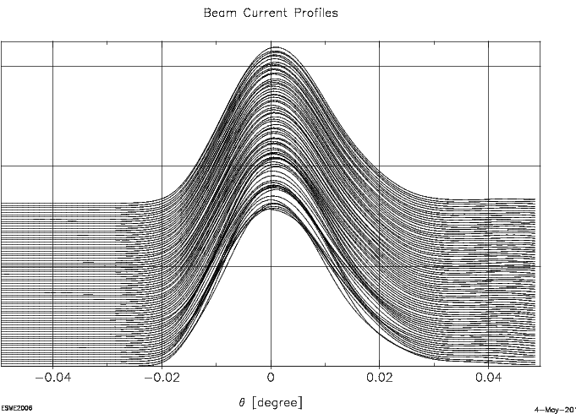
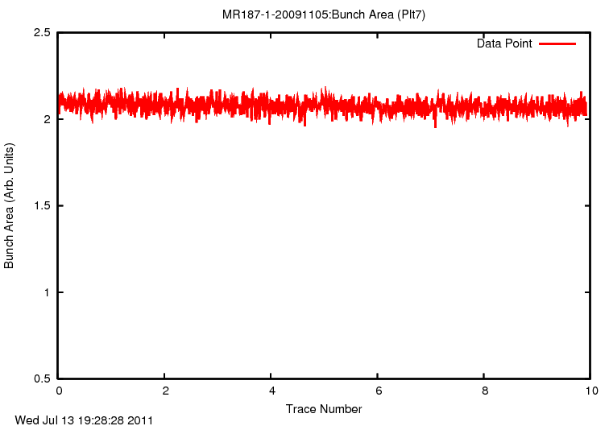
MR187: Beam Loss case (Single Harmonic)
Data
Trace@10s &
ESME Simulation
ESME
Simulation
♦
♦
♦
♦
♦
♦
Data
ESME
♦

Slide 10
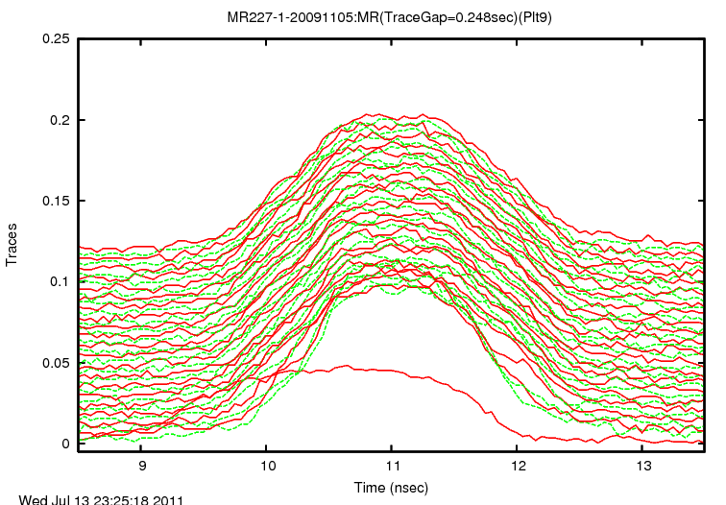
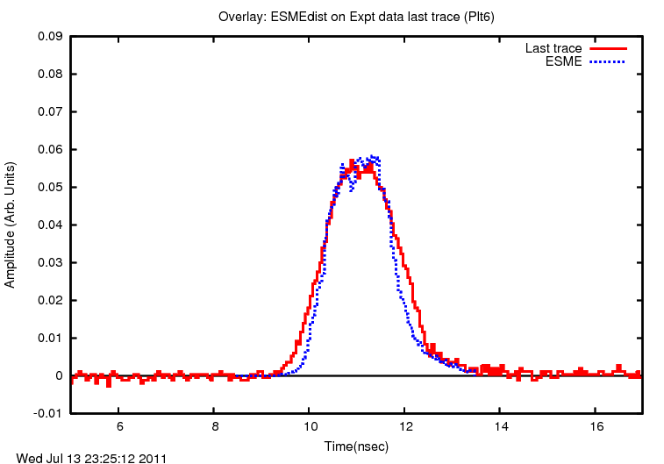
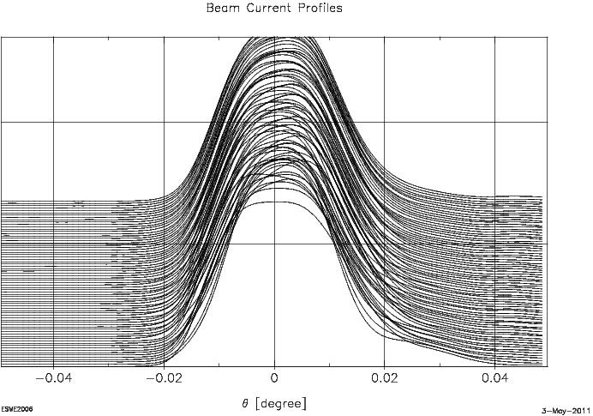
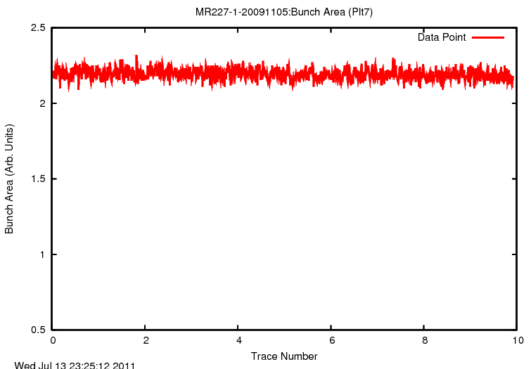
MR227: Beam Loss case (BLM)
Data
Trace@10s &
ESME Simulation
ESME
Simulation
Data
ESME
♦

Slide 11
Summary and Conclusion
We have studied observed the single bunch instabilities in the SPS and taken a lot of data
Tried to analyze within the frame work of longitudinal beam dynamics simulations using ESME
Results are very promizing.

