Slide 1
Summary of the dedicated MD on July 4th 50ns in SPS with nominal and low γ_{t} optics – transverse aspects
T. Argyropoulos, H. Bartosik, T. Bohl, A. Burov, S. Cettour Cave, H. Damerau, J. Esteban Muller, A. Guerrero, W. Höfle, G. Rumolo, Y. Papaphilippou, B. Salvant, E. Shaposhnikova, D. Valuch

Slide 2
MD Overview
Both optics in parallel for direct comparison
Nominal optics (“LHCMD1”)
low γ_{t} optics (“LHCFAST3”)
Setting up of 50ns beams (double batch) with 4 batches
Basic setup – orbit, tunes, chromaticity, kicker timings, RF-voltage program
“Advanced setup” – transverse dampers, longitudinal feedback
Measurements with nominal intensity (~1.3e11 ppb injected)
Transverse emittance measurements in both cycles
Longitudinal beam parameters in both optics
Studies on transmission efficiency with nominal optics
Measurements with ultimate intensity (~1.8e11 ppb injected)
Longitudinal beam parameters in both optics

Slide 3
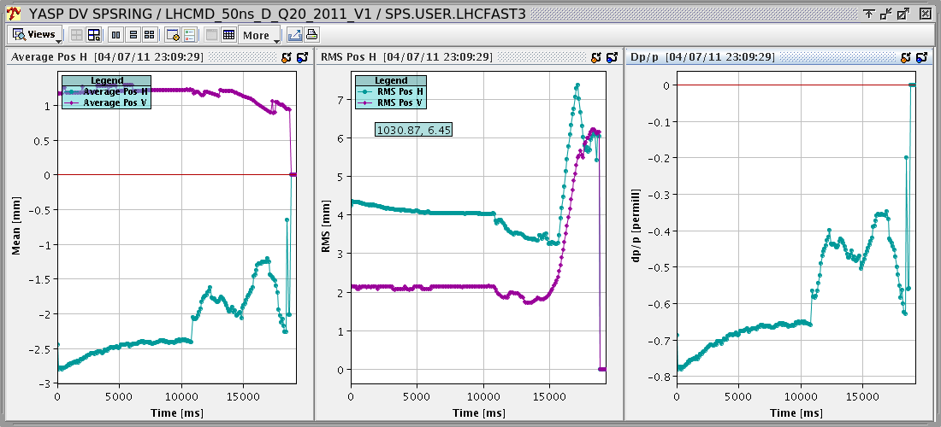
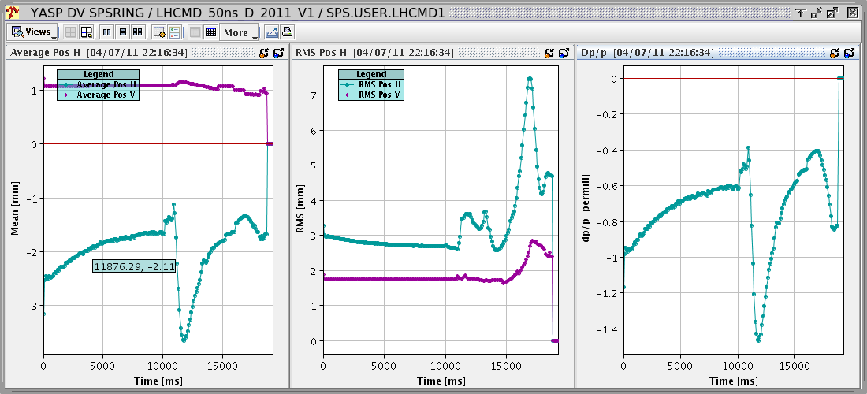
Transverse setup
Correcting orbit
Quite high RMS orbit in vertical plane in Q20 optics for high energy part of cycle → try to correct using available corrector strength next time … (problem for transverse damper? See below …)
Usual picture in nominal optics
Tunes and chromaticity were adjusted in both cycles using Auto-Q
Several iterations needed for chromaticity correction …
Low γ_{t} optics
Nominal optics

Slide 4
Setting-up of SPS damper – Q26 optics
Courtesy W. Höfle
Q26 optics:
phase advance between pick-ups close to 90 degrees (87 degrees)
programming of feedback phase via LSA, assuming 90 degrees phase advance between PUs
H1,H2: LSA 144 degrees delta with respect to theory: +8, +10 degrees
V1: LSA -7 degrees delta with respect to theory: -15 degrees
V2: LSA -80 degrees delta with respect to theory: - 7 degrees
Example H: 0.13*1.5*360 + 90 + 444 – 144 = 460 should be 90 +n x 360 mod -1 for damping
beam (notch/1TD + PU→K) – 144
differences to theory can either be due to actual phase advance error with respect to model or it is a damper setting-up error; pretty good though

Slide 5
Setting-up of SPS damper – Q20 optics
Courtesy W. Höfle
Q20 optics:
phase advance between pick-ups are 67 degrees
programming of feedback phase via LSA, assuming 90 degrees phase advance between Pus fails
H1,H2: LSA 65 degrees
V1: LSA -90 degrees
V2: LSA 65 degrees could not be well adjusted
→ H1,H2,V1 could be well adjusted but not V2
→ we need to change the way we program the pick-up mixing for the Q20 optics, more function generators needed or special FPGA firmware (preferred way is more function generators)
→ also a not-explained delay error was corrected for V1, to be followed up

Slide 6
Nominal intensity – 4 batches
4 batches of 36 bunches with ~1.3e11 ppb injected
Similar transmission in both optics (~95%)
Nominal optics
Low γ_{t} optics

Slide 7
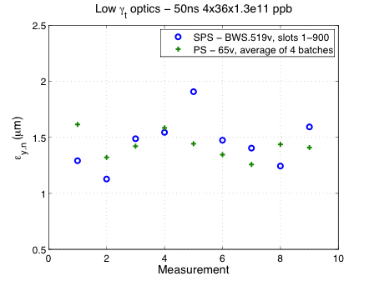
Emittance measurements
Transverse emittances were measured mainly in vertical plane (BWS.519) in order to identify emittance blow-up
Wirescans in PS (all batches at extraction) and SPS at extraction using the bunch selection mode (STANDARD with gating), slots 1-900 selected
Inconsistencies were observed which are currently investigated with BI expert (very small emittances measured in SPS in some cases, clearly below the PS values)
Switching between Q20 and Q26 not automatic (optics functions need to be selected/set manually)
Clearly more experience with emittance measurement of multi bunch/multi batch beams needed
Similar (avg.) emittances for both optics
PS: average emittance ε_{y,n}=1.45μm
SPS: average Q20 optics ε_{y,n}=1.45μm
SPS: average Q26 optics ε_{y,n}=1.40μm
Smallest emittance in SPS: 1μm !?!
To be investigated …

Slide 8
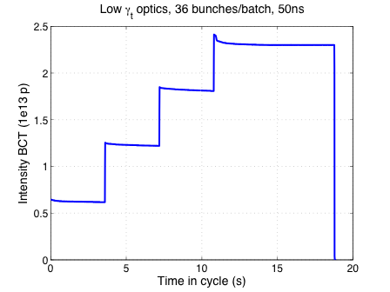
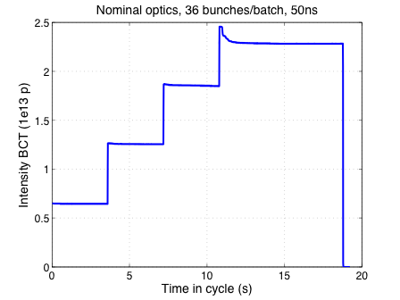
Ultimate intensity
No major beam dynamics issues with ultimate intensity (1.8e11 ppb injected)
No time for optimization and transverse emittance measurements
No obvious problem in transverse plane for both optics
Beam stable longitudinally in Q20 with 800MHz on but without longitudinal emittance blow-up
Beam slightly unstable longitudinally in Q26 with 800MHZ on → normally emittance blow-up needed, but not applied during MD for direct comparison
Transmission around 90% in both cycles without optimization (tunes not corrected, dampers, …) - no controlled longitudinal emittance blow-up in nominal optics

Slide 9
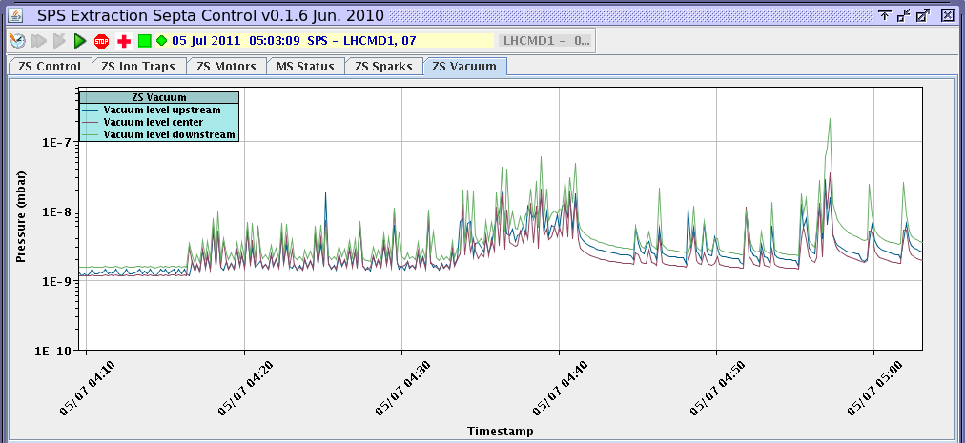
Ultimate intensity – issues
Kicker heating had to be monitored permanently …
Vacuum and BLM interlocks when increasing the bunch intensity and going to 4 batches (ultimate intensity 1 batch around 4:10, 4 batches around 4:40)
BLM, mainly in Q20 optics (cycle optimization lnot done at this point due to lack of time!!)
Vacuum interlocks because of ZS outgassing, sparks, …

Slide 10
Summary
Some issues were encountered in setup of Q20 beam
Transverse damper setup – modifications in LSA needed?
Vertical orbit at high energy → to be followed up
Inconsistencies in multi bunch/multi batch emittance measurements
To be understood
From beam dynamics point of view no obvious show stopper for 50ns multi batch in Q20 – very promising!!
Further MDs with injection into LHC should be done
Further studies with ultimate intensity 50ns beams for both optics needed
Optimization for high intensities: tunes, dampers, RF, …
Emittance measurements
Longitudinal beam characteristics
What happens with 25ns beams in Q20 optics?

