Slide 1
PS Logbook entry (23 March 2011) Steve Hancock
LHC25ns with 3*80MHz cavities: Increasing BU3 (from 12 to 18kV total) increases the longitudinal emittance (from 1.3 to 1.7eVs) and improves the margin of stability during acceleration. Switching on the third 80MHz cavity returns the bunch length delivered to the SPS to the canonical 4.0ns, with the optimum rotation time unchanged. This may provide some wiggle room for higher intensities in the future, but note that the impedance presented by the extra cavity causes the bunch train to exhibit a slight tendency to longer bunches towards the end of the batch.
http://elogbook.cern.ch/eLogbook/event_viewer.jsp?eventId=1392638

Slide 2
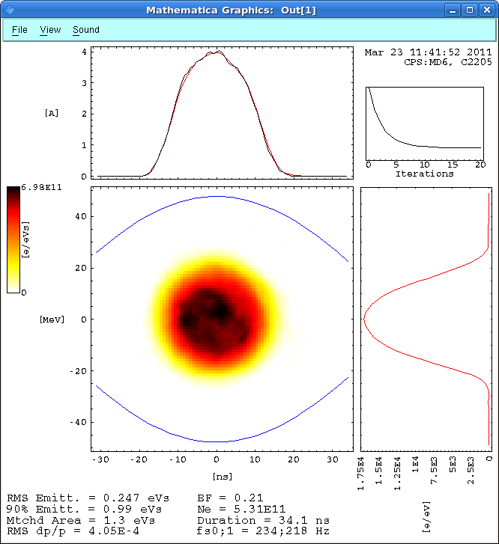

Slide 3
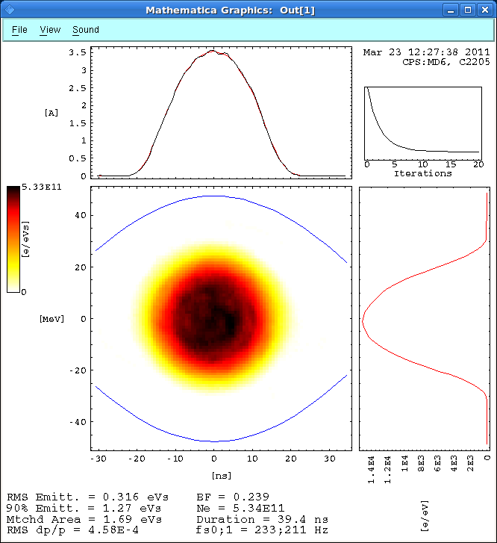

Slide 4
