Slide 1
Preliminary investigation on SPS space charge effect
23-02-2011
G. Franchetti
Thanks to B. Salvant, H. Bartosik

Slide 2
SPS possible resonances
SPS
working point
3rd order
4th order

Slide 3
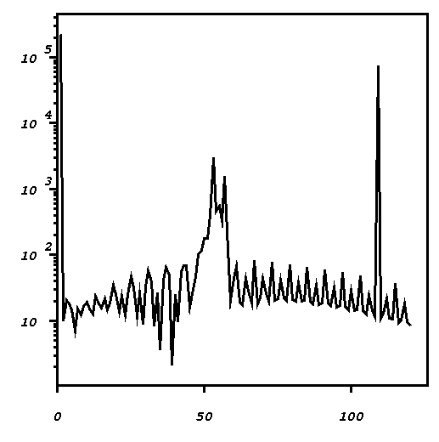
Harmonics excited by SPS optics
Harmonics 108
108 is the periodicity
of beta functions (FODO)
Harmonics 52
4 Qx = 104
and
2 Qx = 52
The structure resonance
of second order is excited
harmonic number

Slide 4
Simulation
Scan
This resonance
can be excited by
space charge

Slide 5
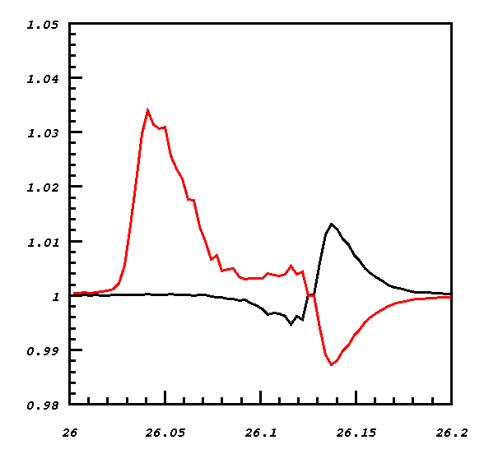
Self consistent 2D coasting beam
Is it a second
order resonance ?
Qx0 = 26.13
Ex/Ex0
Ey/Ey0
Ex = Ey = 0.072 mm-mrad
Peak current 13 A
DQx = DQy ~ 0.2
Gaussian distribution
truncated at 3 sigma
(parameters to be
checked )
Qy0

Slide 6
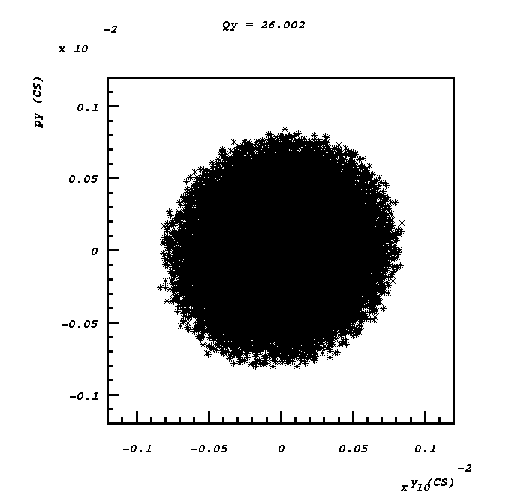
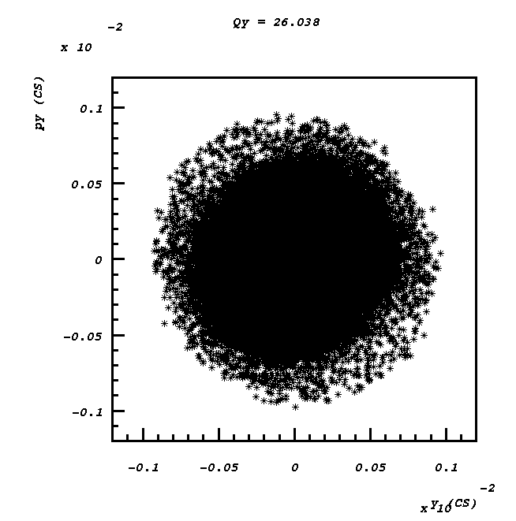
Phase space after 1500 turns
2 islands appears

Slide 7
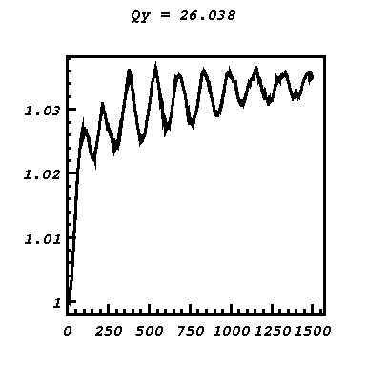
The excitation of the
2nd order structure resonance
might play a role for a high
intensity bunched beam
Ey/Ey0
(Periodic crossing of a
space charge structure
resonance…. to be checked)
turns

Slide 8
Possible new working point

Slide 9
Low gamma
Now the tunes are
Qx = 20.088
Qy = 20.221
40
80
The second and
forth order resonances are
2 Qx = 40
4 Qx = 80
The 4th order resonance is not excited
The second order resonance has harmonics
much weaker than for the case of the high
Q lattice → roughly a factor 10.

