Slide 1
Preliminary results of the multipacting measurements
Bat. 181, Meyrin site / magnet reference MBB013,uncoated
Week 15

Slide 2
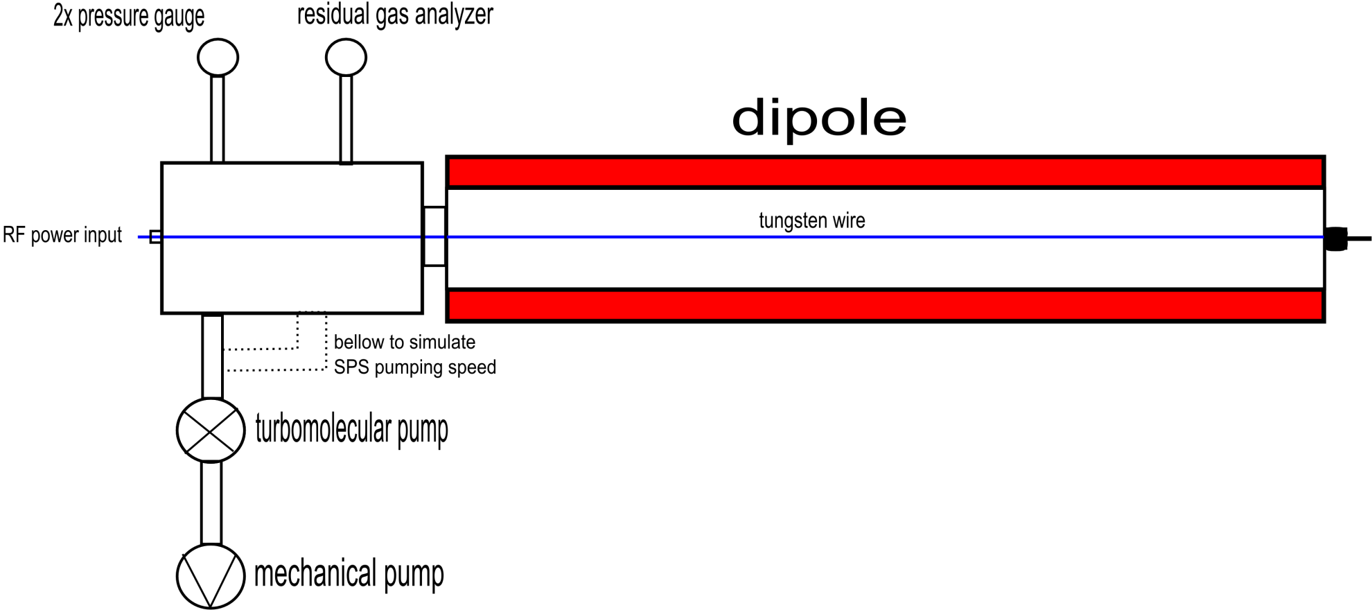
Principle

Slide 3
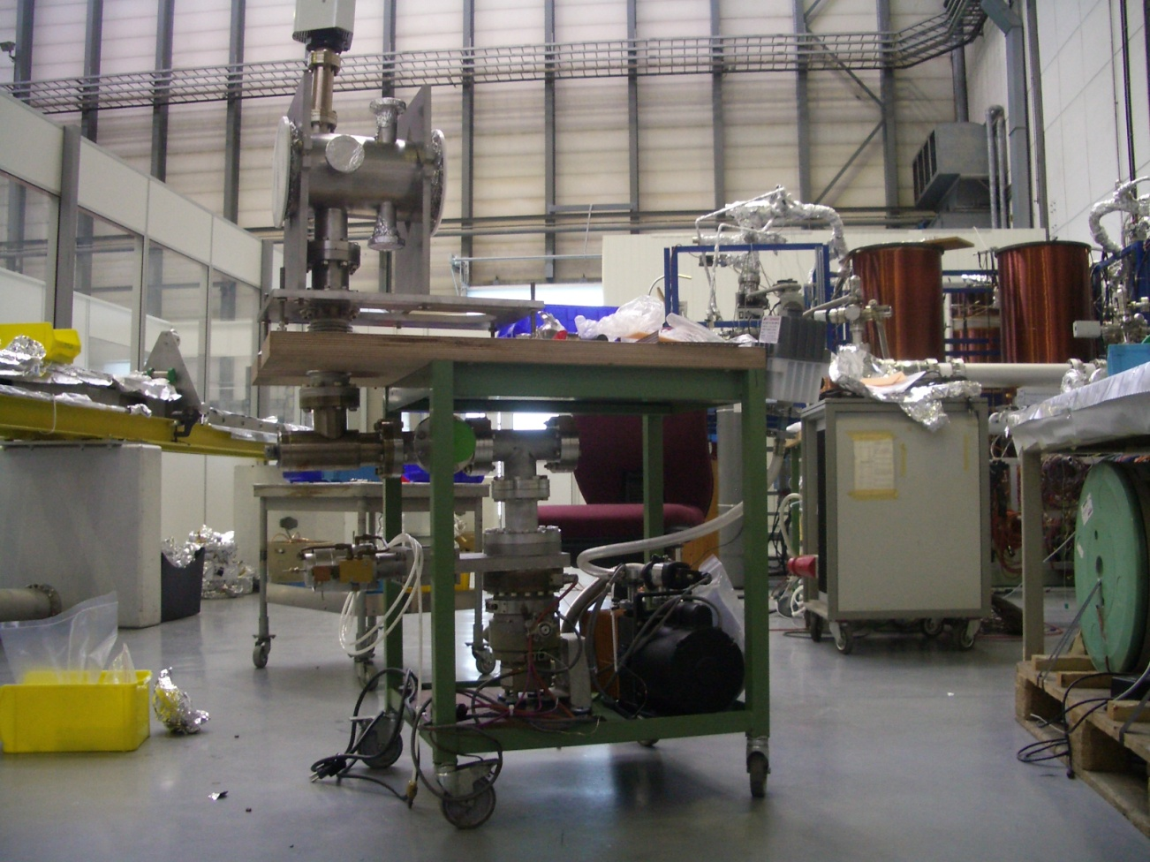
assembly of the vacuum system
(week 11 )
General assembly outside the supervised area during week 11

Slide 4
Set up of the vacuum system in front of the MBB magnet (week 12-13)
Connected the vacuum system to the MBB magnet
(magnet reference MBB 013, uncoated)
Connected the residual gas analyzer (RGA) and the pressure gauges to acquire pressure data
Leak detection for several days, RGA showed increased oxygen, nitrogen and argon => air leak (fixed)
RGA’s filaments have been very dirty
=> started degassing procedure

Slide 5
Simultaneously made a labview program to acquire pressure data automatically and save it to a spreadsheet format (e.g. Excel)
Attached tungsten wire (had to open flanges which resulted in a vacuum loss)

Slide 6
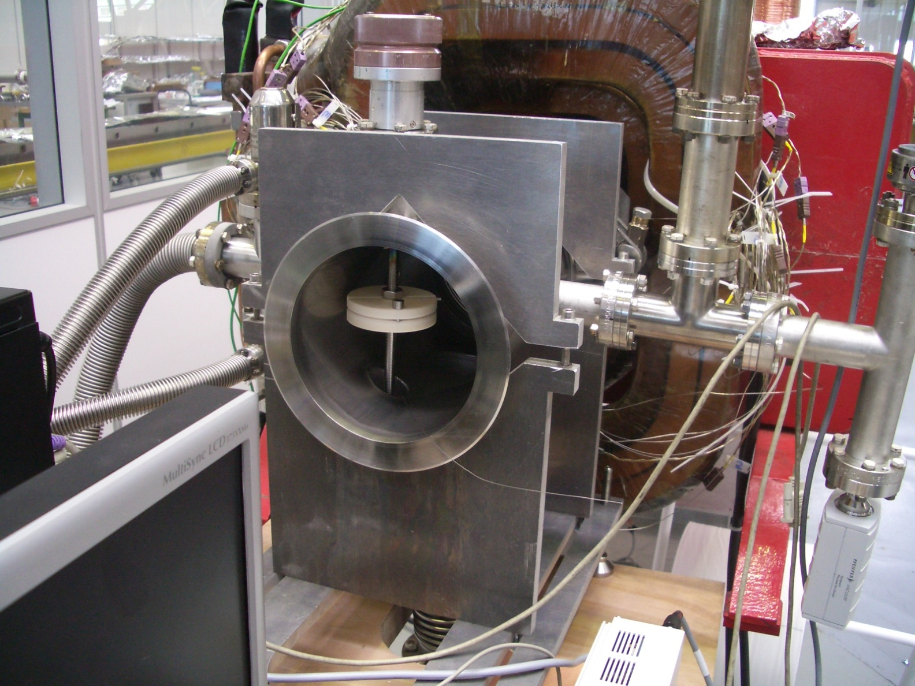
Attachment of the tungsten wire

Slide 7
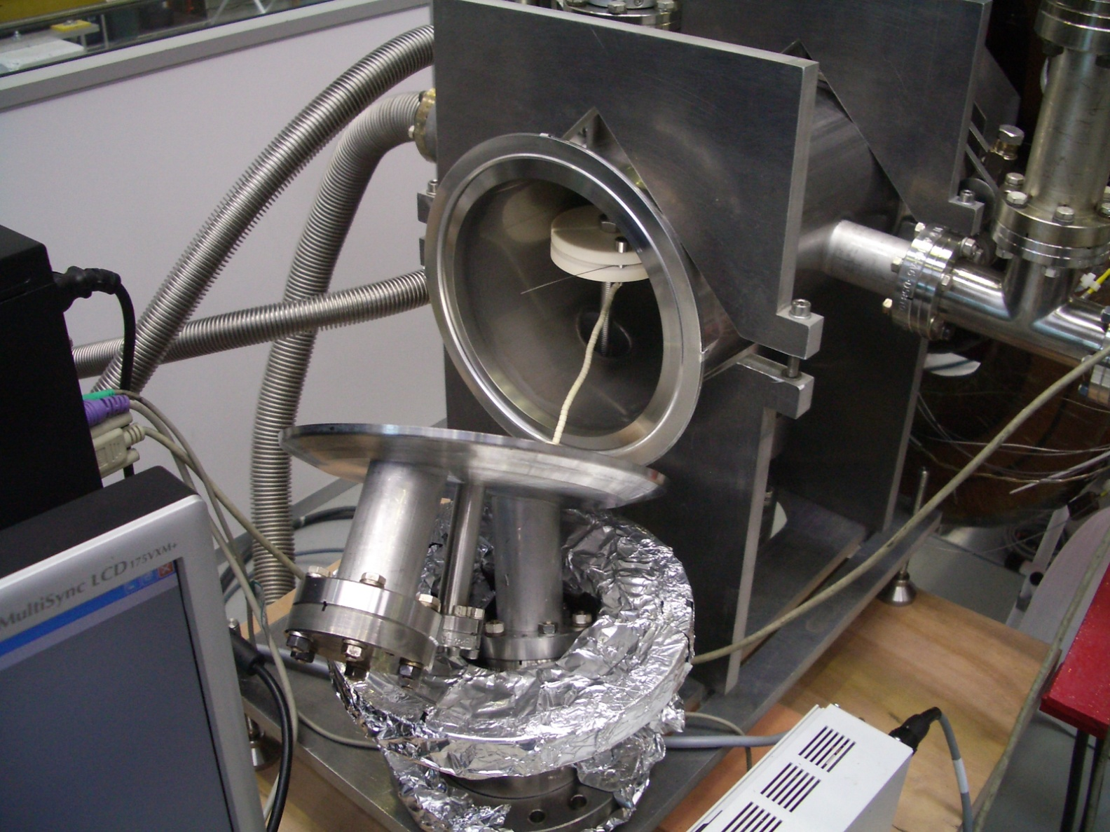

Slide 8
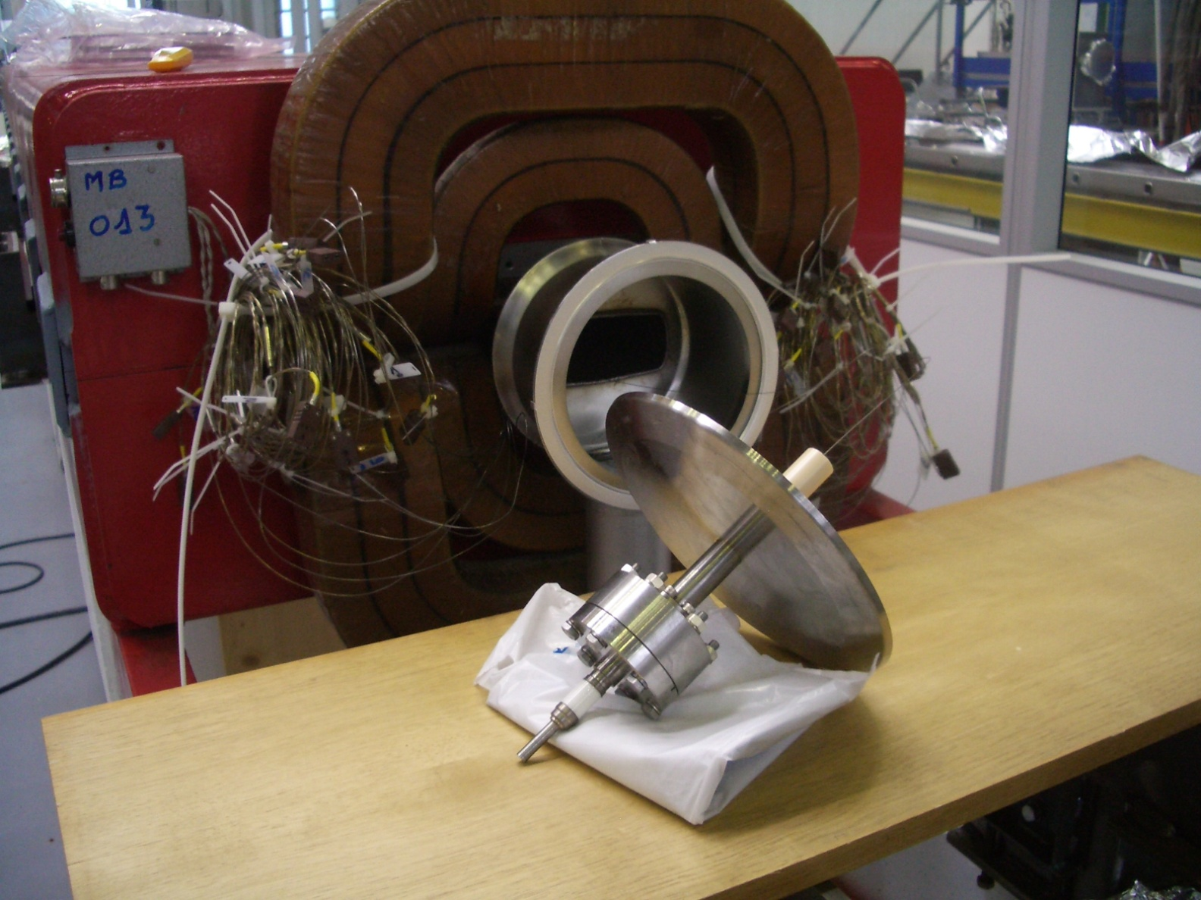

Slide 9
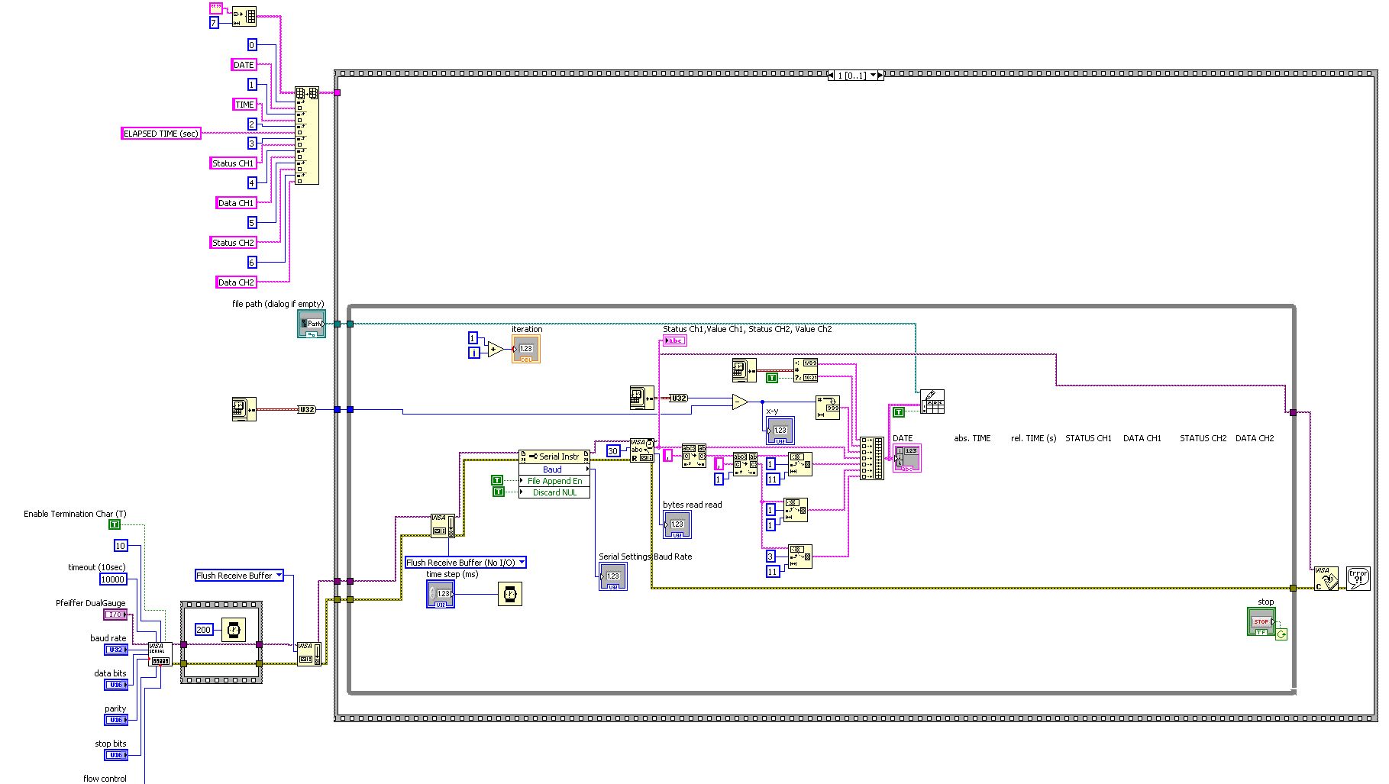
Labview data acquisition program
Block diagram

Slide 10
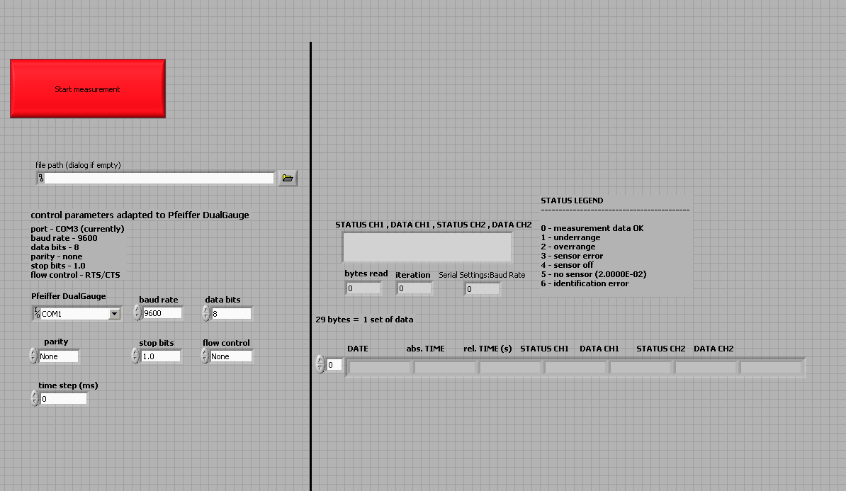
Graphical user’s interface

Slide 11
Network analysis of the tungsten wire
Applied vector network analyzer (Agilent E5071C)
Short circuit at the end of the wire
Measurement of the characteristic impedance
showed short circuit at 2 – 3 meters
=> conclusion:
tungsten wire touched bottom of the beam pipe
After tightening the wire, characteristic impedance looked (almost) as it should be

Slide 12
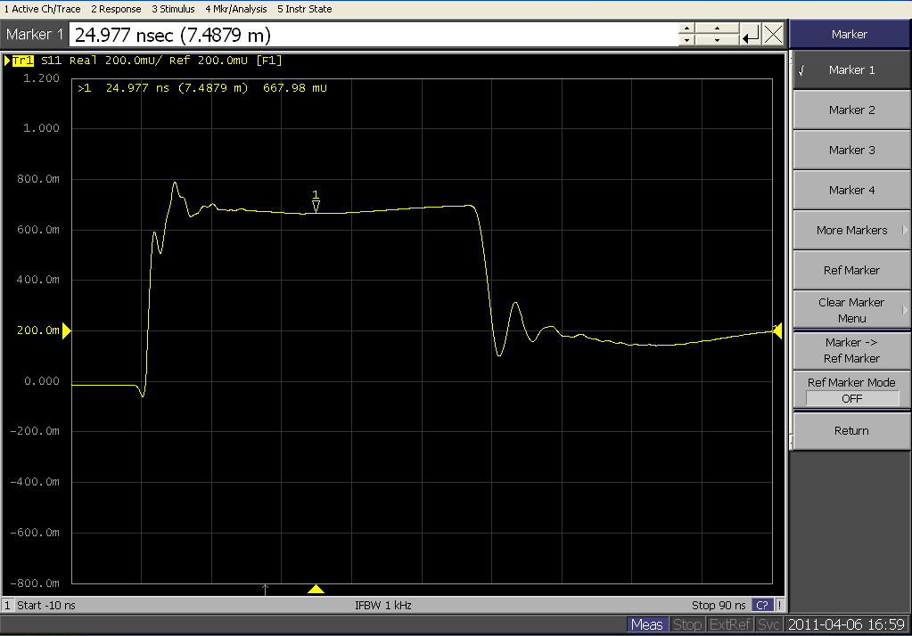
Characteristic impedance over time

Slide 13
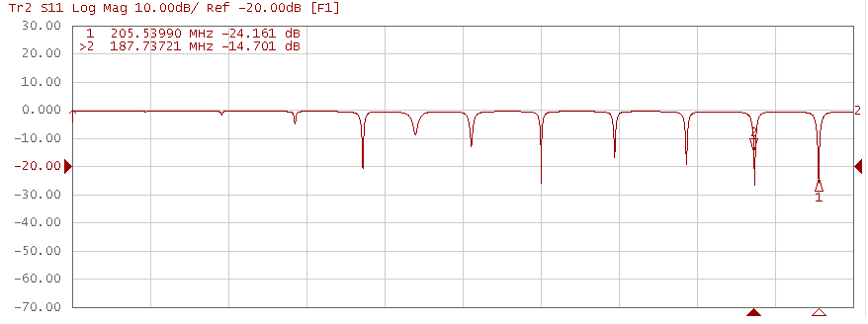
Measurement of S11 (reflection) showed good resonances at 187.73 MHz (marker 2) and 205.54 MHz (marker 1)

Slide 14
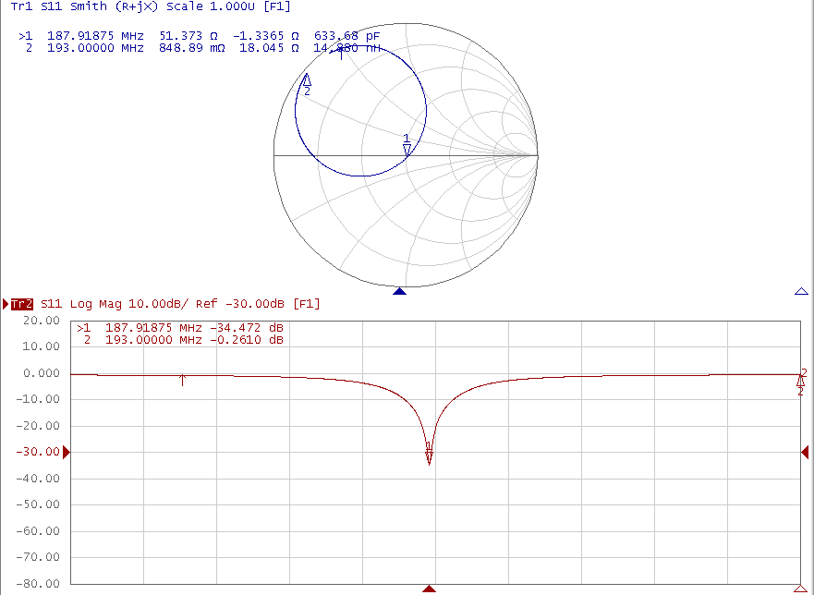
After applying a matching network with a trombone, smith-chart showed critical coupling for f=187.73 MHz

Slide 15
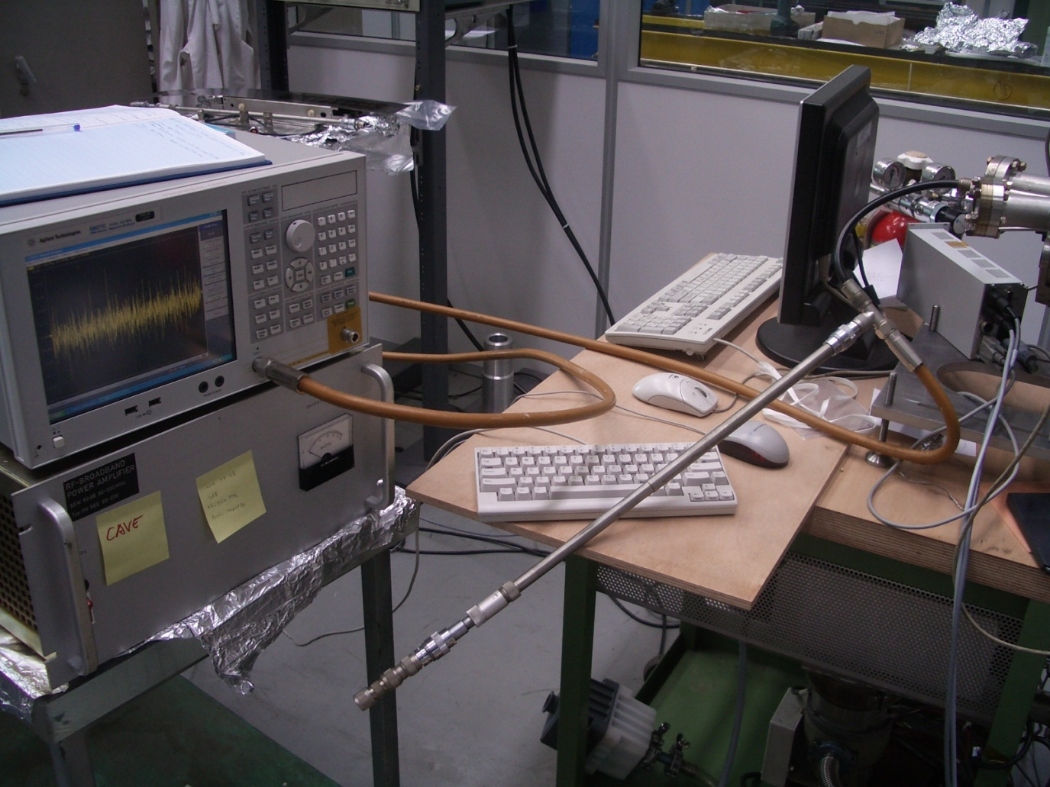
Matched network with trombone

Slide 16
First test runs with injected RF power
Available power amplifier amplifies with 50 dB in a frequency range of 30 MHz – 200 MHz up to 50 W
Therefore the excitement frequency 187.73 MHz has been selected for the first test run

Slide 17
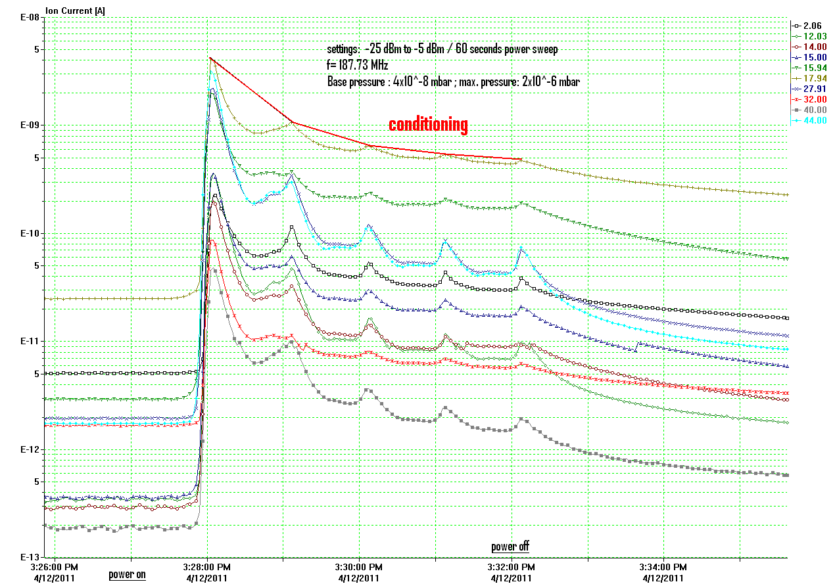

Slide 18
Main gas in the system is water (normal)
Multipacting starts at the end of the power sweep close to its maximum power
Scrubbing effect and conditioning over several power cycles (surface becomes more and more clean)
These results fit to former results

Slide 19
Measurements at other resonances
(e.g. 130.38 MHz; 225.25 MHz with open circuit) did not cause any different behavior after matching the network
No dependency on frequency so far

Slide 20
First tests with magnetic field
Applying a magnetic field has a huge impact on multipacting
Selected frequency is 130.48 MHz
Measurements with various magnetic field strengths

Slide 21
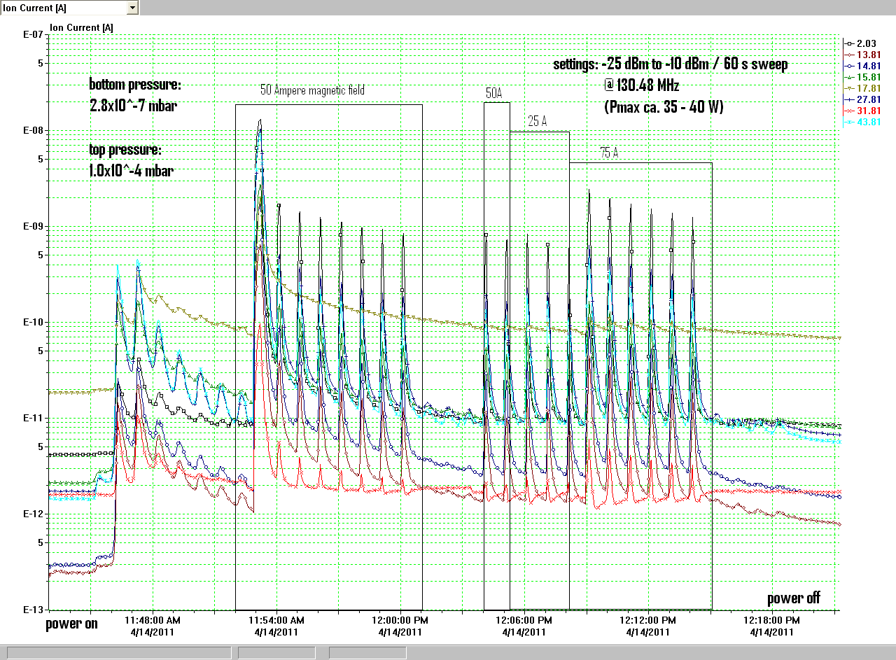

Slide 22
Hydrogen is the main content in the system now
Conclusion:
Electrons are concentrating on smaller areas due to the magnetic field. The higher intensity is releasing hydrogen from deeper layers of the beam pipe material

Slide 23
Outlook
Measurements with magnetic field and a closed main valve to simulate SPS pumping speed
Simulations with microwave studio / particle studio to acquire simulation data for comparison and to track the particles

Slide 24
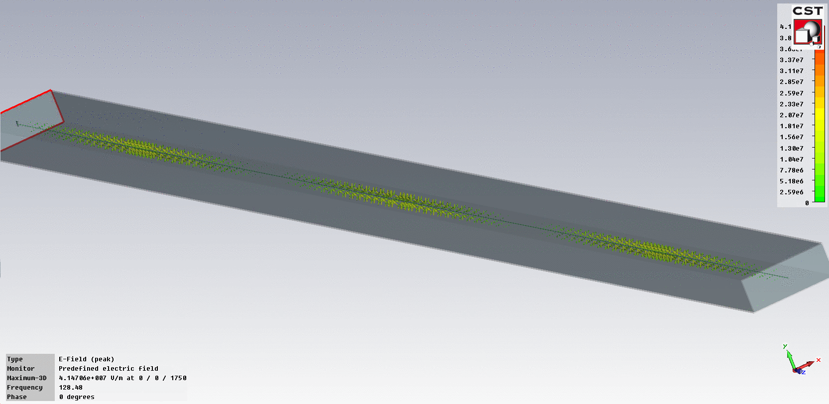
Electric field distribution, Phase=0°

Slide 25
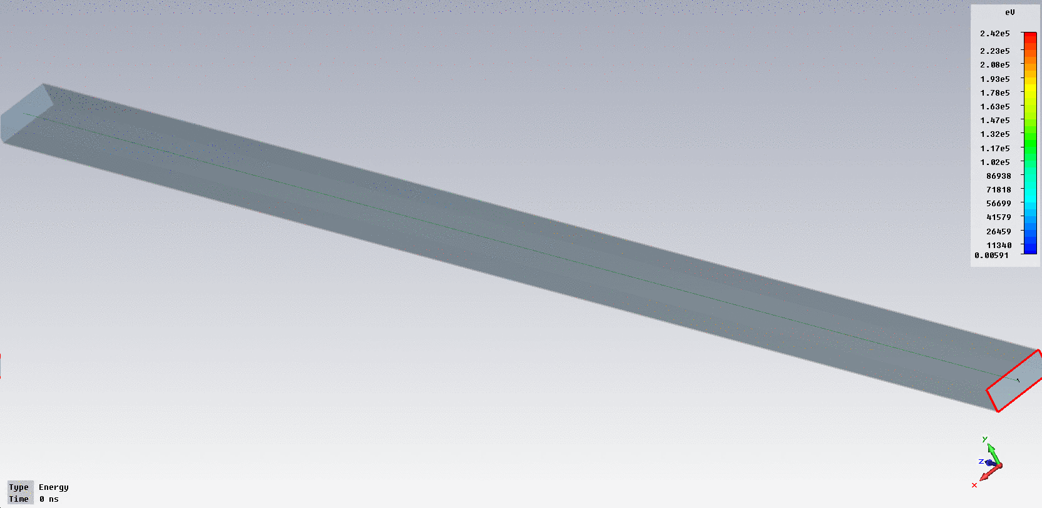
Particle tracking
Primaries' energy = 400 eV, 10% spread, 960 initial particles
40 Watt constant power, one initial pulse
Simulation time is 20 ns

Slide 26
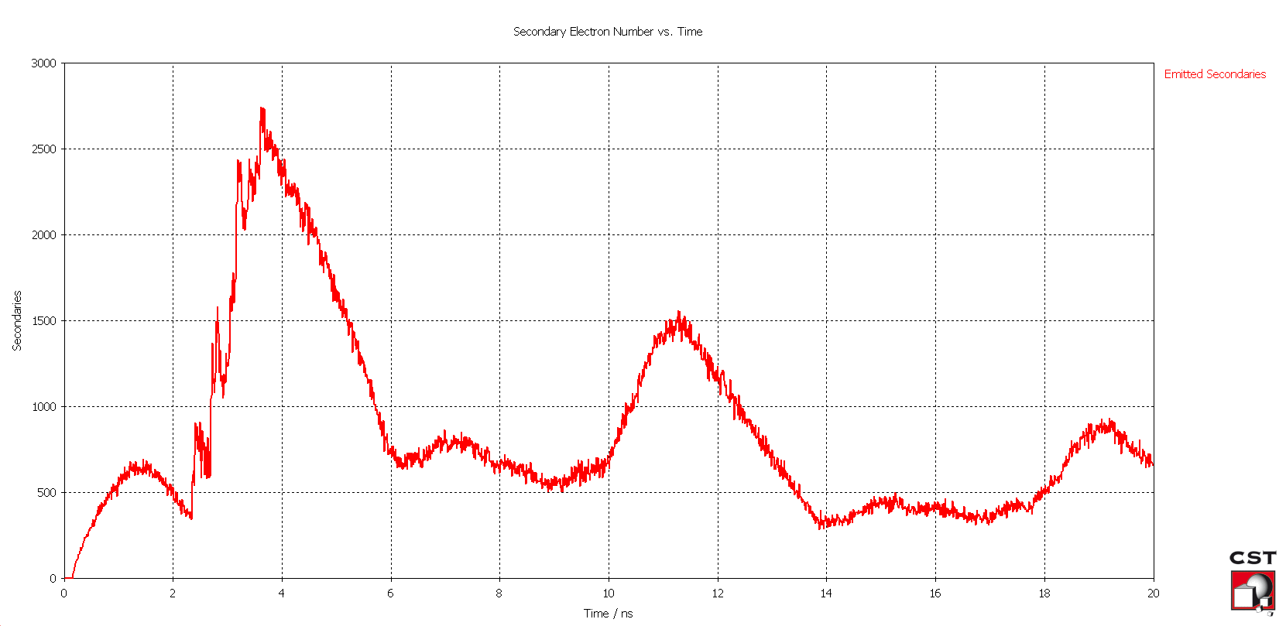
Emitted secondaries

Slide 27
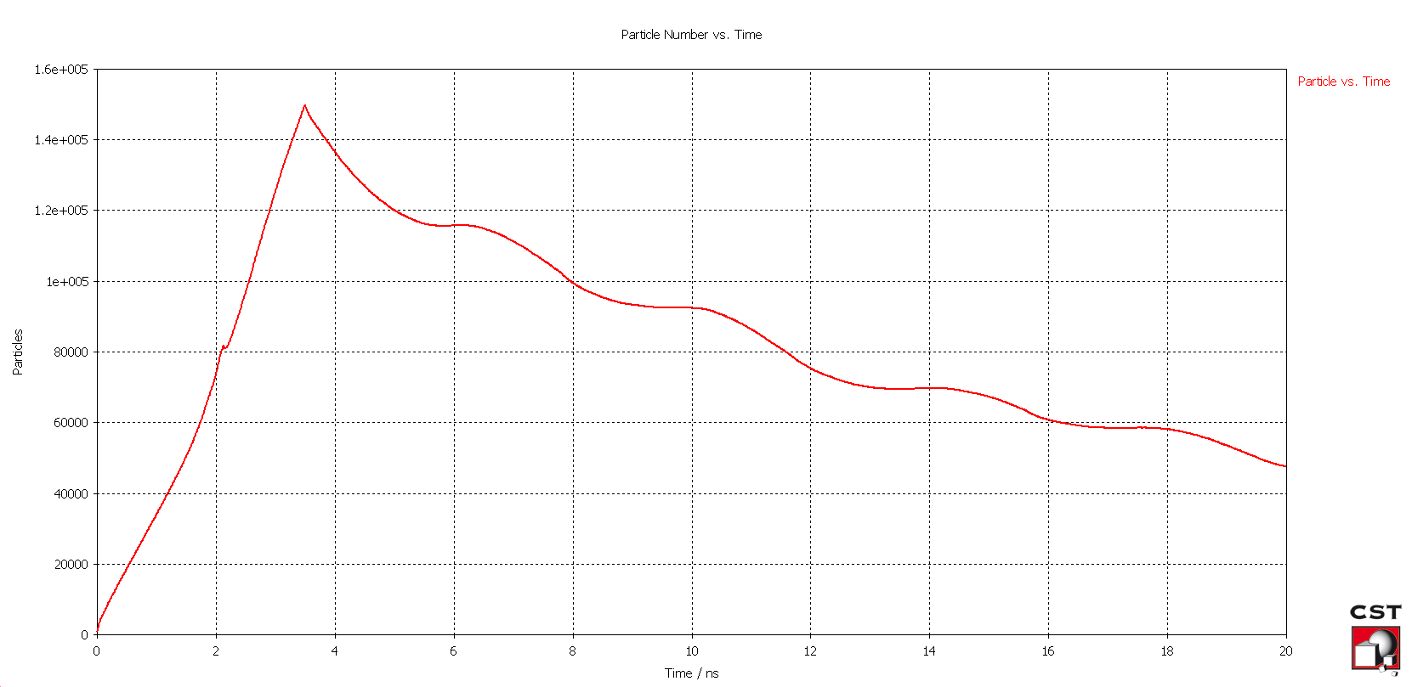
Particles versus time

Slide 28
Summary concerning the simulation
Primary energy of 400 eV chosen, most secondaries are expected at this primary energy
(see SEY measurements of stainless steel)
Simulation data is preliminary
Have to check all the parameters and choose the correct excitation signal and particle distribution

