Slide 1
Low frequency RF system in the SPS?
E. Shaposhnikova
with input from H. Damerau (last slide)
SPSU-BD meeting on 14.04.2011

Slide 2
Motivation
PS:
coupled-bunch instabilities for large bunch spacing (150, 75, 50 ns) with threshold: ε/N = const (H. Damerau) → ε ~ N
SPS:
non-negligible capture losses even for nominal LHC beam parameters (0.35 eVs, 4 ns), increase for larger emittances (MD in 2010)
coupled bunch instabilities for small injected emittances (during ramp and on flat top) → controlled longitudinal emittance blow-up by mismatched capture voltage and band-limited noise
no limitation on injected emittance, only on bunch length (200 MHz)
→ Larger longitudinal emittance is good for both PS and SPS stability, but with present RF voltage in the PS will lead to larger bunch length at extraction from PS and therefore capture loss in the SPS:
low harmonic (LH) RF system in the SPS
more 40 MHz/80 MHz voltage in the PS

Slide 3
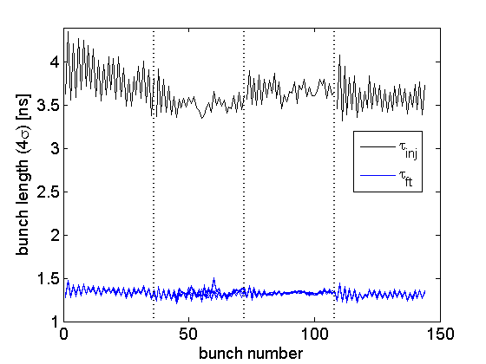
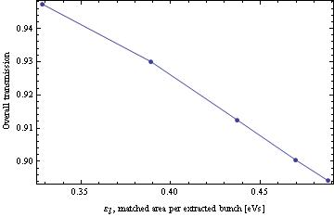
Longitudinal emittance in the SPS
Narrow window for the injected parameters: losses increase for longer bunches and beam is unstable for lower emittance (blow-up is required for 50&75 ns beams)
even with blow-up (T. Bohl, 2011)
50 ns beam
SPS transmission decreases for larger ε
ε=0.46 eVs
T. Argyropoulous
Loss of Landau damping due to inductive impedance?
T.A., H. Damerau, E.S., 2010

Slide 4
PS-SPS beam transfer – some history
R. Garoby, Requirements to the PS RF system for filling the LHC with 25 ns spacing between bunches, CERN PS/RF/Note 93-04
D. Boussard, RF scenarios at 26 GeV in the SPS as LHC injector, CERN SL/Note 93-12
R. Garoby, A non-adiabatic procedure in the PS to supply the nominal proton bunches for LHC into 200 MHz RF buckets in SPS, CERN PS/RF/Note 93-17
T. Linnecar, E.S., Requirements for beam parameters in the SPS when used a LHC injector, SL Note/94-87
SPS limitations taken into account for parameter choice: 200 MHz impedance,
microwave instability, TMCI, beam loading
The 80 MHz RF system in the SPS was proposed and eliminated after consideration of the coupled bunch instability and bunch rotation on the SPS flat bottom: “Scenario where the 9 ns long bunches are held all along 4.8 s flat bottom is unrealistic.” (D. Boussard, reduction of 200 MHz impedance by factor 10)
→ bunch compression in the PS is much better and needs less HW

Slide 5
New facts since that time
No microwave instability in the SPS (no uncontrolled emittance blow-up on flat bottom and during ramp
LHC beam in the SPS is unstable due to coupled- bunch instabilities cured by the 800 MHz RF system in bunch-shortening mode and controlled emittance blow-up
low γ_{t} optics is possible in the SPS without HW modifications
e-cloud is a serious performance limitation

Slide 6
Main criteria
Frequency f_{rf} = k x 40 MHz, k=1-4 →
40, 80, 120, 160 MHz
Maximum injected bunch length:
bucket size ~ 1/frf,
max bunch length = 0.9 of bucket momentum height
Longitudinal stability:
S ~ η(εh)², injected emittance 0.5 eVs (0.35 eVs now)
Minimum voltage possible (in presence of the 200 MHz RF) and difference with matched V

Slide 7
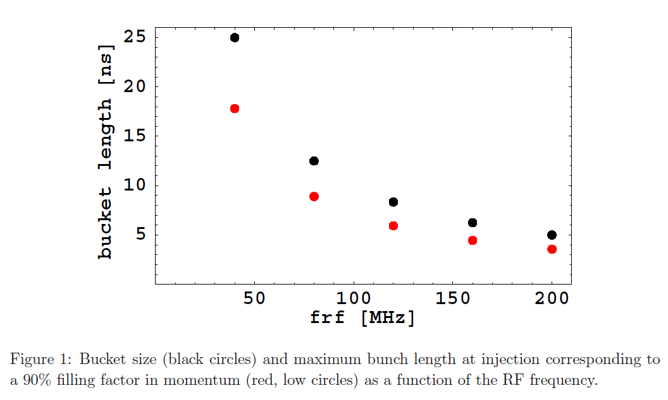
Bucket size and maximum bunch length
→ 40 MHz or 80 MHz
too short!

Slide 8
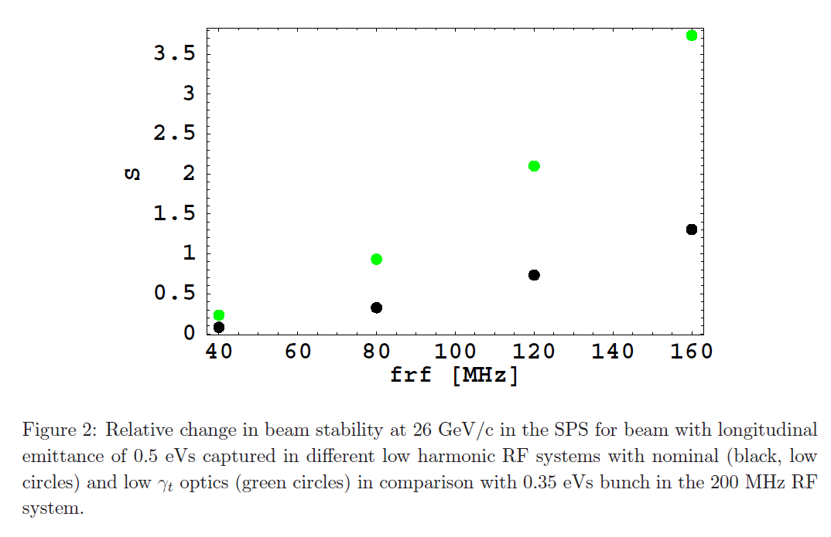
Beam stability
more unstable for 40-120 MHz
→ 80 MHz with low γ_{t}

Slide 9
A need to keep the SPS 200 MHz RF system
as Landau cavity: we lose in stability for all LH RF except 160 MHz. Presently the 800 MHz RF system is used for beam stability in the 200 MHz RF system
for acceleration: due to large bandwidth (TW) it works for ions and protons from 14 GeV/c
for beam transfer to LHC: otherwise one needs the 200 MHz RF in LHC and even then the situation will be worse with transfer from the 40 & 80 MHz RF system in the SPS

Slide 10
Consequences of keeping the 200 MHz RF system in the SPS
Need to transfer into the 200 MHz RF (flat bottom or beginning of the ramp – more accurate analysis needed)
Insure beam stability in the presence of the 200 MHz impedance → active control
Residual beam induced voltage is not negligible for ultimate current even with FF and FB in operation → accurate phase control as Landau cavity is difficult
Difficult to control voltages below 500 kV (now counter phasing for total V< 3 MV, T. Bohl)
Limitation to the LH voltage to V= h₀/h x V₂₀₀…
At 80 MHz: V >> 2.5 x 500 kV = 1.25 MV → tails after filamentation → losses at beam transfer into the 200 MHz

Slide 11
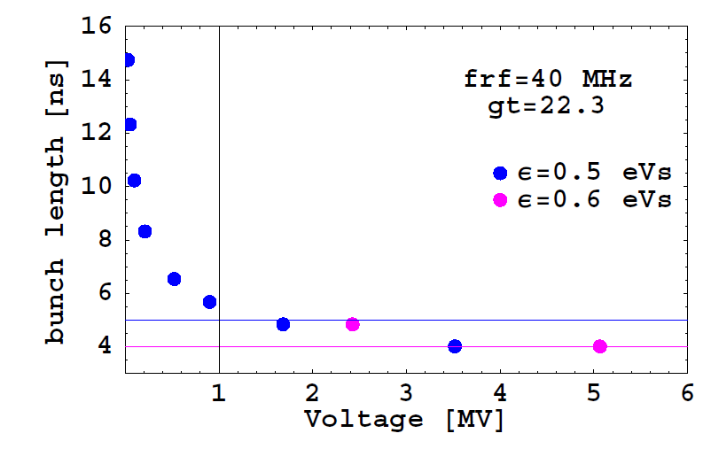
The 40 MHz RF system

Slide 12
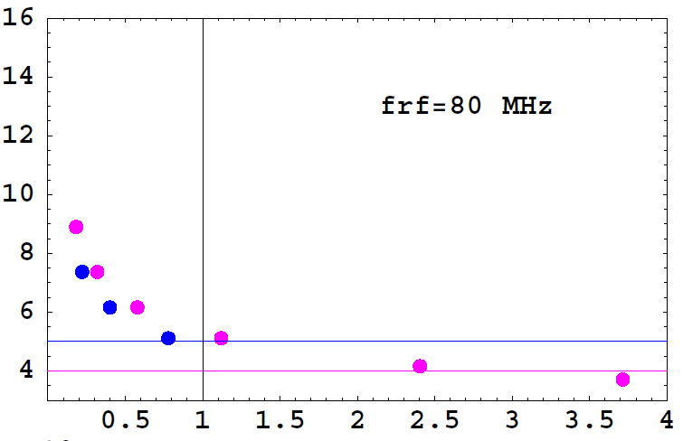
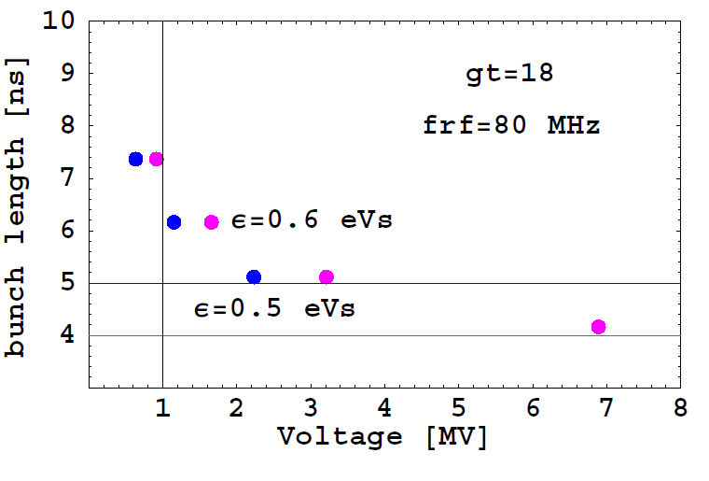
The 80 MHz RF system
nominal optics
low γ_{t} optics

Slide 13
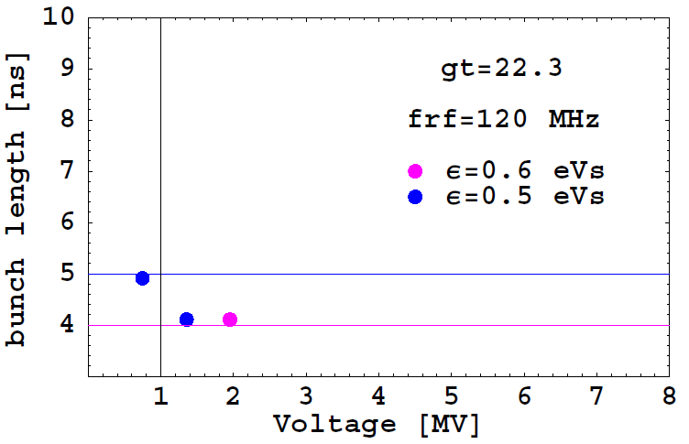
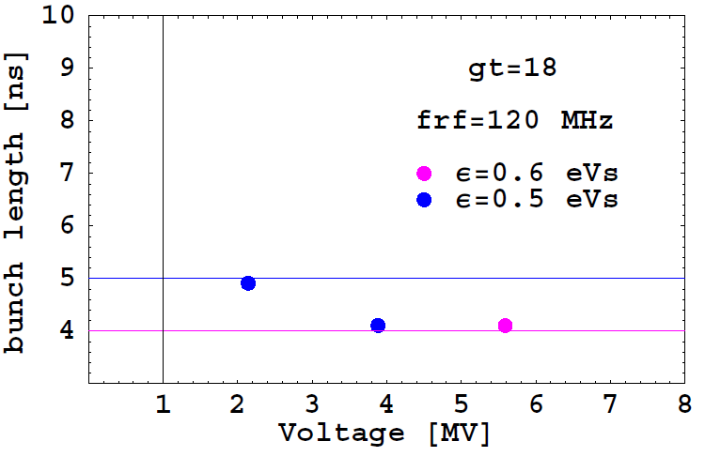
The 120 MHz RF system
nominal optics
low γ_{t} optics

Slide 14
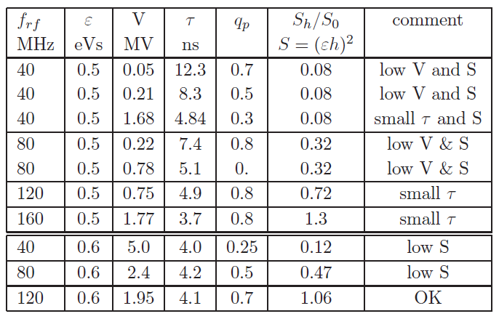
Summary for nominal optics

Slide 15
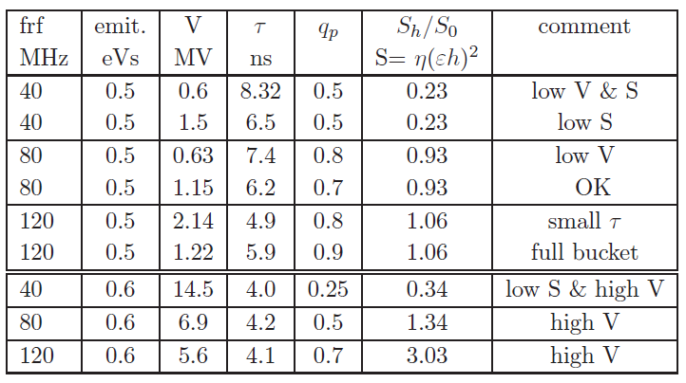
Summary for low γ_{t} optics

Slide 16
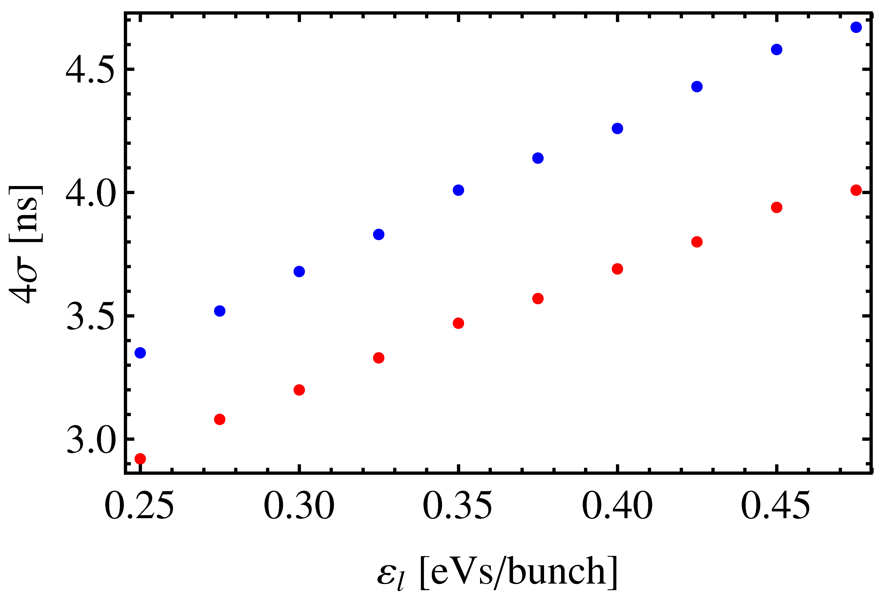
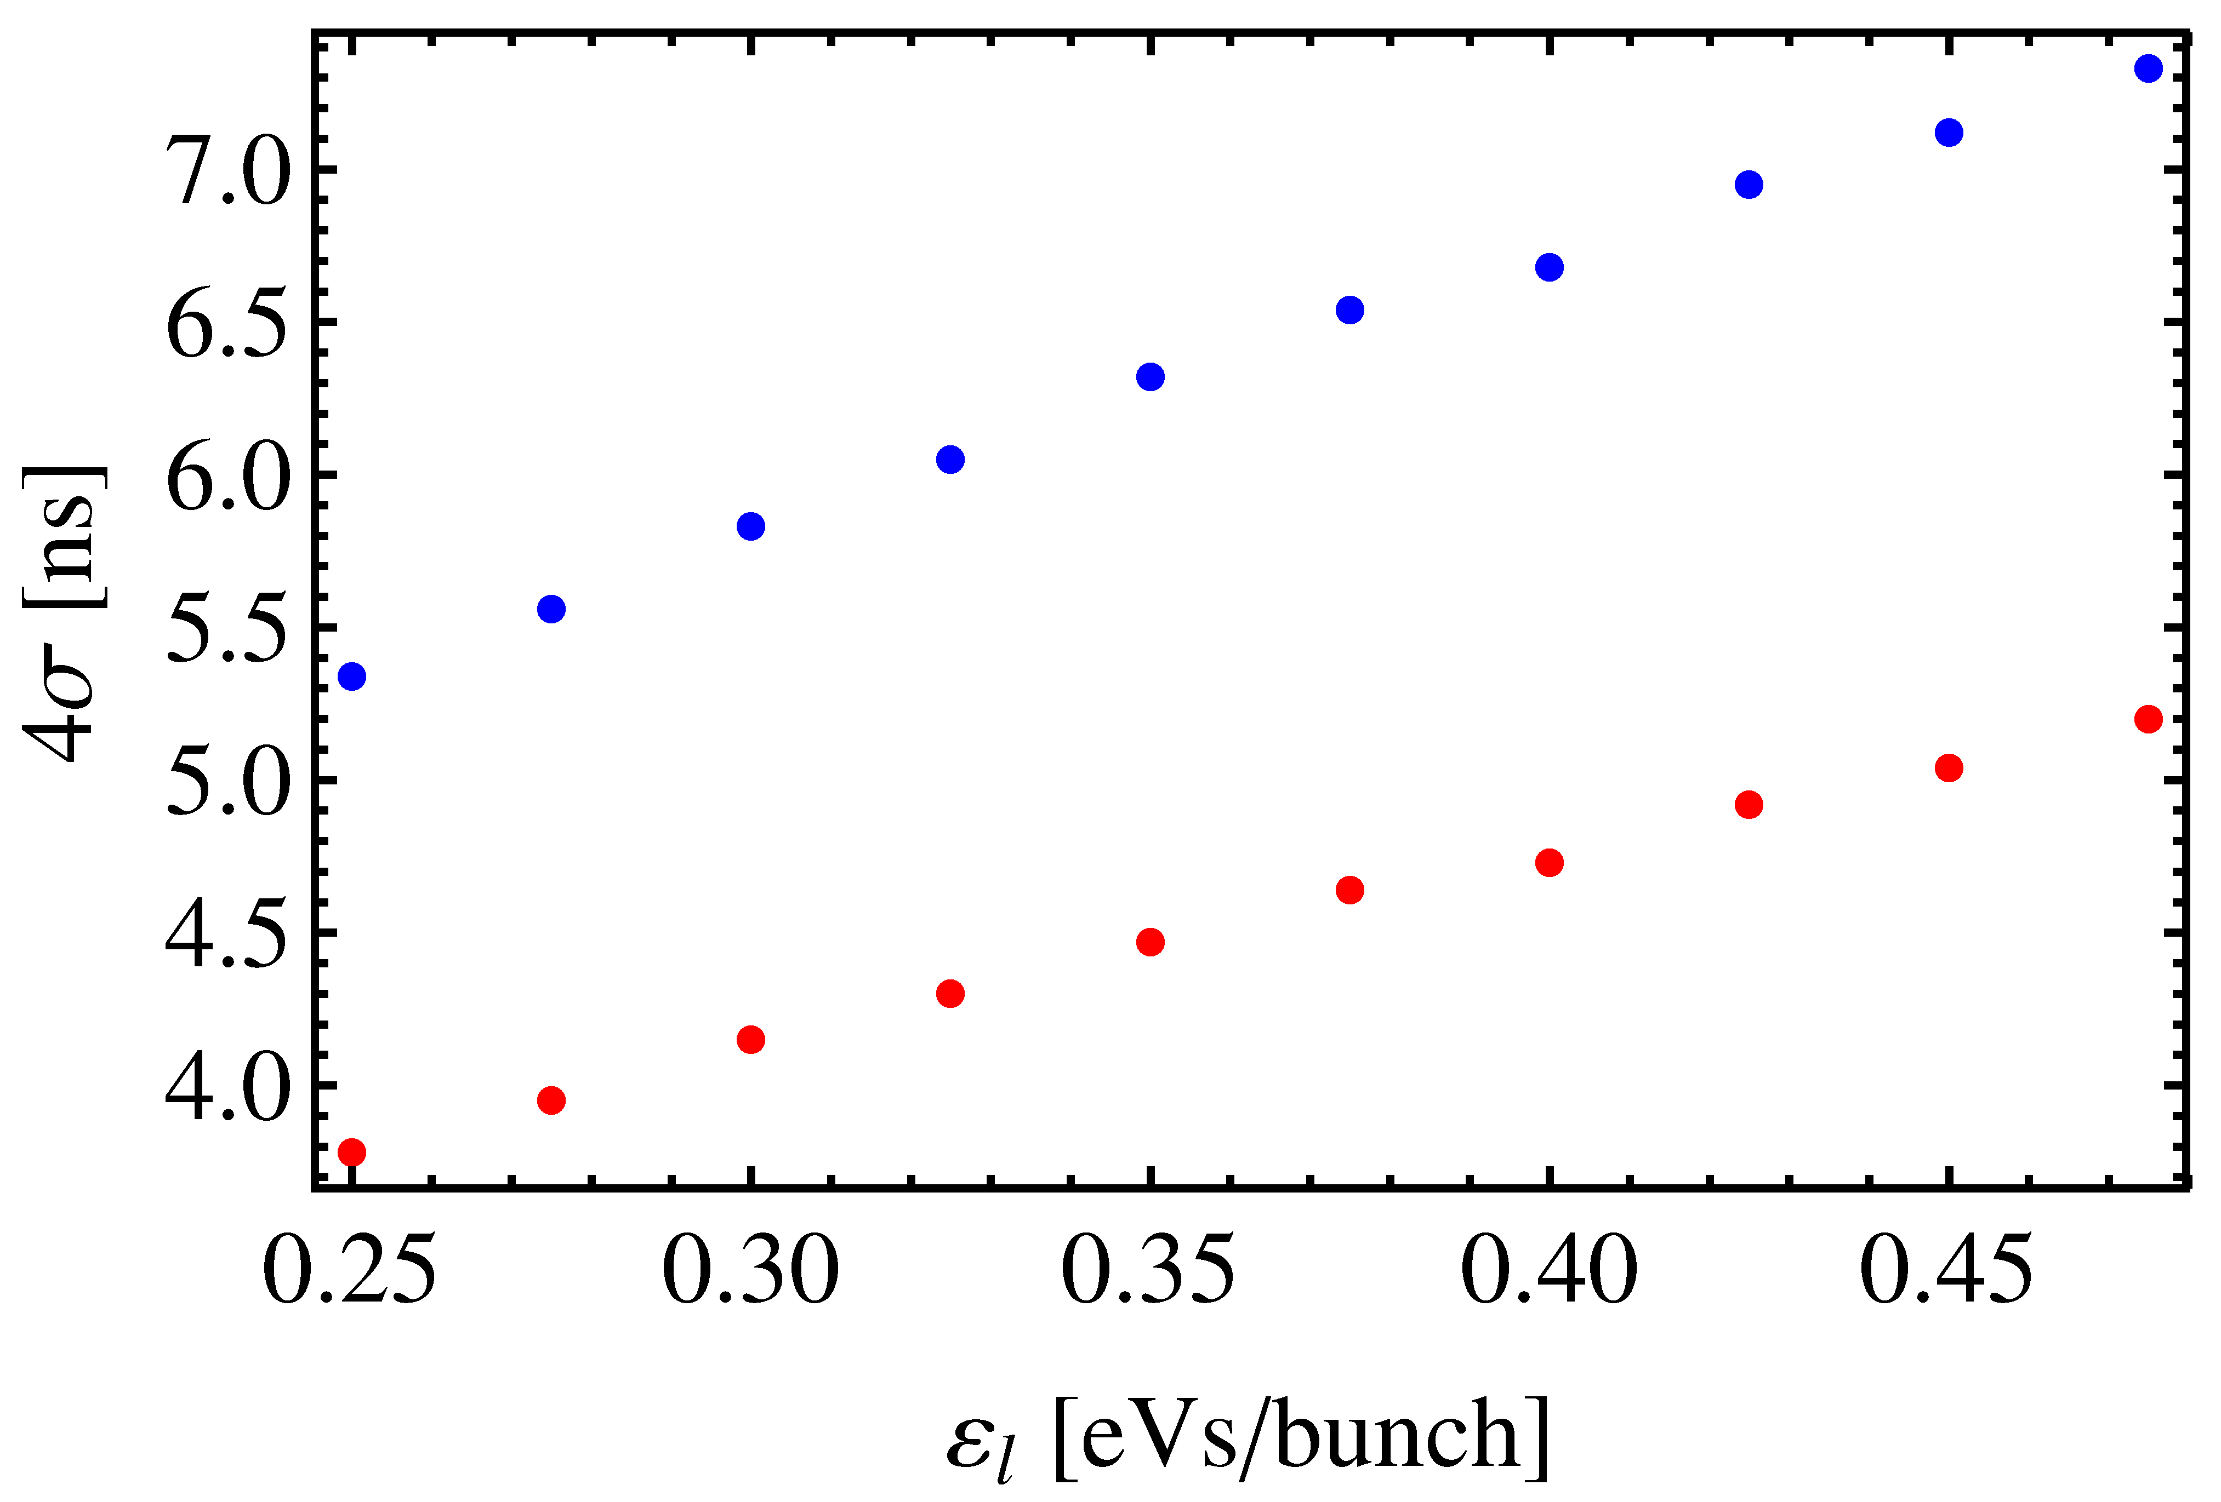
Bunch length at extraction from the PS
(H. Damerau: from simple particle tracking)
Bunch rotation 40/80 MHz
Bunch rotation 40 MHz only
300/600 kV
300 kV
SPS limit 200 MHz
SPS limit 80 MHz
Nom.
Beam test in 2011 (Steven)
600 kV
300/900 kV
More 80 MHz voltage → 0.43 eVs within 4 ns length
Tracking and measurements agree: MD this year (S. Hancock)
Under favorable conditions in the SPS, both 40 MHz or still 40 + 80 MHz for bunch rotation in the PS
Some margin with ε_{l} > 0.45 eVs

Slide 17
Summary: comparison with RF system in the PS
LH capture system in SPS
Extra RF voltage (cavity) in the PS
Only the 80 MHz has some chance (for 6-7 ns PS bunch)
+ improves beam stability in PS
+ helps for space charge and e-cloud
- worse for the SPS beam stability (except 160 MHz)
- possible only with low γ_{t}
- introduces extra impedance – big system (a few MV)
- still need the 200 MHz RF in SPS for acceleration & LHC transfer
extra RF manipulation → reduces reliability
Two 40 MHz or 40 + 80 MHz cavities in the PS still needed (H. Damerau)
+ improves beam stability in PS and SPS
introduces extra impedance, but
+ increases reliability and flexibility (ions, hot spare) – see talk of E. Jensen at IEFC (March 2011)
+ 1 cavity will already help

