Slide 1
Electron cloud effects in the SPS in nominal and low γ_{t} optics
H. Bartosik, E. Benedetto, K. Li, Y. Papaphilippou, G. Rumolo

Slide 2
Motivation
Study impact of the new low γ_{t} optics in SPS on the onset of electron cloud instability
Difference between low γ_{t} (Q20) and nominal optics (Q26)
Q20 has higher slippage factor (η is increased by a factor of 2.85 at injection and 1.6 at extraction)
→ higher synchrotron tune for same bucket parameters (in this case Q_{s}~η)
Q20 has increased average β-functions and increased dispersion function
Q20 has lower tunes → may affect incoherent effects
Expected scaling of instability threshold?
Interaction with electron cloud is non-linear
N_{b,th}~Q_{s}/β (similar to TMCI)?
Goal
Understand scaling of threshold with Q_{s} and with β
Study the electron cloud density threshold in the two optics for different bunch intensities

Slide 3
E-cloud simulations with HeadTail
HeadTail is used to study the impact of a given elctron cloud on the stability of a single bunch → build-up of cloud itself not simulated
Consecutive bunch slices interact with the cloud sequentially and deform it dynamically (“pinch”) → electron cloud serves as “wake field”
After all bunch slices have interacted, cloud is reset to uniform distribution
Electron cloud interaction regions (“kicks”) can be distributed symmetrically around the circumference → reduce numerical effects due to strong local kick
Bunch particles interact with electrons, but no proton-proton or electron-electron interaction
Uniform focusing used for now (smooth approximation, constant β-functions)
Electron cloud in field free regions and in dipole fields
Electron motion in field free region defined by interaction with proton bunch in both transverse dimension
Electron motion in dipole regions “frozen” in horizontal direction to model magnetic field (Larmor precession); electrons move only in vertical direction → no pinching and no instability in horizontal direction
Coherent head-tail motion can be observed as exponential emittance growth → used to find instability threshold

Slide 4
Simulation parameters
E-cloud distributed over 192 kicks (for numerical convergence)
Simulations for injection energy (26 GeV), ε_{x,y}=2.5μm, 512 turns
Synchrotron motion in nonlinear bucket
No additional non-linearity (Chromaticity set to 0, no octupoles, …)
RF-voltage adjusted to provide same bucket parameters in both cases
Parameter | Low γ_{t} optics | Nominal SPS optics
Bunch length (rms) | 0.23 m | 0.23 m
Momentum spread | 0.002 | 0.002
RF-voltage (injection) | 5.75 MV | 2 MV
Synchrotron tune | 0.017 (=1/59) | 0.0059 (=1/170)
Momentum compaction factor | 0.00308 | 0.00192
Transition energy (γ_{t}) | 18 | 22.8
Tunes (Q_{x}, Q_{y}) | 20.13, 20.18 | 26.13, 26.18
Average β-functions in LSS (β_{x}, β_{y}) | 54.6m | 42m
Average β-functions in MBB (β_{x}, β_{y}) | 45.5m, 78.4m | 34.4m, 72.3m
Average dispersion in MBB (D_{x}) | 3m | 1.8m

Slide 5
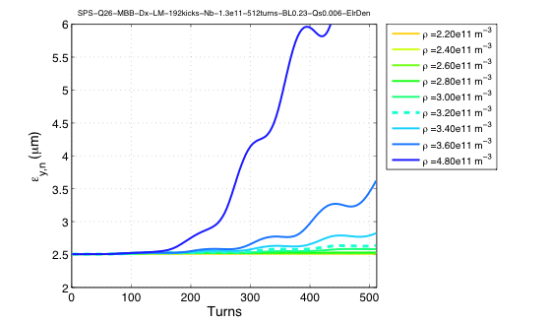
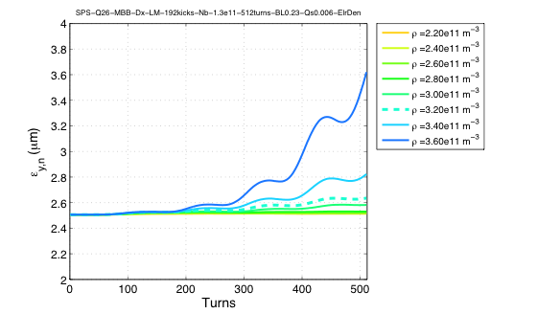
Instability threshold
Threshold can be identified when scanning electron cloud density ρ
Start with low density → almost constant emittance
Clear exponential growth for ρ above the threshold
→ Possible definition of threshold: smallest value of electron cloud density for which the emittance after investigated number of turns is bigger than threshold value (arbitrary!!)
Threshold considered here: emittance growth by ~5% after 512 turns
Absolute rise-times are compared (not with respect to synchrotron periods)
Threshold density marked in plots as dashed line
For ρ above threshold (but not too high), instability observed as exponential growth of emittance

Slide 6
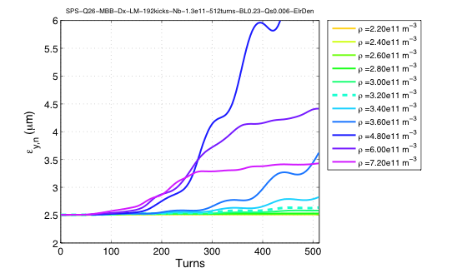
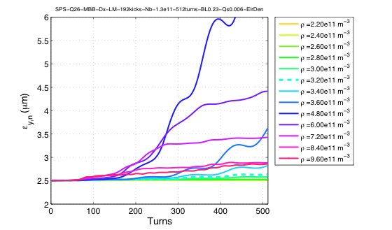
Incoherent effects for high ρ
“Incoherent” effects far above threshold density
Depend on kicks per turn, number of particles, tune, number of grid points, …
Saturation of growth rate after initial fast growing emittance for intermediate ρ
For ρ far above threshold, incoherent growth of emittance can be observed
Simulation artifact?
Makes high electron cloud density appear less harmful …
We are interested in onset of instability → very important to start scan from low values of ρ
ρ is the quantity to scan to find instability threshold!
Scanning for other parameters (like bunch intensity) may not reveal threshold (if by chance ρ is too high)

Slide 7
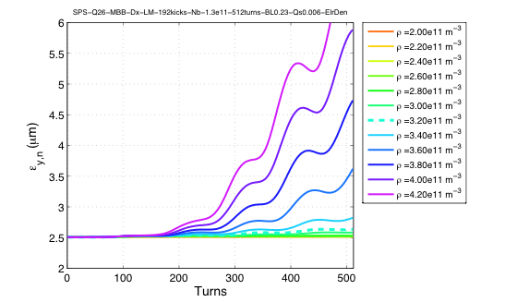
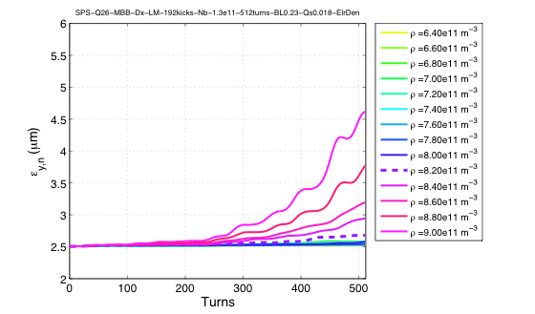
Changing synchrotron tune Q_{s}
Electron cloud density scans for different values of Q_{s}
Changing momentum compaction factor and RF-voltage for constant longitudinal bunch parameters
Corresponds to change of optics
Simulation for dipole regions
Higher threshold for higher Q_{s →} higher synchrotron tune helps stabilizing beam
ρ_{th}(Q_{s}=0.006)~3.2e11/m³
ρ_{th}(Q_{s}=0.018)~8.4e11/m³
Factor 3??
Qs=0.006
Qs=0.018

Slide 8
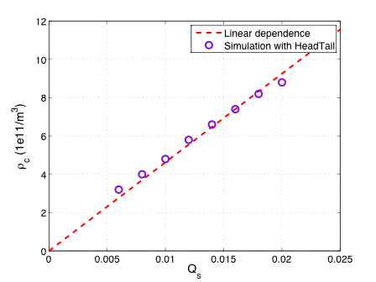
Threshold as function of Q_{s}
Within the studied range, threshold increases linearly with synchrotron tune
Extrapolation of data-points (linear fit) is not crossing origin → maybe explained by roughness of scan
Definition of threshold not optimal?
Within “precision“ of simulation: ρ_{th}~Q_{s}
Dipole regions
Nominal optics
N_{b}=1.3e11ppb
512 turns
Constant longitudinal bunch parameters
Dispersion included in simulation

Slide 9
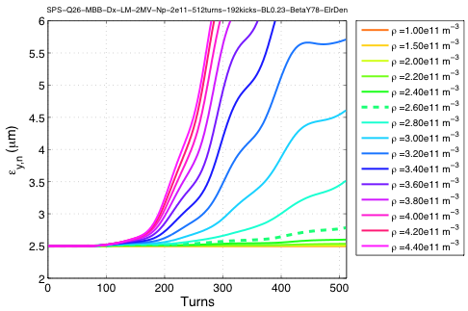
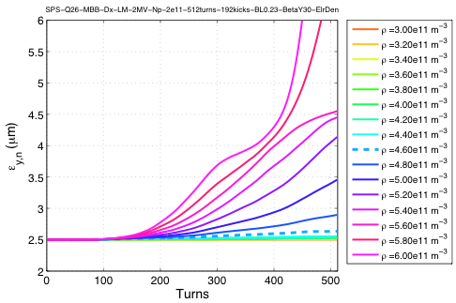
Changing β_{y} in dipole regions
For constant β_{x}, β_{y} is changed in dipole regions
Pinch depends on charge density of proton bunch → beam dimensions (and bunch intensity)
Similar to wakefield due to impedance, kick strength due to interaction with electron cloud increases for higher values of β function → threshold should decrease for higher β
Simulation for nominal optics and N_{b}=2e11ppb
β_{y}=30m
β_{y}=78m

Slide 10
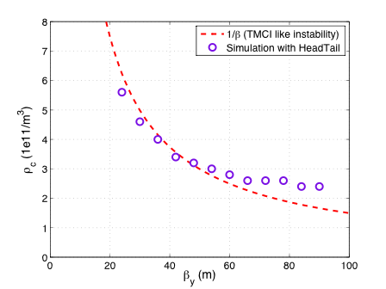
Threshold as function of β_{y}
Simulation for dipole regions
Within studied range, threshold decreases with β_{y}
Scaling not like classical TMCI (~ρ_{c}~1/β) but rather like ρ_{c}~1/β^{n}, with 0.5<n<1
Depending on β_{x} ? (Through the dependence of the electron oscillation frequency on the proton charge density and thus beam size)
What happens when changing simultaneously β_{x} and β_{y}?
Dipole regions
Nominal optics
N_{b}=2e11ppb
512 turns
Constant longitudinal bunch parameters
Dispersion included in simulation

Slide 11
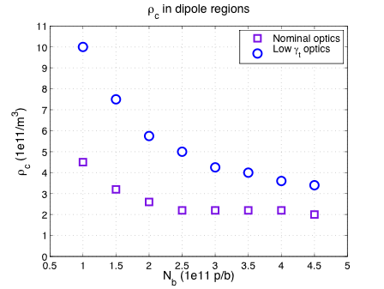
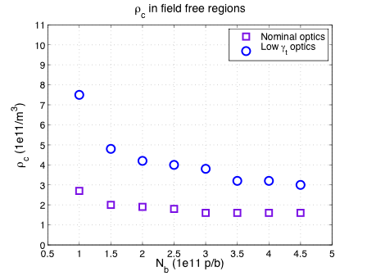
Threshold as function of intensity
Comparing the two optics
Thresholds for different values of bunch intensity for parameter sets of nominal and low γ_{t} optics
Simulations for field free and dipole regions
In both cases, increased threshold for low γ_{t} optics for all intensities
Field free region: threshold increased for Q20 by roughly factor 2.3 on average
Dipole region: threshold increased for Q20 by factor 2 on average

Slide 12
Summary
Analyzed onset of electron cloud instability
Threshold not unambiguously defined
Studied dependence of instability threshold on β-functions and synchrotron tune
Threshold increases with higher synchrotron tune
Threshold decreases with larger β-function (dispersion included)
According to simulation, low γ_{t} optics has higher threshold
How about electron cloud build up?
How about incoherent effects → careful setup and choice of parameters needed
Very interesting for comparison with measurements! (To be done …)

