Slide 1
Preliminary results of the MD on transverse emittances for high intensity in the SPS low gamma transition optics
H. Bartosik on behalf of T. Argyropoulos, C. Bhat, T. Bohl, K. Cornelis, J. Esteban Muller, B. Mikulek, G. Rumolo, Y. Papaphilippou, B. Salvant, E. Shaposhnikova

Slide 2
Measurement conditions – PS complex
Scan of the transverse emittances for different intensities delivered from the injectors
Intensity between 1-3e11 ppb, single bunch, with almost constant transverse emittances extracted from the PSB quite stable around 1-1.1 μm
A few measurements of transverse emittances with wire-scanners were taken in the PS
Measurement of emittances in TT2/TT10 not easy
OTR matching screens show weak signal for single bunches which leads to problems in the fitting routine (therefore not usable up to now) → possible solution to inject 4 LHCindiv bunches to increase signal strength
Fluorescent screens on the other hand were saturated
SEM-fils in location with relatively large dispersion → very sensitive to dp/p which cannot be measured easily at extraction due to bunch rotation in the PS
Notes:
TMCI threshold can be increased by increasing chromaticity or longitudinal emittance

Slide 3
Measurement conditions - SPS
Cycle with long flat bottom (suited for injection of 4 batches) and slow ramp for study of potential emittance blow-up in SPS
Only Q20 (low gamma transition) cycle available for single bunch during this MD
RF-voltage according to constant bucket area of 0.55 eVs on flat bottom (eq. to ~3.8 MV) and first part of acceleration, then voltage is kept constant before raised to 7 MV just before extraction for adiabatic bunch squeezing
800 MHz cavity was used with a voltage program adapted from the nominal cycle (around 10% of 200 MHz main cavity RF-voltage)
Nominal Q20 Tunes used for the study Q_{x},Q_{y}~ 20.13,20.18
Notes:
TMCI threshold can be increased by increasing chromaticity or longitudinal emittance

Slide 4
Measurement procedure
For each requested intensity, the tunes (mainly the vertical) along the ramp were corrected before taking emittance measurements
Wire-scanners WS519 and in WS416 were used (both rotational mechanics)
Scans in different positions (timings) in the cycle (flat bottom and flat top)
Initially injected and flat top intensity as measured from the DC-BCT were recorded for each emittance measurement
Representative samples of the longitudinal bunch profiles for different times in the cycle and different injected intensities were taken with the wall current monitor
Remark
“cross calibration measurements” between the wire-scanners for intermediate intensity (~2e11 ppb) measuring with the different devices in the same cycle with short delay between them in the flat bottom were taken
Measurements from BWS.416 (systematically giving smaller emittances) will be scaled to match better the results of BWS.519 – (therefore no results of BWS.416 presented here)
Notes:
TMCI threshold can be increased by increasing chromaticity or longitudinal emittance

Slide 5
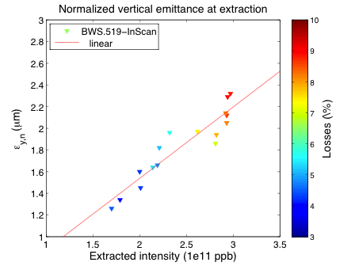
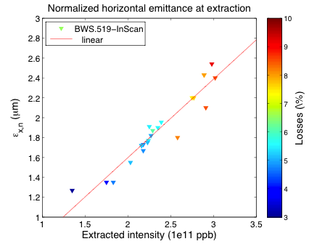
Emittances extracted from the SPS
Extracted intensity together with total losses along the cycle as extracted from the BCT plotted
0 dp/p considered for horizontal measurements (→ overestimation of horizontal emittance), dependence of dp/p on intensity at flat top (increasing filling factor) may explain steeper slope in horizontal plane
Emittances in PSB: ~ 1μm < 1.5e11p / ~ 1.1μm @ 2e11p / ~ 1.3μm @ 3e11p
Bunch length increasing with intensity
τ=2.9ns τ=3.5ns
τ=2.9ns τ=3.5ns

Slide 6
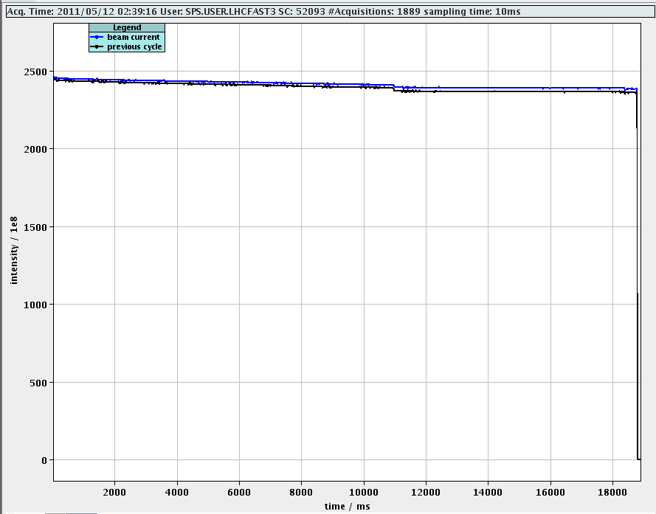
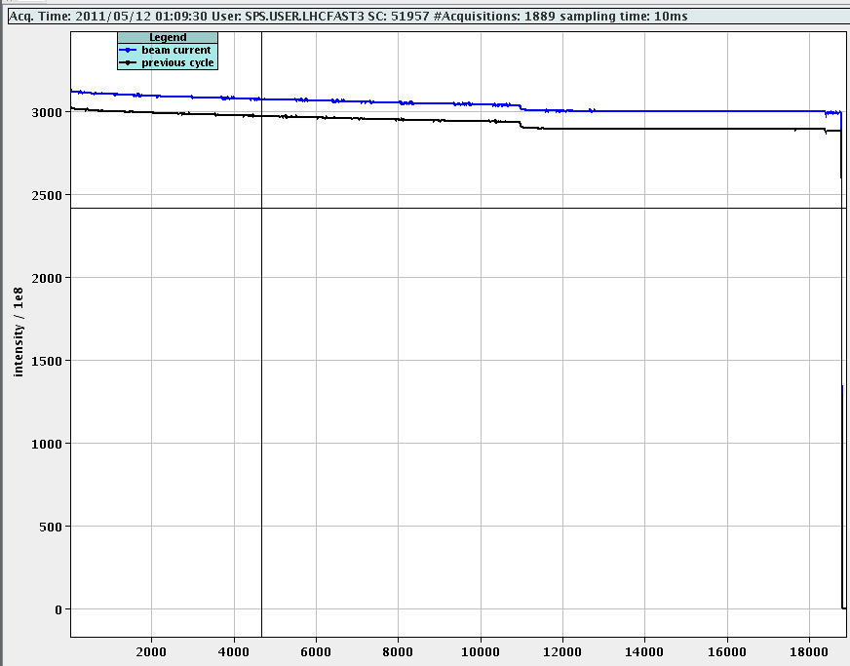
Losses
Total losses on the DC-BCT increase from around 3% for 1.5e11ppb linearly up to 9% for 3.5e11ppb injected
Increasing slow losses along the flat bottom with increasing intensity – resonance crossing due to space charge?
A few percent of capture losses manifesting at beginning of ramp may be reduced by optimizing RF-voltage program
Further analysis of the integrated bunch intensity from wall current monitor necessary to understand better the loss mechanism
Can slow losses on flat bottom be reduced by changing the working point?

Slide 7
Observations
Longitudinal instability for intensities above 2.5e11ppb at flat top
Observed with the voltage program of 800MHz cavity copied from nominal Q26 cycle
During the instability, low frequency part of transverse tune spectra in both planes become dominant
Slight improvement in stability achieved by increasing the voltage of 800MHz cavity – further studies and optimization needed!
4σ bunch length
flat bottom (0.55eVs bucket area): ~2.9ns @1.5e11ppb/~3.45ns @3e11ppb
Extraction (7MV in 200MHz cavity): ~1.45ns @1.5e11ppb/1.65ns @3e11ppb
Strange activity on difference signal of the headtail monitor in the horizontal plane at injection with high intensities (above 2.5e11ppb) – further investigations needed!

Slide 8
Summary
Transverse emittances measured with the “standard” BWS.519 wire-scanner shows “linear” increase of emittance with intensity above 1.5e11ppb
Emittances of about 2μm for intensities of around 2.3e11ppb
Peak values of around 2.6μm in horizontal plane for 3e11ppb extracted (almost 10% losses during the whole cycle)
Clear attribution of emittance blow-up to PS and SPS will be difficult
Significant losses (>5%) above 2.4-2.5e11ppb
Longitudinal instability at flat top above 2.5e11ppb observed → further studies will follow
Same study should/will be repeated for nominal optics and comparable longitudinal parameters (constant bucket area of 0.55eVs at first part of the cycle)
Verification of the optics at the wire scanner location may be neccessary
Future studies with alternative working points should be anticipated

