Slide 1
SPS MD W19
Observations

Slide 2
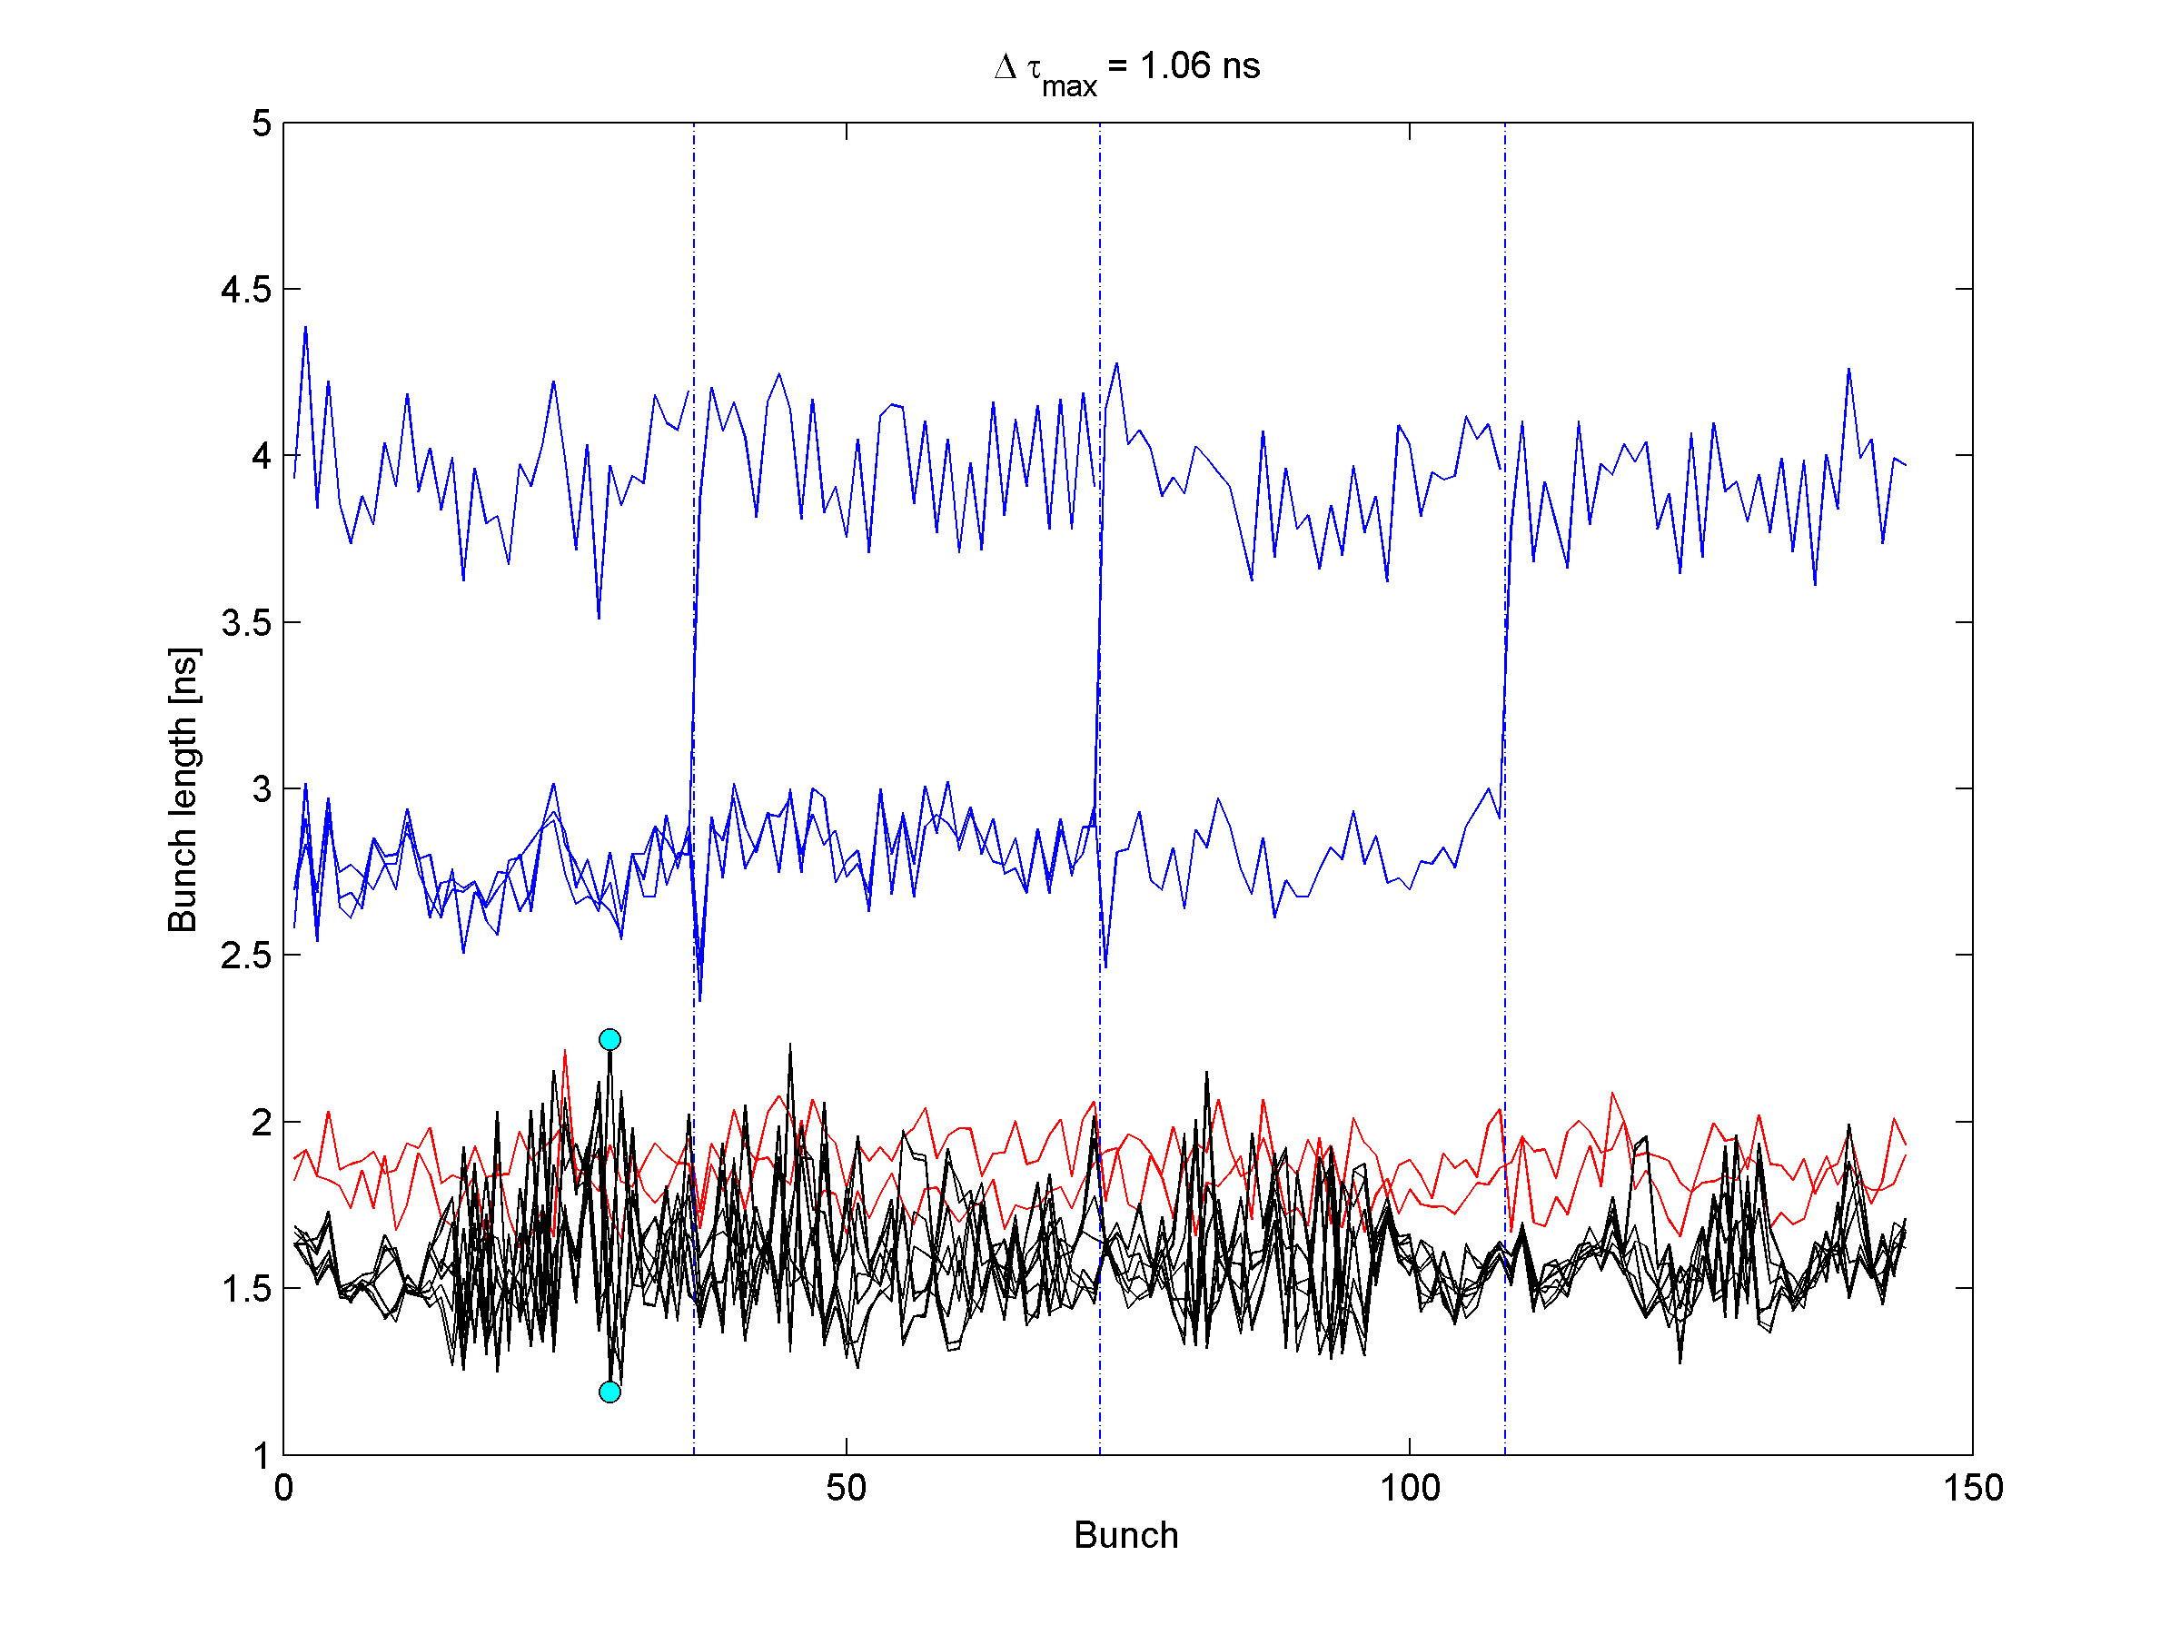
Nominal emittance Nominal bunch rotation

Slide 3
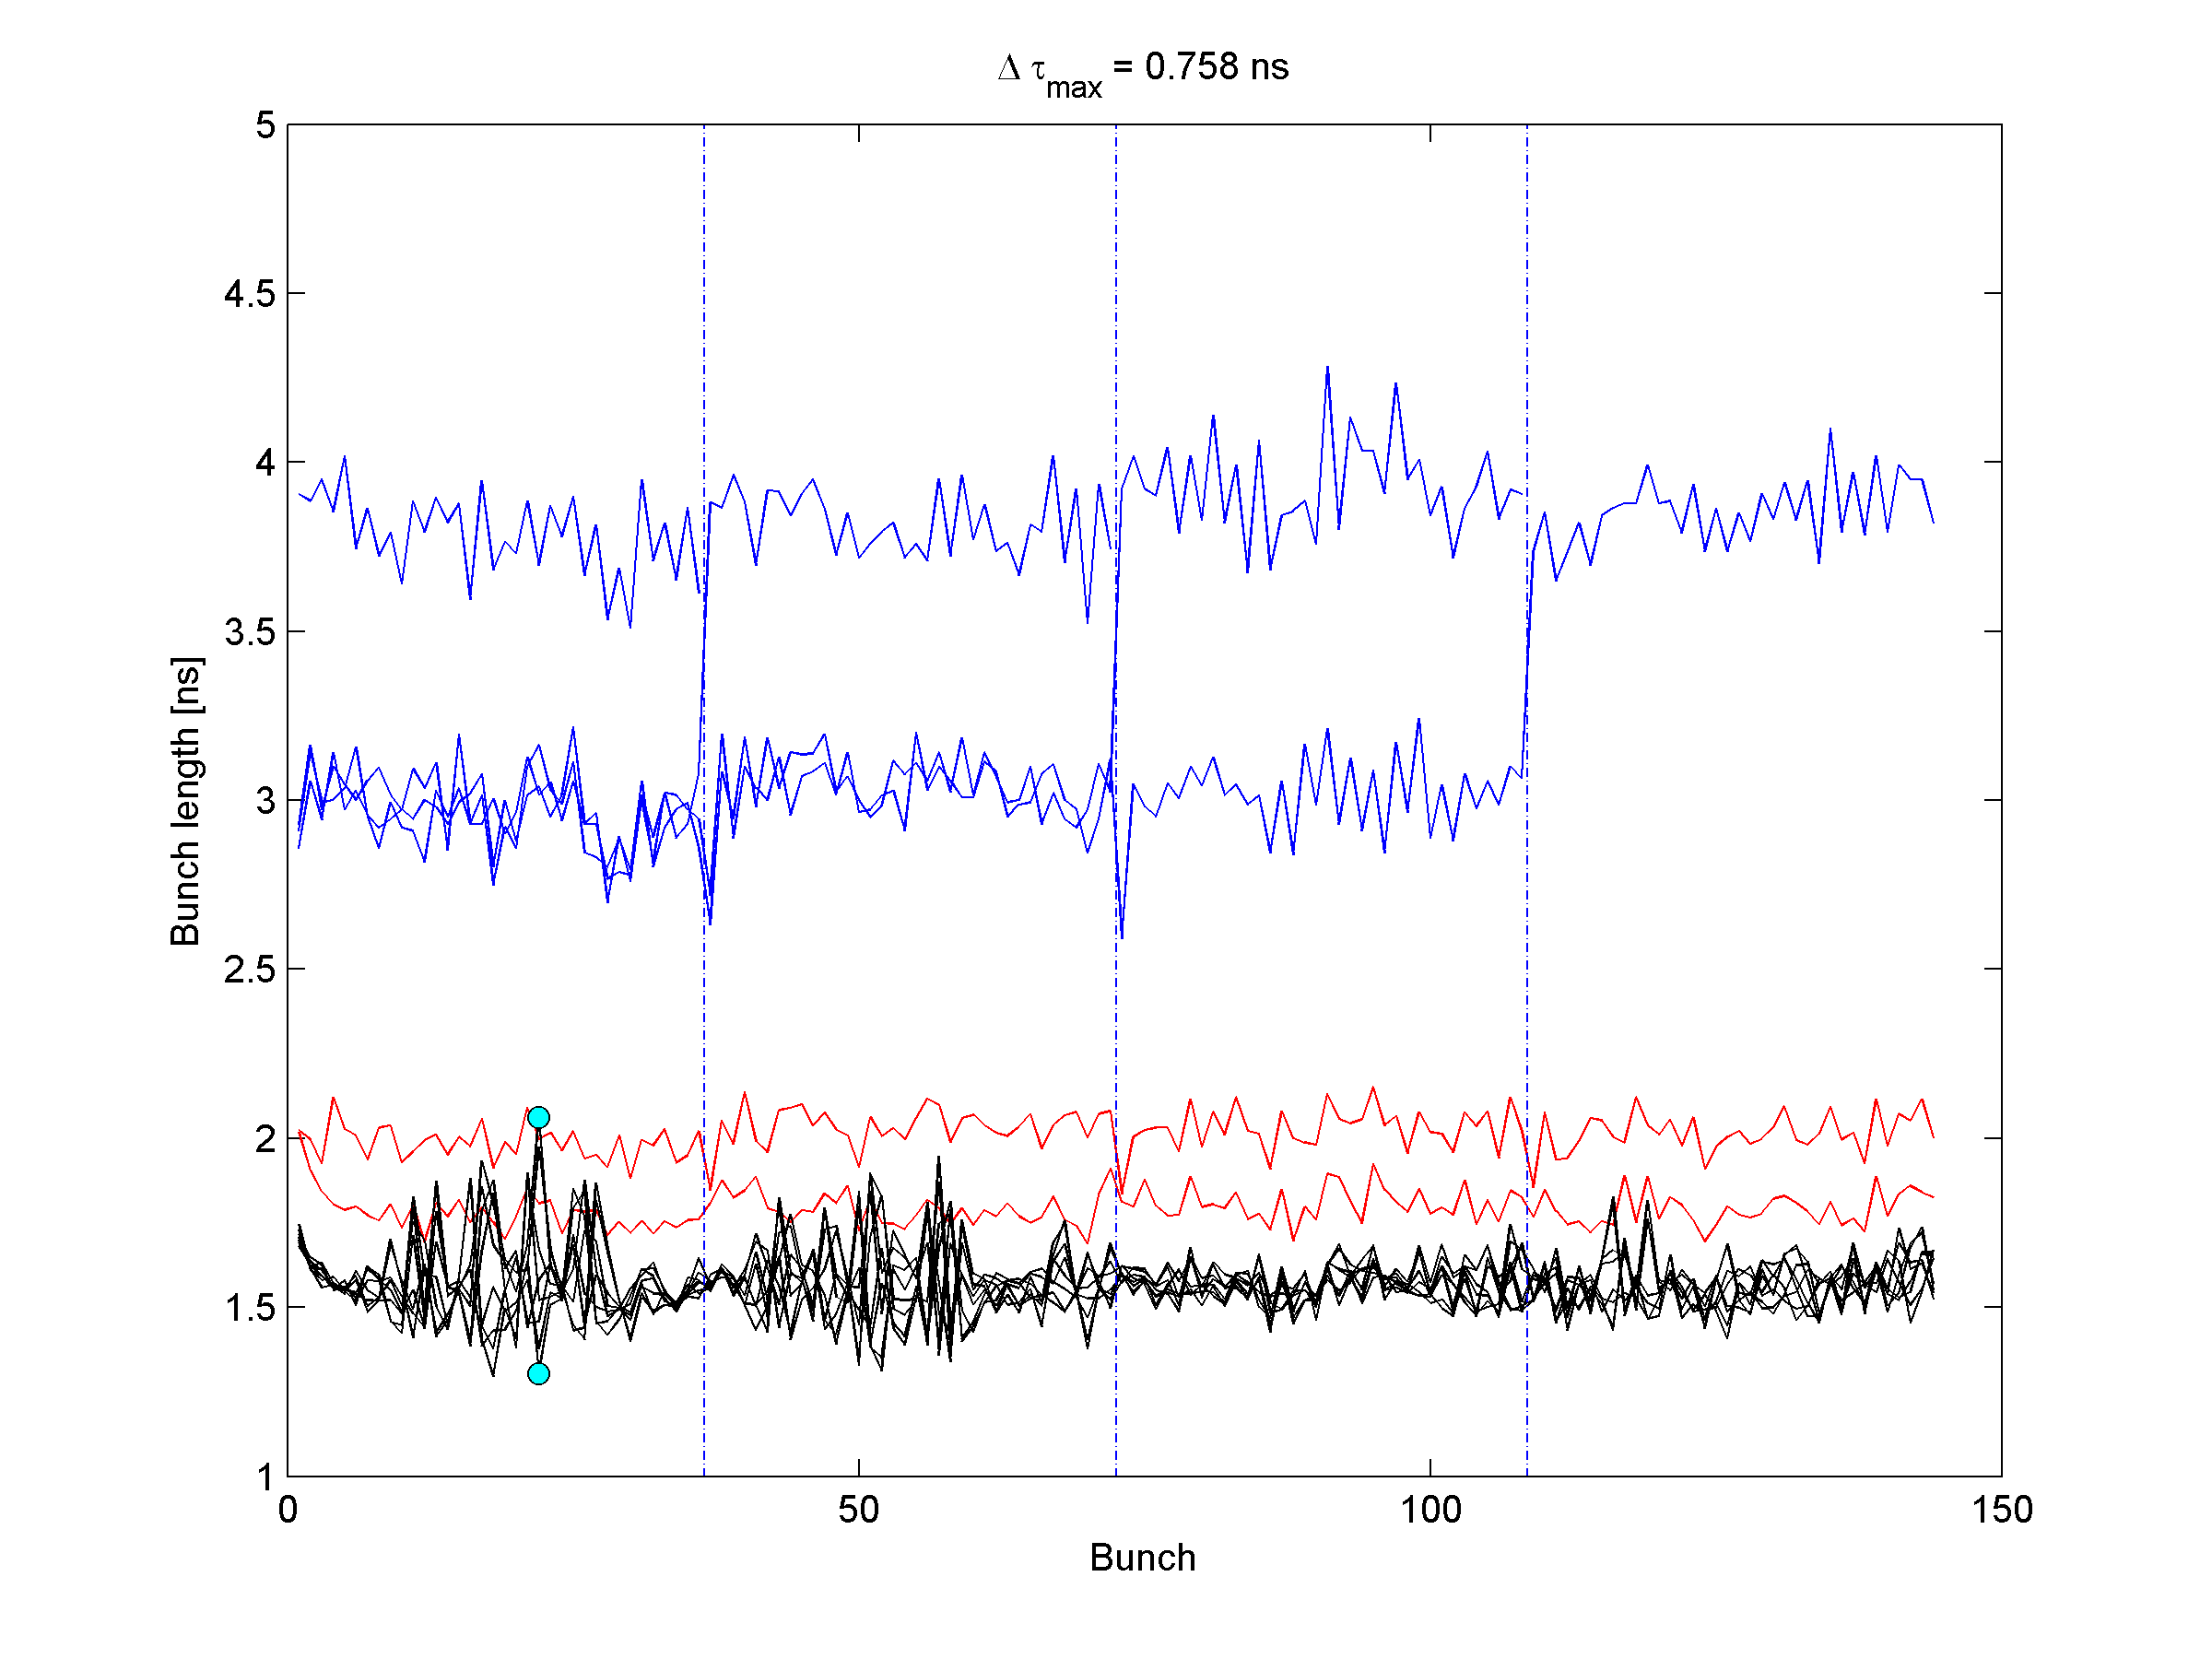
Larger emittance Nominal bunch rotation

Slide 4
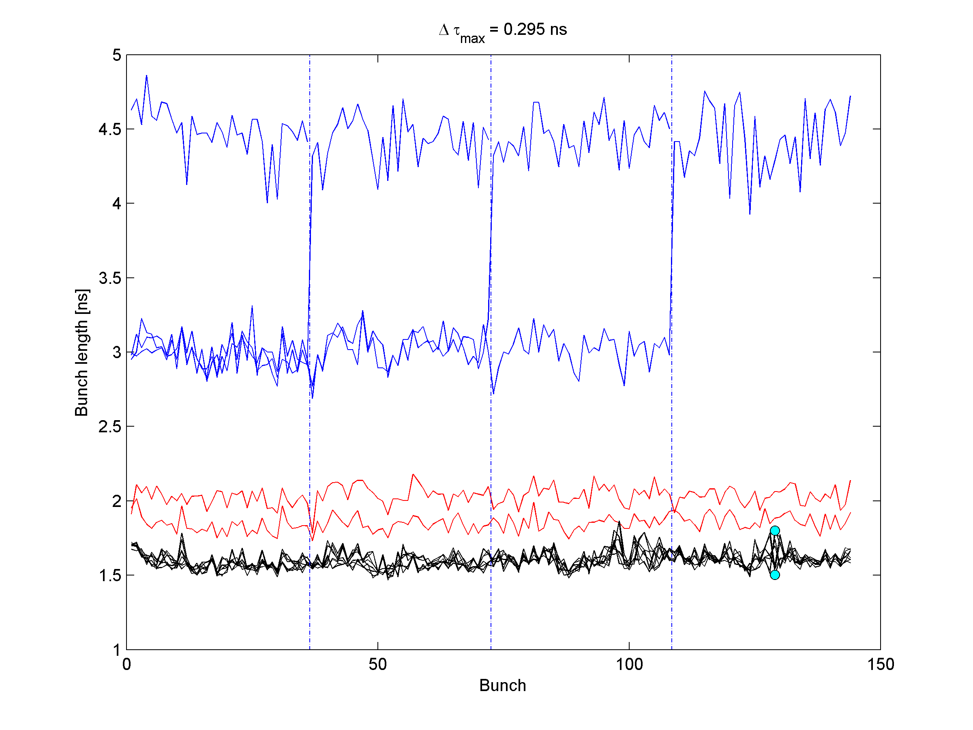
Two cavities only

Slide 5
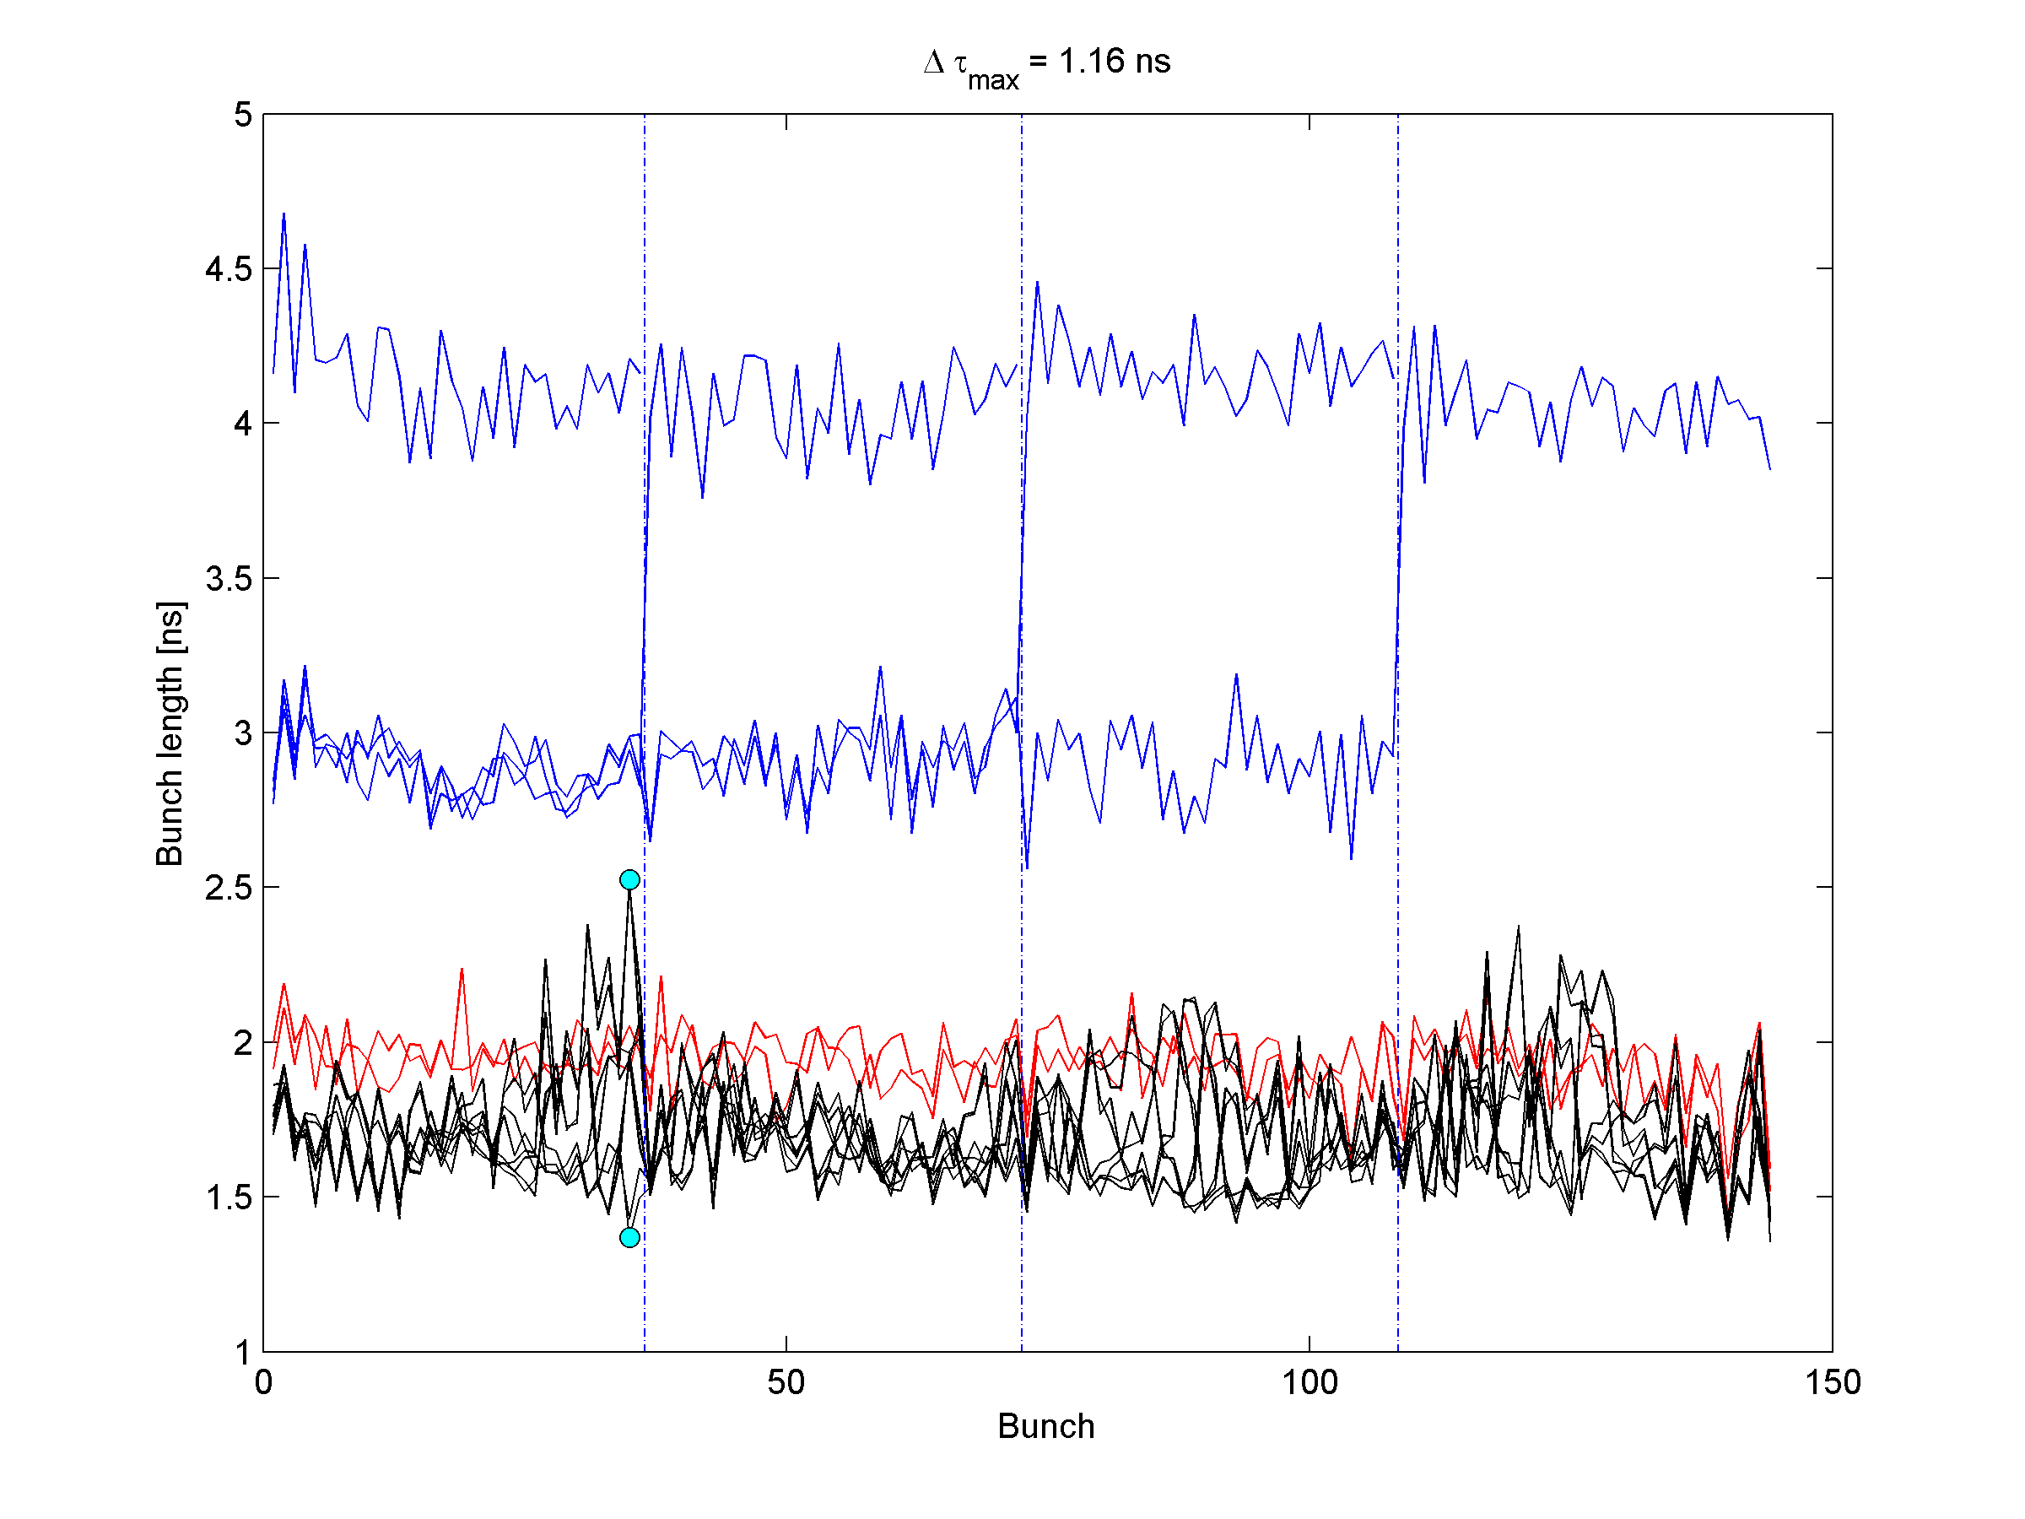
Blow-up reduced

Slide 6
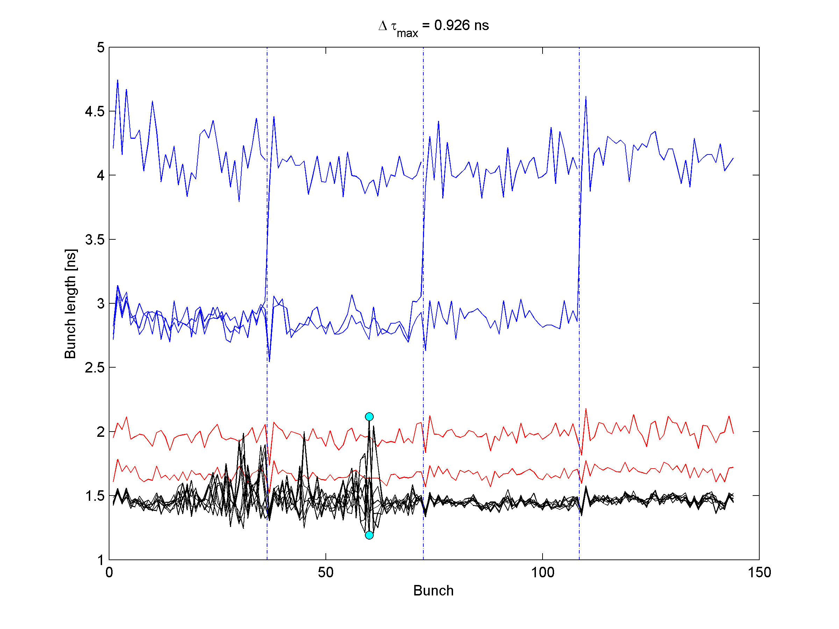
Without blow-up

Slide 7
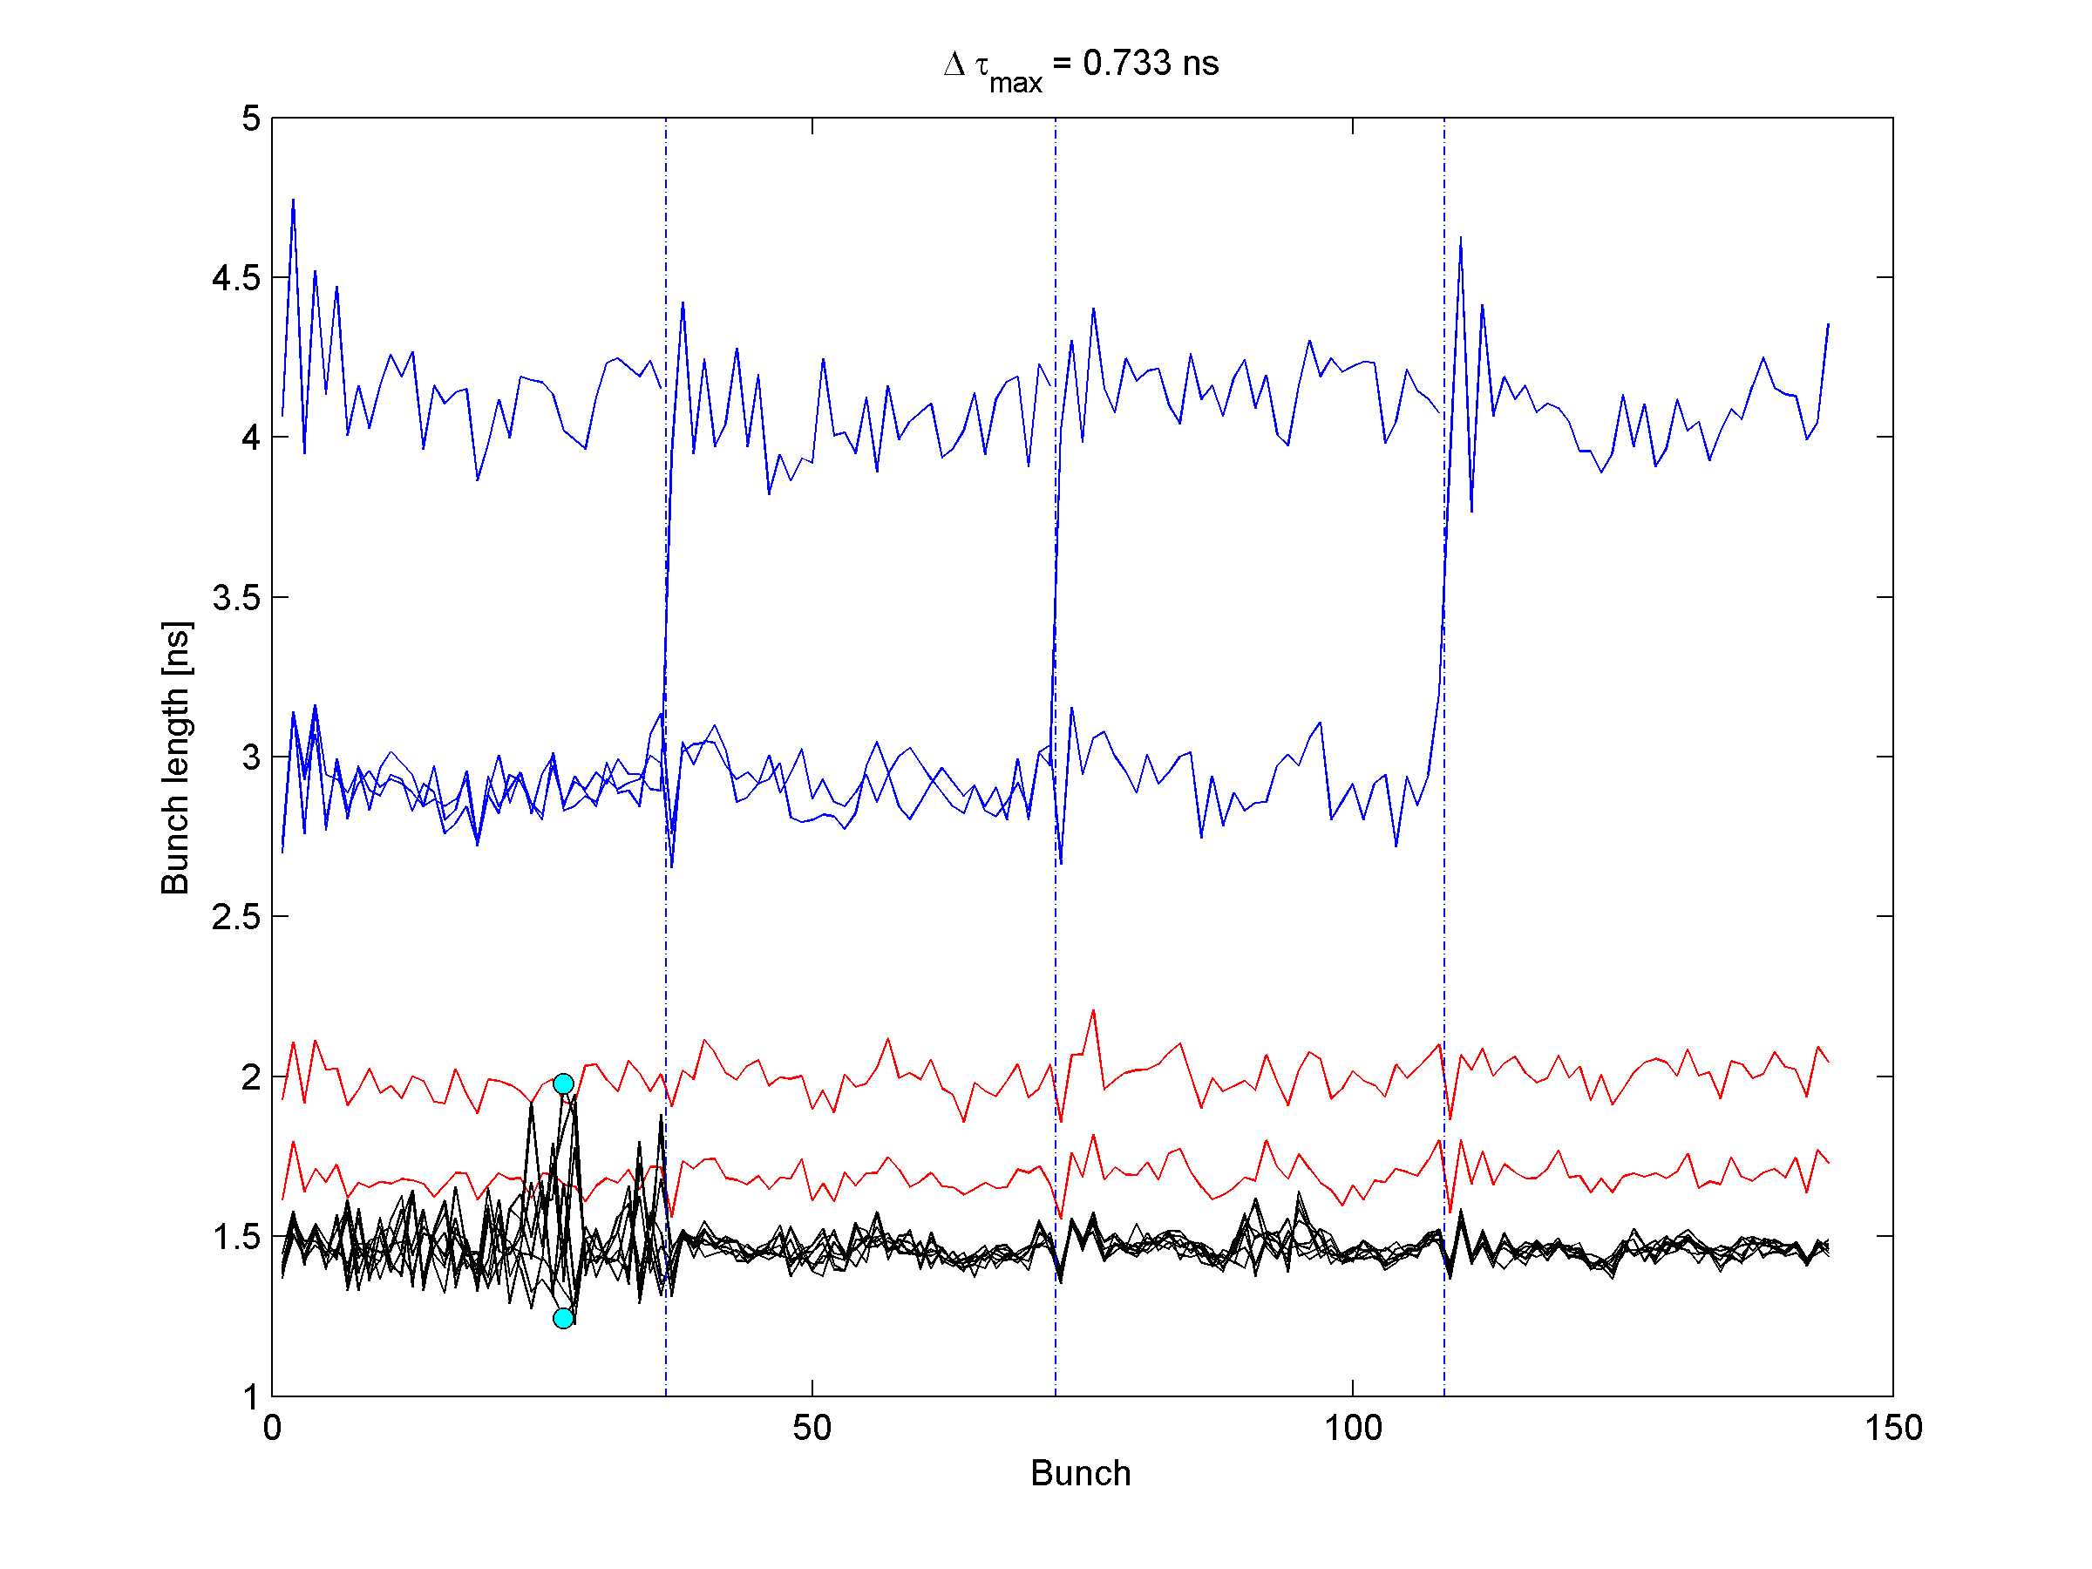
Chromaticity corrected (higher) Less losses

Slide 8
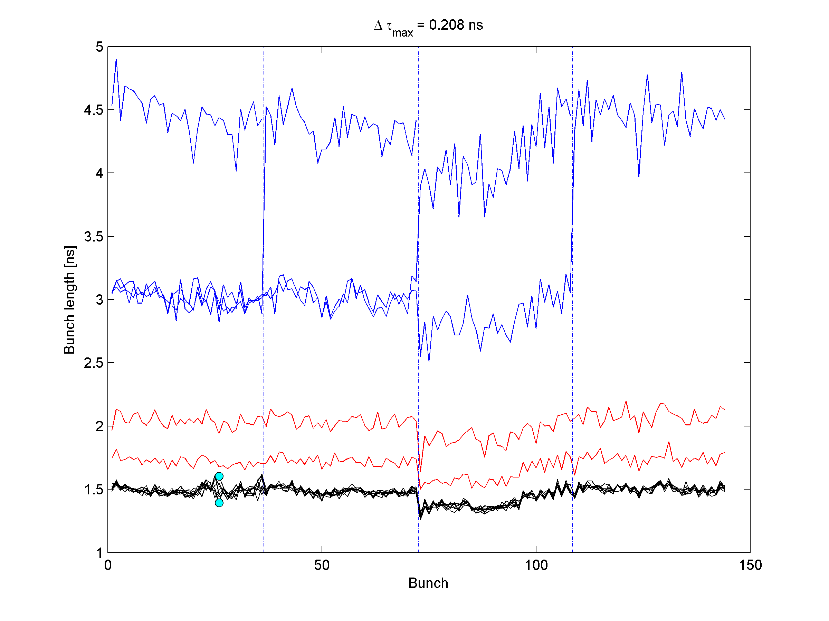
Higher emittance

Slide 9
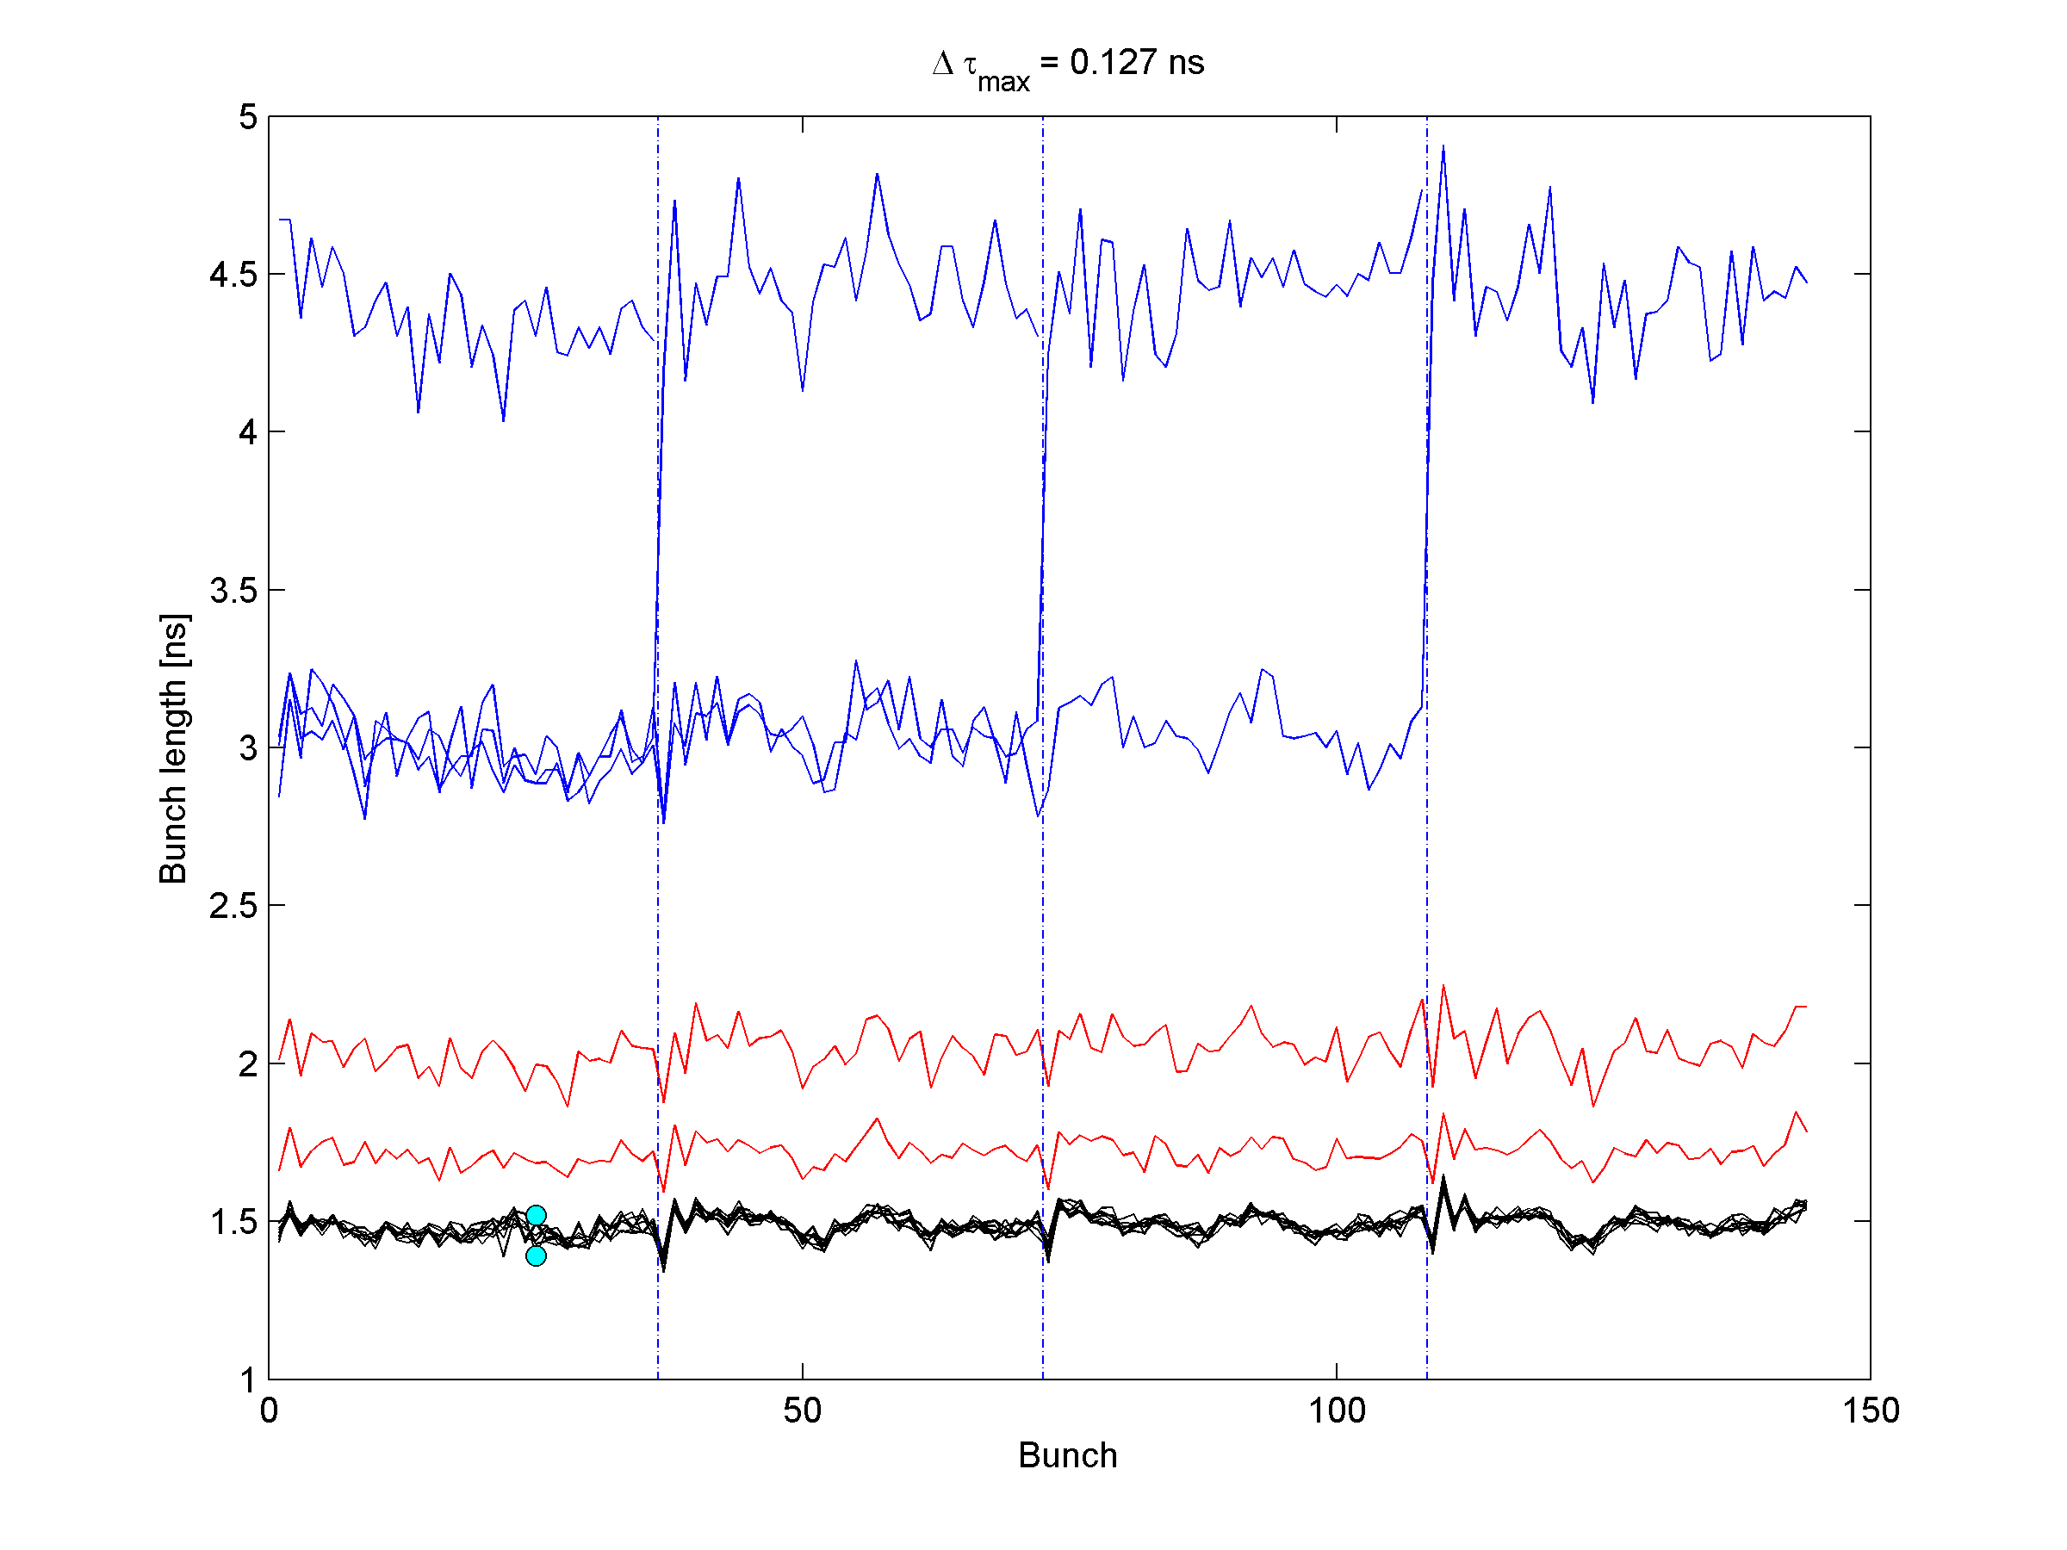
Gain of phase loop decreased More losses

Slide 10
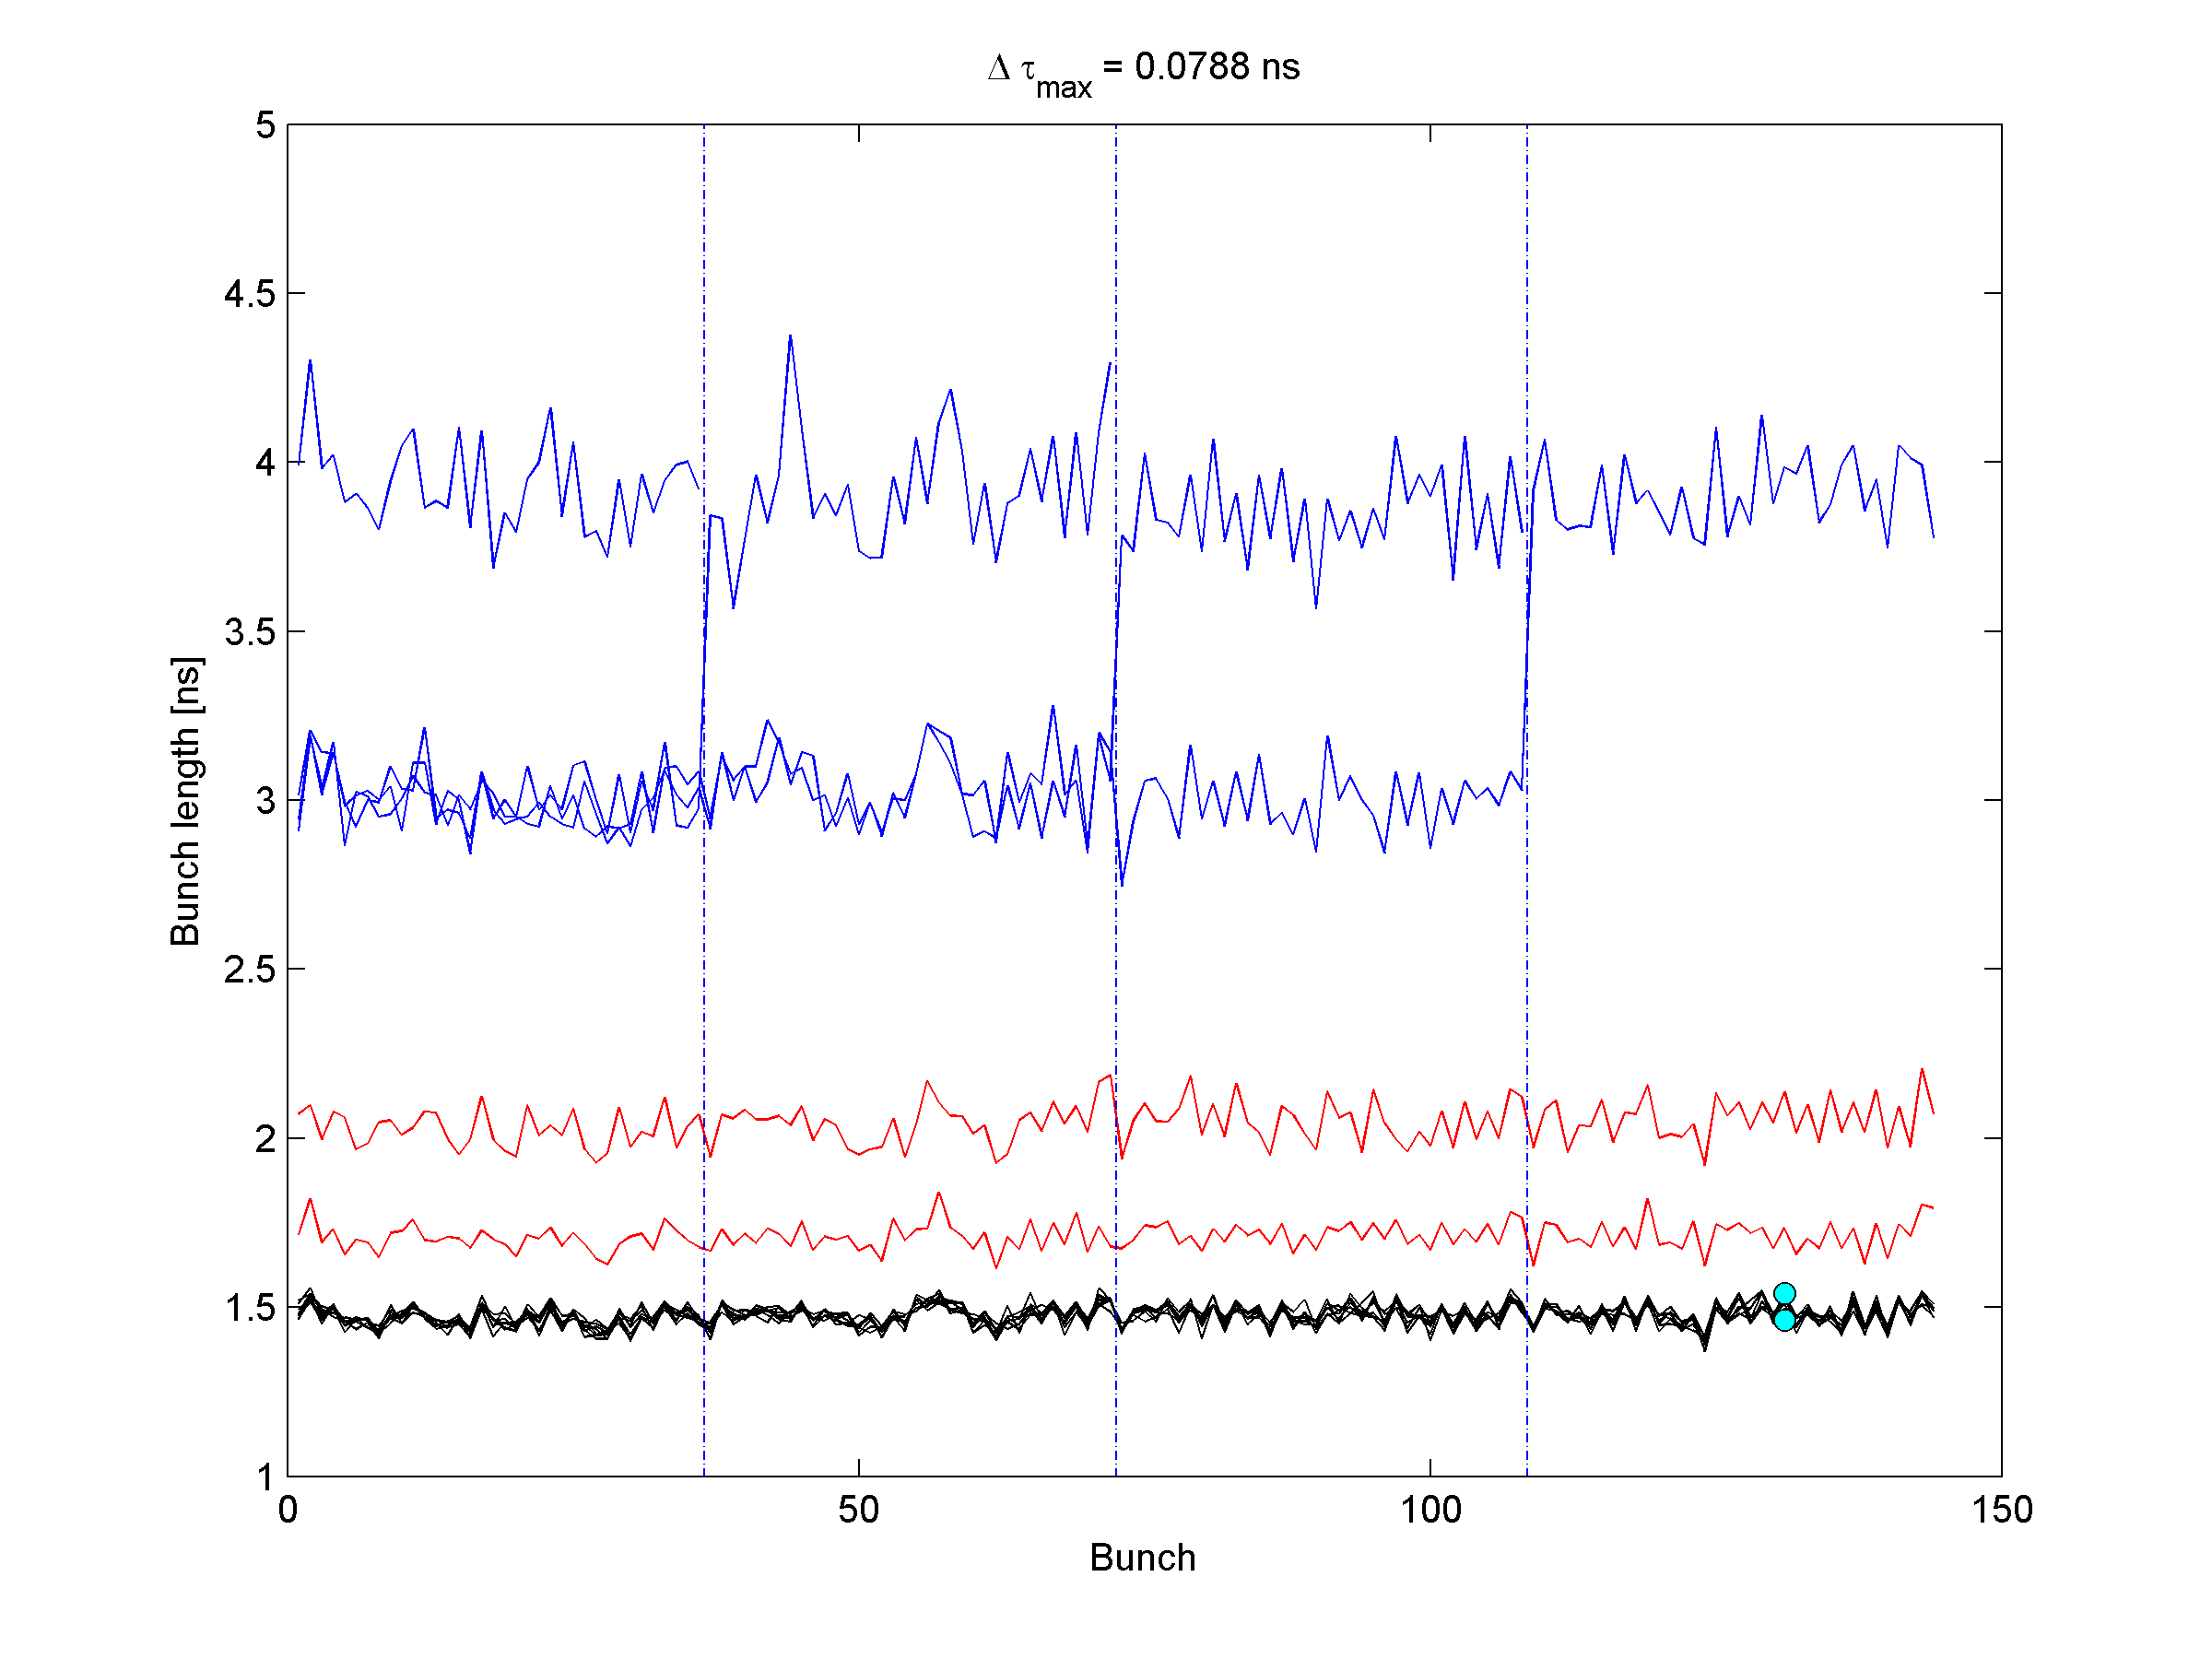
Lower gain 3 Cavities

Slide 11
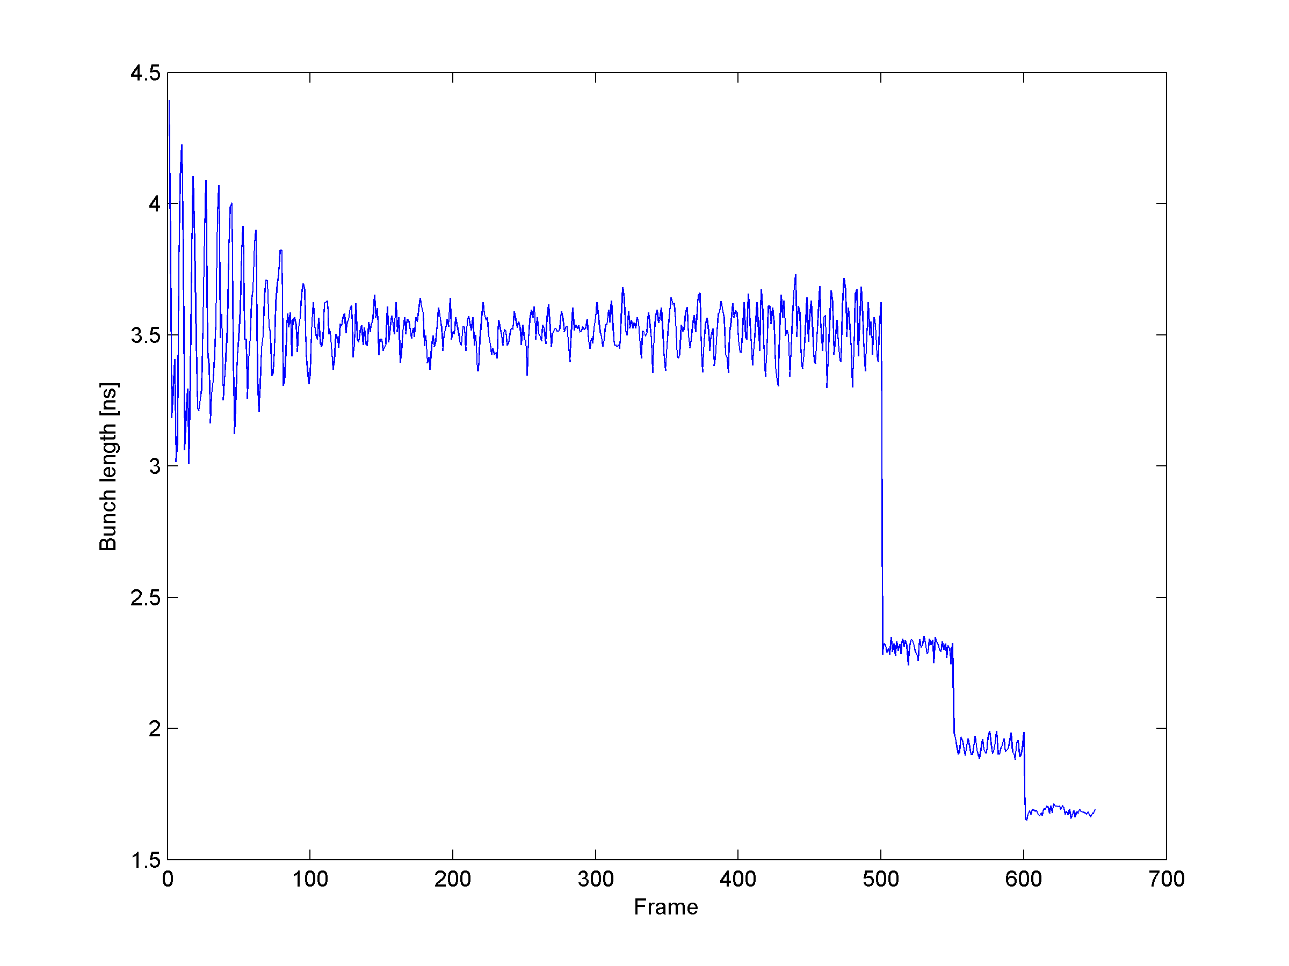
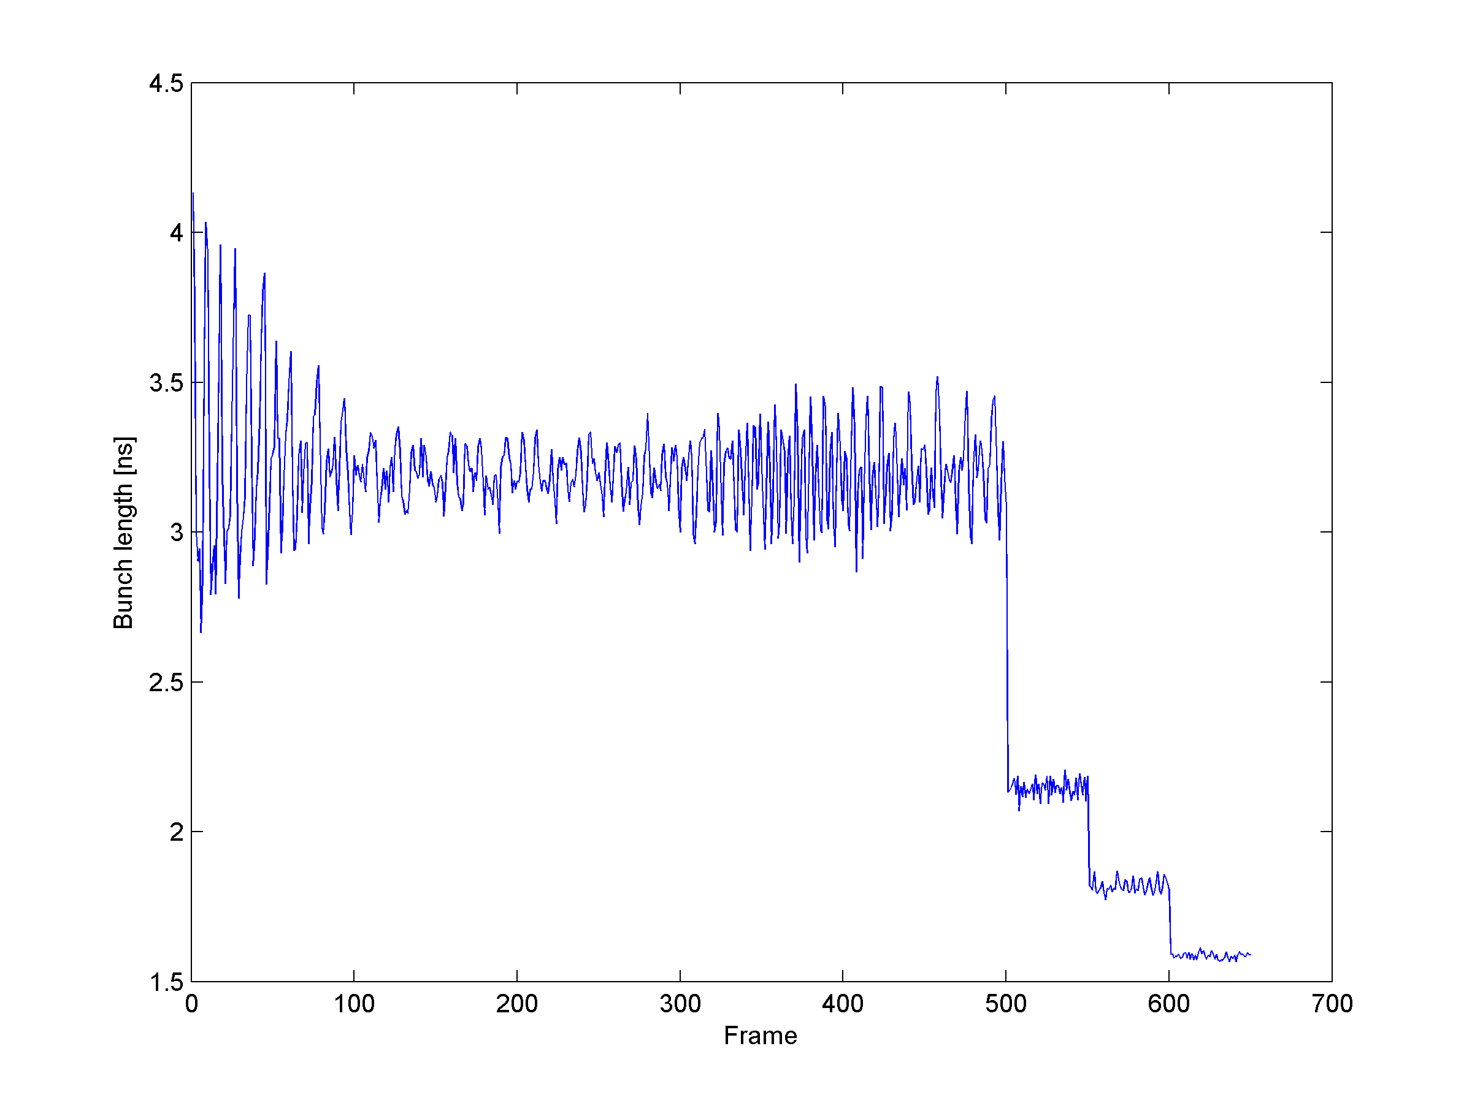
Q20 - Single bunch
Int. ~ 3E11
Int. ~ 2.5E11

