Slide 1
Multipacting measurements
Using high magn. fields (SM18)

Slide 2
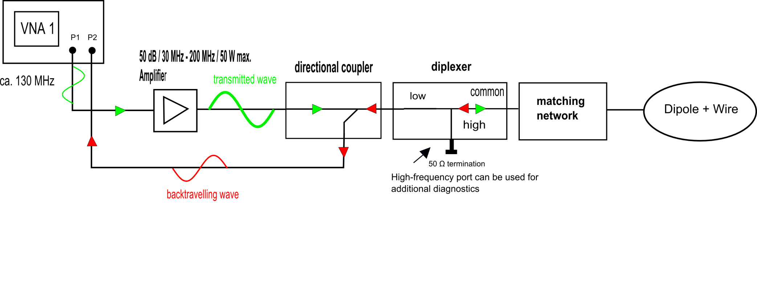
RF measurement set-up

Slide 3
Move to SM18
The multipacting test stand is completely moved to SM18
The same tests have been repeated on MBE054 dipole (very similar results, compared to MBB013)
First tests using high currents (1000A – 5000A, in 1000A steps) have been performed.

Slide 4
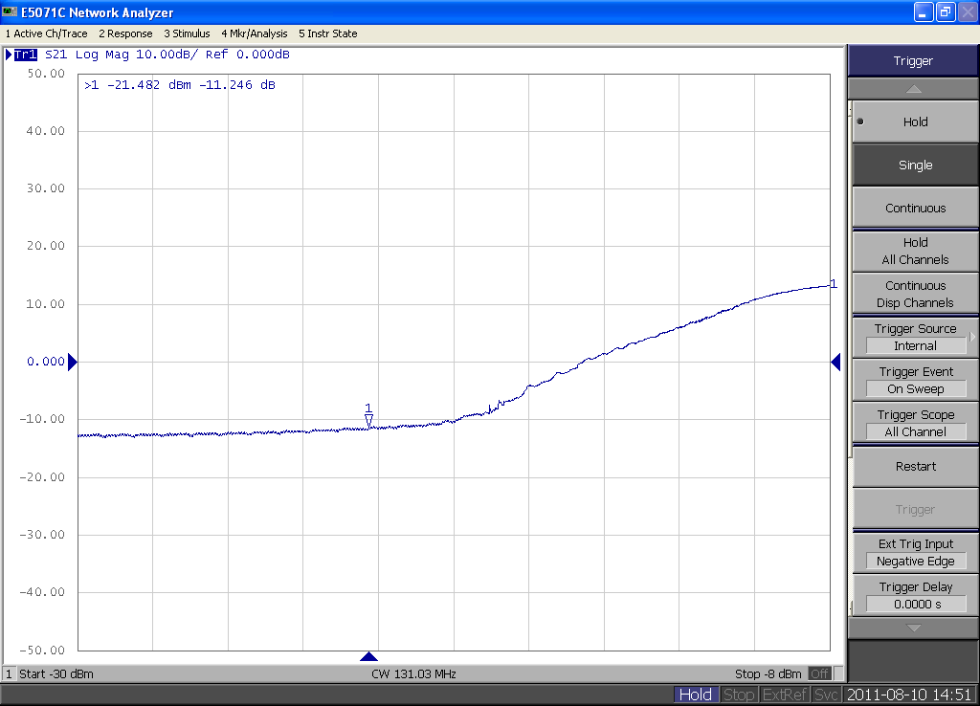
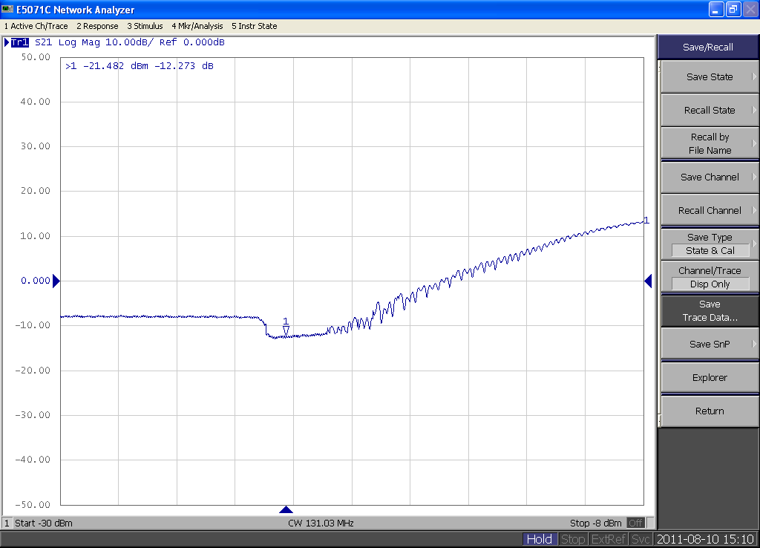
→1000 A (ca. 380 mT)
2000 A (ca. 760 mT) →

Slide 5
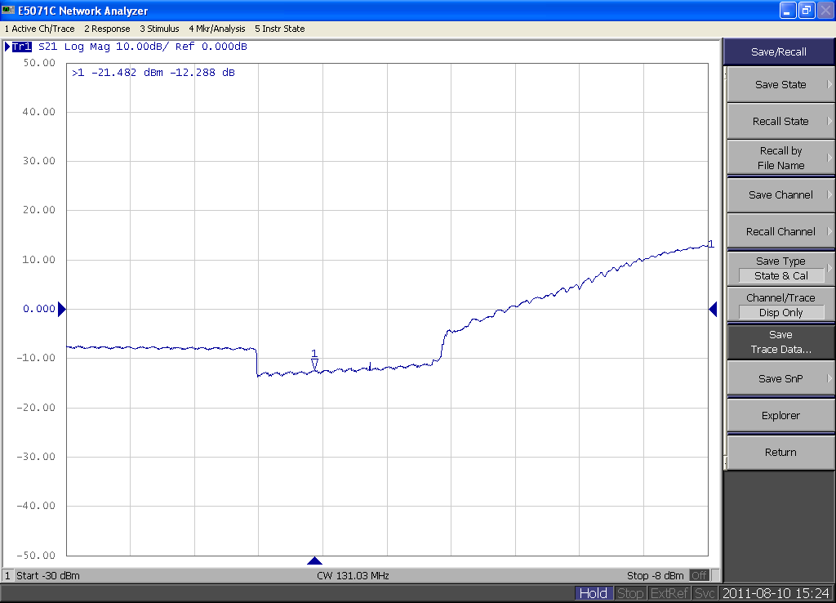
→ 3000 A (ca. 1.1 T)
4000 A (ca. 1.5 T) →

Slide 6
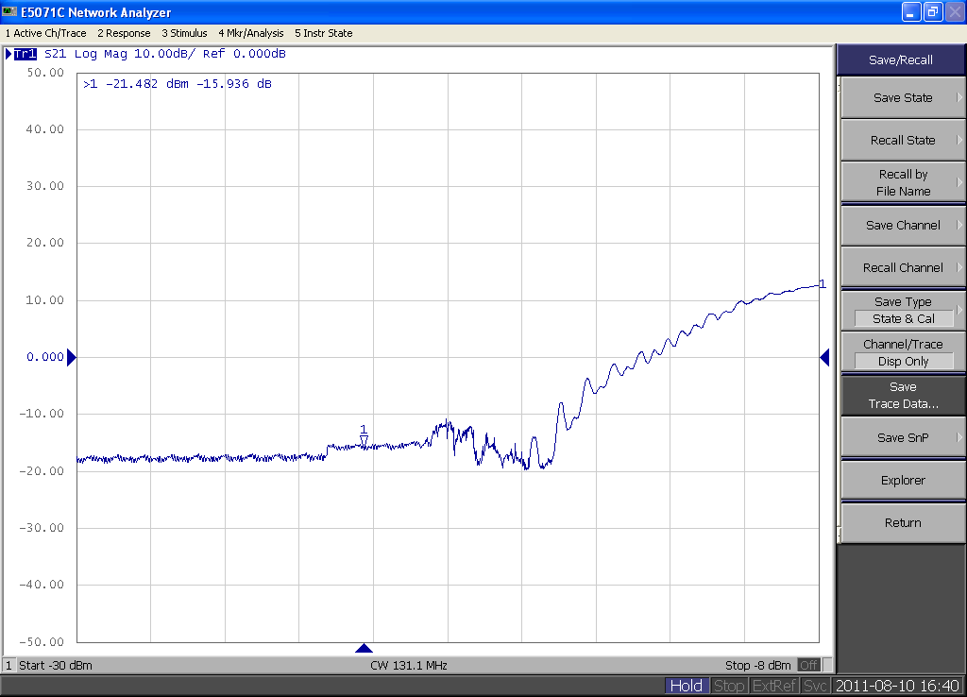
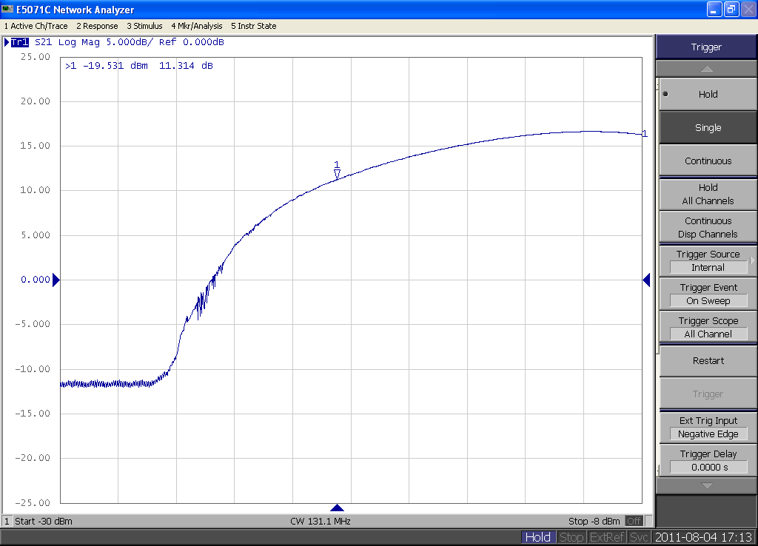
→ 5000 A (ca. 1.8 T)
11 A (ca. 4.6 mT, resonant condition) →

Slide 7
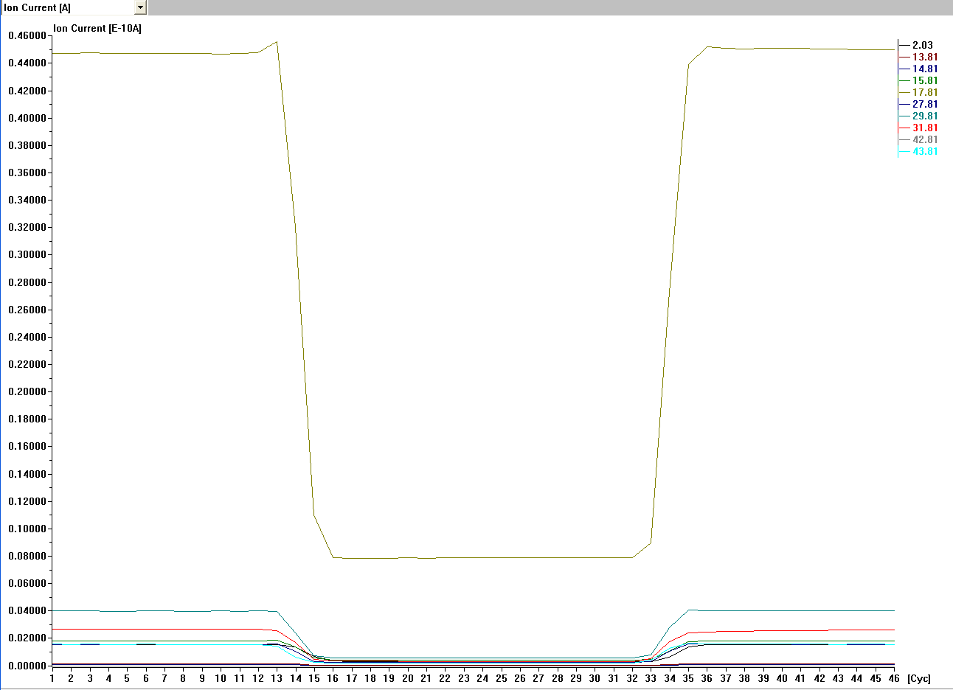
Influence on residual gas analyzer

Slide 8
Summary
It seems that the maxima of multipacting occur periodically with increasing the magnetic field. (few test at lower currents should be made to confirm that)
Compared to the multipacting under resonant conditions (keyword: cyclotron resonance), multipacting with any other fields is much less
At high fields, the residual gas analyzer is not reliable anymore and gets influenced too much by the magnetic field

